Slide 1
ELENA Project Review
Power Converters
John Baillie TE/EPC/MPC
15th October 2013

Slide 2
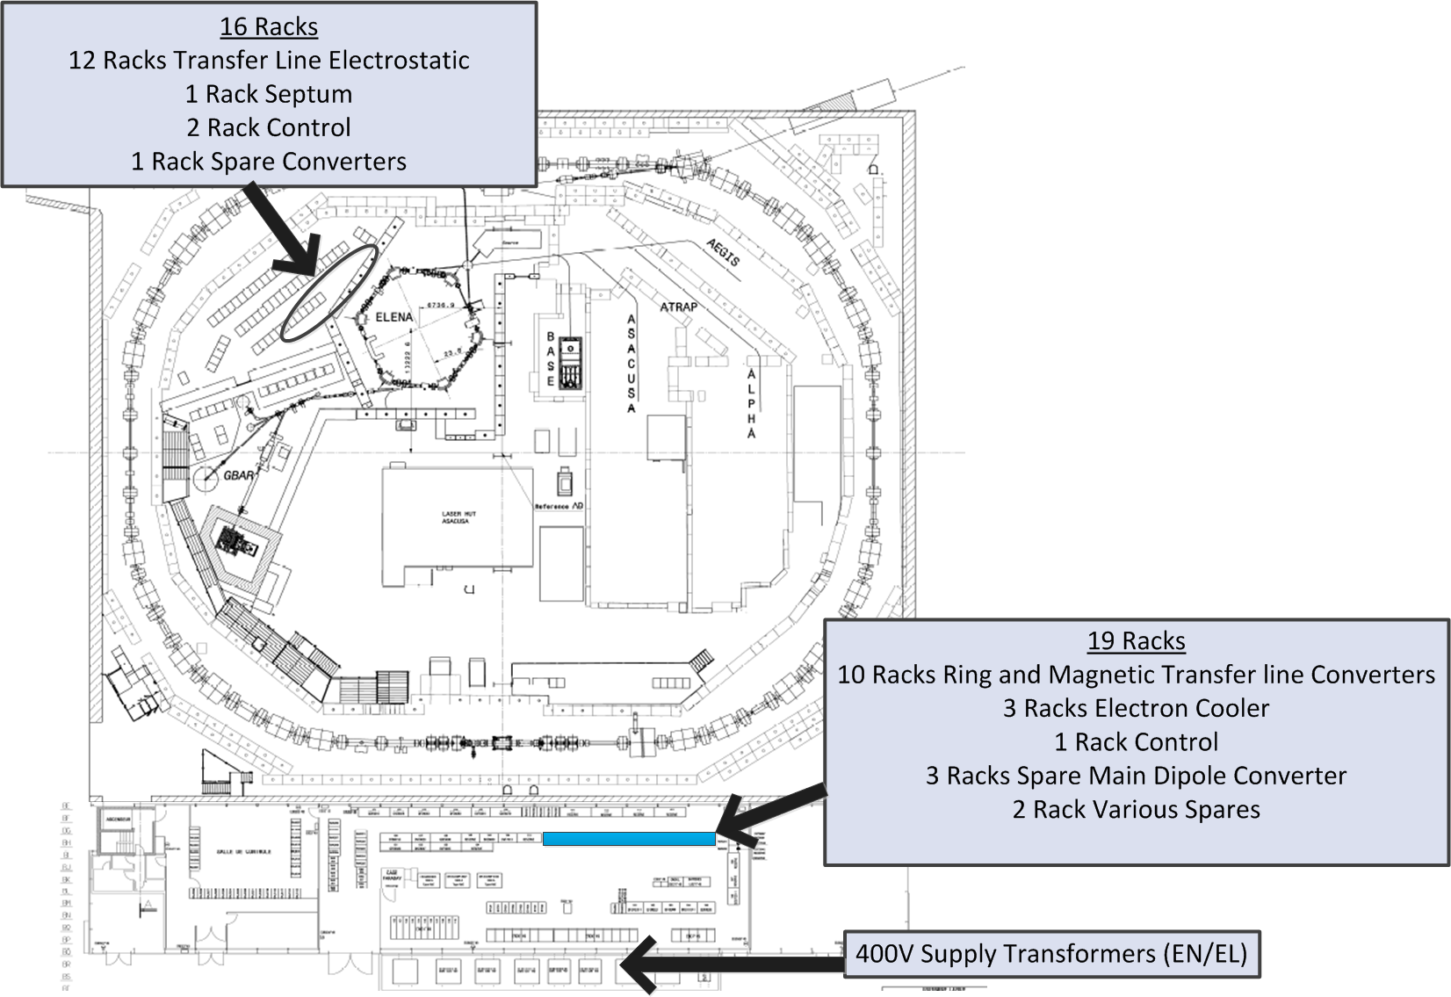
Overview of Power Converters for ELENA
Around 400kVA Installed Power
All power derived from 400V Network
Ring: 26 Magnetic Circuits
Electron Cooler: 11 Circuits
Transfer Lines: 12 Magnetic Circuits
184 Electrostatic Circuits
Total: 233 Circuits

Slide 3
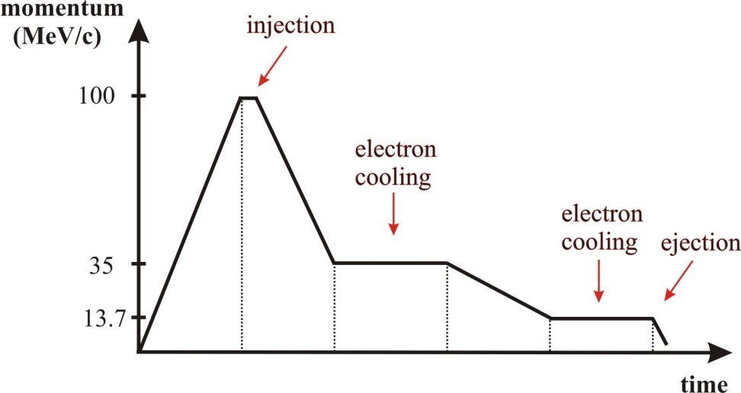
Cycling Magnetic Circuits
Magnetic Elements in the ring will follow a varying current or field reference.
Uncertainty of 500ppm, referred to instantaneous requested current/field, must be respected at all energy levels
All circuits require relatively small voltages at lowest energy level
Expected duration up to 30s
Maximum ramp time of 1s has been assumed for dimensioning of ring power converters

Slide 4
ELENA Ring: Overview of Circuits
Magnet Type | Number of Circuits | Number of Magnets in series per circuit | Total Circuit Resistance / mΩ | Total Circuit Inductance / mΩ | Flat-top Current / A | Minimum Current / A | Maximum Voltage / V | Power Converter Model and Accuracy Class | Nominal Voltage / V | Nominal Current / A | Uncertainty (one year) / mA | Minimum Relative Uncertainty
Bending PXMBHEKCWP | 1 | 7 | 337 | 238 | 326 | 44.662 | 188 | AUXPS_Type 2 50ppm | 450 | 400 | 30 | 6.72x10⁻⁴
Quadrupole PXMQNLGNAP | 3 | 4 | 479 | 146 | 37 | 5.100 | 23.1 | CANCUN_50 100ppm | 30 | 50 | 5 | 9.86x10⁻⁴
Sextupole PXMXNADNAP | 2 | 2 | 187 | 10 | 21 | 2.900 | 4.1 | CANCUN_50 100ppm | 30 | 50 | 5 | 1.74x10⁻³
H/V Corrector PXMCCAYWAP | 16 | 1 | 100 | 4 | 40 | 5.500 | 4.2 | CANCUN_50 100ppm | 30 | 50 | 5 | 9.12x10⁻⁴
Skew Quadrupole PXMXNADNAP | 2 | 1 | 100 | 0.013 | 33 | 4.500 | 3.7 | CANCUN_50 100ppm | 30 | 50 | 5 | 1.11x10⁻⁴
Comp. Solenoid PXMLNAFNAC | 2 | 1 | TBD | TBD | TBD | TBD | TBD | CANCUN_50 100ppm | 30 | 50 | 5 | TBD
Notes: Total circuit impedances include cables which have been estimated based on conductor material, length and cross section <2A/mm^{2.} Minimum current assumes 0.137 x max flat-top current.

Slide 5
Cycling Magnetic Circuits: V/I Waveforms
Main Dipoles
Sextupole
Compensation Solenoid Awaiting magnet parameters
All converters are 4 quadrant. Can provide negative voltage if necessary and have no problem operating near 0V which is a strong requirement for these circuits.
Degaussing waveforms is possible for all magnets
Main Quadrupoles
Skew Quadrupole
HV Corrector

Slide 6
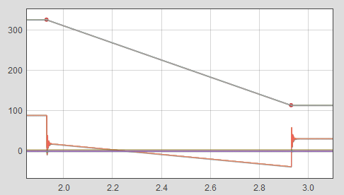
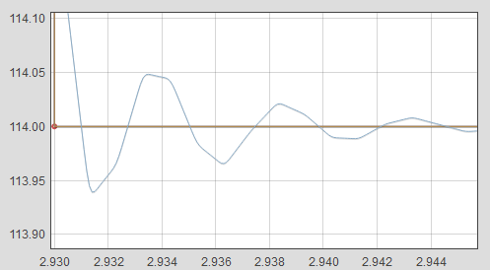
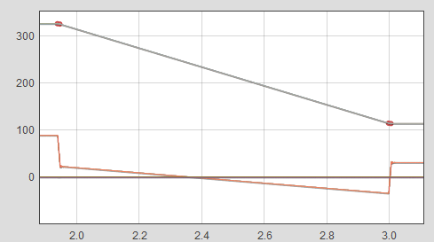
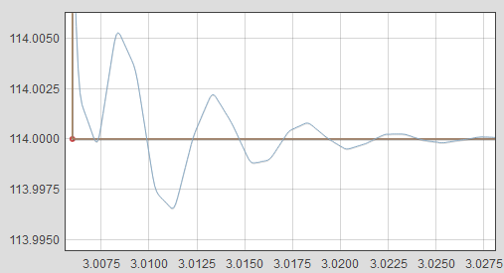
Dynamic Performance using Function Generator Controller
Looking at the transition between first and second plateaux for the main dipole:
Table of points
50mA overshoot
PPPL Function
5mA overshoot
10us resolution of point placement is available for a 100s cycle
Notes:
Function Generator Library and explanations can be found here: http://project-cclibs.web.cern.ch/project-cclibs/
Note voltage waveform is cleaner when reference is smoothed
The PPPL reference was created for the CPS main magnet controls. The field is ramped up in stages with a series of linear plateaus defined parametrically using seven values. These specify a fast parabolic acceleration followed by a slow parabolic deceleration, then a fast parabolic deceleration and finally a linear section that is not necessarily constant.

Slide 7
Transfer Line: Overview of Magnetic Circuits
Magnet Type | Number of Circuits | Number of Magnets in series per circuit | Total Circuit Resistance / mΩ | Total Circuit Inductance / mΩ | Flat-top Current / A | Flat Top Steady-State Voltage / V | Power Converter Model | Nominal Voltage / V | Nominal Current / A | Uncertainty (one year) / mA | Flat-top Current Relative Uncertainty | Polarity Reversal
Bending PXMBHCBCWP | 1 | 2 | 108 | 68 | 285 | 30.8 | 2 x COBALT 1000ppm | 50 | 400 | 400 | 1.4x10⁻³ | NO
Quadrupole PXMQNLGNAP | 3 | 1 | 177 | 36 | 37 | 6.5 | CANCUN_50 100ppm | 30 | 50 | 5 | 1.35x10⁻⁴ | YES
Quadrupole PXMQNAFNWP | 1 | 1 | 65 | 3 | 200 | 12.9 | COBALT 1000ppm | 30 | 200 | 5 | 1.00x10⁻³ | NO
H/V Corrector PXMCCAYWAP | 6 | 1 | 107 | 4 | 40 | 4.3 | CANCUN_50 100ppm | 30 | 50 | 5 | 1.25x10⁻⁴ | YES
Septum | 1 | 1 | 9 | 0.42 | 950 | 9.1 | Commercial | 15 | 1200 | TBD | TBD | No
Possible to ramp all magnets to full current. Bending magnet is limited to approximately 1.5s
Notes:
Notes: Total circuit resistance and inductance values include estimates of cable impedance based on assumed current density of <2A/mm²
There are 8 H/V corrector elements therefore16 H/V corrector circuits
Measurement uncertainty is referred to the requested value i.e I_MIN=44.662…A for Main Dipole and could be 44.6512…A

Slide 8
Electron Cooler: Overview of Circuits
Rep. | Function | Oper. | Oper. | Quantity | Model | Input Voltage | Output Voltage / V | Output | Quadrants | Control
 |  | Voltage | Current |  |  | / V |  | Current / A
 |  | / V | / A
1 | Cathode | -350 | -0.001 | 1 | Commercial | 230 | -500 | -0.001 | 1 | FGC3 / PLC
2 | Grid | ±120 | ±0.001 | 1 | Commercial | 230 | ±500 | ±0.001 | 2 | FGC3 / PLC
3 | Repeller | -300 | -0.001 | 1 | Commercial | 230 | -500 | -0.02 | 1 | FGC3 / PLC
4 | Collector | -250 | -0.01 | 1 | Commercial | 230 | -500 | 0.02 | 1 | FGC3 / PLC
5 | Filament | 16 | 12 | 1 | Commercial | 230 | 35 | 24 | 1 | FGC3 / PLC
6 | Expansion | 18.8 | 152 | 1 | CERN COBALT | 400 | 50 | 200 | 1 | FGC3
 | Solenoid
7 | Gun/Collector | 1.4 | 45 | 1 | CERN COBALT | 400 | 50 | 200 | 1 | FGC3
 | Solenoid
8 | Drift Solenoid | 3.15 | 45 | 1 | CERN COBALT | 400 | 50 | 200 | 1 | FGC3
9 | Toroïd | TBD | TBD | 1 | CERN COBALT | 400 | 50 | 200 | 1 | FGC3
10 | Electron Beam |  | 10 | 10 | CERN | 400 | 75 | 20 | 4 | FGC3
 | steerer |  |  |  | CANCUN 20
11 | Field correction coil |  | 10 | 4 | CERN | 400 | 75 | 20 | 4 | FGC3
 |  |  |  |  | CANCUN 20

Slide 9
Electrostatic Elements: Powering Strategy
Bending and Quadrupole elements are powered using two back-to-back unipolar power supplies, polarity reversal is only possible with the addition of a polarity switch
Electrodes are always powered with a positive and negative power supply: Neither electrode is at ground potential

Slide 10
Electrostatic Elements: Powering Strategy
H/V Correctors powered using two back-to-back biploar power supplies; polarity reversal is inherently possible.
Electrodes are always powered with a positive and negative power supply: Neither electrode is at ground potential

Slide 11
Electrostatic Elements: Overview of Circuits
197 elements and 184 circuits; some elements will be powered in parallel from the same power converter.
Differential Voltage range of 250V to 70kV. Achievable using commercial HV Cassette type power supplies.
Controlled using a PLC
Setting Resolution | 1x10⁻⁴
Residual Ripple | < 1x10⁻⁴ pk-pk + 50mV pk-pk
Stability (8h constant conditions) | <1x10⁻⁴
Element Type | Number of Circuits
Matching Quadrupole | 74
Bending | 12
Defocusing Quad | 8
Focusing Quad | 7
Corrector | 82
Total | 184
Zone | Number of Circuits | Number of Polarity Reversal Units | Number of Racks
LNE00 | 18 | 8 | 1
LNE01 | 28 | 0 | 2
LNE02 | 18 | 0 | 1
LNE03 | 13 | 0 | <1
LNE04 | 12 | 0 | <1
LNE05 | 13 | 0 | 1
LNE06 | 24 | 0 | 2
LNE07 | 27 | 0 | 2
LNE50 | 17 | 0 | 1
LNS | 8 | 8 | <1
LNI | 6 | 4 | <1
Totals | 184 | 20 | 13

Slide 12
Installation Overview
Justification for using B193_R-407:
2 pairs of 400mm² cables available.
  Main Dipole (326A)
  TL Dipole (285A)
  EN/EL have final say
False floor would need to be constructed in B195
Close to 400V distribution transformers

Slide 13
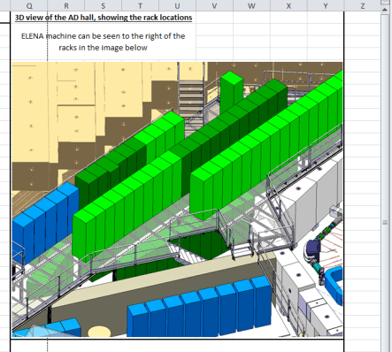
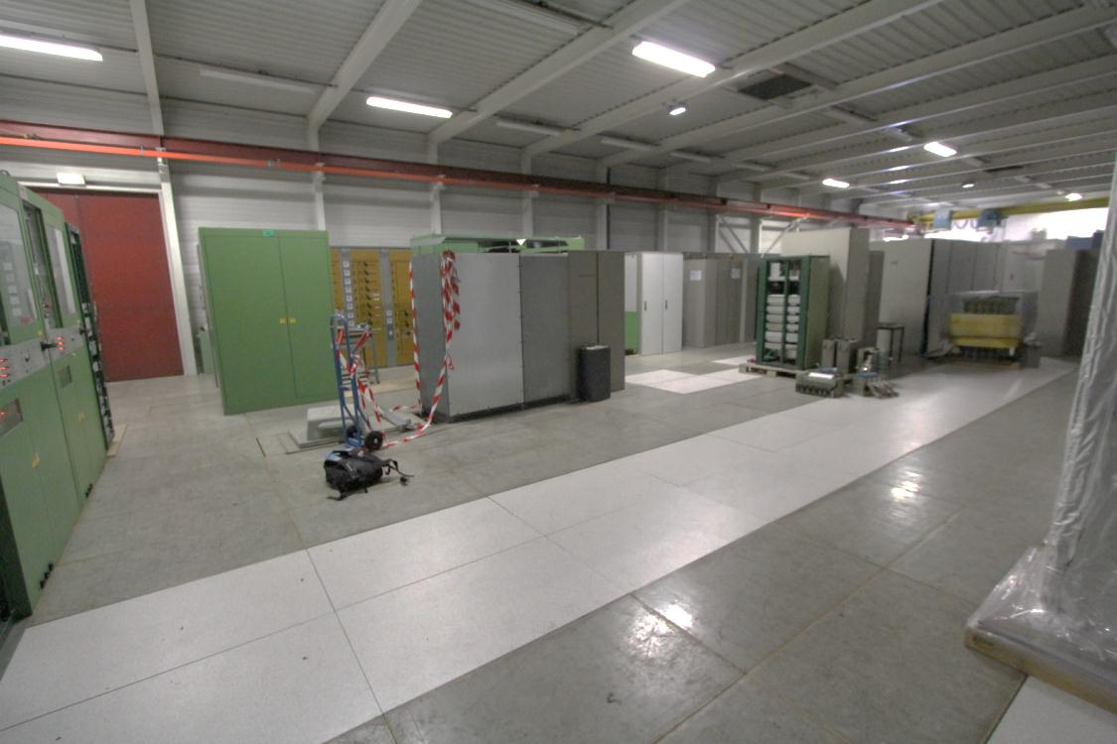
ELENA Ring (LNR): Installation Overview
AD Upper Floor
B193_R-407

Slide 14
B193_R-407 Electrical Requirements: AC Side
Cabinet | Application | Number of Racks | Number of DC Outputs | Models | Required Phases | Input Voltage / V | Input Current Full Load/ A | Power Full Load / VA
A | Operation | 1 | 2 | 3 x COBALT | 3PN+E | 400 | 60 | 41569
B | Operation | 1 | 6 | 6 x CANCUN_50 | 3PN+E | 400 | 17 | 11432
C | Operation | 3 | 1 | 1 x CERN_AuxPS_Type2 | 3P+E | 400 | 286 | 198000
D | Operation | 1 | 6 | 6 x CANCUN_50 | 3PN+E | 400 | 17 | 11432
E | Operation | 1 | 6 | 6 x CANCUN_50 | 3PN+E | 400 | 17 | 11432
F | Operation | 1 | 6 | 6 x CANCUN_50 | 3PN+E | 400 | 17 | 11432
G | Operation | 1 | 5 | 6 x CANCUN_50 | 3PN+E | 400 | 14 | 9526
H | Operation | 1 | 5 | 6 x CANCUN_50 | 3PN+E | 400 | 14 | 9526
I | Operation | 1 | 5 | 5 x HCE 35 -650 | 3PN+E | 400 | 9 | 6163
J | Operation | 1 | 3 | 3 x COBALT | 3PN+E | 400 | 60 | 41569
K | Operation | 1 | 3 | 1 x COBALT, 2x CANCUN 30 | 3PN+E | 400 | 26 | 17667
L | Spare | 3 | 0 | 1 x CERN_AuxPS_Type2 | 3P+E | 400.00 | 286 | 0
M | Spare | 1 | 0 | 4 x CANCUN_50 | 3PN+E | 400 | 17 | 0
N | Spare | 1 | 0 | 1 x CANCUN_50; 1 x CANCUN 20; 1 x SM 35-45 1 x SM15400 | 3PN+E | 400 | x | X
O | Control | 1 | 0 | FGC Gateway, Ethernet Switch, Pulse Injector | 3PN+E | 400 |  | ~2000
 |  |  |  |  |  |  | Total Power | 375kVA
15 Feeders, 19 Racks
Notes:
Notes: All input voltages are 3 phase
All converters have input protective devices (fuse or circuit breaker).

Slide 15
B193_R-407 Electrical Requirements: DC Side
 |  |  | Circuit 1 |  | Circuit 2 |  | Circuit 3 |  | Circuit 4 |  | Circuit 5 |  | Circuit 6
Cabinet | Application | Number of DC Outputs | Output Voltage / V | Output Current / A | Output Voltage / V | Output Current / A | Output Voltage / V | Output Current / A | Output Voltage / V | Output Current / A | Output Voltage / V | Output Current / A | Output Voltage / V | Output Current / A
A | Operation | 2 | 50 | 200 | 50 | 200 | x | x | x | x | x | x | x | x
B | Operation | 6 | 30 | 50 | 30 | 50 | 30 | 50 | 30 | 50 | 30 | 50 | 30 | 50
C | Operation | 1 | 450 | 400 | x | x | x | x | x | x | x | x | x | x
D | Operation | 6 | 30 | 50 | 30 | 50 | 30 | 50 | 30 | 50 | 30 | 50 | 30 | 50
E | Operation | 6 | 30 | 50 | 30 | 50 | 30 | 50 | 30 | 50 | 30 | 50 | 30 | 50
F | Operation | 6 | 30 | 50 | 30 | 50 | 30 | 50 | 30 | 50 | 30 | 50 | 30 | 50
G | Operation | 5 | 30 | 50 | 30 | 50 | 30 | 50 | 30 | 50 | 30 | 50 | 30 | 50
H | Operation | 5 | 30 | 50 | 30 | 50 | 30 | 50 | 30 | 50 | 30 | 50 | 30 | 50
I | Operation | 5 | 650 | 0 | x | x | x | x | x | x | x | x | x | x
J | Operation | 3 | 50 | 200 | x | x | x | x | x | x | x | x | x | x
K | Operation | 3 | 50 | 200 | 75 | 30 | 75 | 30 | x | x | x | x | x | x
L | Spare | 0 | x | x | x | x | x | x | x | x | x | x | x | x
M | Spare | 0 | x | x | x | x | x | x | x | x | x | x | x | x
N | Spare | 0 | x | x | x | x | x | x | x | x | x | x | x | x
O | Control | 0 | x | x | x | x | x | x | x | x | x | x | x | x

Slide 16
AD Upper Floor Electrical Requirements: AC Side
Cabinet | Application | Number of Racks | Number of DC Outputs (up to) | Models | Required Phases | Input Voltage / V | Power Full Load / VA
A | ES Operation | 1 | 18 | Commercial | 3PN+E | 400 | <2000
B | ES Operation | 1 | 18 | Commercial | 3PN+E | 400 | <2000
D | ES Operation | 1 | 18 | Commercial | 3PN+E | 400 | <2000
E | ES Operation | 1 | 18 | Commercial | 3PN+E | 400 | <2000
F | ES Operation | 1 | 18 | Commercial | 3PN+E | 400 | <2000
G | ES Operation | 1 | 18 | Commercial | 3PN+E | 400 | <2000
H | ES Operation | 1 | 18 | Commercial | 3PN+E | 400 | <2000
I | ES Operation | 1 | 18 | Commercial | 3PN+E | 400 | <2000
J | ES Operation | 1 | 18 | Commercial | 3PN+E | 400 | <2000
K | ES Operation | 1 | 18 | Commercial | 3PN+E | 400 | <2000
L | ES Operation | 1 | 18 | Commercial | 3PN+E | 400 | <2000
M | ES Operation | 1 | 18 | Commercial | 3PN+E | 400 | <2000
N | SEP Operation | 1 | 3 | Commercial | 3PN+E | 400 | <2000
O | Control | 1 | 0 | PLC | 3PN+E | 400 | <2000
P | Control | 1 | 0 | FGC Gateway, Ethernet Switch, Pulse Injector | 3PN+E | 400 | <2000
Q | Spares | 1 | 0 | Commercial | 3PN+E | 400 | 0
16 Feeders, 16 Racks

Slide 17
AD Upper Floor Electrical Requirements: DC Side
184 Electrostatic Circuits!
Circuit voltages and polarity reversal options to be finalized
EPC will specify cables and connectors and request a job for the placement by EN/EL.
Septum converter rated 1200A. Magnet designed for 1150A.
Latest operational requirement is 950A.
Assuming copper cables of 800mm^2 (2x 400mm^2):
8.7V is required in steady state
9.1V is required for 1 second ramp
3 x 15V 400A converters connected in parallel is proposed
Current sharing is active
Voltage drop of cables is very significant as resistance of the septum is only 8mΩ.

Slide 18
Cooling and Ventilation
Only the ring dipole power converter is water cooled.
The expected power to the cooling circuit is <10kW.
<10degC temperature rise inlet to outlet
Total max pressure drop of circuit = 3.5bar
In B193_R-407 total losses to air of the order of 40kW -> will be able to provide a more accurate figure. This is also strongly a function of the cycle definition.

Slide 19
List of Power Converters
Designation | Manufacturer | Model | Operation Quantity | Spare Quantity | Output Voltage / V | Output Current / A
1 | CERN | CERN_AuxPS_TYPE2 | 1 | 1 | 450 | 400
2 | CERN | COBALT | 7 | 1 | 50 | 200
3 | CERN | CANCUN_50 | 34 | 5 | 30 | 50
4 | Commercial | Commercial | 1 | 1 | 15 | 1,200
5 | CERN | CANCUN_20 | 2 | 1 | 75 | 20
6 | Commercial | Commercial | 77 | 7 | 7000 | 0.002
7 | Commercial | Commercial | 12 | 2 | 2500 | 0.005
8 | Commercial | Commercial | 13 | 2 | 70000 | 0.000
9 | Commercial | Commercial | 81 | 8 | 1300 | 0.010
10 | Commercial | Commercial | 4 | 1 | 650 | 0.050
11 | Commercial | Commercial | 1 | 1 | 35 | 45
 |  | Totals | 233 | 30

Slide 20
Conclusions
Still to define:
  Compensation Solenoid Power Converter (Working on base of CANCUN_50)
Still to confirm:
  Polarity Reversal Requirements of Electrostatic Elements
  Electron Cooler requirements
Documentation to upload to EDMS
  Work Package Descriptions
  Data for EN/EL: AC, DC and control cabling requirements
Circuits must be finalised by the end of November to ensure that EPC can respect foreseen install date of June 2015.

Slide 21
Overview of Project Plan
2013 | 2014 | 2015 | 2016
Technical Design Report Work Package Descriptions end of year | Market Surveys and Call for Tenders where necessary Procurement and Manufacture of Power Converters Systems | Install Power Converters 01/06 – 30/10 | ELENA Commissioning 01/04-01/07

Slide 22
BACKUP – Normal Quadrupole Magnet Characteristics
Parameter | Value | Unit | Remark
Type | Racetrack
Cooling | Air-cooled |  | The maximum allowed j_{rms} shall therefore be respected
Conductor cross section | 6.3 x 4 | mm × mm | Without insulation, IEC 60317-02
Interturn insulation thickness | 0.1 | mm | Enamelled copper wire
Ground insulation thickness | 3 | mm
Edge rounding radius | 1 | mm
Number of turns | 6 × 11 = 66
Distance between coil and yoke | 3 | mm
Nominal current density j | 1.52 | A/mm²
Resistance @ 20 °C | 0.103 | Ω | For four coils
Inductance | 36.4 | mH | For four coils
Conductor length per coil | ~ 36.3 | m | = 66 × (2.75 × yoke length)
Weight per coil | ~ 13 | kg
Parameter | Value | Unit | Remark
Nominal current I_{max} | 37 | A
Rise time | ≥1 | s
Flat top time | ≥10 | s
Fall time | ≥1 | s
Required voltage on magnet at ramp up end | 5.1 | V | Ramp time 1 s
Required voltage at steady operation of the magnet | 3.8 | V
Power dissipation | 140.5 | W
Magnets powered in series | 4

Slide 23
BACKUP – Skew Quad Magnet Characteristics
Parameter | Value | Unit | Remark
Type | Racetrack
Cooling | Air-cooled
Conductor material | Copper
Conductor dimensions | 6.3 x 4 | mm x mm | IEC 60317-0-2, dimensions given without insulation
Conductor insulation | 0.1 | mm | Enamel
Coil windings | 4 x 11 = 44
Coil cross-section | 71.5 x 16.8 | mm x mm | = (11 x 6.3 + conductor insulation) x (4 x 4 + conductor insulation); used in simulations
Bending radius | 8 | mm | = 2 x conductor thickness
Resistance at 20˚C | 33 | mΩ | For four coils in series
Inductance | 10.3 | mH | For four coils in series
Coil mass | ~ 2.5 | kg
Parameter | Value | Unit | Remark
Current | 33.0 | A
Current density | 1.36 | A/mm²
Voltage | 1.1 | V | At steady operation
Voltage during ramp to I_{nom} in 1 s | 1.4 | V
Power dissipation | 35.6 | W | At steady operation

Slide 24
BACKUP – H/V Corrector Magnet Characteristics
Parameter | Value | Unit | Remark
Type | Racetrack
Cooling | Air-cooled
Conductor material | Copper
Conductor dimensions | 8 x 4.5 | mm x mm | Following IEC60317-0-2
Cross section of conductor | 35.14 | mm²
Insulation | 0.1 | mm | Enamelled copper wire
Coil windings | 3 x 7 + 2 x 6 x 4 = 69 |  | The coil is divided in a “main coil” and two “compensation coils” (see Figure 2)
Coil cross-section | 14.1 x 57.4 + 2 x 28.2 x 32.8 | mm x mm | Does not include 2 mm ground insulation
Bending radius | 12 | mm
Resistance at 20˚C | 33.3 | mΩ | For two coils in series per plane
Inductance | 3.9 | mH | Per plane
Coil mass | 15 | kg | Weight per coil; Estimate
Parameter | Value | Unit | Remark
Magnet | MCR
Current | 40 | A
Current density | 1.09 | A/mm²
Voltage per plane | 1.3 | V | At steady operation
Maximum voltage during ramp to I_{nom} in 1 s per plane | 1.46 | V
Power dissipation per plane | 53.3 | W | At steady operation

Slide 25
BACKUP – Sextupole Magnet Characteristics
Parameter | Value | Unit | Remark
Type | Racetrack
Cooling | Air-cooled
Conductor material | Copper
Conductor dimensions | 2.5 x 7.1 | mm x mm | Table 2, IEC 60317-0-2
Cross section of conductor | 17.20 | mm²
Insulation | 0.1 | mm
Coil windings | 6 x 4 = 24
Average turn length | 400 | mm | Estimate
Coil cross-section | 14.8 x 47.8 | mm x mm | Includes 2 mm ground insulation
Bending radius | 10 | mm | = 4 x cable thickness
Resistance at 20˚C | 60 | mΩ | For six coils in series per magnet
Inductance | 5 | mH | Per magnet
Coil mass | 2 | kg | Estimate
Parameter | Value | Unit | Remark
Magnet | MXR
Current | 21 | A
Current density | 1.2 | A/mm²
Voltage | 1.3 | V | At steady operation
Maximum voltage during ramp to I_{nom} in 1 s per magnet | 1.4 | V
Maximum voltage during ramp to I_{nom} in 1 s per circuit | 2.8 | V
Power dissipation per magnet | 26 | W | At steady operation

Slide 26
BACKUP – TL Dipole Magnet Characteristics
Parameter | Value | Unit | Remark
Type | Racetrack
Cooling | Water-cooled
Conductor material | Copper
Conductor dimensions | 10 x 10 | mm x mm | Luvata Nr. 8139
Hole diameter of conductor | 5.7 | mm
Cross section of conductor | 73.6 | mm²
Insulation | 0.5 | mm
Coil windings | 8 x 8 = 64
Coil cross-section | 94 x 94 | mm x mm | Includes 3 mm ground insulation
Bending radius | 20 | mm | = 3.5 x hole diameter
Resistance at 20˚C | 47 | mΩ | For two coils in series per magnet
Inductance | 32 | mH | Per magnet
Coil mass | 70 | kg | Estimate
Parameter | Value | Unit | Remark
Magnet | MBL
Current | 285 | A
Current density | 3.9 | A/mm²
Voltage | 13.4 | V | At steady operation
Maximum voltage during ramp to I_{nom} in 2 s per magnet | 18 | V
Maximum voltage during ramp to I_{nom} in 2 s per circuit | 44 | V
Power dissipation per magnet | 3.8 | kW | At steady operation

Slide 27
Table from DS 07/08/2013
Element type | Label | Short label | Total number of magnets | Resistance in mOhm | Inductance in mH | Current in A at maximum field
Bending Magnet, Horizontal | PXMBHEKCWP | MBR | 8 | 47 | 34 | 326
Quadrupole, Normal | PXMQNLGNAP | MQR | 13 | 103 | 36 | 37
Sextupole, Normal | PXMXNADNAP | MXR | 5 | 60 | 6 | 21
Quadrupole, Skew | PXMQSABNAP | MQS | 3 | 33 | 10 | 33
Corrector H+V* | PXMCCAYWAP | MCR | 9 | 32 | 4 | 45
Solenoid | PXMLNAFNAC | MLR | 3 | TBD | TBD | TBD
TL Bending magnet | PXMBHCBCWP | MBL | 3 | 47 | 32 | 285

Slide 28
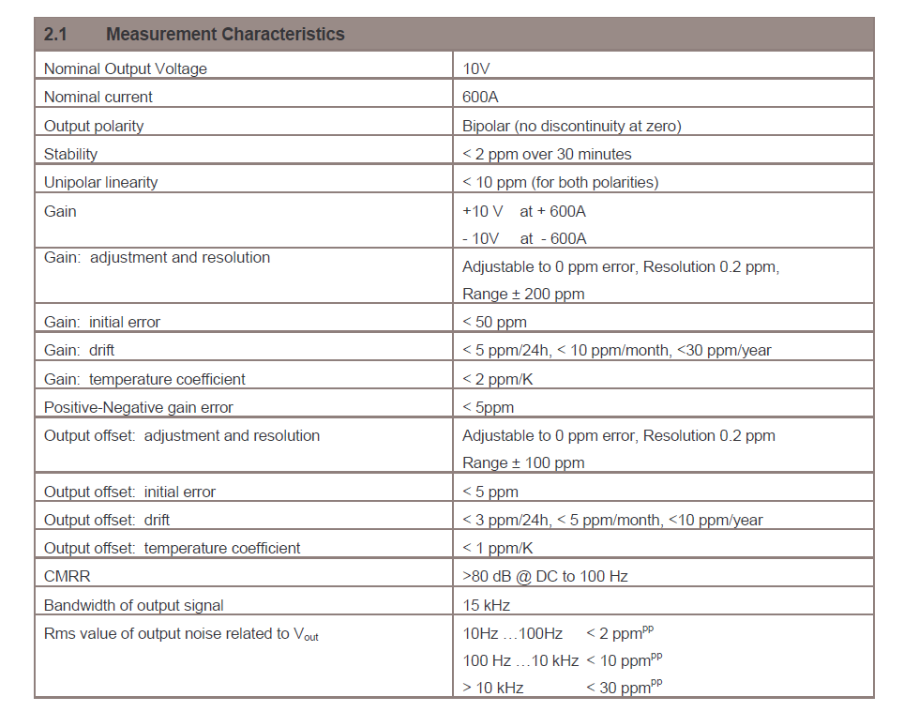
Example DCCT data

