Slide 1
Status and Outlook
Status and next steps within a few weeks or months
  Machine (layout, main parameters ..) well defined and no major changes expected any more – unless as outcome of the review
  Completion of Technical Design Report within a few weeks (instead of summer 2013) – unless this review leads to fundamental changes of the project
  Update budget (including spending profile) and planning
    Significant changes since project approval, transfer lines as example
      >100 m instead of ~60 m of lines
      Fast switches with electric fields for extraction (and distribution to experiments) instead of (expensive) travelling wave kickers and septa
  Setting up of project monitoring and control tool (EVM)
  (next pages contain only budget when project was set up)
New building 393 available ~February 2014, then installation of infrastructure
  Installation of AD kicker electronics during first half of 2015 (after AD run 2014) to free space for ELENA
ELENA installation second half 2015 & beginning 2016
Commissioning of ELENA ring (mainly with external source) up to end 2016
Installation of electrostatic lines and commissioning during first half of 2017
Start of antiprotons physics with ELENA from (late) summer 2017

Slide 2
Schedule

Slide 3
Budget ELENA with building 393, but not GBAR (and negative indexation): 16 897 kCHF
Code | Workpackage | Dept | Group | Budget code | Responsible | 2012 | 2013 | 2014 | 2015 | 2016 | Total WP
1 | Project Management | BE | BE/ABP | 61560 | CARLI Christian | 20 | 49 | 297 | 49 | 20 | 434
1.1 | Optics & Machine Parameters | BE | BE/OP | 67560 | BELOSHITSKII Pavel | 10 | 10 | 0 | 0 | 0 | 20
1.2 | Commissioning & Operation | BE | BE/OP | 67561 | ERIKSSON Tommy |  | 0 | 0 | 10 | 10 | 20
1.3 | User Interface and Safety | BE | BE/ABP | 61561 | BREUKER Horst | 10 | 10 | 10 | 10 | 0 | 39
1.4 | Software Definition & Integration | BE | BE/OP | 67562 | PASINELLI Sergio | 10 | 10 | 10 | 10 | 0 | 39
1.5 | External Institutions Contact | BE | BE/ABP | 61562 | OELERT Walter | 5 | 10 | 0 | 0 | 0 | 15
1.6 | Integration, Production | EN | EN/MEF | 89127 | BUTIN François | 0 | 88 | 88 | 49 | 10 | 234
1.7 | Installation and Planning | EN | EN/MEF | 89127 | GILBERT Nicolas | 0 | 10 | 10 | 10 | 10 | 39
1.8 | Integration | EN | EN/MEF | 89127 | MARIDOR Stéphane |  | 0 | 0 | 0 | 0 | 0
1.9 | Webmaster | BE | BE/OP |  | S. Pasinelli |  | 0 | 0 | 0 | 0 | 0
1.1 | Radio Protection | DGS | DGS/RP | Bc10 | VOLLAIRE Joachim |  | 0 | 29 | 63 | 0 | 93
2.1 | Mechanical Design & Construction | EN | EN/MME |  | PERINI Diego |  | 0 | 0 | 0 | 0 | 0
2.2 | Magnets | TE | TE/MSC | 99165 | ZICKLER Thomas | 80 | 117 | 390 | 683 | 146 | 1416
2.3 | RF & Schottky Pick-Up | BE | BE/RF | 69560 | ANGOLETTA M.- EE. | 30 | 195 | 184 | 162 | 10 | 581
2.4 | Power Converters | TE | TE/EPC | 99250 | BAILLIE J./SIMONET G. | 0 | 151 | 284 | 472 | 20 | 926
2.5 | Vacuum System/ring and beam lines | TE | TE/VSC | 99784 | KERSEVAN Roberto | 100 | 902 | 307 | 156 | 49 | 1514
2.6 | Electron Cooler | BE | BE/BI | 64560 | TRANQUILLE Gerard | 20 | 176 | 683 | 293 | 98 | 1268
2.7 | Beam Instrumentation | BE | BE/BI | 64561 | TRANQUILLE Gerard | 10 | 146 | 224 | 244 | 63 | 688
2.8 | Injection & Ejection Kickers | TE | TE/ABT | 99262 | SERMEUS Luc | 0 | 205 | 195 | 284 | 98 | 781
2.9 | Injection & Ejection Septa | TE | TE/ABT | 99264 | BORBURGH Jan | 10 | 24 | 10 | 0 | 0 | 44
2.8/2.9 | Kickers and Septa Electronics | TE | TE/ABT | 99261 | CARLIER Etienne | 30 | 78 | 351 | 341 | 59 | 859
2.10 | Injection, Extraction, Transfer lines | TE | TE/ABT | 99260 | BARTMANN Wolfgang | 2 | 390 | 778 | 1560 | 390 | 3120
2.11 | Experimental Areas | EN | EN/MEF | 89129 | EFTHYMIOPOULOS Ilias | 0 | 10 | 39 | 29 | 20 | 98
2.12 | Controls | BE | BE/CO | 66560 | CATTIN Mathieu | 0 | 10 | 49 | 146 | 293 | 497
2.13 | B-Train | TE | TE/MSC | 99166 | BUZIO Marco |  | 10 | 49 | 49 | 10 | 117
2.14 | Interlock System | TE | TE/MPE | 99340 | PUCCIO Bruno | 0 | 0 | 68 | 34 | 0 | 102
2.15 | H­ Source | BE | BE/ABP | 61563 | To Be Defined |  | 0 | 0 | 0 | 0 | 0
2.16 | Magnetic measurements | TE | TE/MSC | 99167 | GALBRAITH Peter | 0 | 49 | 73 | 49 | 10 | 180
3.1 | Survey | BE | BE/ABP | 61564 | DOBERS Tobias |  | 0 | 0 | 0 | 0 | 0
3.2 | Handling & Transportation | EN | EN/HE | 55135 | PELLETIER Serge | 0 | 29 | 36 | 32 | 0 | 98
3.3 | Civil Engineering | GS | GS/SE | 76170 | LOPEZ-HERNANDEZ L | 15 | 1755 | 1560 | 0 | 0 | 3330
3.4 | Cooling & Ventilation | EN | EN/CV | 53662 | BODY Yannic | 0 | 20 | 78 | 0 | 0 | 98
3.5 | Access System | GS | GS/ASE | 72475 | CHAPUIS D./MORAND B. |  | 0 | 34 | 0 | 0 | 34
3.6 | Cabling | EN | EN/EL |  | LELONG Patrick |  | 0 | 0 | 0 | 0 | 0
3.7 | Electrical Distribution | EN | EN/EL | 55125 | NECCA René | 0 | 20 | 78 | 0 | 0 | 98
3.8 | Scrapers | EN | EN/STI | 63126 | LOPRETE Frederic | 0 | 59 | 59 | 0 | 0 | 117

Slide 4
Budget for GBAR installation in addition: 1 706 kCHF
=> In total for ELENA and Gbar: 18 603 kCHF
Code | Workpackage | Dept | Group | Responsible | 2012 | 2013 | 2014 | 2015 | 2016 | Total WP
1 | Infrastructure Management/Installation | EN | EN/MEF | BUTIN François | 0 | 0 | 24 | 24 | 0 | 49
1.1 | Gas | EN | EN/MEF | FAYET Fabrice | 0 | 20 | 10 | 5 | 5 | 39
1.2 | Electricity distribution | EN | EN/EL | BOURREL Thierry | 0 | 10 | 29 | 10 | 0 | 49
1.3 | Cooling (demineralized water) | EN | EN/CV | POIREAU Johan | 0 | 10 | 20 | 10 | 0 | 39
1.4 | Gas extraction | EN | EN/CV | BODY Yannic | 0 | 10 | 10 | 0 | 0 | 20
1.5 | Racks | ? | ? | ? | 0 | 10 | 10 | 39 | 0 | 59
1.6 | Laser hut | ? | ? | ? | 0 | 0 | 0 | 15 | 20 | 34
1.7 | Metallic structures | EN | EN/MEF | BAIS Franck | 0 | 20 | 10 | 10 | 0 | 39
1.8 | Integration | EN | EN/MEF | MARIDOR Stéphane | 0 | 20 | 20 | 20 | 10 | 68
1.9 | Access control | GS | GS/ASE | CHAPUIS Didier | 0 | 0 | 0 | 34 | 0 | 34
1.10 | Safety systems | EN | EN/MEF | BAIS Franck | 0 | 0 | 0 | 10 | 5 | 15
1.11 | Radioprotection | DGS | DGS/RP | VOLLAIRE Joaquim | 0 | 0 | 0 | 39 | 10 | 49
1.12 | Transport | EN | EN/HE | BERTONE Caterina | 0 | 0 | 0 | 29 | 10 | 39
1.12 | Magnetic Extraction Kicker | TE | TE/ABT | SERMEUS Luc | 0 | 0 | 98 | 293 | 34 | 424
1.13 | Magnetic Extraction Septum | TE | TE/ABT | BORBURGH Jan |  | 0 | 49 | 98 | 49 | 195
1.14 | Transfer line | TE | TE/ABT | BARTMANN Wolfgang |  | 0 | 49 | 195 | 39 | 283
1.15 | Beam Transfo/2 Profile monitors | BE | BE/BI | TRANQUILLE Gerard |  | 0 | 15 | 24 | 15 | 54
1.16 | Vacuum | TE | TE/VSC | KERSEVAN Roberto |  | 0 | 146 | 0 | 0 | 146
1.17 | Controls | BE | BE/CO | CATTIN Matthieu |  | 0 | 0 | 24 | 49 | 73

Slide 5
Organization and Planning
ELENA constructed with substantial contributions from external institutes
- Memorandum of Understanding MoU signed in summer 2012
- Essential for the project and a clear sign of interest in the project
Univ. Tokyo and MPQ-MPI:
- 2 MCHF (electron cooler, discussions for specifications ongoing, diagnostics for extraction lines)
- 7 FTE (identified, electrostatic transfer lines and devices)
Cockcroft Institute & Univ’s and Swansea University:
- Costing of the order of 500 kGBP has been applied by U Liverpool,
- Contributions by Cockcroft institute: position PUs, transfer lines studies, rest gas interactions, optics modeling
with stray fields (bendings, cooler solenoid), emittance measurement by scraping
Denmark: Resources for ring bending magnets available
IKP-FZ Jülich:
- External proton and H⁻ source for commissioning: upgrades (for 100 keV) and refurbishment of source underway
Univ. Brescia: 50 kEuros (to be transferred in two slices end of last year and this year)
RIKEN
- Discussions on materiel contributions (compensation solenoids for electron cooer?) and manpower (student)
TRIUMF: Help for design of electrostatic transfer lines
Hemholtz Institute Mainz: Construction of supports
Manne-Siegmann: Help with ELENA commissioning

Slide 6
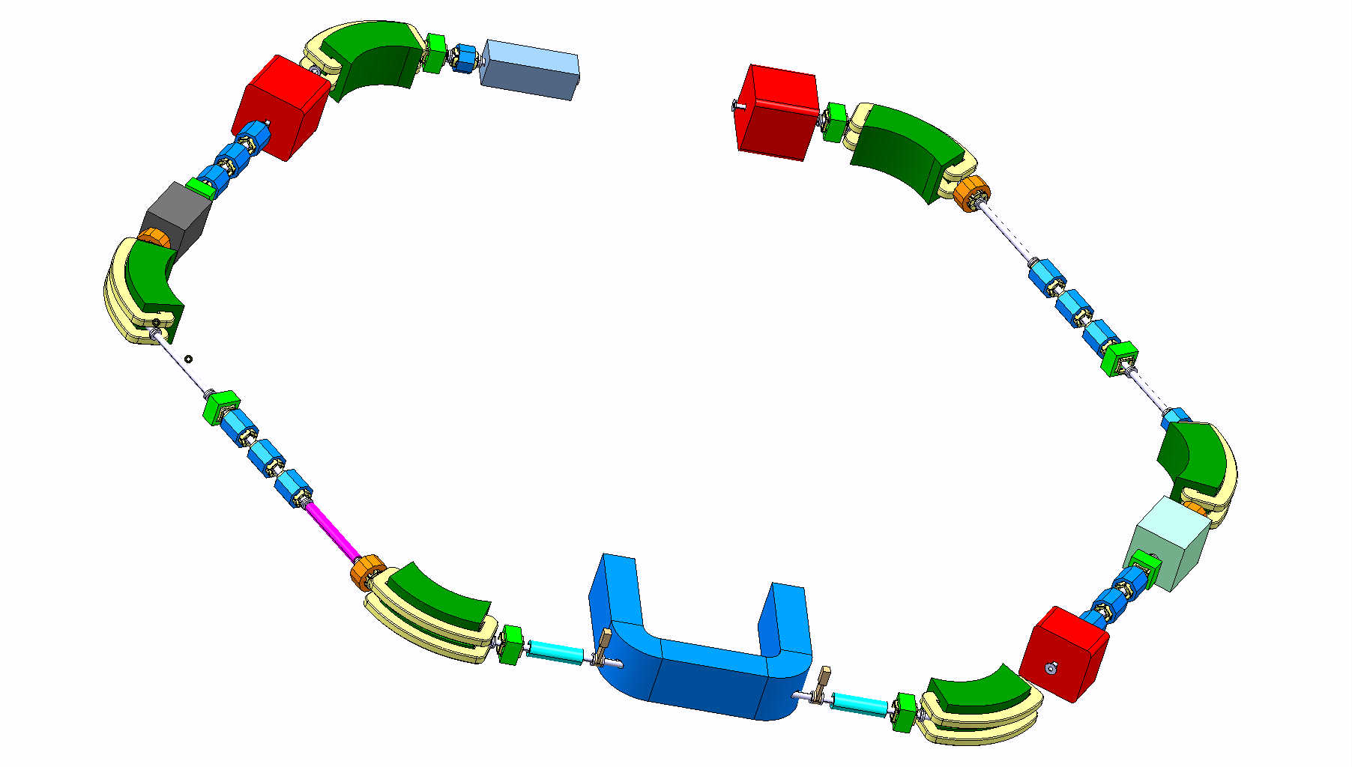
Thanks for your attention !

