Slide 1

The ELENA Electron Cooler
- Requirements and
Magnet System
Lars V. Jørgensen, BE-OP
ELENA Review – Oct. 14, 2013

Slide 2
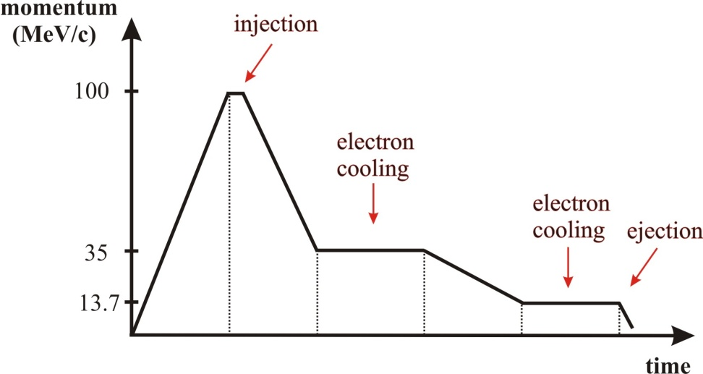
The Need for Electron Cooling
Electron cooling essential in ELENA to counter emittance blow-up caused by the deceleration process.
To prepare bunches with sufficiently low emittance for extraction to the experiments via the electrostatic extraction lines.
Cooling needed at 2 momenta: 35 MeV/c and 13.7 MeV/c.
Expected emittances prior
to cooling:
@ 35 Mev/c:
ε ~ 50 π mm mrad
(Δp/p) = ± 2 × 10⁻³
Needed emittances at extraction:
ε ≤ ~ 3 π mm mrad
(Δp/p) ≤ ± 1 × 10⁻³

Slide 3
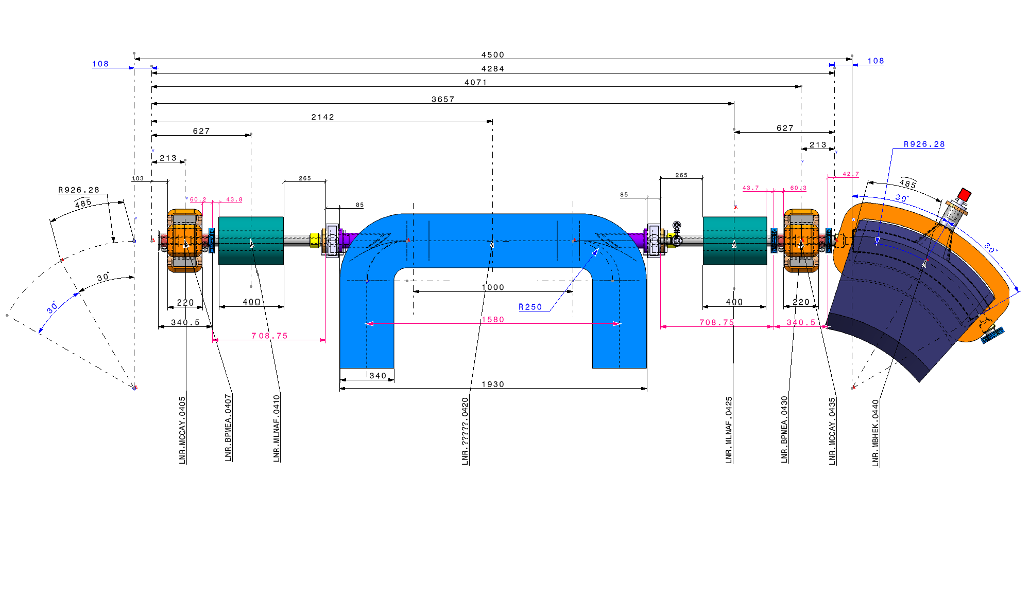
General requirements
Must be very compact!
Must fit in Section 4 incl. solenoid compensators and correctors.
~ 2 meters available for the electron cooler.
Space constraints also necessitate 90°bends on relatively small radius (25 cm)
E-cooler length

Slide 4
Further requirements
Operate at very low electron energies (down to 55 eV).
Operate at very low magnetic field to minimize disturbance to circulating low energy antiprotons – we have chosen 100 Gauss in the cooler.
Have extremely good vacuum.
Adiabatic expansion to reduce transverse temperatures.
Very good field quality – especially in the cooler solenoid (B˔/B_{ǁ} < 5 × 10⁻⁴ ).
Orbit correctors and solenoid compensators.

Slide 5
Electron Cooler parameters
Momentum (MeV/c) | 35 | 13.7
β | 0.037 | 0.015
Electron beam energy (eV) | 355 | 55
Electron current (mA) | 5 | 2
Electron beam density (m⁻³) | 1.38 x 10¹² | 1.41 x 10¹²
B_{gun} (G) | 1000
B_{drift} (G) | 100
Expansion factor | 10
Cathode radius (mm) | 8
Electron beam radius (mm) | 25
Twiss parameters (m) | β_{h}=2.103, β_{v}=2.186, D=1.498
Flange-to-flange length (mm) | 1930
Drift solenoid length (mm) | 1000

Slide 6
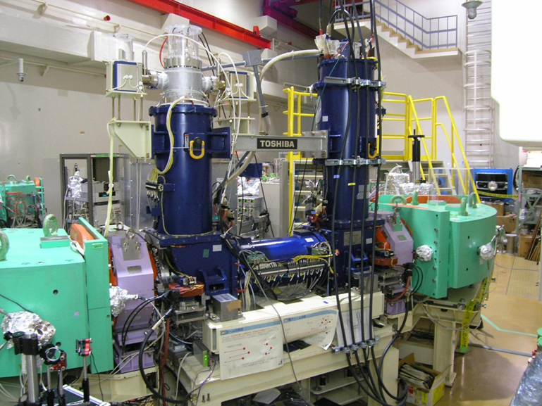
Kyoto connection
- requirements lead us to look for inspiration at the very compact and relatively low energy e-cooler built by Toshiba Corp. for the S-LSR ring in Kyoto.
S-LSR electron cooler
Magnetic field uniformity in drift solenoid | 5×10⁻⁴
Electron beam energy (keV) | 1-5
Electron current (mA) | 50-400
Gun perveance (µP) | 2.2
B_{gun} (G) | 1500
B_{drift} (G) | 500
Expansion factor | 3
Cathode radius (mm) | 15
Electron beam radius (mm) | 25
Twiss parameters | β_{h}=1.7, β_{v}=2.4
Bending radius (mm) | 250
Drift solenoid length (mm) | 800

Slide 7
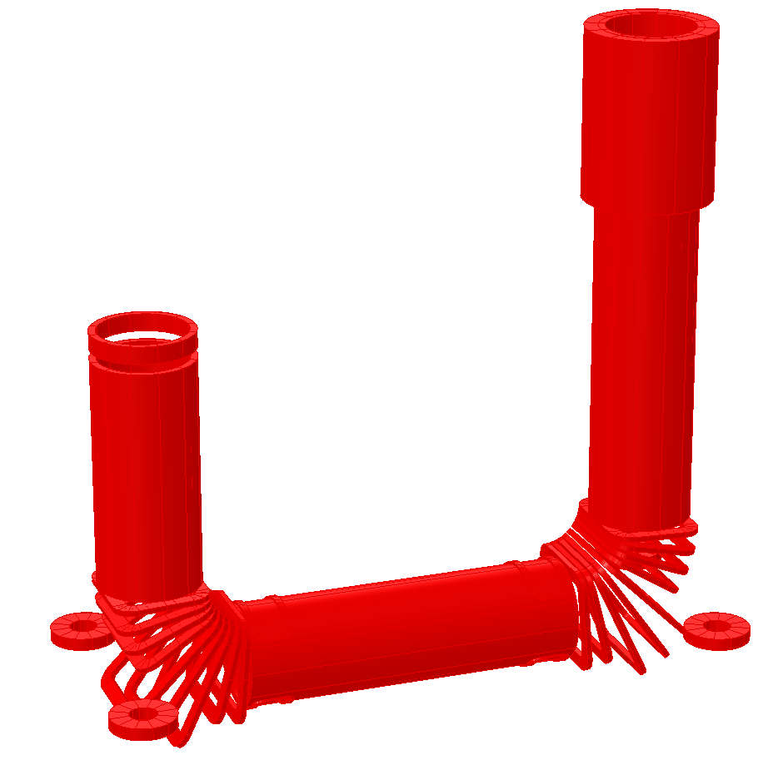
The magnet system
Magnetic system components
Main cooler solenoid
Gun solenoid
Collector solenoid
Expansion solenoid
Reverse coil at collector
2 x Toroid section consisting of
9 racetrack coils each
Various corrector coils to
ensure good field quality
Orbit correctors
Solenoid compensators

Slide 8
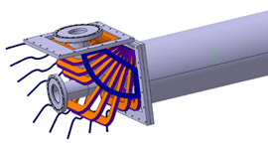
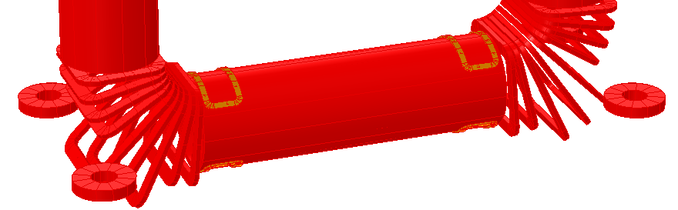
Correction coils
Double Helmholtz transverse correctors for the 3 main solenoids – to correct for stray fields and other remnant static fields
End winding correctors on 3 main solenoids – in case it is needed!
Main Y correctors at the end of the cooler solenoid – crucial to extend the good field region
Several (up to 8) small Y correctors inside the cooler solenoid – for fine tuning the good field region
Coils inside the toroid section to steer the electrons – if needed
Toroid kick orbit correctors just outside the toroids – to cancel out the kick to the antiprotons from the toroids
Solenoid compensators further out – to cancel out the horizontal-vertical coupling induced by the solenoid field

Slide 9
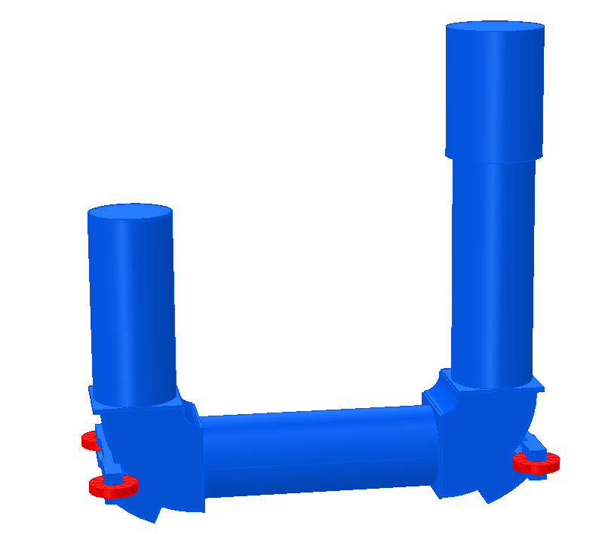
The whole package
The whole system will be shielded to attain better field quality and to exclude stray fields - ~ 1 Gauss in the area of the AD where it will be installed.
The electron cooler will be mounted horizontally for ease of maintenance.

Slide 10
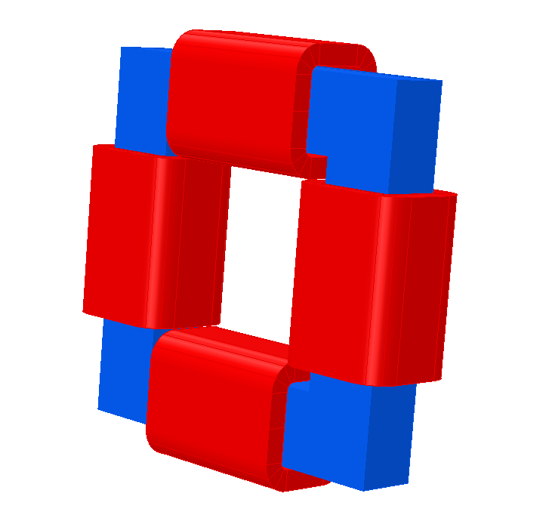
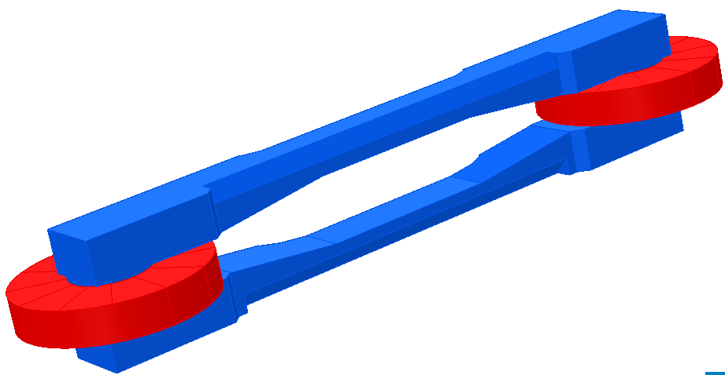
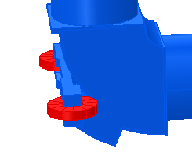
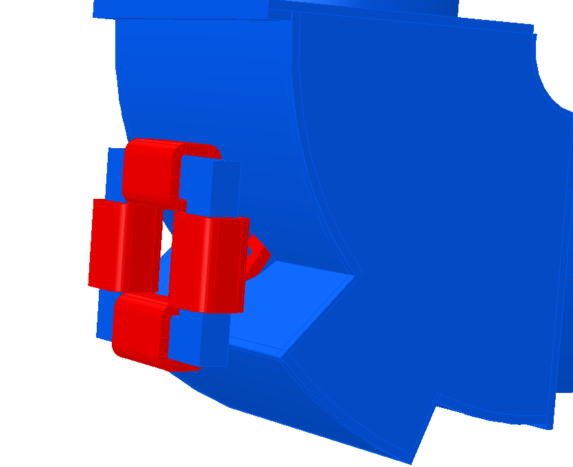
Orbit correctors
Two types of orbit correctors have been studied:
Kyoto-style
Standard
Kyoto-style is more compact
Standard is based on an existing LINAC4 design and offers the possibility of a local bump (steering in both directions)

Slide 11
Axial field - electrons
Axial field without correction
Conclusion: The expansion coil has a significant influence on the axial field in the drift solenoid.

Slide 12
Transverse field - electrons
Transverse field without correction
Conclusion: Moving the expansion coil further away makes the field at the center of the drift solenoid flatter and much easier to correct.

Slide 13
Orbit correctors

Slide 14
Axial field - antiprotons
Final field incl. all transverse and orbit correctors

Slide 15
The good field region
Standard: B˔/B║ < ±3 × 10⁻⁴ for 63 cm
77 A/cm2 in orbit correctors
14 A/cm2 in US transverse corrector
7 A/cm2 in DS transverse corrector
Kyoto: B˔/B║ < ±5 × 10⁻⁴ for 65 cm
32 A/cm2 in orbit correctors
14 A/cm2 in US transverse corrector
7 A/cm2 in DS transverse corrector

Slide 16
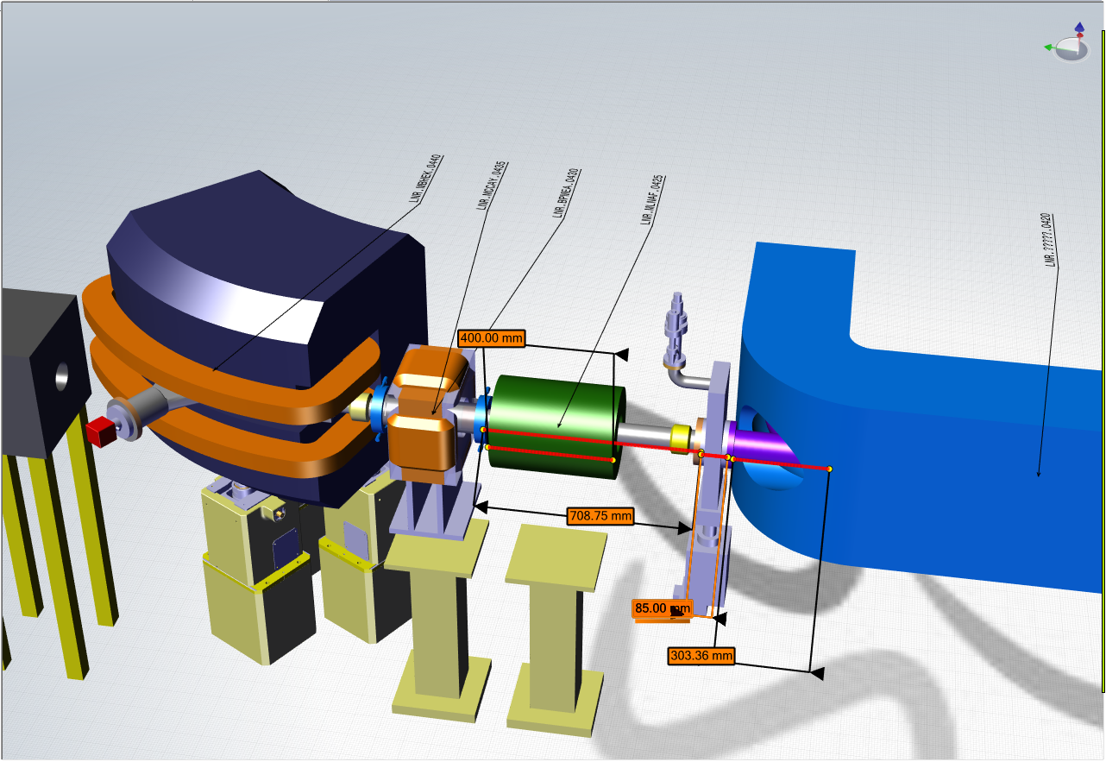
Orbit correctors and bumps
The standard orbit correctors take up more space – and we would have to go to a different design to be able to make a sizeable local bump – but luckily we have a little space left over!

