Slide 1


ELENA Vacuum System
R. Kersevan, TE-VSC-IVM
R. Kersevan, “ELENA Vacuum System”, - ELENA Project Review, Oct14-15, 2013, CERN

Slide 2
Agenda
Machine physics vacuum requirements
Materials, requirements
Expected gas loads and pumping speeds
Lattice Design and Integration Issues
Vacuum Sectoring and Pumping
Conclusions
R. Kersevan, “ELENA Vacuum System”, - ELENA Project Review, Oct14-15, 2013, CERN

Slide 3
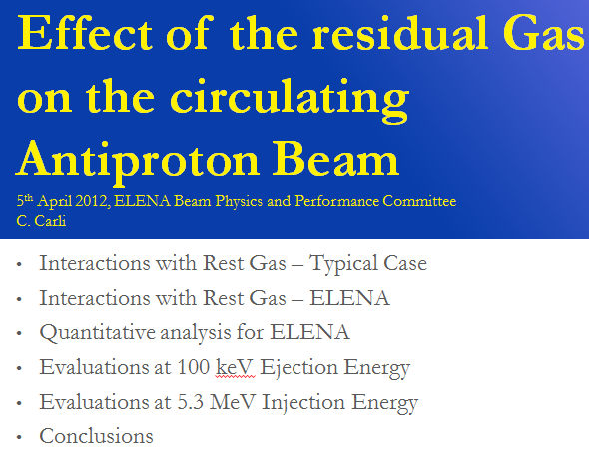
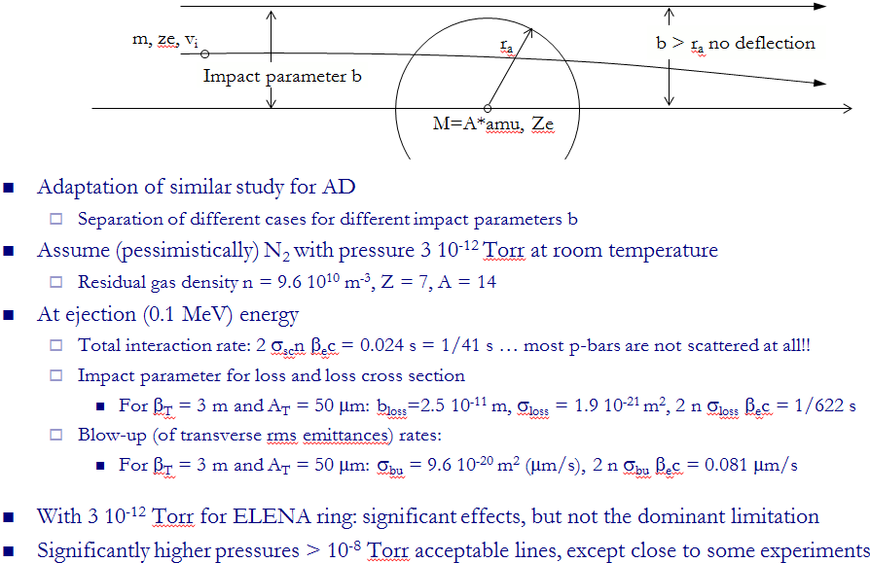
Machine physics vacuum requirements
C. Carli, this review.
This translates into an average pressure at the lower limit of Ultra-High Vacuum Range:
P_{average} < 3.0E-12 Torr ( < 4E-12 mbar) N₂-equiv.!!
R. Kersevan, “ELENA Vacuum System”, - ELENA Project Review, Oct14-15, 2013, CERN

Slide 4
Materials
Requirements:
Availability, Cost
Known Cleaning Procedures
Low Magnetic Permeability
Weldability
Low Outgassing Rate
Capable to Sustain Bake-Out up to 250 ºC
Reliable Sealing Techniques
Requirements 1 through 7 identify 316 LN Stainless-Steel as the Material of Choice, With ConFLat Flanges to be Used Anywhere Possible
R. Kersevan, “ELENA Vacuum System”, - ELENA Project Review, Oct14-15, 2013, CERN

Slide 5

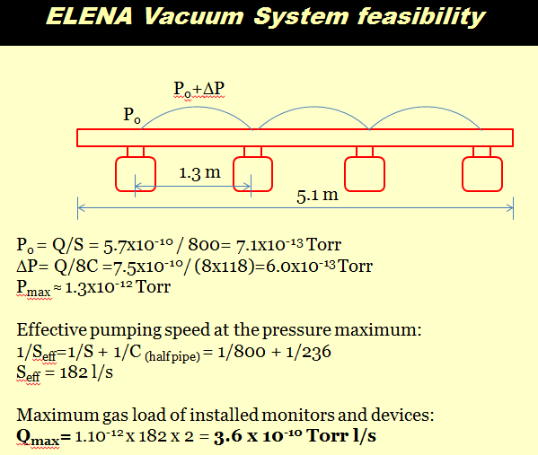
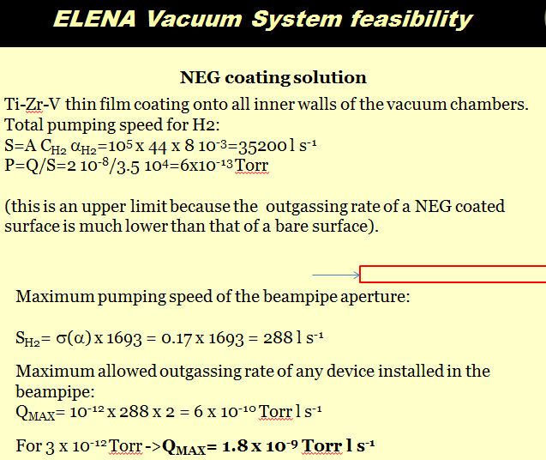
Expected Gas Loads and Pumping Speeds
The (very) initial estimate of the expected gas load and pumping scheme/requirements dates to this meeting…
(presentation by P. Chiggiato, TE-VSC-IVM)
Today’s Update:
Estimated total geometric area of vacuum chamber: ~10 m²
Estimated total outgassing rate at 1.0E-12 Torr*l/s/cm²:
1~5E-7 Torr*l/s
R. Kersevan, “ELENA Vacuum System”, - ELENA Project Review, Oct14-15, 2013, CERN

Slide 6
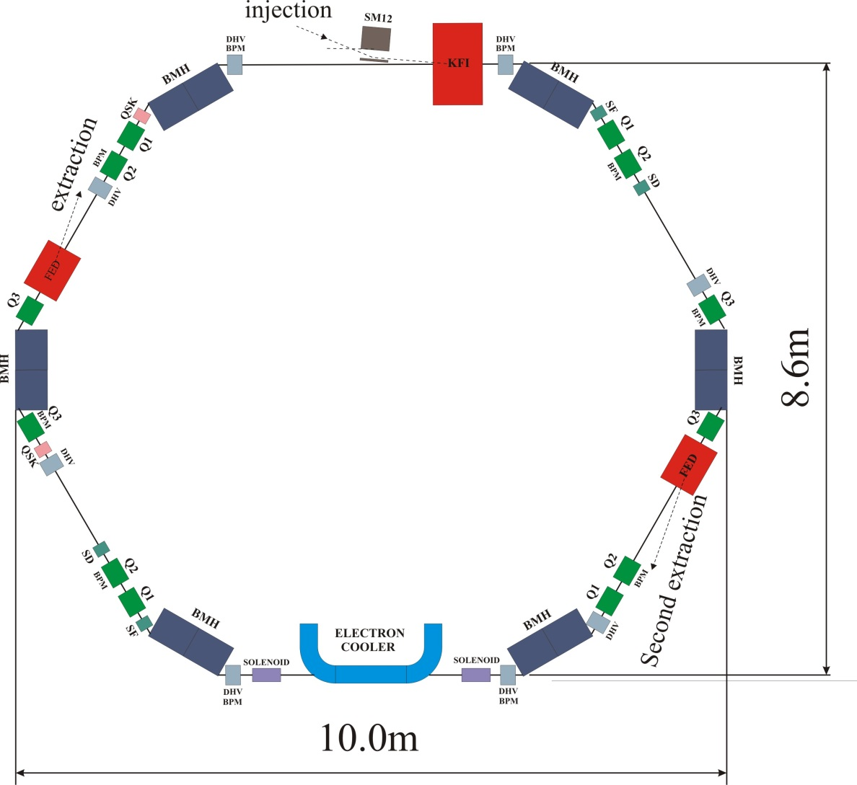
Lattice Design and Integration Issues
The initial lattice seemed to leave sufficient space for installing lumped pumps in each straight section (plus,eventually,one pump on each dipole)…
… and also sufficient space for bellows, gate valves, etc… : GREAT!
R. Kersevan, “ELENA Vacuum System”, - ELENA Project Review, Oct14-15, 2013, CERN

Slide 7
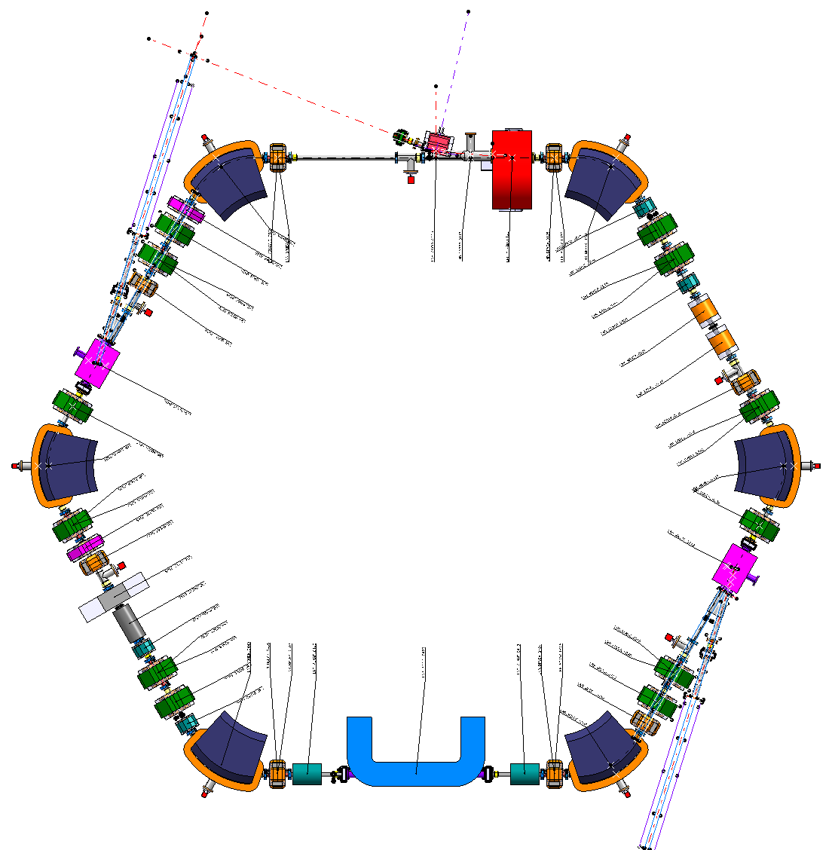
Lattice Design and Integration Issues
… but once all machine/diagnostic components have been designed, the space for pumps has been reduced by a lot…
X
X
R. Kersevan, “ELENA Vacuum System”, - ELENA Project Review, Oct14-15, 2013, CERN

Slide 8
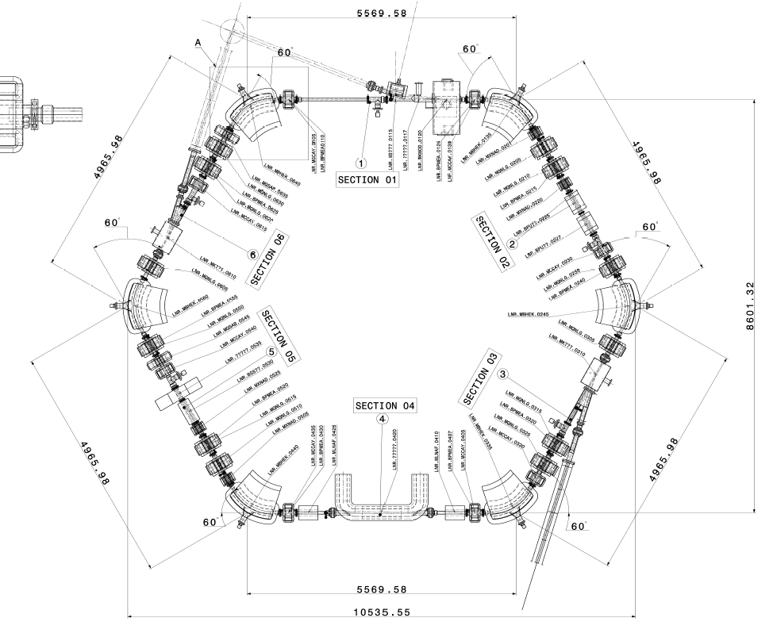
Lattice Design and Integration Issues: Ring
R. Kersevan, “ELENA Vacuum System”, - ELENA Project Review, Oct14-15, 2013, CERN

Slide 9
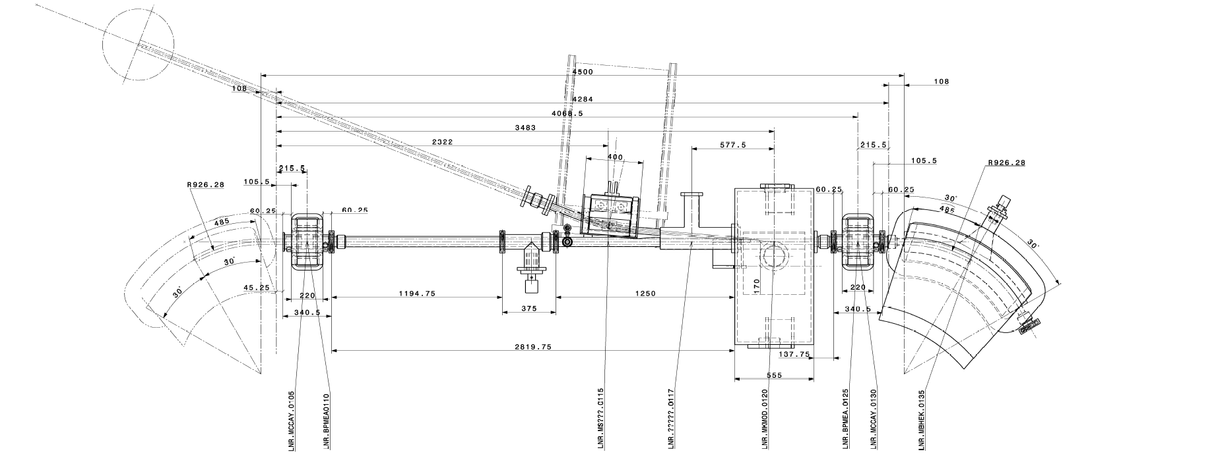
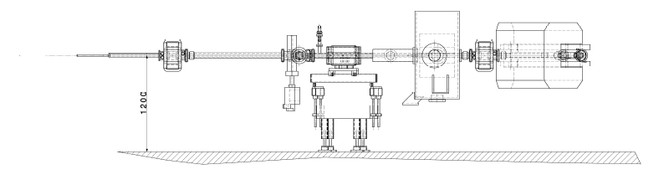
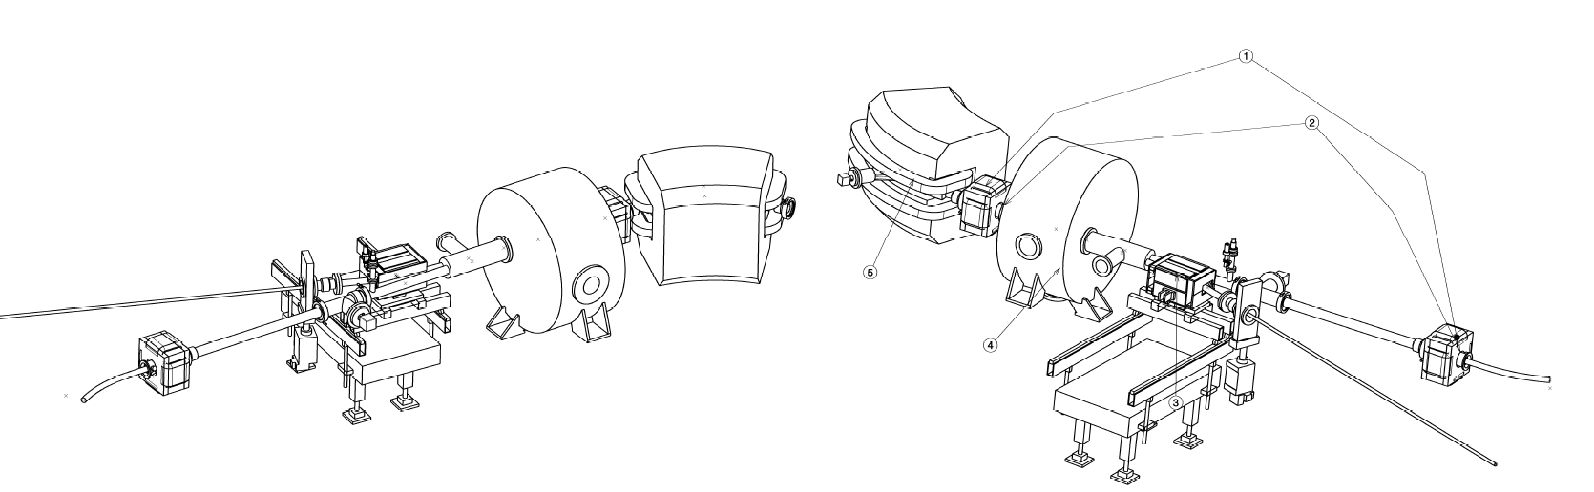
Lattice Design and Integration Issues: Sector 1 (case study)
Details of injection septum/kicker tank and magnet
2x Coaxial BPMs
Injection Septum Tank w/ Kicker
R. Kersevan, “ELENA Vacuum System”, - ELENA Project Review, Oct14-15, 2013, CERN

Slide 10
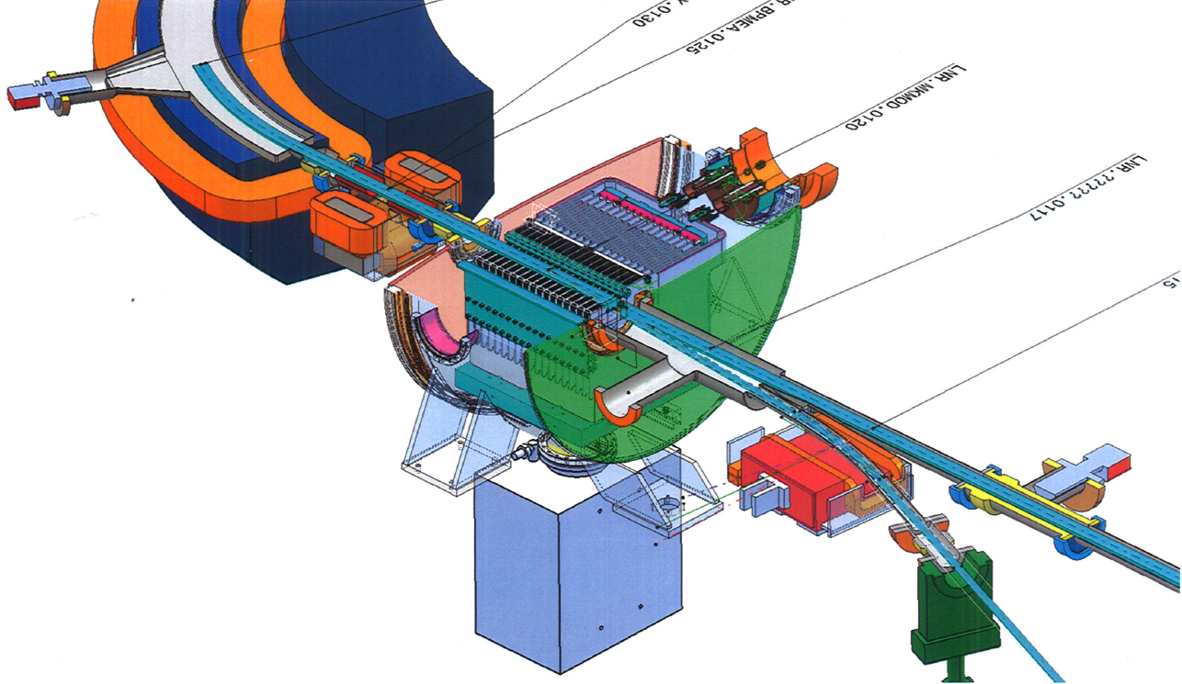
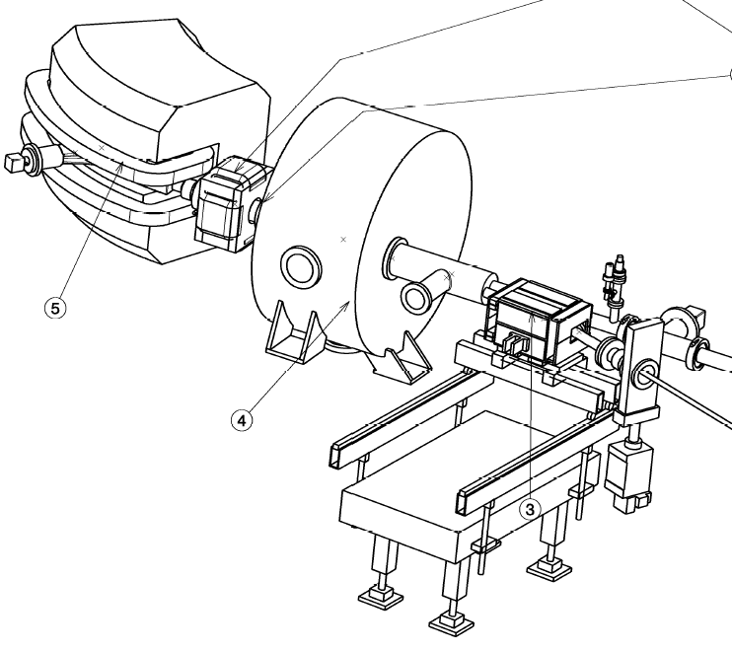
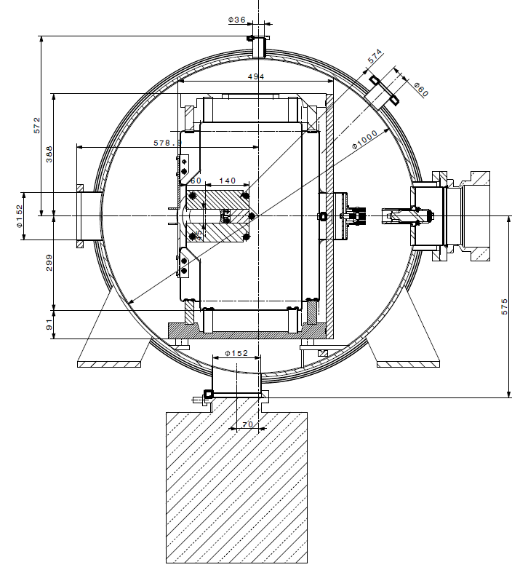
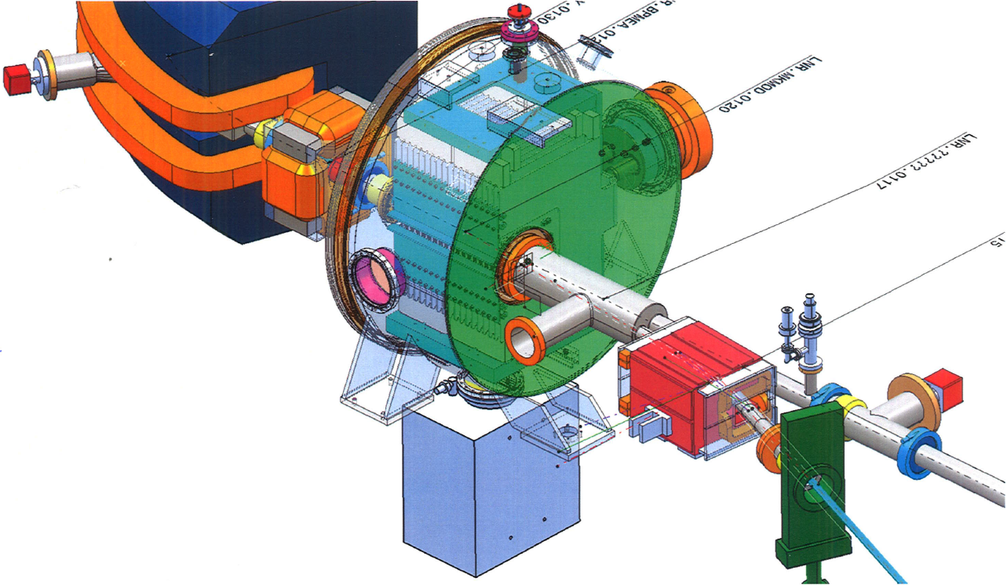
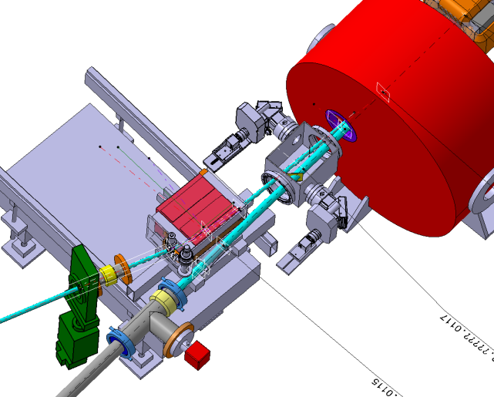
Lattice Design and Integration Issues: Sector 1
Details of injection septum/kicker tank and magnet
Latest Version
R. Kersevan, “ELENA Vacuum System”, - ELENA Project Review, Oct14-15, 2013, CERN

Slide 11
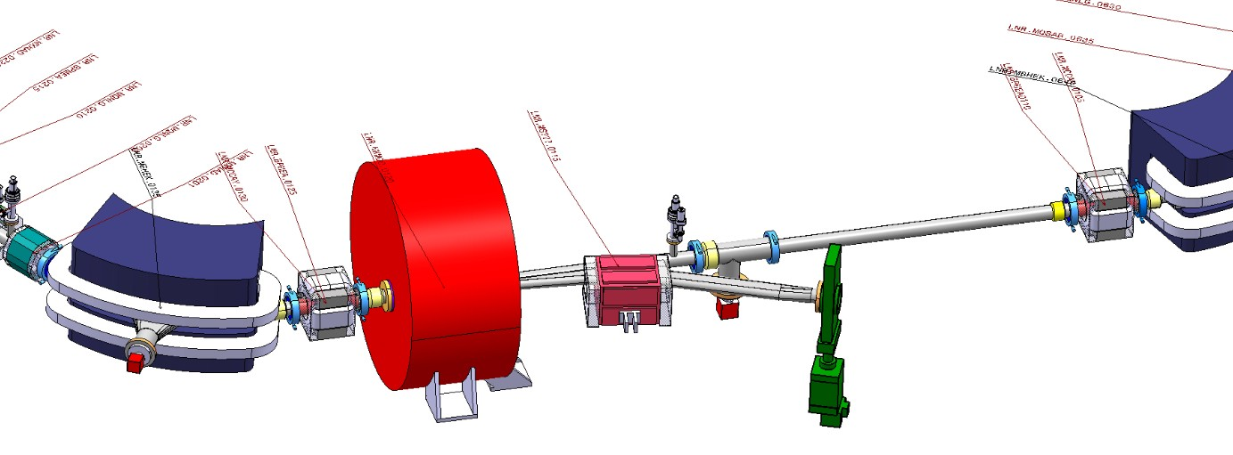
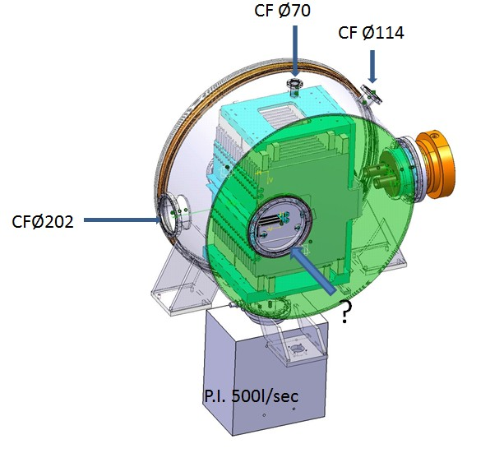
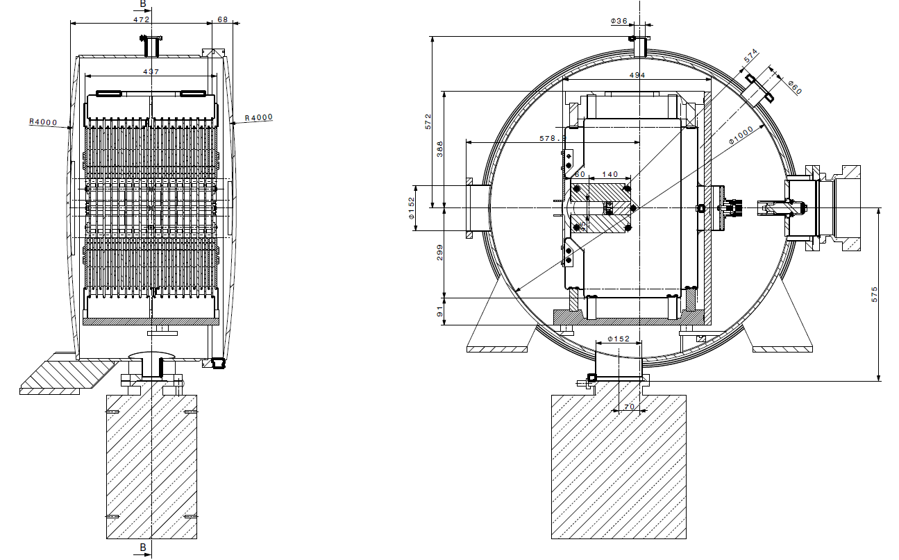
Lattice Design and Integration Issues: Sector 1
Details of injection septum/kicker tank and magnet
Bad conductance to 500 l/s Ion-Pump (plate under magnet)
1000 l/s NEXTorr pump added
NEG-coating of Tank MANDATORY
Average Pressure Along Section is at the Limit the 3E-12 Torr Specification
R. Kersevan, “ELENA Vacuum System”, - ELENA Project Review, Oct14-15, 2013, CERN

Slide 12
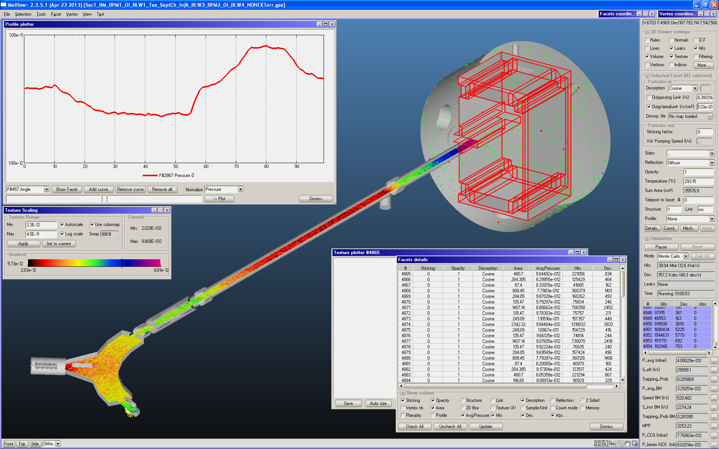
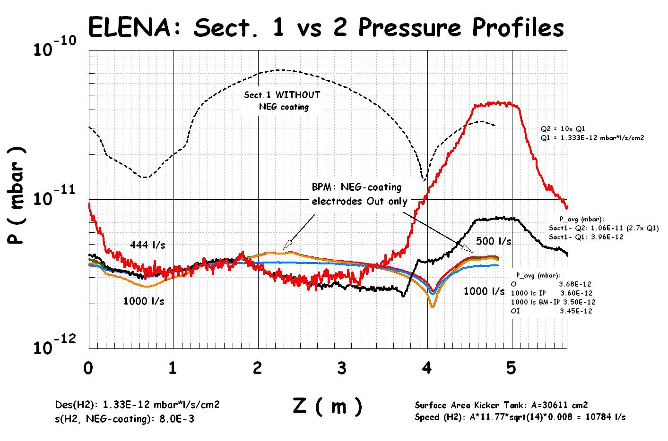

Lattice Design and Integration Issues: Sector 1
Details of injection septum/kicker tank and magnet
R. Kersevan, “ELENA Vacuum System”, - ELENA Project Review, Oct14-15, 2013, CERN

Slide 13
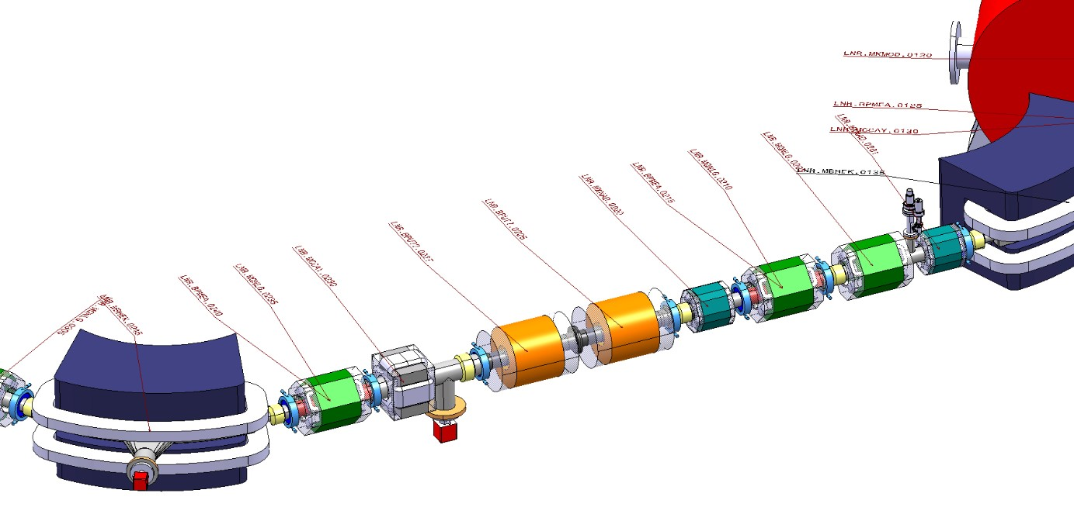
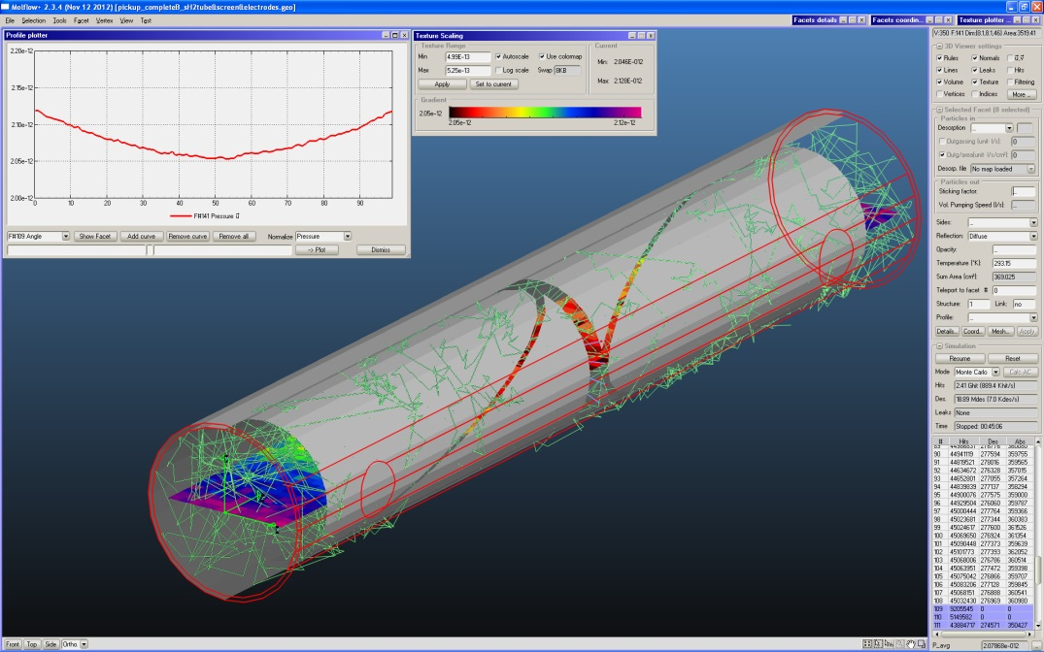
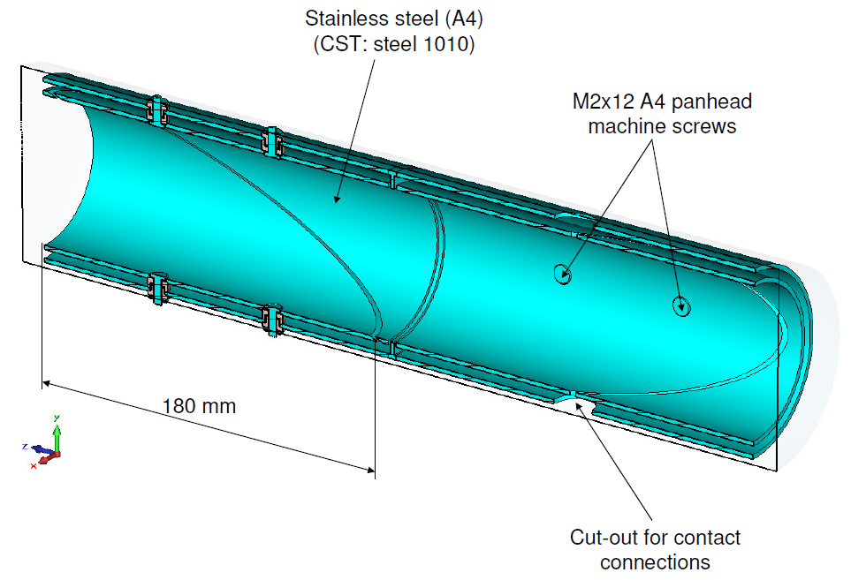
Lattice Design and Integration Issues: Sector 2
Details of Coaxial BPMs
NEG-coating of ALL surfaces inside BPMs MANDATORY
Bellows convolutions contribute significantly to outgassing (larger surface per unit length), will be coated too
R. Kersevan, “ELENA Vacuum System”, - ELENA Project Review, Oct14-15, 2013, CERN

Slide 14
Lattice Design and Integration Issues
Vacuum Sectoring
Sector
Gate Valves
(GV)
Outcome: unevenly long vacuum sectors
R. Kersevan, “ELENA Vacuum System”, - ELENA Project Review, Oct14-15, 2013, CERN

Slide 15
Vacuum Sectoring and Pumping
Expected Gas Loads and Pumping Speeds
Vacuum Sectors
R. Kersevan, “ELENA Vacuum System”, - ELENA Project Review, Oct14-15, 2013, CERN

Slide 16
Vacuum Sectoring and Pumping
Expected Gas Loads and Pumping Speeds
2x
Pumps
NEXTorr
(NEG pump with integrated Ion-pump)
Or
Ion-Pumps
16 Bellows in the straight sections
+ 6x2 on Dipoles
R. Kersevan, “ELENA Vacuum System”, - ELENA Project Review, Oct14-15, 2013, CERN

Slide 17
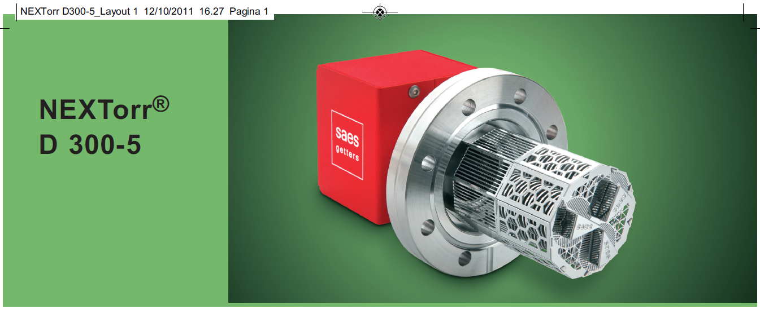
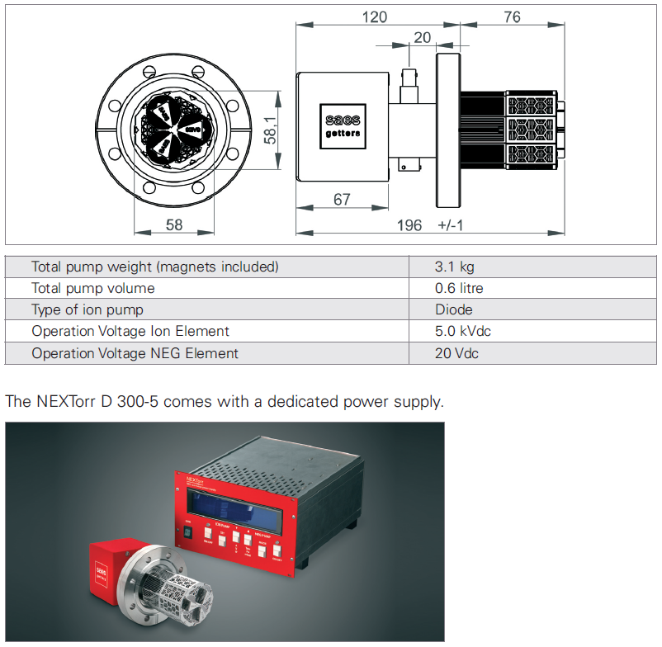
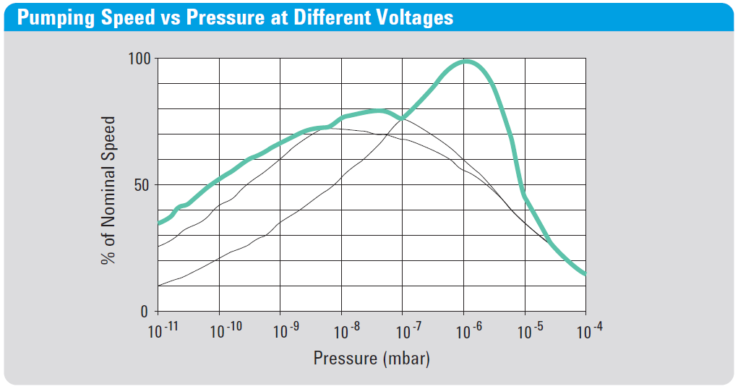
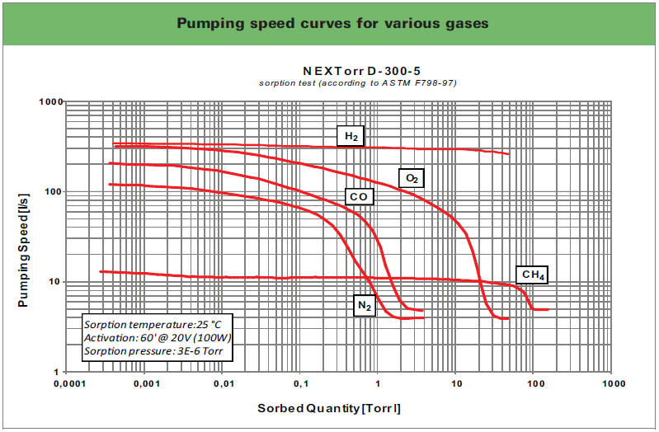
Vacuum Sectoring and Pumping
“NEXTorr D300” integrated NEG/Ion-pump (SAES Getters, Milan)
ELENA will employ either D1000 or D2000 models (i.e. 1000 or 2000 l/s @H₂) on dipoles, and D300 on cylindrical chambers except on injection and extraction elements, cavities, where higher gas loads and localized pressure bumps may be expected. Ion-Pumps will be installed there.
Note how the pumping speed of the ion-pump (StarCell,Agilent) decreases with the pressure, while the speed for the NEG-pump is pressure independent
R. Kersevan, “ELENA Vacuum System”, - ELENA Project Review, Oct14-15, 2013, CERN

Slide 18
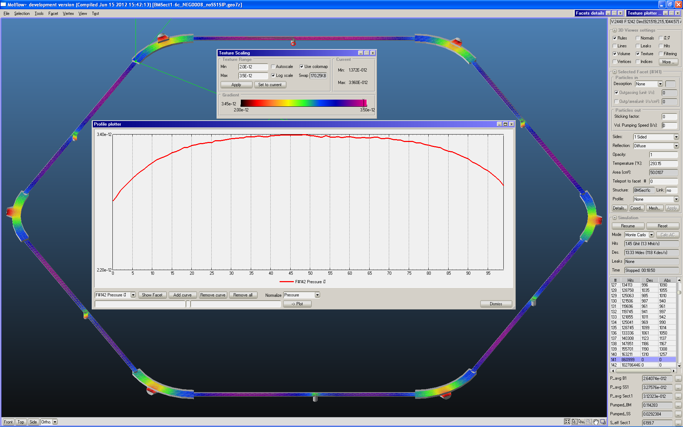
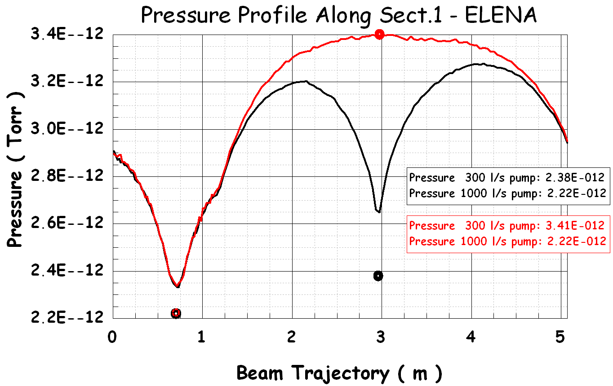
Vacuum Sectoring and Pumping
Zero Pumping Speed on Sect.1 Straight Section Pump: 5% increase of <P> at Sect.1
Switch-off or malfunction of SS1 NEG/Ion-Pump means ~ 5% pressure rise ΔP_{H2} at Sect.1, i.e. ΔP_{H2}< 1% over complete ring.
R. Kersevan, “ELENA Vacuum System”, - ELENA Project Review, Oct14-15, 2013, CERN

Slide 19
Conclusions:
The design of the vacuum system of the ELENA ring is being finalised.
All major integration issues (but 1, refer to 7 below) have been solved
The material chosen for the vacuum chambers is 316 LN stainless-steel
Conical ConFlat flanges (PS-type geometry) with collar are implemented everywhere except on gate valves, cavities, and injection/extraction devices. This saves us some space,longitudinally, as they do not need to have available the length of the screws
NEG-coating will be applied as much as possible
Extensive numerical modeling of the pressure distributions show that the pressure specification compatible with the operation of the machine will be met (P_{average} < 3.0E-12 Torr)
Only notable vacuum issue not solved yet is the reduction of H₂ gas leaking out of the H^{+/-} commissioning source (see talk by T.Eriksson on Tue 15/10). A dedicated differential pumping system is under study.
R. Kersevan, “ELENA Vacuum System”, - ELENA Project Review, Oct14-15, 2013, CERN

Slide 20
Conclusions (cont.):
The ELENA transfer lines (TL) to the experiments will be made using as much as possible a repetitive modular design (not discussed here, see W.Bartmann’s presentation)
Optimization of the pumping speed of the fast switching electrostatic elements has been initiated. Preliminary calculations show that pressures in the low 1.0E-10 Torr should be easily reached
Pumping of the TLs will either be obtained via ion-pumps of NEG-pumps. NEG-coatings only if extremely low pressure will be needed bu experiments (TBD)
The fabrication of the modified AD extraction line (“Line 7000”) has been started
Tests on thin-film heating devices will be done shortly
Modifications/re-cabling of the control cabinets for vacuum controllers is underway (within LS1 program)
The e-cooler design and integration has not been done yet (other than identifying the available space in Sector 4). See G. Tranquille’s presentation for further details.
Thanks for your attention! ☺
R. Kersevan, “ELENA Vacuum System”, - ELENA Project Review, Oct14-15, 2013, CERN

Slide 21
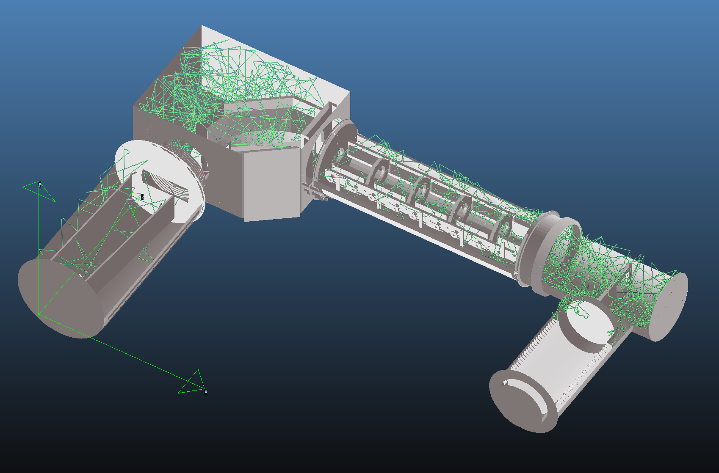
Bonus:
ATRAP ES Switchyard, With Lenses and Beam Diagnostic Device
R. Kersevan, “ELENA Vacuum System”, - ELENA Project Review, Oct14-15, 2013, CERN

Slide 22
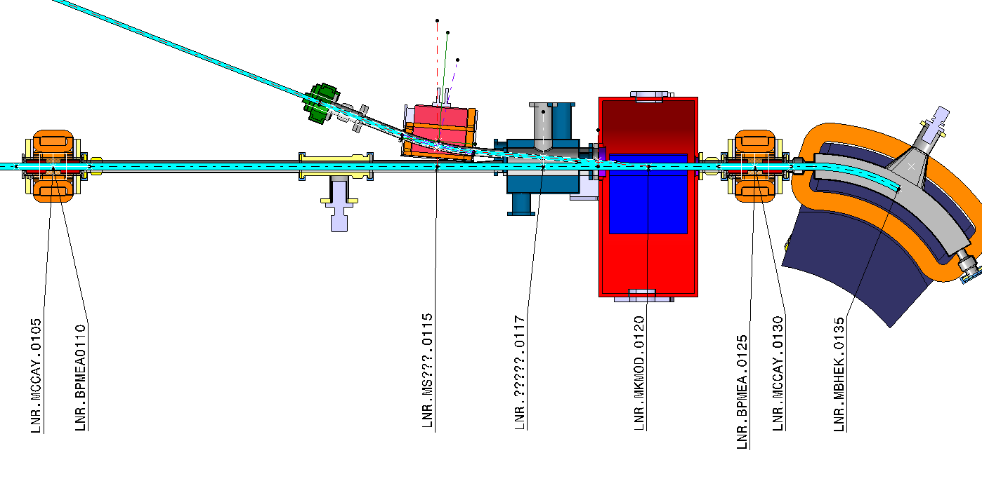
Bonus:
Cross-section of the chamber through the plane of the orbit
R. Kersevan, “ELENA Vacuum System”, - ELENA Project Review, Oct14-15, 2013, CERN

Slide 23
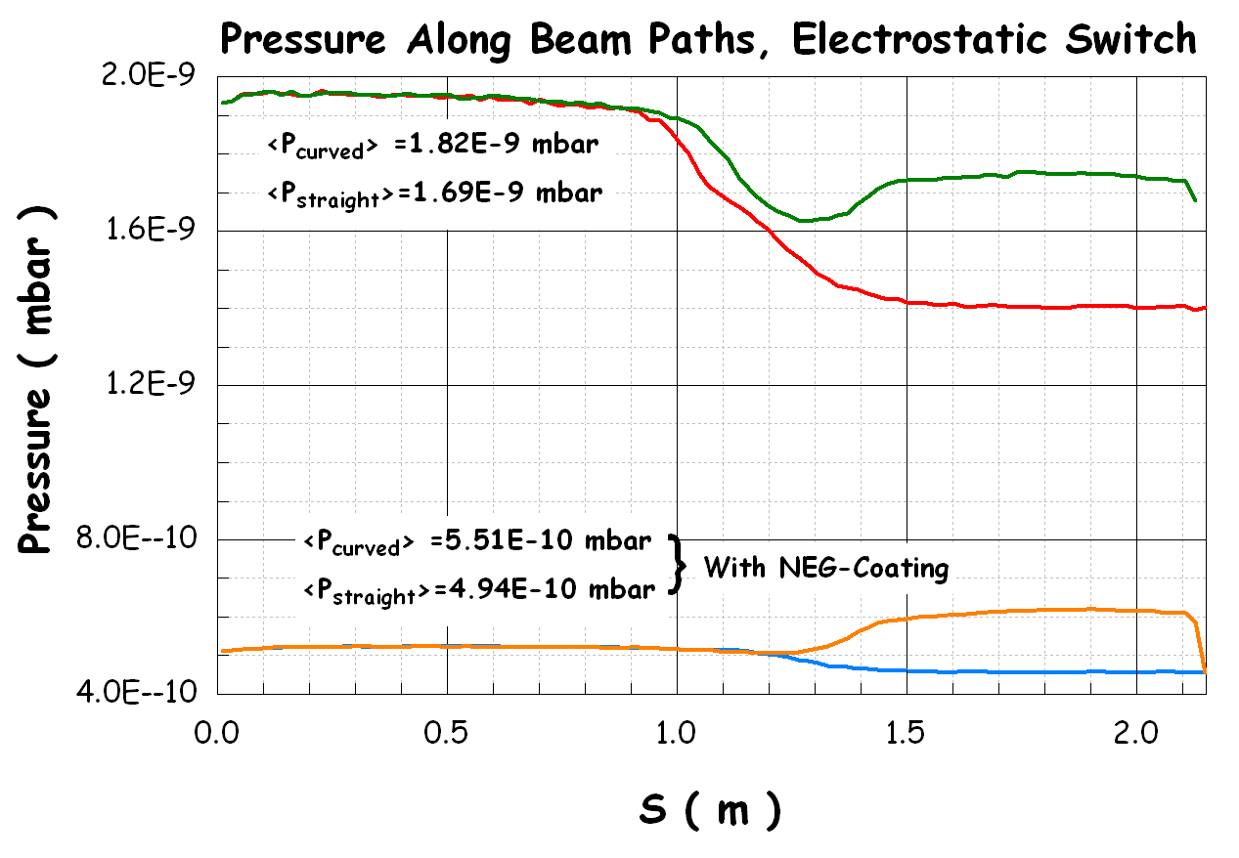
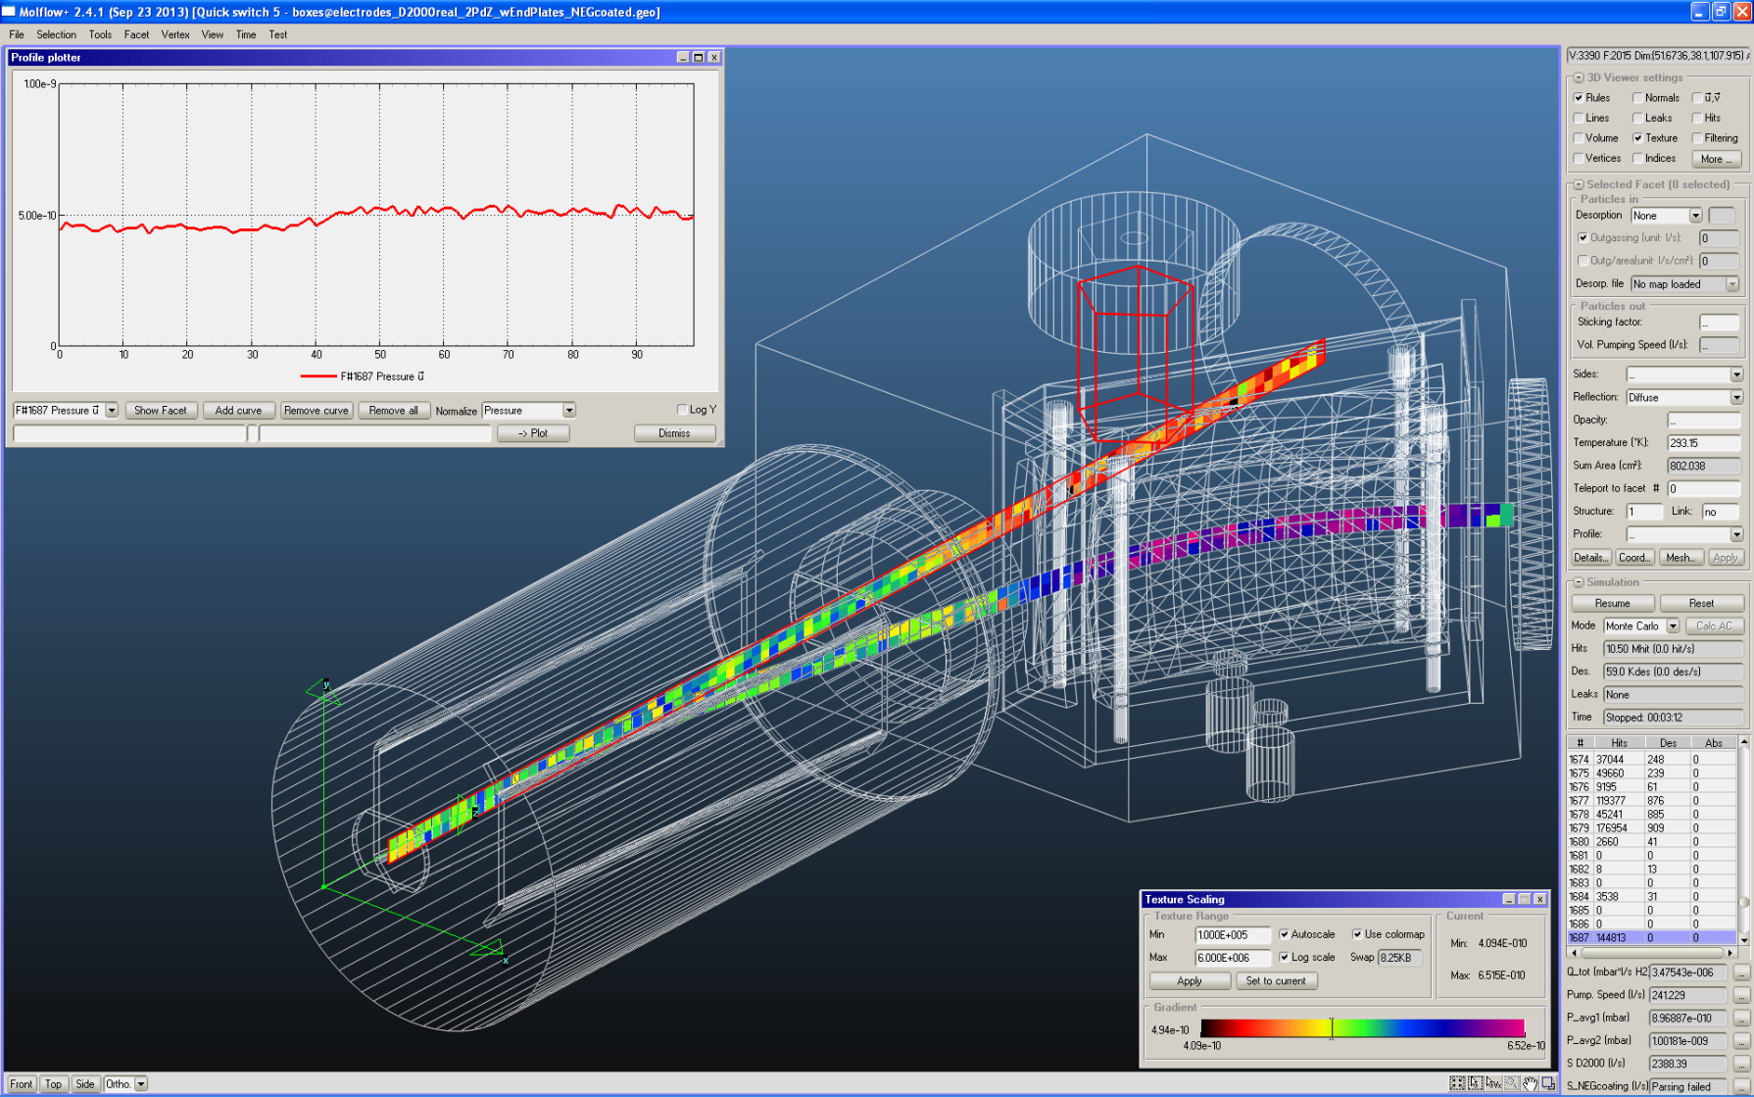
Bonus:
Pressure Profile, With and Without NEG-Coating on Tanks, Item on Previous Page
R. Kersevan, “ELENA Vacuum System”, - ELENA Project Review, Oct14-15, 2013, CERN

Slide 24
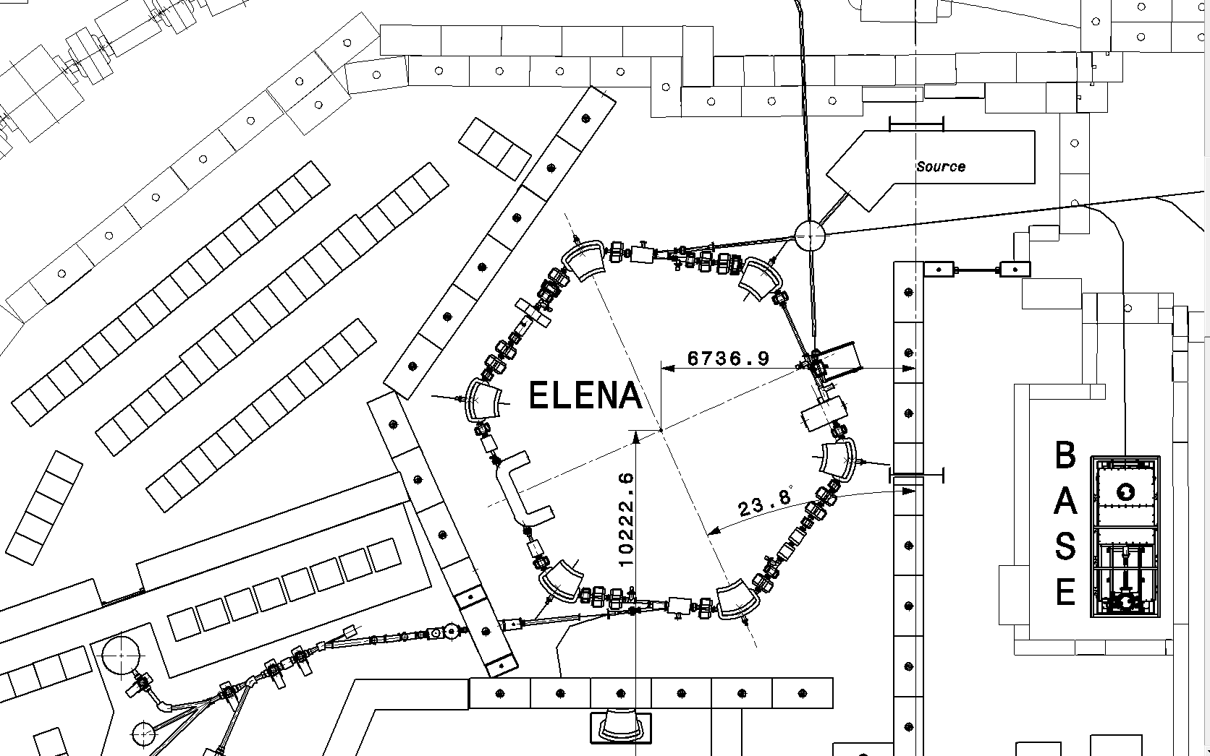
Bonus:
Area yet to be defined in detail…
R. Kersevan, “ELENA Vacuum System”, - ELENA Project Review, Oct14-15, 2013, CERN

Slide 25
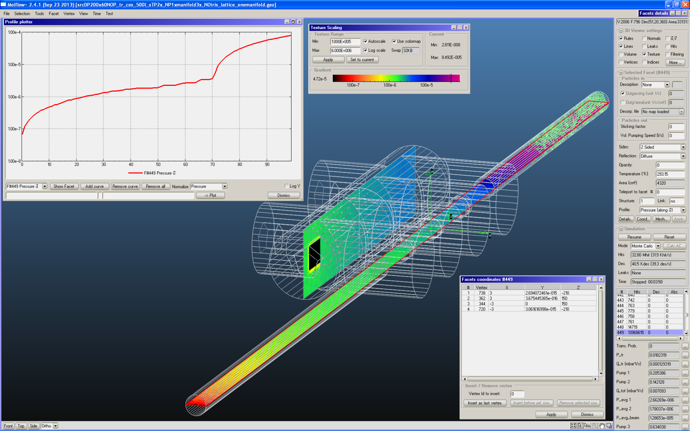
Bonus:
Differential Pumping Concept for H^{-/+} Commissioning Injector
R. Kersevan, “ELENA Vacuum System”, - ELENA Project Review, Oct14-15, 2013, CERN

