Slide 1
ELENA Beam Instrumentation
On behalf of many people

Slide 2
AD – ELENA transfer line
Position
Profile
(Intensity)
ELENA ring
Position
Tune
Profile
(Intensity)
Recombination rate
Experimental zones
Profile
(Intensity)

Slide 3
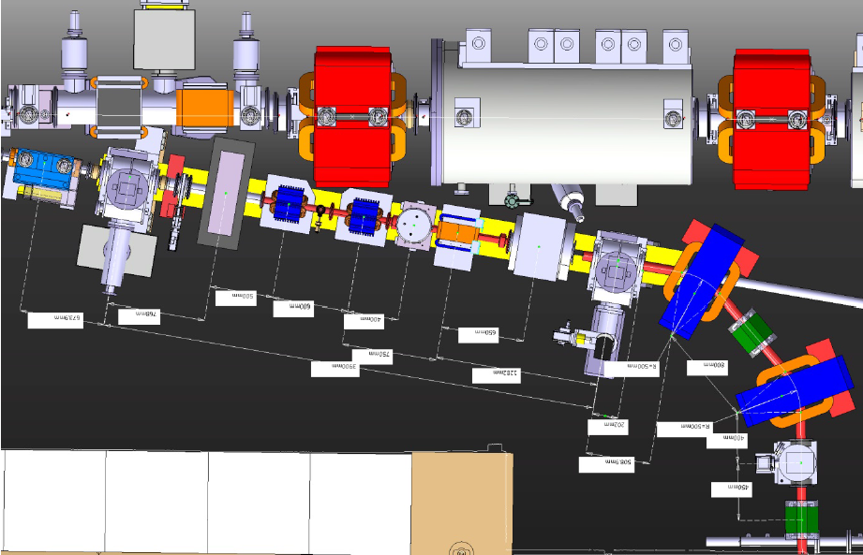
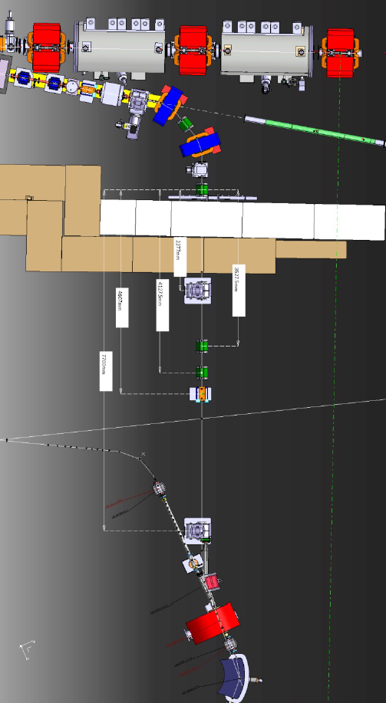
AD-ELENA transfer line
Modification of the existing 7000 line
New line linking 7000 line to ELENA

Slide 4
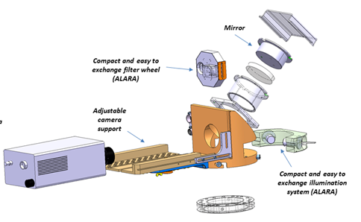
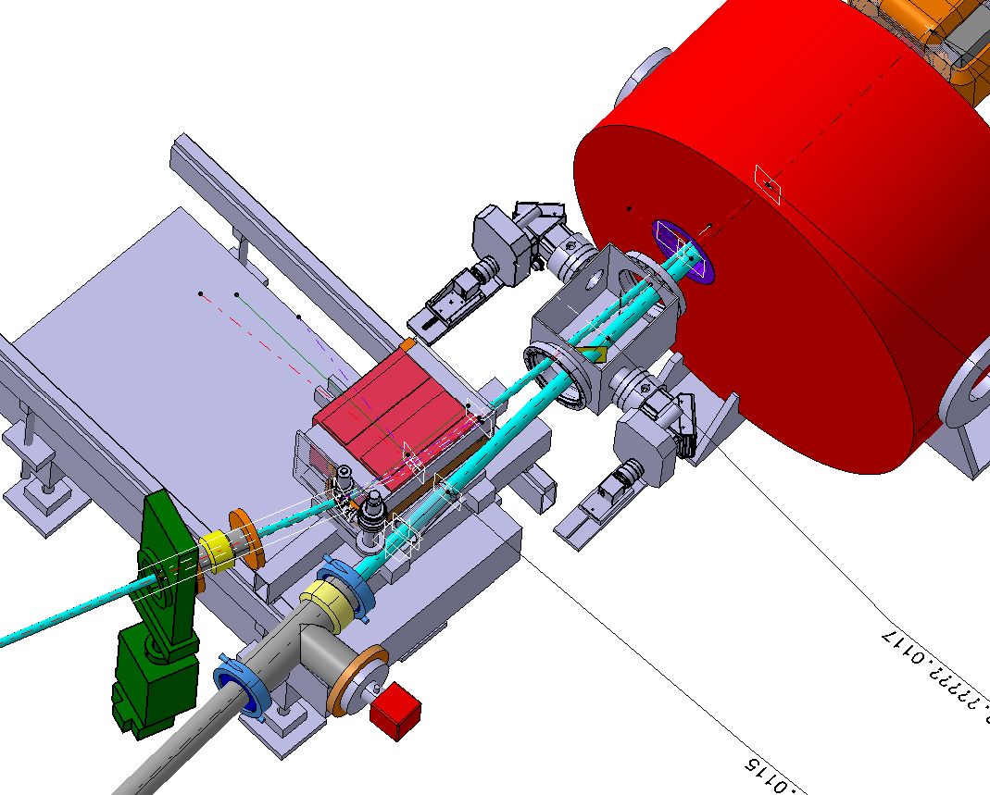
BTV (S. Burger)
At present in the AD, Al₂O₃ scintillating screens are installed in the transfer lines and coupled to a CCD camera have provided information on the antiproton beam position and size. One such device will be moved from its current location in the 7000 line and will be installed after the second bending magnet that will deflect the antiproton beam from the AD to ELENA.
A new system is also being developed that will be capable of measuring the beam position and size just before the injection kicker and at the first turn in the ring. It consists of two distinct systems each incorporating a 6 cm x 4 cm screen, a CCD camera, filter wheel, optical elements and a pneumatic in/out movement.

Slide 5
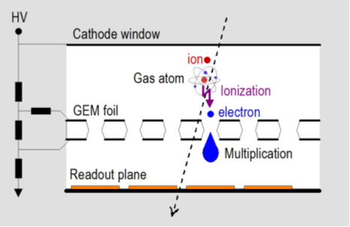
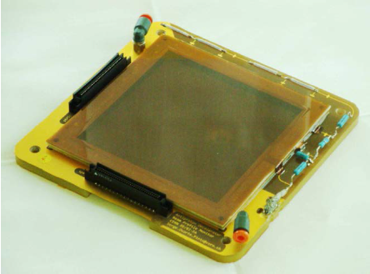
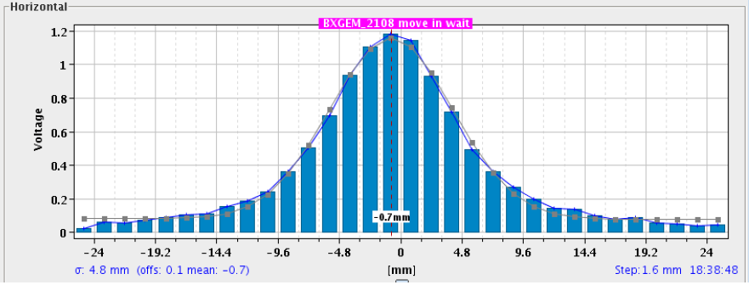
GEM (BI-EA)
GEMs have been deployed extensively in the present AD experimental areas and give excellent results for both position and profile measurements. Like multi-wire proportional chambers these detectors are also gas-filled, and essentially the same physical phenomenon is exploited to multiply ionization charge.
A GEM is a 50 µm thick foil of Kapton, copper clad on both sides, pierced with microscopic holes at a high density (our 10×10 cm² foils have about a million holes). A voltage of a few hundred volts applied to the top and bottom copper layers causes an electric field that focuses in the centre of these holes where it is just as strong as close to the wires of a wire chamber. Ionization electrons enter the holes from one side, are multiplied inside the holes, and then exit on the other side where they are collected by a strip pattern that integrates the charge and reads out the profile.

Slide 6
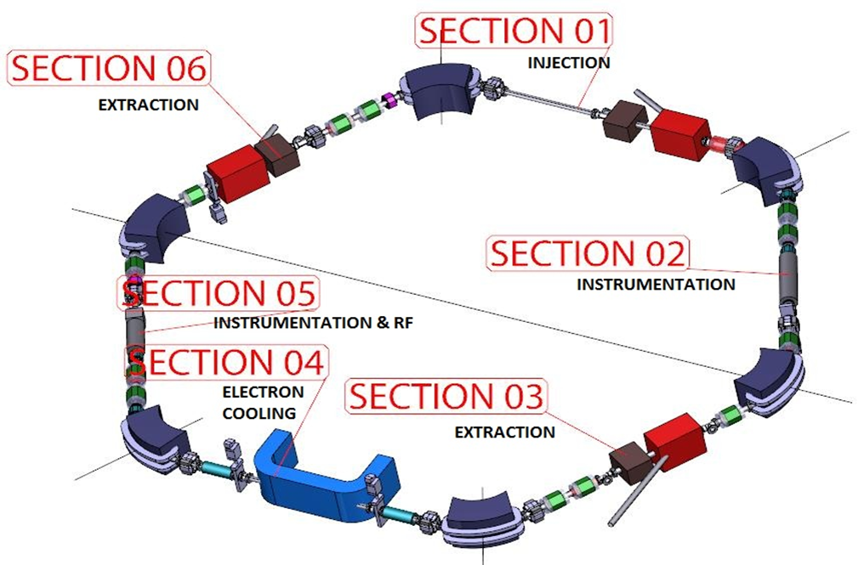
ELENA ring

Slide 7
Beam Position (L. Soby)
The ELENA orbit measurement system will be based on 20 circular BPMs made out stainless steel with vacuum as dielectric, and mounted inside quadrupoles and dipoles.
Design of PU, analogue electronics as well as digital acquisition is optimized in view of using the 20 BPMs as one big Schottky PU.
The proposed design is based on a stainless steel body containing 2 diagonal cut BPMs. Two such elements will be inserted in to a vacuum tank, 100mm diameter, in order to have a position measurement in both planes. The sum and difference signals will be generated in the head amplifier.
After amplification of the signals, by low noise amplifiers located very near to the BPMs, the signals will be transported by ~50m cables, digitized and processed using digital Δ/Σ normalization for the position calculations.
Resolution | 0.1mm
Accuracy | 0.3-0.5mm
Precision | 0.1mm
Max. beam displacement | 33mm
Time resolution | ~10ms
Revolution frequencies | 1050-145kHz
Overall maximum length | 400mm
Inner diameter | 66mm
Bake out temperature | 250°C
Vacuum | 3 × 10⁻¹² Torr

Slide 8
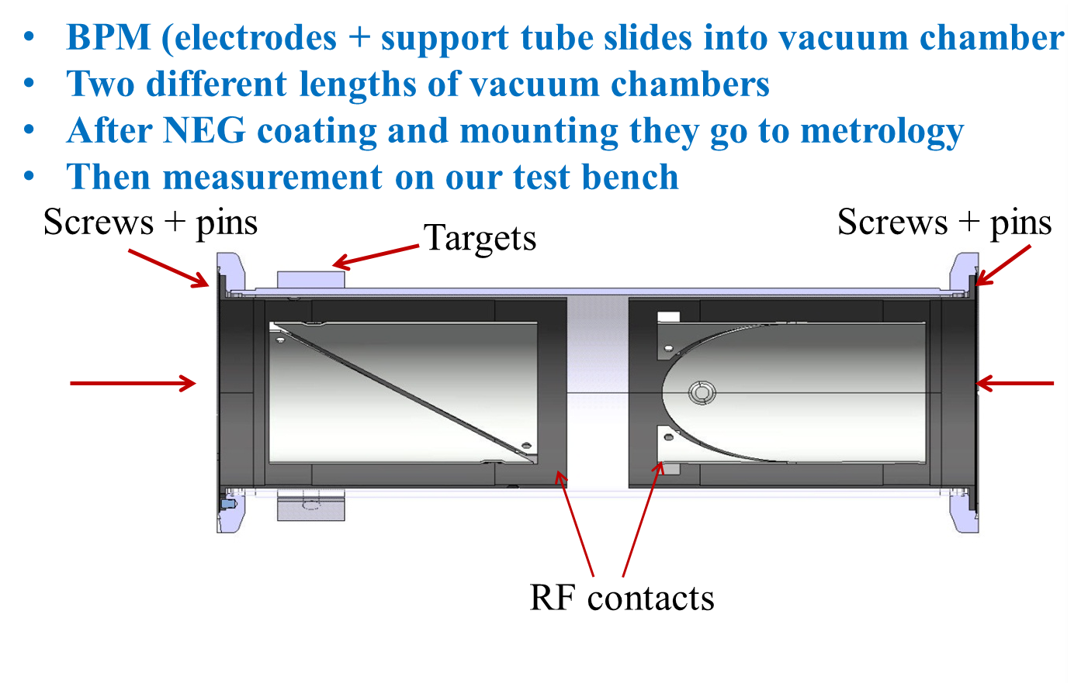

Slide 9
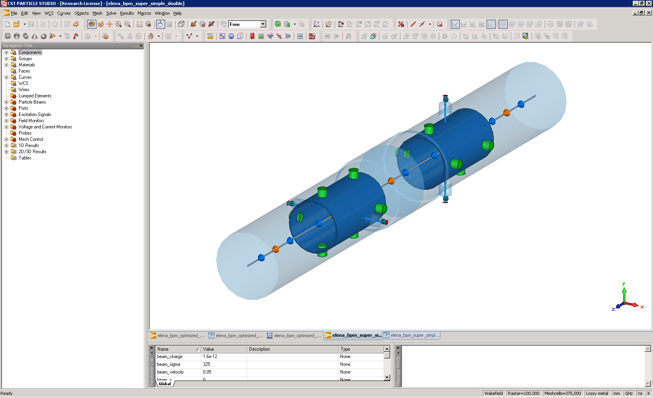
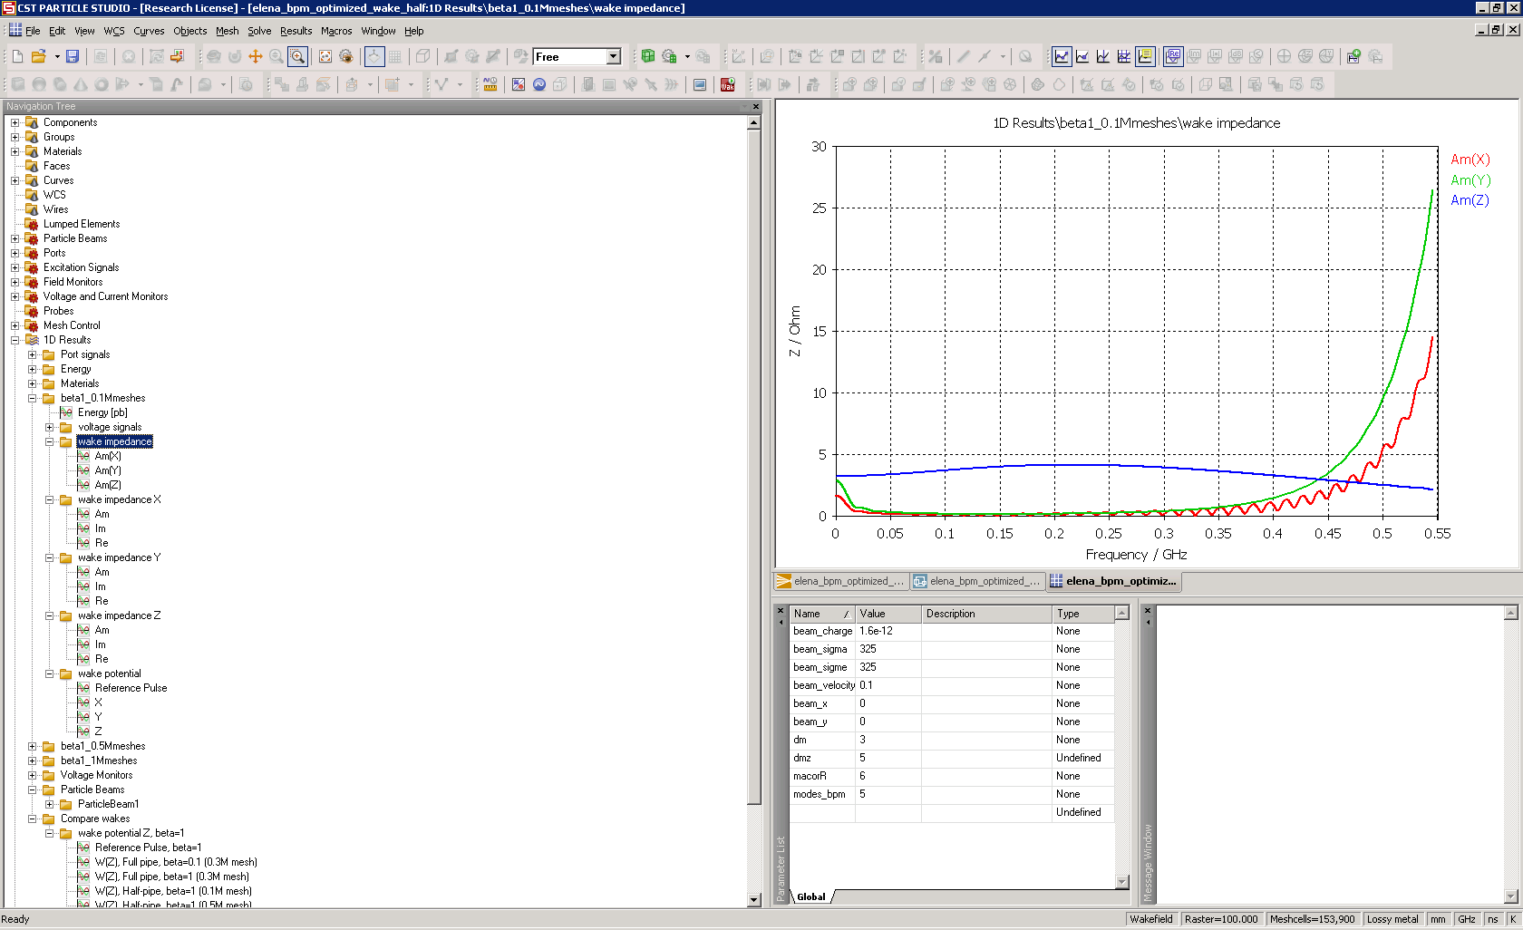
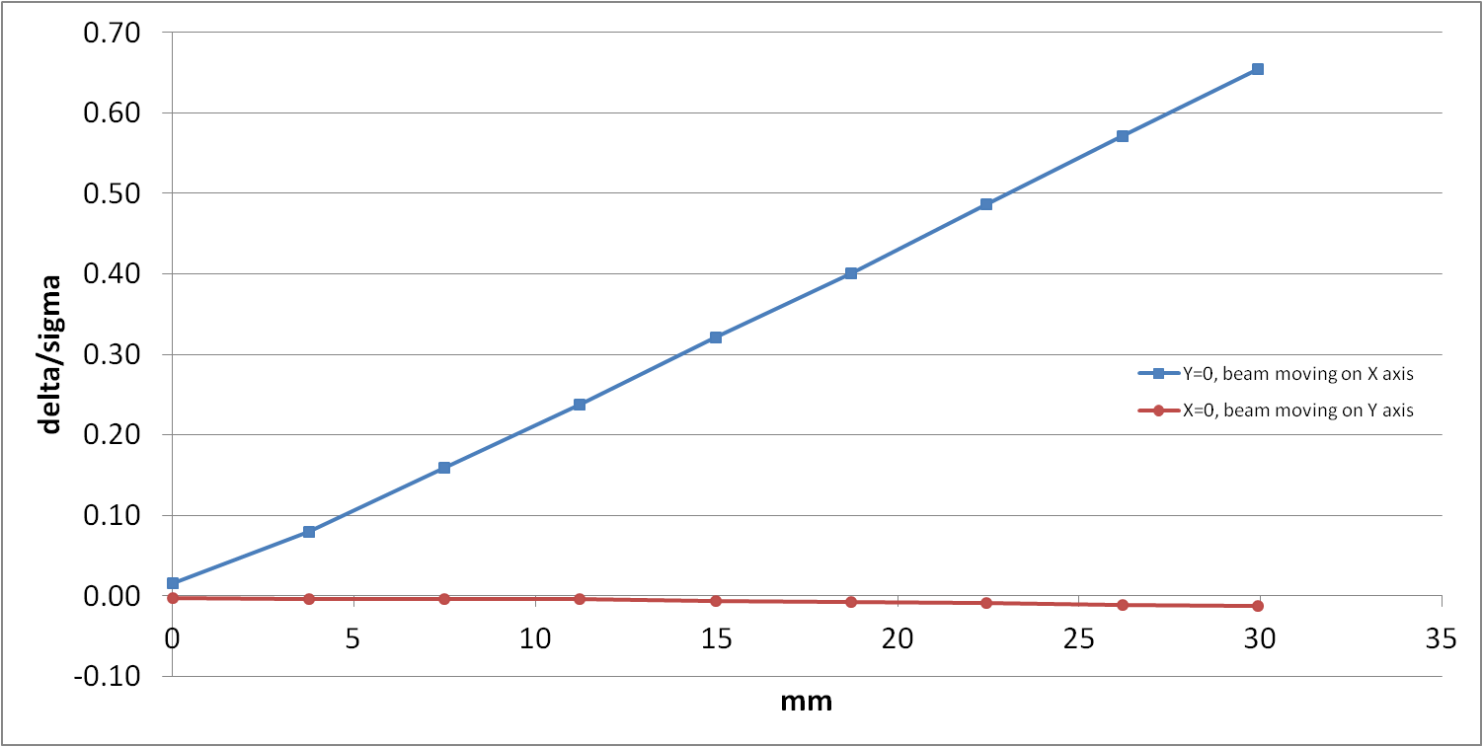
Electrode length | 120mm
Electrode area | 1.24E-02 m²
Electrode capacitance | 17pF
Cable capacitance (20cm, 75Ω) | 10pF
Amplifier input capacitance | ~20pF
Number of charges | 1E7
Bunch length | 1.5m
Bunching factor | 20
Max. input signal amplitude | 3.0mV
Transverse sensitivity | ~90µV/mm
Transverse sensitivity
Wakes and impedances

Slide 10
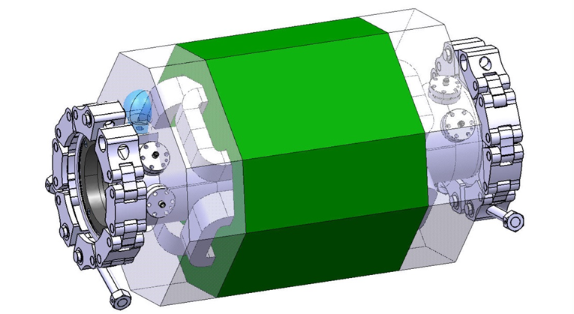
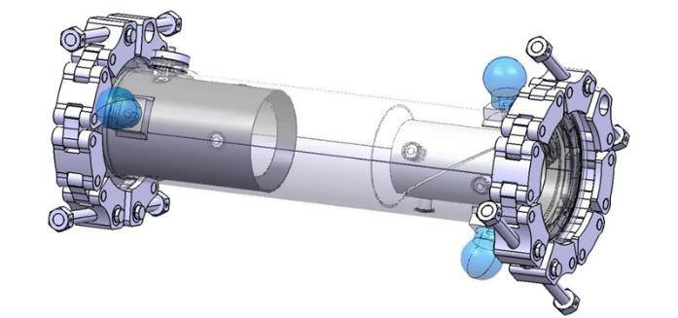
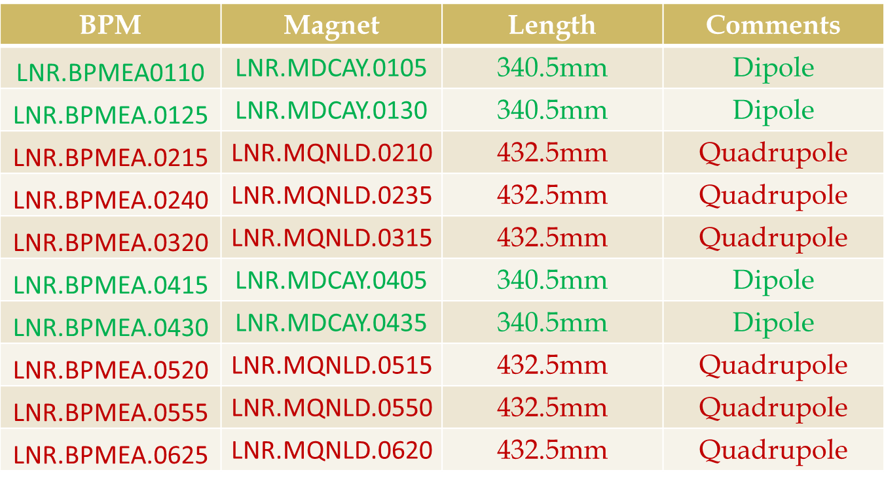

Slide 11
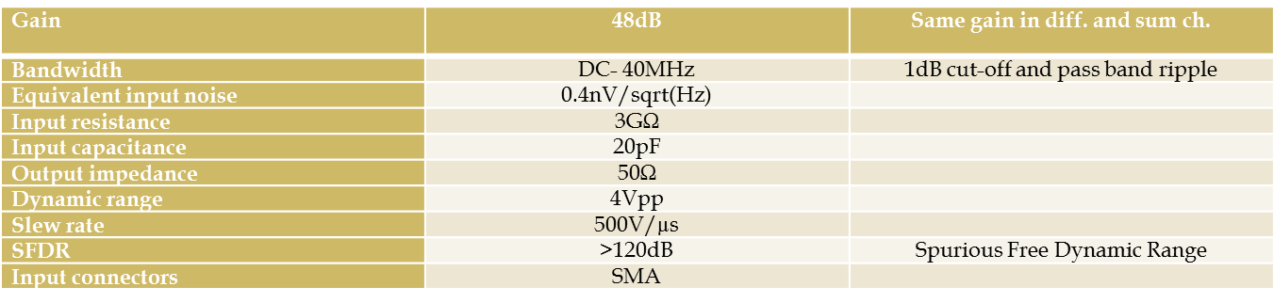
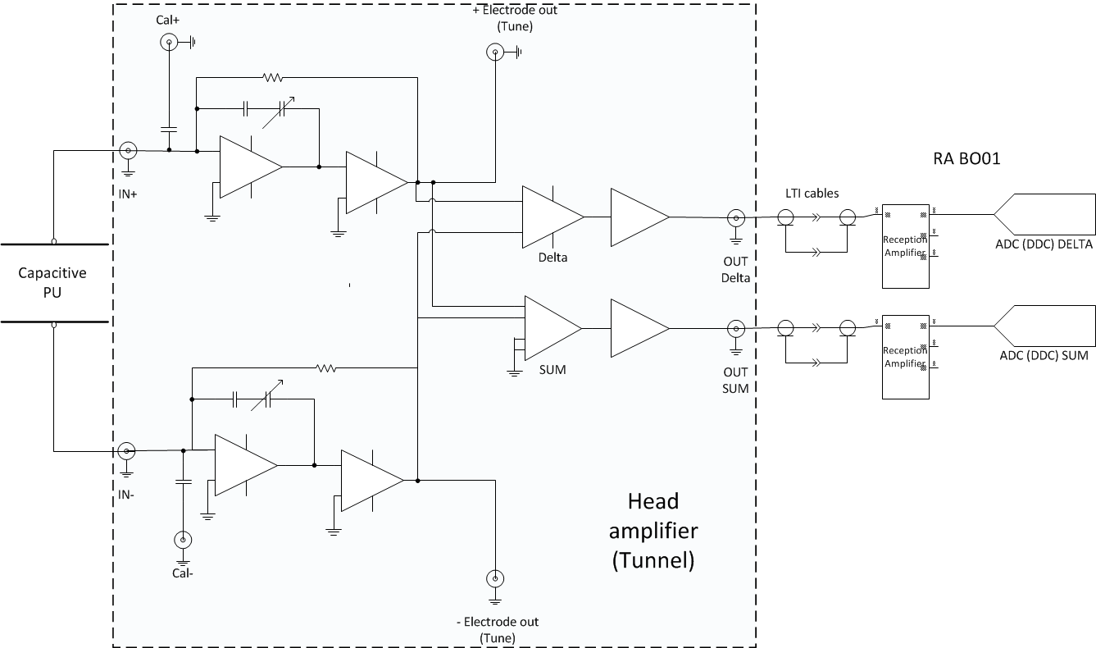

Slide 12
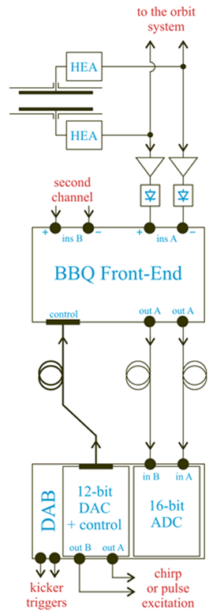
Tune (M. Gasior)
Base-Band Tune (BBQ) measurement systems are highly sensitive and based on a direct diode detection principle. The AD will soon be equipped with such a system and it is planned to use a similar setup for ELENA.
As with all BBQ setups the system will consist of:
• Diode detectors, converting beam-induced pulses from electrodes of a position pick-up to slower varying signals, from which DC offsets corresponding to the beam orbit is removed with series capacitors.
• An analogue front-end amplifying and filtering the detector signals.
• Two 16-bit ADC for parallel acquisition of horizontal and vertical betatron oscillation signals.
• A VME, FPGA based Digital Acquisition Board (DAB) providing the read-out and processing of the ADC samples, spectra calculation, data buffering and storing for subsequent transmission through the VME bus to a front-end computer.
• Two 12-bit DACs implemented as a DAB mezzanine, used to generate signals for beam chirp excitation, independently for horizontal and vertical machine planes; the DAB can also provide tune kicker triggers synchronised with the acquisition.

Slide 13
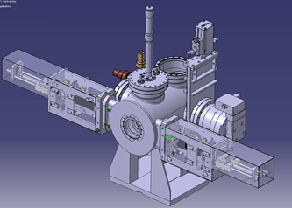
Beam Profile (R. Folch & BI-EA)
The profile of the circulating beam will be measured destructively using a scraper system. In this device a blade is moved quickly across the beam and creates a particle shower due to the interaction of the beam with the blade. A simultaneous detection of the intensity of the particle shower outside the vacuum chamber with a scintillator/photomultiplier assembly and the blade position gives an image of the beam profile.
For ELENA, 4 scraper blades (2 horizontal and 2 vertical) will be installed in a vacuum tank in section 5 of the ring . Their design is based on the Linac 4 beam stopper and will consist of a 50 mm X 20 mm aluminium plate fixed on a rigid arm which is moved into the beam by a stepping motor or a pneumatic jack. A stroke of approximately 40 mm is required to completely kill the circulating beam and the plate has to move to the IN beam position in about 1 second. The exact position is read via LVDT sensors and end switches. The movement control will be done using standard PLC based controls. All external components of the tank will be enclosed in a frame and protected by a cover to avoid any damage and for human safety. The components under vacuum will be fully bakeable and the tank will be NEG-coated.

Slide 14
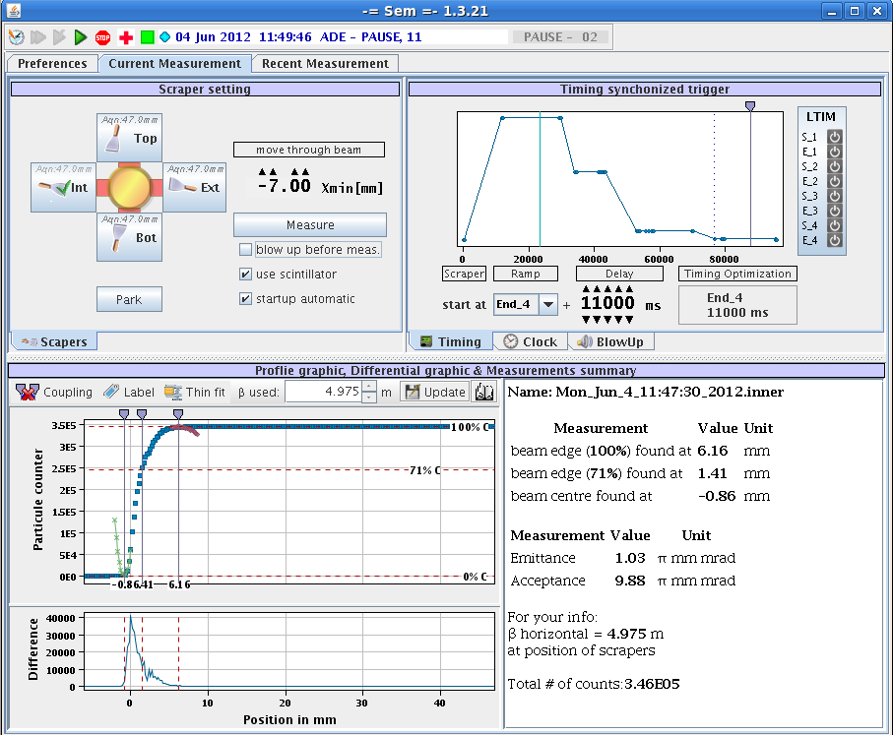

Slide 15
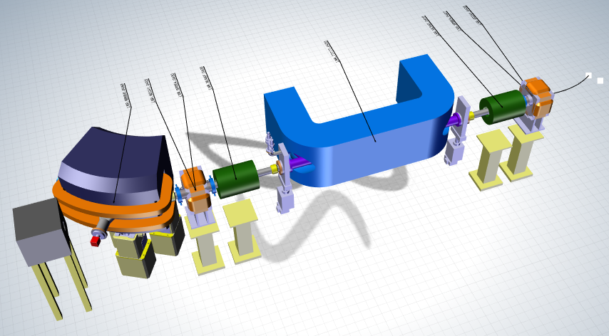
Recombination Monitor (BI-EA)
For commissioning at 100 keV with the proton source, optimisation of the electron cooler can be performed by measuring the recombination rate of electrons with the circulating protons. The choice of detector depends on the required information.
A scintillator coupled to a photomultiplier can be used to measure the recombination rate from which the transverse energy of the electron beam can be evaluated. It will be a good means to correct any angular deviations between the electron and ion beams as the maximum signal is obtained when the beams are correctly aligned.
Using an imaging monitor (MCP with strip read-out) one can derive the profile and position of the ion beam from the profile and position of the recombined beam.
The detector will be installed in an extension of the bending magnet vacuum chamber downstream from the electron cooler. It’s design will be started soon.

Slide 16
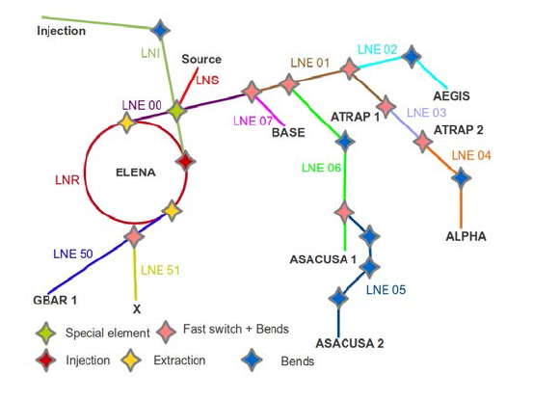
Experimental Lines
The 100-keV antiproton beam extracted from ELENA will be transported to seven experiments using electrostatic beam lines of total length >100 m. The dipoles and quadrupoles comprising the beam lines must be precisely tuned to focus the antiprotons into the acceptance of the trap experiments.

Slide 17
μWire Monitor (M. Hori)
This monitor is based on the devices used by the ASACUSA collaboration since 1999 to measure 100-keV antiproton or proton beams that emerged from the Radiofrequency Quadrupole Decelerator (RFQD).
The semi-non destructive monitor allows most of the antiprotons to pass through without any degradation, while the small portion (1-3%) intercepted by the wires produces the signal. The device is sensitive to antiproton, proton, and H⁻ beams of energies between 10 keV and 5.3 MeV. It consists of two position-sensitive photocathode grids providing the X and Y projections of the beam, sandwiched between three anode grids with a distance of 2 mm between them. Each grid consisted of between 32 and 48 gold-coated tungsten wires of diameter of 5–20 μm stretched over a ceramic frame, with a pitch 0.5–1.5 mm between neighbouring wires.
The cathode grids at ground potential are irradiated by the beam, and the secondary electrons emitted from them are accelerated toward the anode grids biased at 50 V. The beam profile is obtained by using charge-sensitive preamplifiers to measure the charge Q_{i} ejected from the cathode wires on the X- and Y-grids with high sensitivity.

Slide 18
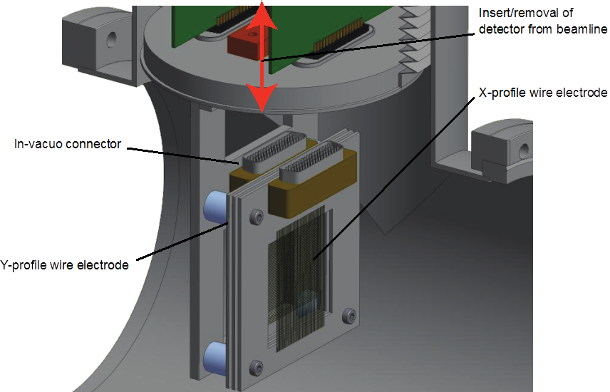
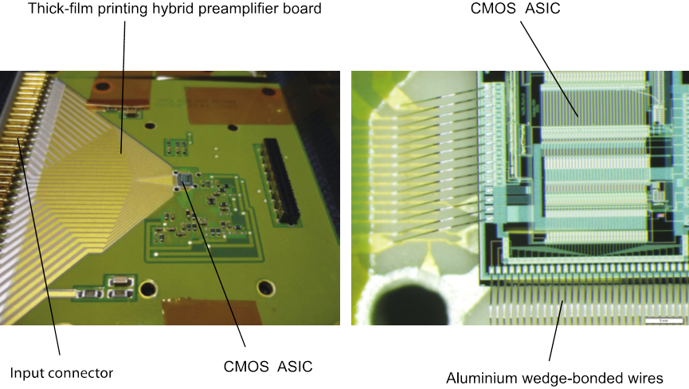
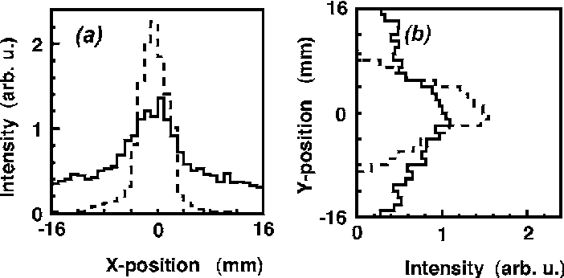

Slide 19
Number of detectors 40 - 60
Beam type Antiprotons, protons, H- ions
Beam energy 10 keV - 6 MeV (previously used in AD and RFQD)
Aperture 62 x 62 mm
Active area 48 x 48 mm (variable)
Spatial resolution 0.5 - 1.5 mm (variable)
Dynamic range 10000 (limited by charge-sensitive preamplifier)
Channels 64 or 92 channels parallel readout
Sensitivity >5 x 10⁵ particles in a 300-ns-long bunch
Transmission 97-99% (depending on wire diameter and pitch) per detector
Chamber length along beam line 290 mm
Chamber diameter 200 mm
Flange and tube diameter DN200CF
Materials Stainless steel 316LN, alumina, gold, copper, Kapton ribbon insulator
Vacuum compatibility <10⁻¹⁰ mbar
Readout electronics 0.8 μm N-well CMOS ASIC (IDEAS VA32 or VA64)
Digitization 14-bit flash ADC
Calibration In-situ calibration using DAC pulsar
Power +/- 12 V DC, 4 A
Hardware interface CERN standard VME64x backplane bus
Software interface CERN standard PS control system

Slide 20
Future Developments
Use of BPM PUs for longitudinal Schottky measurements on de-bunched beams as well as intensity and position of bunched beams.
Cryogenic current comparator (CCC) based on a superconducting quantum interference device (SQUID) for the measurement of the circulating beam intensity.
Collaboration with GSI
Prototype to be tested in AD
If BPM summing successful then replace magnetic LPU and install CCC
Investigate the possibility to use residual gas ionisation or luminescence for circulating beam profile measurements.

Slide 21
To Do
Finish integration of injection/1st turn BTV. Choose IN/OUT mechanism.
Design/integrate strip-line kicker for tune measurement. Is there some space for a PU?
Complete the integration of the scraper movement.
Design recombination monitor.

