Slide 1
The SMC (Short Model Coil) dipole
R&D Program
Strain Gauges
Mechanical measurements
M. Guinchard
A. Chiuchiolo
Mechanical Measurement Lab, 2013.08.20
EDMS no. 1289879

Slide 2
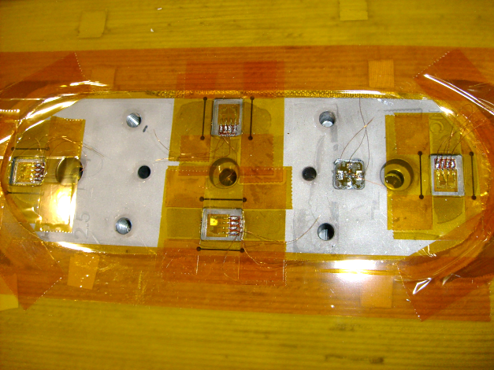
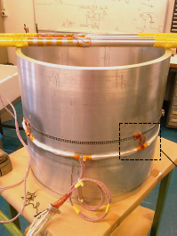
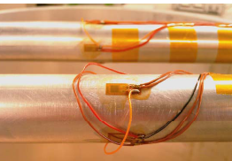
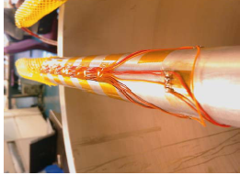
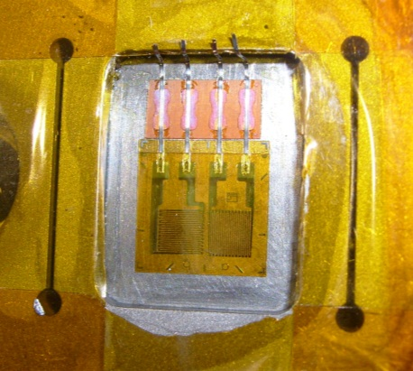
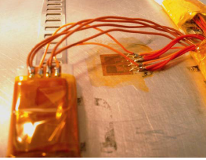
Mechanical instrumentation for SMC3
 | CERN Coils | Shell | Rods
Type of measurements | Local strain values | Local strain values | Traction/Compression stress | Bending stress
Number of measurements | 8 points for each coil | 8 (Z direction) 8 (Θ direction) | 1 for each rod | 1 for each rod
Bridge configuration | Half bridges compensated by poison effect | Half bridges compensated with thermal compensator | Full bridge | Half bridge
Strain gauges | Chromium – Nickel / Polyimide | Chromium – Nickel / Polyimide | Chromium – Nickel / Polyimide | Chromium – Nickel / Polyimide
Power Supply | 2.5 V @4.8 kHz | 2.5 V @4.8 kHz | 2.5 V @4.8 kHz | 2.5 V @4.8 kHz

Slide 3
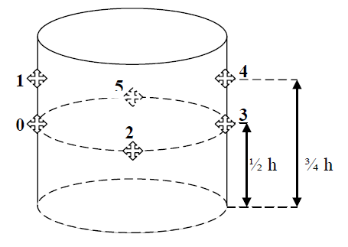
Mechanical instrumentation for SMC3 : Shell
 | Shell
Type of measurements | Local strain values
Number of measurements | 8 (Z direction) 8 (Θ direction)
Bridge configuration | Half bridges compensated with thermal compensator
Strain gauges | Chromium – Nickel / Polyimide
Power Supply | 2.5 V @4.8 kHz
Th2_Down

Slide 4
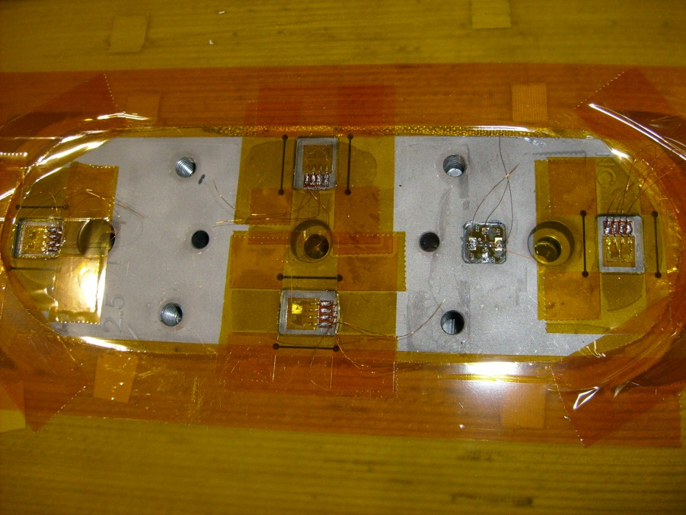
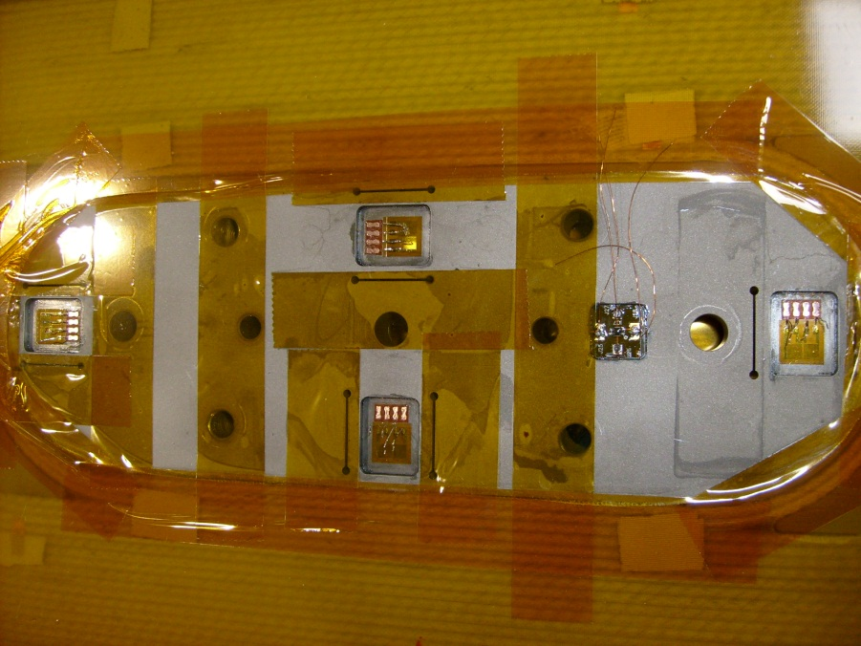
Mechanical instrumentation for SMC3 : Coils
CERN Coils
Type of measurements | Local strain values
Number of measurements | 8 points for each coil
Bridge configuration | Half bridges compensated by poison effect
Strain gauges | Chromium – Nickel / Polyimide
Power Supply | 2.5 V @4.8 kHz
Face Up
Th1_Up
Th3_Up
Th2_Up
Th4_Up
Face Down
Correlation between positions for the same coil
Th1_up | Th4_down
Th1_down | Th4_up
Th2_up | Th2_down
Th3_up | Th3_down
Th1_Down
≈
≈
Th3_Down
Th2_Down
≈
≈
Th4_Down

Slide 5
Mechanical instrumentation for SMC3 : Rods
 | Rods
Type of measurements | Traction/Compression stress | Bending stress
Number of measurements | 1 for each rod | 1 for each rod
Bridge configuration | Full bridge | Half bridge
Strain gauges | Chromium – Nickel / Polyimide | Chromium – Nickel / Polyimide
Power Supply | 2.5 V @4.8 kHz | 2.5 V @4.8 kHz
Th2_Down

Slide 6
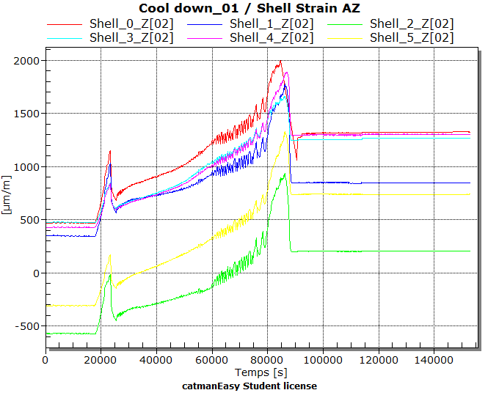
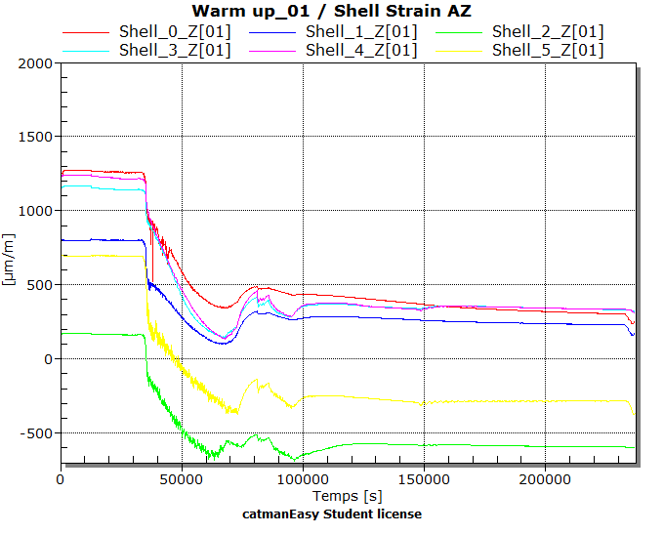
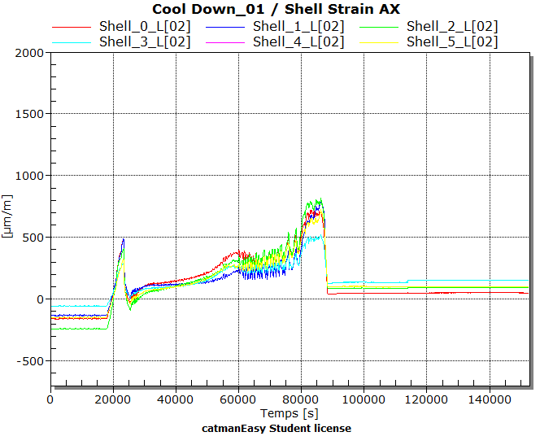
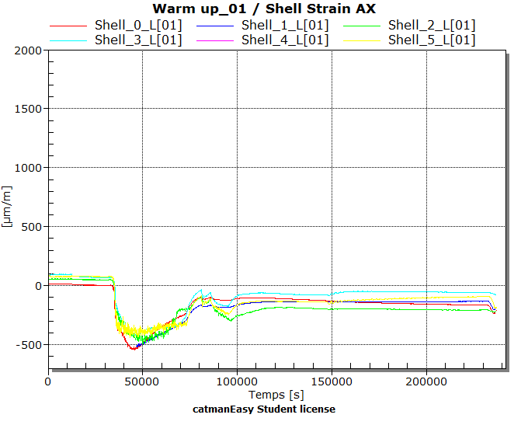
1 st cool down and warm up– Strain measurements Shell

Slide 7
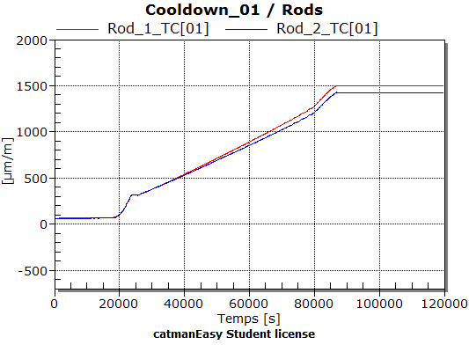
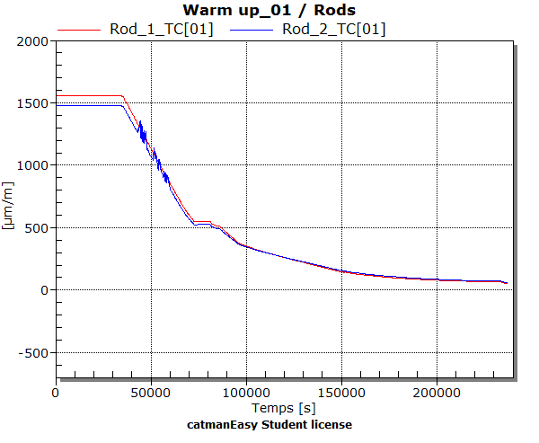
1 st cool down and warm up– Strain measurements Rods

Slide 8
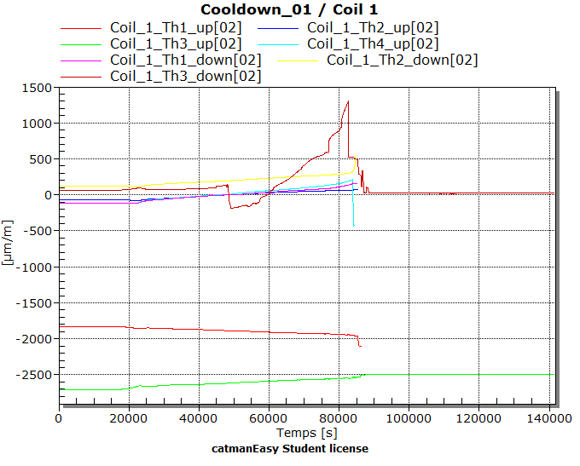
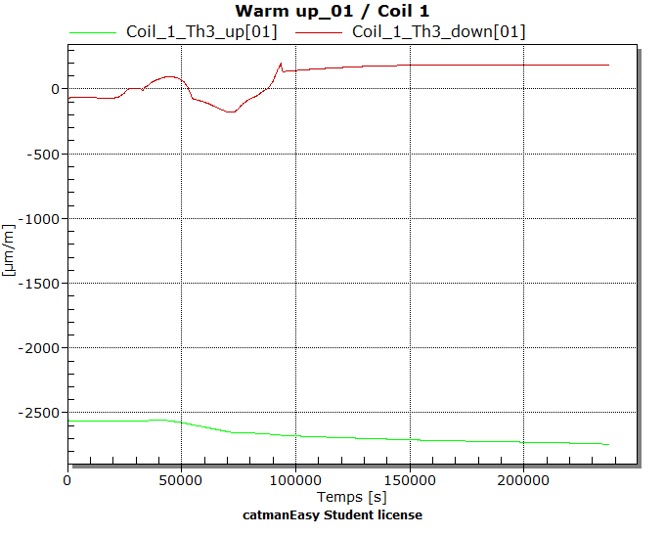
1 st cool down and warm up– Strain measurements Coil 1
Coil#1_Th3_Up
Coil#1_Th3_Down
Coil#2_Th3_Up
Coil#2_Th3_Down
Coil#1_Th1_Up
Coil#1_Th4_Down
Coil#2_Th1_Up
Coil#2_Th4_Down
Remarks :
Two signals after the first cooldown
Coil#1_Th4_Up
Coil#1_Th1_Down
Coil#2_Th4_Up
Coil#2_Th1_Down
Coil#1_Th2_Up
Coil#1_Th2_Down
Coil#2_Th2_Up
Coil#2_Th2_Down

Slide 9
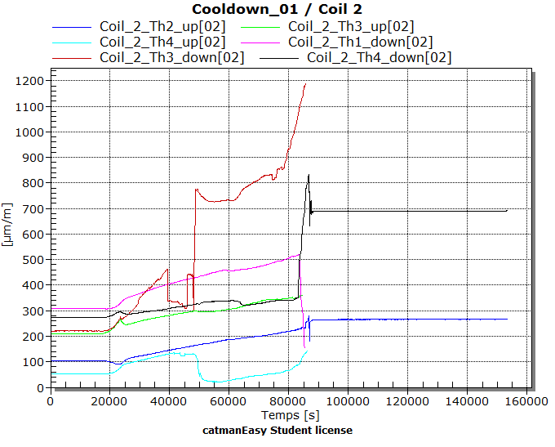
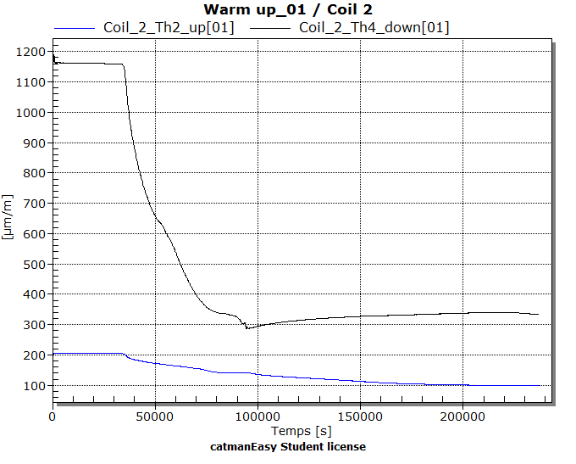
1 st cooldown and warm up – Strain measurements Coil 2
Coil#1_Th3_Up
Coil#1_Th3_Down
Coil#2_Th3_Up
Coil#2_Th3_Down
Coil#1_Th1_Up
Coil#1_Th4_Down
Coil#2_Th1_Up
Coil#2_Th4_Down
Remarks :
Two signals after the first cooldown and no signal after the second cooldown
Coil#1_Th4_Up
Coil#1_Th1_Down
Coil#2_Th4_Up
Coil#2_Th1_Down
Coil#1_Th2_Up
Coil#1_Th2_Down
Coil#2_Th2_Up
Coil#2_Th2_Down

Slide 10
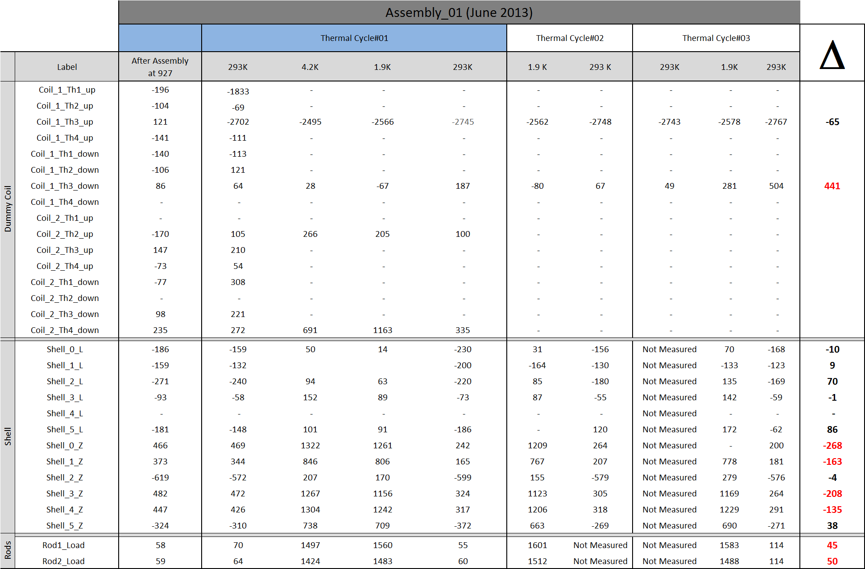
Several thermal cycles at 1.9K
Th2_Down

Slide 11
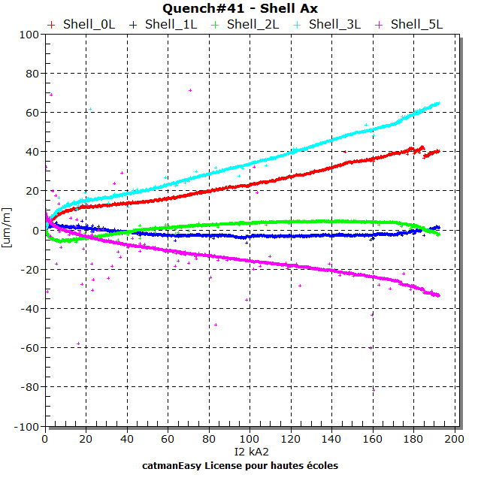
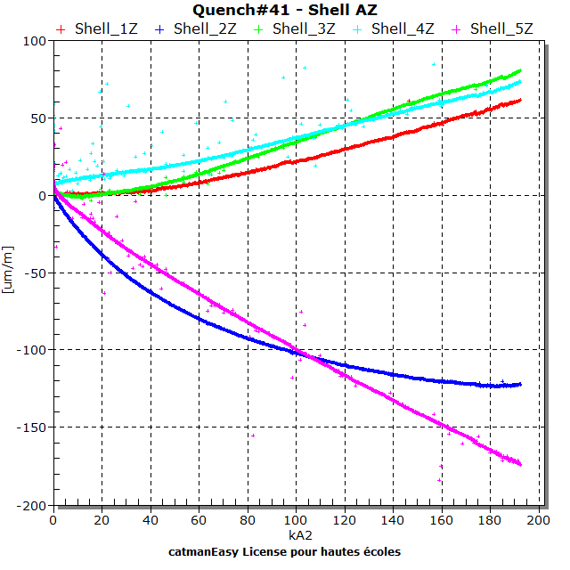
Quench 41 – Shell strain measurments

Slide 12
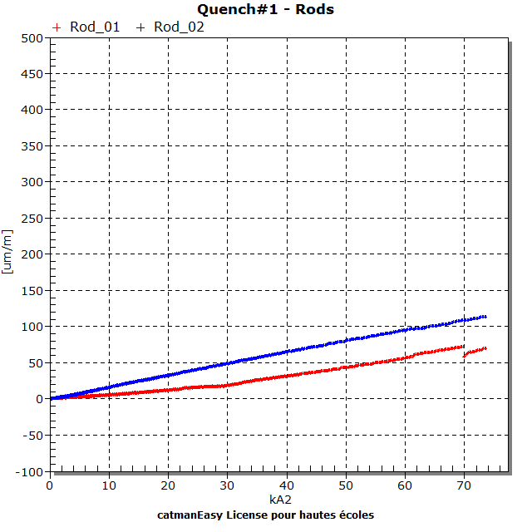
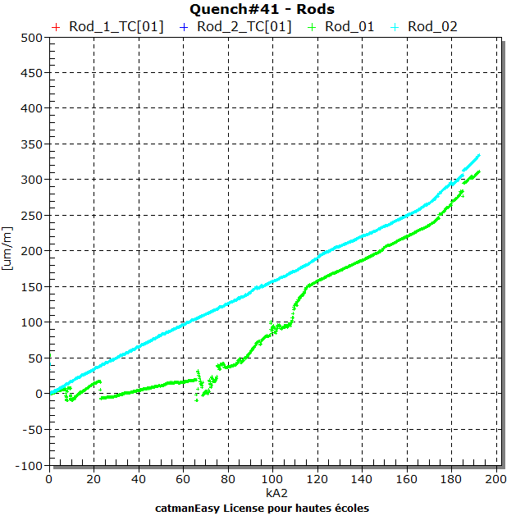
Quench 41 – Rods strain measurements

Slide 13
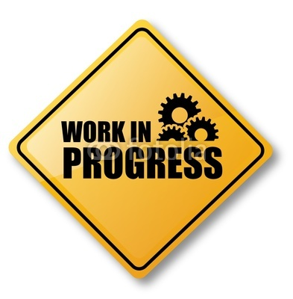
The SMC (Short Model Coil) dipole
R&D Program
Fiber Optic Sensors
Mechanical measurements
A. Chiuchiolo
M. Guinchard
Mechanical Measurement Lab, 2013.08.20
EDMS no. 1289879

Slide 14
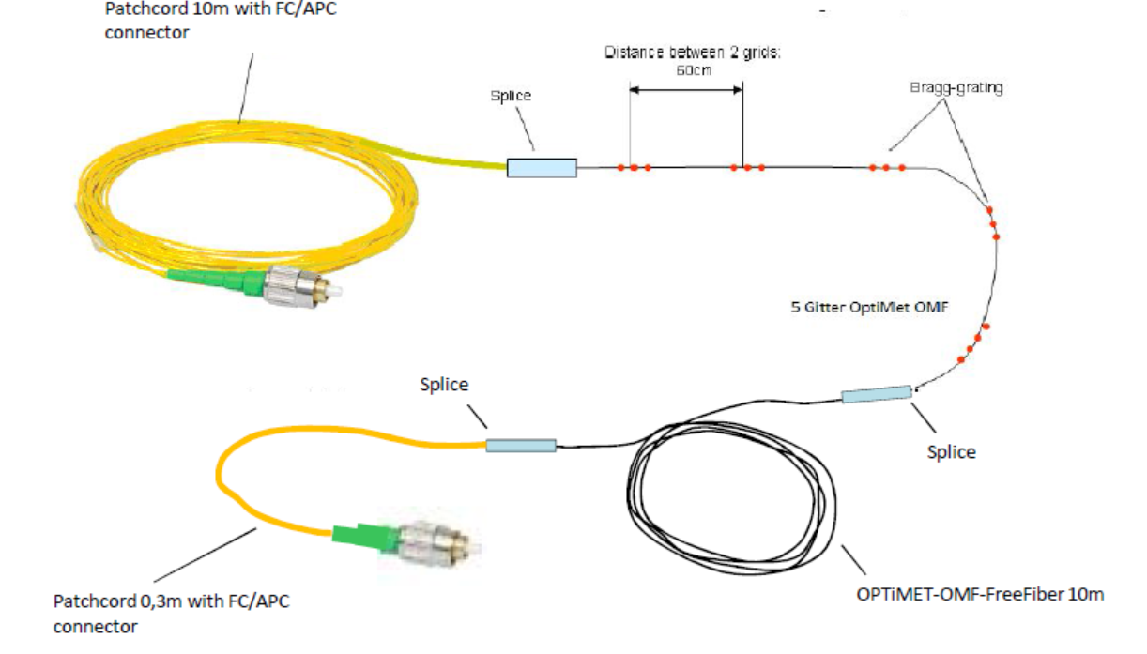
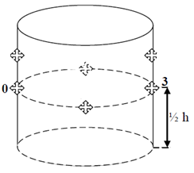
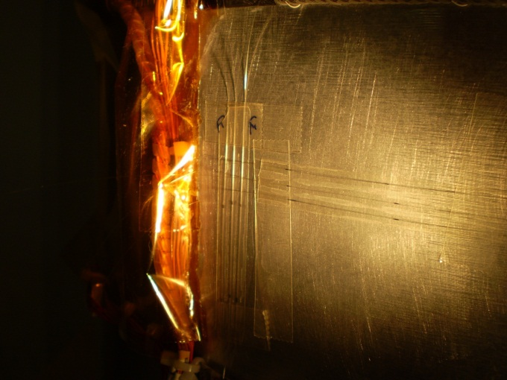
FOS instrumentation for SMC3 : Shell
Side 0 | Side 3
8 coated sensors (HBM) : 3 in // and in Z direction 3 in // and in L direction 2 free | 5 coated sensors (HBM): 2 in // and in Z direction 2 in // and in L direction 1 Thermal compensator
3 bare sensors (Optosmart): 1 in Z direction 1 in L direction 1 free | 3 bare sensors (Optosmart): 1 in Z direction 1 in L direction 1 Thermal compensator
Electrical strain gauges
(2 sensors 8 wires)
Optical strain sensors
(8 sensors 1 fiber)
Remark:
Gluing issues after the first cooldown at 77 K for bare sensors ;

Slide 15
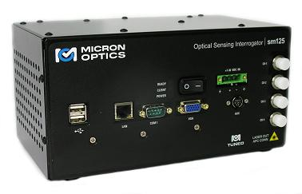
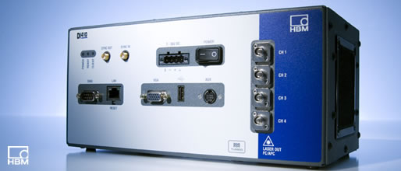

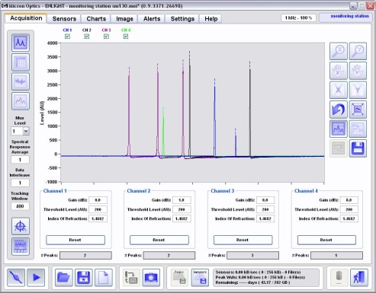
FOS DAQ for SMC3
The light is emitted to a Bragg gratings which only reflect the specific wavelength component and work like a narrowband reflecting filter
Enlight
Remark:
Different acquisition rates and peak finding algorithms ;
Software parameters settings still to be improved with Catman for tracking along the temperature range ;
Synchronization with SG missing for Enlight ;

Slide 16
1 st cool down– Strain measurements Shell (Examples)
From 7 peaks at warm
to
6 peaks at cold (HBM Fibers)
From 3 peaks at warm
to
1 peaks at cold (Optosmart fibers)

Slide 17
1st and 2nd cool down – Strain measurements Shell (Examples)
FBGs AX
Close FBGs are not back to the same initial position: different strain on the shell or different sensitivity? ... Under investigation
Degradation of some signals after the second cool-down

Slide 18
Powering after the first thermal cycle
AZ side 0
AX side 0
≅ 15 um/m with k=0.8
AZ side 3
AX side 3
Remark:
The quenches are clearly seen by the fiber optic sensor with the same order of magnitude

Slide 19
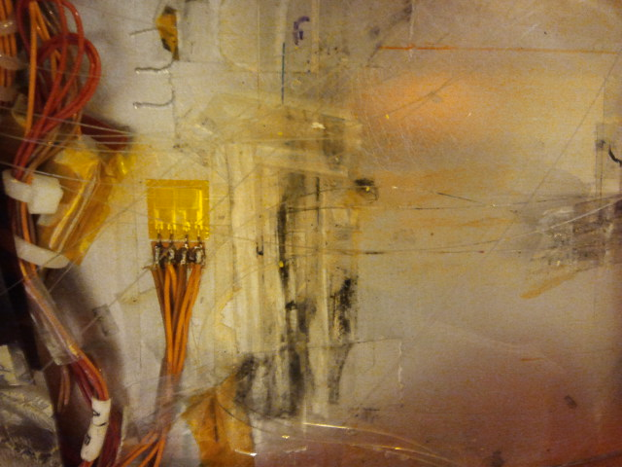
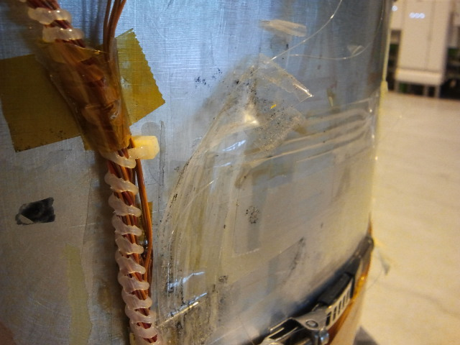
Detachment of the fibers after the test
Remark:
The cold cycles and the powering effect the mechanical connections of the fiber ( Glue problem or protection issues ?) ;
The improvement of the bonding and protection procedure is needed ;
We need to improve the feedthrough on the cryostat with dedicated optical systems.

Slide 20
Backup slides
Mechanical Measurement Lab, 2013.08.20
EDMS no. 1289879

Slide 21
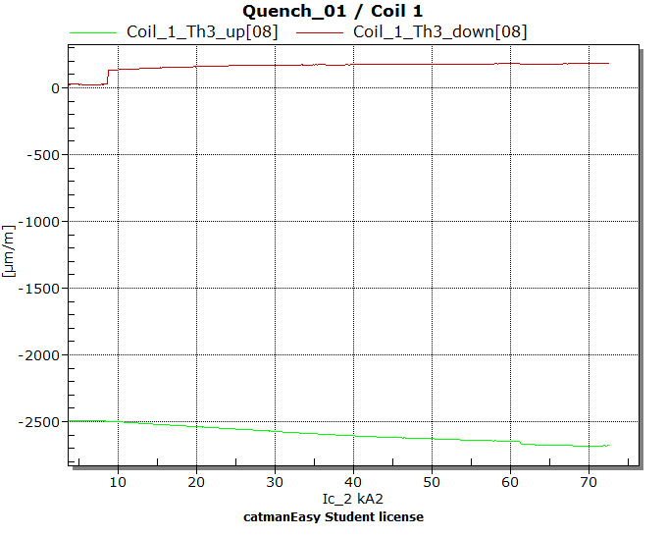
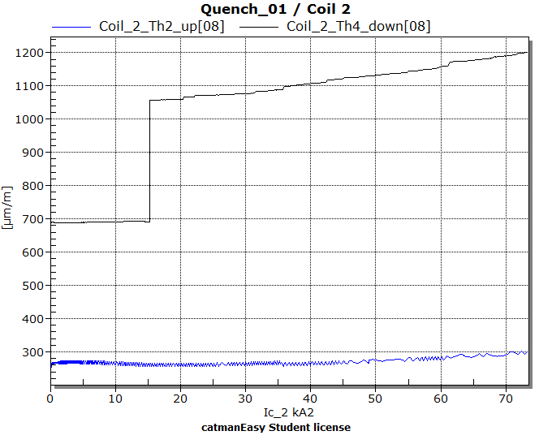
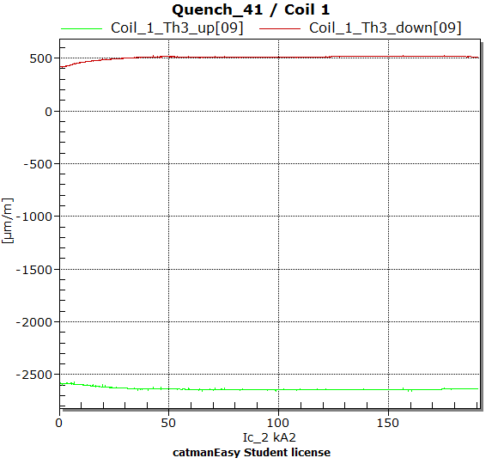
Quench 01 and Quench 41 – Coil#01 and Coil#02

Slide 22
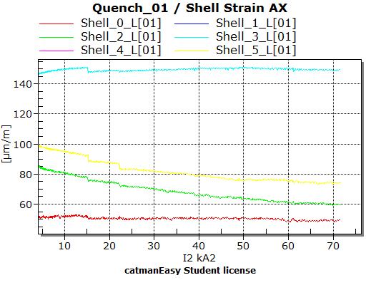
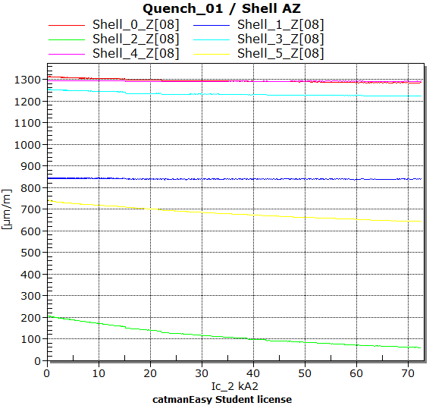
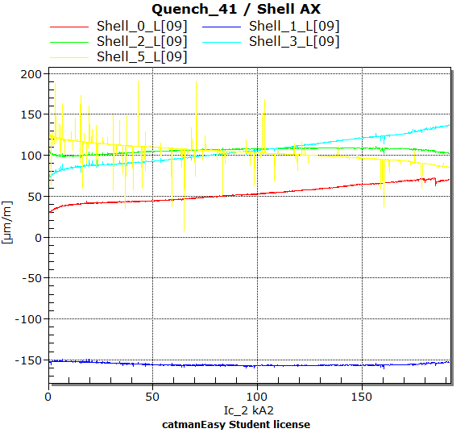
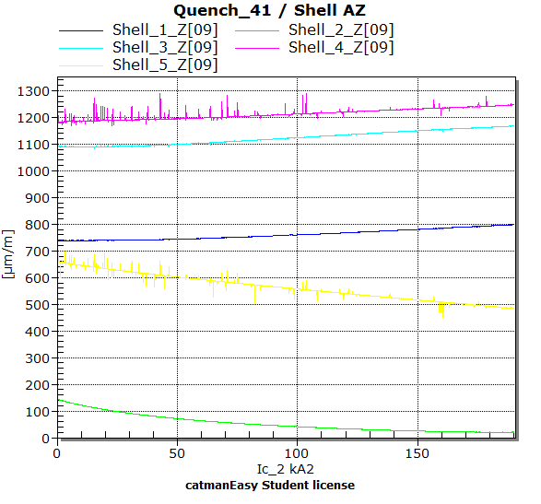
Quench 01 and Quench 41 – Shell

Slide 23
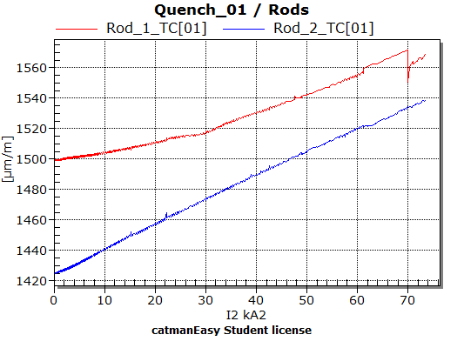
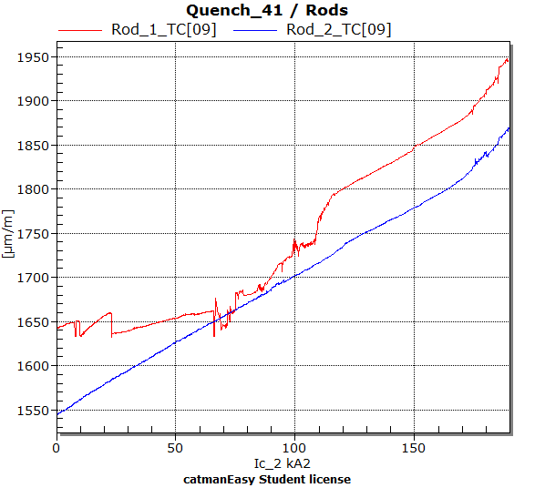
Quench 01 and Quench 41 – Rods

