Slide 1

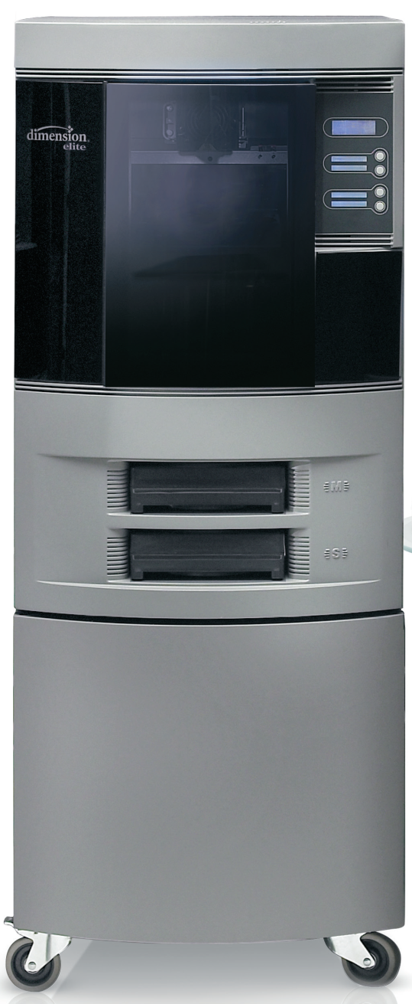
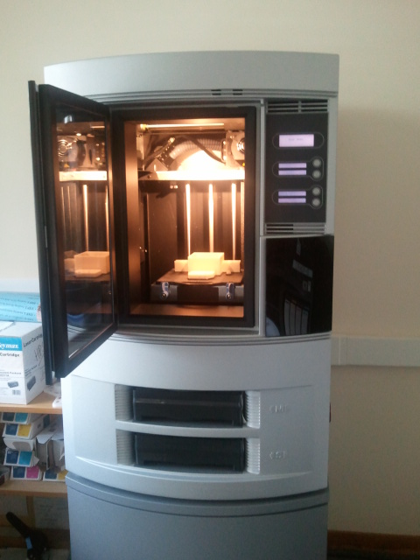
Training seminar
Rapid prototyping
Christophe Bault
PH-DT-EO
August 29th 2013

Slide 2
Summary
Introduction
What is rapid prototyping?
extract from a training* given by Fondation Suisse pour la Recherche en Microtechnique
  Training given by 2 EPFL teachers
  Subject of the training: 3d print, Industrial applications (in French)
List (not exhaustive) of usable materials
extract from a presentation* given by company 3T RPD Ltd at Cern
  http://www.3trpd.co.uk/
  British company, specialized in manufacturing by additive process
  (same activity branch than Initial)
Rapid prototyping limits and possibilities
extract of 3T RPD Ltd presentation at Cern
Our machines at Cern (department TE) and PH-DT
List (not exhaustive) of suppliers
Conclusion
  * Available entirely, contact me.

Slide 3
Introduction
After some use in the past of rapid prototyping techniques for real detector components or validation parts, a few months ago, PH-DT decided to buy its own rapid prototyping machine:
Why?
Mainly for frequent need of validating the 3D design concepts with close to real parts: integration, clearance value, assembly with tools and access… (limitation: working with reduced / scaled parts)
To present concepts designed in 3D during project reviews or brainstorming.
To manufacture quickly some parts needed for assembly, test, tools.
How?
Investigating on the web to understand existing rapid prototyping technologies
Following training on rapid prototyping (organized by Fondation Suisse pour la Recherche en Microtechnique)
Following a commercial presentation made by a company specialized in additive manufacturing
-> It became clear that 2 types of machine exist:
  Overbudget
  Reasonable budget
Organizing a market survey and procuring a 3D Dimension Elite

Slide 4
Introduction
The 3d Dimension Elite can be useful for lots applications, but cannot cover all possible needs.
For requirements not covered by our printer, we need specialized company which can offer high accuracy machine and employ high performance materials
The choice of the technology (and thus of the external company) is driven by material characteristics (mechanical, radiation resistance, etc…) and the precision required
We are not (yet) specialists. We learn each time by using it. And we still have some problems to solve.
But we want to share with you our experience, and we are happy to learn more thanks to your personal feedback on each specific application.

Slide 5
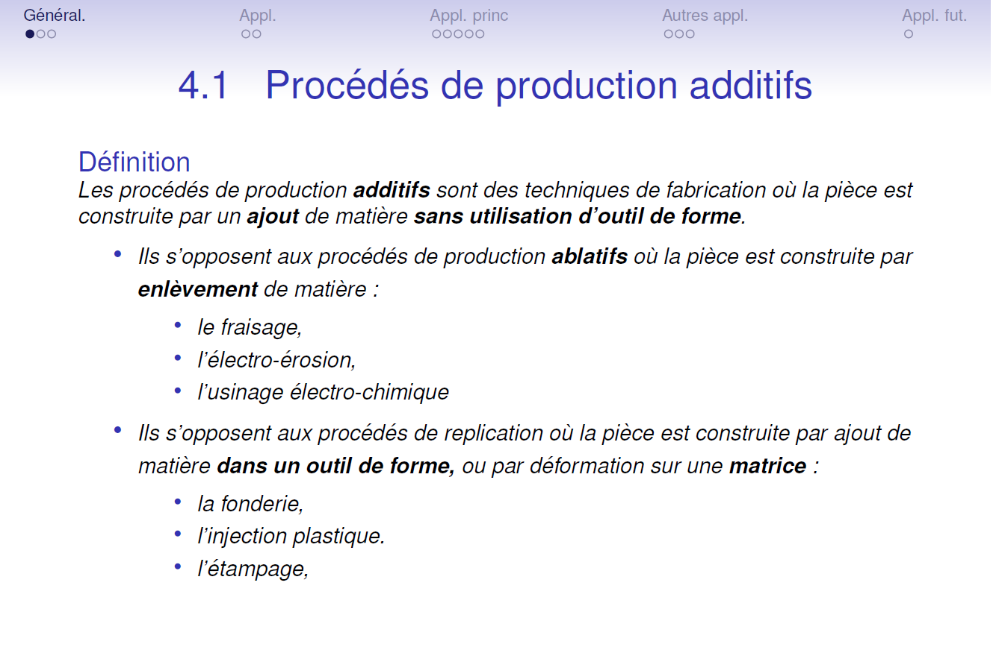
What is rapid prototyping?
Extract from FSRM training

Slide 6
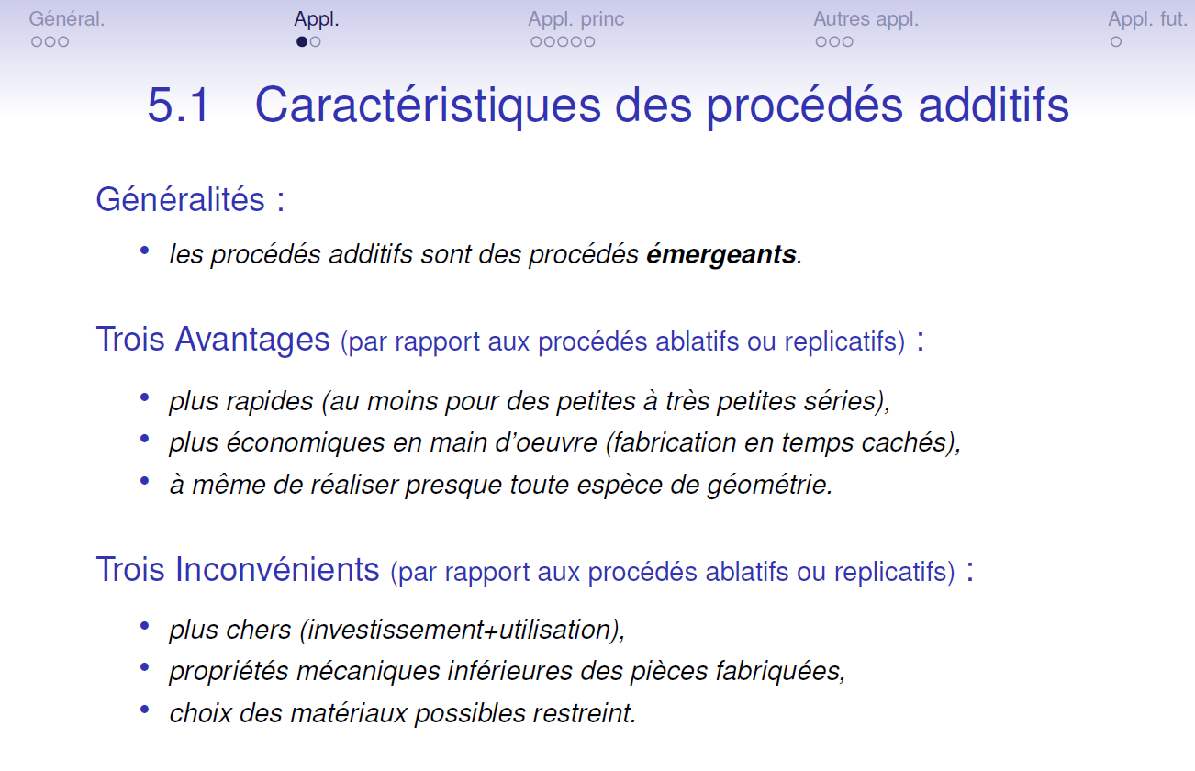
What is rapid prototyping?
Extract from FSRM training

Slide 7
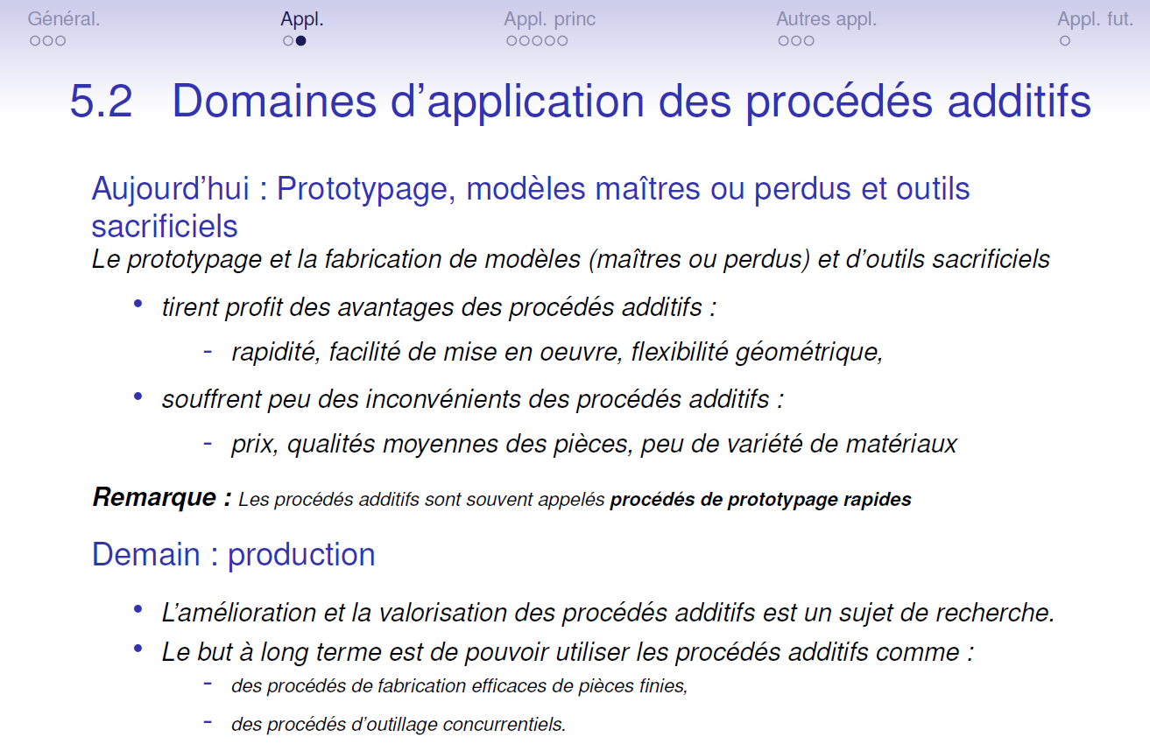
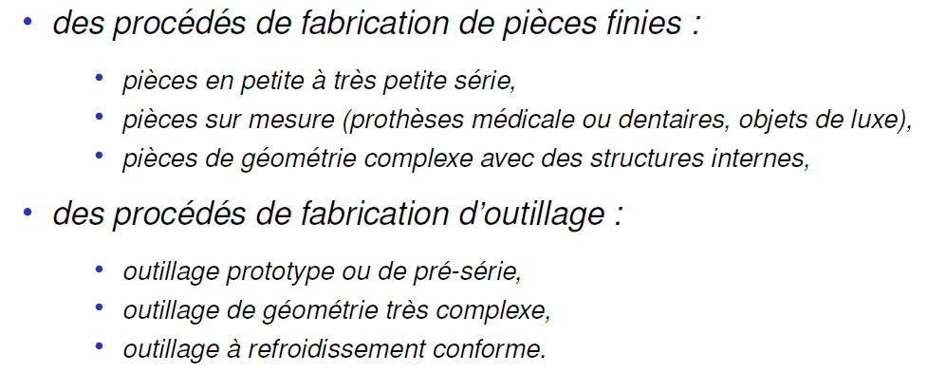
What is rapid prototyping?
Extract from FSRM training

Slide 8
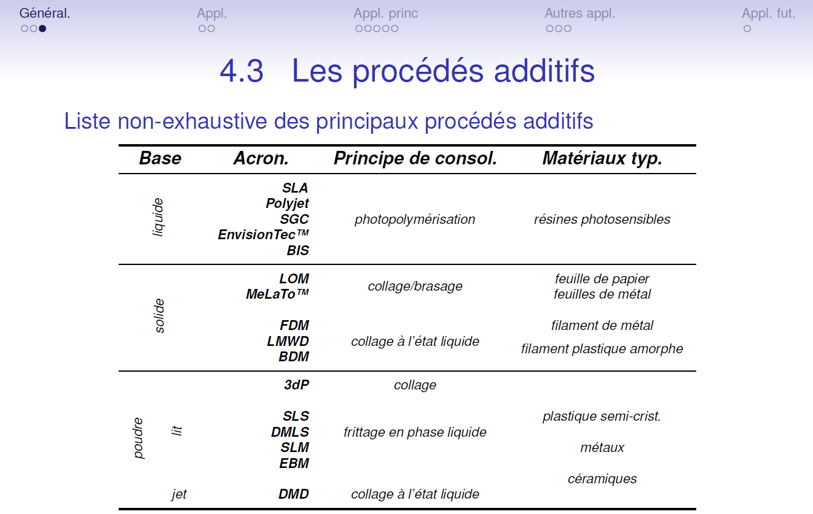
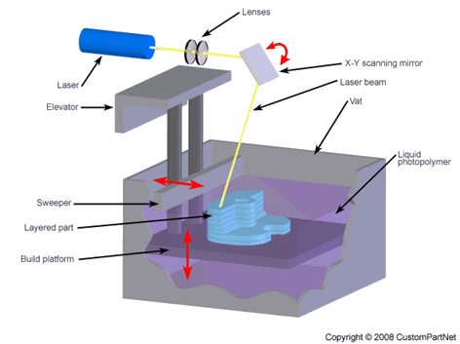
What is rapid prototyping?
Extract from FSRM training
Stereolithography
For each type of process, the training document gives a detailed explanation, with the corresponding applications, pro and cons, and examples of companies able to manufacturing

Slide 9
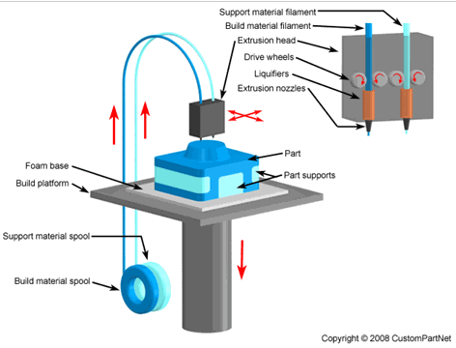
What is rapid prototyping?
Extract from FSRM training
Fused Deposition Modeling
For each type of process, the training document gives a detailed explanation, with the corresponding applications, pro and cons, and examples of companies able to manufacturing

Slide 10
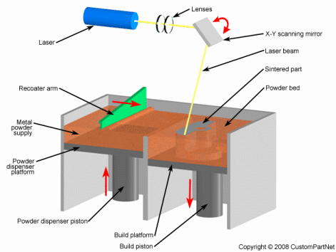
What is rapid prototyping?
Extract from FSRM training
Direct Metal Laser Sintering
For each type of process, the training document gives a detailed explanation, with the corresponding applications, pro and cons, and examples of companies able to manufacturing

Slide 11
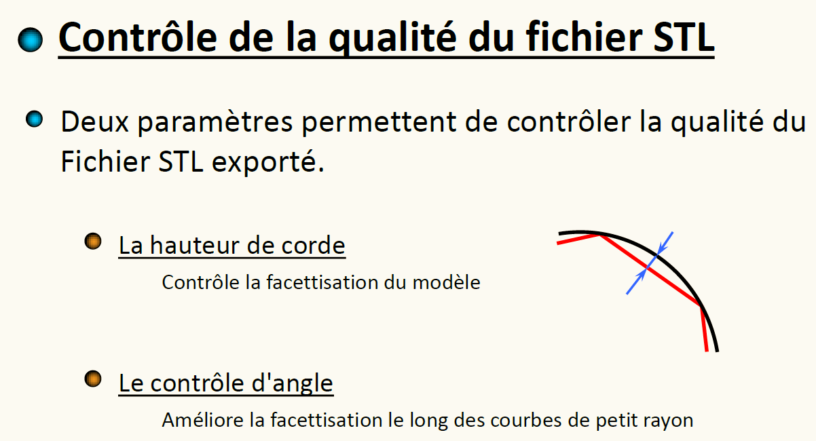
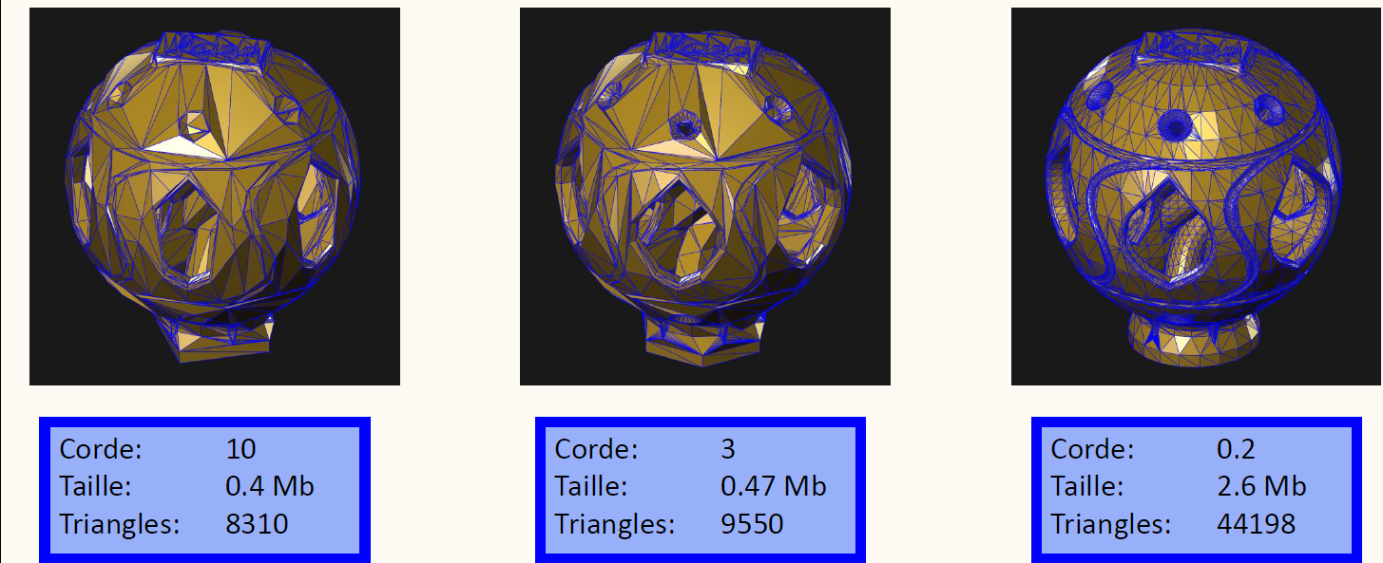
What is rapid prototyping?
Extract from FSRM training
See FAQ: https://espace.cern.ch/cad-service/faq/Surface%20Design/How%20to%20generate%20optimized%20STL%20files.aspx explanation to generate a stl file from a Catia file (Part or Product)

Slide 12
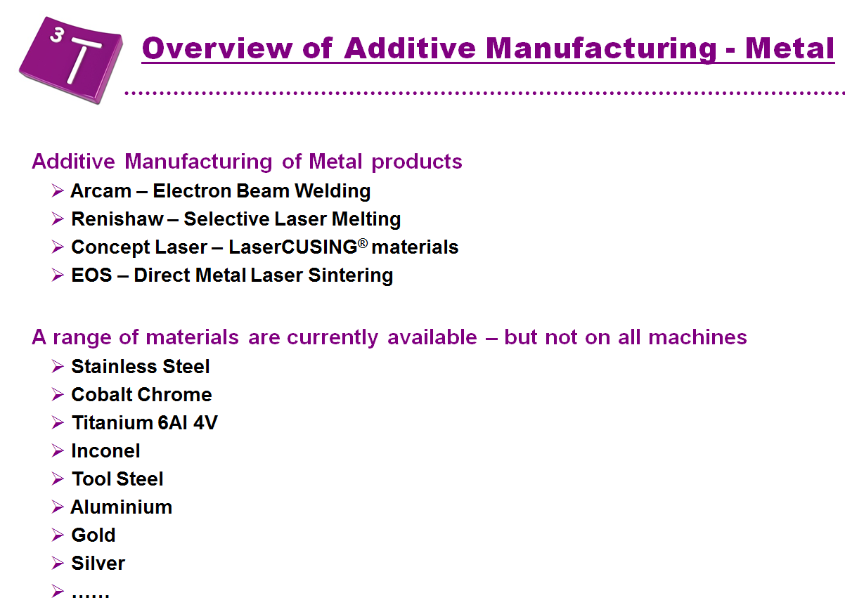
List (not exhaustive) of usable materials
Extrait of 3T RPD Ltd presentation

Slide 13
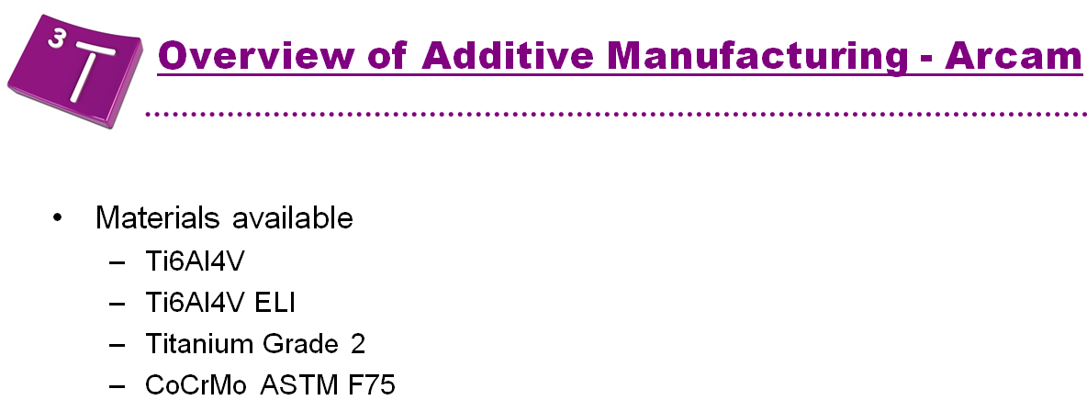
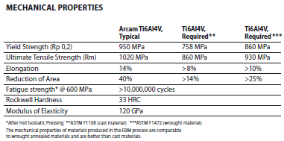
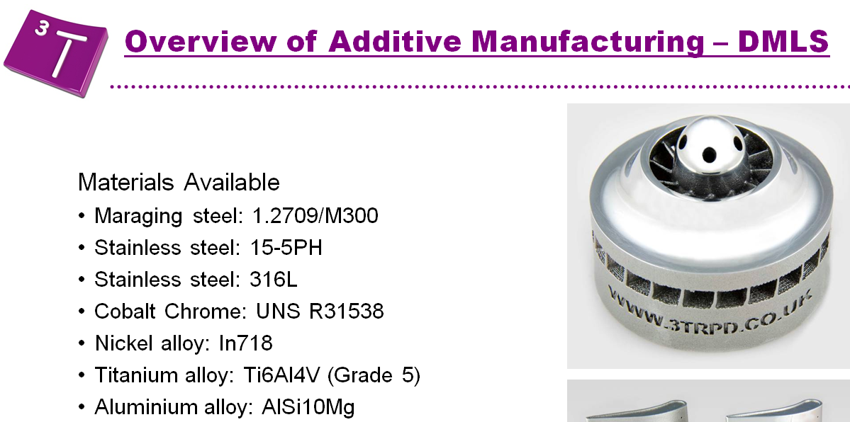
List (not exhaustive) of usable materials
- EBM
Extract of 3T RPD Ltd presentation
Cast
Wrought

Slide 14
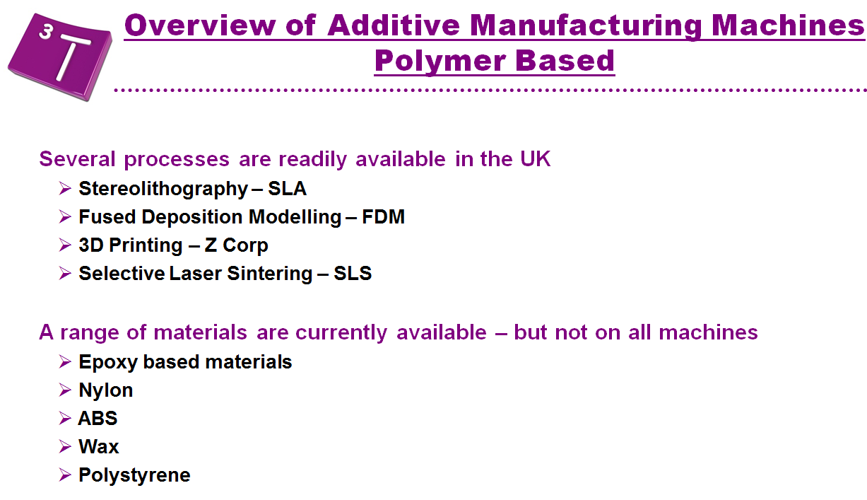
List (not exhaustive) of usable materials
Extract of 3T RPD Ltd presentation

Slide 15
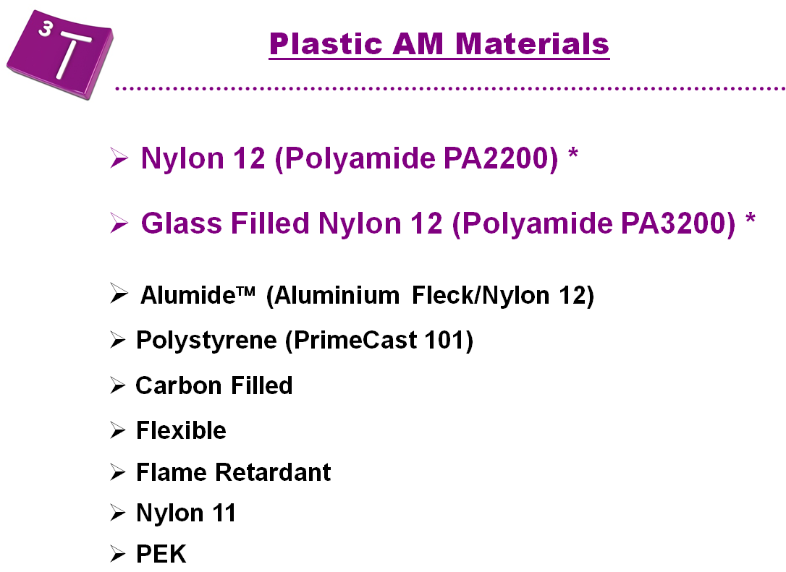
List (not exhaustive) of usable materials
Extract of 3T RPD Ltd presentation

Slide 16
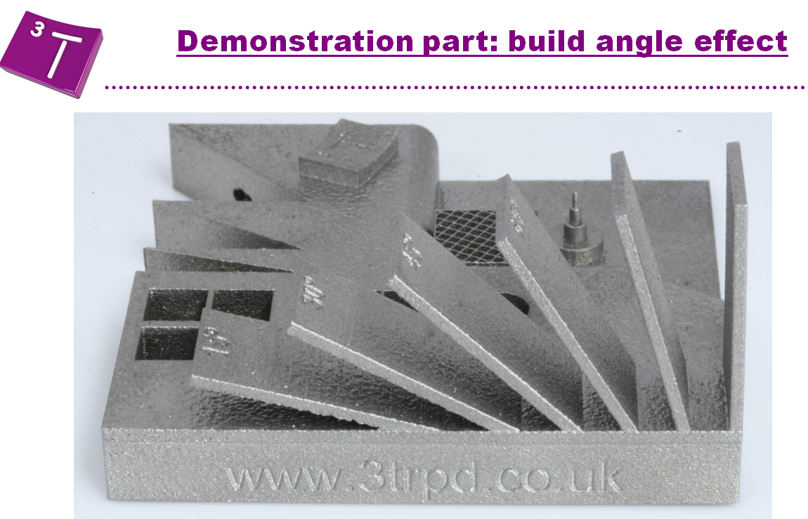
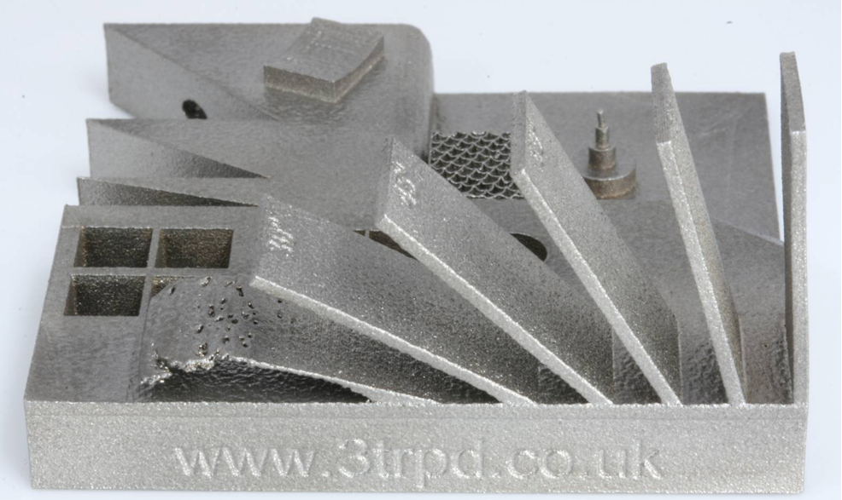
Rapid prototyping limits and possibilities
Extract of 3T RPD Ltd presentation

Slide 17
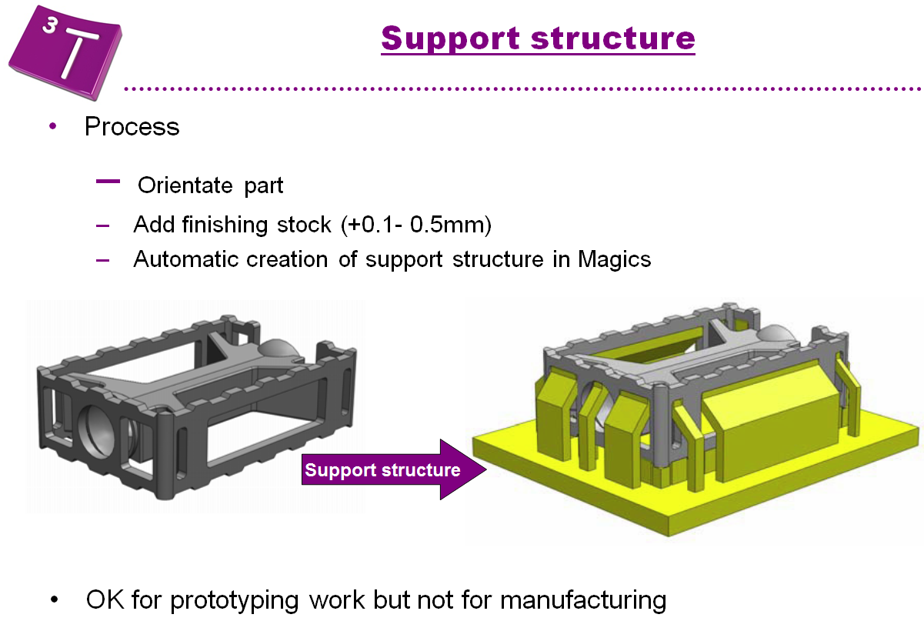
Rapid prototyping limits and possibilities
Extract of 3T RPD Ltd presentation

Slide 18
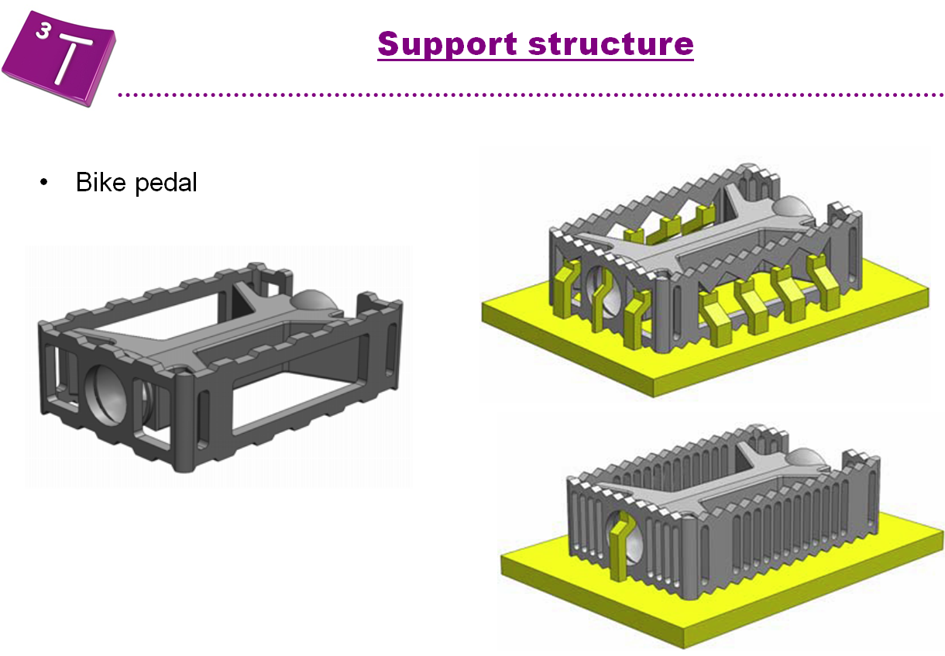
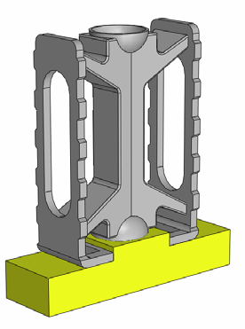
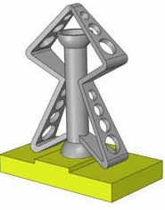
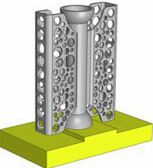
Rapid prototyping limits and possibilities
Extract of 3T RPD Ltd presentation

Slide 19
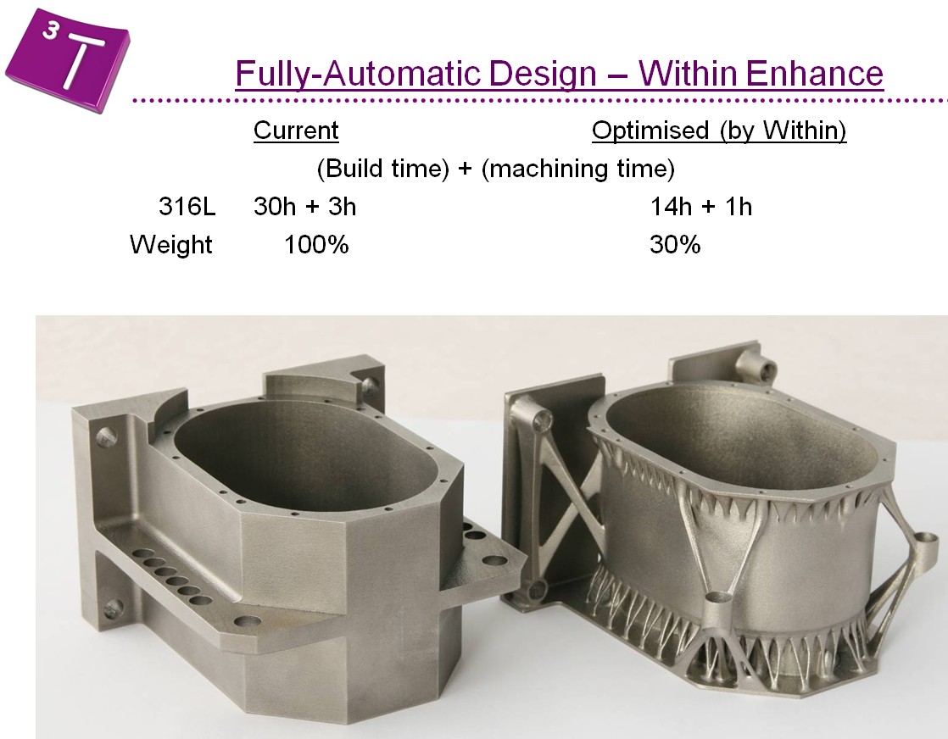
Rapid prototyping limits and possibilities
Extract of 3T RPD Ltd presentation

Slide 20
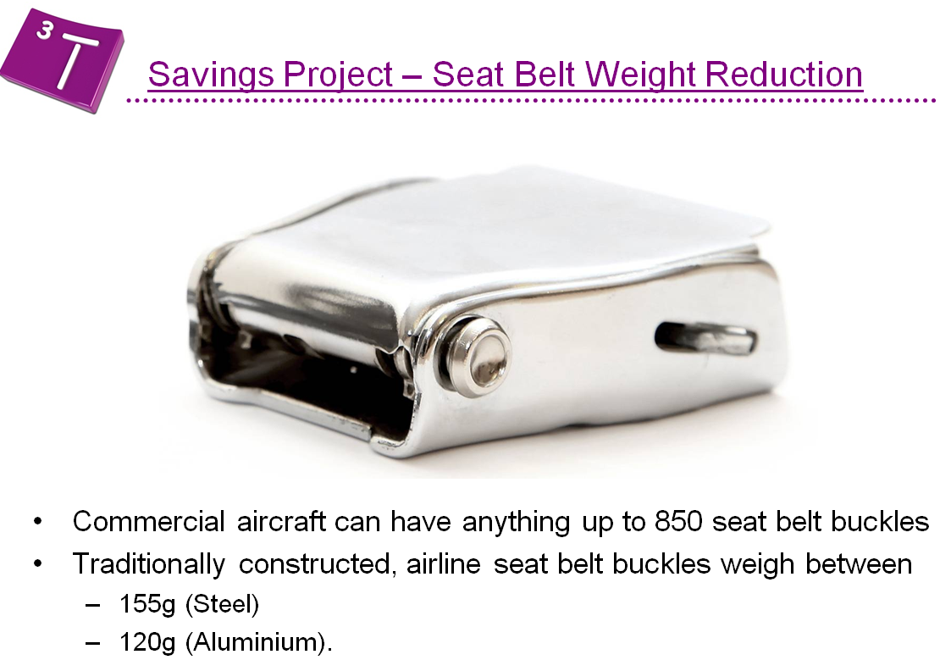
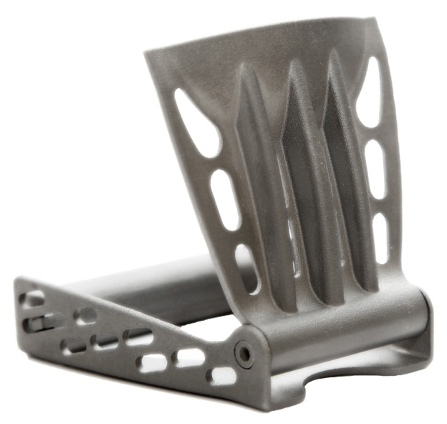
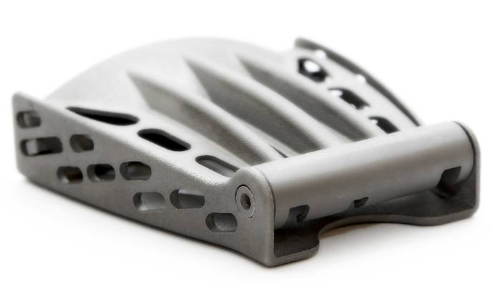
Rapid prototyping limits and possibilities
Extract of 3T RPD Ltd presentation
Manufactured in Titanium using additive manufacturing, weight is reduced to 68g without compromising strength

Slide 21
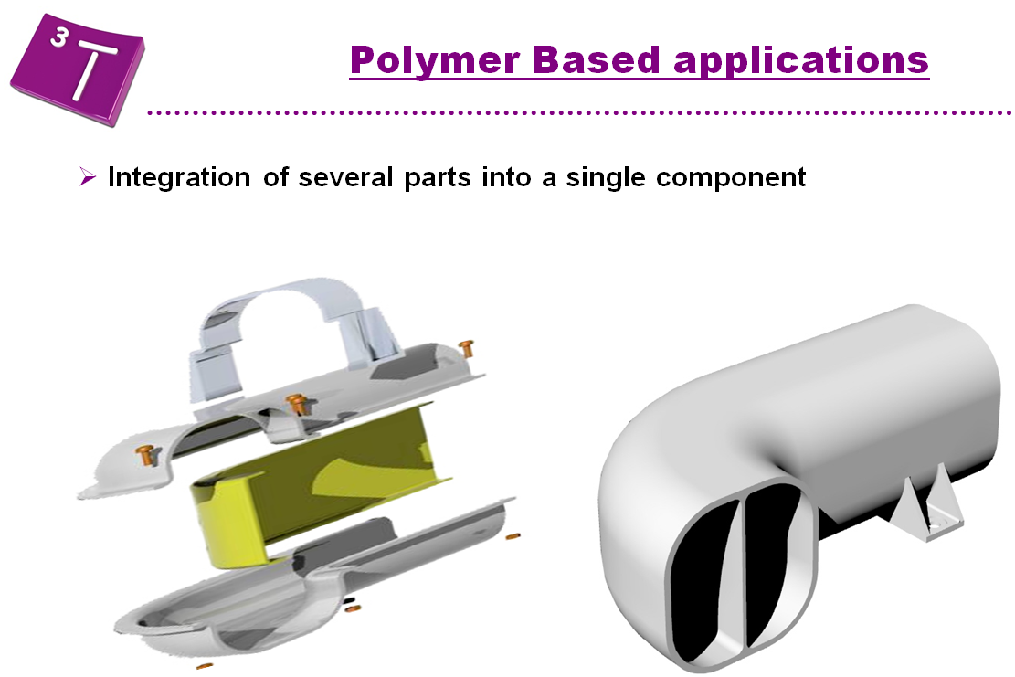
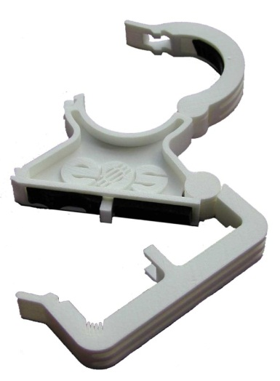
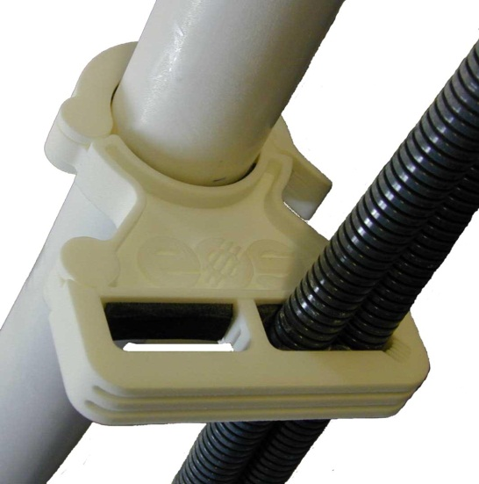
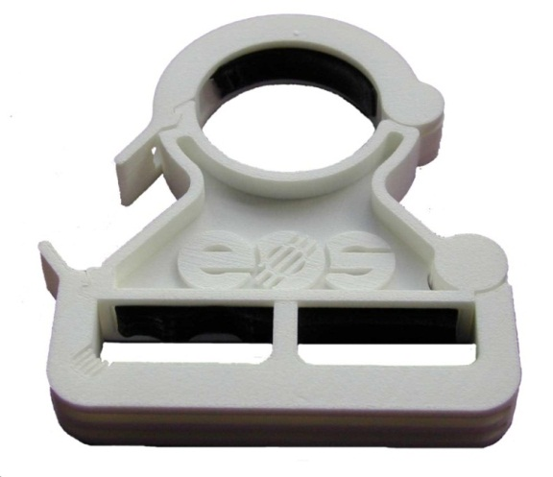
Rapid prototyping limits and possibilities
Extract of 3T RPD Ltd presentation

Slide 22
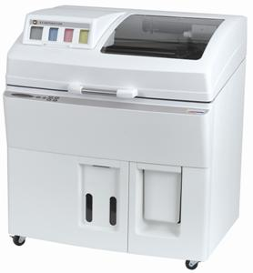
Our machines at Cern (department TE)
Polymer workshop building 110
Model Z Corp. 510
3dP technology
Maxi part dimension: 360 x 270 x 230
Accuracy: +/- 0.1mm
Mini wall thickness: 2mm

Slide 23
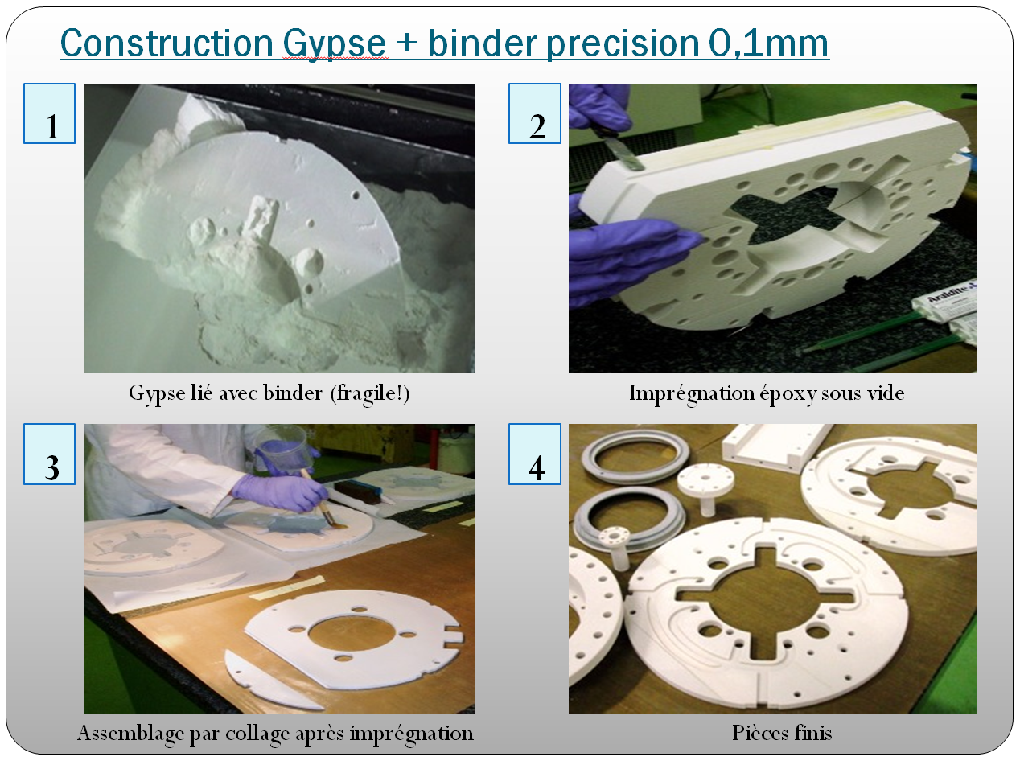
Our machines at Cern (department TE)
Polymer workshop building 110
Extract of presentation by S. Clément
(Catia forum 8th december 2011)

Slide 24
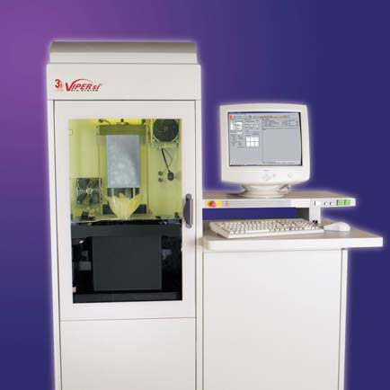
Our machines at Cern (department TE)
Polymer workshop building 110
Viper SLA System
Material: Epoxy resin, could be charged with ceramic
Maxi part dimension: 250 x 250 x 250
Accuracy: +/- 0.0076mm
Some tests are in progress to measure radiation resistance of material

Slide 25
Our machines at Cern (Ph-dt)
Section EO, 25 R 028
3d Dimension Elite
Fused Deposition Modeling
Material: ABS plus, different colors.
  Deposition of soluble support
Maxi part dimension: 203 x 203 x 305
Layer thickness (Z movement): 0.178 or 0.254mm
Solid part or «light» (massive external wall + structure like honey comb)
Estimated accuracy: ~ +/- 0.1mm
Mini thickness wall: 0.6mm
Tips and tricks:
  A big part can be done by printing of several smaller parts, assembled by gluing. Recommanded to create male/female specific shapes allowing accuracy fitting
  In progress, search for screw assembly solution: 3d thread (for M8 and up), use of threaded inserts, nuts gluing in hexagonal hole, simple hole to be threaded.

Slide 26
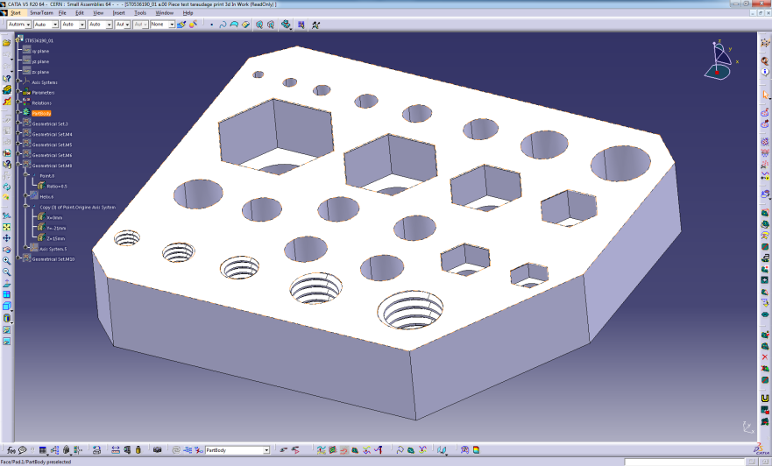
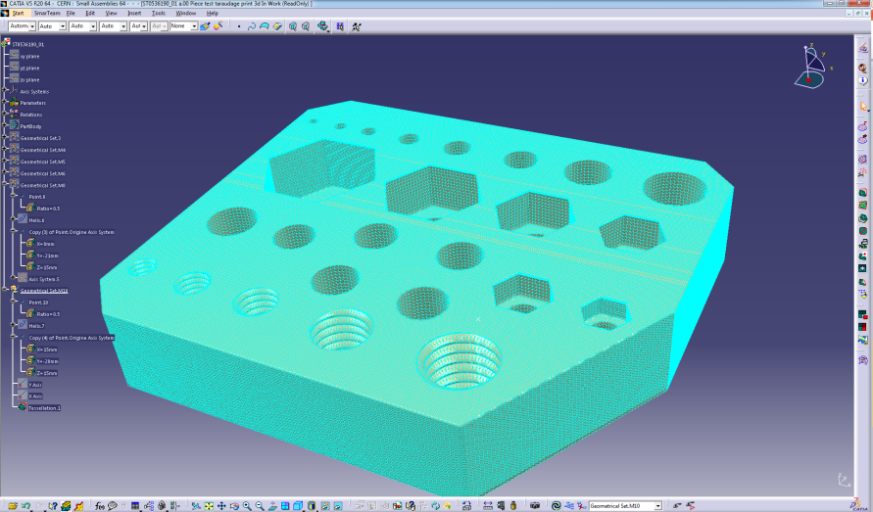
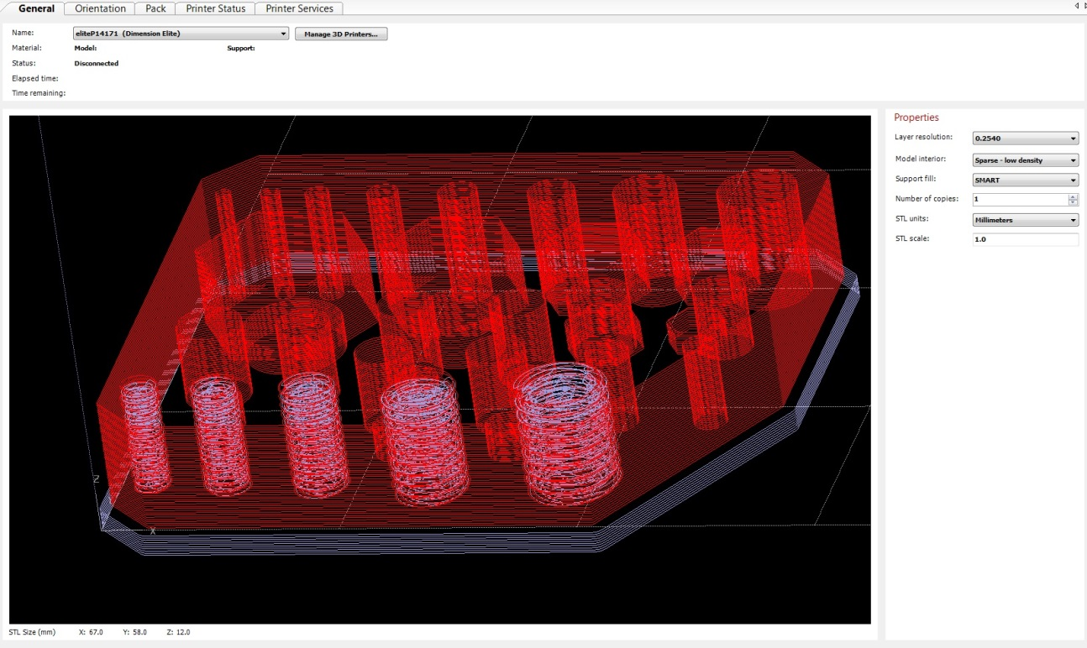
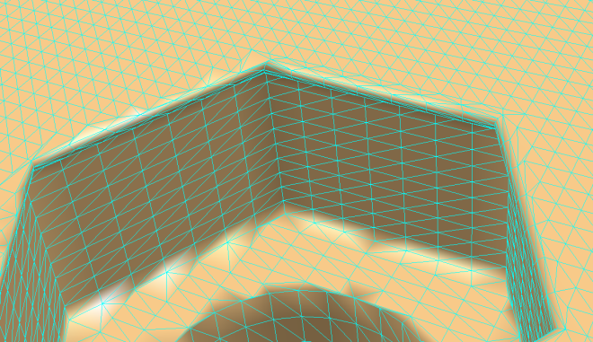
Our machines at Cern (PH-DT)
Section EO, 25 R 028
Process:
1- 3d modelisation (catia or .stp)
2- Converted in .stl (triangular meshing)
3- Insertion in Catalyst: part orientation, quantity, other parts can be added to fill the tray

Slide 27
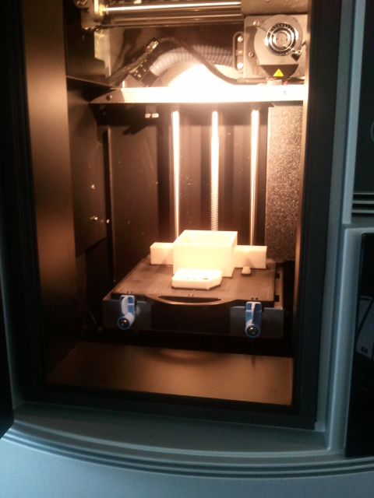

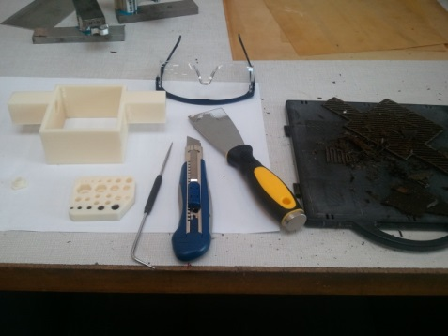
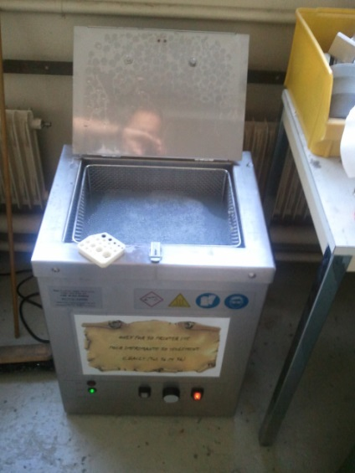
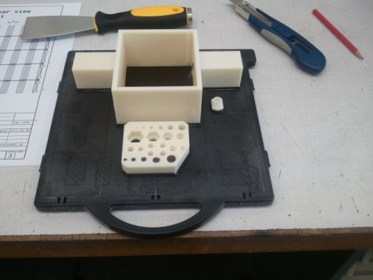
Our machines at Cern (PH-DT)
Section EO, 25 R 028
3d Dimension Elite
4- 3d printer on, heating (75°C, printer heads at ~270°C)
5- After few hours (13h in this case) of printing: bringing out of tray
6- Removal of support material:
Maximum manually removal
The rest by plunging the part in a tank filled of water + washing at 70°C during ~4h

Slide 28

Our machines at Cern (Ph-dt)
Section EO, 25 R 028
3d Dimension Elite
Printing cost:
1 tray per printing (théorical. In reality, by careful cleaning and degreasing, we can re-use it 2 or 3 times: 10 CHF
Matérial: 0.51 CHF/cm³
Support: 0.51 CHF/cm³
Matérial: 93.26 cm³, 47.64 CHF
Support: 15.38 cm³, 7.86 CHF
Total: 55.50 CHF
Matérial: 0.74 cm³, 0.38 CHF
Support: 0.3 cm³, 0.15 CHF
Total: 0.53 CHF
Matérial: 21.12 cm³, 10.79 CHF
Support: 4.74 cm³, 2.42 CHF
Total: 13.21 CHF

Slide 29
Our machines at Cern (EN-MME)
EN-MME consider to buy a DMLS (Direct Metal Laser Sintering) or EBM (Electron Beam Melting) machine.
Budget 500 000 to 1 000 000 CHF
Goal: Printing metallic parts at Cern, but especially make some research to test other materials, not currently agreed by this type of technology (example: Invar)
Today, EN-MME is trying to identify the use, to justify this investement.
If you have some ideas about possible applications, thanks to feedback.
Contact EN-MME is: Thomas Sahner

Slide 30
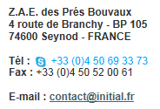
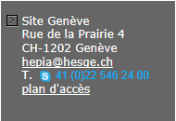
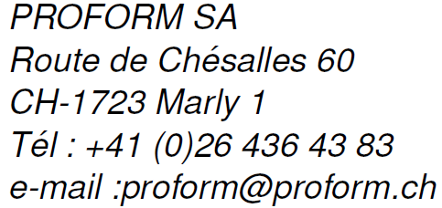
List (not exhaustive) of suppliers
Initial: http://www.initial.fr/
Propose lots of rapid prototyping technologies: Stereolithography, 3d Printing, Selective Laser Sintering (Polymer), Fused Deposition Modeling (ABS), Direct Metal Laser Sintering…
Haute Ecole du Paysage, d’Ingénierie et d’Architecture de Genève: http://www.hepia.hesge.ch
Contact: herve.sthioul@hesge.ch
Technology: Polymer jetting
Recommanded for stereolithography and Fused Deposition Modeling (ABS)

Slide 31
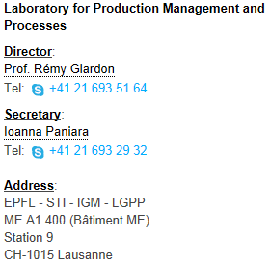
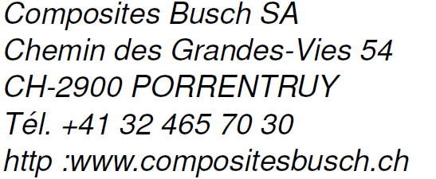
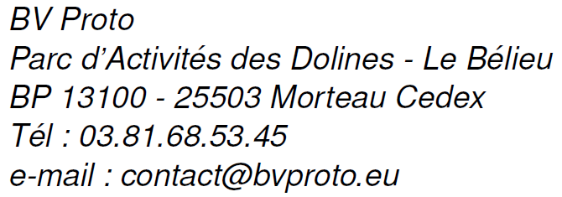


List (not exhaustive) of suppliers
Ecole Polytechnique Fédérale de Lausanne: Selective Laser Sintering
http://lgpp.epfl.ch/
Recommanded for Direct Polyamide Laser Sintering
http://www.bvproto.eu
Recommanded for Direct Metal Laser Sintering and Selective Laser Melting
Recommanded for Electron Beam Melting

Slide 32
Conclusion
Additive manufacturing processes are in progress.
Until last years, they were mainly used for prototypes production to validate concepts, and in specific activities like medical and dental prostheses and for molding ( model production for sand mold, core…)
Improvement of processes (better precision, diversity of usable materials, mechanical characteristics, lower costs machine) could make an interesting alternative compared to traditional manufacturing processes, especially in following cases:
Small parts
Small series
Shape very difficult to obtain by machining
Use of expensive material
Research of low mass (X0)

Slide 33
Conclusion
Do not limit yourselves to additive technologies available at Cern, request advises to specialized companies.
And thanks to give me a feedback about personal experience you could have.
Combine with scanning process, a 3d part can be quickly reproduced without original 3d model.
I’m available to give you some helps in search of solutions.

Slide 34

Annex
Extract of FSRM training

Slide 35
Annex
Few youtube videos:
https://www.youtube.com/watch?v=aWB84gCi5Sg
https://www.youtube.com/watch?v=zknjvQtn6e4
https://www.youtube.com/watch?v=BUfh5wxj3qA

