Slide 1
HL-LHC WP 14
Beam Transfer and Kickers
  Elements related to the injection and extraction of the LHC beams
  Hardware starts at the entrance of the injection septa MSI. LIU takes care upstream of the MSI
Organisation
  WP Leader: Jan Uythoven
  Deputy: Brennan Goddard
  Sc. Secretary: Anton Lechner

Slide 2
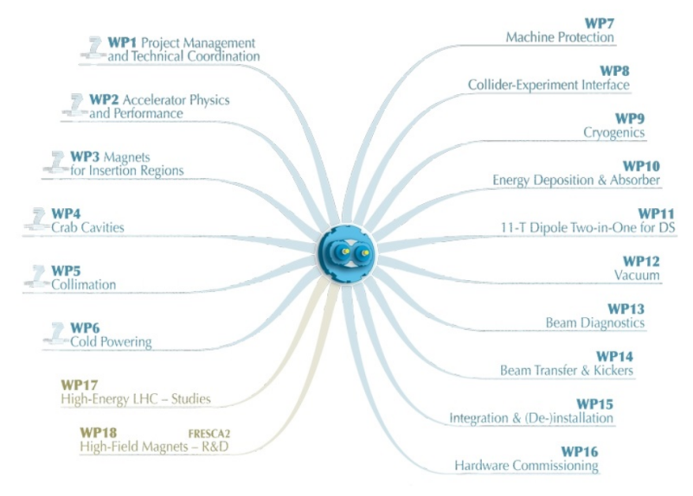
Link to other Work Packages
General link
Strong Link

Slide 3
WP2 Accelerator Physics and Performance
Optics and Trajectories in the injection and dump regions
  Phase between kickers and protective elements
  Aperture in the region
    Especially for failure scenarios
  See talk Riccardo later in this meeting
Layout options
Beam impedance of Absorber Elements
E-cloud of elements (MKI)
G.Arduini, A.Wolski, R.de Maria

Slide 4
WP5 Collimation
Injection and dump protection depends on collimation hierarchy and tolerances
  Asynchronous dumps
  Protection of TCTs
Collimation control system and interlocking
S.Redaelli, R.Appleby

Slide 5
WP7 Machine Protection
Injection and dump protection originally part of WP7 before the “Beam Transfer and Kickers” WP existed
Can be redefined within WP7 (talked to Markus and Daniel)
Strong collaboration through MPP
D.Wollmann, J.Wenninger

Slide 6
WP8 Collider-Experiment Interface
Not mentioned in the WP description, but seems logical to me that it also contains:
  Protection of Experiment in case of injection or dump failures
  Lay-out
    ALICE ZDC recombination chamber close to TDI, meeting planned with ALICE for 18th July via LTEX
  Relation LTEX and WP8 ?
B. Di Girolamo, D. Lacarrere

Slide 7
WP10 Energy Deposition
Collaboration, sharing models and people
Actual simulations of absorbers (TDI, TDE etc.) will be done under WP14
F.Cerutti, N.Mohkov

Slide 8
Less strong Dependence
WP1: Project Management and Technical Coordination
WP12: Vacuum
  As Vacuum in all equipment, dump window
  MKI: multi-pacting, e-cloud
  Absorbers: bake-out etc.
WP13: Beam Diagnostics
  Related to injection and beam dump
  BTVs, BLMs (injection losses), BCTs, AGM etc.
WP15: Integration & (de-)installation
WP16: Hardware commissioning

Slide 9
WP 14
TDI studies ongoing, see later this meeting
  Functional spec to be published
  Installation in LS2
TCDD, TCLIA/B, TCLIM to be adapted?
Injection kickers MKI
  extrapolation of operational data, changes required?
Injection protection failure studies, interlocking
Beam dumping system
  TDE, window VDWB, BTVs
  TCDQ, (button) TCSG, TCDQM and its positioning, asynch dump, abort gap
Beam dump failure studies and interlocking

Slide 10
Modus Operandi WP14
Bi-weekly meetings on Tuesday mornings at 10:30
  Regular after the summer holidays
  Indico and webpages to be put in place
In the beginning the accent will be on the TDI

