Slide 1
CERN, accelerating innovation
Nick Ziogas
Knowledge Transfer Group

Slide 2
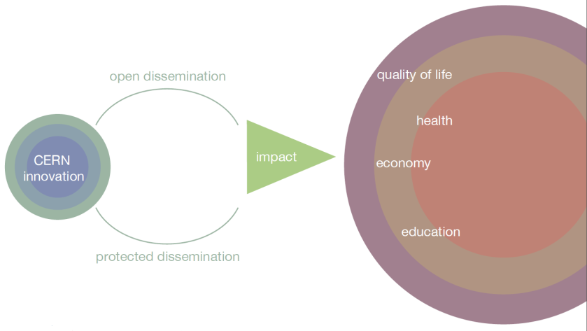
Why Knowledge Transfer?

Slide 3
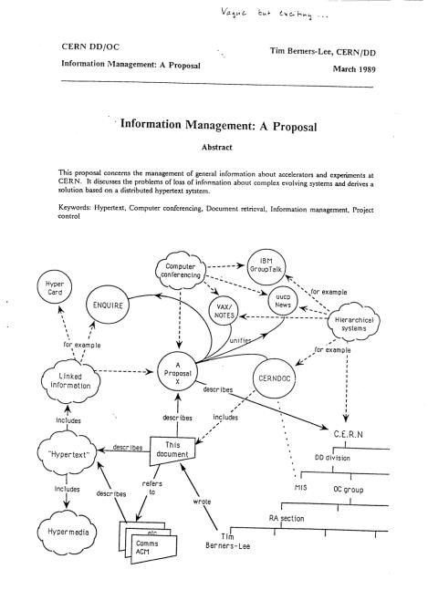
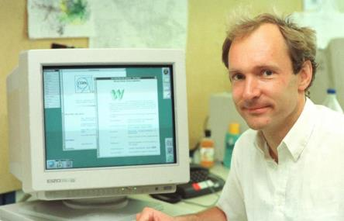
The WWW

Slide 4
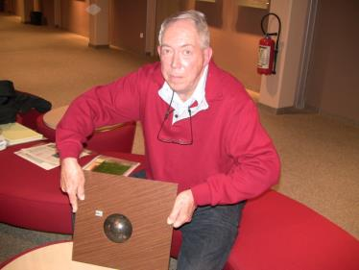

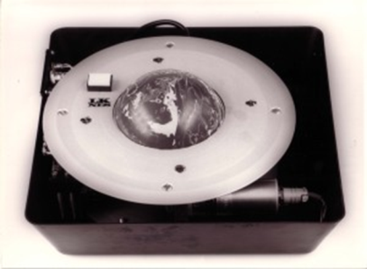
Did you know?

Slide 5
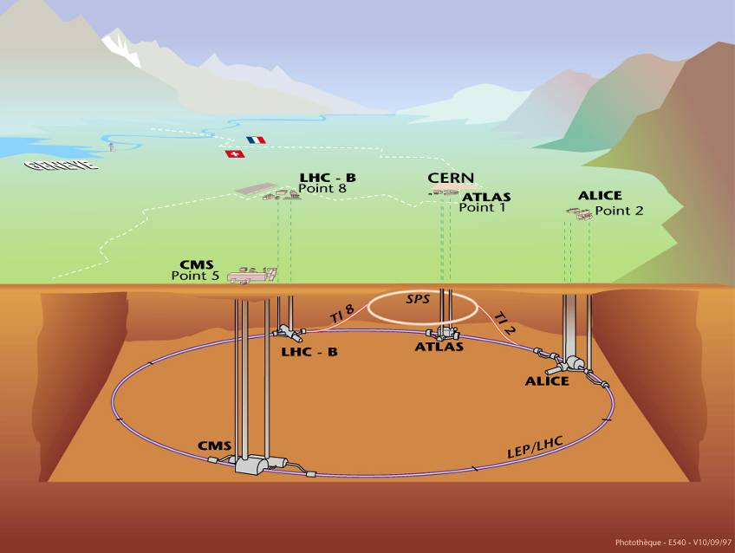

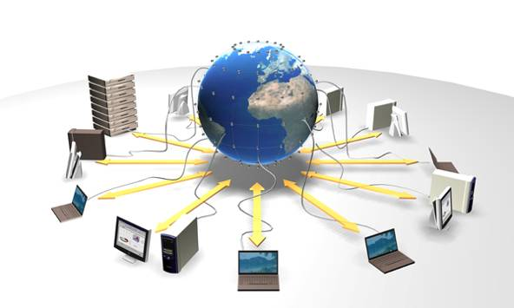


CERN’s areas of excellence
Accelerating
particle beams
Detecting
particles
IT technologies

Slide 6
Accelerator Technologies
Base Technologies: LHC
Superconductivity
(12kA)
Cryogenics
(1.9 K)
Vacuum
(10⁻¹³ atm)
Magnets
(8 T)

Slide 7
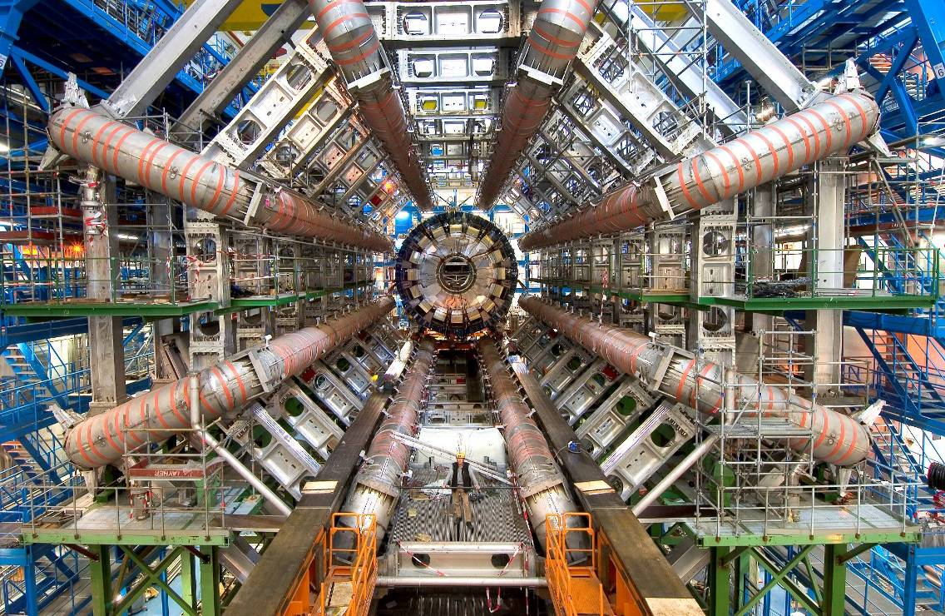
Detector Technologies
Challenge: sample the results of up to 600
million proton-proton collisions per second!
Οι ανιχνευτές του LHC διαθέτουν εξελιγμένα ηλεκτρονικά συστήματα ενεργοποίησης που μετρούν το χρόνο διέλευσης ενός σωματιδίου με ακρίβεια μερικά δισεκατομμυριοστά του δευτερολέπτου. Το σύστημα ενεργοποίησης καταγράφει επίσης, τη θέση των σωματιδίων σε εκατομμυριοστά του μέτρου. Αυτό είναι απαραίτητο για την εξασφάλιση ότι το σωματίδιο που καταγράφεται σε διαδοχικά στρώματα ενός ανιχνευτή είναι ένα και το αυτό.

Slide 8
Computing Technologies: the Grid
Detector data stream ~300 GByte/s of data. After filtering for "interesting events", ~ 300 MByte/s. This represents ~200 interesting collisions per second.
Several MBs of data to be stored for each collision...
more than 25 Petabytes/year of data!
8 Megabyte (8MB)
A digital photo
1 Gigabyte (1GB)
= 1000MB
A DVD movie
1 Terabyte (1TB)
= 1000GB
World annual
book production
> 25 Petabytes (25PB)
= 25000TB
Annual LHC data output
CERN, home of the World Wide Web, is a driving force
in Grid Computing

Slide 9
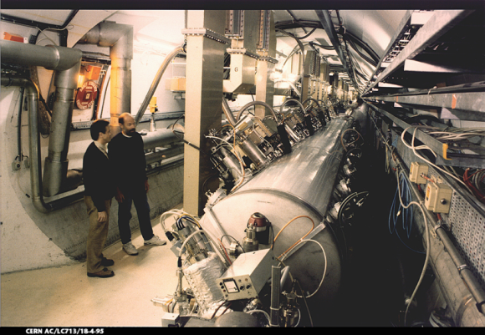
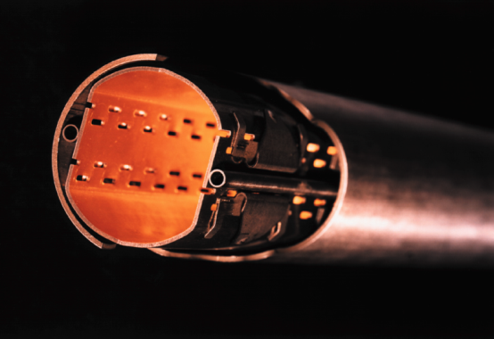

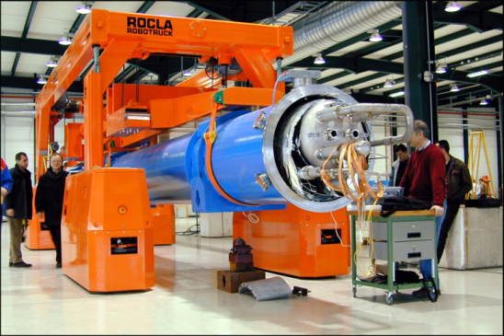
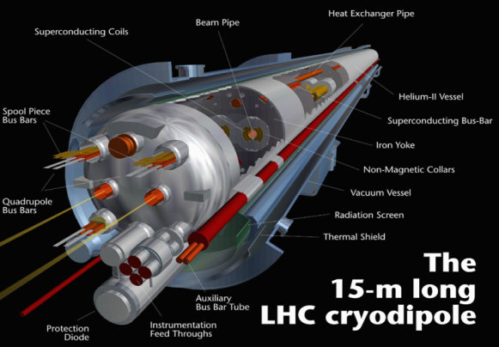
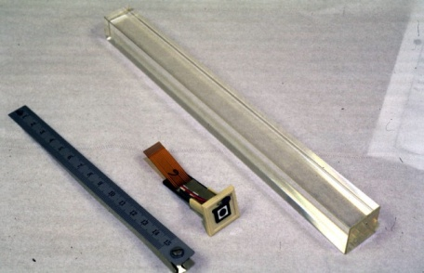
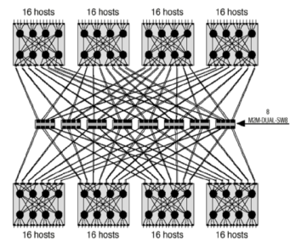
CERN Core Competences
Super-conductivity
(13kA, 7MJoules)
Vacuum
(10⁻¹² Torr)
Cryogenics (1.9 K)
Very high performance
detectors and electronics
Magnets
(10 T)
Data processing

Slide 10
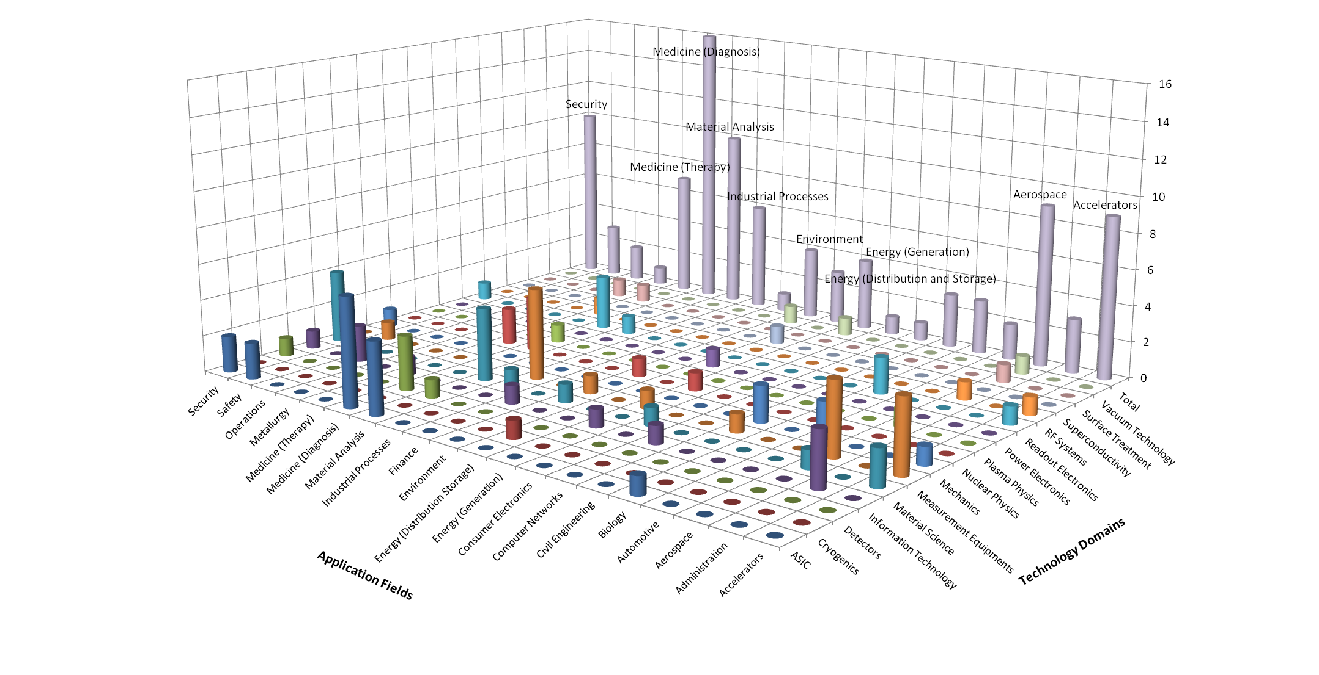
CERN’s Technology Portfolio

Slide 11
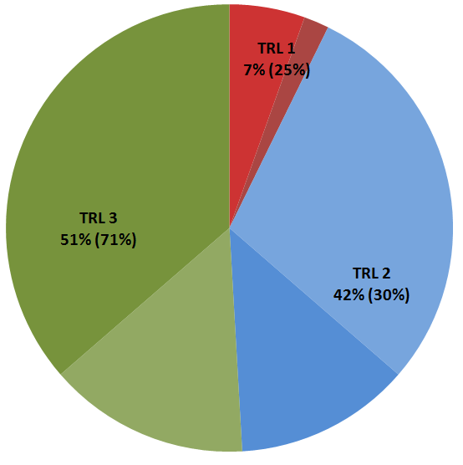
Technology Portfolio - statistics
Technology Portfolio - General Statistics
~200 TT cases (40% open, 20% protected by patent)
  ~40 new disclosures per year
  Exploitation level: ~50%
TRL | Simplified Definition
1 | Technology application formulated and basic concept demonstrated
2 | Functional validation in laboratory environment
3 | Representative prototype fully qualified (technology ready to transfer)

Slide 12
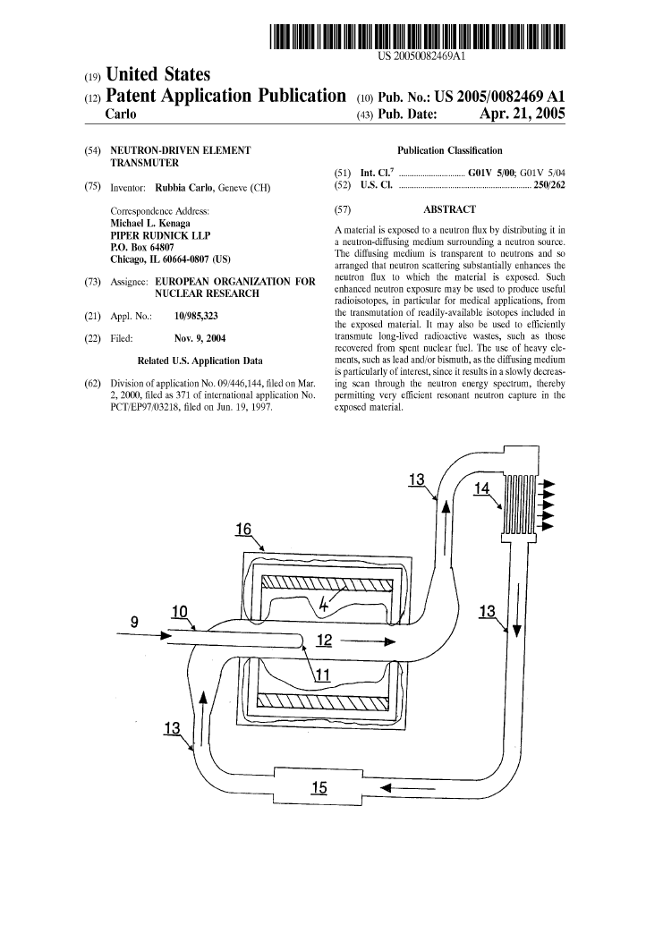
CERN and Patents
Patents are taken in order to:
Increase the probability of having the technology transferred (justify development investments from industry)
Significantly enhance the commercial value of the technology
Ensure CERN’s recognition as the originator of an exceptional invention

Slide 13
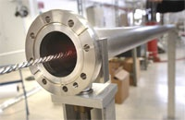
From high vacuum…
NEG (Non-Evaporable Getter thin film coatings)
Technology used to create and maintain ultra-high vacuum in the accelerator vacuum chambers.

Slide 14
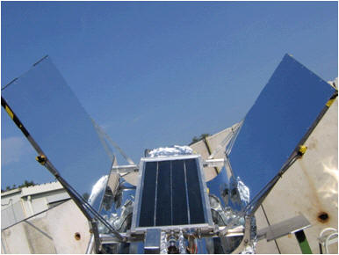
… to solar energy!
License and partnership with a start-up company
Development of a commercial product able to use diffused or indirect light and reach very high temperatures of up to 300 degrees
Development of a prototype production chain

Slide 15
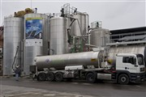
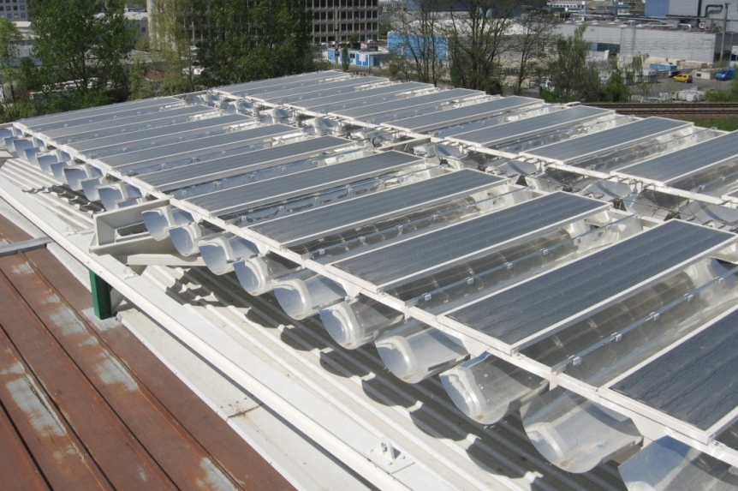
Solar panels plant
Civil-engineering company opened a new solar power plant
Environmentally friendly "solar field" heats close to 80,000 cubic metres of bitumen to 180 degrees.

Slide 16
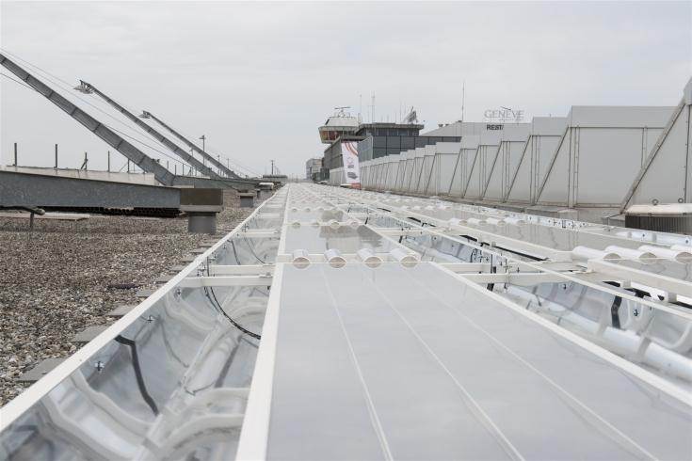
Installation at GVA airport

Slide 17
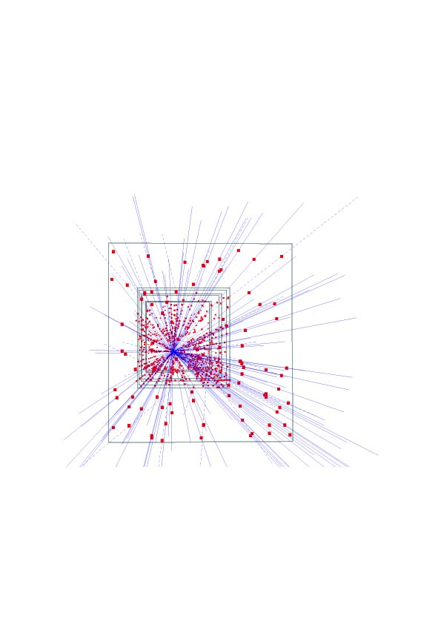
Silicon pixel detectors (SPDs)
Hybrid silicon pixel detectors for tracking applications in High Energy Physics
153 high energy particle tracks flying through a telescope of half a million pixels in the WA97 experiment back in 1995

Slide 18
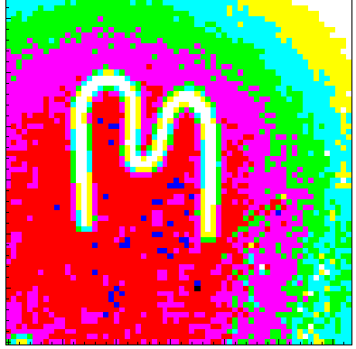
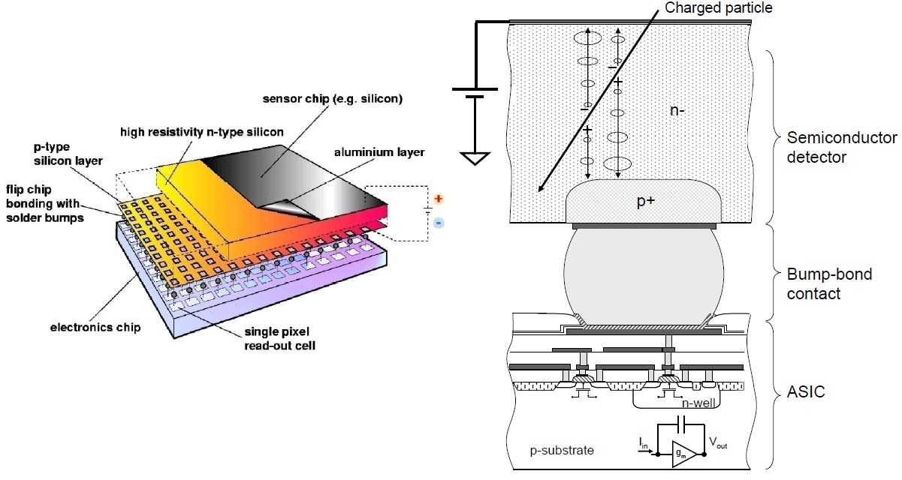
Medipix

Slide 19
Medipix
A family of single photon counting integrated circuits used in Hybrid Silicon Pixel Detectors
The Medipix collaborations (close to 20 institutes) contributed to the development and dissemination of the technology
A good example of how (fundamental) science fosters innovation which can be transferred to society… and back!

Slide 20
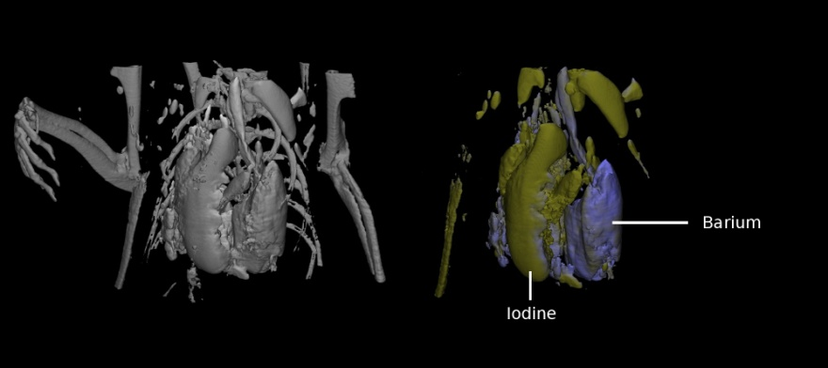
Application: Medical imaging
MARS project
  Colour CT X-ray scanner based on the Medipix technology
(courtesy of MARS Bioimaging Ltd)

Slide 21
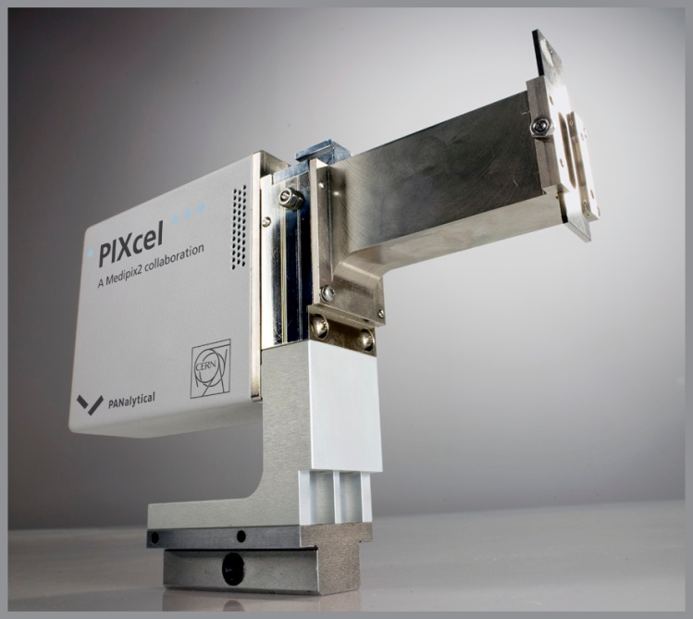
Application: Material analysis
Partnership and license agreements with a company to build a X-ray diffractometer

Slide 22

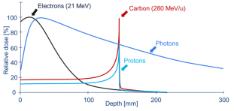
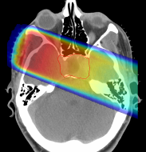
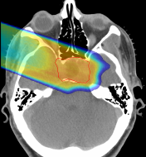

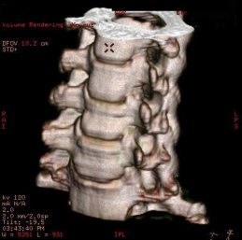
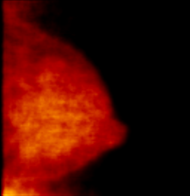
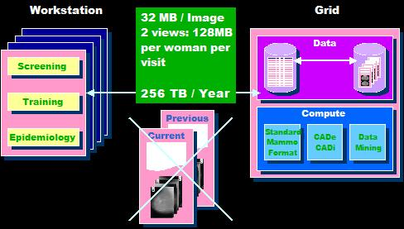
Example: medical applications
Particle accelerators for hadron therapy
Particle detectors for medical imaging
Grid computing for medical data management and analysis
Photons
Protons

Slide 23
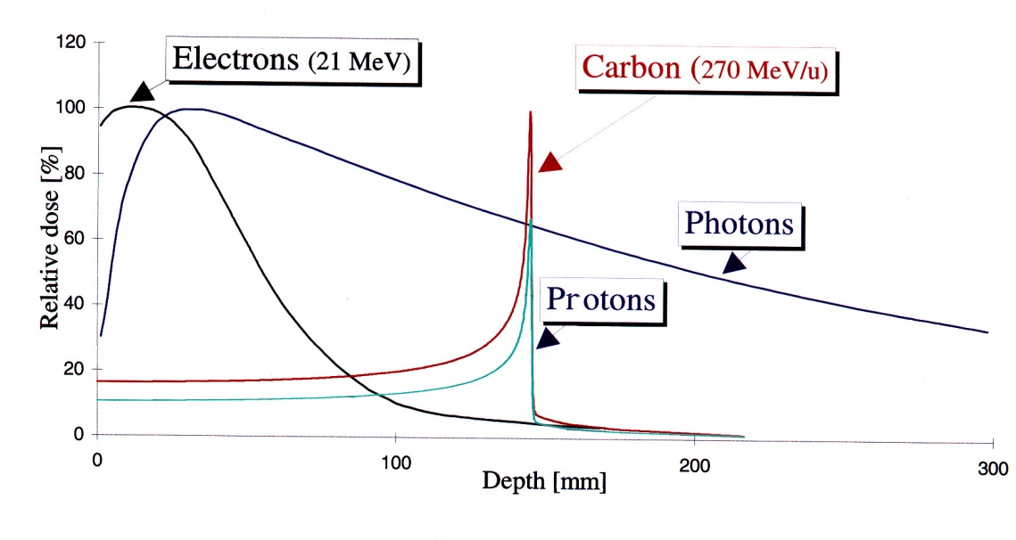
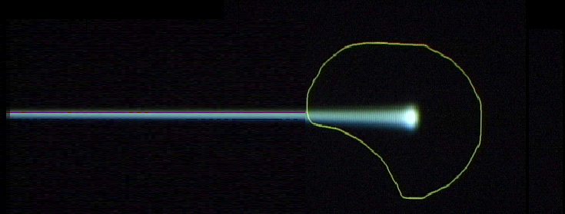
Hadrontherapy
Hadron beams:
new treatment opportunities for deep-seated tumours
tumour
target
charged hadron beam
that loses energy in matter
X rays
protons or
carbon ions
Photons
Protons
C ions: 24 times more energy than protons
GSI

Slide 24
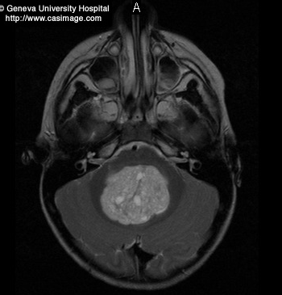
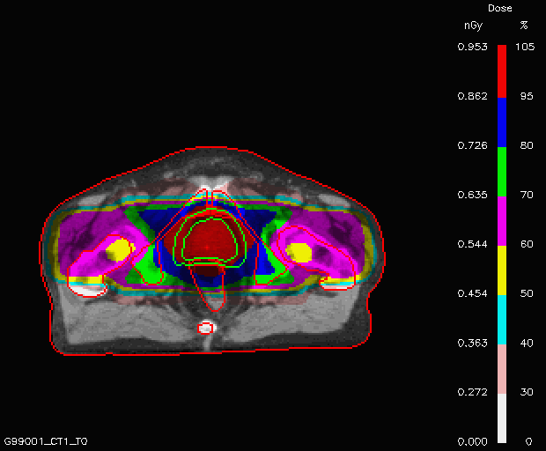
X-ray therapy
80
50
30

Slide 25
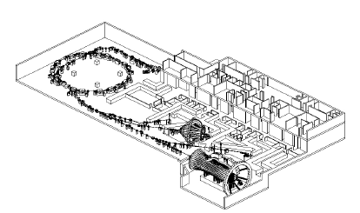

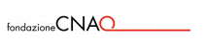
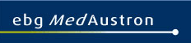
CERN’s PIMMS Study
PIMMS 2000 (coordinated by CERN) has led to:
Treatment centre in Pavia, Italy.
First patient treated with Carbon ions in November 2012!
Treatment centre in Wiener Neustadt, Austria,
foundation stone 16 March 2011, will be ready in 2015

Slide 26
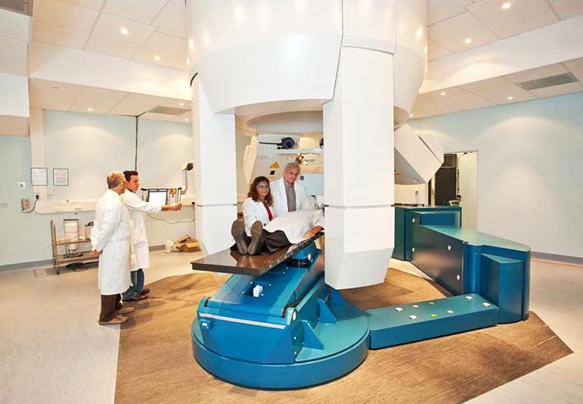
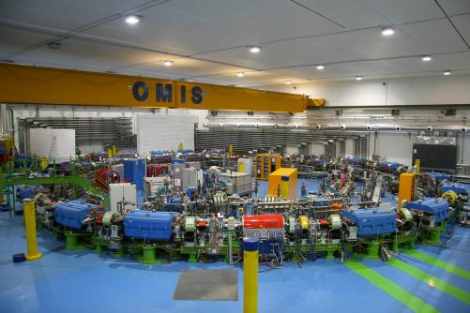
CNAO

Slide 27
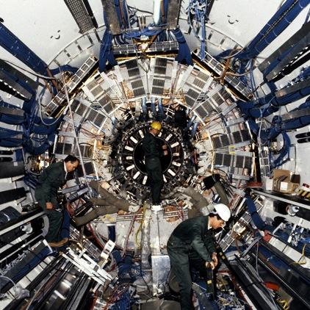
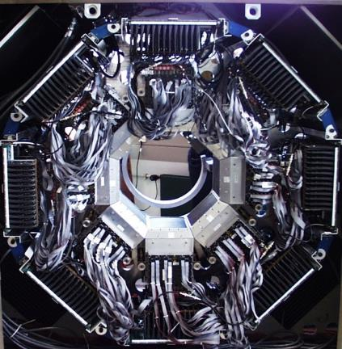
Medical imaging and particle physics

Slide 28
PET: How does it work
Drug is labeled with positron
(+) emitting radionuclide.
Drug localizes in patient according to metabolic properties of that drug.
Trace (pico-molar) quantities of drug are sufficient.
Radiation dose fairly small
(<1 rem = 0.01 Sv).

Slide 29
PET detection
Neutron-deficient
radioisotope
p n + e⁺ + ν_{e}
n
n
p
p
n
detector
p
p
n
p
Positron range
n
Photon (511 keV )
e⁺
e⁻
~180º
detector
Photon (511 keV)

Slide 30
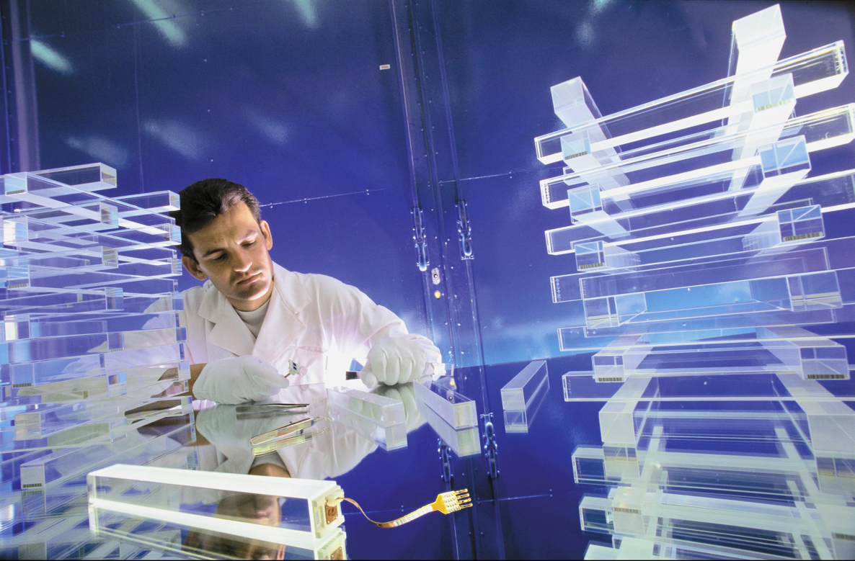
Crystals for HEP and … PET

Slide 31
Other ways of dissemination
The Technology Transfer process:
invention disclosure → IP protection → license to a company
is difficult, especially for the world of particle physics. Collaborative R&D (with industry and other research institutes) is key for a successful transfer.
Other ways of dissemination are also very important for the Organization

Slide 32
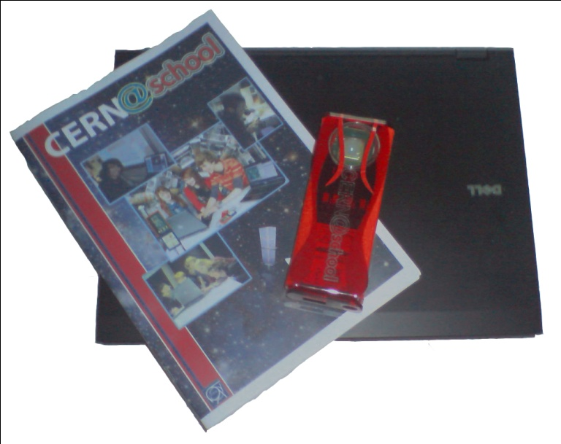
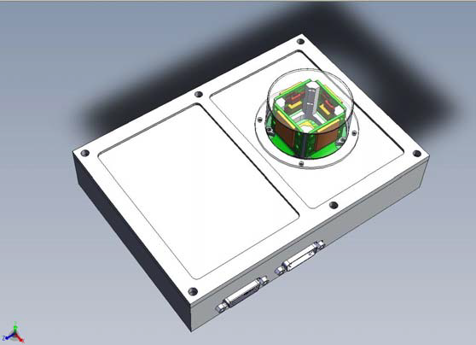

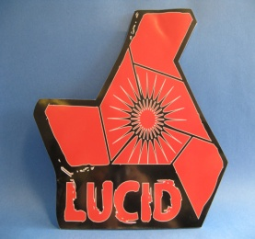
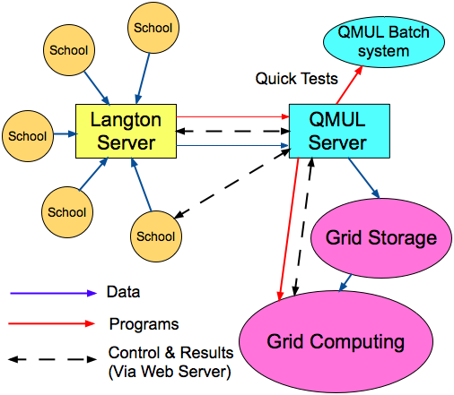
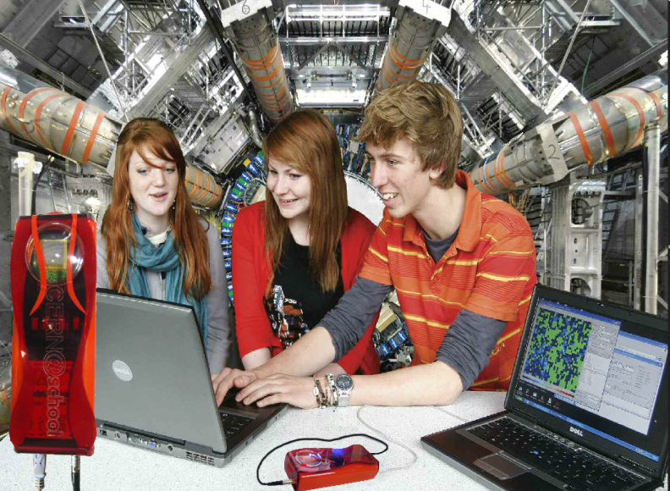
Langton Ultimate Cosmic ray Intensity Detector uses 5 Timepix chips to monitor the radiation environment in Space
CERN@school allows students to use a Timepix chip in the lab to visualise radiation
Data from LUCID and CERN@school detectors will be uploaded to the Grid and made available for students to analyse

Slide 33



CERN Business Ideas Accelerator
CERN
Pre-Incubator
CERN STFC BIC
NATIONAL BIC
NATIONAL BIC
NATIONAL BIC
NATIONAL BIC

Slide 34

Turning CERN technologies into new business opportunities

Slide 35
Knowledge Transfer through Procurement
Results from a survey of companies involved in technology-intensive
procurement contracts with CERN.
178 questionnaires analyzed, related to 503 MCHF procurement
budget.
Results:
44% indicated technological learning
42% increased their international exposure
38% developed new products
36% indicated market learning
13% started new R&D teams
52% would have had poorer sales performance without CERN
41% would have had poorer technological performance

Slide 36


Knowledge Transfer through People
Every year, hundreds of students come to CERN to contribute to our research programs
An opportunity for young people to learn in a multicultural environment
Not only for physicists! Also engineers, computer scientists, administrative students…

Slide 37
More info / Contacts
www.cern.ch/knowledgetransfer
Nick.Ziogas@cern.ch
mail-KT@cern.ch

Slide 38

Ευχαριστώ για την προσοχή σας
Ερωτήσεις ;

Slide 40
Incubators in the MS
The STFC CERN BIC is a pilot scheme which we plan to replicate in other Member States
Integration into existing structures is crucial
To “fill” these incubators, we are working on a “pre-incubator” concept: CERN technologies + (external) fundings + (external) entrepreneurs → new companies generation

Slide 41

CERN Open Hardware Licence
A legal framework to facilitate knowledge exchange across the electronic design community.
In the spirit of knowledge and technology dissemination, the CERN OHL was created to govern the use, copying, modification and distribution of hardware design documentation, and the manufacture and distribution of products.

Slide 42


CERN Easy Access IP
Notes:
This is a screenshot of our website.
We have implemented the scheme pioneered by the University of Glasgow. We are ready to give a free license (for some of our technologies) to companies who will demonstrate that they can turn it into a product.

Slide 43

KT implementation ways
Market Pull
Transfer to Existing Companies
Technology Push
Creation of New Companies
Spin-Off Support

Slide 44


10 years of ENLIGHT Collaboration
CERN philosophy into health field
  Common multidisciplinary platform
  Identify challenges
  Share knowledge
  Share best practices
  Harmonise data
  Provide training, education
  Innovate to improve
  Lobbying for funding
  Coordinated by CERN
> 150 institutes
> 400 people
> 25 countries
(with >80% of MS involved)
Notes:
44

Slide 45

One of the ENLIGHT platform projects: PARTNER
Particle Training Network for European Radiotherapy
4-year Marie Curie Training project
  Funded by the EC with 5.6 M Euros
  2008 - 2012
Aimed at the creation of the next generation of experts
Brought together key academic institutes and research centres and IBA and Siemens
Research and training opportunities for 25 young biologists, engineers, physicians and physicists
PARTNER research published in Open Access Journal of Radiation Research

Slide 46


Envision and Entervision
Accurate positioning is a crucial challenge
for targeting moving organs during particle treatment
R&D in real-time medical imaging for more precise and effective hadron therapy
Now in its last year
  2 demonstrators for real time imaging have been constructed and are being tested
  More than 40 scientific publications and 80 conference talks/posters
Marie Curie ITN for young scientists
  Uses ENVISION as training platform
15 researchers recruited so far
  12 Early Stage, 3 Experienced
  9 nationalities
  From medical physics, engineering, nuclear physics, HEP, biological physics

Slide 47




ULICE
Transnational access to beam time at HIT and CNAO successfully implemented
Joint research activities: New gantry design being finalized
Training courses at HIT and CNAO
  For physicians and physicists already working in hadron therapy
  For physicians, physicists, biologists who want beam time for their experiments

Slide 48


International Conference on Translational Research in Radio-Oncology
&
Physics for Health in Europe
February 27 – March 2, 2012 at CICG, Geneva
2 days devoted to physics, 2 days to medicine, 1 day of overlapping topics
Over 700 people registered, nearly 400 Abstracts
Chairs: Jacques Bernier (Genolier) and Manjit Dosanjh (CERN)
Next ICTR-PHE Conference
10-14 February 2014
Four physics subjects :
Radiobiology in therapy and space
Detectors and medical imaging
Radioisotopes in diagnostics and therapy
Novel technologies

Slide 49


LEIR based biomedical facility
LEIR

