Slide 1
From bare cavities to dressed cavities to cryomodules: Introduction to specifications
Ofelia Capatina
on behalf of the CERN specification team

Slide 2
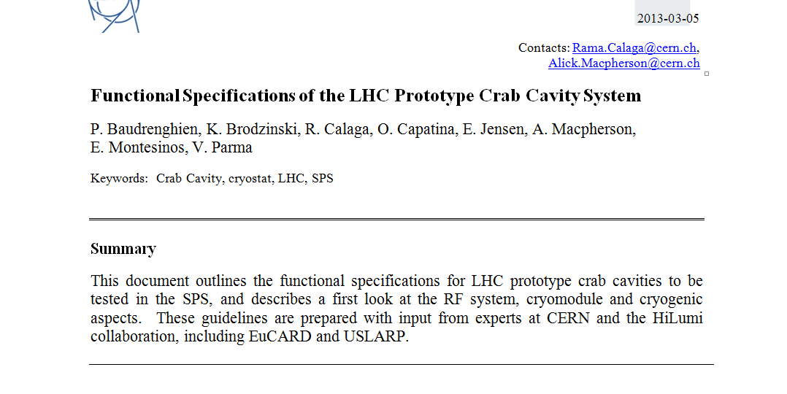
Functional specification
https://espace.cern.ch/HiLumi/WP4/Lists/Team%20Discussion/AllItems.aspx

Slide 3

General
SM18 area
Cold tests and clean room facilities – cold test of cryomodules prior tunnel installation
SPS BA4 (vertical or horizontal crabbing)
One or two cryomodules with 2 identical cavities to be tested before LS2
LHC Point 1 (vertical crabbing)
4 cavities / IP side/ beam
to be installed during LS3
LHC Point 5 (horizontal crabbing)
4 cavities / IP side/ beam
to be installed during LS3

Slide 4
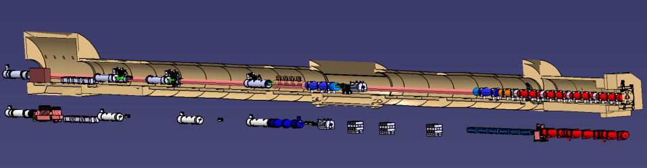
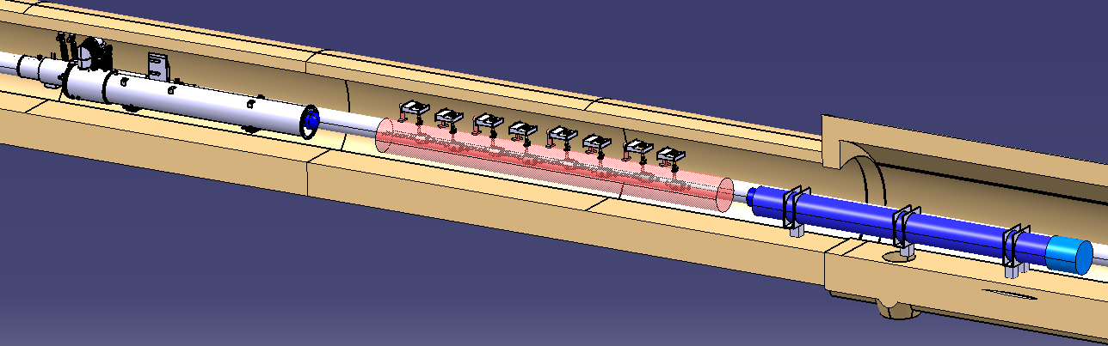
General
LHC environment
4 cavities / IP side / beam between D2 and Q4
=>
Total 32 cavities in LHC
Paolo Fessia

Slide 5
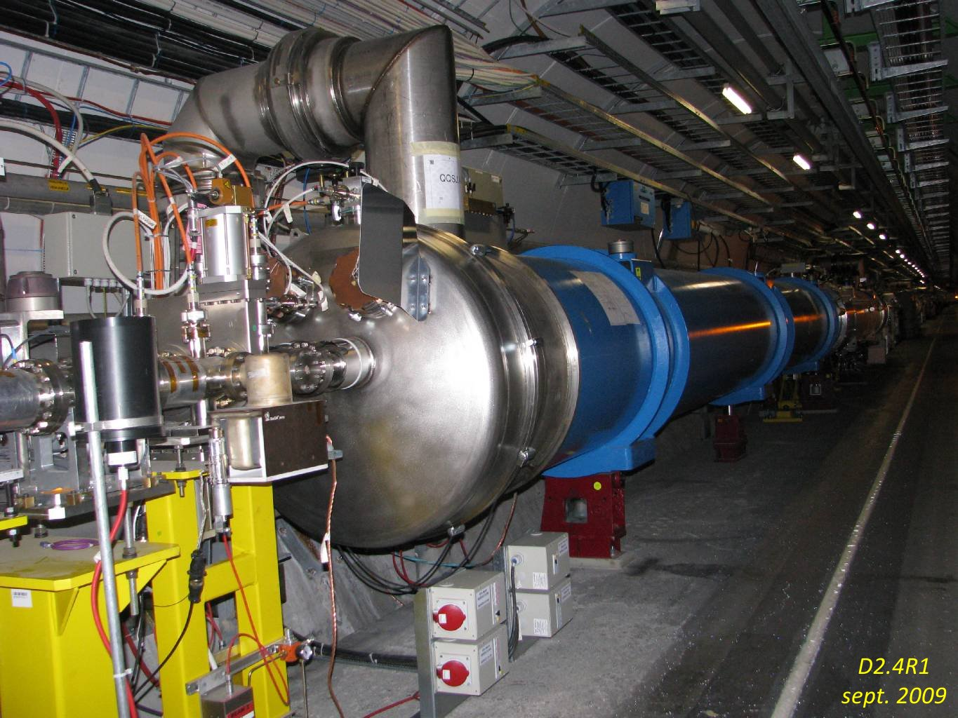
General
LHC environment

Slide 6
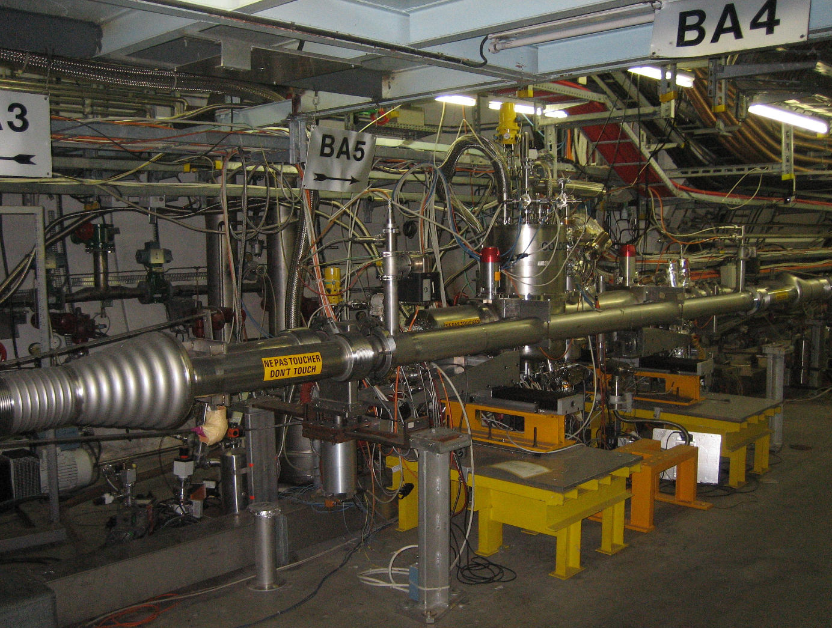
General
SPS environment
Alick Macpherson talk tomorrow

Slide 7
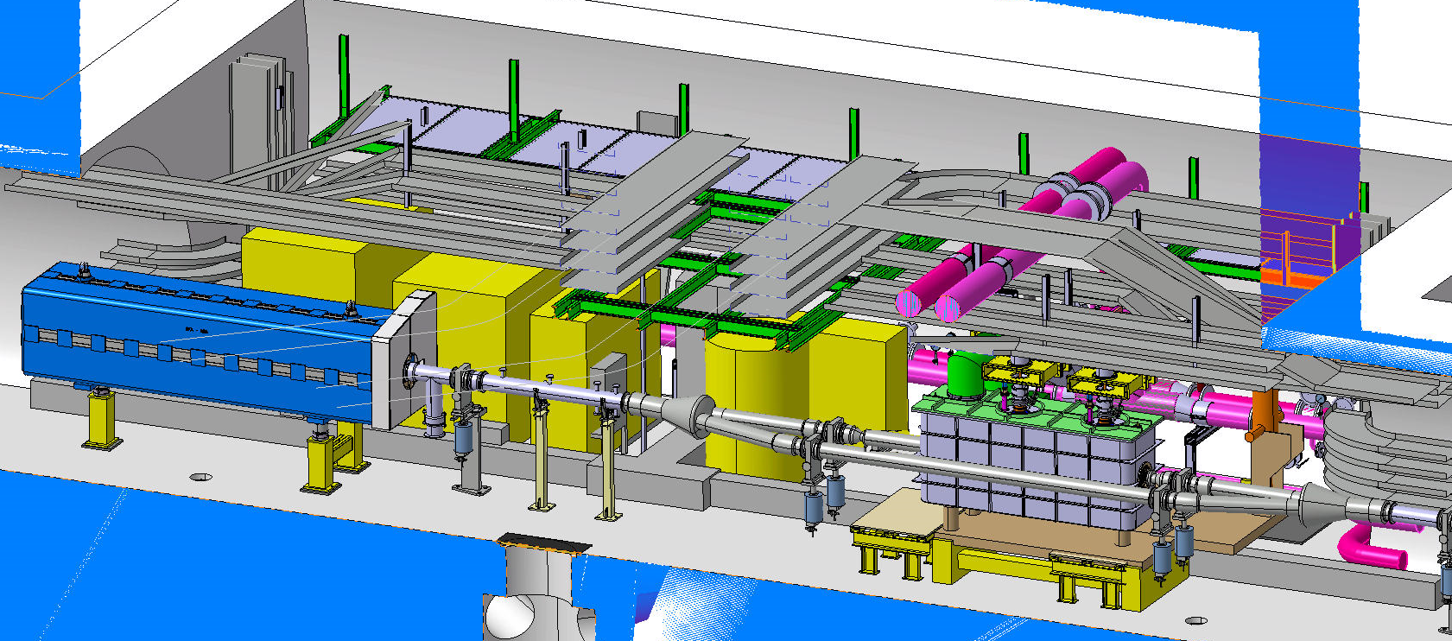
General
SPS environment

Slide 8
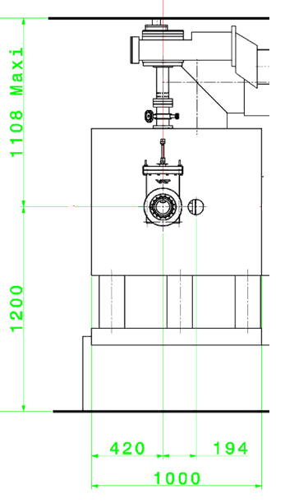
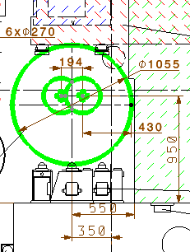
Cryomodule
LHC configuration
SPS configuration

Slide 9
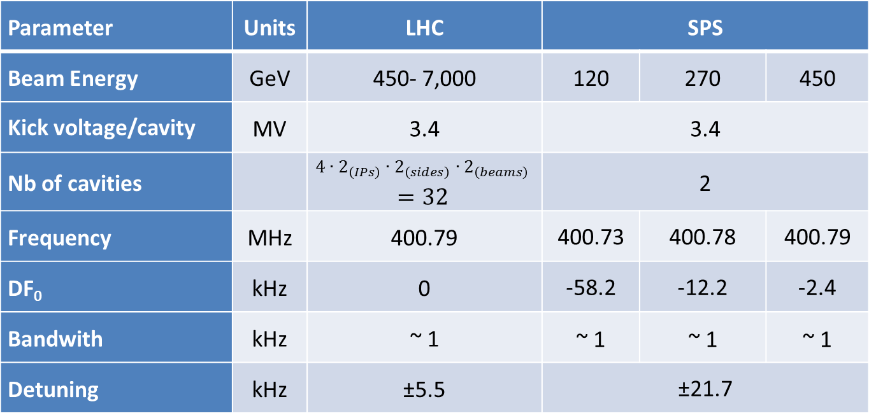
Cavity
Parameters
Parameter | Units | LHC | SPS
Beam Energy | GeV | 450- 7,000 | 120 | 270 | 450
Kick voltage/cavity | MV | 3.4 | 3.4
Nb of cavities |  | $$4∙2_{\left(IPs\right)}∙2_{\left(sides\right)}∙2_{\left(beams\right)}$$ $=32$ | 2
Frequency | MHz | 400.79 | 400.73 | 400.78 | 400.79
DF₀ | kHz | 0 | -58.2 | -12.2 | -2.4
Bandwith | kHz | ~ 1 | ~ 1 | ~ 1 | ~ 1
Detuning | kHz | ±5.5 | ±21.7

Slide 10
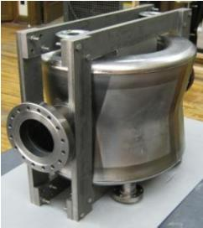
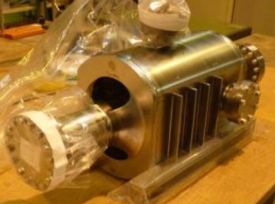
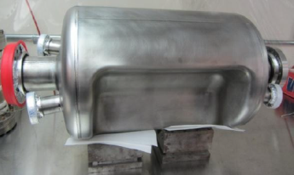
Bare cavities
Three valid Nb prototypes exist – very compact concepts to allow for their integration in LHC
4-rod (UK) | RF Dipole (ODU) | Double ¼-wave (BNL)
Covered by talks this morning

Slide 11
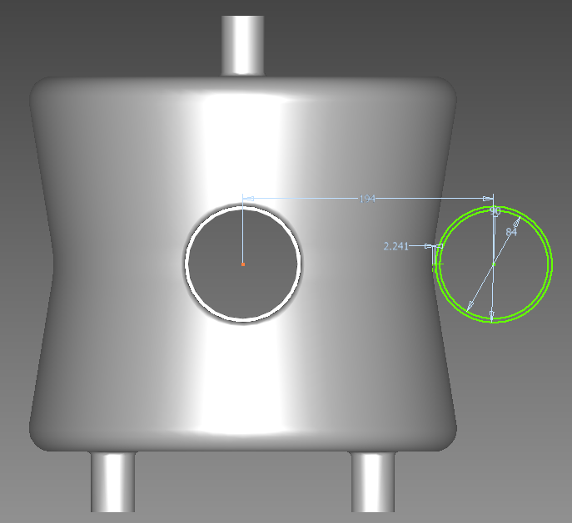
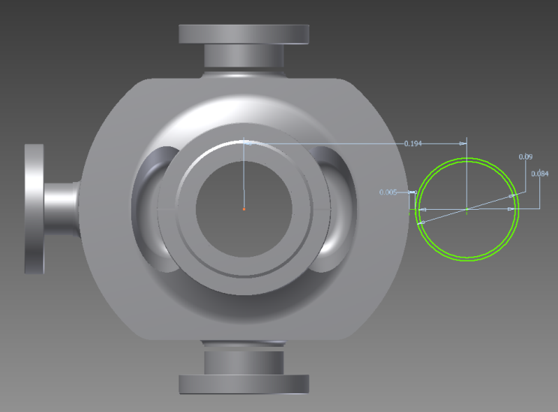
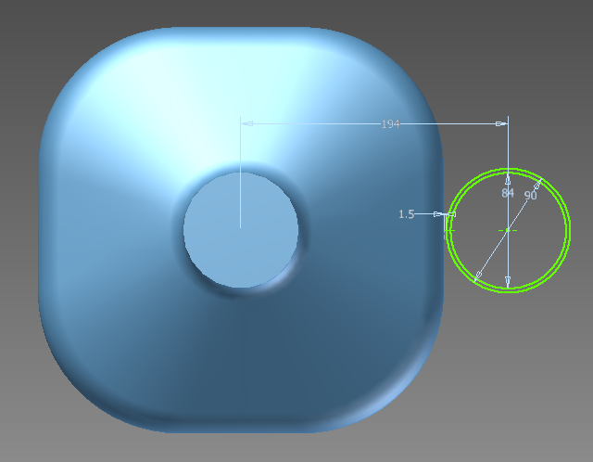
Bare cavities
Cavity maximum dimensions (SPS and LHC)
  Maximum radius external dimension (including wall thickness) at room temperature < 145 mm, both planes (vertical and horizontal)
  Adjacent beam pipe at 194mm horizontally from the cavity beam pipe

Slide 12
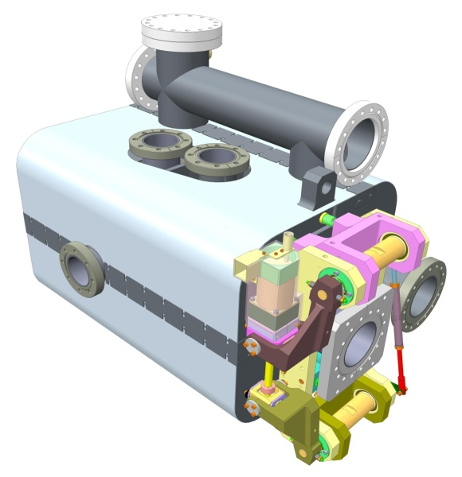
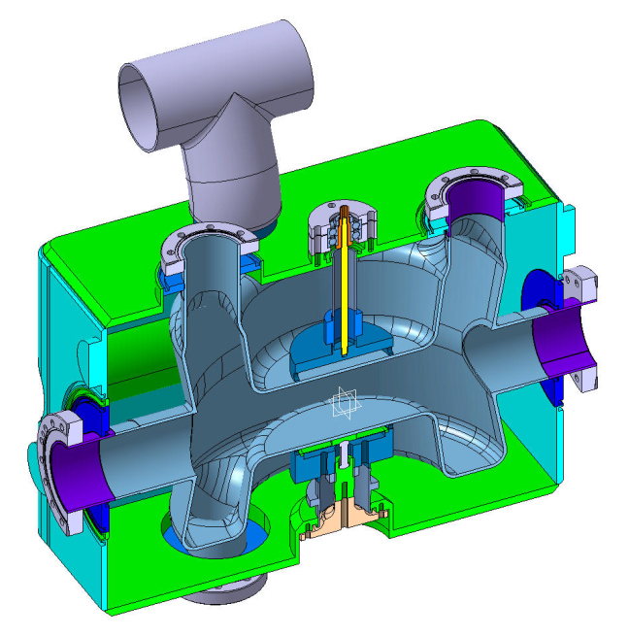
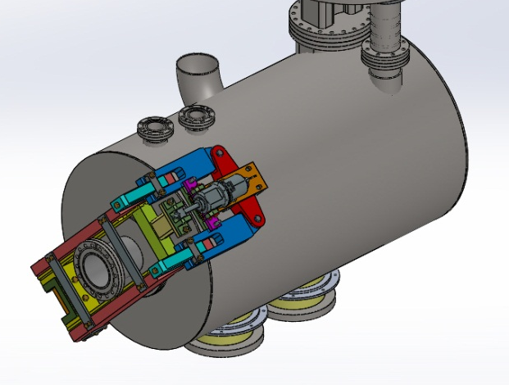
Dressed cavities
Helium tank and tuner designs are part of cavity design since their behaviour determine cavity operation behaviour
4-rod (UK) | RF Dipole (ODU) | Double ¼-wave (BNL)
Covered by next talks this after-noon

Slide 13
Dressed cavities
Tuning (SPS tests)
  Frequencies at SPS tests to be adjusted (“slow”) with tuner during operation:
    Required total range ~ 80 kHz
    Required resolution ~ 200 Hz (bandwidth ~ 1kHz)
Tuning (LHC operation)
    Required total range ~ 11 kHz
    Required resolution ~ 200 Hz

Slide 14
Dressed cavities
Stability / pressure fluctuation (SPS and LHC)
  Operating helium pressure ~ 20 mbar
  Pressure stability: 1 mbar
    Design cavities for sensitivity to pressure fluctuation accordingly
    Cavity bandwidth ~ 1kHz => sensitivity to pressure fluctuation should be significantly lower (cavity specific)

Slide 15
Dressed cavities
Remarks / tuning
  If ~ μm/kHz (cavity specific) => cavity stability and shape adjustment in the order of 100 nm !
  Tuning system has also to compensate for shift in frequency due to manufacturing, processing, cooldown etc… (cavity specific)
  Cavity mechanical design compromise between
    Rigidity to ensure stability (Lorentz detuning, pressure fluctuation, …)
    Flexibility to ensure tunability

Slide 16
Dressed cavities
Helium tank (SPS and LHC)
  Operating temperature 2 K (saturated superfluid helium)
  Maximum pressure
    Safety valve set pressure 1.8 bar
    Rupture disc 2.2 bar
  Helium tank to be dimensioned correctly to extract maximum heat load (static + dynamic)
  SPS only: Minimize reasonably the liquid helium volume (max. 40 L/cavity if possible)

Slide 17
Dressed cavities
Materials (SPS and LHC)
  Helium tank material not imposed; however titanium involves
      More complex interfaces
      Not covered by the Harmonised European Standards
  Stainless steel flanges (1.4429, AISI 316LN) for beam pipe interface
  Equivalent to EN conventional material grades are preferred

Slide 18
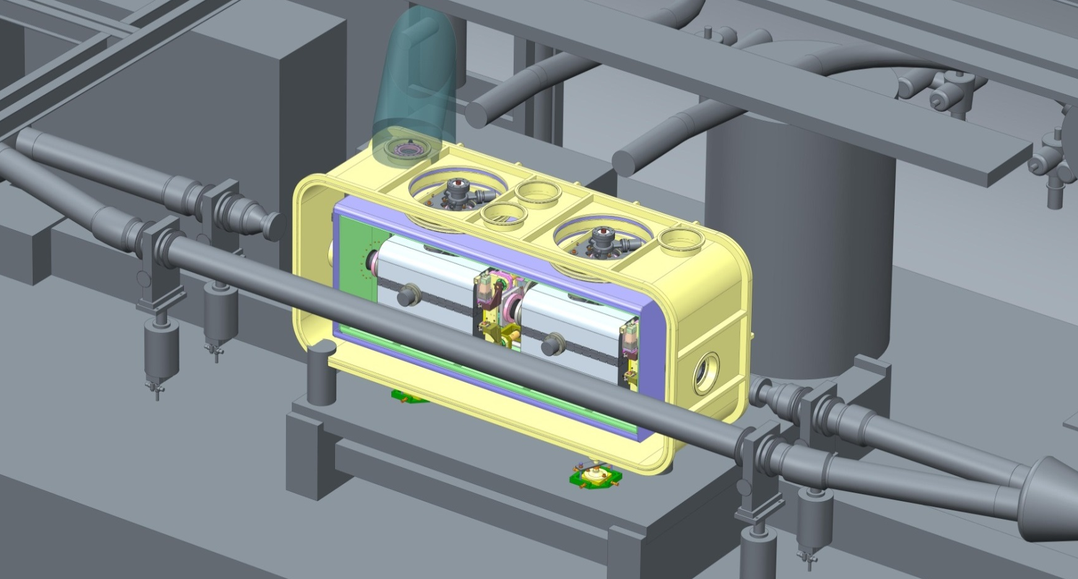
Cryomodule
SPS :
    2 (identical) cavities in a cryomodule
    3 different cryomodules
Shrikant Pattalwar talk tomorrow

Slide 19
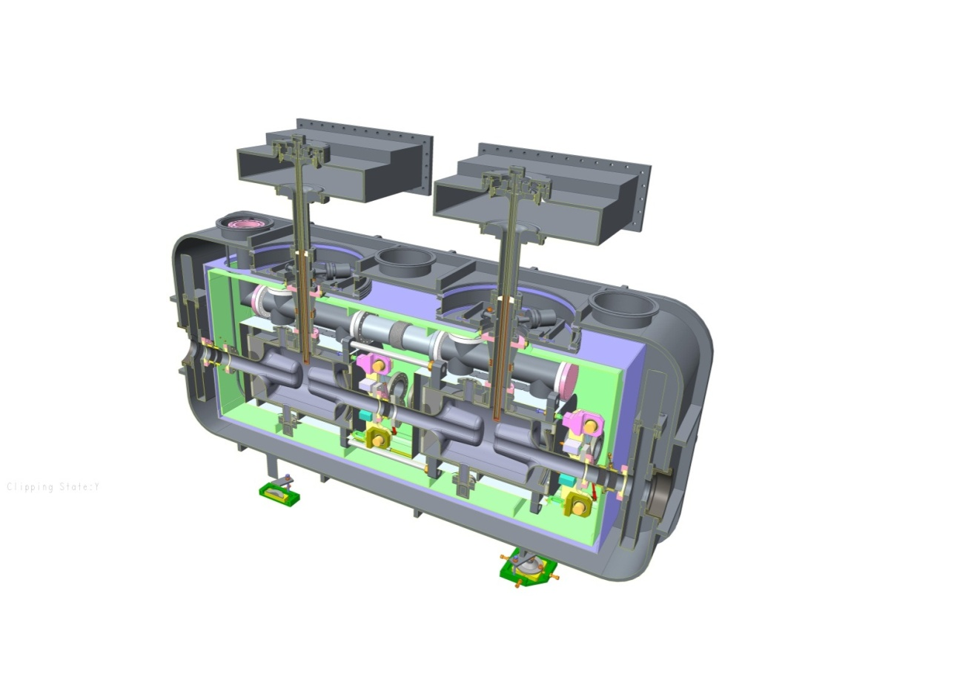
Cryomodule
SPS :
    2 (identical) cavities in a cryomodule
    3 different cryomodules
Shrikant Pattalwar talk tomorrow

Slide 20
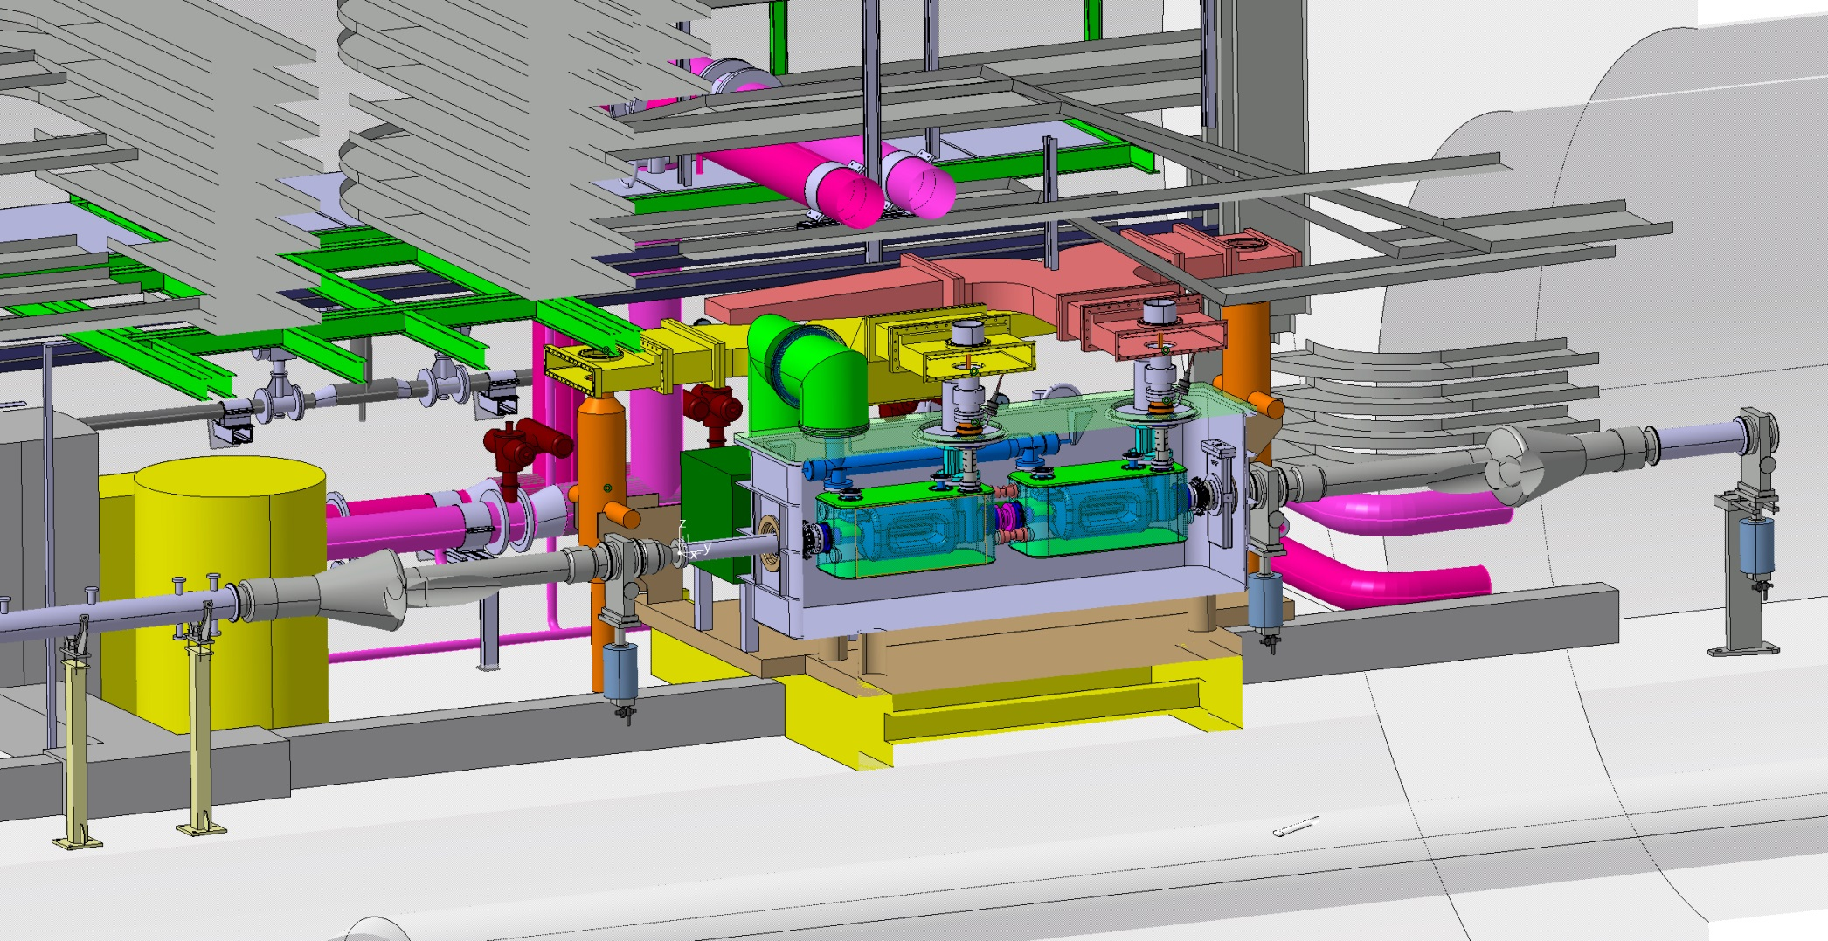
Cryomodule
SPS :
    2 (identical) cavities in a cryomodule
    3 different cryomodules
Thomas Nicol talk tomorrow

Slide 21
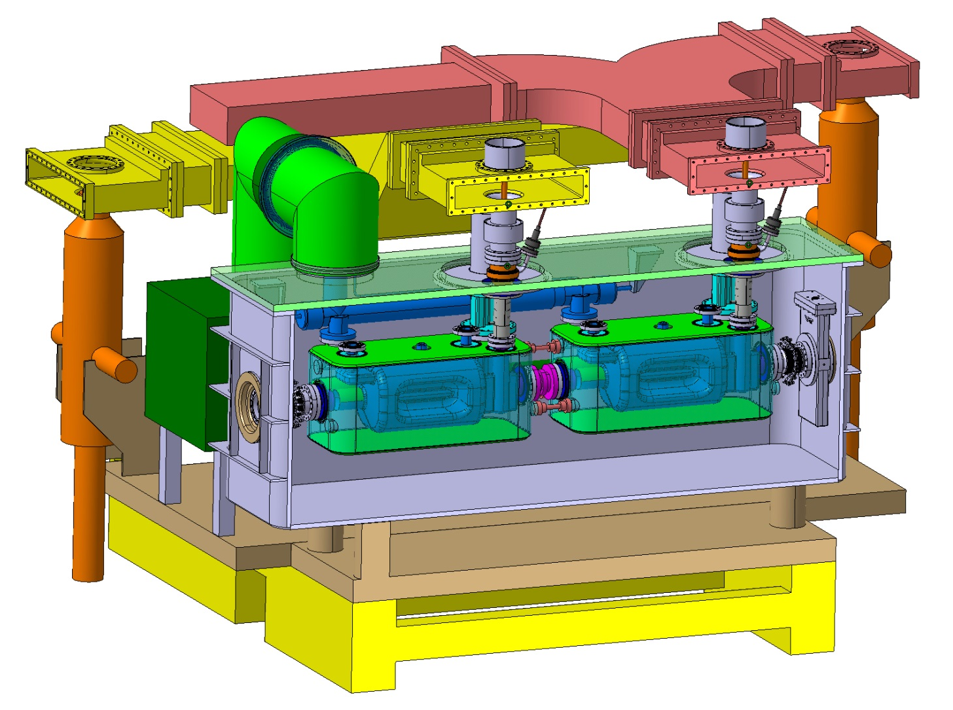
Cryomodule
SPS :
    2 (identical) cavities in a cryomodule
    3 different cryomodules
Thomas Nicol talk tomorrow

Slide 22
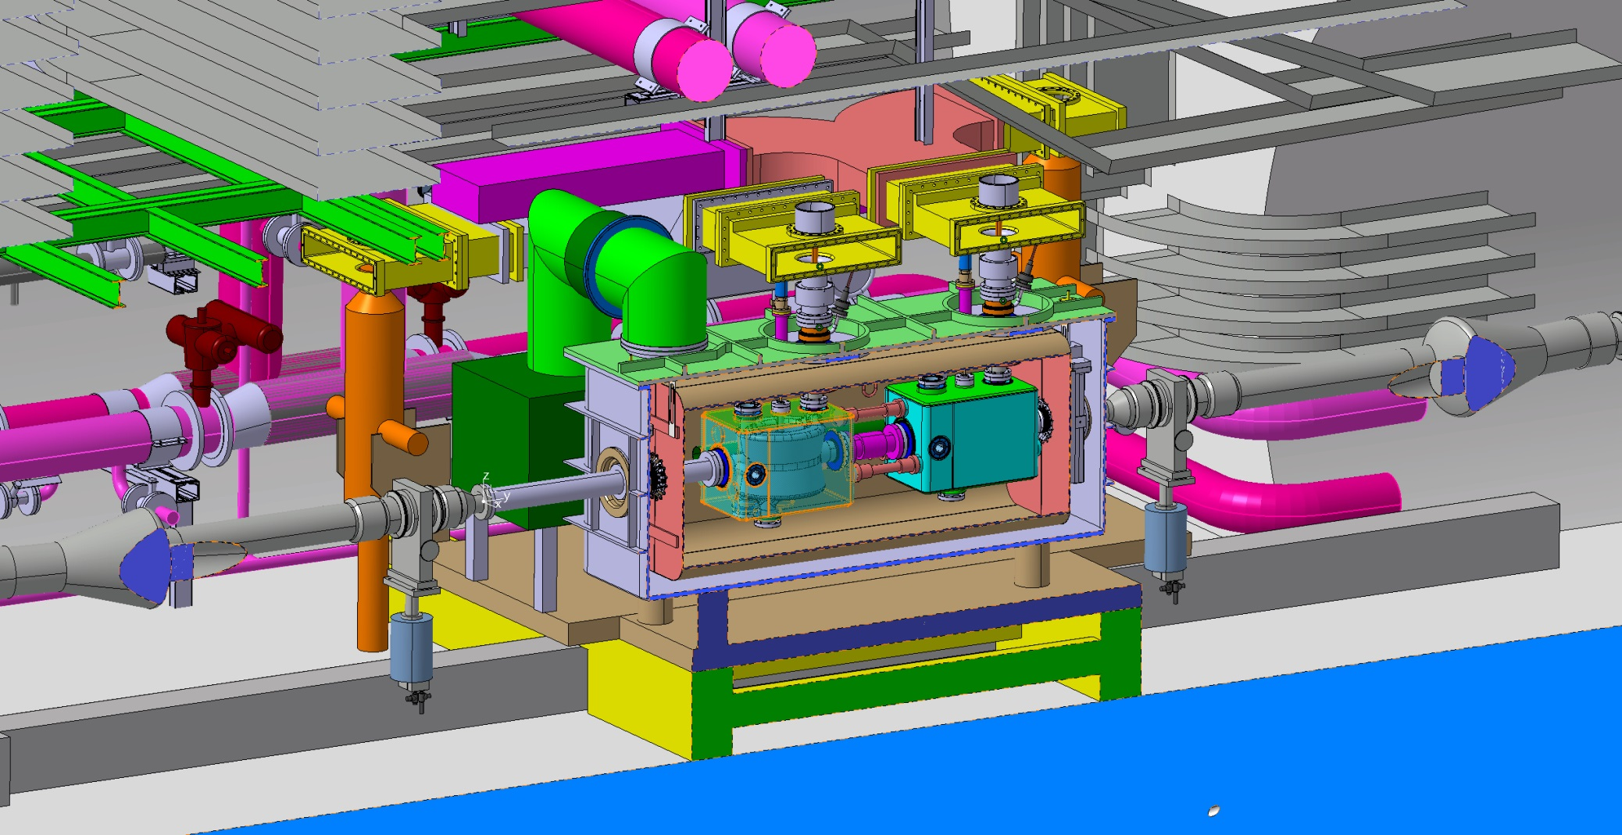
Cryomodule
SPS :
    2 (identical) cavities in a cryomodule
    3 different cryomodules
Luis Alberty talk tomorrow

Slide 23
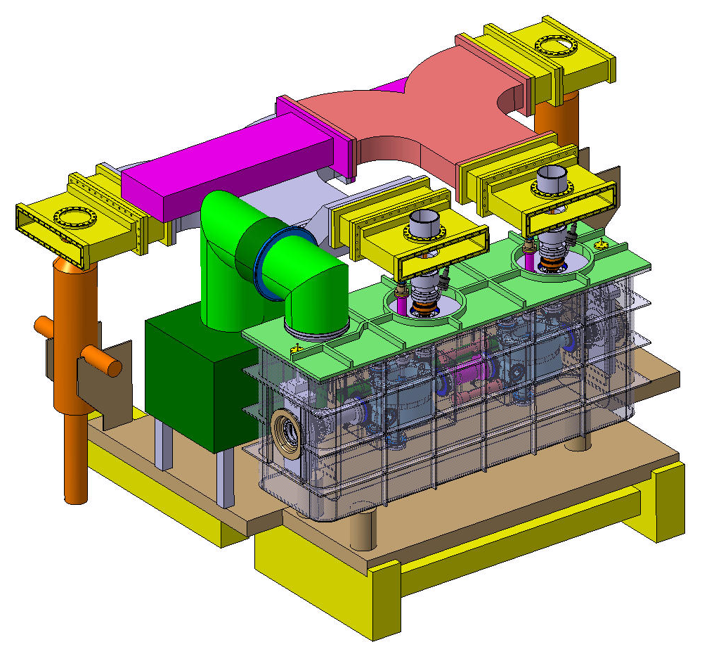
Cryomodule
SPS :
    2 (identical) cavities in a cryomodule
    3 different cryomodules
Luis Alberty talk tomorrow

Slide 24
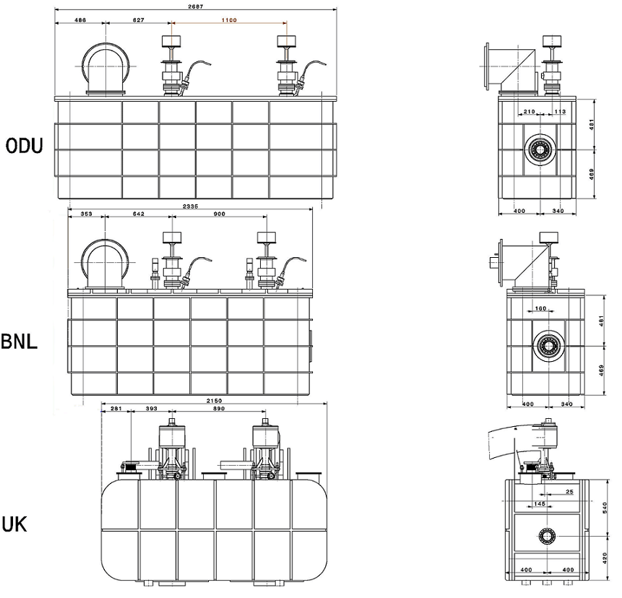
Cryomodule
Design principle, dimensions and interfaces (RF, cryo) to be standardized as much as possible
Metric system !

Slide 25
Cryogenics
SPS:
  Two circuits: 2 K and 80 K
  Operated at 2 K saturated helium bath -> ~20 mbar
  Screening at 80 K provided with LN2
  Main interface from the top
cryostat interface
thermal screen at ~80 K
common pumping collector
helium tank
CWT
crab cavity
CWT
Power coupler intercept
Krzysztof Brodzinski talk tomorrow

Slide 26
Alignment
LHC - Alignment requirements (position accuracy and position stability) – based on general beam dynamics considerations:
  Transverse rotation per cavity should be less than 5 mrad
  Transverse misalignment per cavity (in both planes) should be less than 0.7 mm
  Cavity tilt with respect to the longitudinal axis should be less than 1 mrad
  Cavity longitudinal misalignment should be less than 10 mm

Slide 27
Alignment
SPS
  Alignment required for operation less than LHC
  To limit SPS crymodule complexity (win time and limit risk)
    No active alignment needed for SPS tests
    Foresee a system for monitoring the cavity positions instead

Slide 28
Magnetic shielding
Static magnetic field shielding required
  The field to be below 1 µT at the outer surface of the cavity
  Numerical simulations to determine the material thickness and specification, as well as geometry

Slide 29
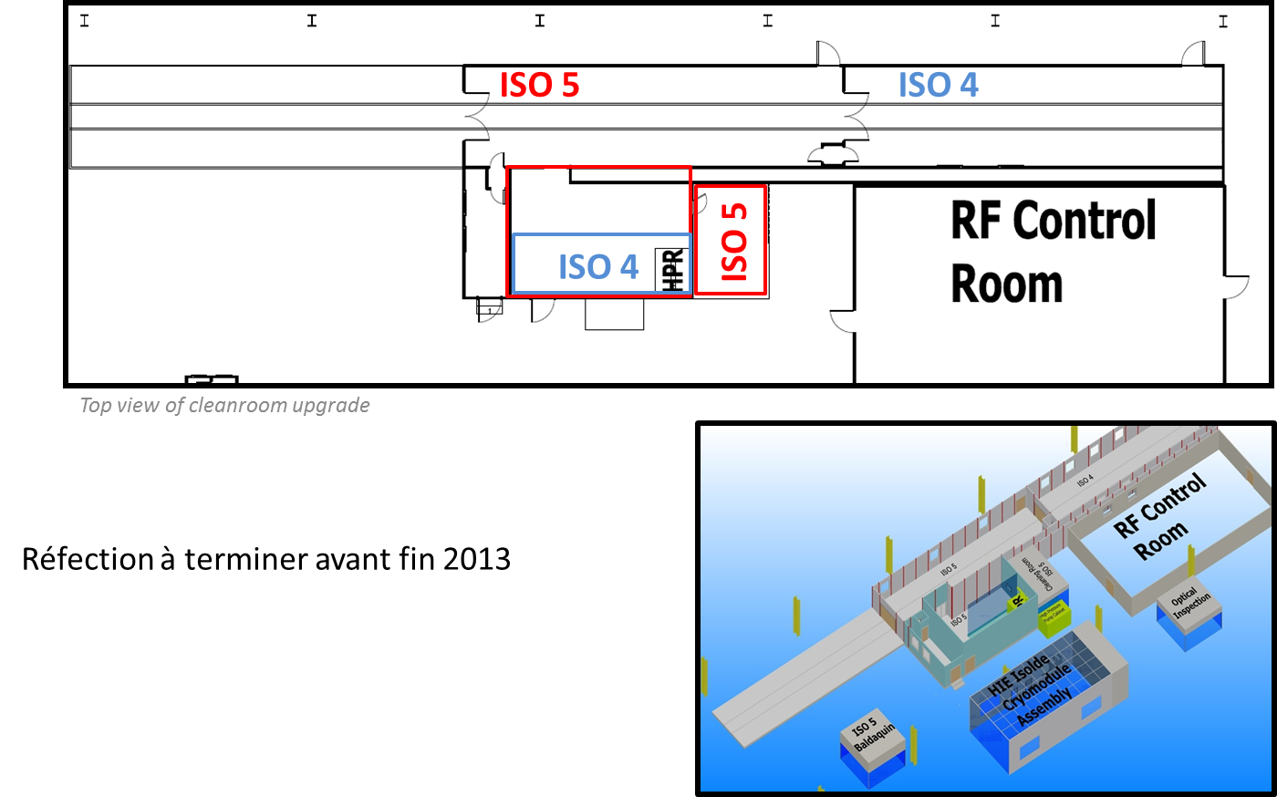
Cryostating
Integration into cryostat at CERN - most likely location SM18
Cold tests of full cryomodules in SM18 prior tunnel installation
Vittorio Parma talk tomorrow
Mathieu Therasse talk tomorrow

Slide 30
Couplers
Fundamental Power Couplers
  Talk by Eric Montesinos tomorrow
Impedance budget and HOM power & couplers
  Talk by Benoit Salvant tomorrow

Slide 31
Summary
Bare cavities for SPS designed to be the same as for the LHC
Dressed cavity for SPS tests design as much as possible compatible with LHC
Conceptual design of SPS cryomodule for the 3 cavities
  2 identical cavities in 3 different cryomodule
  Effort to standardize interfaces, basic choices in-between the 3 cryomodules
The 3 SPS cryomodules could be tested in SM18 (if no down-selection since then)
1 or 2 cryomodules to be tested in SPS, after test in SM18
SPS cryomodule design as much as possible compatible with the LHC

