Slide 1



CRISP & SKA
WP19 Status

Slide 2
Overview
Staffing
SKA Preconstruction phase
Tiered Data Delivery Infrastructure
Prototype deployment

Slide 3
Staffing
Rahim (Raz) Lakhoo
Iain Emsley

Slide 4
SKA Preconstruction
Baseline design published
Consortia being appointed for major components preconstruction phase
  Dish
  Low Frequency Aperture Arrays
  Signal and Data Transport
  Central Signal Processing
  Science Data Processor
  Telescope Management
  …
Full Concept of Operations still to be released
Preconstruction in 2 phases
  74 weeks – Element PDR
  82 weeks – Element CDR
CRISP participants part of SKA Science Data Processor Consortia
Phase starting 1st Nov 2014...

Slide 5
Preconstruction
Generation of documentation and input materials to support future Construction Phase
Some prototyping but majority of effort towards inputs to reviews before start of Construction Phase
No guarantee that ‘Preconstruction’ members will be in ‘Construction’

Slide 6
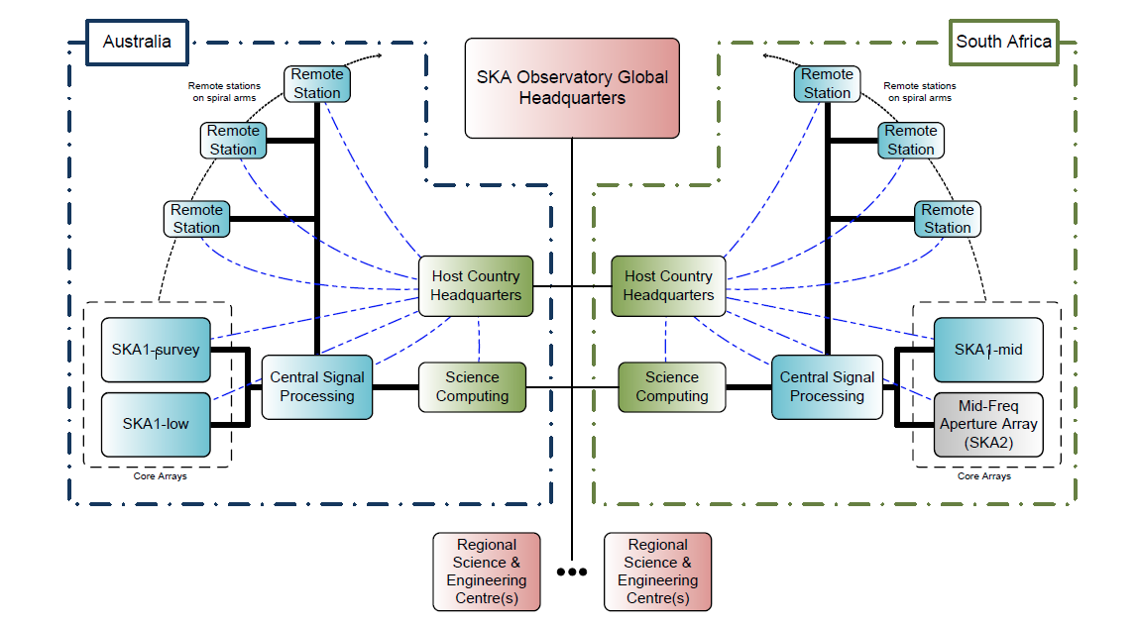

Slide 7
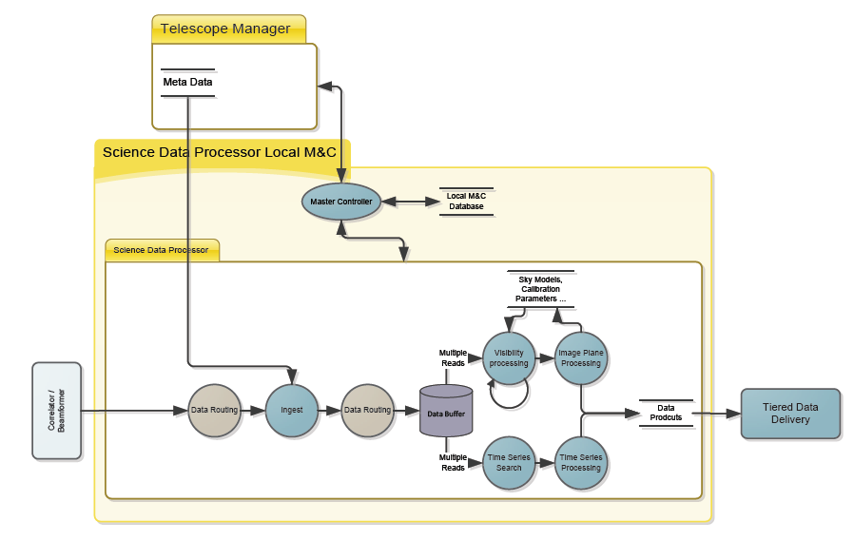

Slide 8
Science Data Processor
4. SKA.TEL.SDP.COMP science and data processor computing platform
  The SDP computing platform hosts the processing pipelines and data layer. The platform includes hardware, operating system, SKA-originated software, and third party software. There may be multiple configurations tuned to the different telescopes.
4. SKA.TEL.SDP.DATA science and data processor data layer
  The SDP data layer includes all access to data within the SDP Element, responsibility for persistence of data objects.
4. SKA.TEL.SDP.PIP science and data processor pipelines
  The processing pipelines include all software for ingesting, calibrating, editing, imaging, cataloguing, and searching to produce science data products. The processing pipelines execute on the SDP computing platform or platforms.
4. SKA.TEL.SDP.DELIV Data delivery and tiered data model
  Covers the delivery of data to the end users. It includes items associated with users gaining access to data and processing resources from locations away from the two observatory sites and their associated data centres.
4. SKA.TEL.SDP.PROT science and data processor prototypes
  Prototypes include all activities necessary to design, procure, assemble, integrate prototype systems for the purpose of verification of particular design solutions. Prototypes includes the verification and testing of prototypes. Prototyping is supported in the field by SKA.OPS.PROT if it is required.

Slide 9
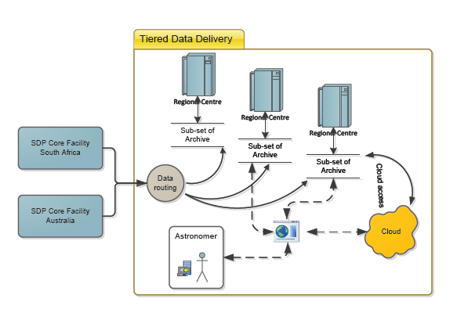

Slide 10
SKA.TEL.SDP.DELIV Data delivery and tiered data model - Activities
Led by Canadian SKA
Stage 1
  Level 4 contribution to the Science Data Processor SRR
  Data delivery chapter to SDP element PDR documentation
  Initial recommendation on common middleware stack
  Report on status of and estimated requirement in R&D, evaluate risks and mitigation strategies
Stage 2
  Data Delivery component of element system design
  Interfacing with SADT
  Fully costed SKA1 middleware design
  Full common middleware stack, including maintenance plan

Slide 11
SKA.TEL.SDP.DELIV Data delivery and tiered data model
SKA.TEL.SDP.DELIV.PI
  This element considers the public interface to SKA data. It includes the provision of web portals / scientific gateways and common software/middleware tools for enabling access to data and processing by users that are not at the data centres associated with the two observatory sites.
  Stage 1
    Document use cases for public interfaces
    Catalogue existing portal solutions
    Select solutions to be explored by prototyping group.
    Create initial PI architecture document
  Stage 2
    Explore options for federating portals.
    Finalize requirements for testbed deployment
    Create final PI architecture document.

Slide 12
SKA.TEL.SDP.DELIV Data delivery and tiered data model
SKA.TEL.SDP.DELIV.TDDM
  This element considers tools that enable access to data at and the movement of data between regional HPC centres. This includes considering the tools for searching for existing data products and for the resources needed to create new products
  Stage 1
    Start to document use cases for data distribution.
    Catalogue existing data management tools.
    Select tools that should be explored by prototyping group.
    Create initial data distribution architecture document
  Stage 2
    Work with scientists using existing radio telescopes to refine use cases.
    Create final data distribution architecture document.

Slide 13
SKA.TEL.SDP.PROT.TDDL
This WBS element will create a distributed test environment that will explore technologies that will be recommended as part of the SKA.TEL.SDP.DELIV WBS element.
Stage 1
  Identify computing resources at site in Canada and the UK.
  Setup data distribution environments based on recommendations from DELIV.
  UK site will configure network emulation tools for testing wide area data distribution in controlled environment.
  Federate sites in Canada and UK.
  Report progress to DELIV.
Stage 2
  Identify additional sites in additional geographic region.
  Deploy software at new sites
  Federate all sites
  Create final reports for DELIV

Slide 14
Prototype
5 node system
  attached to existing 6 node GPU enabled development HPC cluster
  Shared FDR Infiniband high perf network
  Node spec
    Dual 8-core Intel Xeon Processor
    64GB RAM
    2TB SSD
    Mellanox MCB194A-FCAT Connect-IB Dual Port FDR
  Reconfigurable at the node level to create system as required for each test/experiment
Delivered last week!

Slide 15
Prototype
Jade Head Node
FDR Infiniband switch
Jade Node
SKA Test Node
Jade Node
SKA Test Node
Jade Node
SKA Test Node
Jade Node
SKA Test Node
Jade Node
SKA Test Node
Jade Node
Standalone Data testing
ARC GPU Development (K20)

Slide 16
Prototype
SKA SDP - Tiered Data Delivery Laboratory
  “Infrastructure aims to emulate a network, its end points and resources
  Provides a controllable and configurable environment for testing:
    Different types of data
    Resilience
    Reliability
    Performance”
Whole ‘SKA’ analysis chain simulation

