Slide 1
Analysis and evaluation of distributed data infrastructures
Valentina Mancinelli
IT/SDC
23/09/2013

Slide 2
Analysis and evaluation of distributed data infrastructures
Extend a number of existing testing and monitoring tools to produce a coherent suite for quantitative performance evaluation of data access interfaces

Slide 3
Analysis and evaluation of distributed data infrastructures
Evaluate how best to characterise access patterns
Create a test suite to reproduce arbitrary access patterns through parametrisation
Extend the existing HammerCloud system
  used by several of the LHC experiments
  run test suites with HammerCloud for comparative benchmarking of storage installations and protocols.
Notes:
Already been done in some extent for protocol comparison in DPM
a file of 2GB was read over the lan in randomly distributed chunks of 10kB-20kB. The time taken is recorded.

Slide 4
Synergies
The CRISP project would benefit from a quantitative evaluation tool
  Optimize storage software, storage systems and applications
  More efficient use of resources
WLCG would gain valuable insights into how to optimise both applications and storage systems for greater efficiency
Notes:
more physics per dollar!

Slide 5
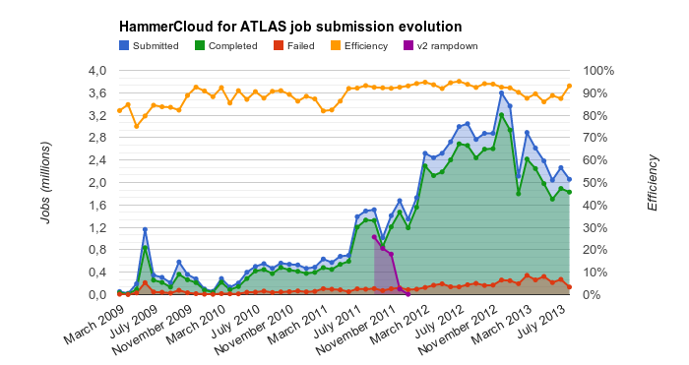
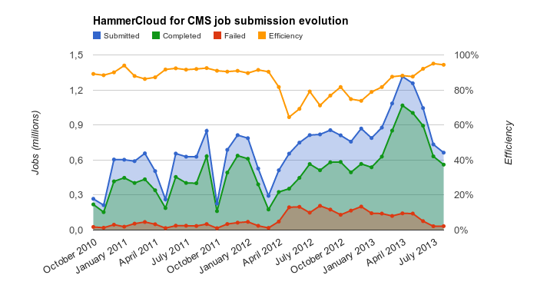
What is HammerCloud
Framework for testing distributed systems
Used by different LHC experiments for:
  Functional testing
  Stress testing and fine tuning
  Testing packages releases
Runs tests in an automated or on-demand manner
Can test anything matching a submit() and get_results() paradigm
23 September 2013
Notes:
we can plug in these 'synthetic tests'

Slide 6
HammerCloud entities
HammerCloud
↘ App
↘↘ Template
↘↘↘ Test
↘↘↘↘ Job
↘↘↘↘↘ Metric
Analysis and evaluation of distributed data infrastructures– V. Mancinelli
23 September 2013
Notes:
Different kind of tests: AFT/PFT, functional, stress

Slide 7




Web Interface
Testing Infrastructure
PanDA
The Grid
DB

