Slide 1
CRYOGENICS OPERATIONS 2008
CERN, Geneva, Switzerland
The world of cryogenics at CERN
L. Tavian, D. Delikaris
1

Slide 2
Content
History & present inventory
Cryogenics at CERN
  LHC and its detectors
  Other detectors
  Test facilities and general services
  Cryogen storage and distribution
Cryogenics operation methodology
Conclusions
2

Slide 3
Cryogenic history
3

Slide 4
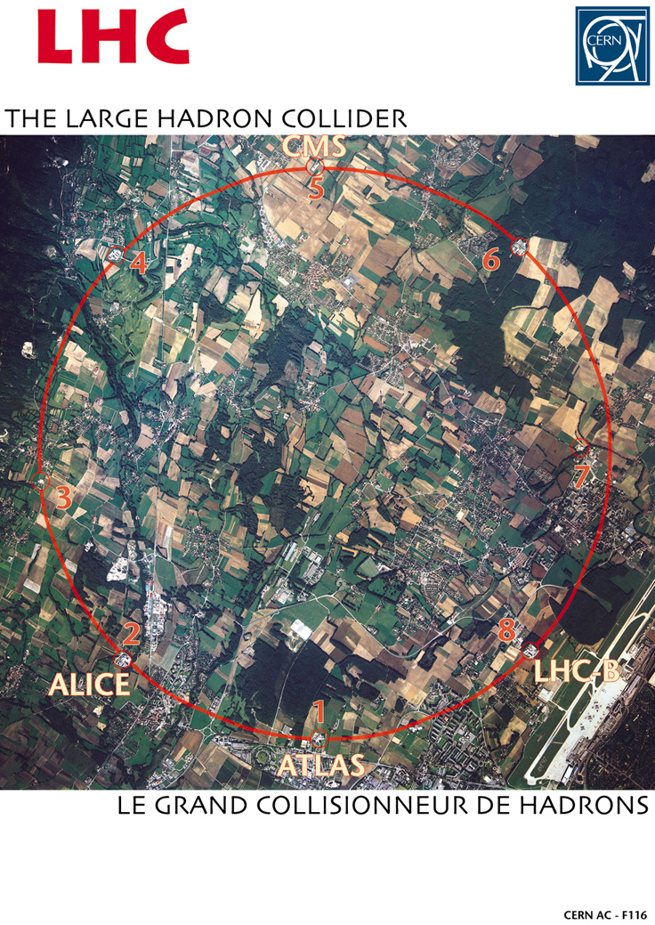
CERN accelerator complex
Cryogenics Operations 2008, CERN, Geneva, Switzerland
L. Tavian, D. Delikaris, 22th-26th September 2008

Slide 5
Footprint of cryogenic plant
LHC accelerator
LHC detectors
Other detectors
Test areas
Central services
Standby
5

Slide 6
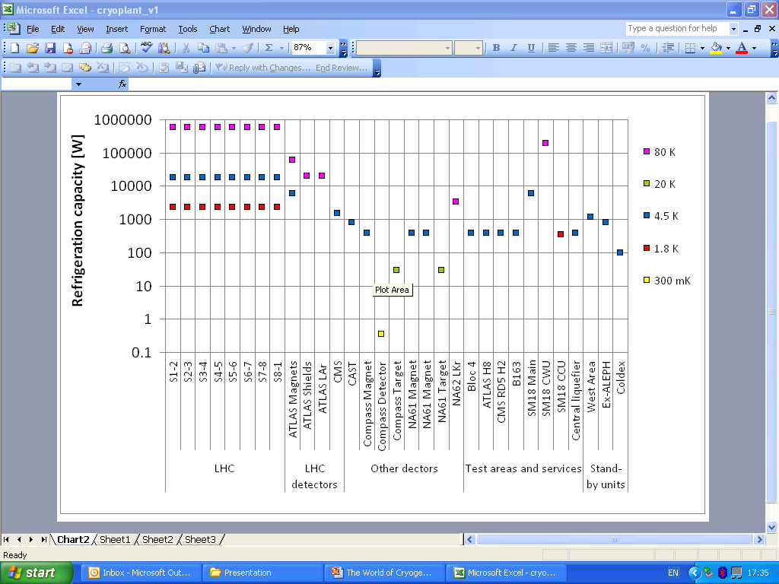
Refrigeration capacity @ CERN
6

Slide 7
Overall refrigeration capacity
T level | Overall installed capacity | # of plants
80 K | 5 MW | 9
4.5 K | 164 kW | 23
20 K | 60 W | 2
1.8 K | 19.6 kW | 9
300 mK | 350 mW | 1
Plants & ancillary equipment to be operated continuously with respect to CERN’s scientific program
7

Slide 8
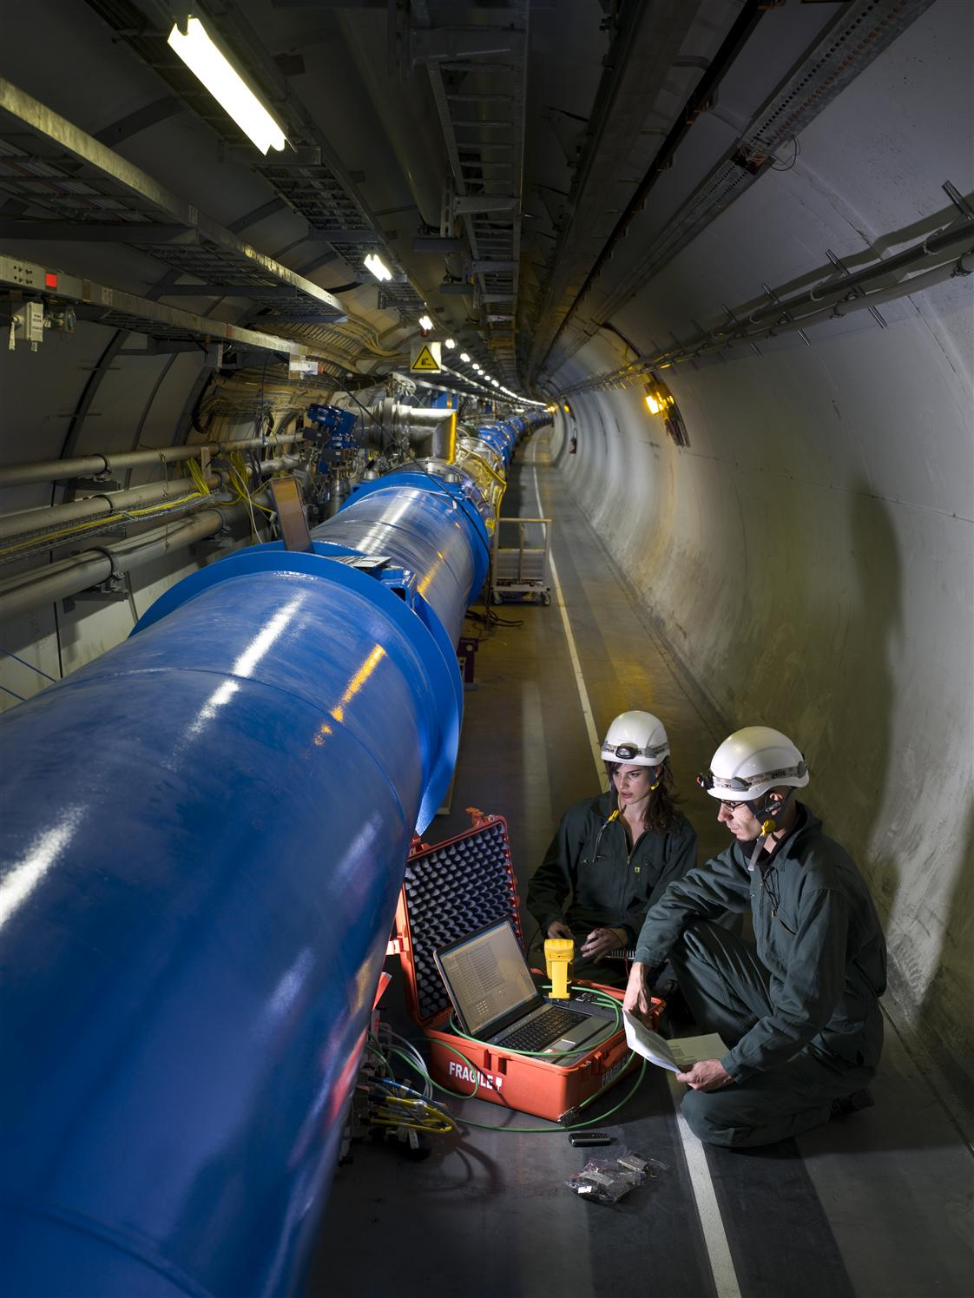
LHC accelerator in the tunnel
36’000 ton of cold mass
(superconducting magnets) distributed
over 26.7 km of the underground
accelerator to be cooled at 1.9 K
8

Slide 9
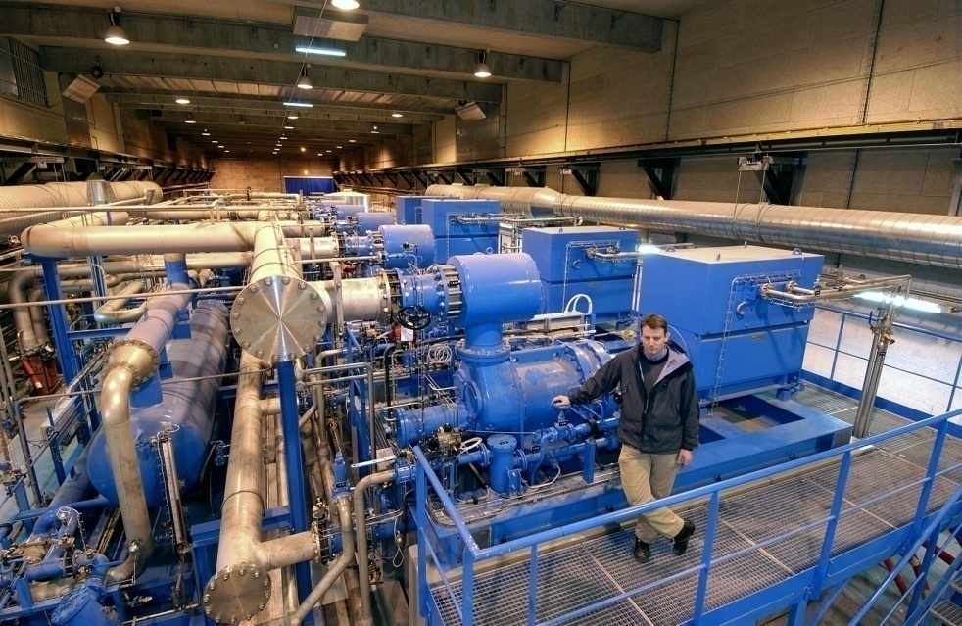
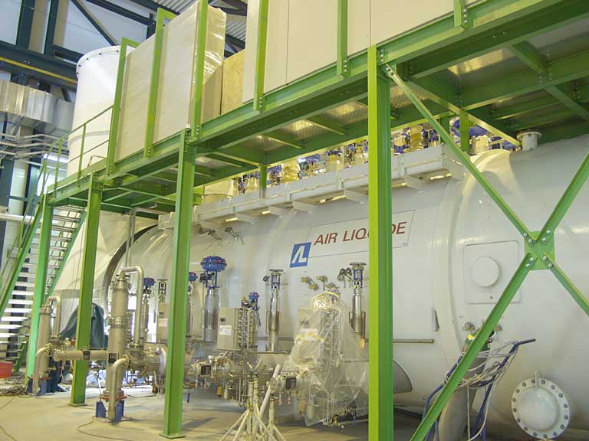
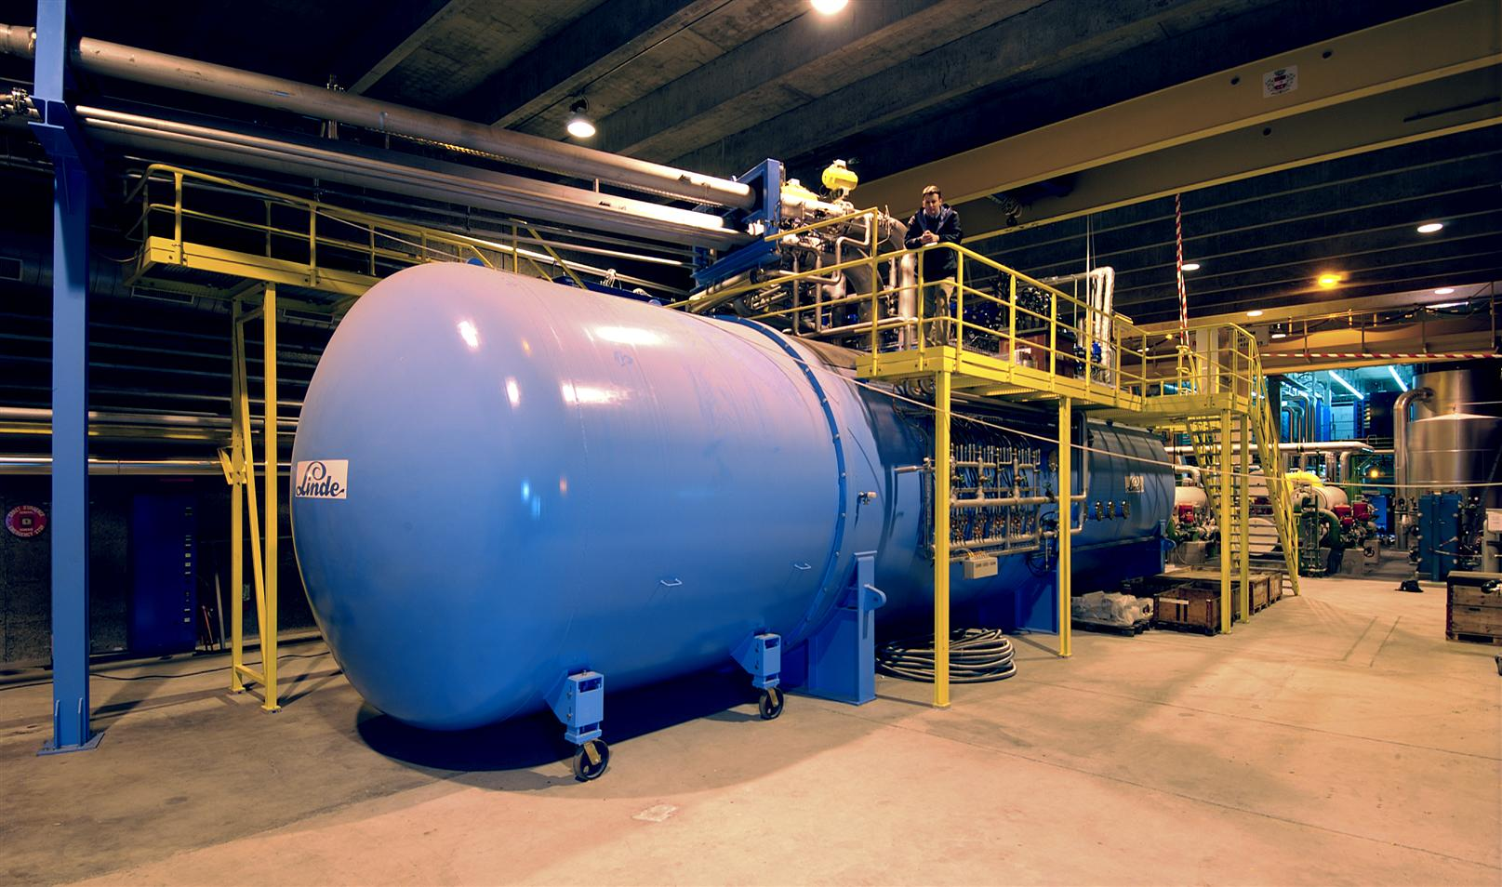
LHC Accelerator Cryogenics
18 kW @ 4.5 K units
Typical
Helium Compressors station
&
Cold Boxes
9

Slide 10
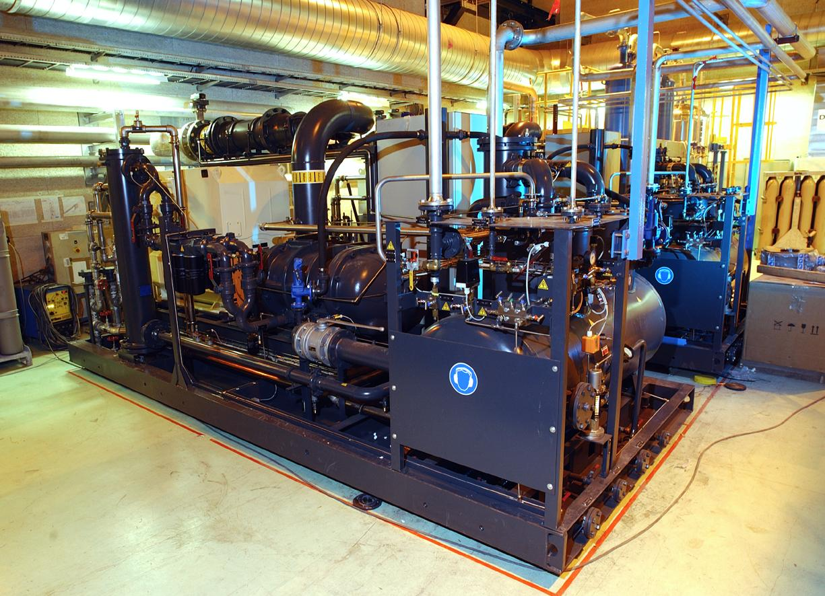
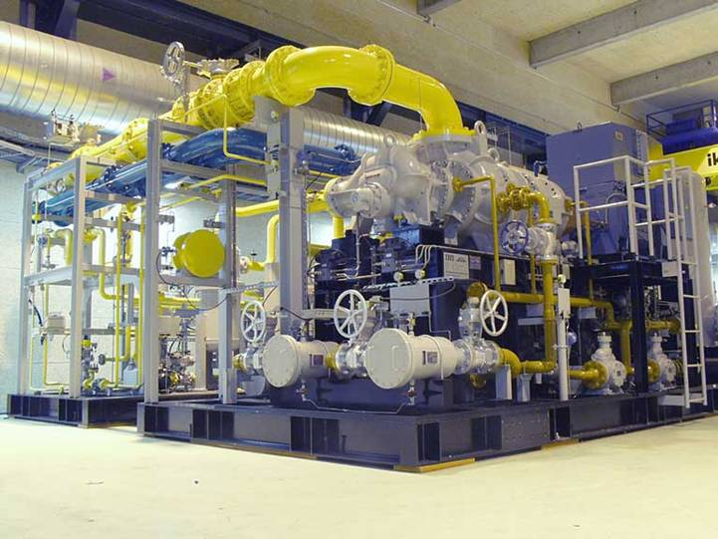
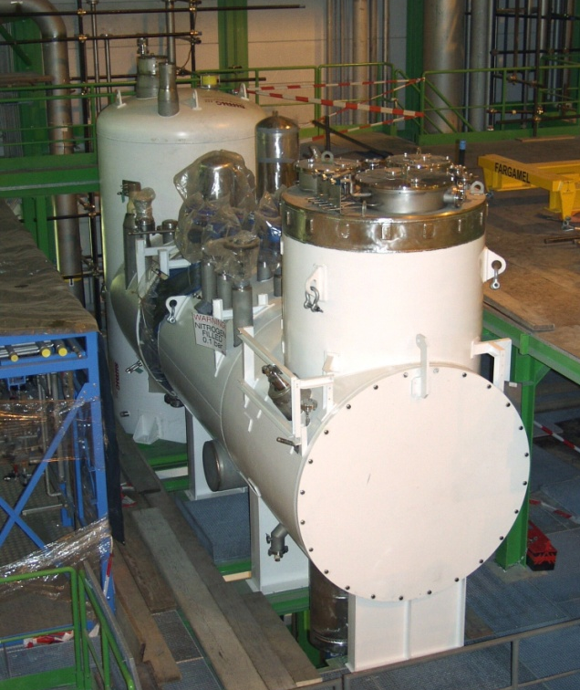
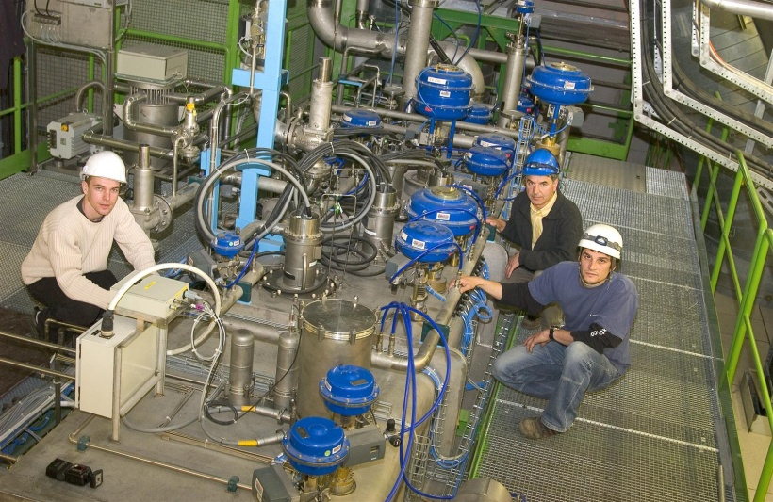
LHC Accelerator Cryogenics
2.4 kW @ 1.9 K units
Air Liquide
IHI- Linde
Warm Compressors &
Cold Boxes
10

Slide 11
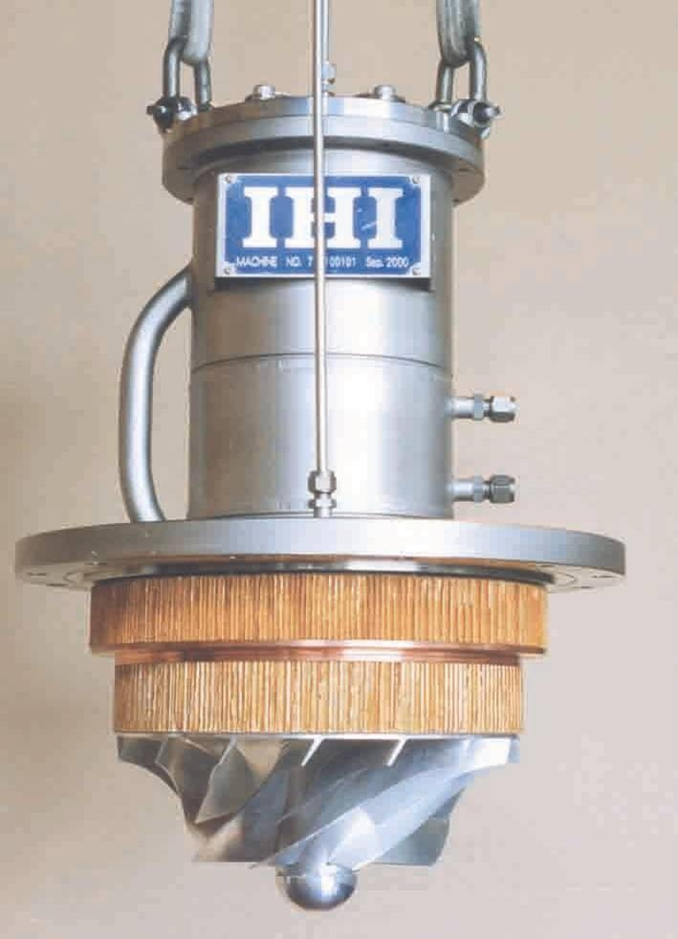
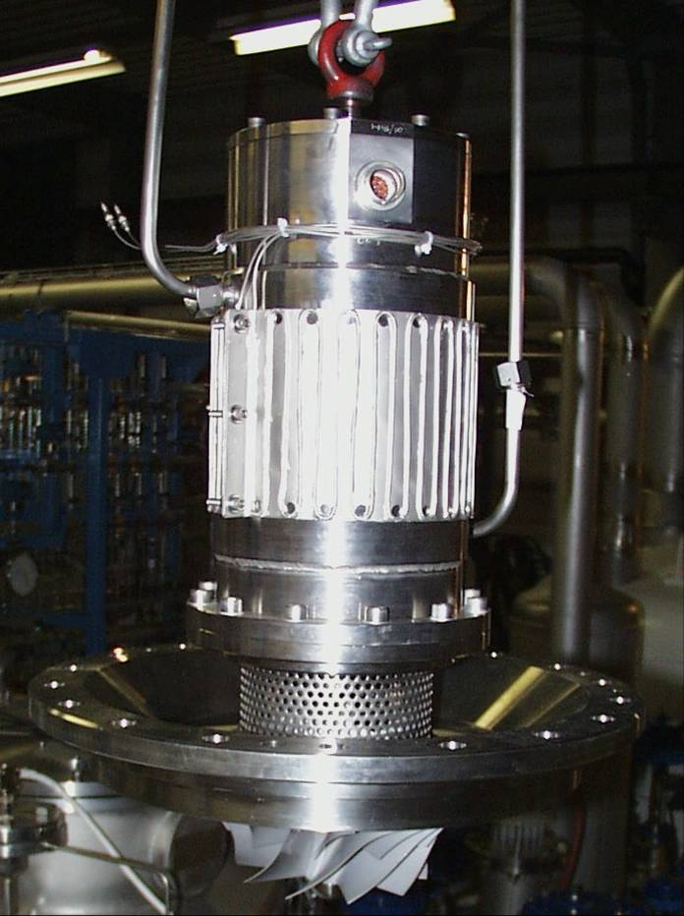
LHC Accelerator Cryogenics
IHI-Linde
Air Liquide
LHC Cold Compressors (speed range 100 – 800 Hz)
11

Slide 12
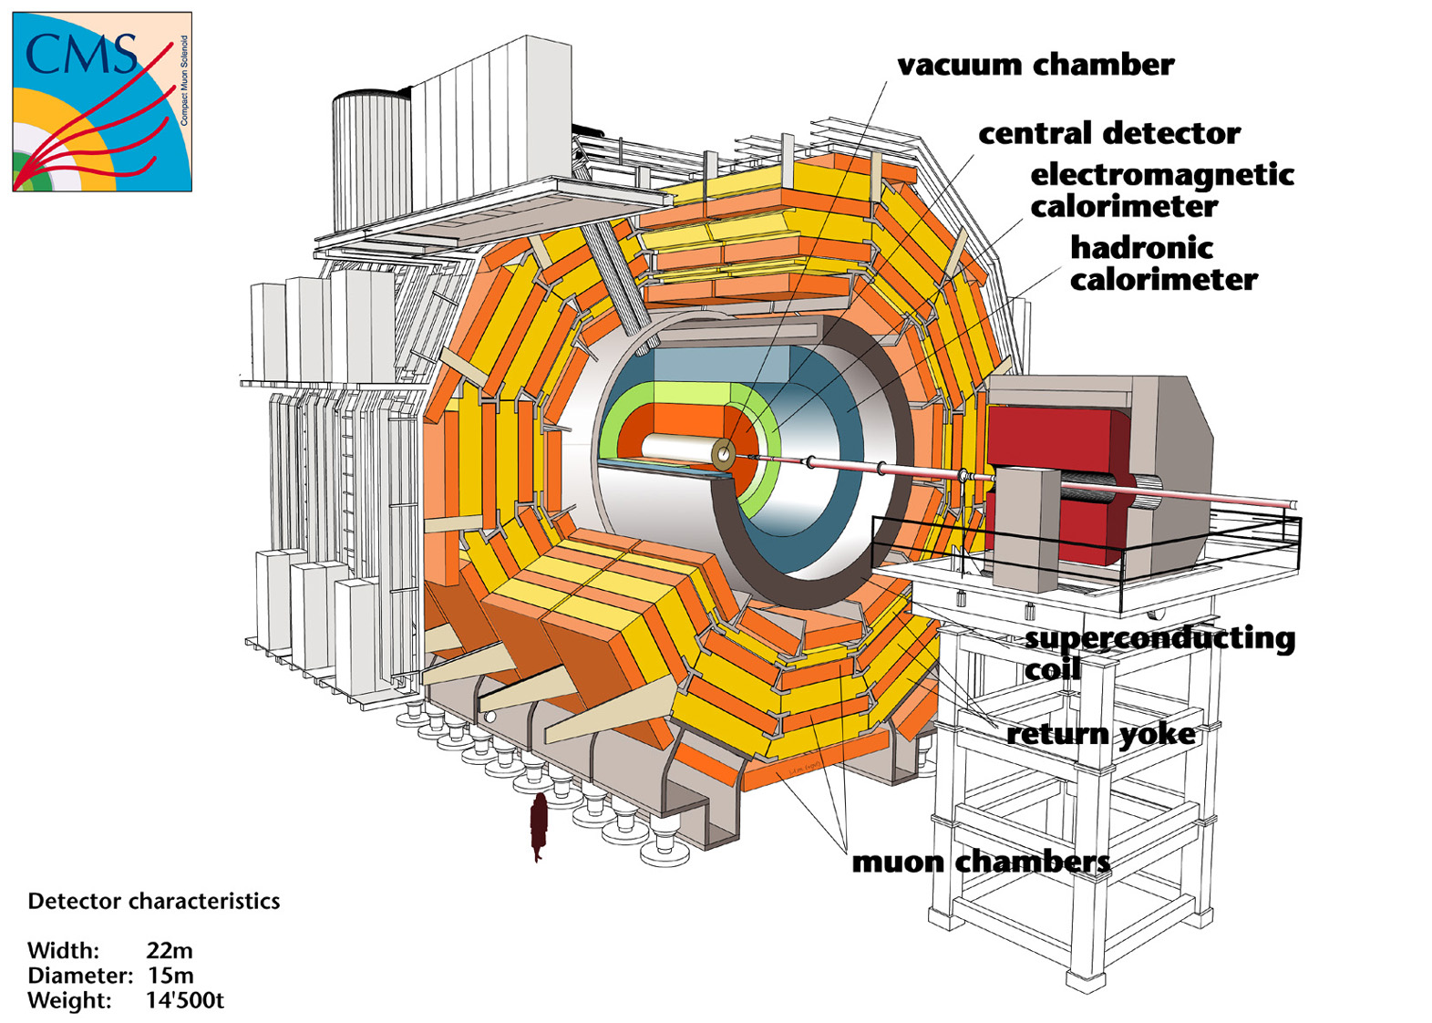
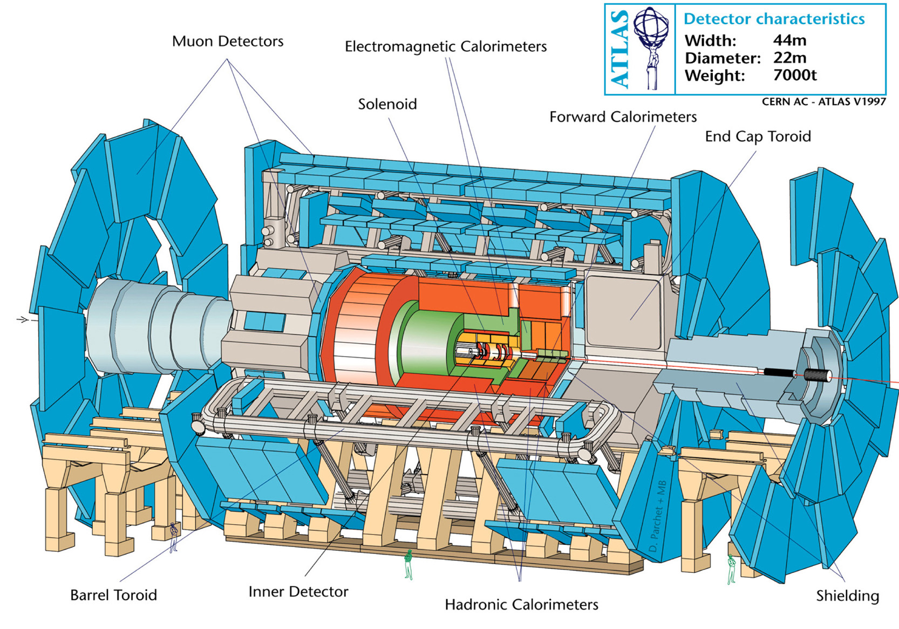
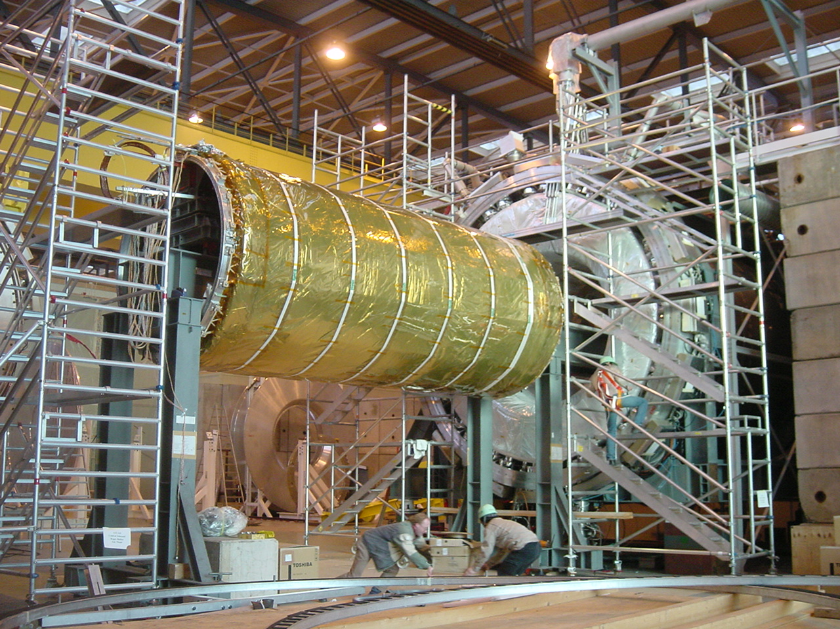
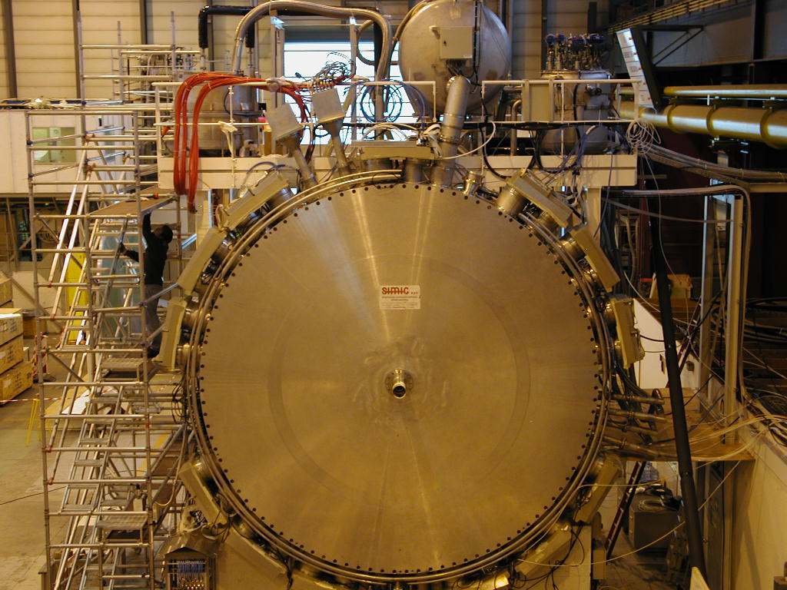
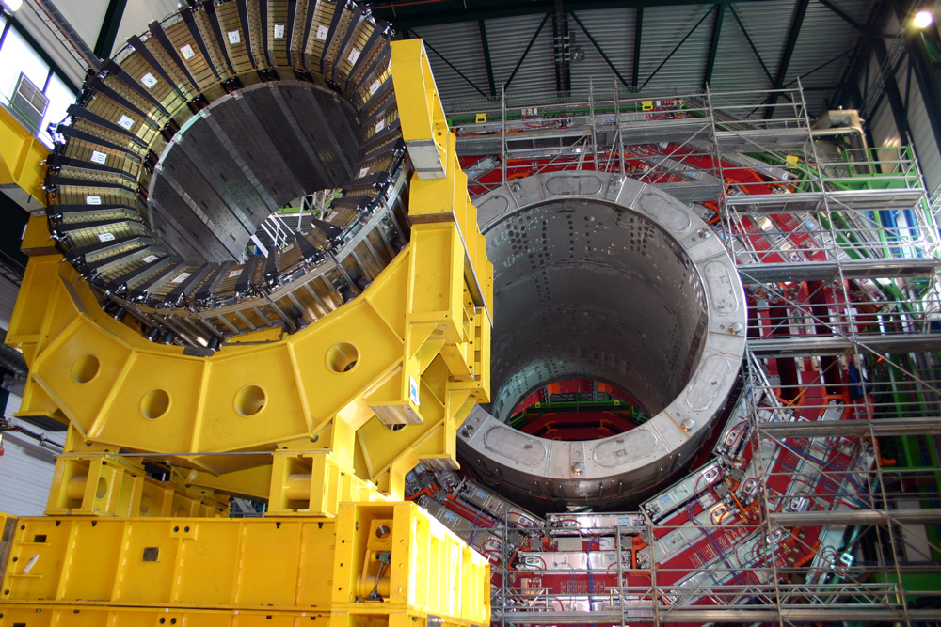

ATLAS & CMS LHC Detectors
ATLAS, cooling at 4.5 K of a toroid superconducting magnetic system and central solenoid (1’275 t of cold mass)
ATLAS, liquid argon (83’000 liters) calorimeter system (660 t cold mass)
CMS, cooling at 4.5 K of a superconducting solenoid (225 t of cold mass)
12

Slide 13
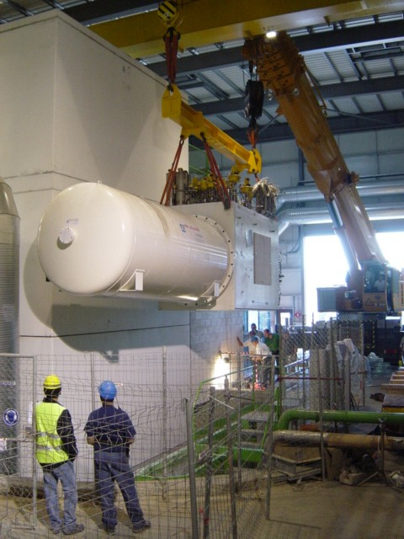
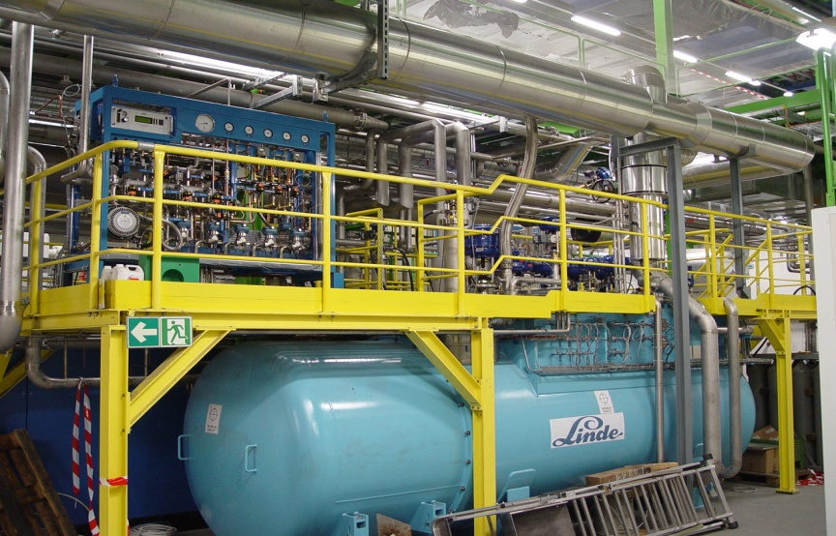
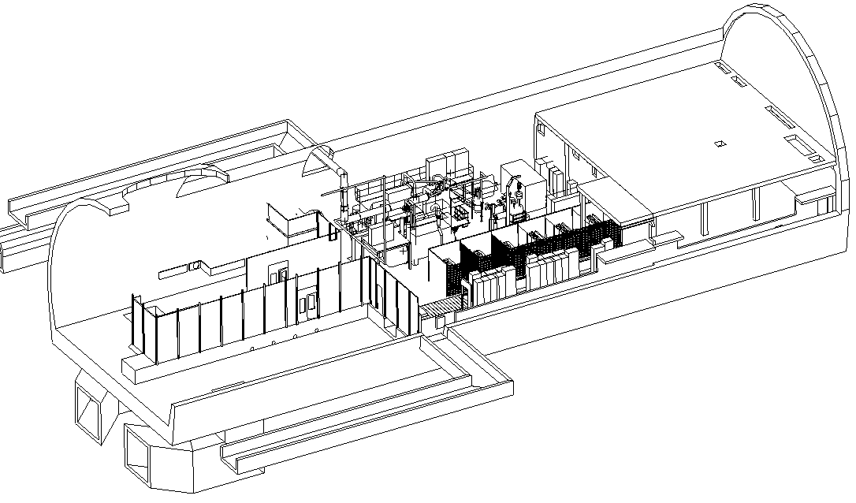
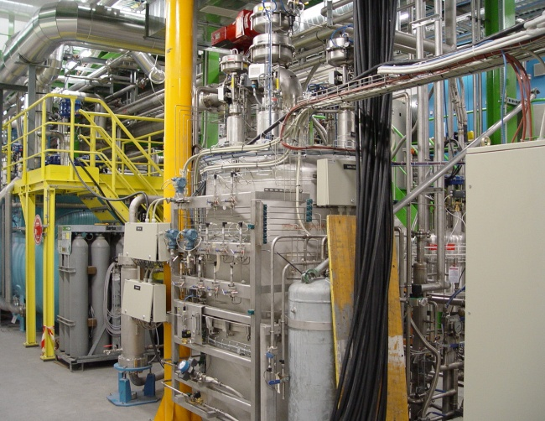
ATLAS Detector Cryogenics (LHC)
He Shield Refrigerator:
- 20 kW 40 - 80 K
- 60 kW 300 - 100 K
He Main Refrigerator:
6 kW @ 4.5 K
Nitrogen Refrigerator:
20 kW @ 84 K
13

Slide 14
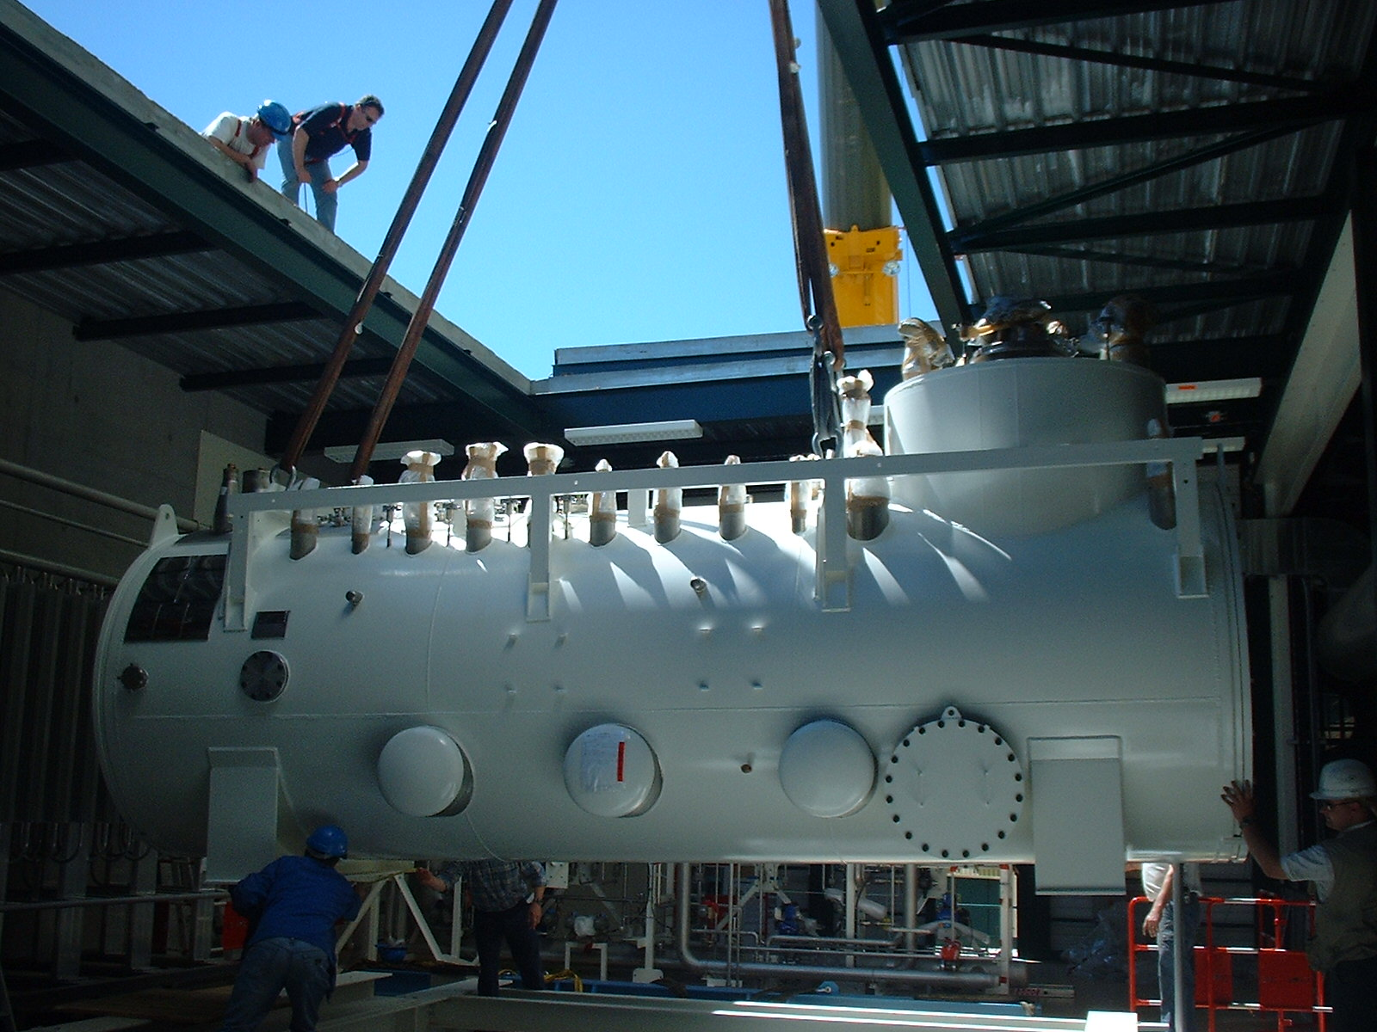
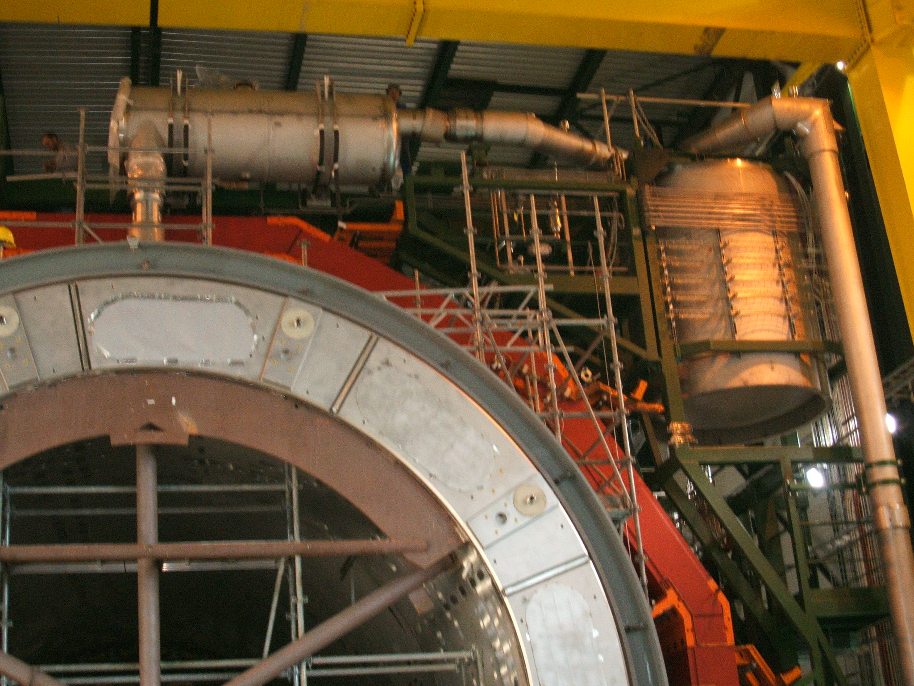
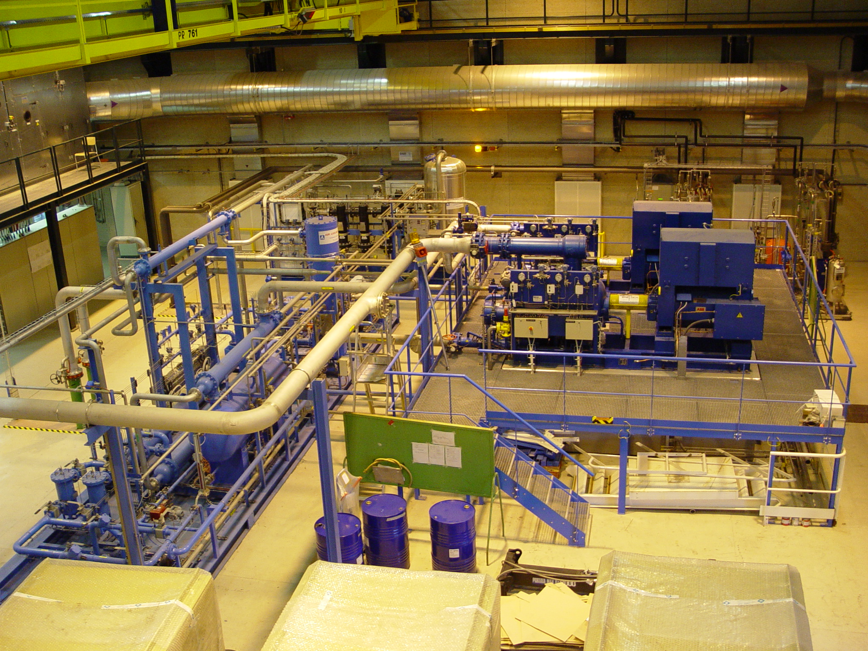
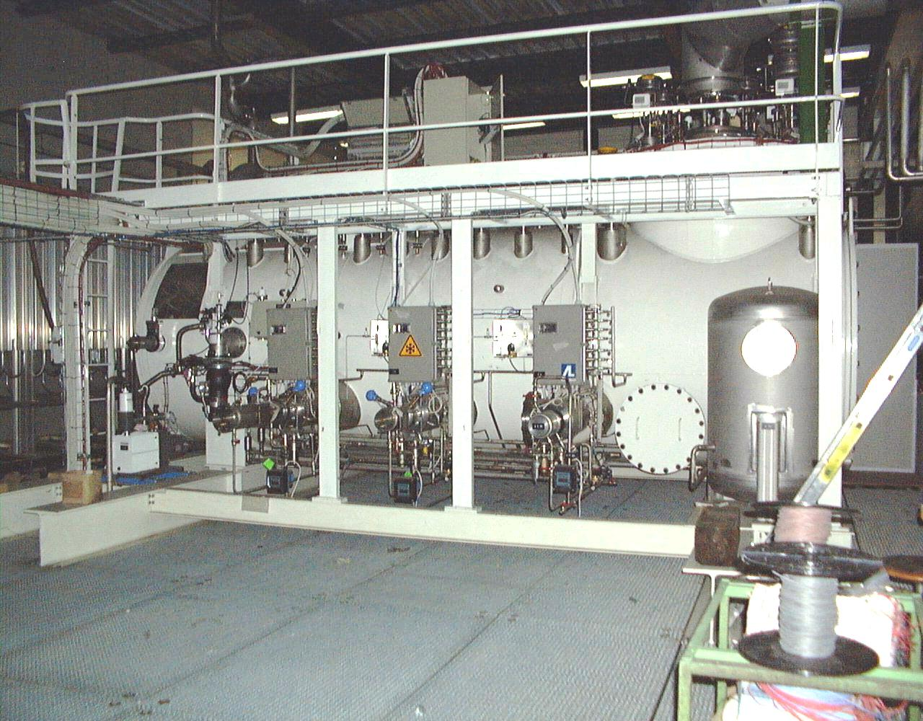
CMS Detector Cryogenics (LHC)
1.5 kW @ 4.5 K unit
14

Slide 15
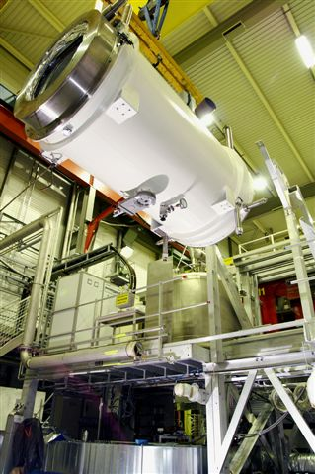
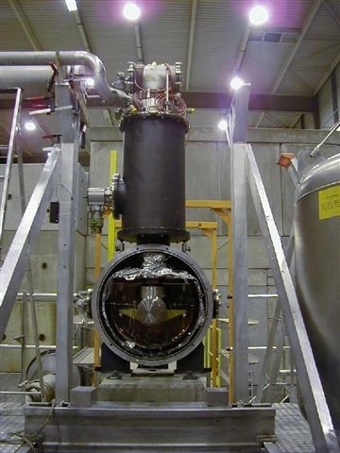
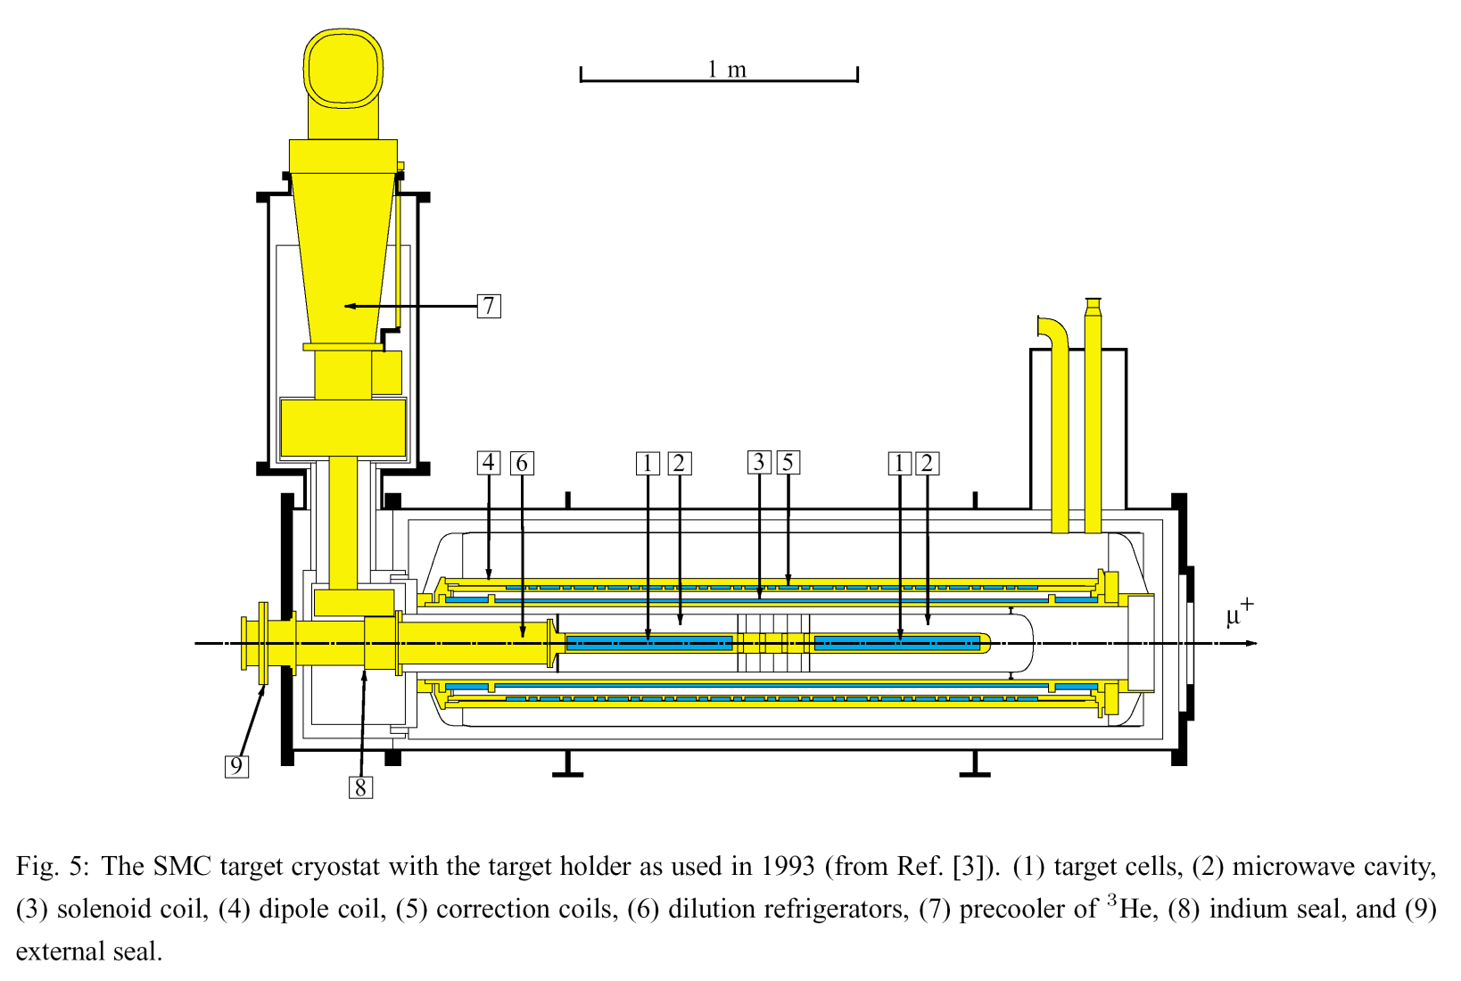
NA58 Compass Detector (SPS)
The Compass
magnet
& dilution
Refrigerator
(400 W @ 4.5 K
&
350 mW @ 300 mK)
15

Slide 16
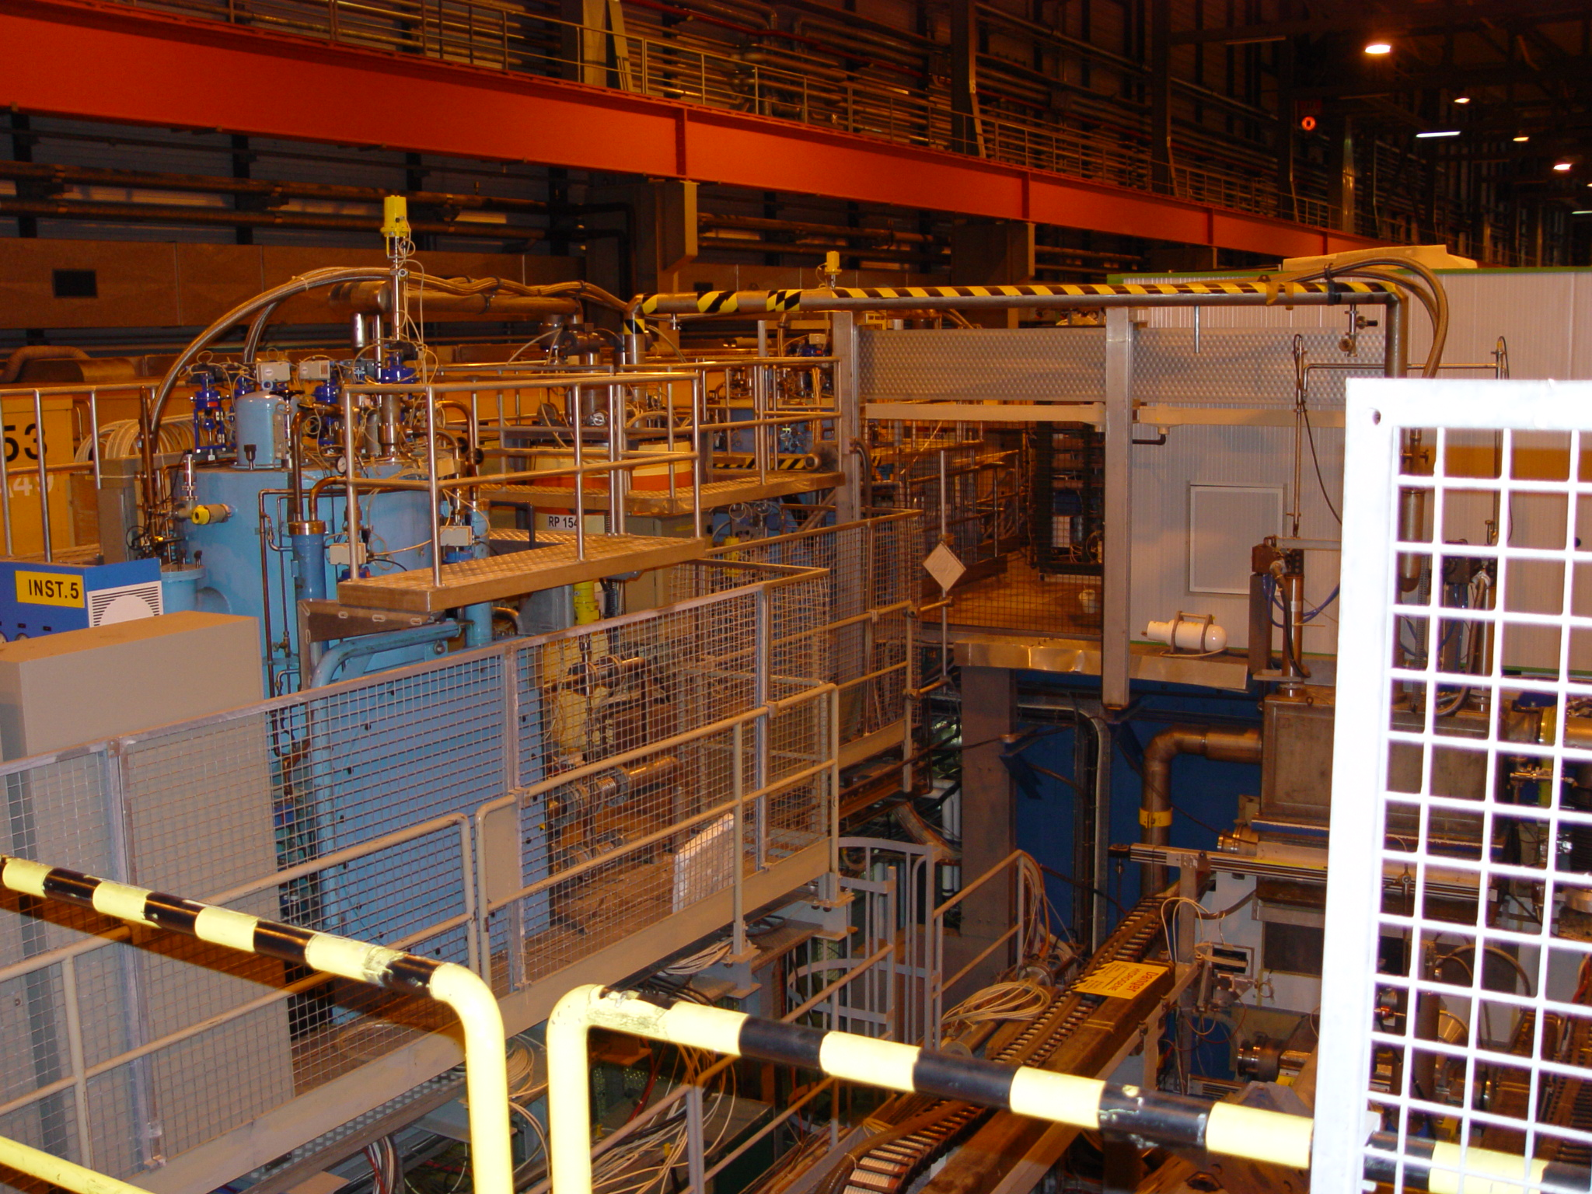
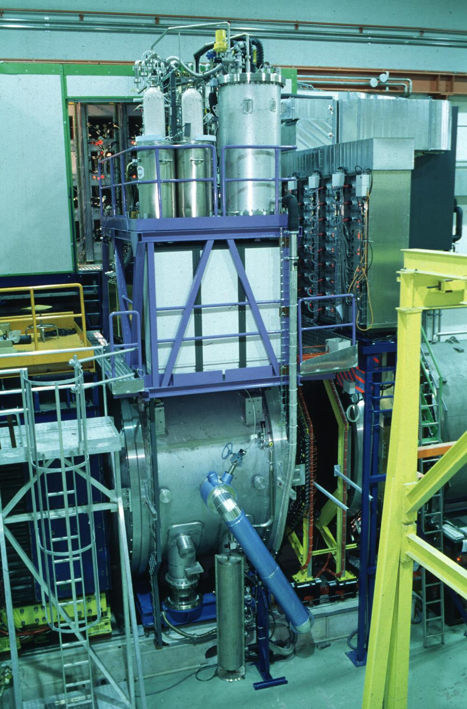
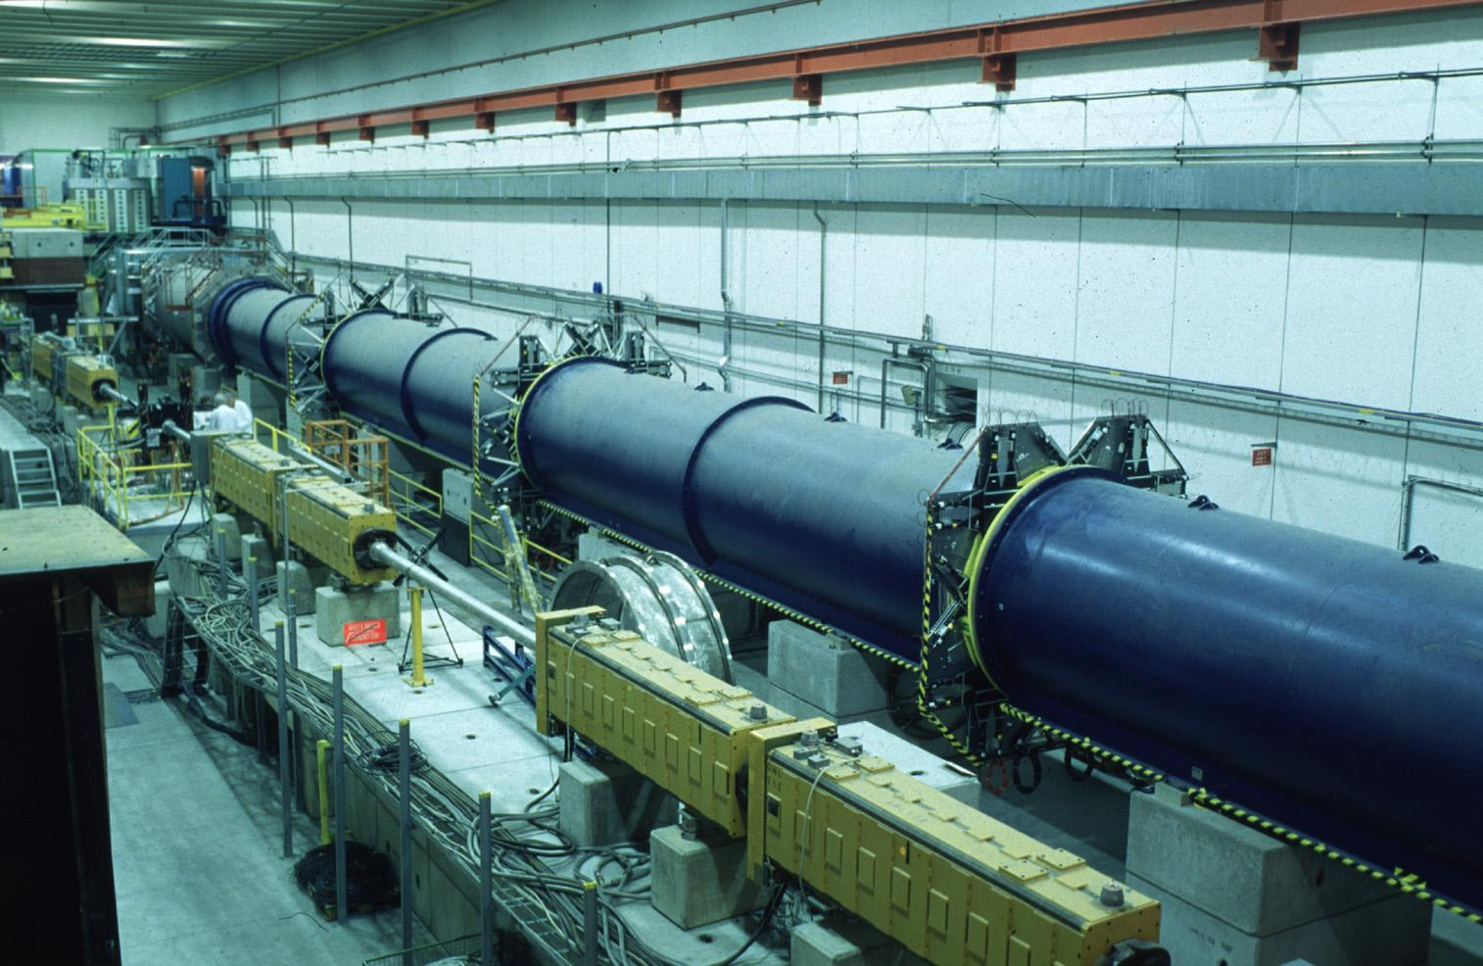
NA61, NA62 Detectors (SPS)
NA61: 2 x 400 W @ 4.5 K
(2 magnets)
NA62: Liquid Krypton
calorimeter(10’000 liters)
16

Slide 17
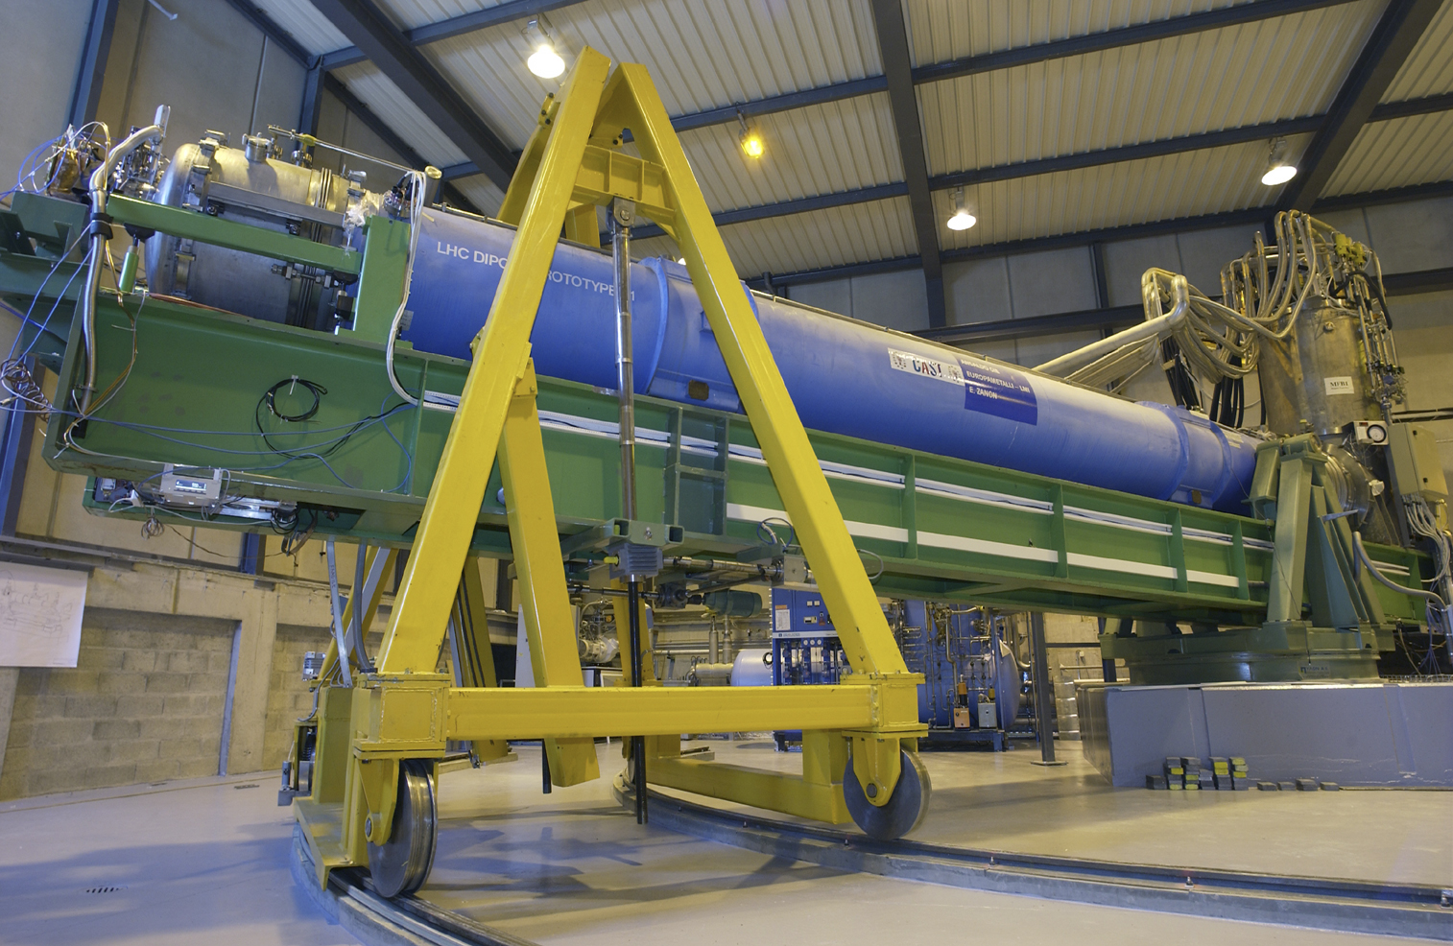
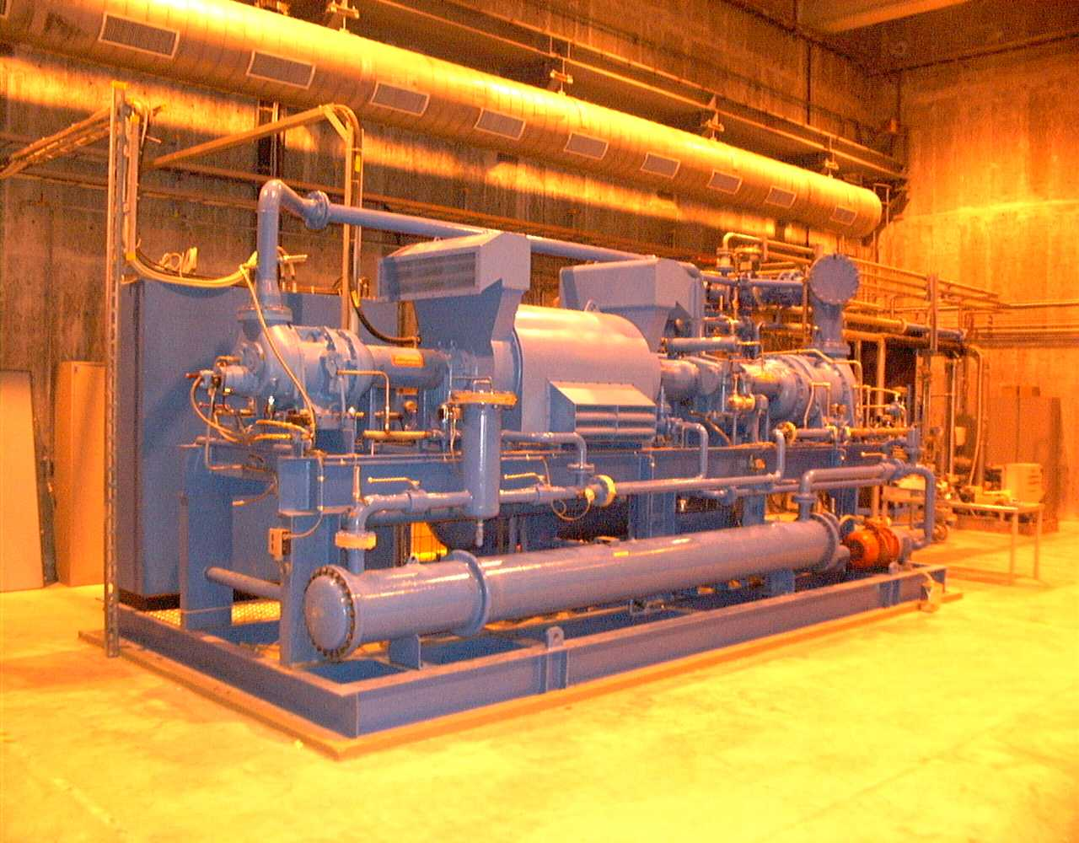
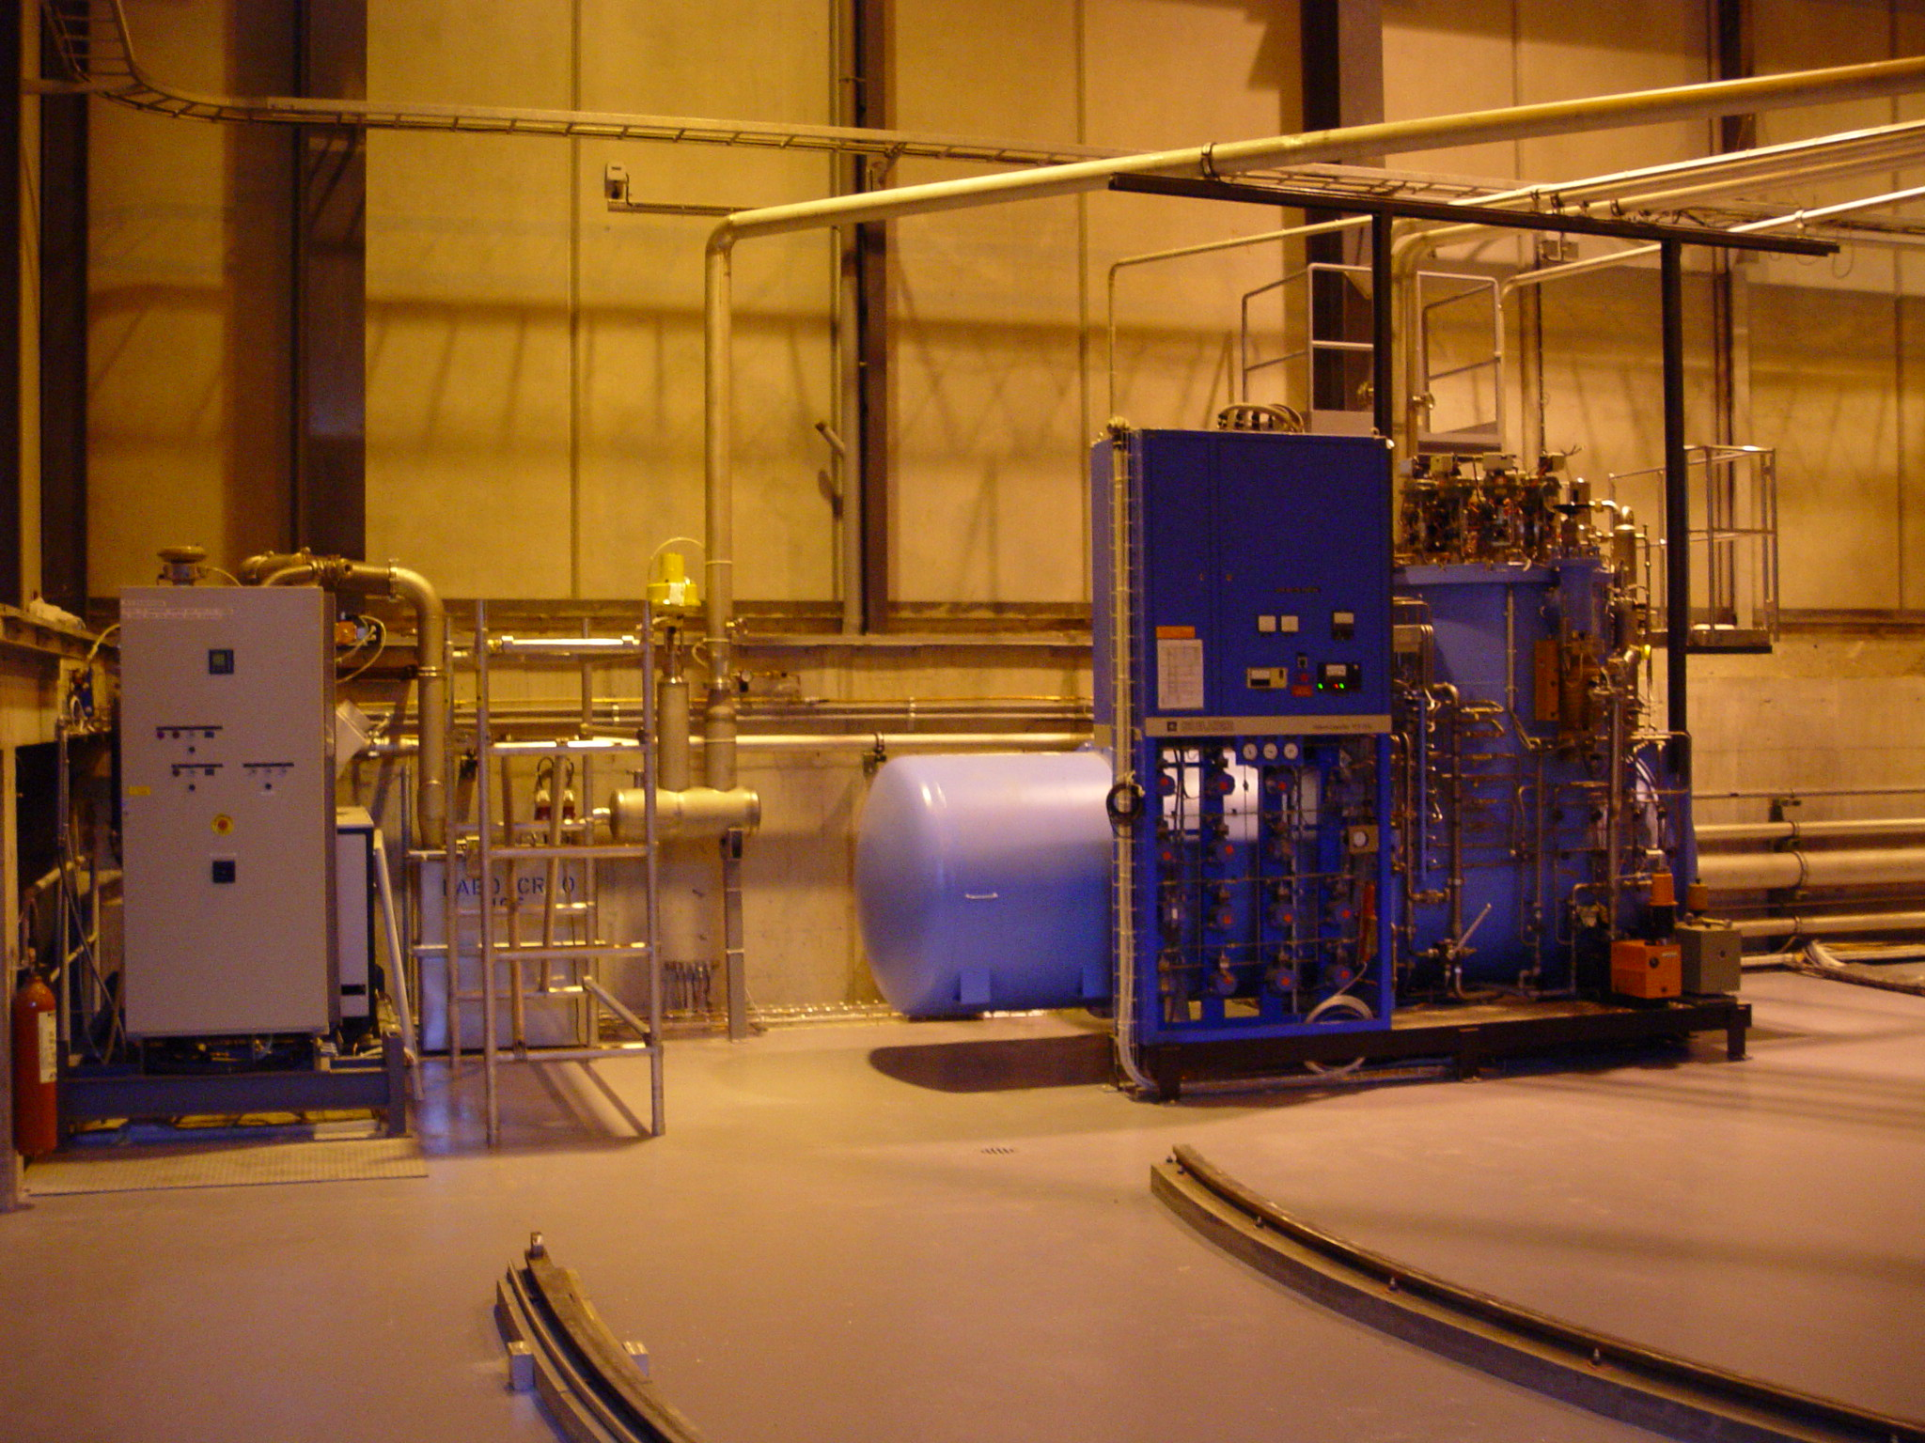
CAST Detector
800 W @ 4.5 K
CERN Axion Solar Telescope
17

Slide 18
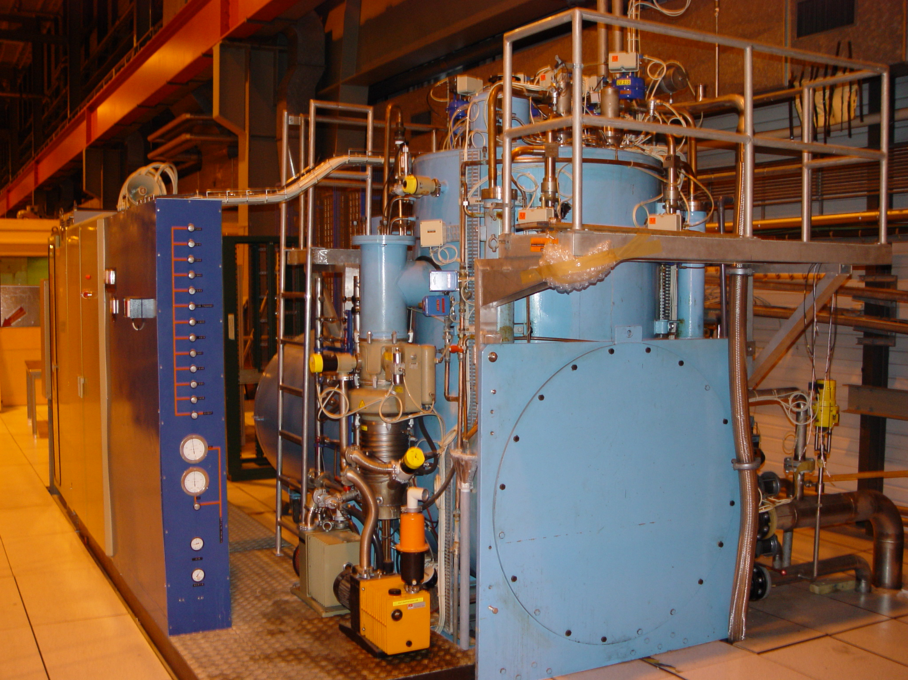
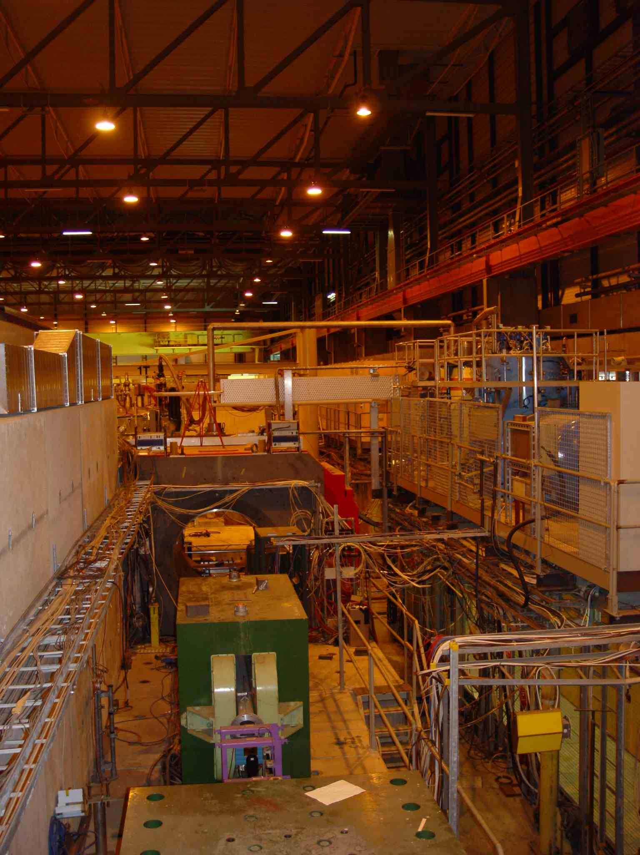
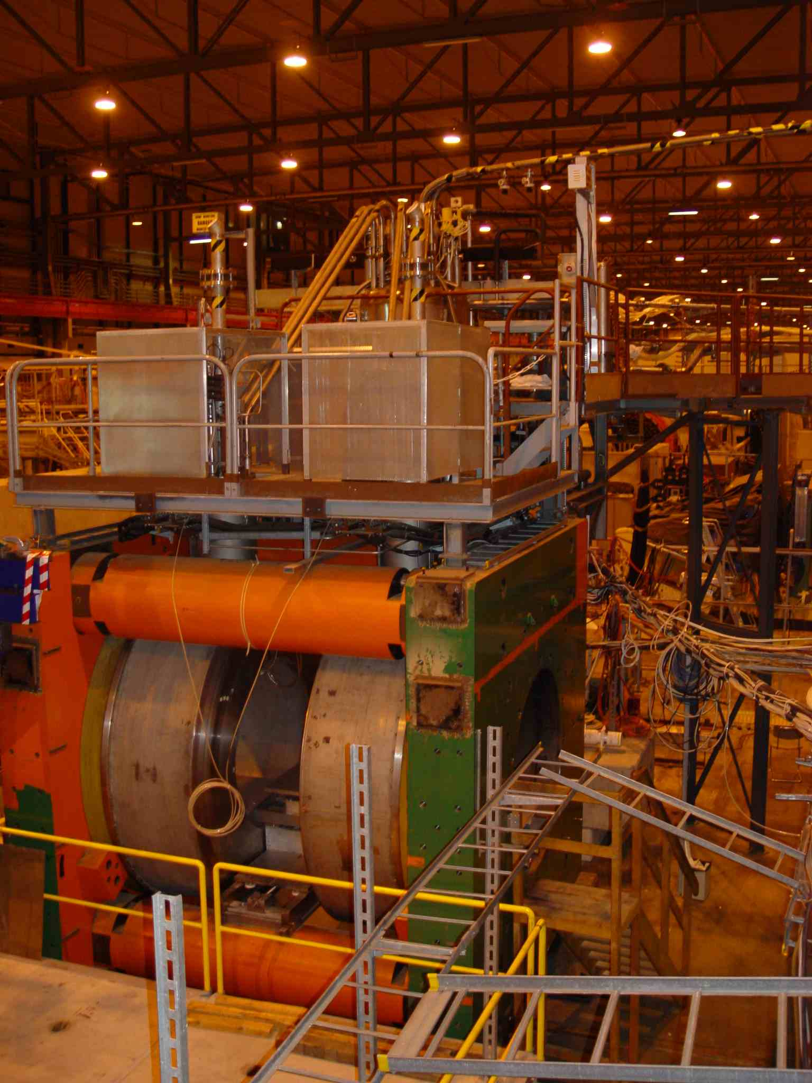
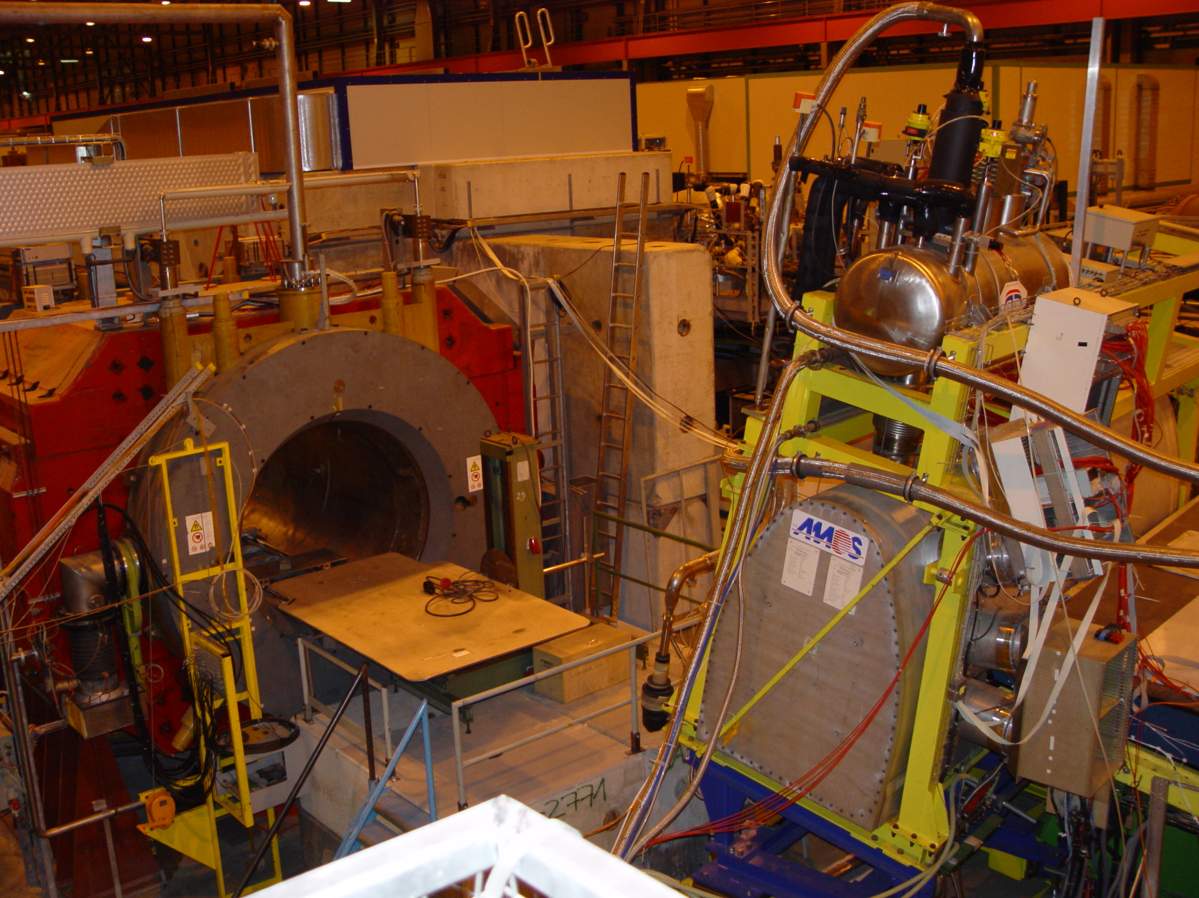
Test Facilities for ATLAS & CMS (SPS)
CMS RD5 H2,
400 W @ 4.5 K
ATLAS H8, 400 W @ 4.5 K
18

Slide 19
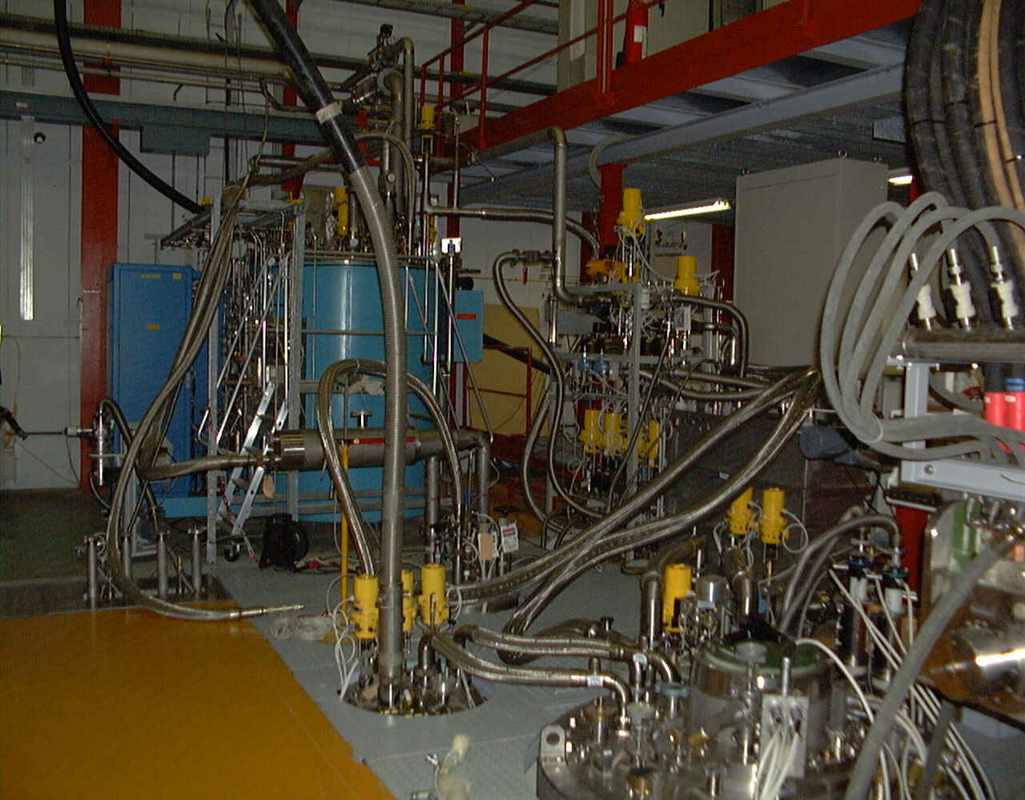
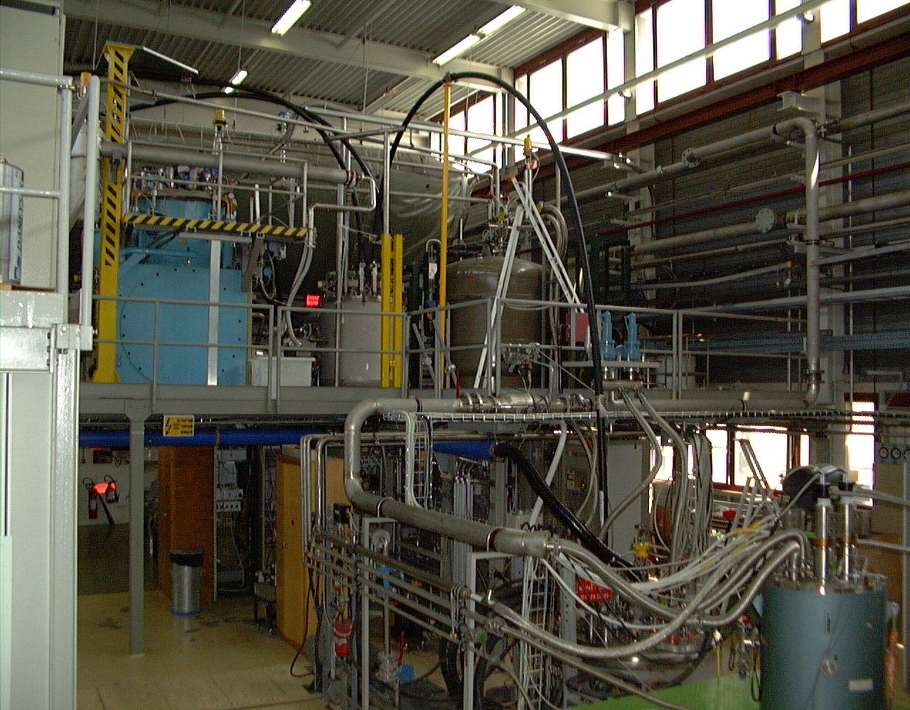
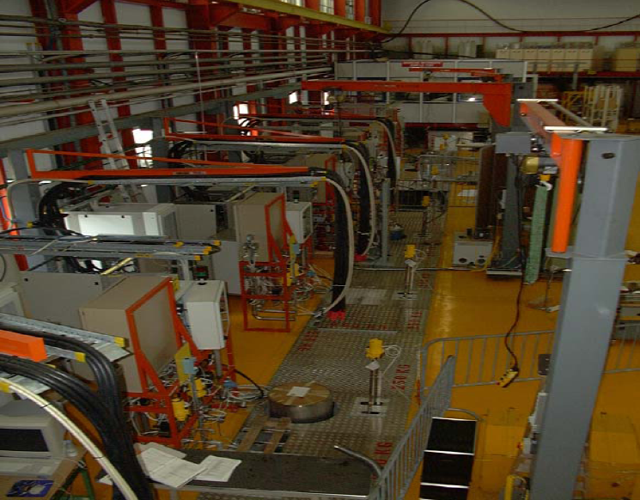
Test facilities & general services
Cryogenic
test benches
for wires,
cables and…
400 W @ 4.5 K
400 W @ 4.5 K
…auxiliary
superconducting
magnets
19

Slide 20
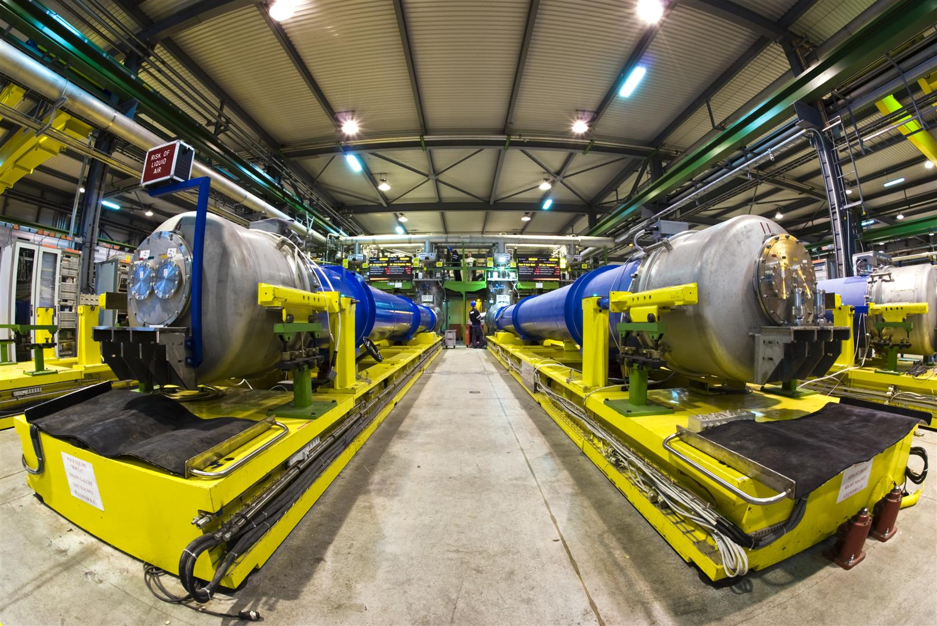
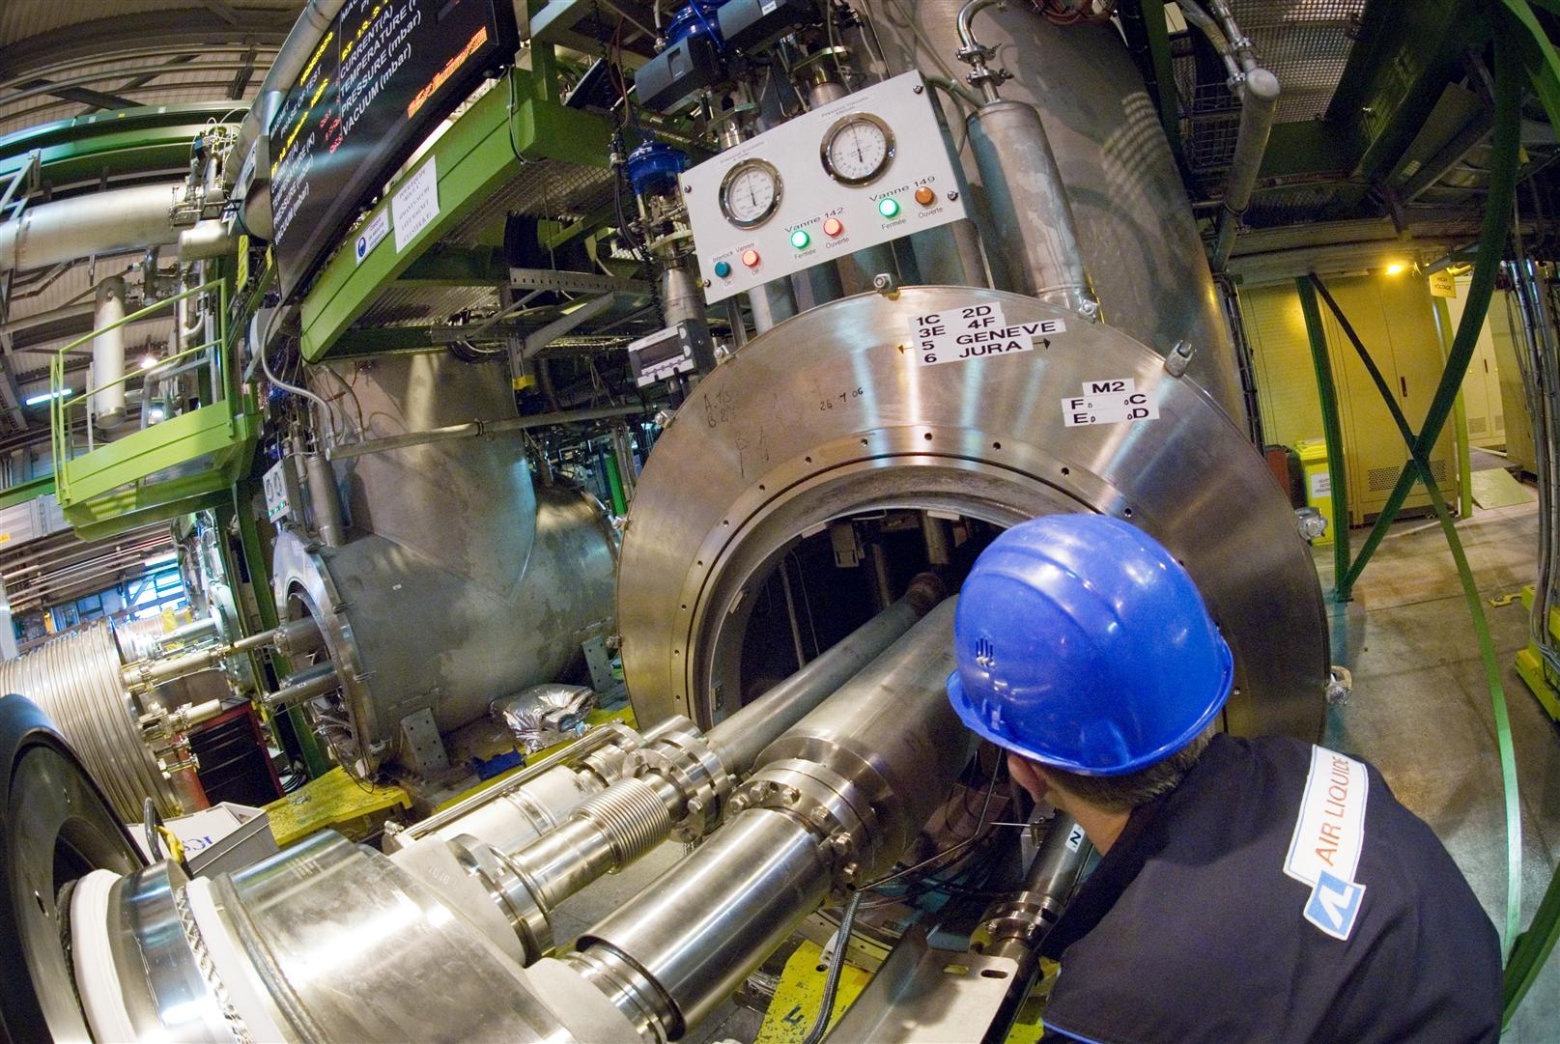
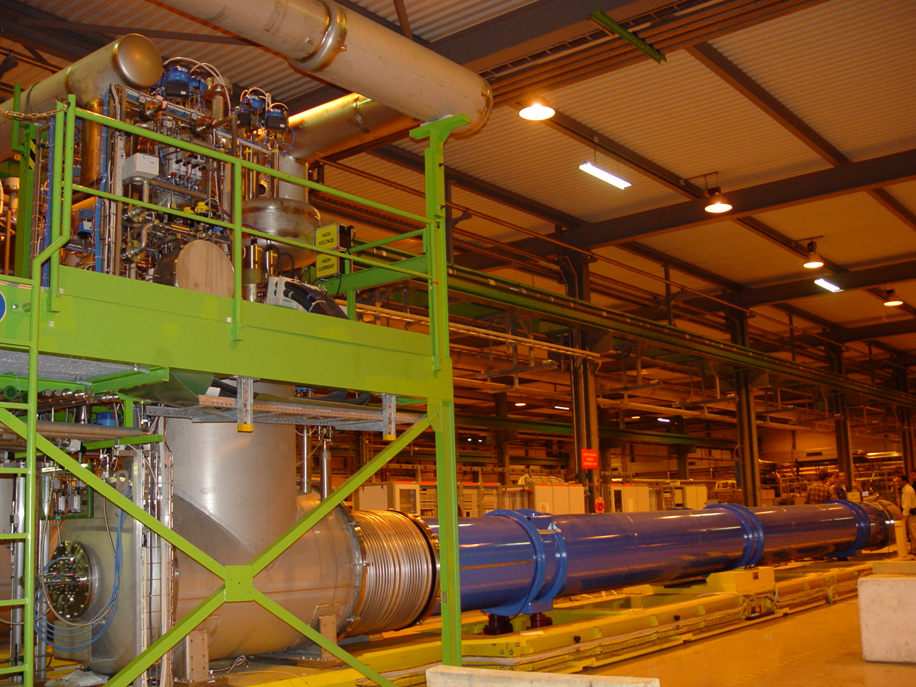
SM18 Test benches (LHC magnets)
Test facilities & general services
12 cryogenic test benches for the LHC magnets nominally tested before underground installation (several years of intensive, 24h/24, 7d/7 cryogenic operation)
20

Slide 21
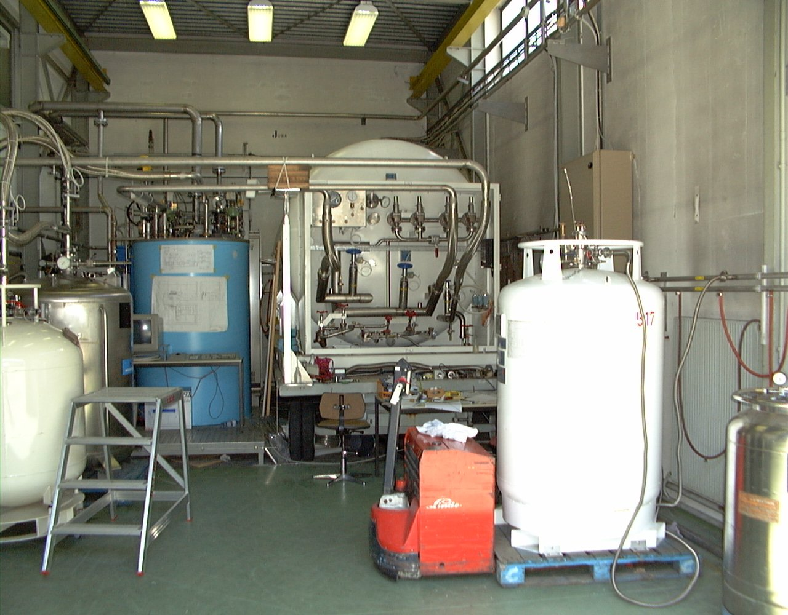
Test facilities & general services
Central liquid helium
production in situ and distribution by means of mobile containers
(from 100 to 2000 liters)
of up to 250’000 liters
peryear
400 W @ 4.5 K
(R&D programs, accelerators & physics detectors without dedicated cryogenic plant)
21

Slide 22
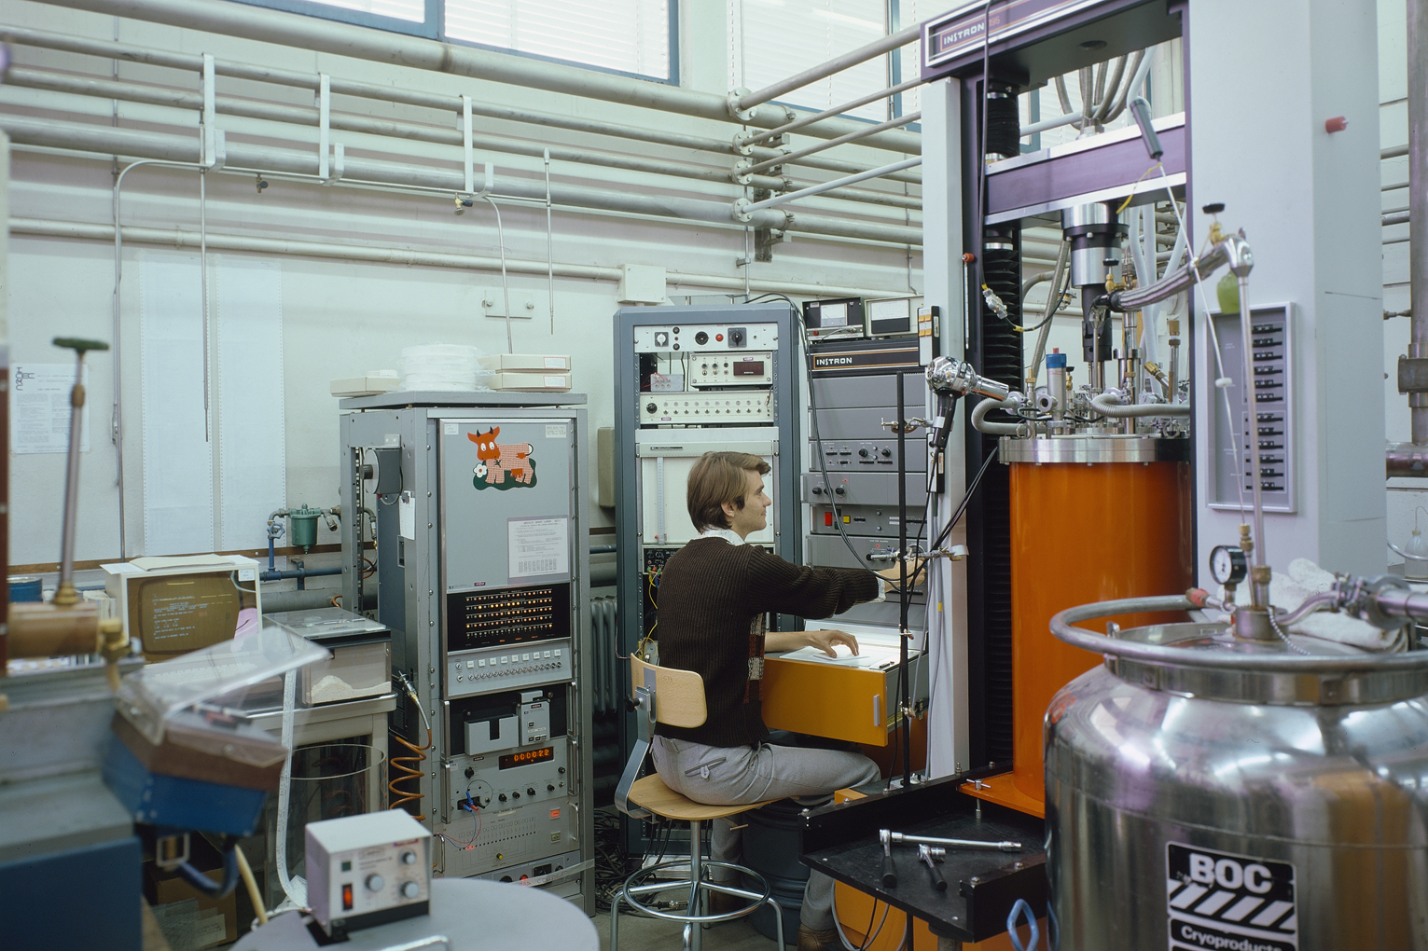
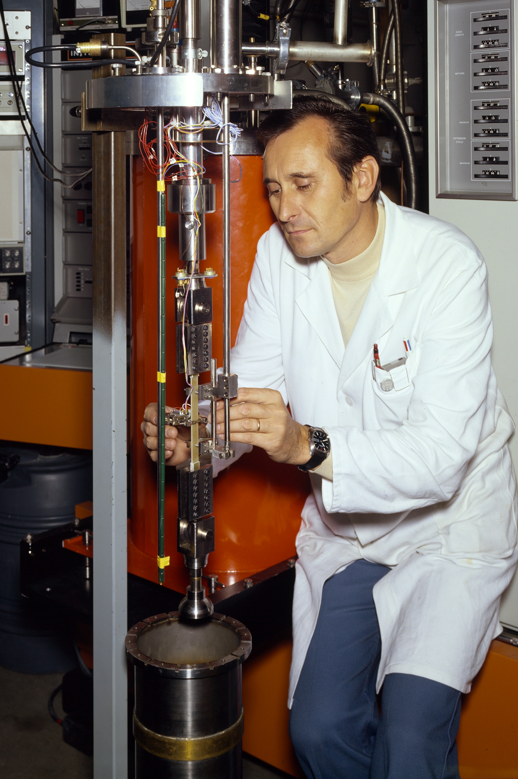
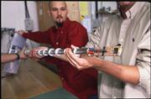
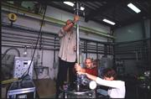
Test facilities & general services Cryogenic Laboratory (Cryolab)
CERN wide support for testing and validating technical solution.
Operation and development of special laboratory measuring equipment for CERN users.
Consultancy for scientific, technical study and development for cryogenics.
Cryogenics Operations 2008, CERN, Geneva, Switzerland
L. Tavian, D. Delikaris, 22th-26th September 2008

Slide 23
Cryogen storage and distribution
Cryogen management (helium, nitrogen): Inventory
LHC (accelerator & detectors) helium full inventory:
136 t, completed by July 08
(LHC accelerator storage capacity: 75 t in situ, 55 t of “virtual storage” in collaboration with industrial suppliers)
Present total helium inventory at CERN: 150 t
LHC (accelerator & detectors) liquid nitrogen needs for a full cool down: 11’500 t, completed by end of June 08
(LHC accelerator full cool down: 10’000 ton in 33 continuous days; equivalent to 500 standard transportable containers delivered by industrial suppliers)
Cryogenics Operations 2008, CERN, Geneva, Switzerland
L. Tavian, D. Delikaris, 22th-26th September 2008

Slide 24
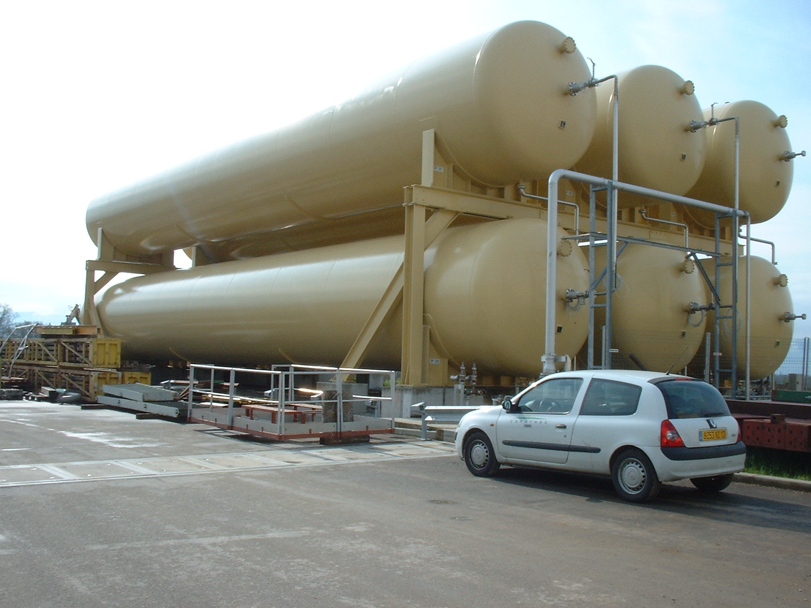





Cryogen storage and distribution
Storage infrastructure (in brackets: capacity dedicated to LHC)
Gas & liquid helium storage capacity at CERN
Gas tank capacity [m³] | 250 (at 2.1 MPa) | 80 (at 1.5 & 2.1 MPa)
Number of units at CERN | 58 (58) | 65 (40)
Liquid tank capacity [liter] | 120’000 (fixed) | 25’000 (fixed) | 11’000 (mobile) | 6’000 (fixed)
Number of units | 2 (2) | 1 | 2 | 1
Liquid nitrogen storage capacity at CERN
Container capacity [liter] | 50’000 | 40’000 | 27’000 | 20’000 | 15’000 | 10’000 | 6’000
Number of units | 14 (13) | 2 | 1 | 2 | 2 | 1 | 7
Cryogenics Operations 2008, CERN, Geneva, Switzerland
L. Tavian, D. Delikaris, 22th-26th September 2008

Slide 25
Cryogen storage and distribution
LHC helium storage
&
distribution
Cryogenics Operations 2008, CERN, Geneva, Switzerland
L. Tavian, D. Delikaris, 22th-26th September 2008

Slide 26
Cryogen storage and distribution
Cryogenics Operations 2008, CERN, Geneva, Switzerland
L. Tavian, D. Delikaris, 22th-26th September 2008

Slide 27
Cryogen storage and distribution
Cryogenics Operations 2008, CERN, Geneva, Switzerland
L. Tavian, D. Delikaris, 22th-26th September 2008

Slide 28
Cryogenics operation methodology
Operation & Maintenance (O&M) of the cryogenic plants & ancillary equipments at CERN:
… - 1995 Under CERN’s direct responsibility
1995 - 2009 Strategic decision to outsource the O&M in the frame of a full task delegation contract by establishing partnership with specialized industrial services provider including performance evaluation with contractual indicators (bonus, penalties application)
Presently, 63 collaborators (42 operators, 17 for technical support & maintenance, 4 for the management team)
Cryogenics Operations 2008, CERN, Geneva, Switzerland
L. Tavian, D. Delikaris, 22th-26th September 2008

Slide 29
Conclusions
Cryogenics at CERN: a long history, since 1960’s for physics and related R&D programs
Very large spectrum of applications and range of working conditions for the refrigeration plants (capacity, temperature, geographical location)
Use of “state of the art” industrial cryogenic equipment at the edge of the present technology (examples: 1.9 K cold compressors refrigeration units; 1200 g/s liquid helium circulators)
Very important cryogen inventory
Cryogenic operation reliability & availability to the users:
over the last 15 years, nearly 590’000 running hours have been cumulated with a mean non availability rate of < 1% depending on the application
Cryogenics Operations 2008, CERN, Geneva, Switzerland
L. Tavian, D. Delikaris, 22th-26th September 2008

