Slide 1
Statistics of Angles in SEM images of Breakdown Sites
27.8.2013
Anders Korsbäck

Slide 2
Statistics of Angles in SEM images of Breakdown Sites
Method for fitting polygons to areas between lines (wormlike features) developed to better deal with low-quality images
New issues discovered when code used on new image data, were solved
Code was run on 15 SEM images taken by Patrick Alknes in 2010. Areas of size less than 100 pixels were excluded

Slide 3
Samples of SEM images the code was run on

Slide 4
Statistics for entire data set
Histograms of angle distribution for different bin widths, fit 3rd degree polynomial as ”background estimate”, with 2σ (95%) confidence bounds:

Slide 5
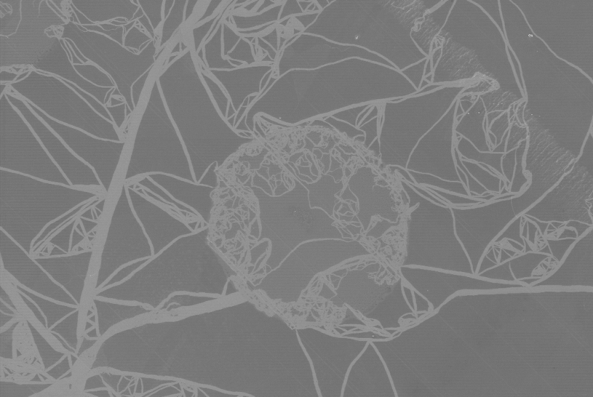
Original image revisited
In light of negative result for entire dataset, latest version of the code was re-run on original image that sparked the investigation. Corresponding histograms:

