Slide 1

ECFA HL-LHC Experiments Workshop Aix-les-Bains Oct. 1-3
D. Contardo, P. Allport
CERN 3rd September
ECFA steering committee and preparatory group meeting
https://indico.cern.ch/conferenceDisplay.py?confId=252045
Steering Committee of the workshop (* Chairs):
ALICE: P. Giubellino (SP), H. Wessels (Deputy SP)
ATLAS: P. Allport* (Upgrades Coord.), D. Charlton (SP), B. Di Girolamo (Tech. Coord.)
CMS: A. Ball (Tech. Coord.), D. Contardo* (Upgrades Coord.), J. Incandela (SP)
LHCb: P. Campana (SP), B. Schmidt (Deputy SP)
Sergio Bertolucci (CERN Dir. Research), Manfred Krammer (ECFA Chair), Peter Jenni (ATLAS) Michelangelo Mangano (LPCC), Steve Myers (Dir. Accelerators), Jim Virdee (CMS)
E-mail list of the workshop SC: HL-LHC_ECFAWorkshop_SC@cern.ch
E-mail list of the PG chairs: HL-LHC-ECFA-PGChairs@cern.ch
E-mail list of the PG members: PGMembers-HL-LHC-ECFA@cern.ch

Slide 2
Reminder: Goals and topics for the Workshop
The ECFA HL-LHC Experiments Workshop is a meeting of the ALICE, ATLAS, CMS and LHCb collaborations to develop a common approach to the HL-LHC program and to identify synergies and possible effort to collaborate in areas of common interest
It addresses Physics goals, Detector Upgrade requirements and subsequent Technology R&Ds. The following areas have identified for discussion:
  Physics goals, theoretical developments and performance reach
  Tracking devices and associated electronics and readout
  Calorimetry and associated electronics and readout
  Muon systems and associated electronics and readout
  Trigger/DAQ/Offline/Computing
  Electronics and read-out systems
  Long Shutdown constraints and radiation and activation effects
  Accelerator and Experiment interface
The Preparatory Groups were formed to identify the key topics to be discussed in each area and to organize the sessions in the workshop. Each has two chairs from ATLAS and CMS - and also 2 theorists for the Physics PG

Slide 3
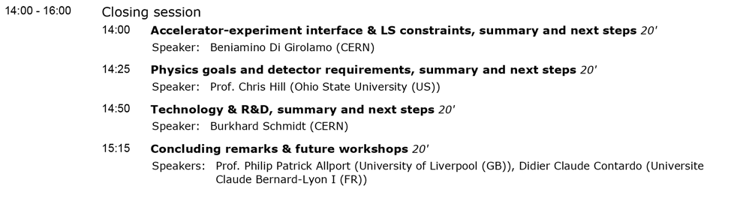
Discussion of topics to be addressed at the workshop
The workshop agenda (see below and following page) can be found at http://indico.cern.ch/conferenceOtherViews.py?view=standard&confId=252045 and further details are at https://twiki.cern.ch/twiki/bin/view/ECFA/ECFAHiLumiLHC
Remember one outcome of the Workshop is to produce a short report, based on the discussion, to present to the Plenary ECFA meeting of 21st and 22nd November, and to specifically identify areas for further joint HL-LHC workshops.
→ Status of PGs with respect to this is the main focus of today’s meeting
The final afternoon is dedicated to the next steps including this discussion of possible future workshops (and whether dedicated topics and/or general overview again)
→ Your views on this would be greatly appreciated

Slide 4
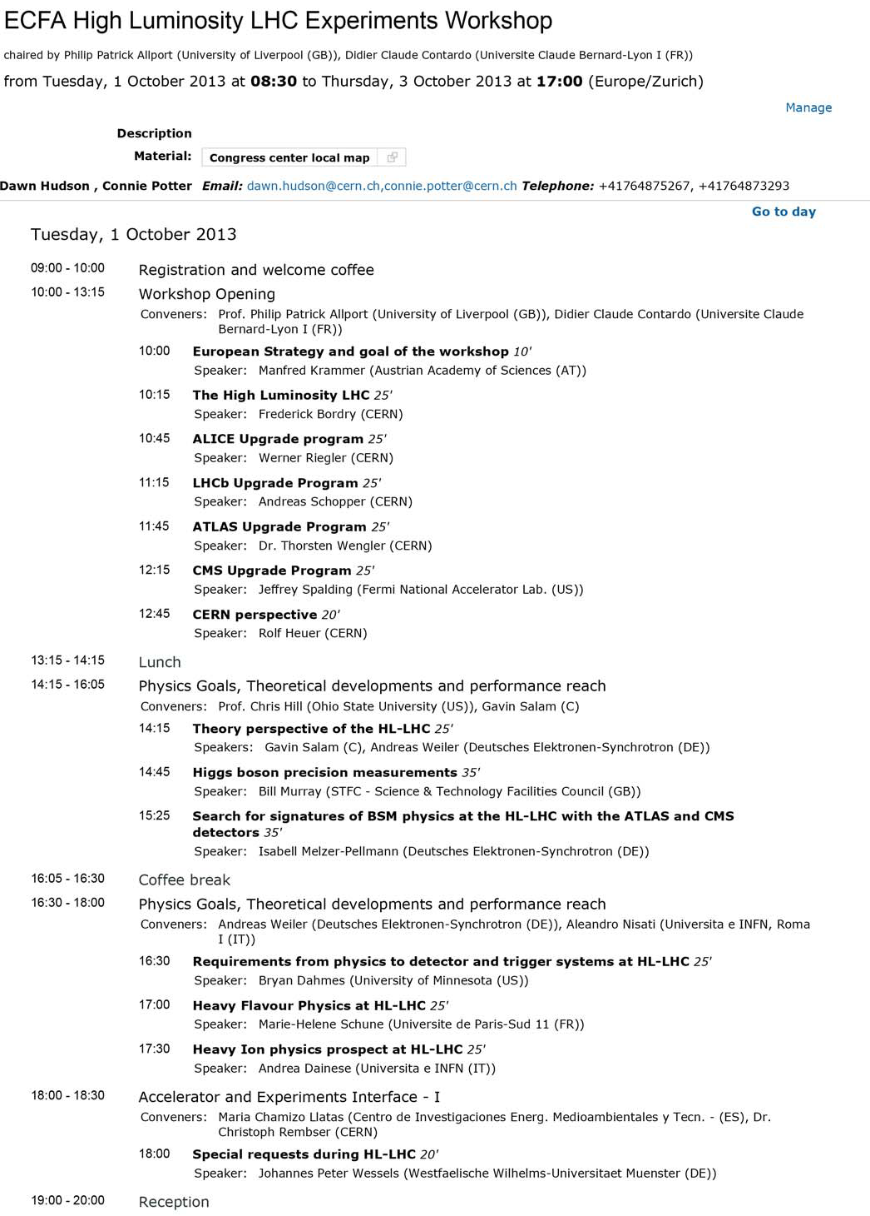
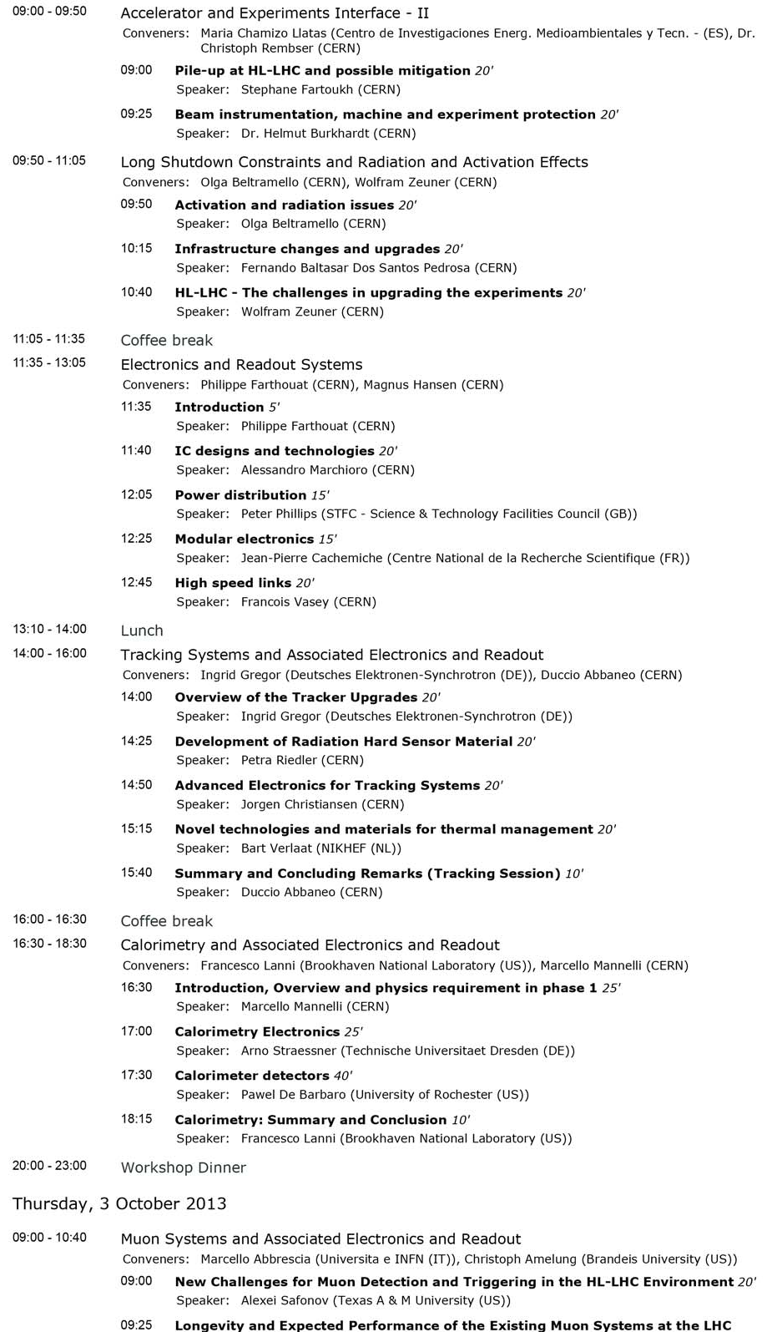
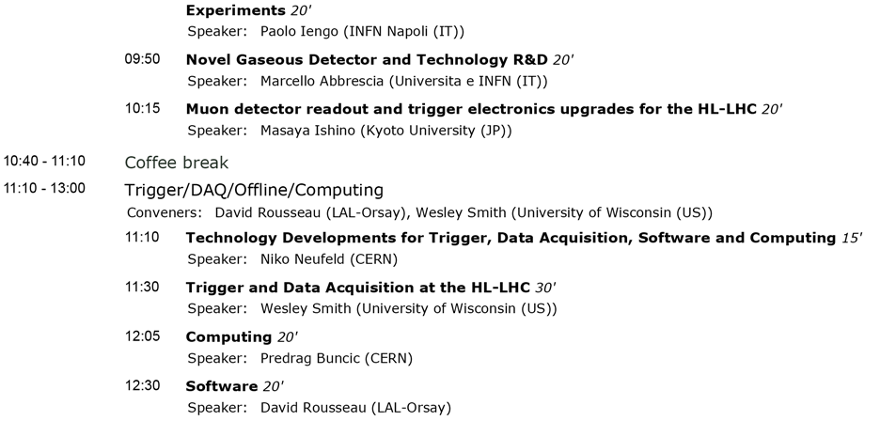
Agenda: https://indico.cern.ch/conferenceOtherViews.py?view=standard&confId=252045

Slide 5
Workshop organization
Dawn Hudson (CMS) and Connie Potter (ATLAS) are the contact persons and should be able to help delegates in case of any difficulties
Registration is due to close at the end of this week (6/9/13) → please encourage colleagues who are coming but have not yet registered (or booked accommodation) to do so asap!
Accommodation, travel information, … available at the conference web site but feedback on this is very helpful particularly in terms of the practical information

Slide 6
Preparatory Groups: Membership (Reminder)
  Physics goals and performance reach
    CERN Theory: G.Salam, A. Weiller
    ALICE: Peter Braun Munzinger, Andrea Dainese
    ATLAS: Leandro Nisati, Pippa Wells, Bill Murray
    CMS: Chris Hill, Markus Klute, Isabell Melzer-Pellmann
    LHCb: Tim Gershon, Guy Wilkinson
  Tracking devices and associated electronics and readout
    ALICE: Vito Manzari, Werner Riegler
    ATLAS: Ingrid Gregor, Didier Ferrere, Craig Buttar
    CMS: Duccio Abbaneo, Francois Vasey, Stefano Mersi
    LHCb: Massimiliano Ferro-Luzzi
  Calorimetry and associated electronics and readout
    ALICE: David Silvermyr
    ATLAS: Francesco Lanni, Alberto Valero
    CMS: Marcello Mannelli, Dave Barney, Pawel. De Barbaro
    LHCb: Frederic Machefert
  Muon Systems and associated electronics and readout
    ALICE: Pascal Dupieux
    ATLAS: Christoph Amelung, Oliver Kortner, Stefano Veneziano
    CMS: Marcello Abbrescia, Kerstin Hoepfner, Alexei Safonov
    LHCb: Alessandro Cardini

Slide 7
Preparatory Groups: Membership (Reminder)
  Trigger/DAQ/Offline/Computing
    ALICE: Pierre Vande Vyvre, Thorsten Kollegger, Predrag Buncic
    ATLAS: David Rousseau, Benedetto Gorini, Nikos Konstantinidis
    CMS: Wesley Smith, Christoph Schwick, Ian Fisk, Peter Elmer
    LHCb: Renaud Legac, Niko Neufeld
  Electronics and read-out systems
    ALICE: Alex Kluge
    ATLAS: Philippe Farthouat, Maurice Garcia-Sciveres, Tony Weidberg
    CMS: Magnus Hansen, Jorgen Christiansen
    LHCb: Ken Wyllie
  Long Shutdown constraints and radiation and activation effects
    ALICE: Werner Riegler
    ATLAS: Olga Beltramello, Beniamino Di Girolamo
    CMS: Wolfram Zeuner, Christoph Schaefer
    LHCb: Rolf Lindner
  Accelerator and Experiment interface
    CERN Accelerator: L. Rossi, O. Bruning
    ALICE: Hannes Wessels
    ATLAS: Christoph Rembser, Beniamino Di Girolamo, Antonio Sbrizzi
    CMS: Maria Chamizo Llatas, Wolfram Zeuner
    LHCb: Burkhard Schmidt

