Slide 1


Semileptonic B decays with open charm
Christoph Schwanda
Institute of High Energy Physics
Austrian Academy of Sciences
Flavour Physics & CP Violation
May 25-30, 2014, Marseille, France

Slide 2
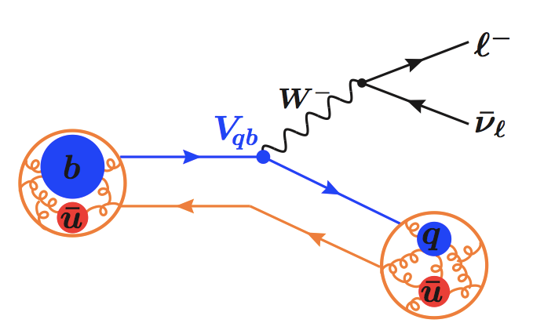

Semileptonic B decays to charm…
B
X_{q}
… allow to determine the magnitude of the Cabibbo-Kobayashi-Maskawa (CKM) matrix element |V_{cb}|
Two types of measurements
  Exclusive: A specific charm final state is reconstructed (e.g., Dlν, D*lν)
  Inclusive: All X_{c}lν final states within a region of phase are reconstructed

Slide 3
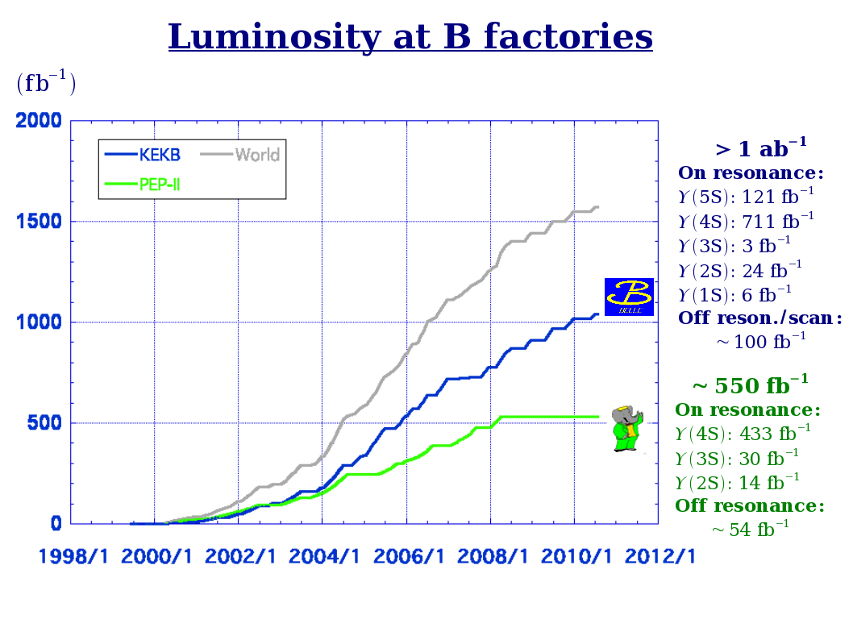
About 771 million
e⁺e⁻ → BB events in the Belle data

Slide 4
Exclusive decays

Slide 5
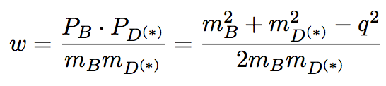


|V_{cb}| from exclusive decays
B → D*lν
B → Dlν
The form factors F(w) and G(w) are parameterized
[NPB 530, 153-181 (1997)]
  B → D*lν parameters: F(1), ρ_{D*}², R₁(1) and R₂(1)
  B → Dlν parameters: G(1), ρ_{D}²
Precision of the parameterization ~2%

Slide 6
Outline of the measurement
Experiments measure the B → D(*)lν decay width in bins of w
Fitting with the theoretical expressions yields F(1)|V_{cb}|, ρ_{D*}² (D*lν) or
G(1)|V_{cb}|, ρ_{D}² (Dlν)
Lattice QCD or heavy flavour sum rule predict the form factor normalization at
w = 1 (“zero recoil”), F(1) and G(1) → determination of |V_{cb}|
[PoS LATTICE2010, 311 (2010); PRD81, 113002 (2010); NPPS 140, 461-463 (2005); PLB585, 253-262 (2004)]

Slide 7
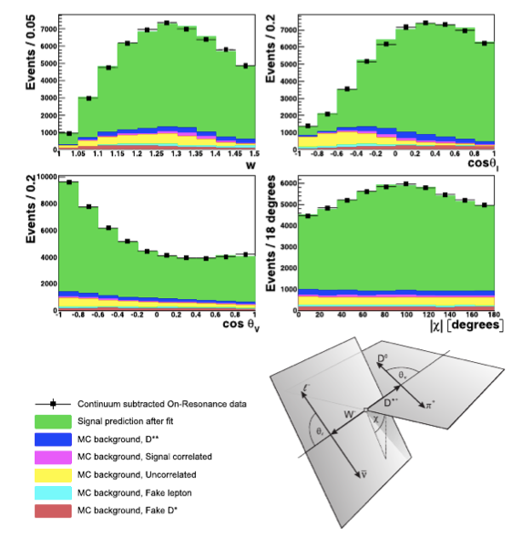
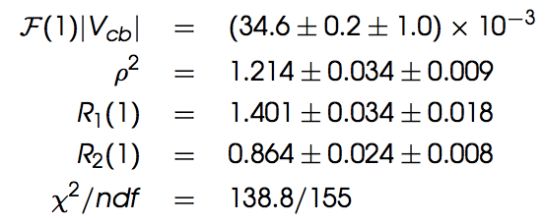
B⁰ → D^{*−}l⁺ν at Belle
[W. Dungel, CS, PRD 82, 112007 (2010)]
711/fb of Belle Y(4S) data
About 120,000 reconstructed B⁰ → D^{*-}l⁺ν decays
Fit in 40 bins of w, cos θ_{l}, θ_{V} and χ to obtain HQET F.F. parameters
Dominant experimental systematics: tracking

Slide 8
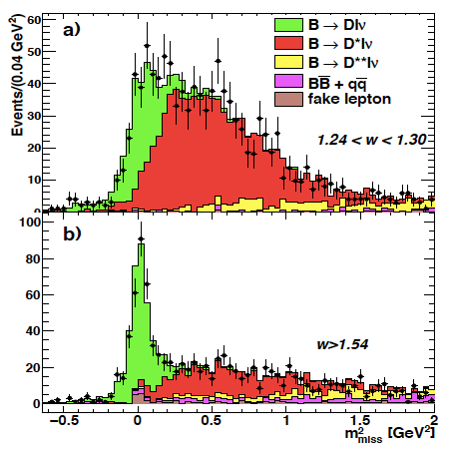


B → Dlν at BaBar
[PRL 104, 011802 (2010)]
417/fb of Y(4S) data
Hadronic tagging (efficiency: 0.5%) to reduce backgrounds and improve w resolution
D’s reconstructed in 16 different modes
2147 +/- 69 B⁺ → D⁰l⁺ν,
1108 +/- 45 B⁰ → D⁻l⁺ν decays reconstructed

Slide 9
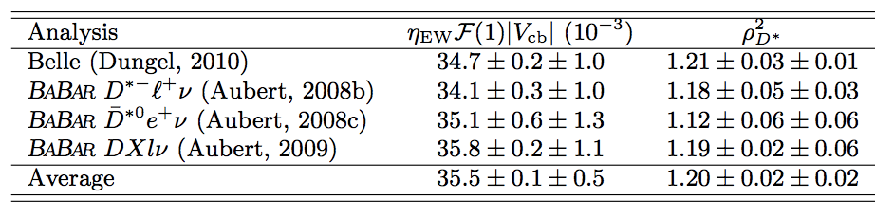
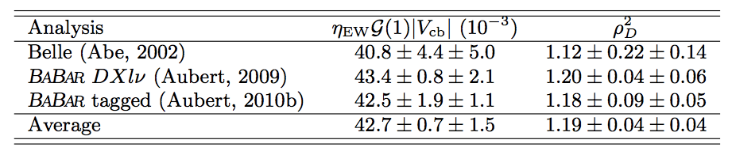
Recent measurements of F(1)|V_{cb}|, G(1)|V_{cb}|
B → D*lν
B → Dlν
(Measurements rescaled to updated values of the lifetime and D branching fractions)

Slide 10
HFAG average
[arXiv:1207.1158]
F(1)|V_{cb}| =
(35.90 +/- 0.11_{stat} +/- 0.44_{syst}) x 10⁻³
G(1)|V_{cb}| =
(42.64 +/- 0.72_{stat} +/- 1.35_{syst}) x 10⁻³

Slide 11
Inclusive decays

Slide 12


|V_{cb}| from inclusive decays
B → Xlν
Based on the Operator Product Expansion (OPE)
<O_{i}>: hadronic matrix elements (non-perturbative)
c_{i}: coefficients (perturbative)
Parton-hadron duality → the hadronic ME depend only on the initial state
 | Kinetic scheme [JHEP 1109 (2011) 055] | 1S scheme [PRD70, 094017 (2004)]
O(1) | m_{b}, m_{c} | m_{b}
O(1/m²_{b}) | μ²_{π}, μ²_{G} | λ₁, λ₂
O(1/m³_{b}) | ρ³_{D}, ρ³_{LS} | ρ₁, τ₁₋₃

Slide 13


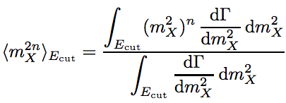
Moments of the E_{l} and M²_{X} spectrum
Also other observables in B → Xlν can be expanded into an
OPE with the same heavy quark parameters, e.g.,
The n^{th} moment of the (truncated) lepton energy spectrum
The n^{th} moment of the (truncated) M²_{X} spectrum
Master plan:
Measure the quark masses and heavy quark parameters using moments
Substitute them in the formula of the semileptonic width
Determine |V_{cb}| from the semileptonic branching fraction

Slide 14
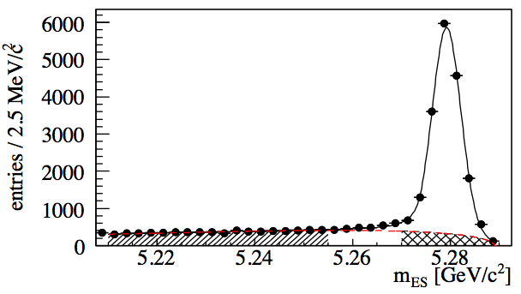
BaBar hadronic moments
232M BB
PRD 81, 032003 (2010)
Fully reconstruct the hadronic decay of one B in Y(4S) → BB (efficiency ~0.4%, purity ~80%)
B_{tag}
e/μ required
p(l) > 0.8 GeV/c
X
B_{sig}
l
Require one identified lepton amongst the signal-side particles (p > 0.8 GeV/c)
Combine all remaining particles to the X system and do a kinematic fit
  4-momentum conservation
  Missing mass consistent with zero mass neutrino
Y(4S)
B_{tag}

Slide 15
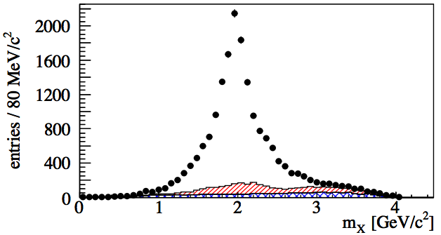
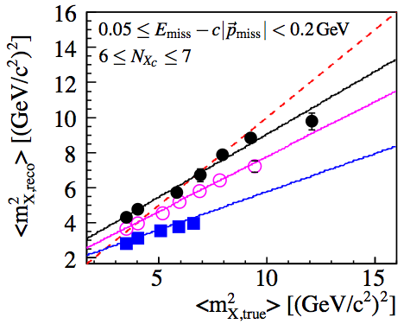
Moment measurement
PRD 81, 032003 (2010)
Hadronic mass spectrum after kinematic fit
Linear correction of the measured moments in bins of X multiplicity, E_{miss}-cp_{miss} and lepton momentum
Moments of the hadronic mass spectrum up to M⁶_{X} for E_{cut} between 0.8 and 1.9 GeV (in B rest frame) are measured
Also mixed mass-energy moments are determined and the electron energy moments from [PRD69, 111104] are re-evaluated

Slide 16
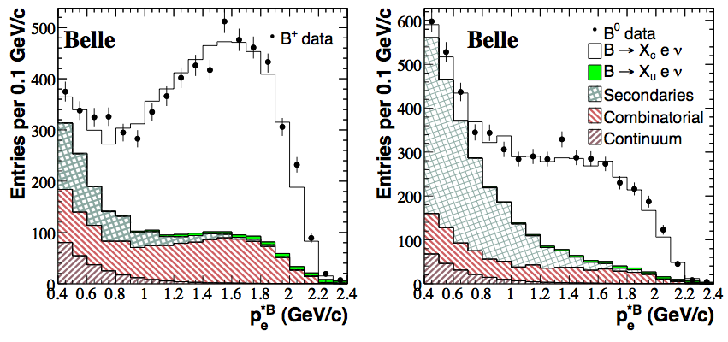
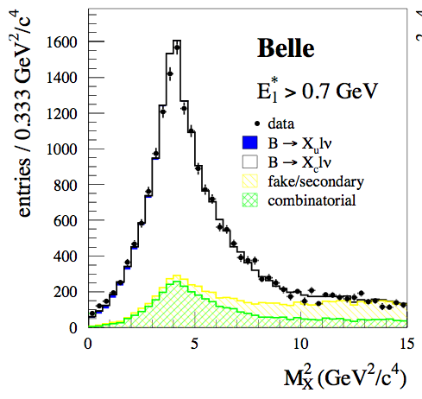
Belle E_{l} and M²_{X} moments
PRD 75, 032001 (2007)
PRD 75, 032005 (2007)
152M BB
For both the E_{l} and M²_{X} measurements, similar experimental method using fully reconstructed events
The finite detector resolution is unfolded with SVD algorithm [NIM A372, 469 (1996)]
<E^{n}_{e}> measured for n=0,…,4 and E_{cut}=0.4-2.0 GeV
<M^{2n}_{X}> measured for n=1,2 and E_{cut}=0.7-1.9 GeV
16

Slide 17
Moment measurements available
BaBar | <E^{n}_{l}>: n=0,1,2,3 [PRD 69, 111104 (2004), PRD 81, 032003 (2010)] <M^{2n}_{X}>: n=1,2, 3 [PRD 81, 032003 (2010)]
Belle | <E^{n}_{l}>: n=0,1,2,3 [PRD 75, 032001 (2007)] <M^{2n}_{X}>: n=1,2 [PRD 75, 032005 (2007)]
CDF | <M^{2n}_{X}>: n=1,2 [PRD 71, 051103 (2005)]
CLEO | <M^{2n}_{X}>: n=1,2 [PRD 70, 032002 (2004)]
DELPHI | <E^{n}_{l}>: n=1,2,3 <M^{2n}_{X}>: n=1,2,3 [EPJ C45, 35 (2006)]

Slide 18
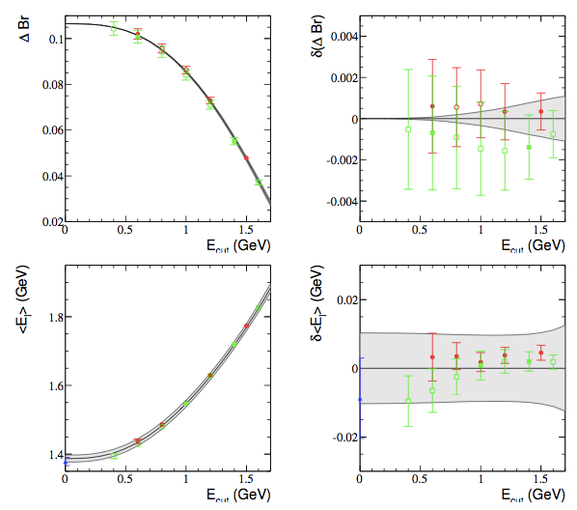
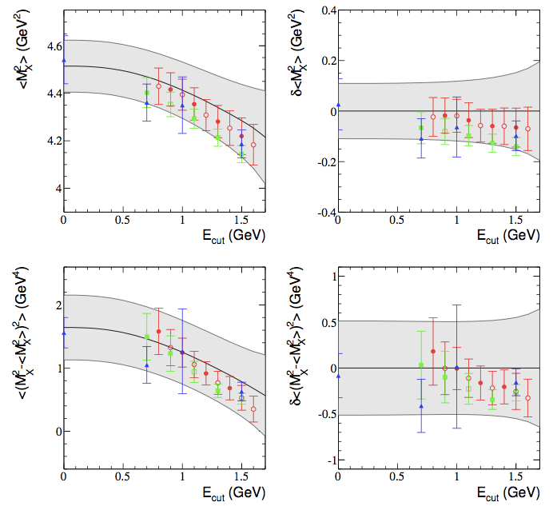
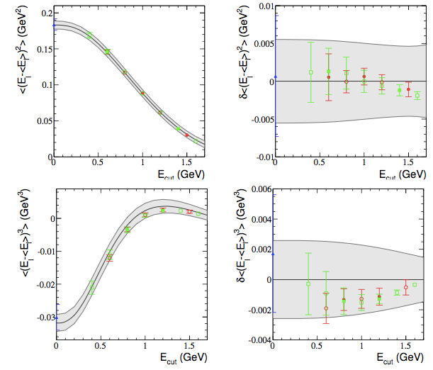
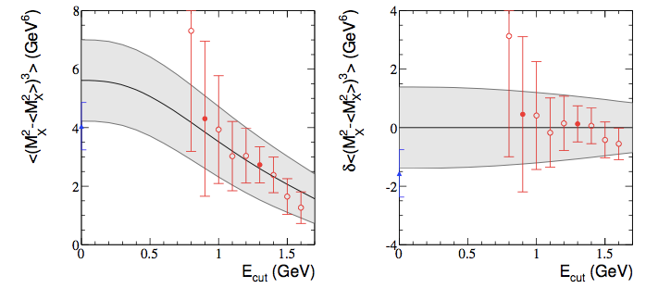
Analysis in the kinetic scheme with 50 moments from BaBar, Belle, CDF, CLEO and DELPHI
[P. Gambino, CS, Phys.Rev.D89, 014022 (2014)]

Slide 19
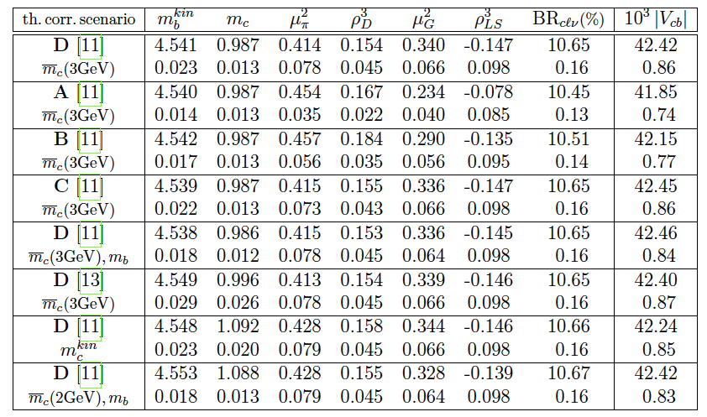
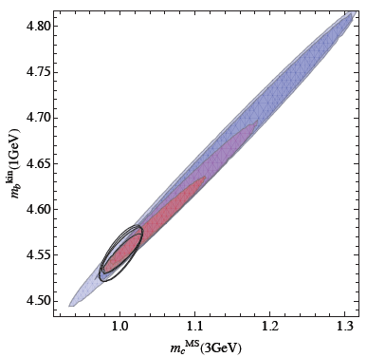
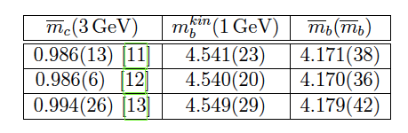
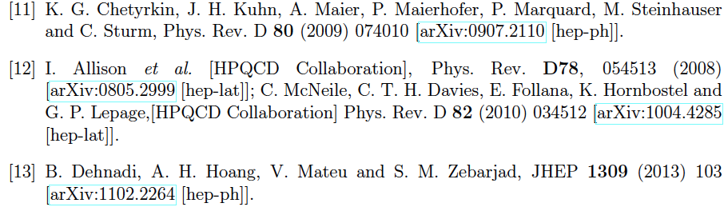
Global fit (kinetic scheme)
[Phys.Rev.D89, 014022 (2014)]

Slide 20
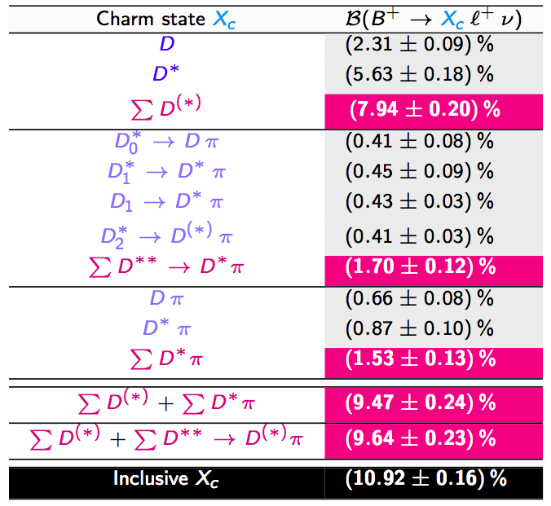
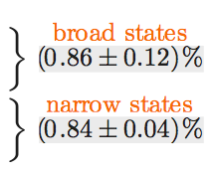
B → D**lν mystery
Inclusive-exclusive gap of (1.45 +/- 0.29)%
1/2 vs. 3/2 puzzle
Belle II might clarify the situation by measuring
B → D^{(*)}nπlν
Sascha Turczyk
CKM 2012 workshop

Slide 21
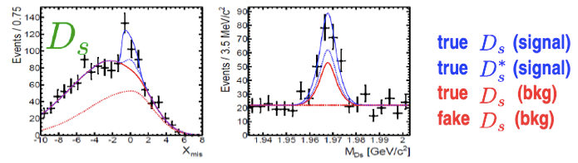

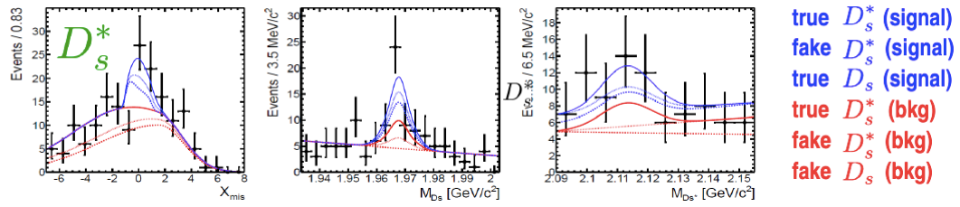

B → D_{s}^{(*)}Klν at Belle
[Phys.Rev.D86, 072007 (2012)]
657 million BB events
D_{s}^{*+} → D_{s}⁺ γ, D_{s}⁺ → φ(K⁺ K⁻)π⁺
First separate measurement of D_{s}K and D_{s}*K
Combined significance 6σ

Slide 22
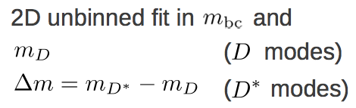
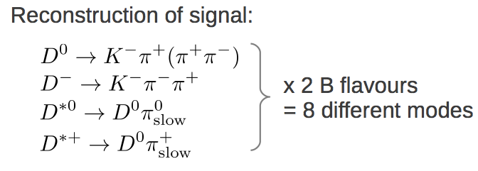
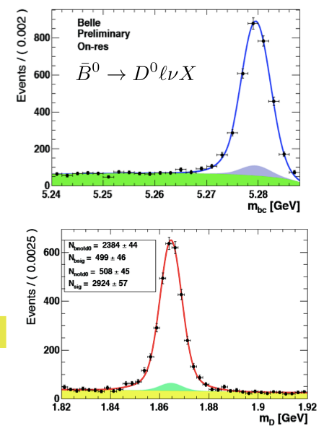

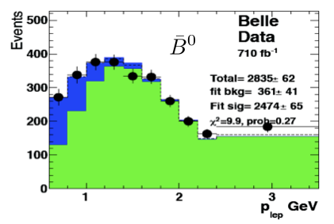
B → D^{(*)}Xlν at Belle
preliminary
711/fb of Y(4S) data
Hadronic tagging

Slide 23

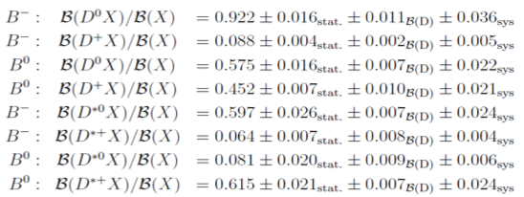
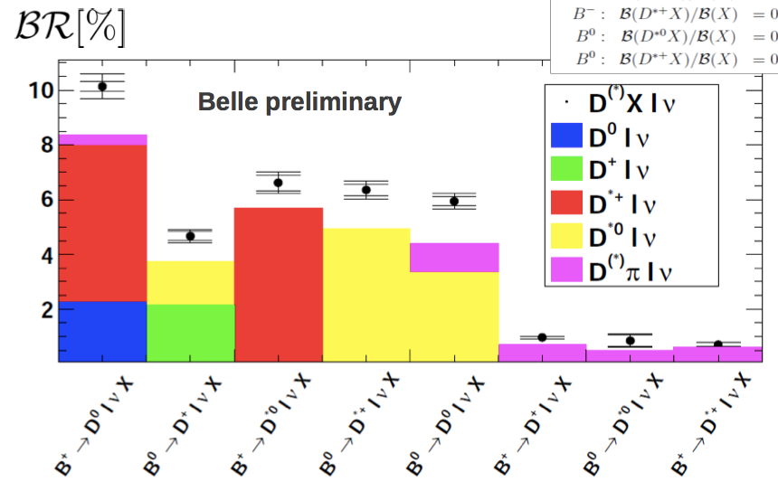
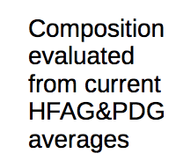
B → D^{(*)}Xlν at Belle (2)
preliminary

Slide 24
EXCLUSIVE VS. INCLUSIVE

Slide 25
|Vcb|
Exclusive (D*lν)
F(1)|V_{cb}| = (35.90 +/- 0.11_{stat} +/- 0.44_{syst}) x 10⁻³
 | F(1) | |Vcb| (10⁻³)
Lattice QCD [PoS LATTICE2010, 311 (2010)] | 0.908 +/- 0.017 | 39.54 +/- 0.50_{exp} +/- 0.74_{th}
Lattice QCD [arXiv:1403.0635] | 0.920 +/- 0.013 | 39.04 +/- 0.49_{exp} +/- 0.56_{th}
Sum rules [PRD81, 113002 (2010)] | 0.866 +/- 0.020 | 41.47 +/- 0.52_{exp} +/- 0.96_{th}
Exclusive (Dlν)
G(1)|V_{cb}| = (42.64 +/- 0.72_{stat} +/- 1.35_{syst}) x 10⁻³
 | G(1) | |Vcb| (10⁻³)
Lattice QCD [NPPS 140, 461-463 (2005)] | 1.081 +/- 0.024 | 39.44 +/- 1.42_{exp} +/- 0.88_{th}
Sum rules [PLB585, 253-262 (2004)] | 1.047 +/- 0.020 | 40.73 +/- 1.46_{exp} +/- 0.78_{th}

Slide 26
|Vcb|
Inclusive
|V_{cb}| = (42.42 +/- 0.86) x 10⁻³
[PRD 89, 014022 (2014)]
While sum rule calculations for the F.F. normalization lead to consistent inclusive/exclusive results, F.F. from the lattice give 2-3σ discrepancy
Different treatment of the electroweak corrections in the different calculations

Slide 27
Summary
Semileptonic B decays to open charm have allowed to determine the CKM matrix elements |V_{cb}| to the level of ~2%
The lattice QCD values for the form factor normalization indicate a discrepancy between exclusive and inclusive
Inclusive/exclusive gap and 1/2 vs. 3/2 puzzle: These issues need to be addressed at the super flavor factories (Belle II)

Slide 28
backup

Slide 29
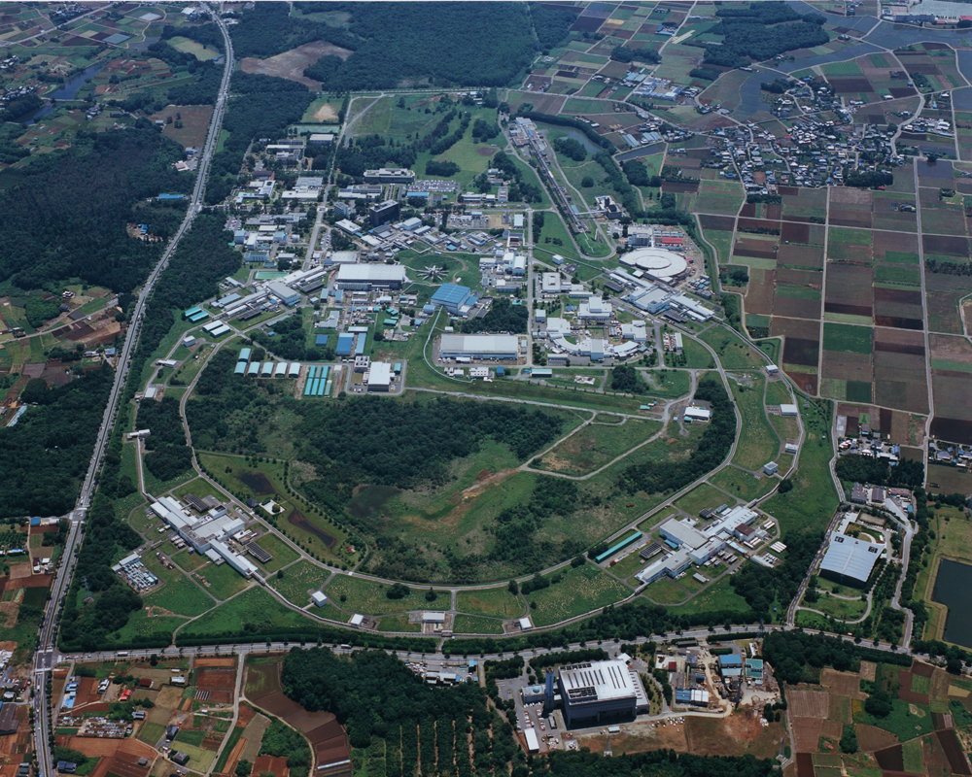
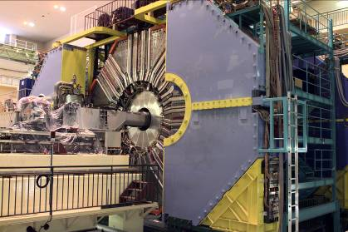
1999 – 2010: B factory at KEK (Japan)
Linac
KEKB double
ring e⁺e⁻ collider
e⁺e⁻ → Y(4S) → BB
Belle detector
World largest B meson sample
~771 million BB events
~400 Belle physics publications

Slide 30
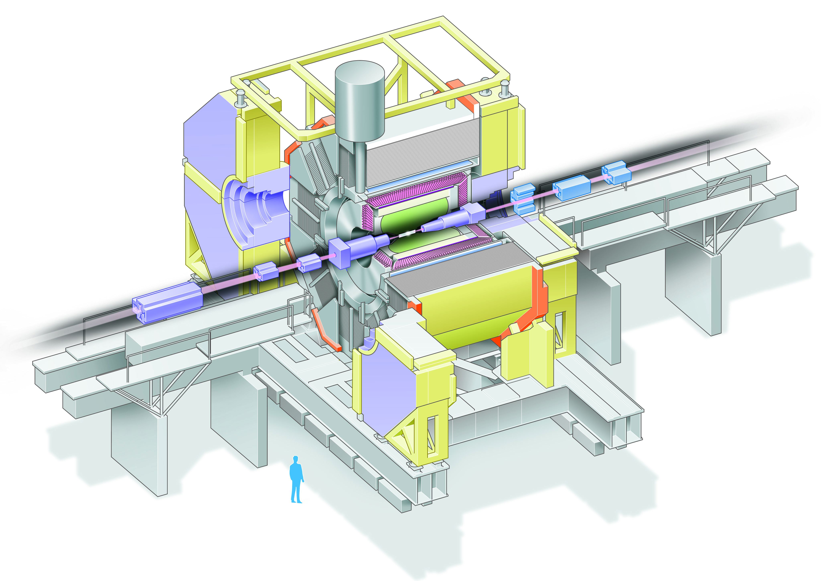
Aerogel Cherenkov cnt.
n=1.015~1.030
SC solenoid
1.5T
3.5 GeV e⁺
CsI(Tl)
16X₀
TOF counter
8 GeV e⁻
Central Drift Chamber
small cell +He/C₂H₅
Si vtx. det.
3(4) lyr. DSSD
μ / K_{L} detection
14/15 lyr. RPC+Fe
Lepton ID efficiency ~90%
Fake rate ~0.1% (electrons), ~1% (muons)

Slide 31
Prospects for |V_{cb}| at Belle II
  Tagged measurement of B → D*lν and B → Dlν will yield |V_{cb}| with a similar level of precision
  Fit with lattice data at different kinematic points?
Expected relative uncertainty in |V_{cb}| from B → D*lν
Sample | Stat | Syst | Th | Total
711/fb | 0.6 | 3.0 | 1.8 | 3.6
5/ab | 0.2 | 1.5 | 1.5 | 2.2
50/ab | 0.1 | 1.1 | 1.0 | 1.5
lattice prospects from
http://www.usqcd.org/documents/13flavor.pdf

Slide 32

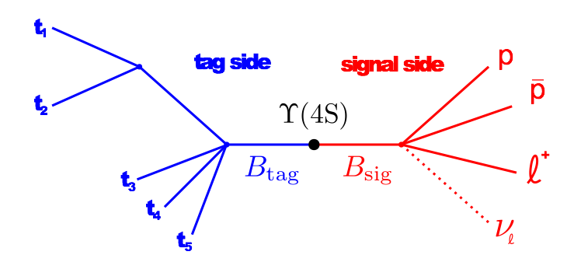
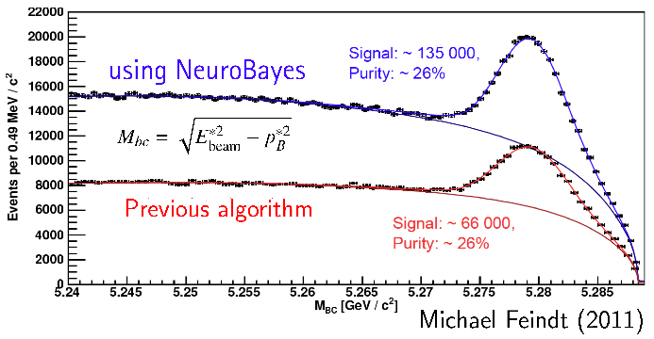
New Belle hadronic tag
[NIM A654, 432 (2011)]
New hadronic tag based on Neurobayes
2-3x statistical gain over previous analyses

Slide 33
Issues in |V_{cb}|
|V_{cb}| exclusive mainly comes from B⁰ → D^{*-} l⁺ ν
  |V_{cb}| from B⁺ → D^{*0}bar l⁺ ν, B⁰ → D⁻ l⁺ ν and
  B⁺ → D⁰bar l⁺ ν is considerably less precise
  Measurements of B⁰ → D^{*-} l⁺ nu by different experiments are consistent but could be affected by common systematics (slow pion tracking)
F(w) and G(w) form-factors
  Calculated only at a single kinematic point (zero recoil w=1) – can lattice predict the F.F. shape also in B decays?
  Precise calculation of F(1) available only from a single lattice group (FNAL MILC)
  Discrepancy with sum rule calculations (~1 sigma)
Radiative and EW corrections?

