Slide 1
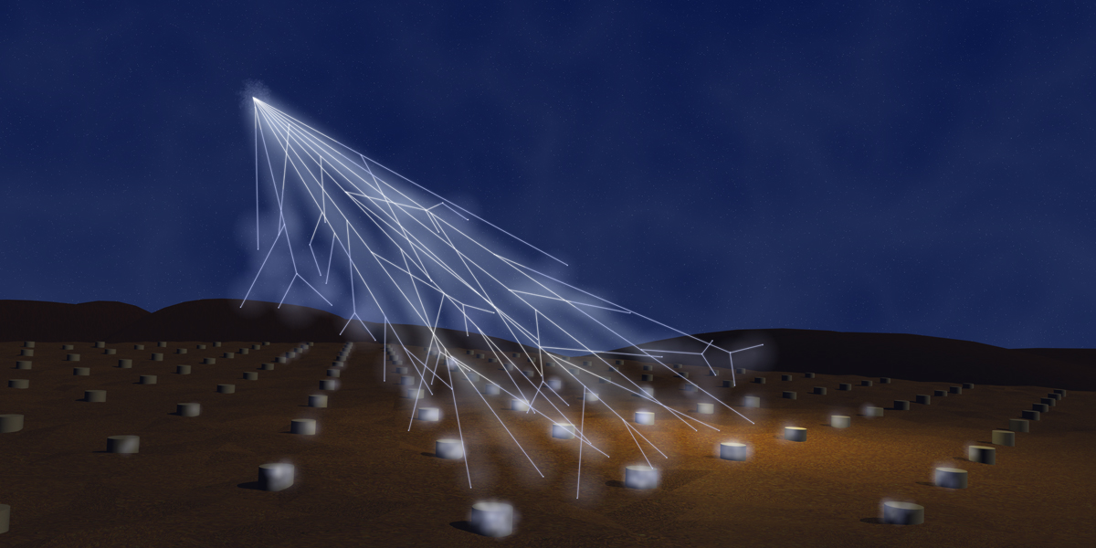
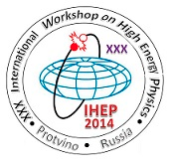
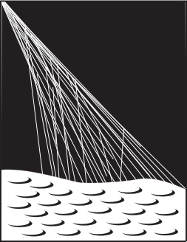

The Pierre Auger Observatory: latest results and future prospects
Fernando Arqueros
Universidad Complutense de Madrid

Slide 2
Outline
Motivation
The Observatory
Latest results:
  Energy Spectrum
  Mass composition
  Anisotropies
  Other components: photons, neutrinos.
The Future

Slide 3
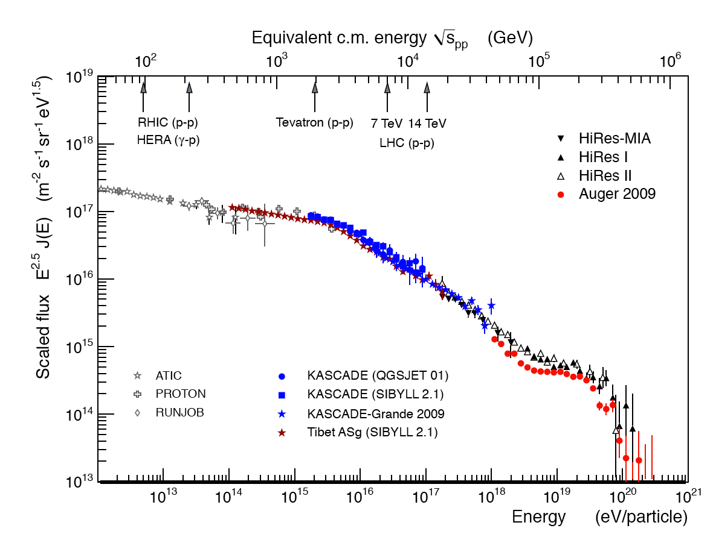
Ultra High Energy Cosmic Rays
The largest energies.
Produced in cosmic accelerators.
Interact with atmospheric nuclei at
the largest c.m. energies.
knee
ankle
Astrophysics
Sources
Propagation
Particle Physics
Hadronic interactions
New physics?
cutoff
Measurements
Energy spectrum
Arrival directions
Mass composition
UHECR

Slide 4
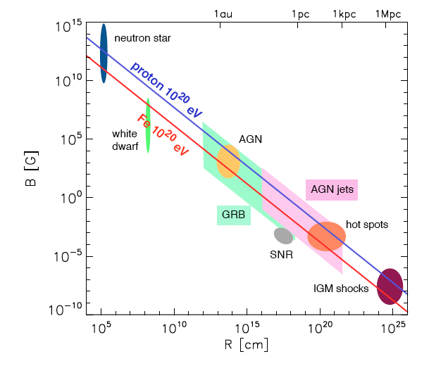
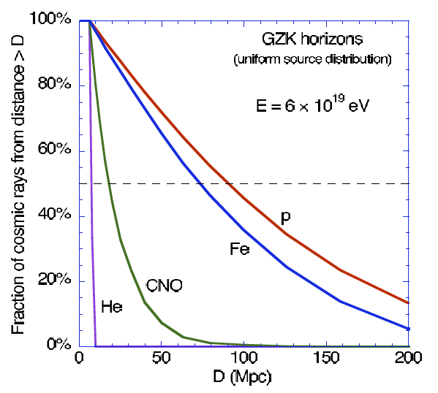
The end of the spectrum
GZK effect (Greisen, Zatsepin and Kuzmin - 1966)
Photo-pion production
cutoff
Photo disintegration
Hillas plot
updated by Kotera and Olinto (2010)
GZK Horizon
and/or
Is the end in the sources?

Slide 5
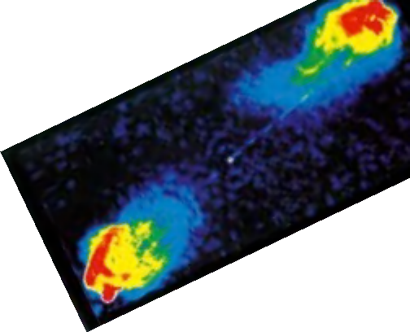
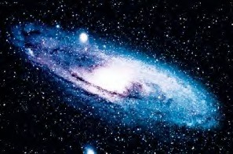
Anisotropies
Cosmic Magnetic Fields
R_{L} = kpc Z⁻¹ (E / EeV) (B / μG)⁻¹
R_{L} = Mpc Z⁻¹ (E / EeV) (B / nG)⁻¹
γ , n
Weak deflection
E > 10¹⁹ eV
p
Strong deflection
E < 10¹⁸ eV
Milky way
B ~ μG
Extra-galactic B < nG ?
Halo B?

Slide 6
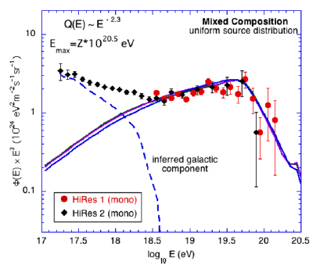
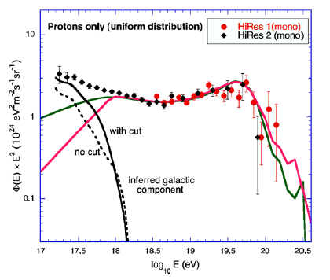
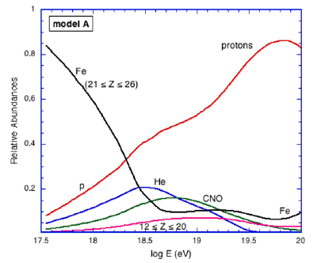
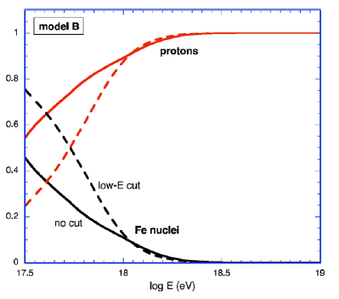
The ankle (GCR/EGCR transition?)
Ankle
D. Allard et al.
Protons only
Relative Abundances
Relative Abundances
Mixed composition

Slide 7
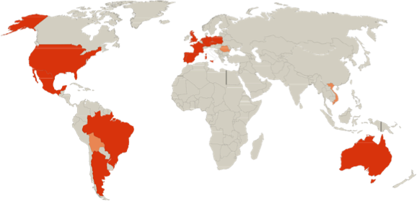
The Pierre Auger collaboration
Argentina
Australia
Brazil
Croatia
Czech Rep.
France
Germany
Italy
Mexico
Netherlands
Poland
Portugal
Slovenia
Spain
United Kingdom
USA
Bolivia*
Romania*
Vietnam*
> 500 Collaborators from 19 countries
Pierre Auger
Observatory
* associate members

Slide 8
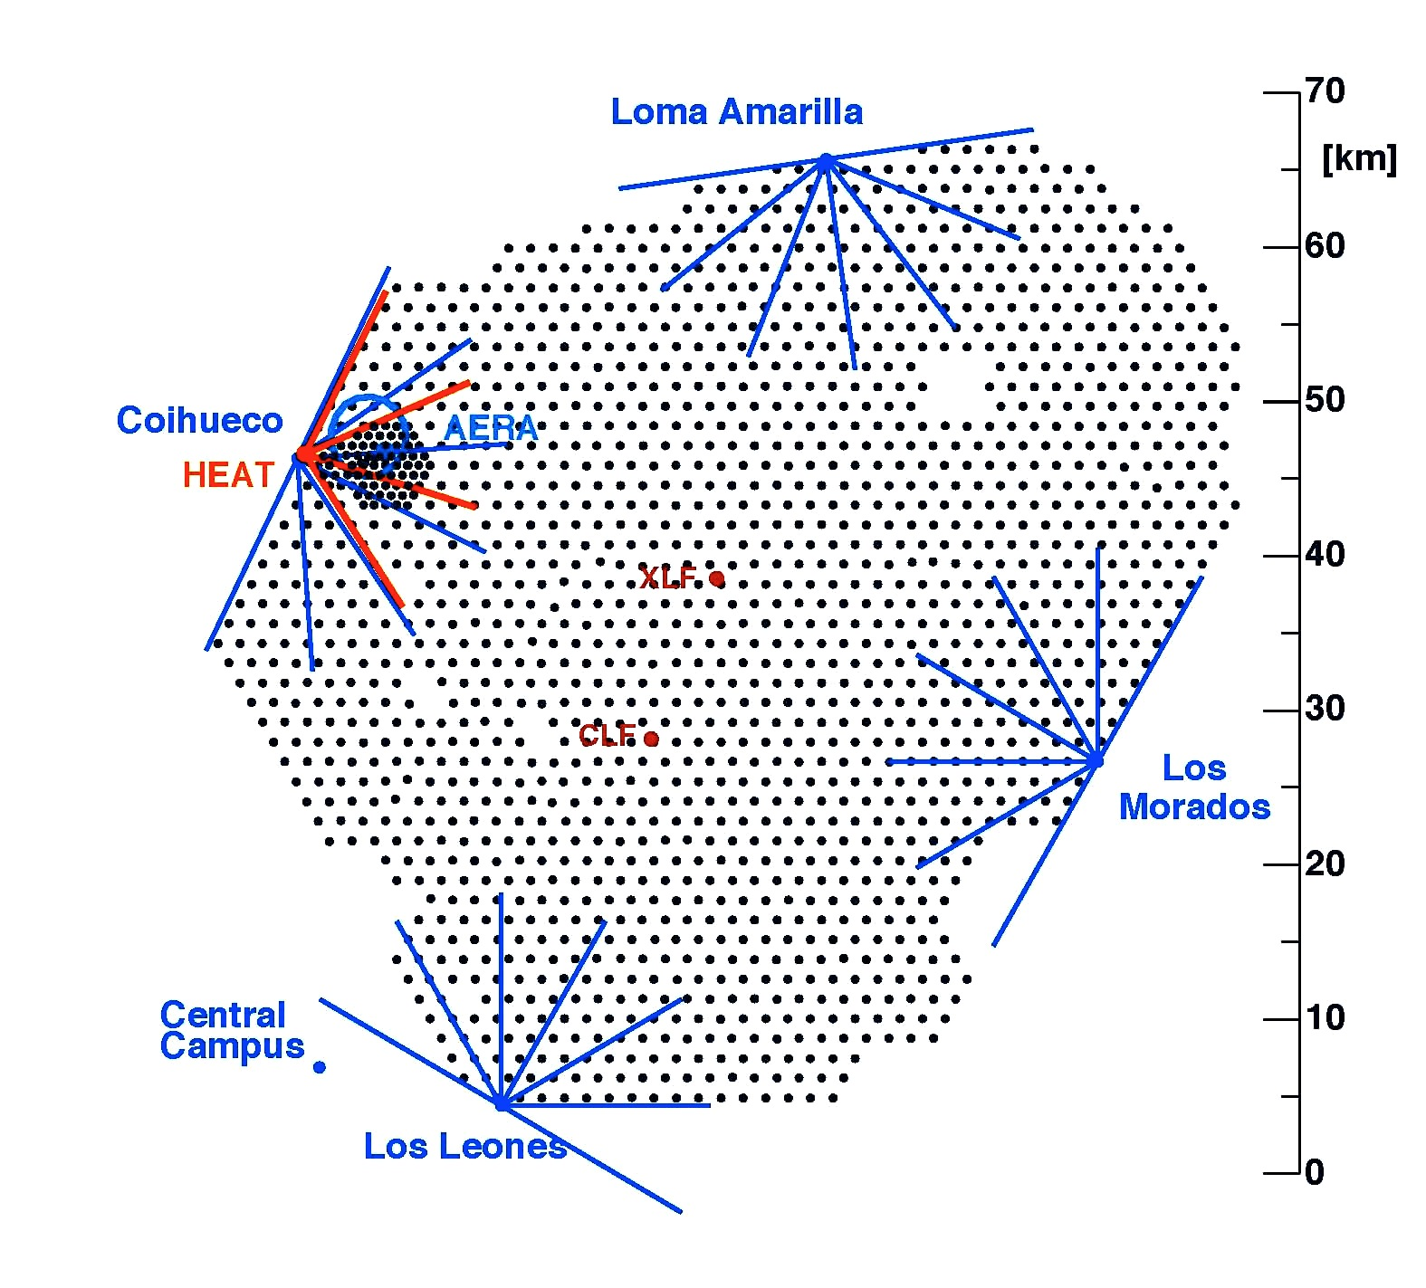
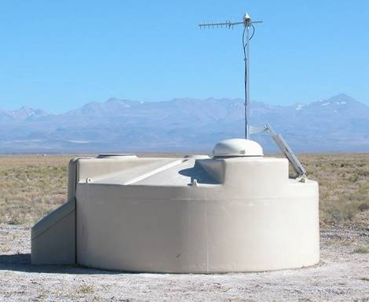
Surface Detector SD
SD
1660 water Č-light
1.5 km spacing; 3000 km²
AMIGA
Infill grid and
muon counters

Slide 9
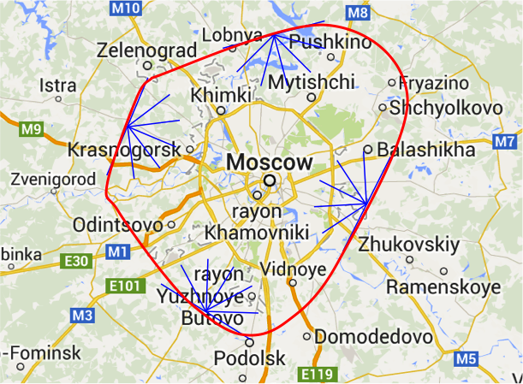
3000 km²

Slide 10
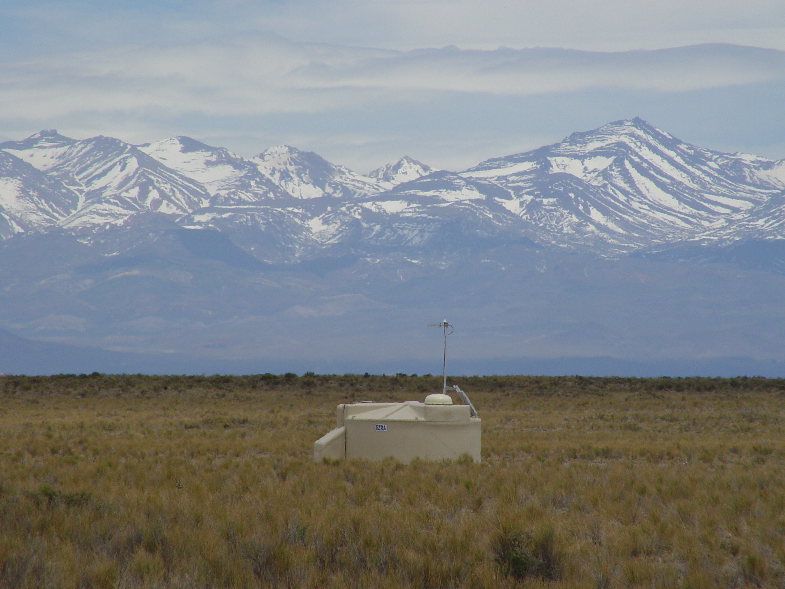
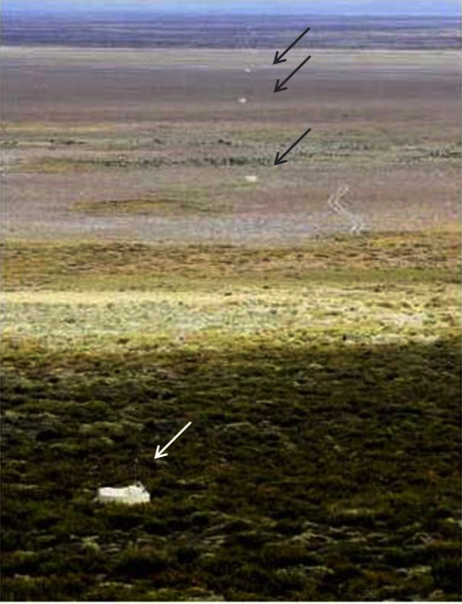
Surface Detector
SD unit
Communications
antenna
GPS antenna
Electronics
enclosure
Solar panels
Battery box
1.5 km
three – 9’’ PMT
Plastic tank with
12 tons of water

Slide 11
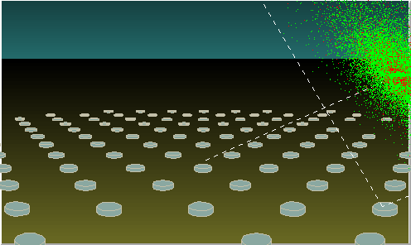
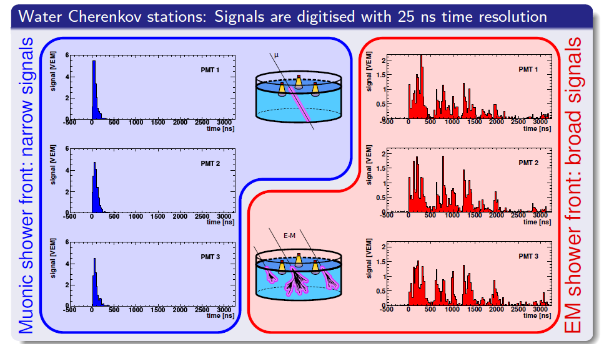
Surface Detector
The time structure of the SD signals
contains very useful information
The SD samples the tail of the shower
Muon rich
EM rich

Slide 12
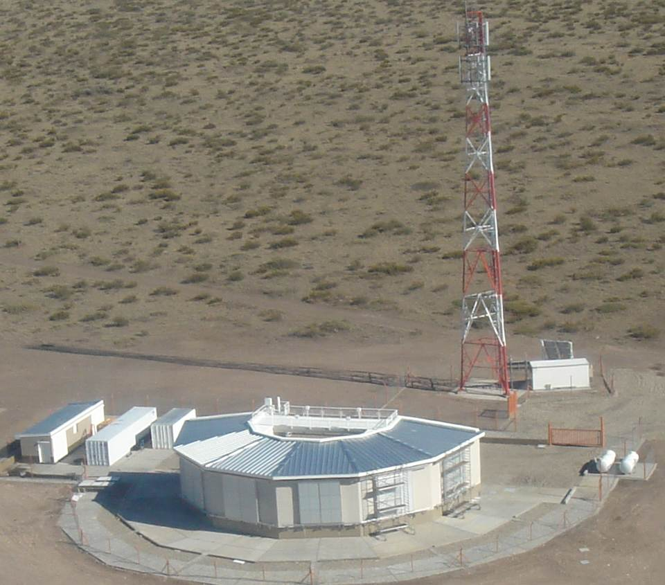
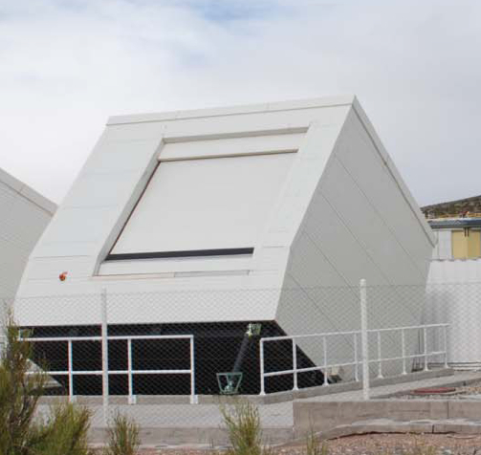
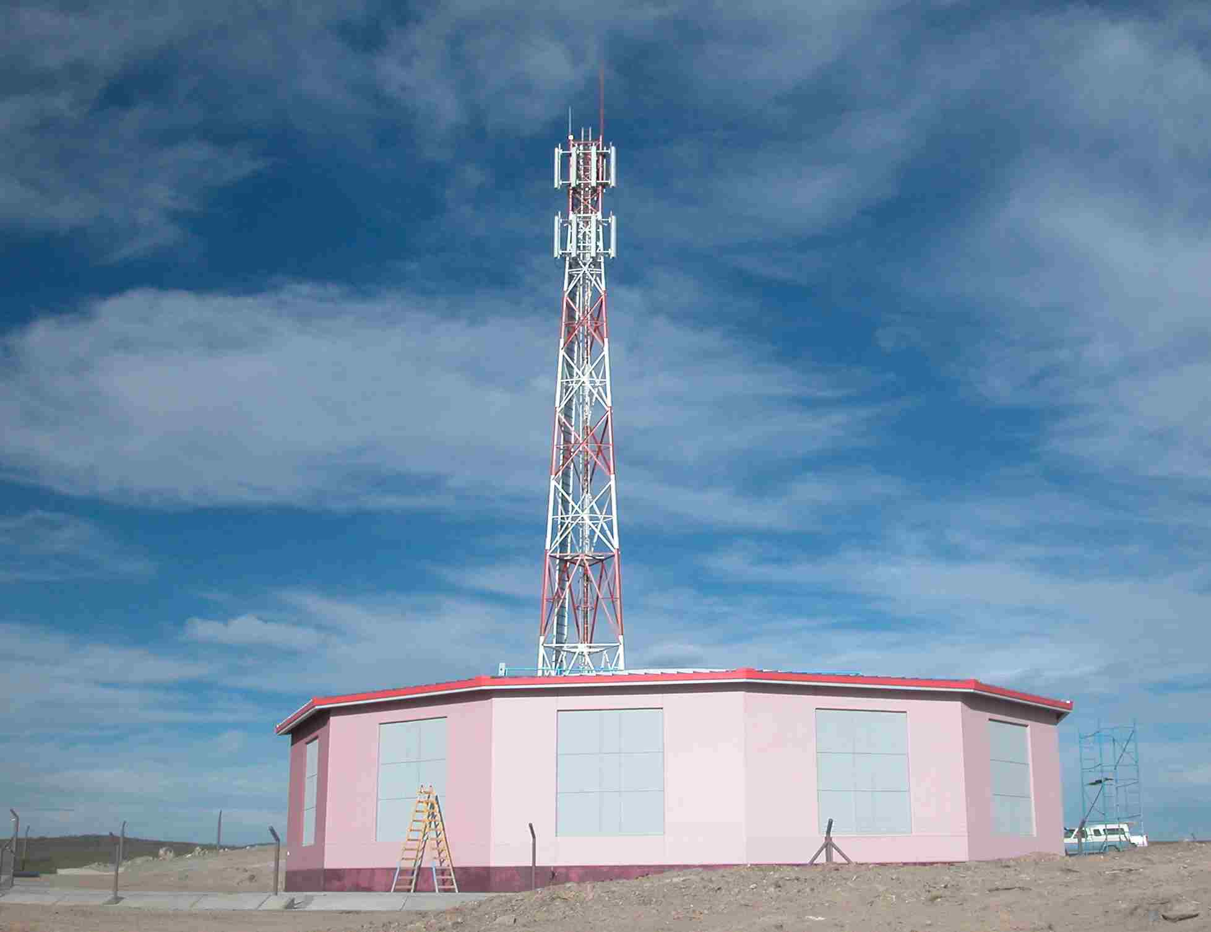
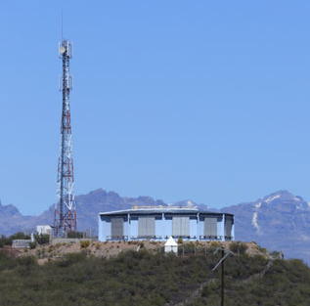
Fluorescence detector FD
AMBER
Radio
4 bays (CO, LL, LM, LA) x 6 =
24 Fluorescence telescopes
Tilted telescopes
overlooking the infill
CLF/XLF

Slide 13
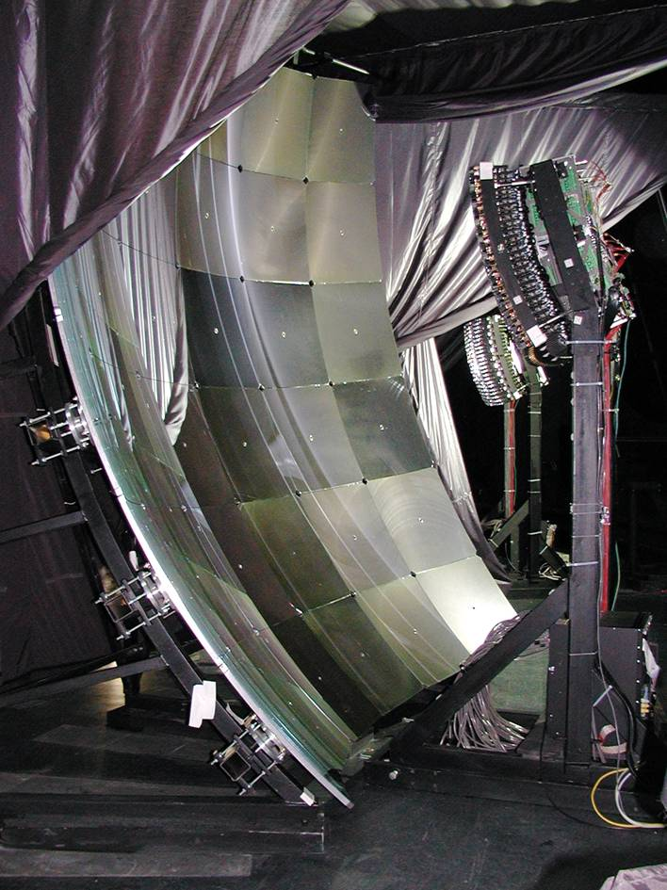
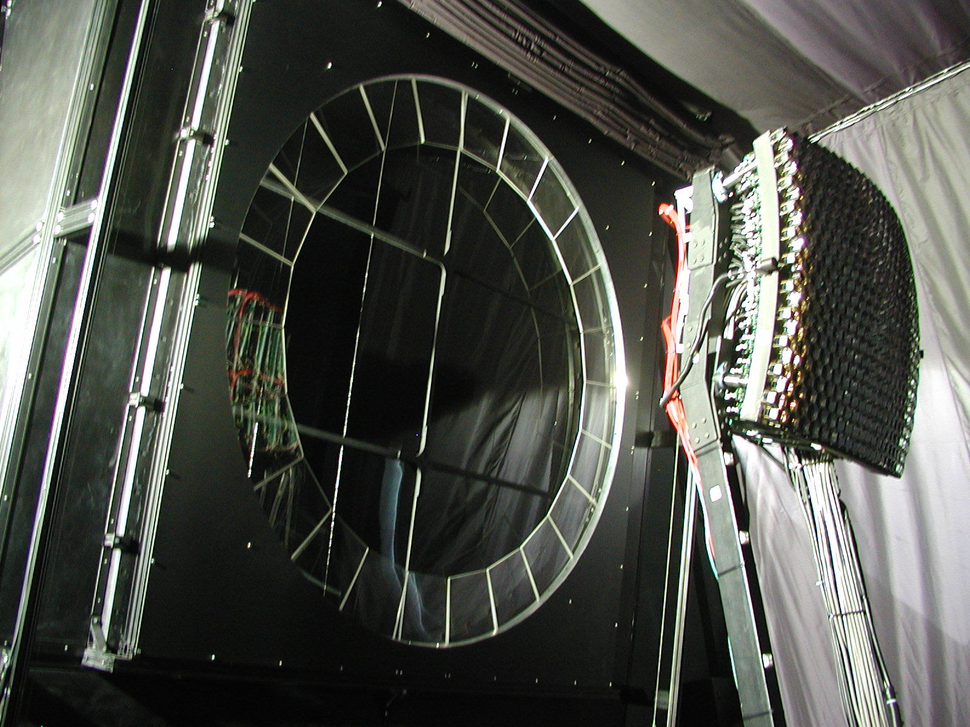
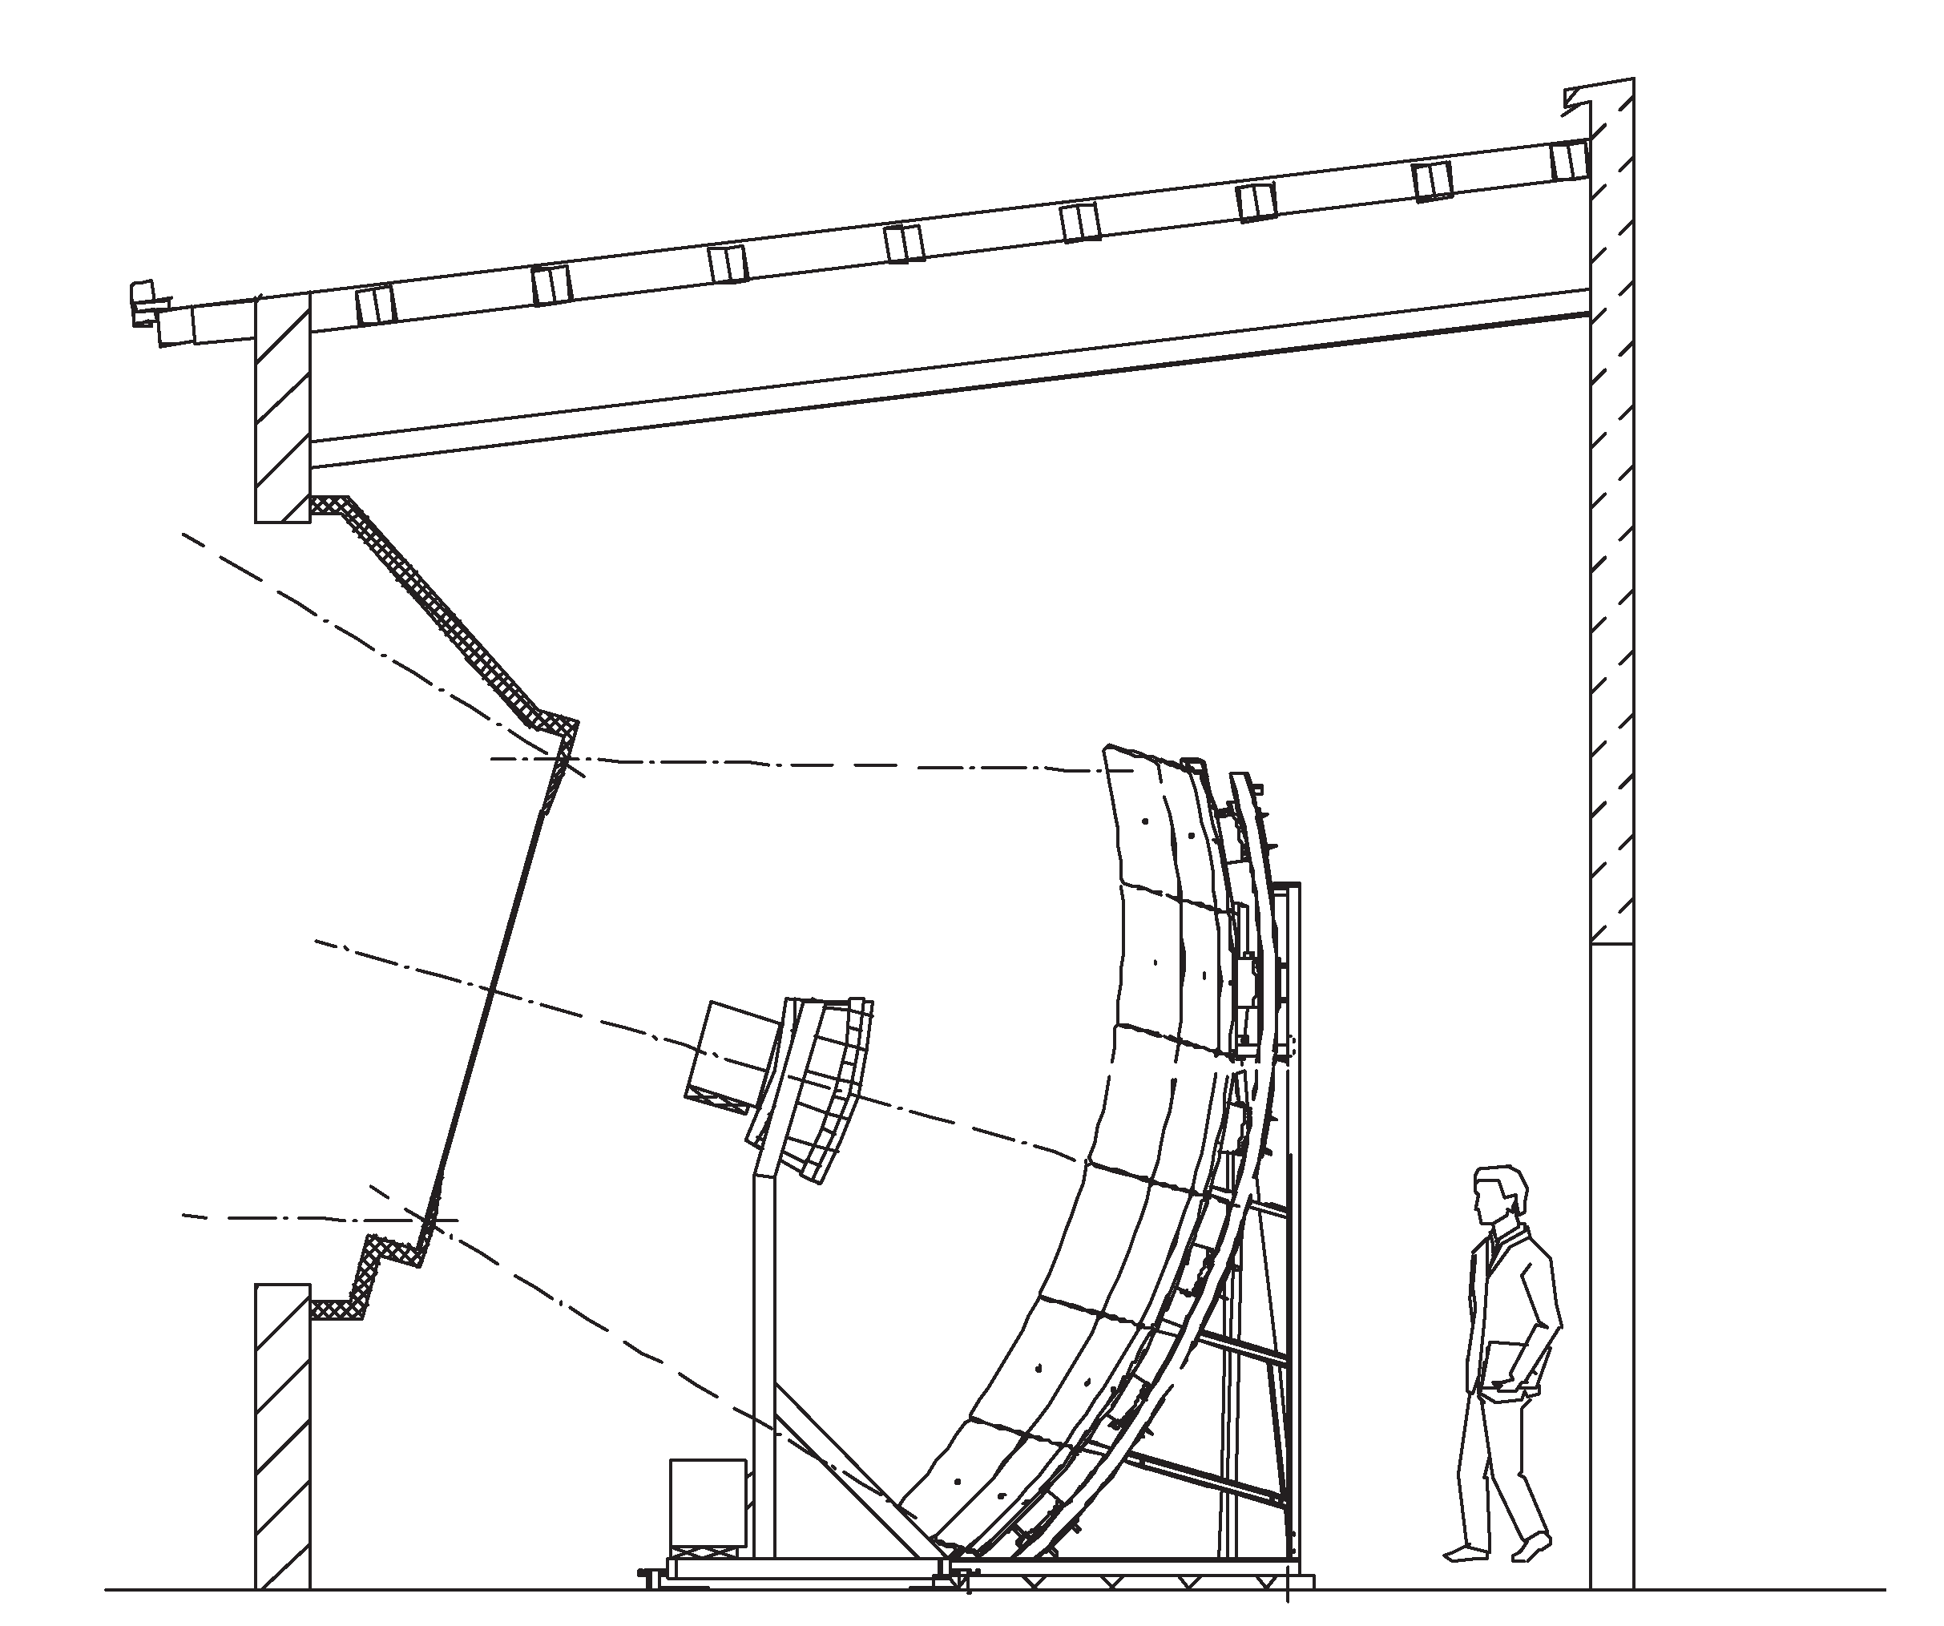
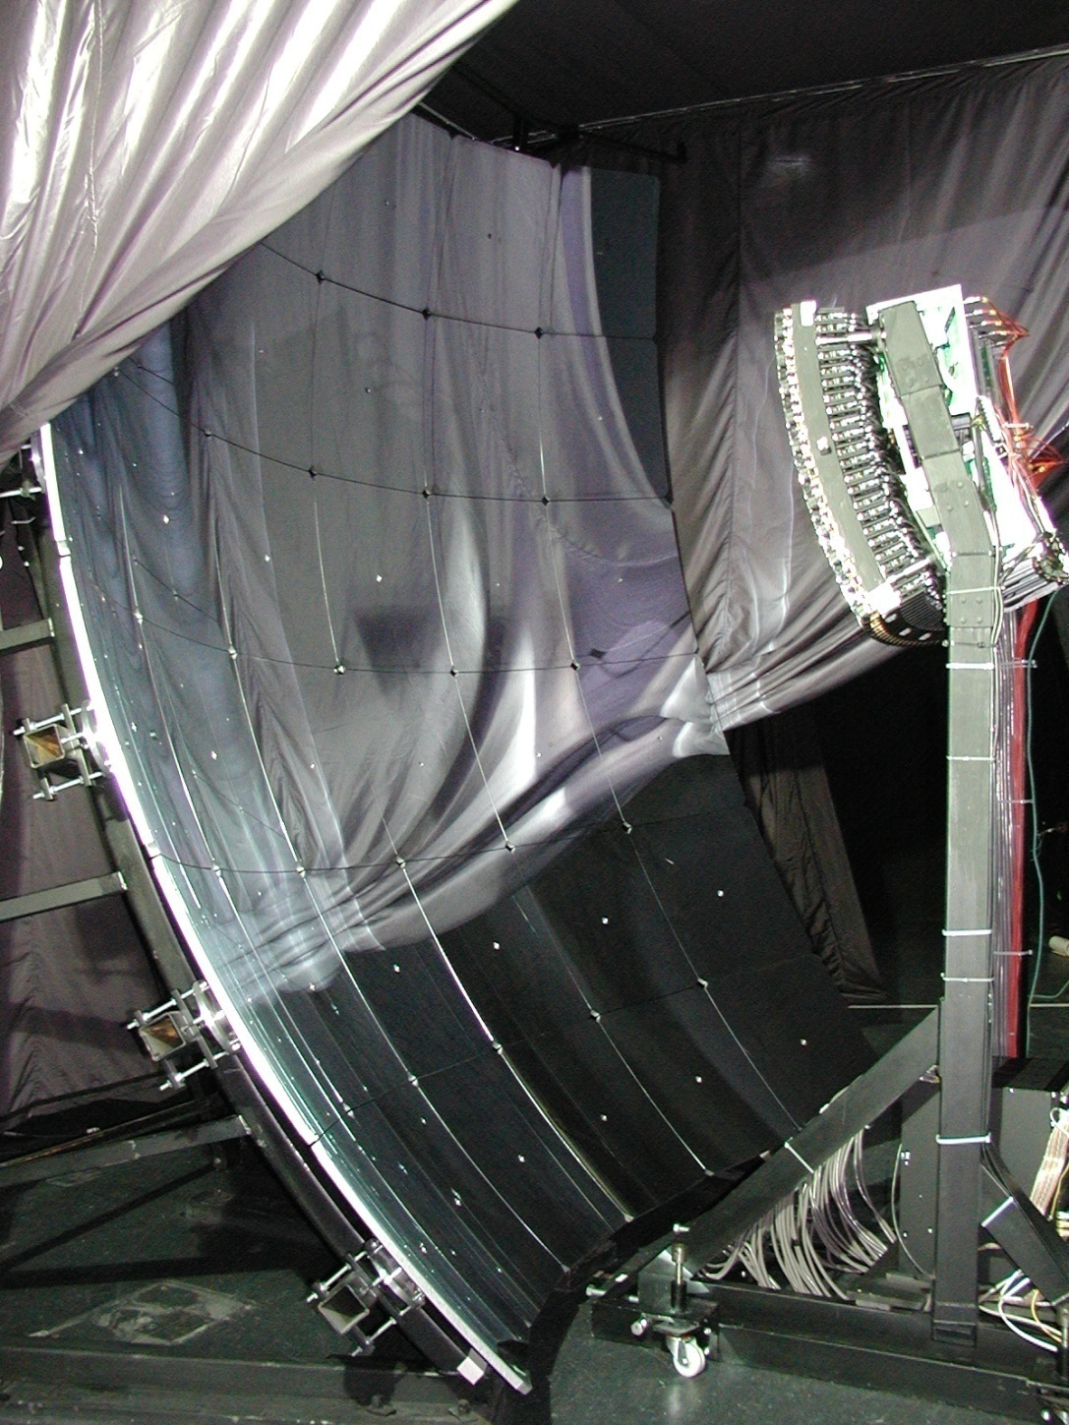
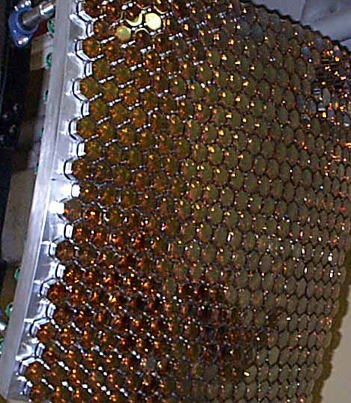
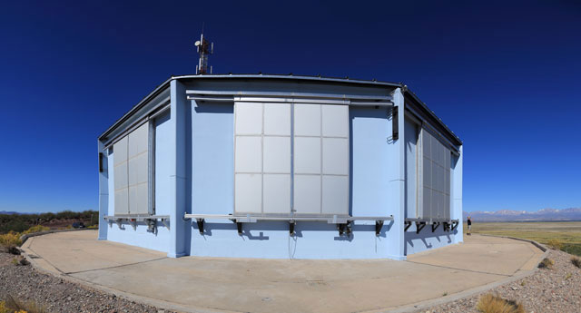
Fluorescence Detector
4 buildings at the boundary of the surface array
6 telescopes each (13% duty cycle)
2.2 m mirror Ø
corrector
ring
3.8 x 3.8 m² mirror
camera
Camera
Corrector ring and camera
UV filter
300 – 400 nm
mirror
Telescope building
30° x 28.6° field of view
440 PMT PHOTONIS XP3062
1.5° fov
100 ns sampling intervals

Slide 14
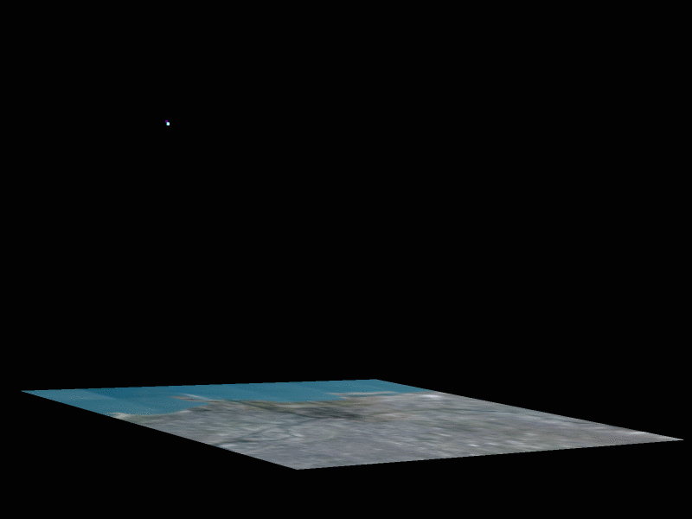
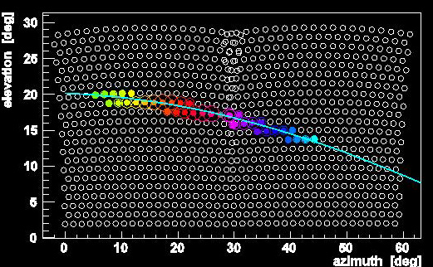

The fluorescence technique
Fluorescence telescopes “see” the UV light emitted by N₂ molecules
excited by shower electrons

Slide 15
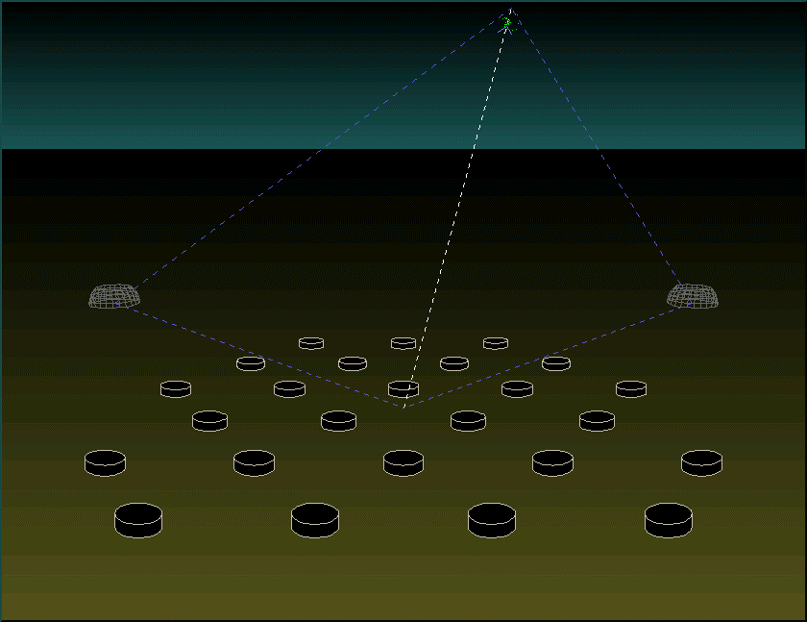
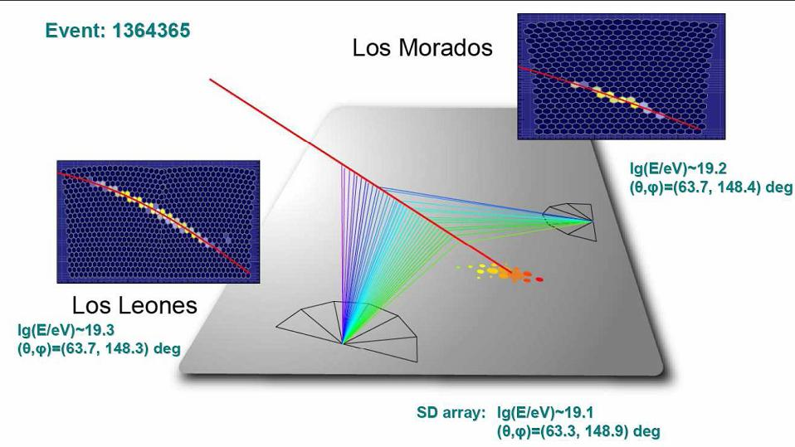
The Hybrid Detector
- Complementary techniques
- Different shower parameters
- Different systematics
Accurate determination of primary properties
arrival direction
energy
nature (mass, photons, neutrinos,..)
SD
Acceptance: Geometric
Energy: Mass and Model dependent
Duty cycle ≈ 100%
FD
Acceptance: E, γ, A, M dependent
Energy: nearly calorimetric
Duty cycle ≈ 13%
Large statistics with accurate knowledge of acceptance and energy

Slide 16
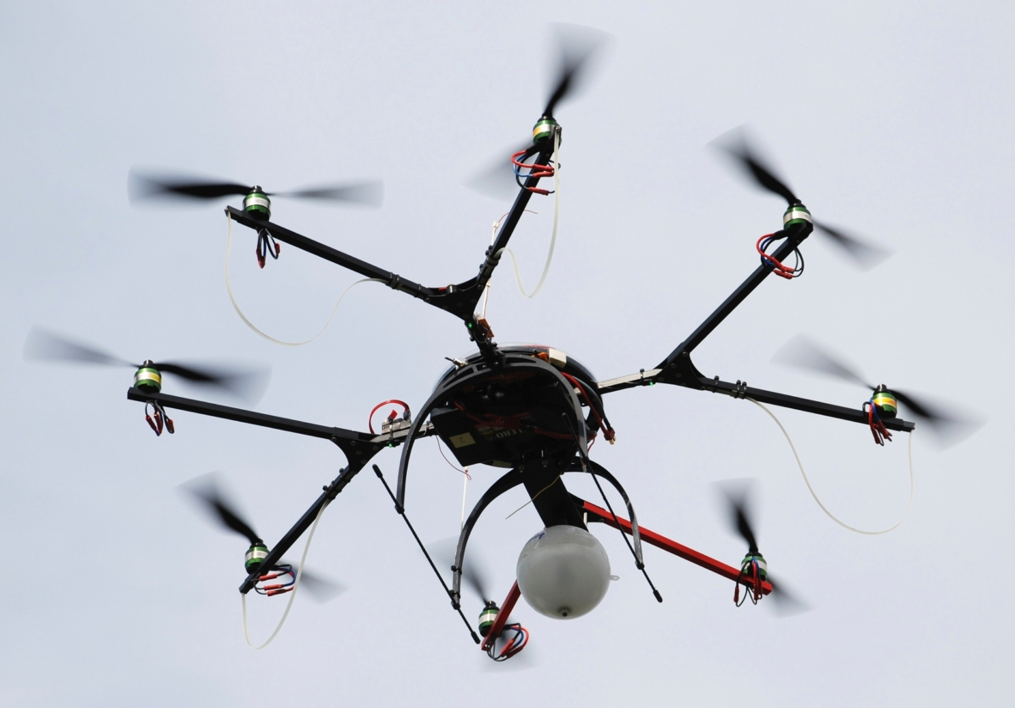
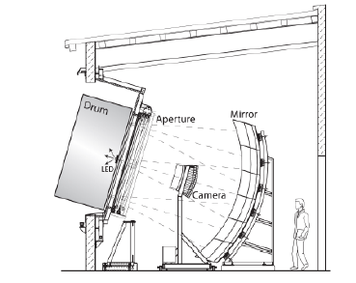
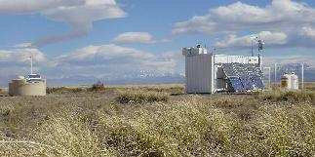
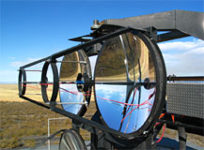
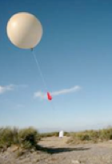
Atmospheric monitoring and calibration tools
Optocopter
AMBER
LIDAR
Drum
CLF/XLF
balloons

Slide 17
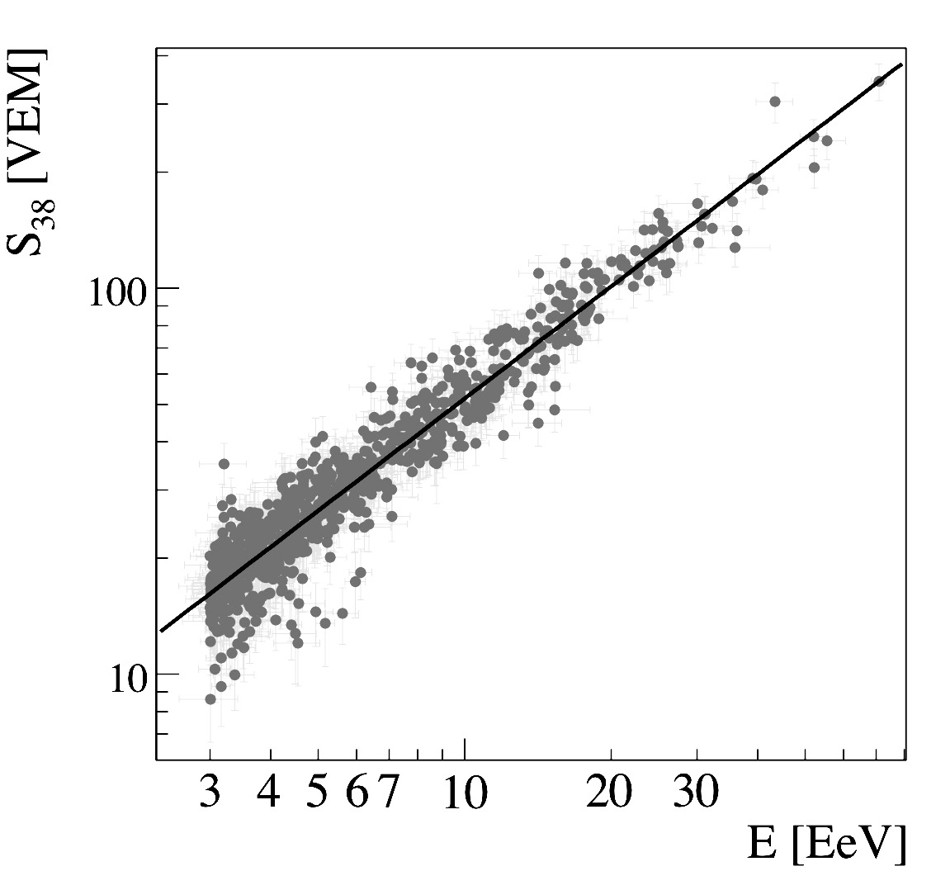
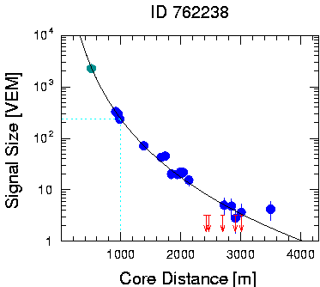
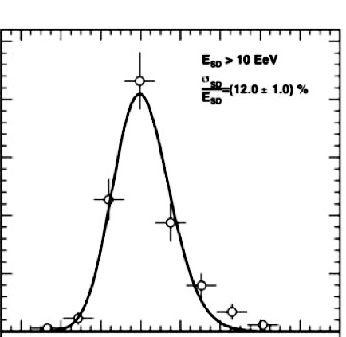
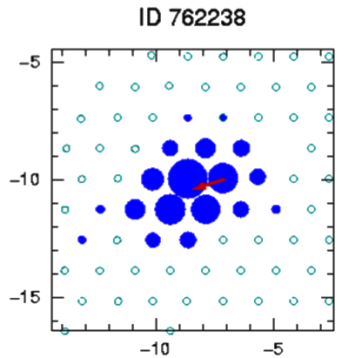
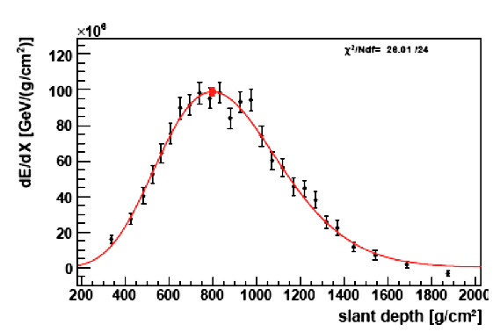

Energy calibration
S(1000)
LDF
SD
E_{FD}[eV]
FD

Slide 18
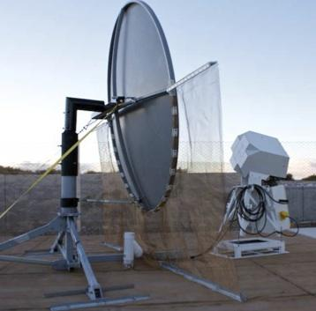
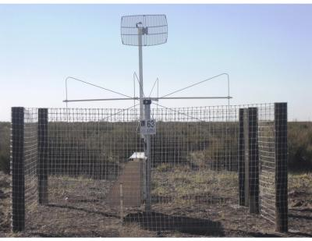
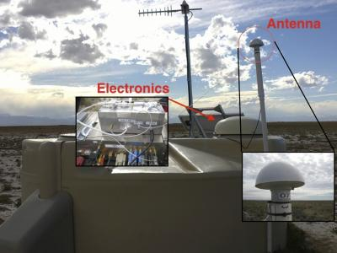
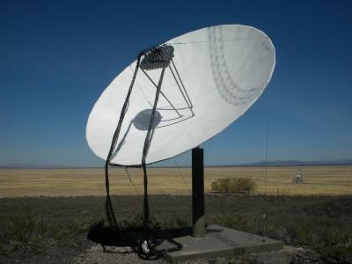
Radio and Microwave
AMBER
Radio
Microwave
detectors
AERA
EASIER
MIDAS

Slide 19
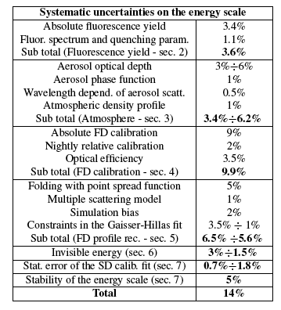
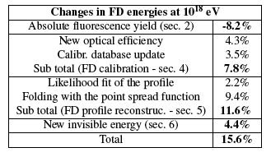
The Energy Scale
Absolute FY
FD calib.
FD recon.
Inv. energy
Increased by 15.6%
14%
22% in ICRC2011
Significant improvement
in the uncertainty

Slide 20



The Energy Spectrum
The energy scale
The largest integrated exposure ever achieved
Calibrated with hybrid events
SD (1500 m) S₃₈
SD (infill) S₃₅
SD inclined N₁₉
Data: 2004 - 2012
Update of the energy scale
E has increased 15.6%
Uncertainty has decreased
down to 14% (22% in 2011)

Slide 21

The Energy Spectrum
total number of events
GZK effect?
84% C.L
Combined energy spectrum of UHECRs

Slide 22

The Energy Spectrum
84% C.L
Models assuming pure proton or iron composition with spectral index β and source evolution parameter m

Slide 23



Mass composition
For a given energy lighter primaries give rise to deeper and more fluctuating showers
At the highest energies our data better resemble the MC predictions for heavier composition.
SD results (MPD and risetime asymmetry) are consistent with this behavior

Slide 24



Mass composition
Relation between observables and moments of lnA at the top of the atmosphere
Evolution with energy:
Medium -> light -> heavy ?
Mixed -> pure ?

Slide 25


Photons and neutrinos
ICRC 2011
Exotic top-down models ruled out
Observation of fluxes compatible with predictions would give an independent proof of GZK effect

Slide 26


Large Scale Anisotropy
First Harmonic in right ascension
Amplitude
Phase
Smooth change of phase
GC
Compatible with isotropy
Prescription still running

Slide 27
Conclusions
The Pierre Auger Observatory is taking data since 2004.
It has pioneered a very successful hybrid technique.
Very relevant results have been achieved:
Strong suppression of CR flux above 40 EeV.
Composition heavier beyond the ankle.
Weak anisotropy at both large and small scale.
Strong limits in the flux of neutrinos and photons. Exotic top-down models are being ruled out.
More muons than predicted by models.

Slide 28
The future
Understand the origin of the flux suppression
GZK effect or maximal energy in the source? or both ?
More data at the highest energies
Improve our capability for mass measurement
  Better determination of muonic content
  Particle physics at E_{cm} ≈ 100 E_{LHC}
Understand the origin of the ankle
Transition GC -> EGC or propagation effect?

Slide 29


Mass and energy
anisotropies

Slide 30

The Pierre Auger Observatory:
A brilliant future
THANKS

