Slide 1

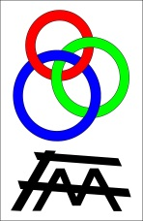

XXXth International Workshop on High Energy Physics
How far can a pragmatist go into quantum theory?
A critical view of our current understanding
of quantum phenomena
History and philosophy of quantum theory
Ángel S. Sanz
Instituto de Física Fundamental (CSIC), Madrid, Spain
Protvino, June 25, 2014

Slide 2
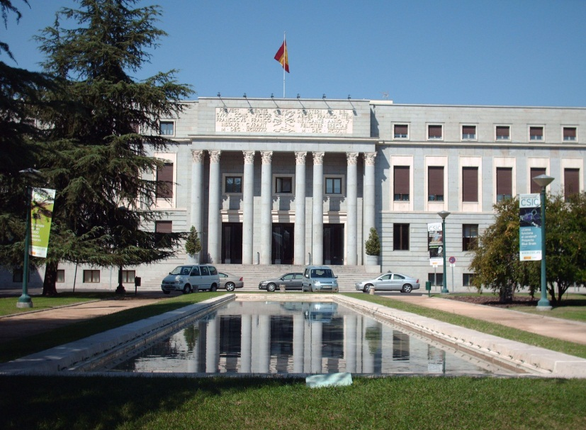
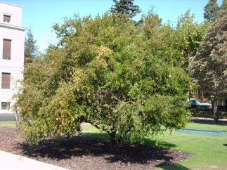
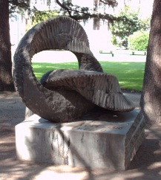

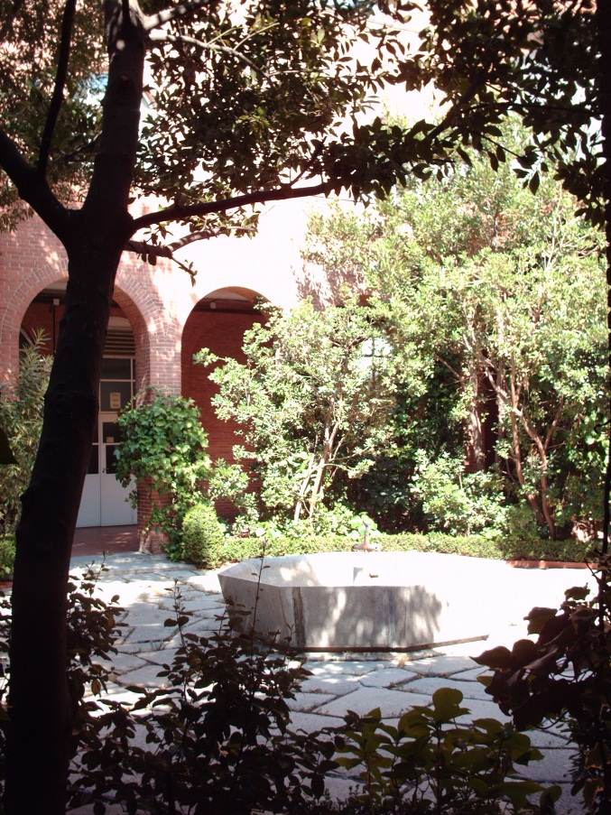
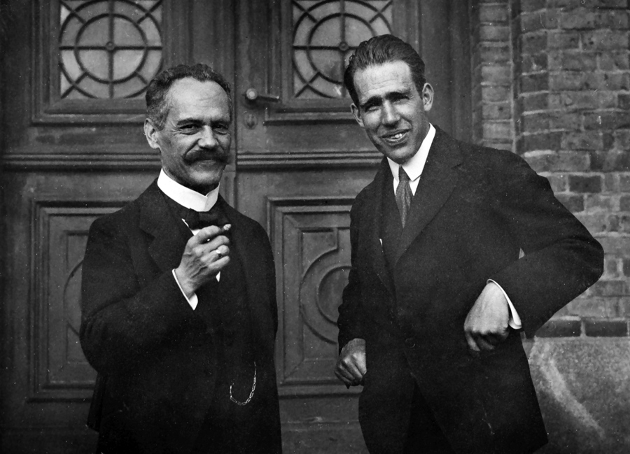
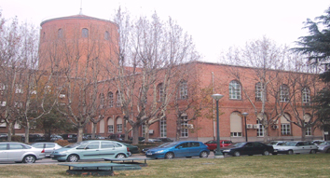
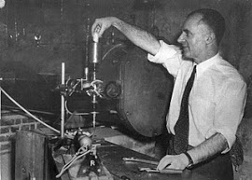
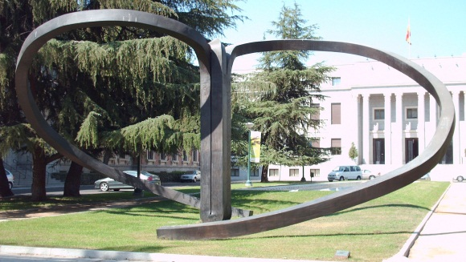
The CSIC Institute of Fundamental Physics
Consejo Superior de Investigaciones Científicas (CSIC)
Centro de Física “Miguel Antonio Catalán” (CFMAC)
Eckert, Arnold Sommerfeld – Science, Life and Turbulent Times (1868-1951) (Springer, New York, 2013)
Instituto de Estructura de la Materia (IEM)
Instituto de Física Fundamental (IFF)
Instituto de Óptica (IO)

Slide 3
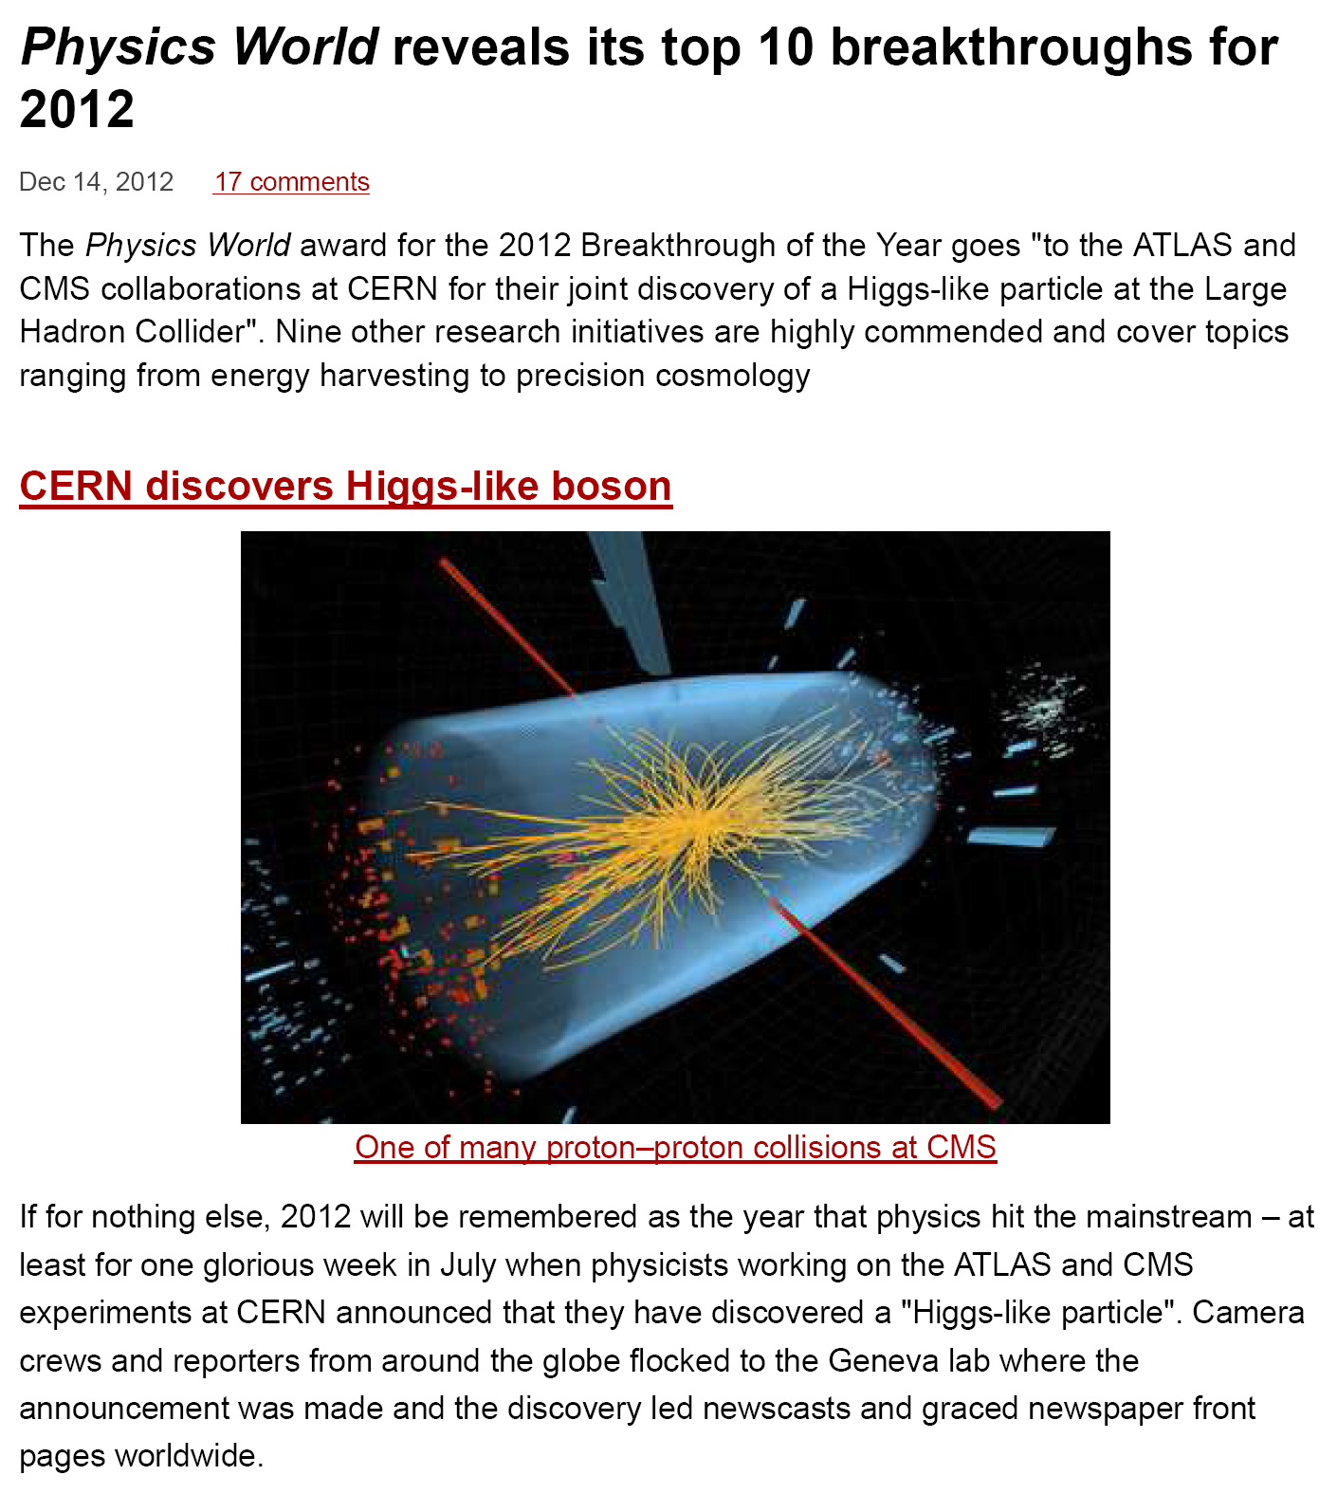
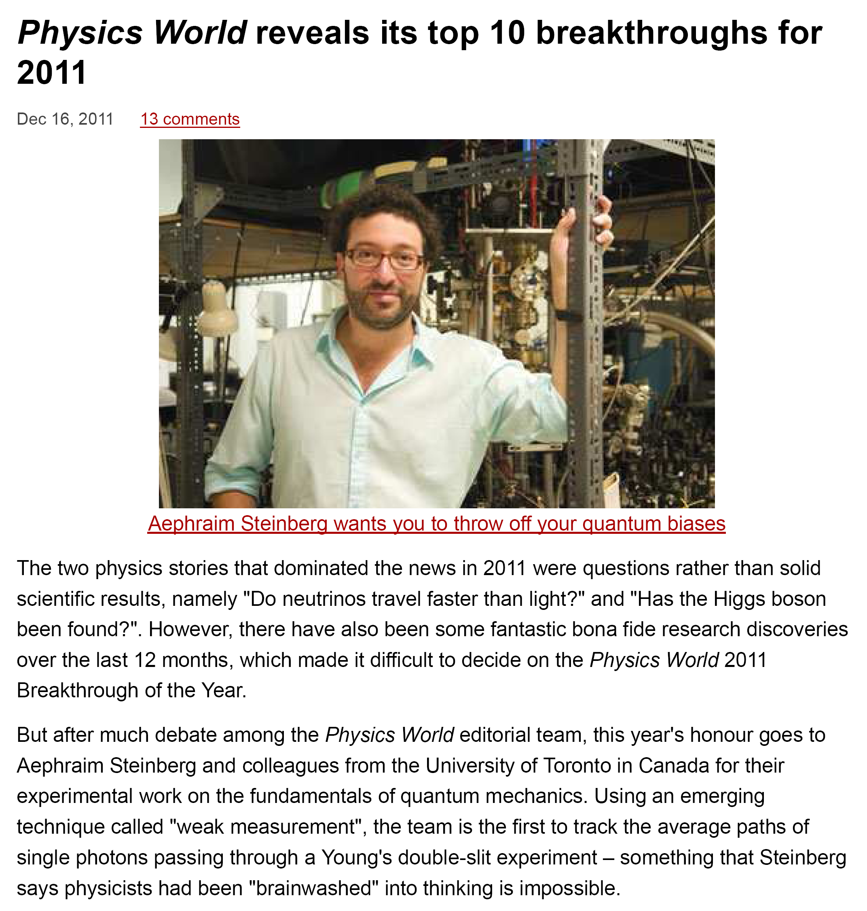
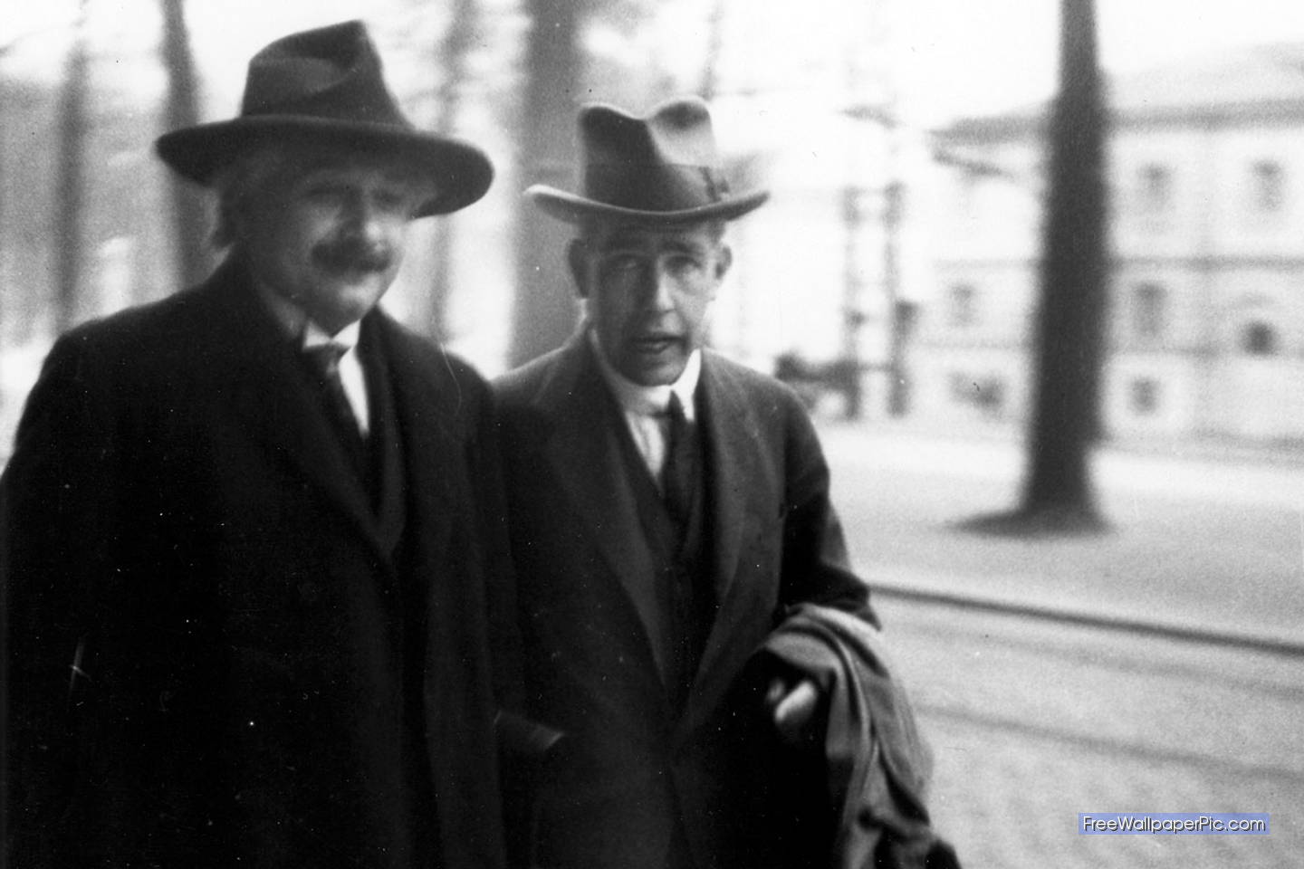
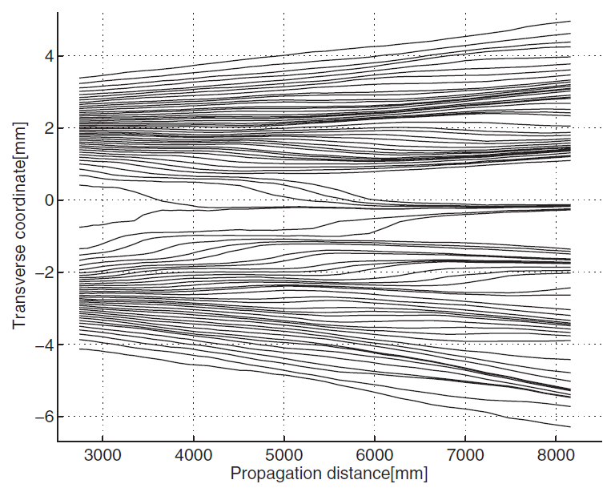
Physics World breakthroughs

Slide 4
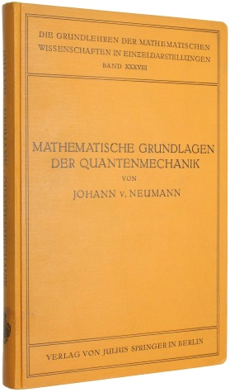
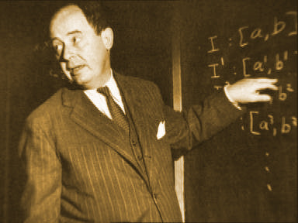
How to interpret the quantum world?
von Neumann (1930’s)
Collapse of the wave function
Quantum mechanics is complete
No hidden variables

Slide 5
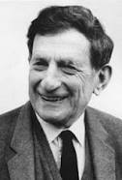

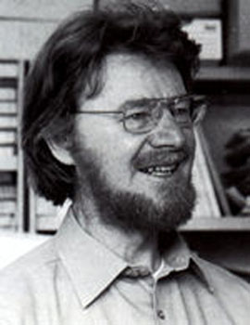
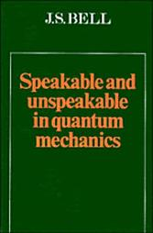
How to interpret the quantum world?
von Neumann (1930’s)
Collapse of the wave function
Quantum mechanics is complete
No hidden variables
Bohm (1952)
Bell (1960’s)
local realism
local hidden variable models/theories
nonlocal realism
nonlocal hidden variable “theories”

Slide 6
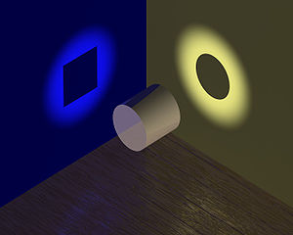
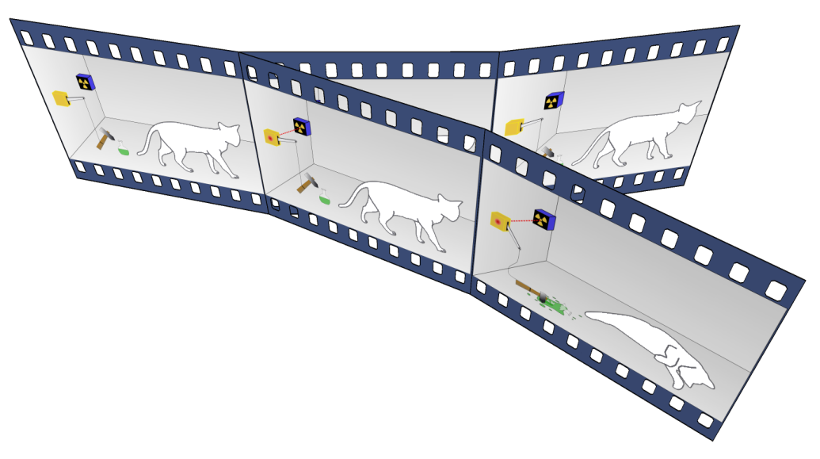
How to interpret the quantum world?
Copenhagen
No solution until observation
System collapse
Subjective (external observer)
Objective (e.g., gravity)
Quantum Information
No description of the physical world, but of the knowledge about it
Many worlds (multiverses)
One solution for each universe
Consistent Histories
A probability is assigned to the history of a system

Slide 7
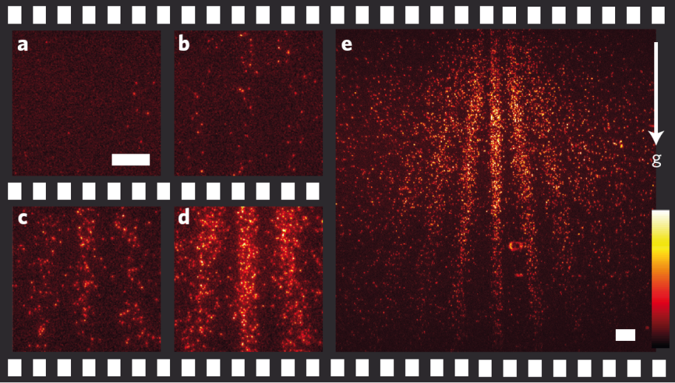
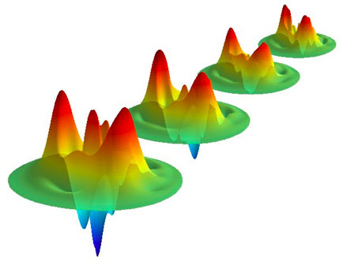

How to interpret the quantum world?
Statistics
Decoherence
Juffmann et al., Nature Nanotech. 7, 297 (2012)
Bohmian mechanics

Slide 8
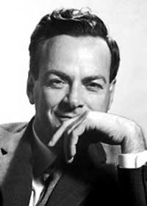
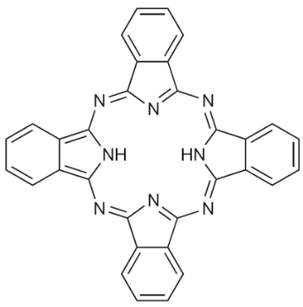
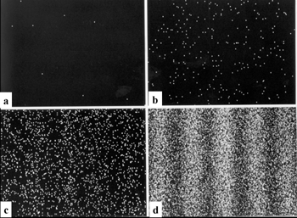

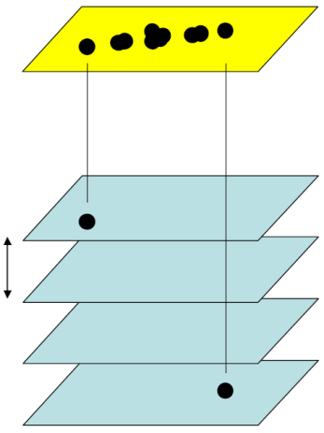

Towards a single-event description
Quantum phenomena occur in real time
Molecular configuration
Entanglement dynamics
Electron ionization
Quantum observables ⇒ statistical outcomes
Pozzi et al., Am. J. Phys. 57, 117 (1989); Matteucci et al., Eur. J. Phys. 34, 511 (2013)
Jönsson, Am. J. Phys. 57, 117 (1989)
Shimizu et al., Phys. Rev. A 46, R17 (1992)
Tonomura et al., Am. J. Phys. 57, 117 (1989)
Juffmann et al., Nat. Nano. 7, 297 (2012)
No time coherence ⇒ one particle is unaware of what others do!

Slide 9
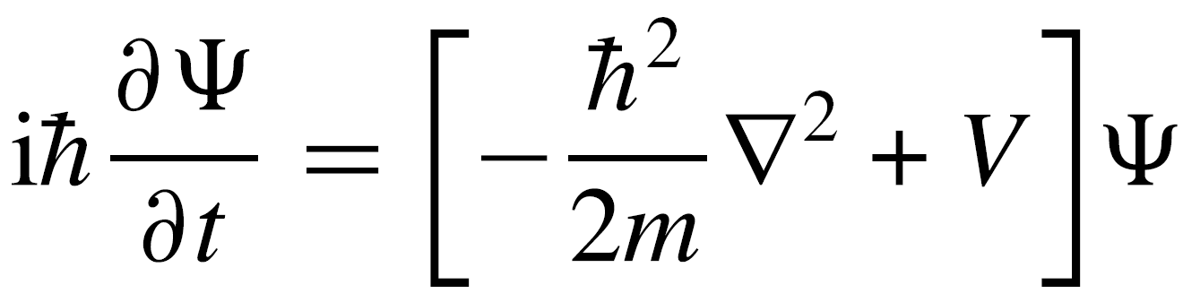
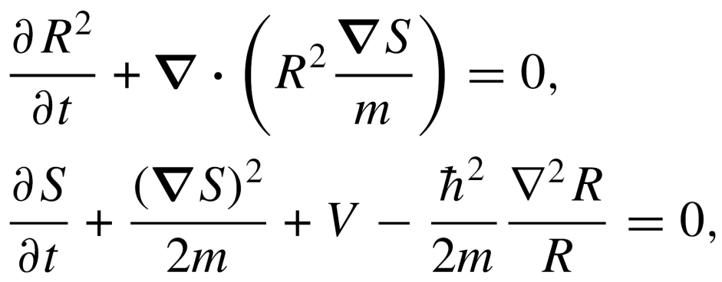
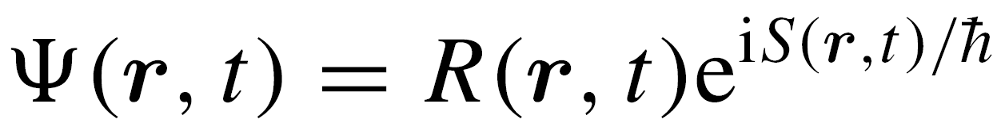
Towards a single-event description

Slide 10
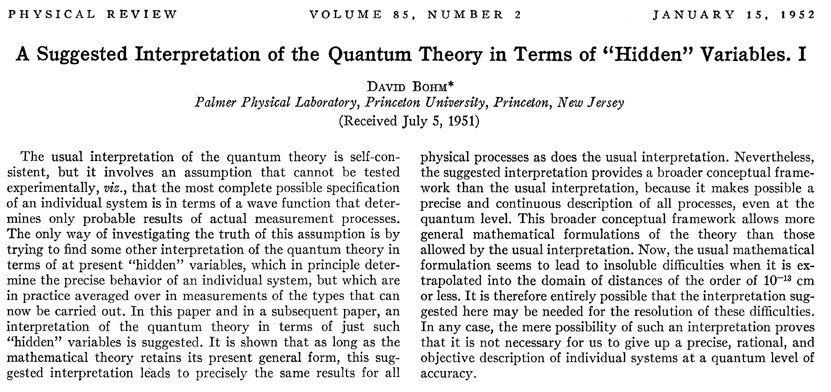
Bohmian mechanics …

Slide 11
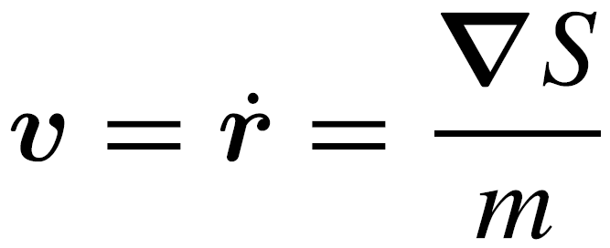
Towards a single-event description
Physical system

Slide 12
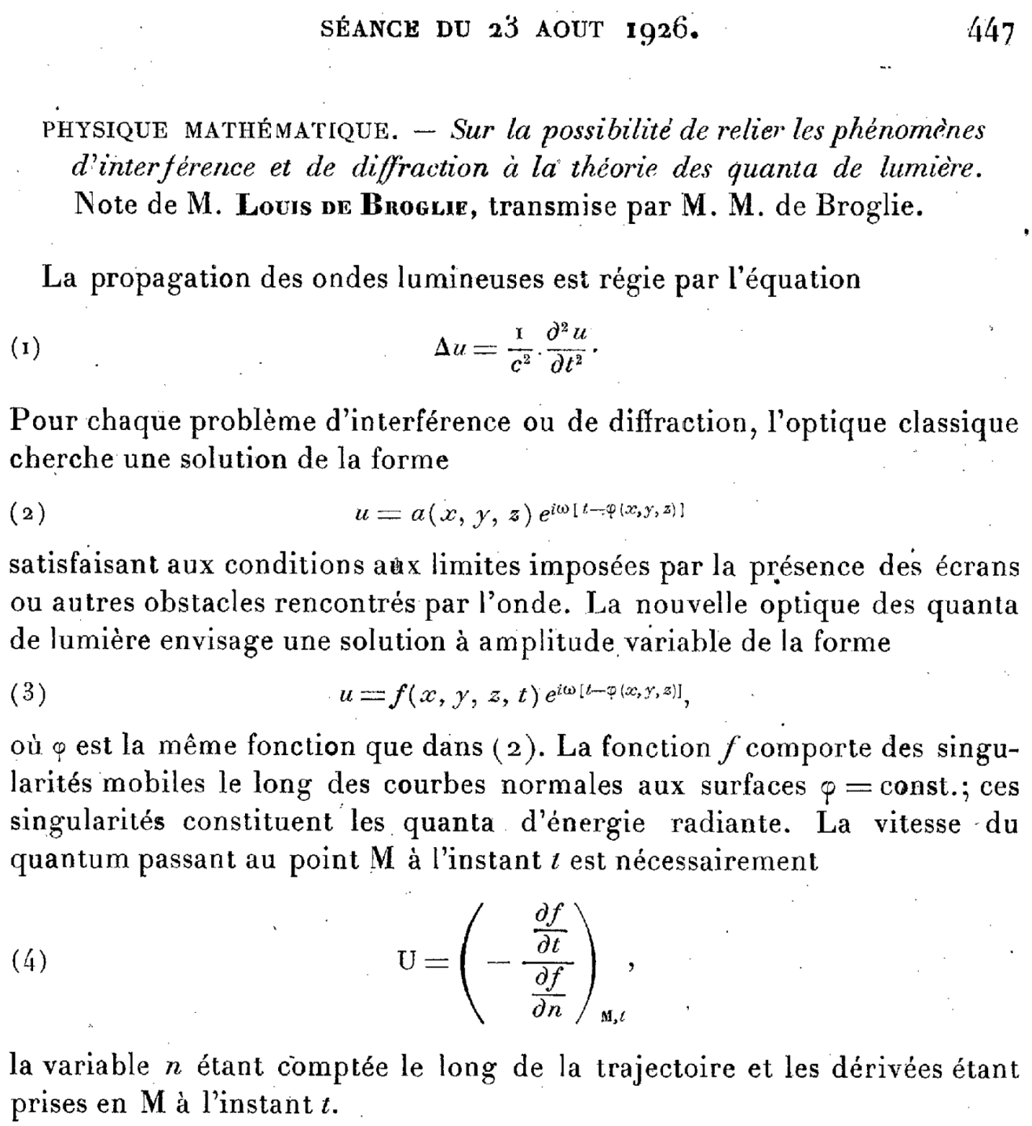
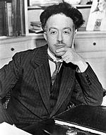
… the pilot wave …

Slide 13
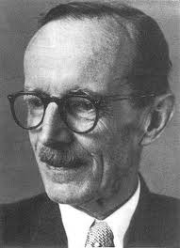
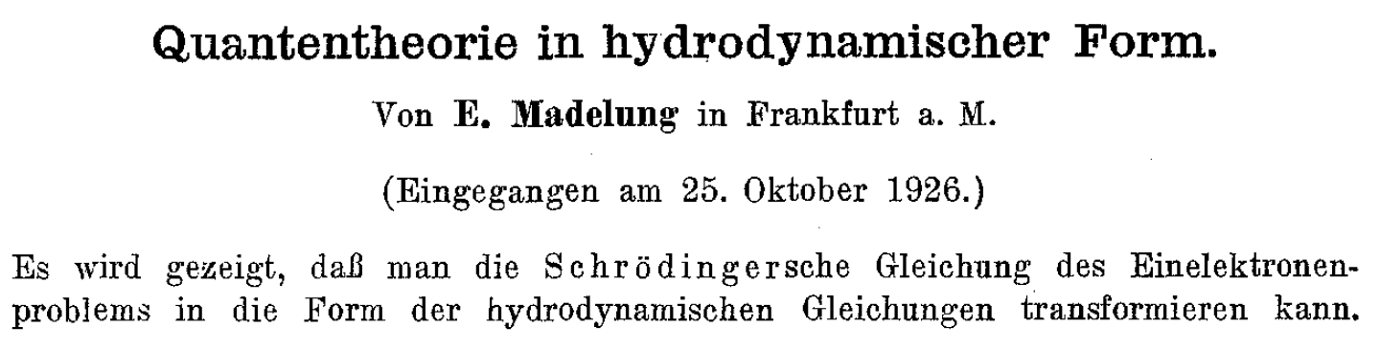
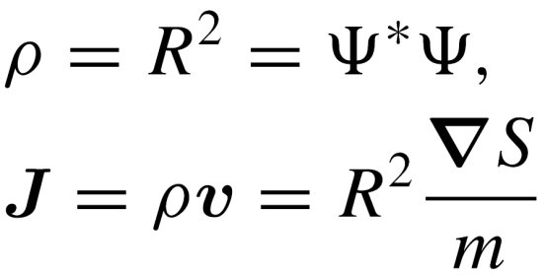
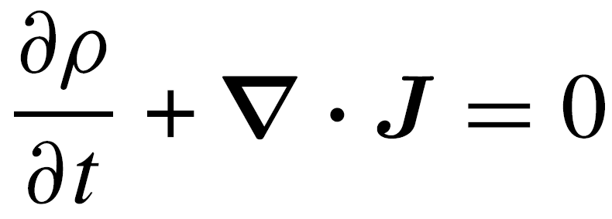
… and quantum hydrodynamics
Quantum hydrodynamics

Slide 14
Towards a single-event description
Physical system
Quantum hydrodynamics

Slide 15
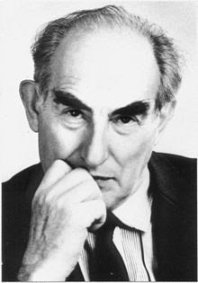
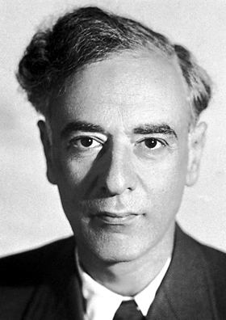
Alternative pictures of quantum mechanics
Heisenberg’s matrix formulation
Dirac’s (interaction) representation
Schrödinger’s wave mechanics
Feynman’s path integrals
Phase-space representations
Wigner–Moyal–Hiley
Husimi
Quantum hydrodynamics (fluid dynamics) approach, aka Bohmian mechanics
Madelung–de Broglie–Bohm–Takabayasi–Landau–Bialynicki-Birula
“Hidden” quantum properties ≠ hidden variables!

Slide 16
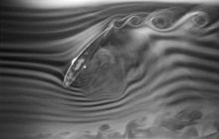
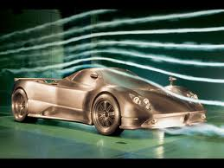
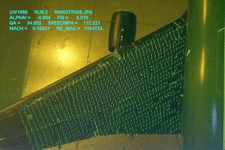
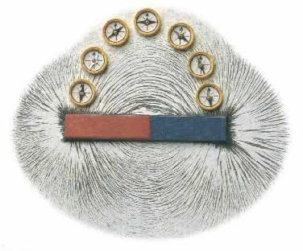
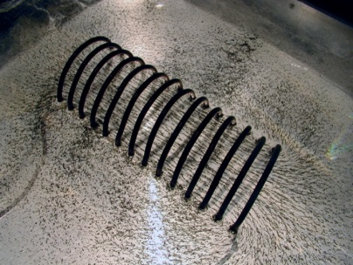
Quantum tracer particles
Bohmian particles are the quantum equivalent of classical tracer particles
Continuum media: hydrodynamics
gas - smoke
tinny floating particles (e.g., pollen, charcoal)
liquid
other liquids (e.g., ink)
Universe as a fluid – galaxies, stars, etc.
Do real quantum particles move along Bohmian trajectories?

Slide 17
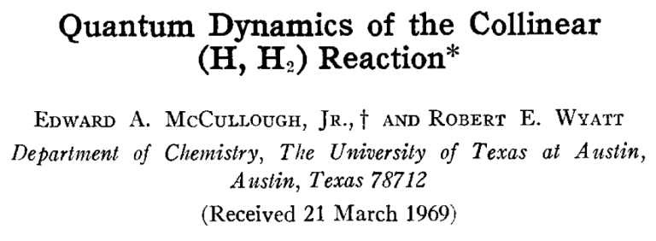
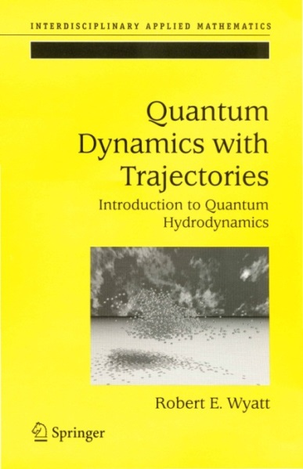
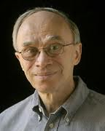
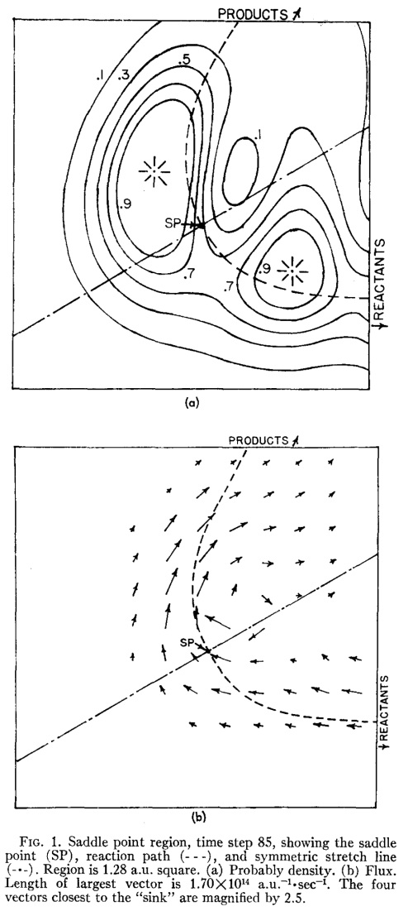
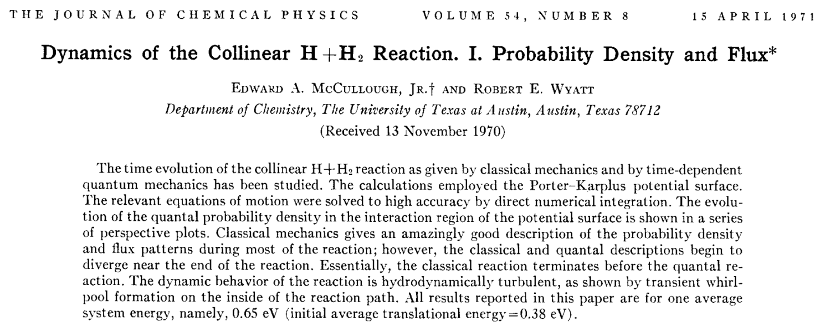
Hydrodynamic approaches in the literature
J. Chem. Phys. 51, 1253 (1969)

Slide 18
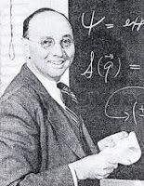




Hydrodynamic approaches in the literature
J. Chem. Phys. 61, 5435 (1974)

Slide 19



Hydrodynamic approaches in the literature

Slide 20


Hydrodynamic approaches in the literature
Int. J. Quantum Chem. 111, 356 (2011)

Slide 21




Hydrodynamic approaches in the literature
Math. Ann. 47, 317 (1896)
Optik 9, 174 (1952)

Slide 22


Hydrodynamic approaches in the literature

Slide 23




Hydrodynamic approaches in the literature
J. Acoust. Soc. Am. 78, 758 (1985)

Slide 24



What about classical waves?
Couder, Boudaoud, Protière and Fort, EPN 41, 14 (2010)

Slide 25





Wheeler’s delayed-choice experiment
Wheeler, The past and the delayed-choice double-slit experiment,
in Mathematical Foundations of Quantum Theory, Marlow (Ed.)
(Academic Press, New York, 1978)
Hiley & Callaghan, Phys. Scr. 74, 336 (2006)

Slide 26





Interference dynamics
Bohmian non-crossing = quantum dynamical noncrossing
AS & Miret-Artés, Chem. Phys. Lett. 445, 350 (2007);
J. Phys. A 41, 435303 (2008); Am. J. Phys. 80, 525 (2012)

Slide 27



Interference dynamics
Bohmian non-crossing = quantum dynamical noncrossing
Kocsis et al., Science 332, 1170 (2011)

Slide 28


“Effective” interference potential
AS & Miret-Artés, J. Phys. A 41, 435303 (2008)

Slide 29






“Effective” interference potential
How does the effective “interference” potential look like?
X_{min} (t)
V₀ (t)
AS & Miret-Artés, J. Phys. A 41, 435303 (2008)

Slide 30

“Effective” interference potential
AS & Miret-Artés, J. Phys. A 41, 435303 (2008)

Slide 31
Wheeler’s delayed-choice experiment
Wheeler, The past and the delayed-choice double-slit experiment,
in Mathematical Foundations of Quantum Theory, Marlow (Ed.)
(Academic Press, New York, 1978)
Hiley & Callaghan, Phys. Scr. 74, 336 (2006)

Slide 32












Wheeler’s delayed-choice experiment
Choque & AS, in preparation

Slide 33


Rays and waves can coexist
Geometrical optics rays
Classical trajectories
Classical
Fermat’s principle
Hamilton’s principle

Slide 34

Rays and waves can coexist

Slide 35

Quantum mechanics should be harder pushed
New Scientist

Slide 36


Quantum mechanics should be harder pushed

Slide 37



Большое спасибо!
How can the symmetry be “sponteneouly” broken?
What is the role of vacuum and what is the stuff it is made of?
Is there any underneath mechanism beyond the Higgs?
Can also space-time be related to a fundamental particle?
Is quantum theory (QFT included) our final theory?

