Slide 1
Half a Century with QUARKS!
The XXX-th International Workshop on High Energy Physics,
IHEP, Protvino, Russia , June 23-27, 2014
Vladimir A. Petrov,
Institute for High Energy Physics, Protvino

Slide 2


Brief History
(1963)1964 - the rise and propagation of the idea
1965 – colouring
1967-1973 – experimental “proof” that quarks exist
1973 – formulation of the strong interaction theory as SU_{flavour}(3) x SU_{colour}(3), QCD
1974 – first heavy quark
1977 – second heavy quark
1995 – third heavy quark (long and torturous search)
QCD = SU_{flavour}(6) x SU_{colour}(3)
2014 – still with 6 coloured quarks

Slide 3
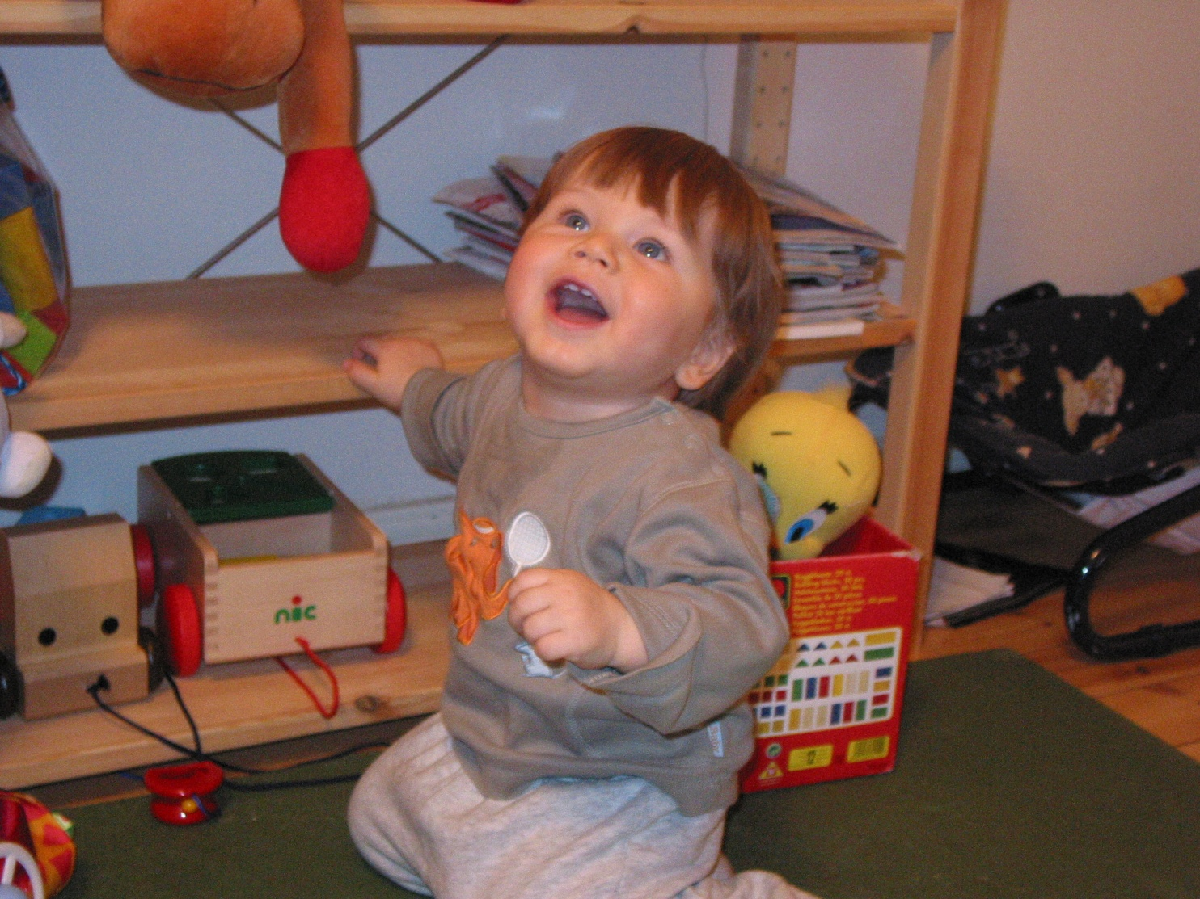
Enjoy coloured quarks!

Slide 4
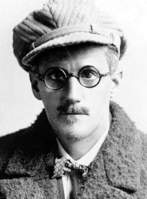

Slide 5

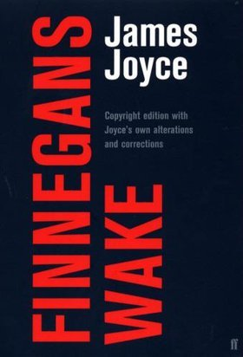
Finnegans Wake.
By James Joyce. 1939
One of the 100 best English-language novels of the 20th century.

Slide 6

Finnegans Wake
(excerpt from Book II)
Finnegan's Wake
Tim Finnegan lived on Walker Street
And a gentle, Irishman, mighty odd;
The fall (bababadalgharaghtakamminarronnkonnbronntonner ronntuonnthunntrovarrhounawnskawntoohoohoordenenthurnuk!) of a once wallstrait oldparr is retaled early in bed and later on life down through all christian minstrelsy. The great fall of the offwall entailed at such short notice the pftjschute of Finnegan, erse solid man, that the humptyhillhead of humself prumptly sends an unquiring one well to the west in quest of his tumptytumtoes: and their upturnpikepointandplace is at the knock out in the park where oranges have been laid to rust upon the green since devlinsfirst loved livvy.

Slide 7
The Picture and the Letter:
Male and Female Creativity in James Joyce’s Finnegans Wake
William L. Miller
1996
Australian Defence Force Academy
University of New South Wales
This thesis is submitted in total fulfilment of the requirements for the degree of
Doctor of Philosophy to the Australian Defence ForceAcademy,
University of New South Wales

Slide 8
Finnegans Wake. Episode 12
“ … So sailed the stout ship Nansy Hans. From Liff away.For Nattenlaender. As who has come returns. Farvel, farerne! Good-bark, goodbye!
Now follow we out by Starloe!
— Three quarks for Muster Mark!
Sure he hasn’t got much of a bark
And sure any he has it’s all beside the mark…”

Slide 9
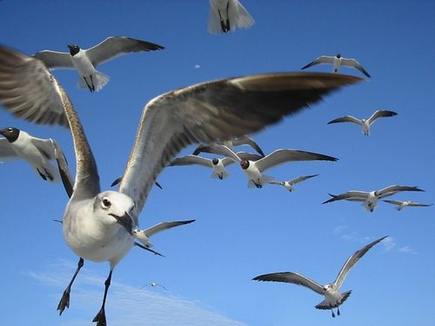
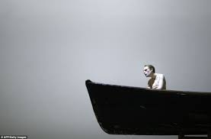
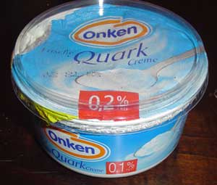

Three quarks for
Muster Mark!
Quark = Curd? Quark= Nonsense? …Squawk :a loud, harsh or discordant noise made by a bird or a person. Muster ≠ Mister! Muster ≠ Master!
Muster,…: a number of things or persons assembled on a particular occasion;
a collection, as a muster of peacocks—Johnson, 1755

Slide 10

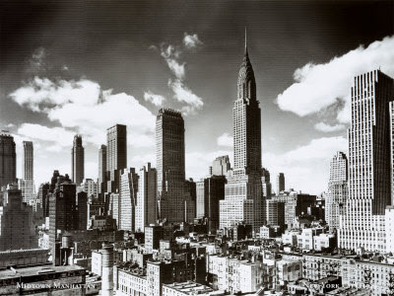
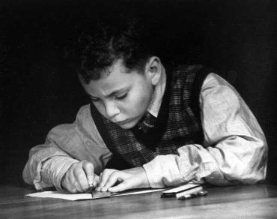
New York 1939:
Three quarks…
Exercise in multiplication :
3 x 3 = 9
3 x 3 x 3 = 27

Slide 11
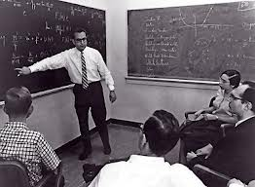
Caltech, Pasadena, California 1964
Three quarks…
3 ⊗3 ⊗ 3 = 10 ⊕ 8 ⊕ 8 ⊕1

Slide 12
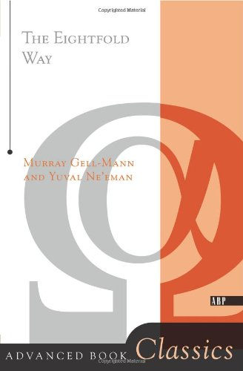
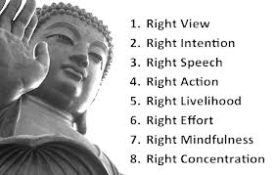
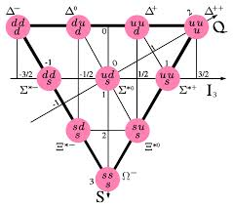
Eightfold Way to Unitary Symmetry

Slide 13
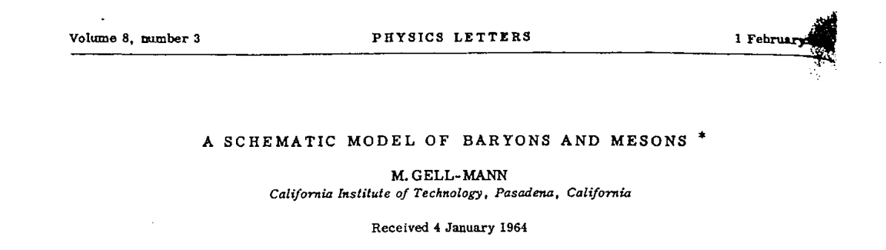
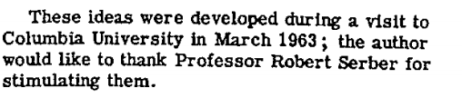
1837 citations according to SPIRES

Slide 14
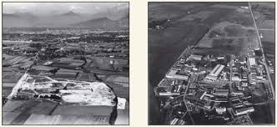
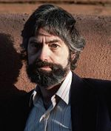
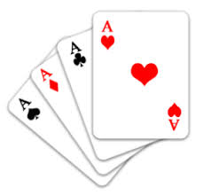
New players
CERN 1964

Slide 15
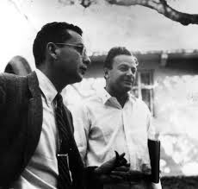
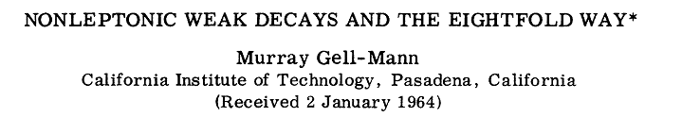
Zweig, George
Two topics in elementary particle physics:
The reaction γn→ πN at high energies.
K leptonic decay and partially conserved currents.
Dissertation (Ph.D.), California Institute of Technology.
Item Type:
Thesis (Dissertation (Ph.D.))
Degree Grantor:
California Institute of Technology
Division:
Physics, Mathematics and Astronomy
Major Option:
Physics
Thesis Availability:
Public (worldwide access)
Research Advisor(s):
Feynman, Richard Phillips (advisor)
Gell-Mann, Murray (advisor)
Tollestrup, Alvin V. (advisor)
Thesis Committee:
Unknown, Unknown
“Murray says your okay, you must be okay”
Defense Date:
1 January 1964

Slide 16
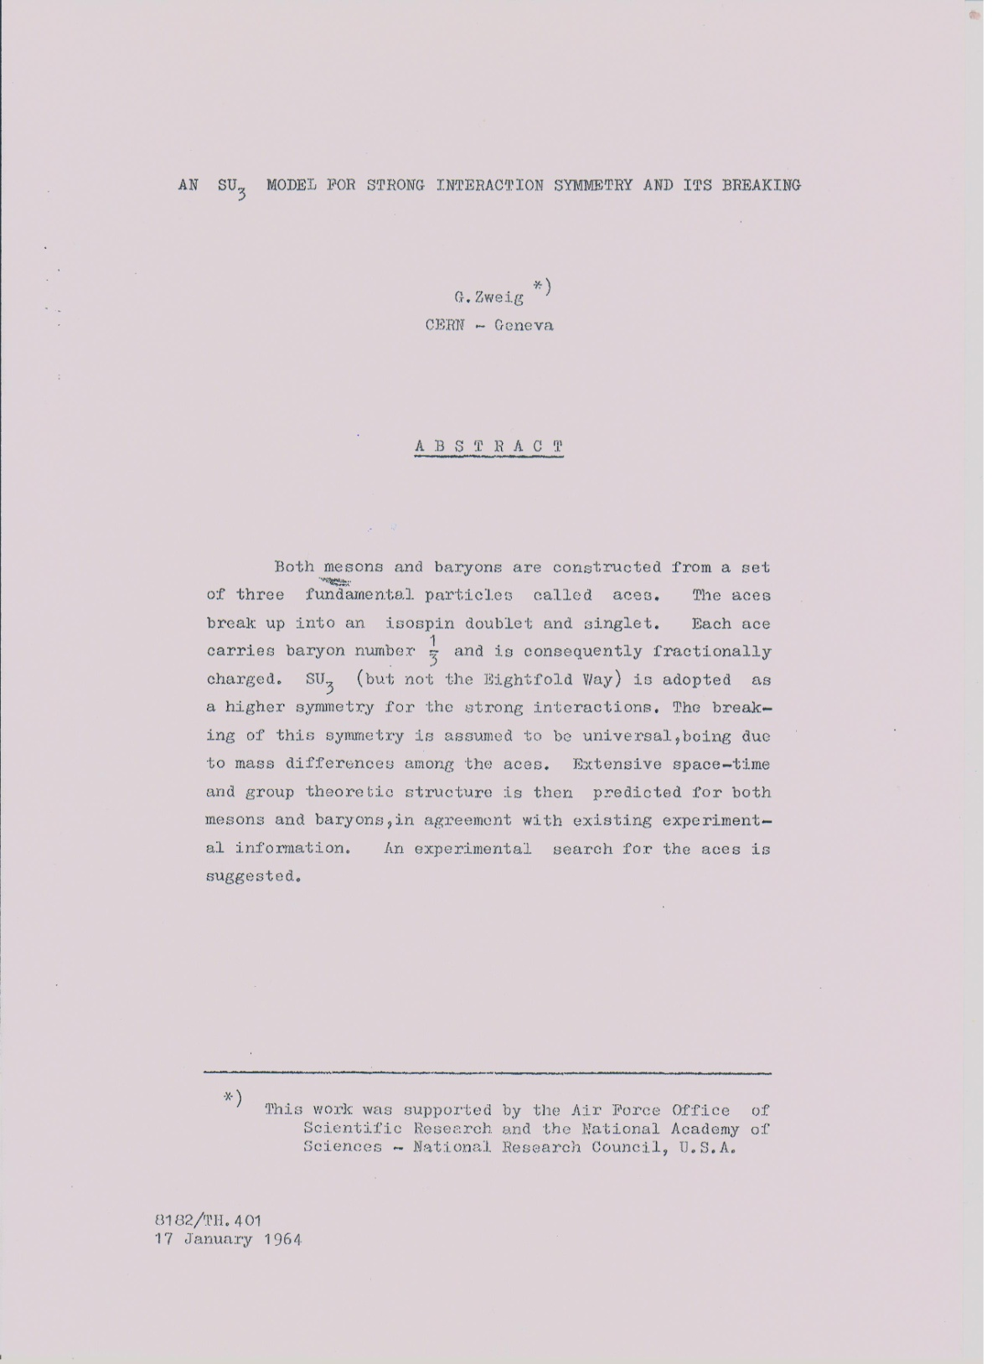
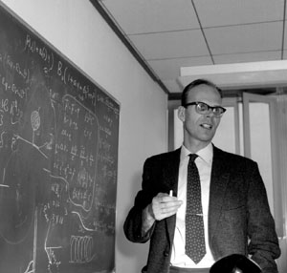
172 citations according to SPIRES
Leon Van Hove
I ….kept exploring this idea (of aces-V.P.) in the spring of 1963.
17 January 1964

Slide 17
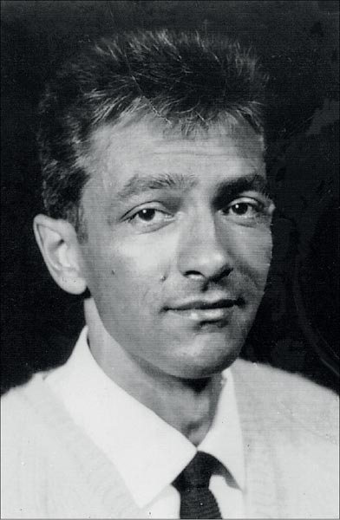
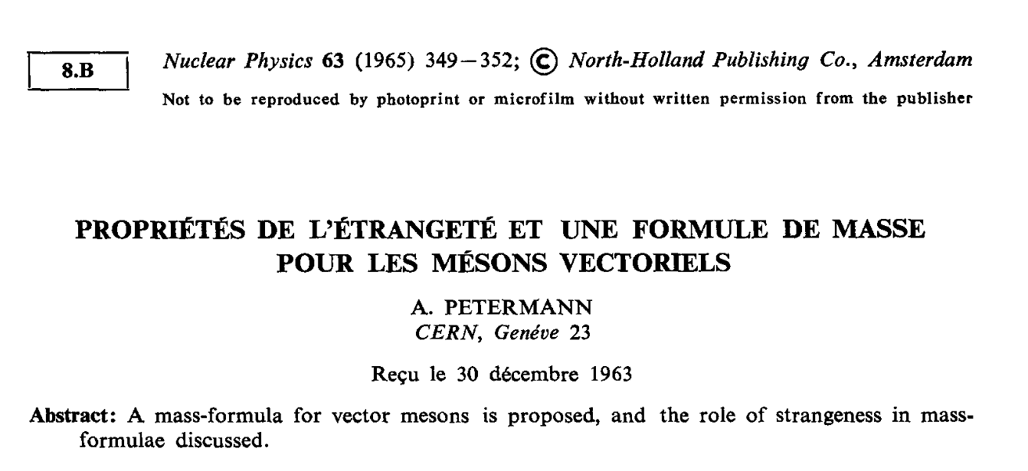



Who Was the First?!
Absent in SPIRES
André Petermann
(1922-2011)
…

Slide 18

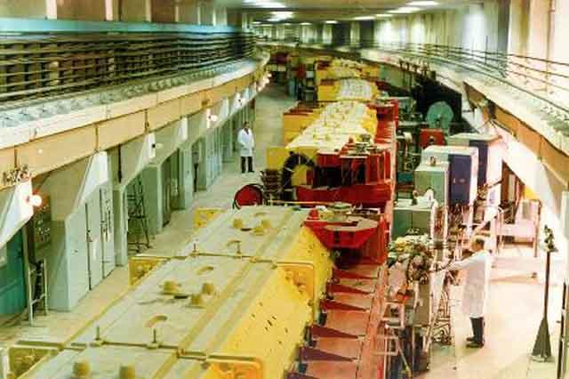
First Searches for Quarks
(Gell-Mann (1964))
Experiment SERP-E-002 1968-Februray 1969 | Search for Quarks with Fractional Charges
WERE NOT FOUND!!!

Slide 19
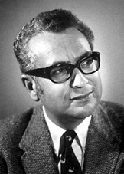
The Magnificent Triplet

