Slide 1




Recent results of the OPERA search for ν_{μ} ◊ ν_{τ} oscillations
T. OMURA
On behalf of The OPERA Collaboration
Belgium
ULB Brussels
Italy
Bari
Bologna
LNF Frascati
L’Aquila
LNGS
Naples
Padova
Rome
Salerno
Korea
Jinju
Croatia
IRB Zagreb
Russia
INR RAS Moscow
LPI RAS Moscow
ITEP Moscow
SINP MSU Moscow
JINR Dubna
France
LAPP Annecy
IPHC Strasbourg
Japan
Aichi edu.
Kobe
Nagoya
Toho
Nihon
Switzerland
Bern
Germany
Hamburg
Israel
Technion Haifa
Turkey
METU Ankara

Slide 2
Goal of OPERA
Prove the ν_{μ} → ν_{τ} oscillation by direct detection of ν_{τ} CC interaction in pure ν_{μ} beam
Requirements:
High energy ν beam for tau production
High intensity and large target mass for statistics
Long base line for oscillation
Micrometric resolution to identify τ kinematics

Slide 3
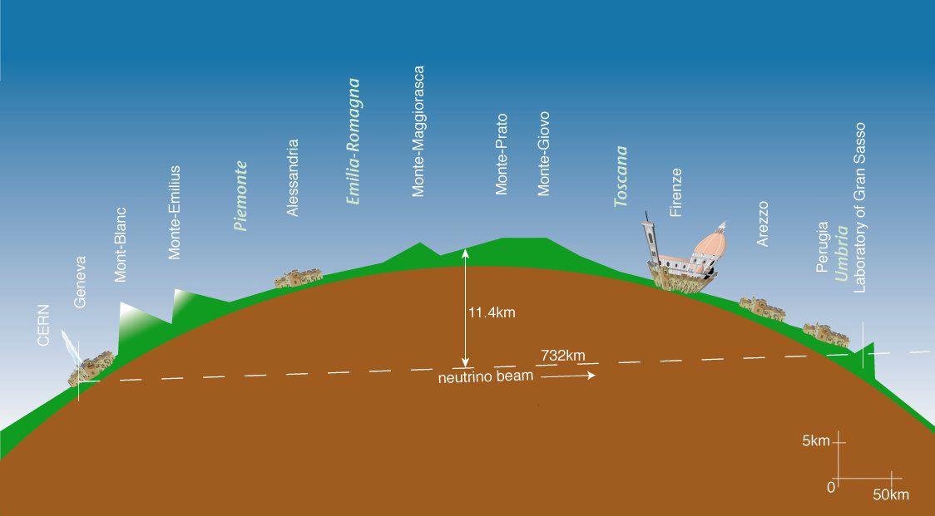
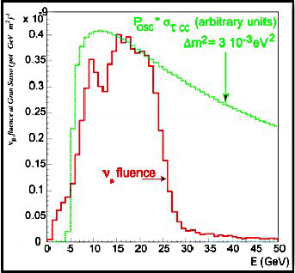
CERN Neutrino to Gran Sasso
730 km
Gran Sasso
CERN
Optimized to maximize ντ CC cross section
Beam property
<Eν> | 17 GeV
(νe + νe) / νμ | 0.87 %
νμ / νμ | 2.1 %
ντ prompt | Negligible
Oscillation probability (2ν model)
(Assuming Δm²₂₃ = 2.43 x 10⁻³ eV², sin² 2θ₂₃ = 1.0)

Slide 4
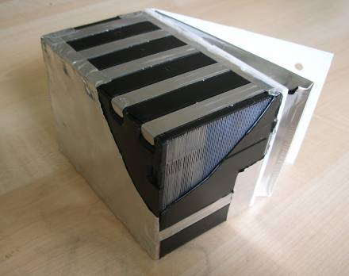
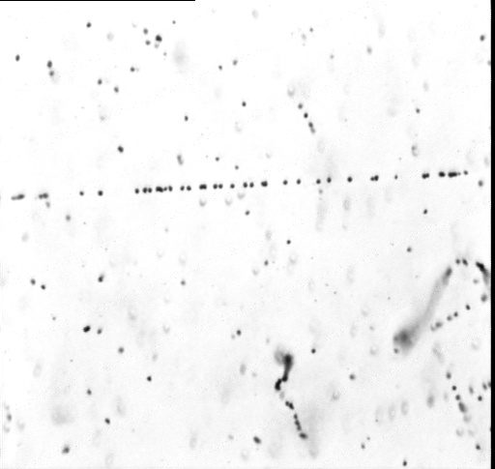

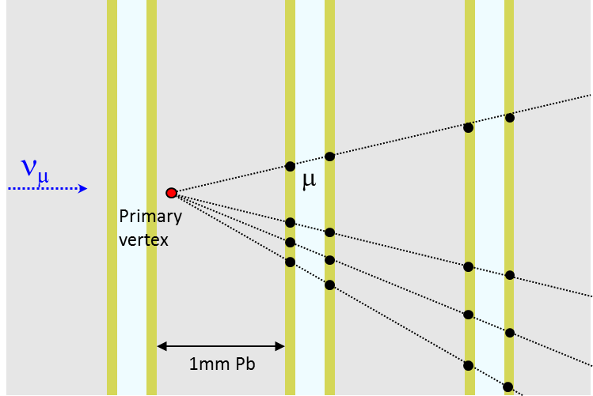
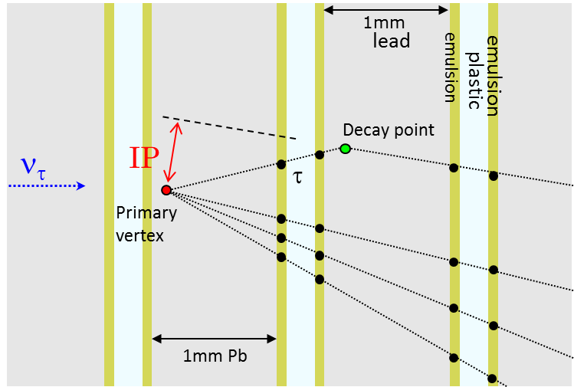
Emulsion Cloud Chamber
_{ECC}
Main target and detector unit
56 lead plates (1mm) + 57 emulsion photographic films (0.3 mm)
3D track reconstruction with micrometric resolution
Momentum measurement by MCS
12.5cm
ν
10cm
Microscopic view
Cross section of film
Emulsion 44 um
8.3kg
10X₀
Plastic base 215 um
M.I.P.
(30 silver grains / 100um)
7.5cm
20 um
ν_{μ} CC interaction
ν_{τ} CC interaction
τ decay channel | B.R. (%)
τ → h | 49.5
τ → 3h | 15.0
τ → e | 17.8
τ → μ | 17.7
No other lepton at the vertex

Slide 5
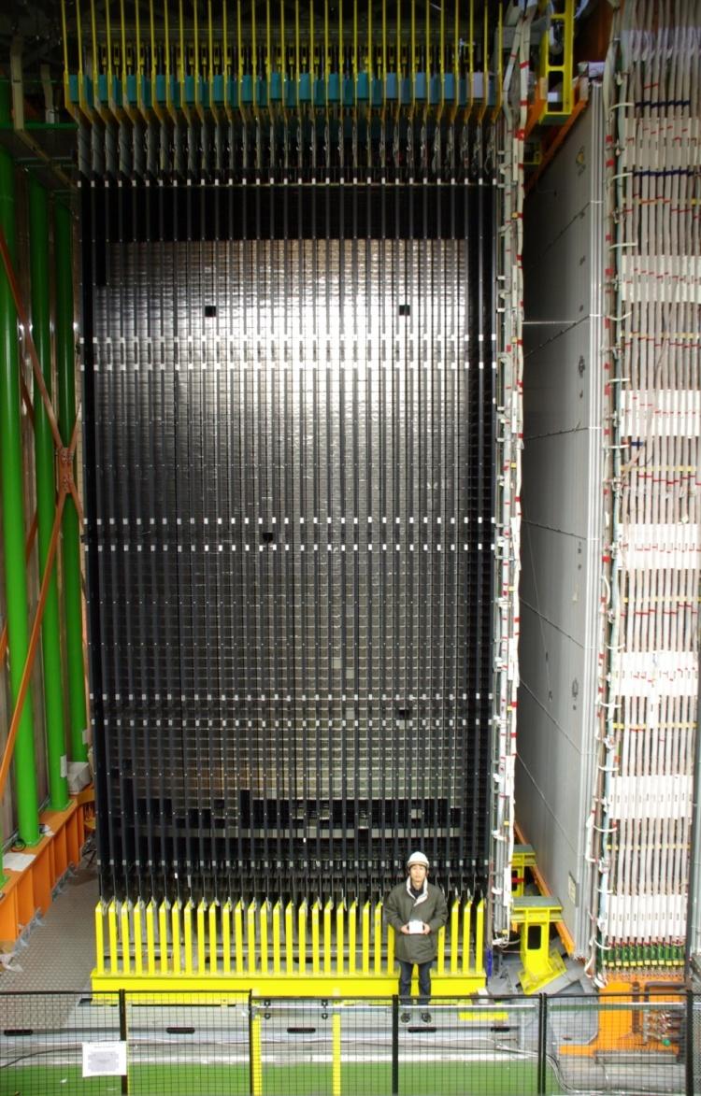
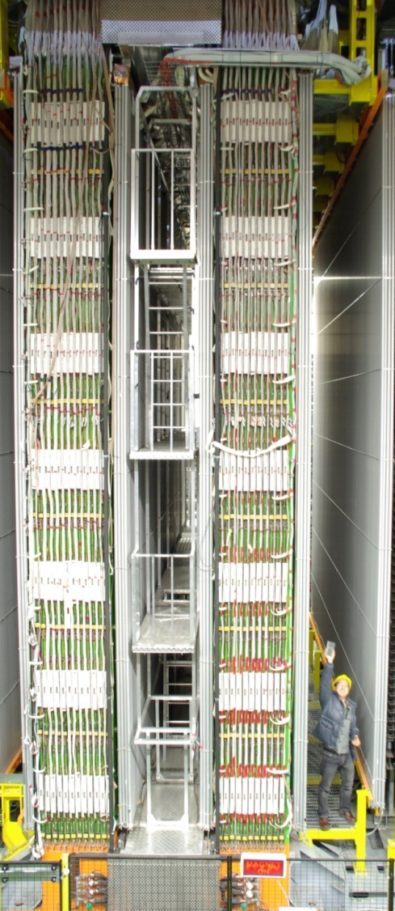
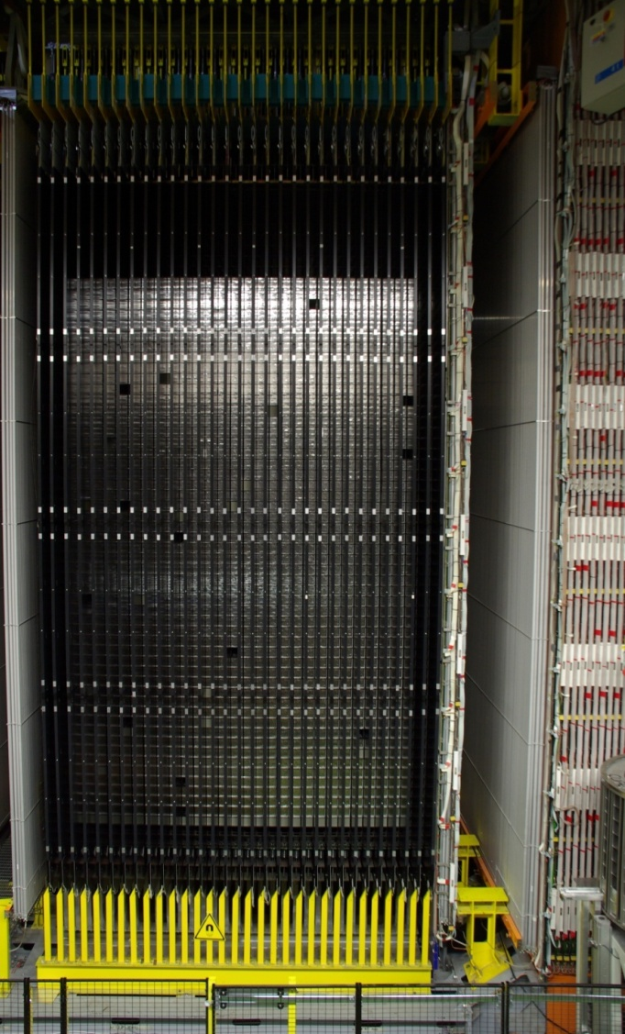
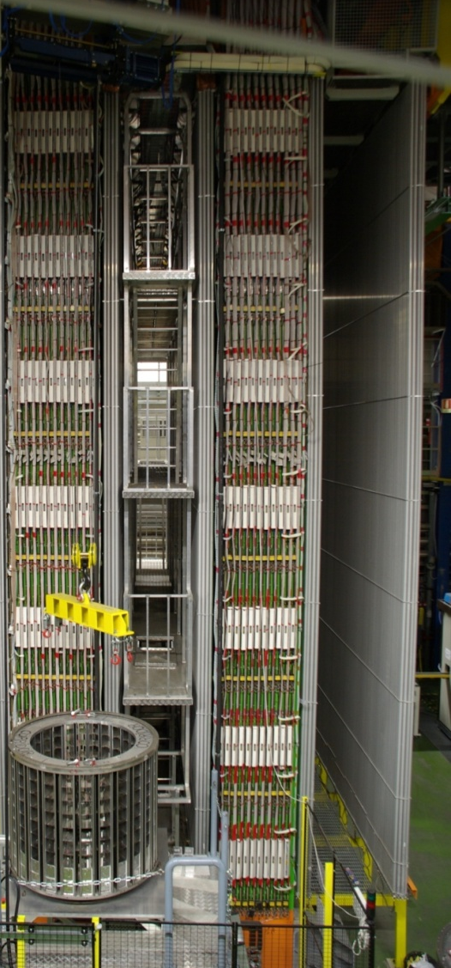
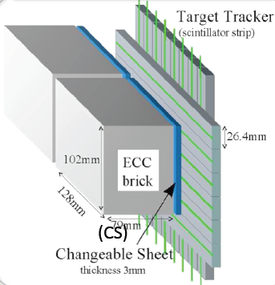
The OPERA Detector
150,000 ECC, 1.25 kt target mass
Target Tracker (TT):
Scintillator bar plains for event trigger and brick prediction
Coarse segmentation (2.6 cm)
ν
Changeable sheets (CS):
Doublet of films as Interface between ECC and TT
Very low background
Detachable/attachable
Target area
Muon
spectrometer
(Drift Tube + RPC + Magnet)
Muon
spectrometer
Target area
Veto

Slide 6
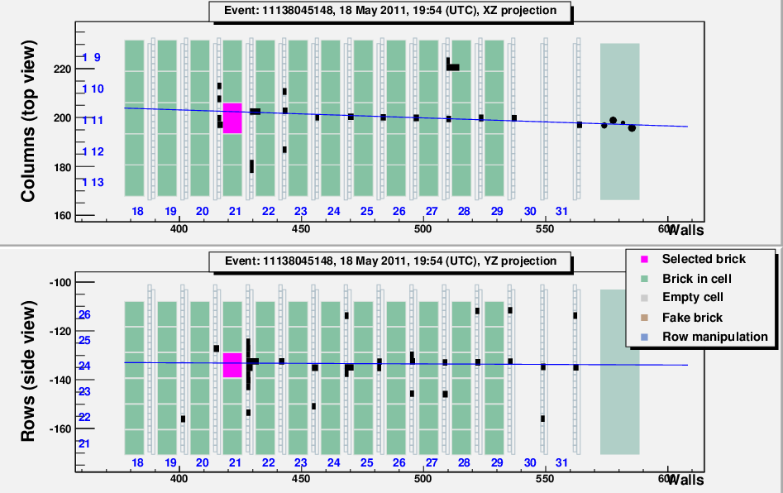
Location step (1) Brick Finding
Drift Tube hits
ν
TT hits
ν
Most probable brick
Event trigger & brick prediction by TT
Extract most probable brick by Brick Manipulator System
Detach CS from ECC and develop it
Validation by scanning CS searching tracks from ν interaction (automatic scanning system)
  Track found → Develop ECC films
  Not found → extract the 2nd probable brick…

Slide 7
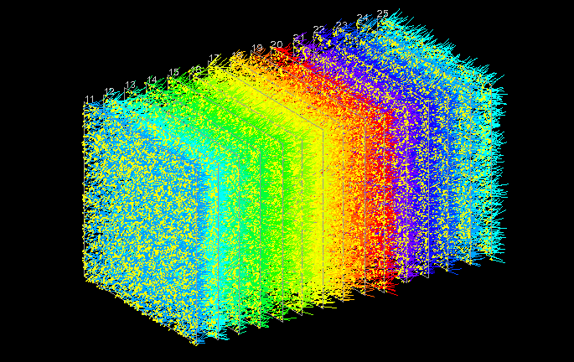
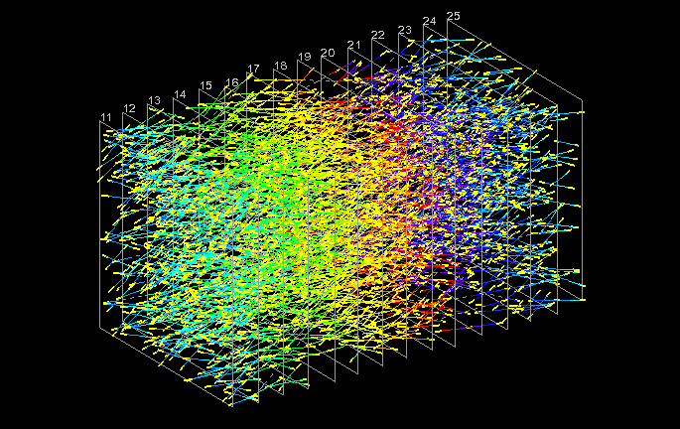
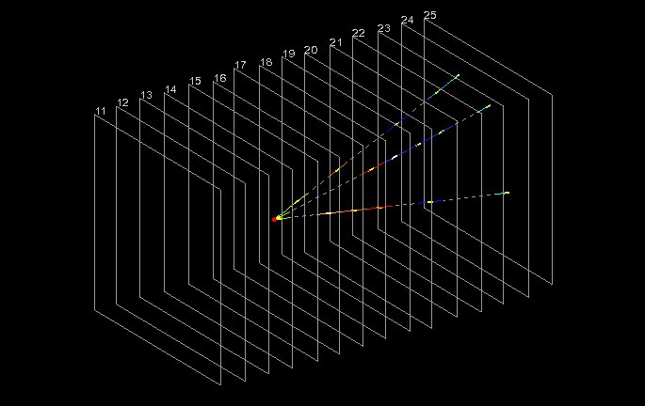
(2) Scanback & Decay search
ECC
CS
TT
Extrapolate track to upstream film by film from CS until stopping point (Scanback)
Volume scan around stopping point
Reconstruct high energy tracks
Vertexing with the scanback track
Decay daughter search with large impact parameter w.r.t. the vertex
lead
2
film
3
4
Raw data
1cm
ν
1cm
15 films

Slide 8
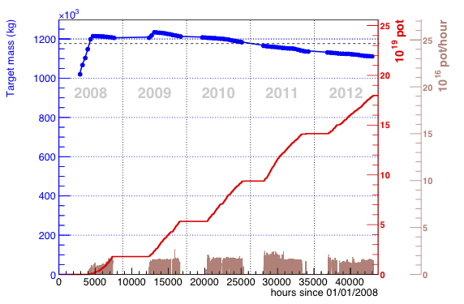
Data taking
17.97 x 10¹⁹ POT
Analysis is on going
6604 events were located
6148 decay searched
(+ ~1000 from XXIXth conference)
1st ν_{τ} (2009): τ → h
2nd ν_{τ} (2011): τ → 3h
NEUTRINO2010
Phys. Lett. B691 (2010) 138
2012 NEUTRINO2012
JHEP 11 (2013) 036
3rd ν_{τ} (2011): τ → μ
4th ν_{τ} (2012): τ → h
NEW
JPS 2013 Spring
Phys. Rev. D 89 (2014) 051102(R)
Seminar @ Gran Sasso (2014 March)
JPS 2014 Spring
NEUTRINO2014

Slide 9
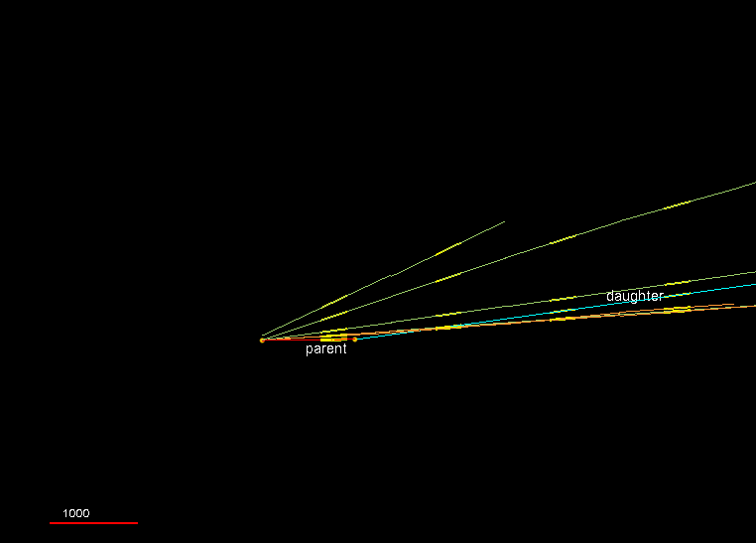
The 4th ν_{τ} event (τ → h)

Slide 10
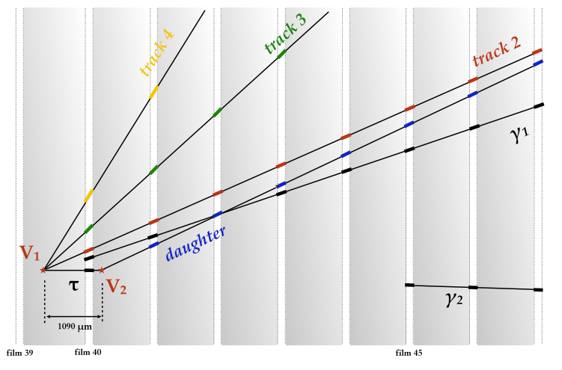
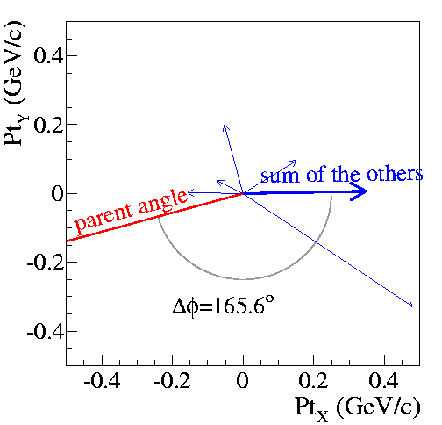
Kinematics
 | ID | Slopes | P (GeV/c)
1ry | 1 parent | -0.144, 0.020 | -
 | 2 | -0.046, 0.078 | 1.9 [1.7, 2.2]
 | 3 | 0.131, 0.146 | 1.1 [1.0, 1.2]
 | 4 | -0.082, 0.352 | 0.7 [0.6, 0.8]
 | γ1 | -0.234, 0.062 | 0.7 [0.6, 0.9]
 | γ2 | 0.113,-0.024 | 4.0 [2.6, 8.7]
2ry | daughter | -0.088, 0.147 | 6.0 [4.8, 8.2]
Good picture as tau:
Large phi angle (back-to-back)
Large Pt at kink (0.82 GeV/c).
Particle ID is important to reject backgrounds from nm CC interaction and determine decay channel

Slide 11
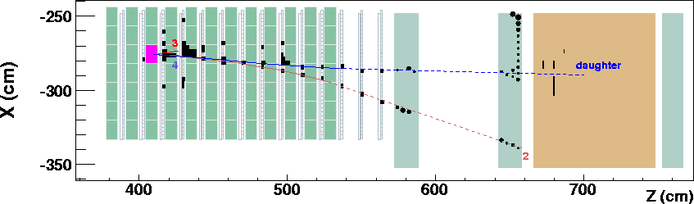
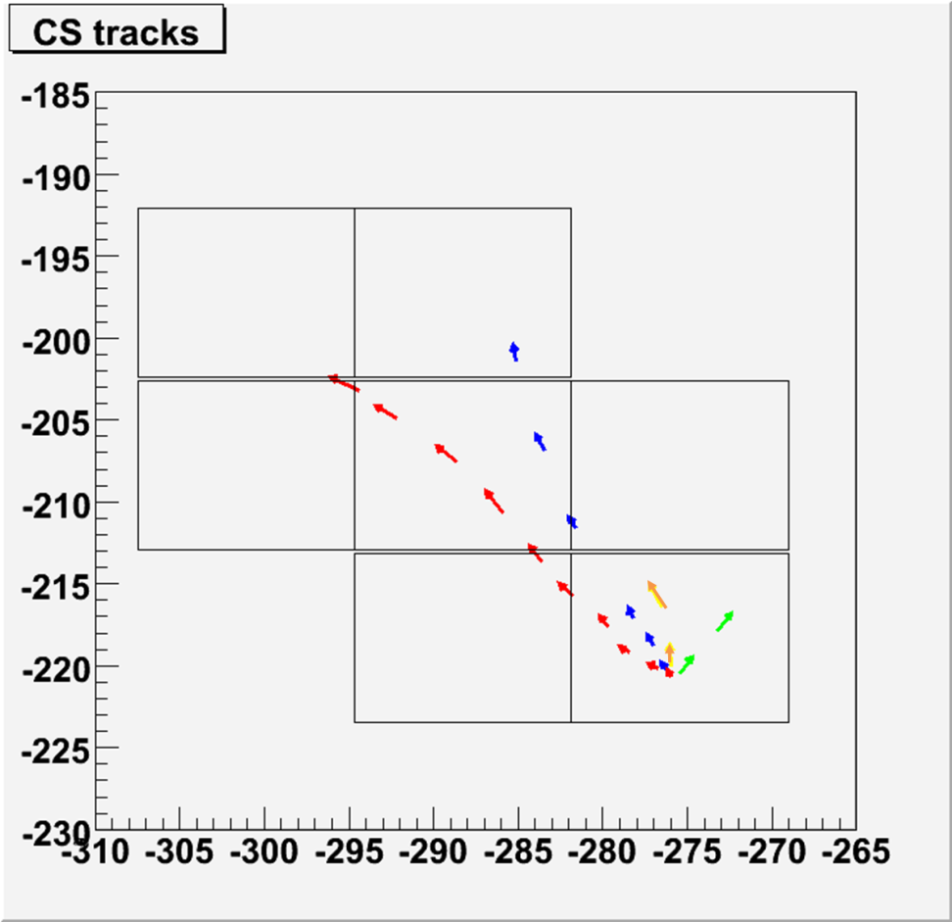
Particle ID
Track follow down was performed on relevant ECC for all tracks
DT
DT
RPC/Iron slab
DT
No hit on RPC
daughter
Track 3: interacted at 2 downstream ECC
Track 2
Track 4: missed at 2 downstream ECC
Track 4
Daughter & Track 2: passed all 9 downstream ECC without interaction and stopped at spectrometer
Track 3

Slide 12
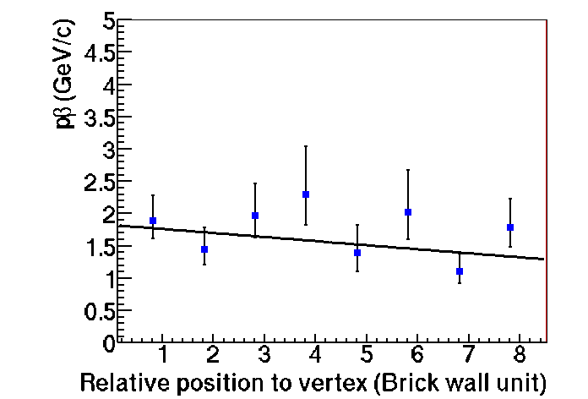
Particle ID
DT
DT
RPC/Iron stab
DT
Measured momentum of track2 by ECC
No hit on RPC
1.9 GeV/c
at vertex
Considering the momentum (1.9 GeV/c) of track 2 and the range of its path, muon hypothesis is inconsistent.
Track 2 is hadron.
Daughter also was judged as hadron by same analysis
→ No muon at 1ry vertex

Slide 13
Criteria
 | Using the mean values | Selection criteria
P daughter (GeV/c) | 6.0 ^{+2.2} _{-1.2} | >2
P_{t} at kink (GeV/c) | 0.82 ^{+0.30} _{-0.16} | >0.6
P_{t} miss at 1ry (GeV/c) | 0.55 ^{+0.30} _{-0.20} | <1
Phi (deg) | 166 ⁺² ₋₃₁ | >90
Kink angle (deg) | _{137 ± 4} | >20
Flight length (um) | _{1090 ± 30} | <2600
Passed all the cut for ντ

Slide 14
Background source
1. Charmed hadron with missed muon
2. Hadronic interaction
3. Large angle scattering of muon
μ (miss ID)
νμ
νμ
νμ
νμ
μ
μ, e, h
h
D+
Estimation by MC
Validation by OPERA data or test beam.

Slide 15
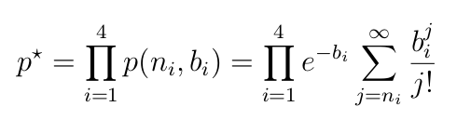
Oscillation analysis
Data samples
4686 events (979 0μ + 3707 1μ)
2008 – 2009: 1st brick + 2nd brick
2010 – 2012: 1st brick
Decay channel | Signal expectation | Total background | Observed events
t → h | 0.4 ± 0.08 | 0.033 ± 0.006 | 2
t → 3h | 0.57 ± 0.11 | 0.155 ± 0.03 | 1
t → m | 0.52 ± 0.1 | 0.018 ± 0.007 | 1
t → e | 0.61 ± 0.12 | 0.027 ± 0.005 | 0
Total | 2.1 ± 0.42 | 0.23 ± 0.04 | 4
Combination of four single channel p-value was calculated in order to take account the difference of background with decay channels
P-value = (式) = 1.03 x 10⁻⁵
➔ No oscillation was excluded with 4.2σ significance
Observation of ν_{τ} appearance

Slide 16
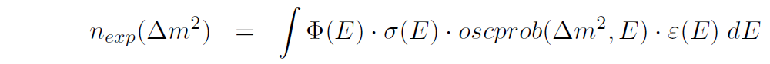
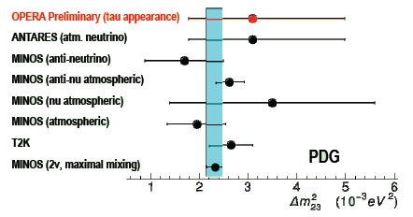
Oscillation parameter from ν_{τ} appearance
First measurement by ν_{τ} appearance
flux
cross section
detection
efficiency
90 % C.L. intervals on Δm²₂₃ by Feldman & Cousin method: [1.8 - 5.0] x 10⁻³ eV²
(assuming full-mixing)
OPERA Preliminary (tau appearance)
ANTARES (atm. neutrino)
MINOS (anti-nu atmospheric)
MINOS (anti-neutrino)
MINOS (nu atmospheric)
MINOS (atmospheric)
T2K
MINOS (2n, maximal mixing)
Consistent with other experiments

Slide 17
Conclusions
OPERA aims direct observation of ν_{τ} from the ν_{μ} → ν_{τ} oscillation .
17.97 x 10¹⁹ POT (80% or proposal) of neutrinos were delivered to the detector from 2008 to 2012.
The analysis on ECC is on going, 6604 neutrino interactions were located up to now.
The 4th ν_{τ} candidate was newly found.
Observation of oscillation at 4.2σ significance.
The first measurement of Δm²₂₃ by appearance mode was done. The value [1.8 – 5.0] x 10⁻³ (90 % C.L.) is consistent with other experiments.

Slide 18
Backup

Slide 19
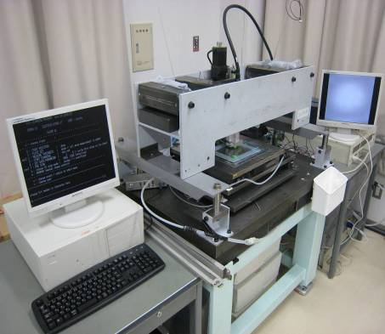
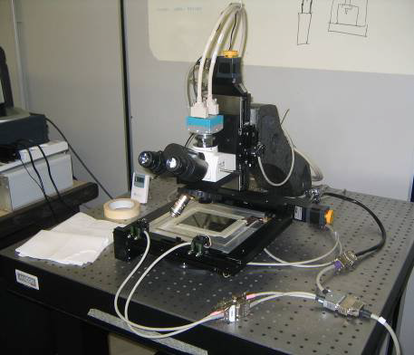
Automatic scanning system
Japanese Scanning System (S-UTS)
European Scanning System (ESS)
Scanning speed/system: 75cm2/h
x 5 system
Scanning speed/system: 20cm2/h
x 10 system
The Scanning analysis is divided half-and-half to Japanese and European lab.

Slide 20
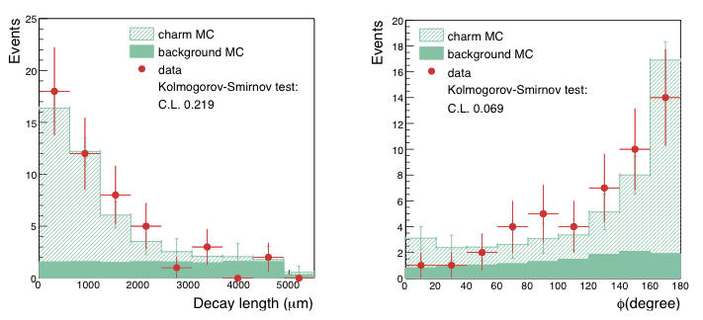
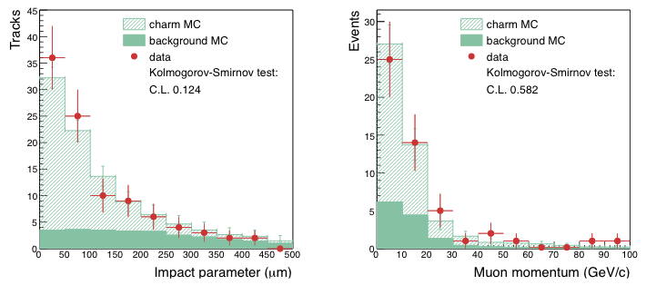
Charm control sample
 | expected | Data
1 prong | 30 ± 4 | 19
2 prong | 18 ± 2 | 22
3 prong | 5 ± 1 | 5
4 prong | 0.9 ± 0.2 | 4
toal | 54 ± 4 | 50
Phi: The angle between 1ry muon and charm in transverse plain
Charm hadrons have near mass and lifetime as tau
Guarantee Decay search efficiency

Slide 21
