Slide 1
High-gradient accelerating structures for proton acceleration
Linear collider development applied to cancer therapy

Slide 2
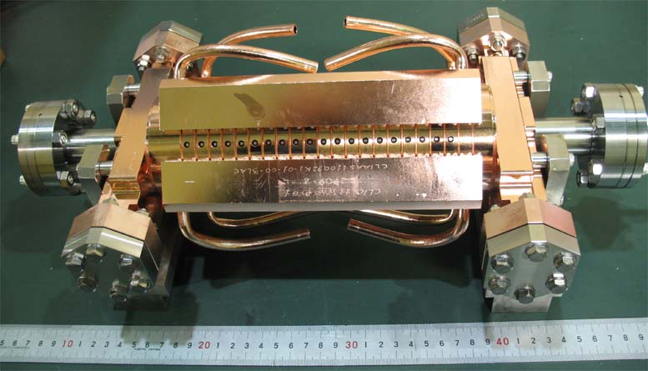
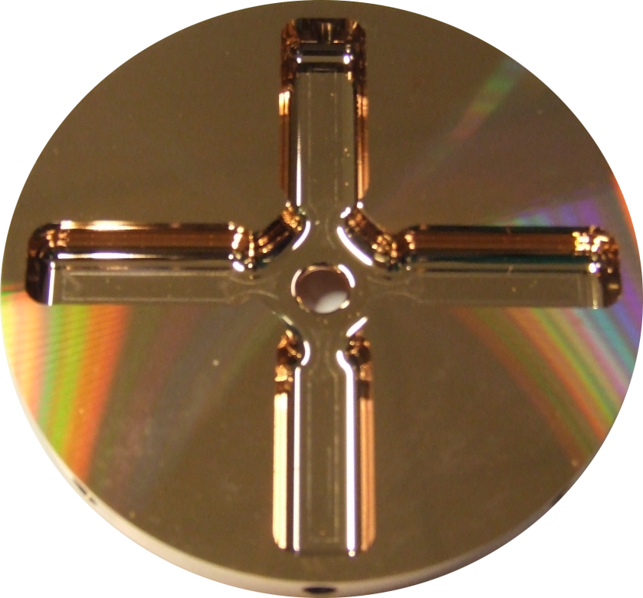
CLIC accelerating structure development
In the context of the study of a TeV-range linear colliders – NLC/JLC and CLIC - we have developed the science and technology for achieving high gradients, 100 MV/m, using short pulse, normal conducting rf.
We are now actively seeking to expand the technological and industrial base for CLIC by promoting the use of high-gradient technology in other applications such as medical linacs, FELs, Compton sources etc.

Slide 3
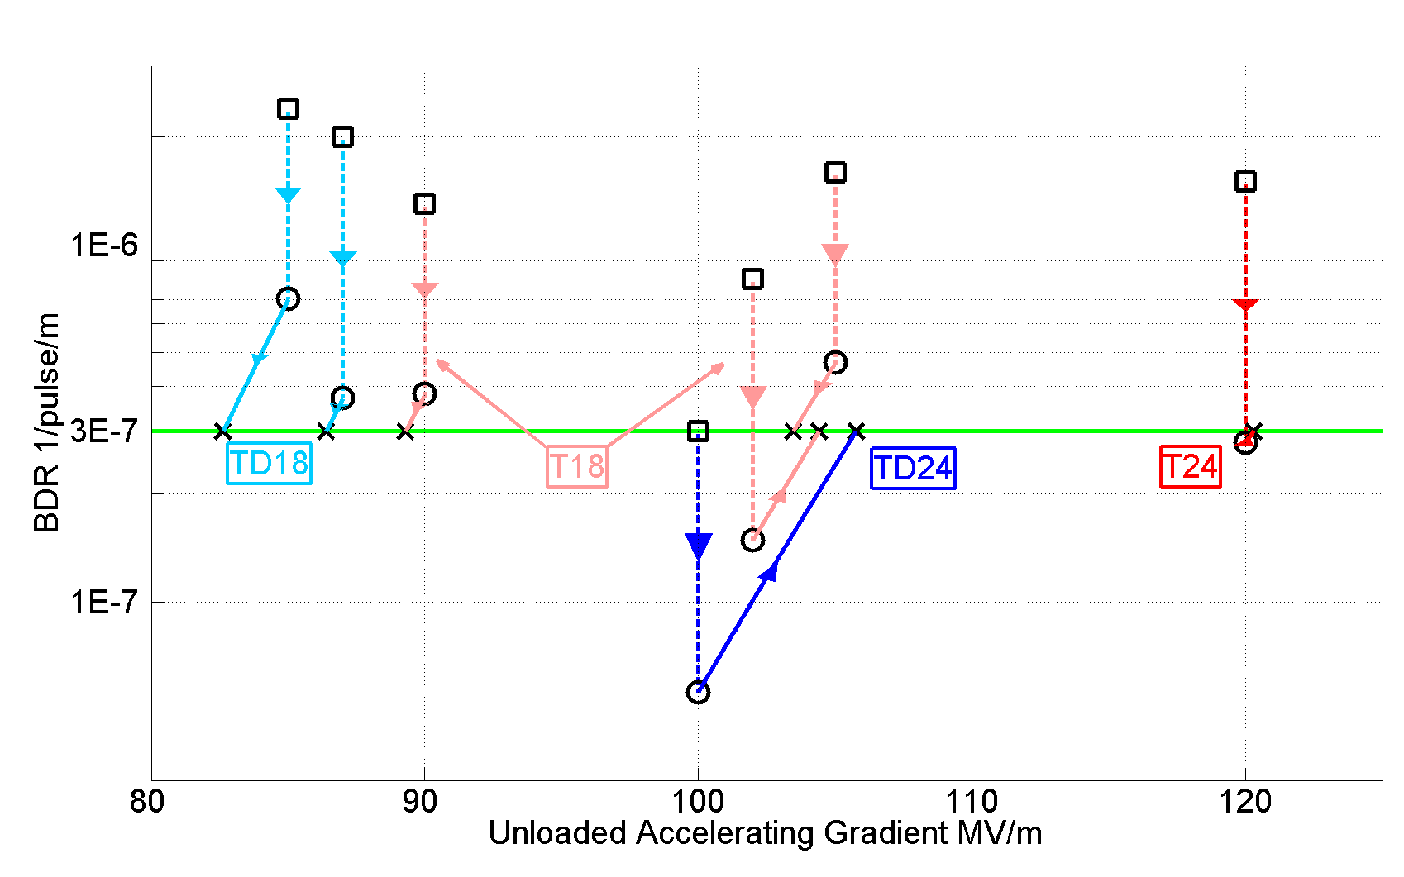
Accelerating gradients achieved in tests.
Status: 4-9-2012
HOM damped

Slide 4
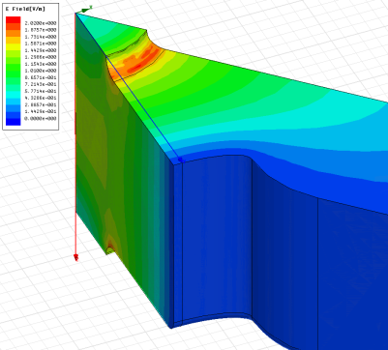
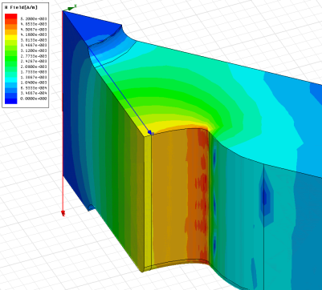
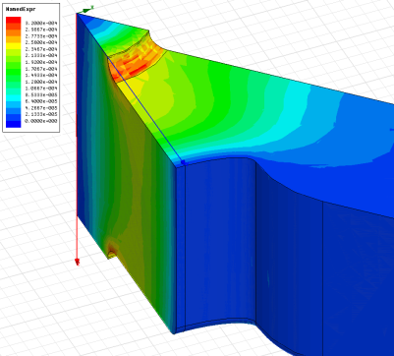
How we got there: High-power design laws
The functions which, along with surface electric and magnetic field (pulsed surface heating), give the high-gradient performance of the structures are:
E_{s}/E_{a}
global power flow
local complex power flow
New local field quantity describing the high gradient limit of accelerating structures.
A. Grudiev, S. Calatroni, W. Wuensch (CERN). 2009. 9 pp.
Published in Phys.Rev.ST Accel.Beams 12 (2009) 102001
H_{s}/E_{a}
S_{c}/E_{a}²

Slide 5
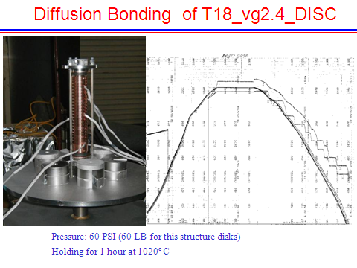
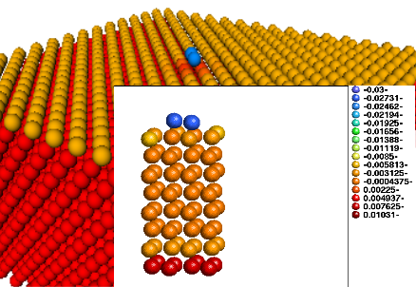
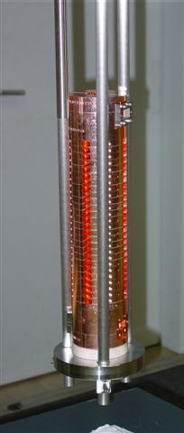
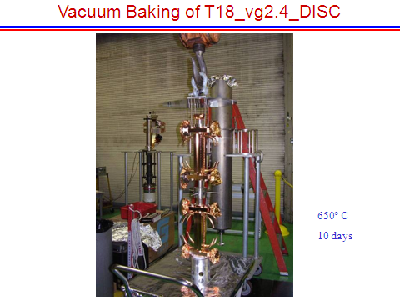
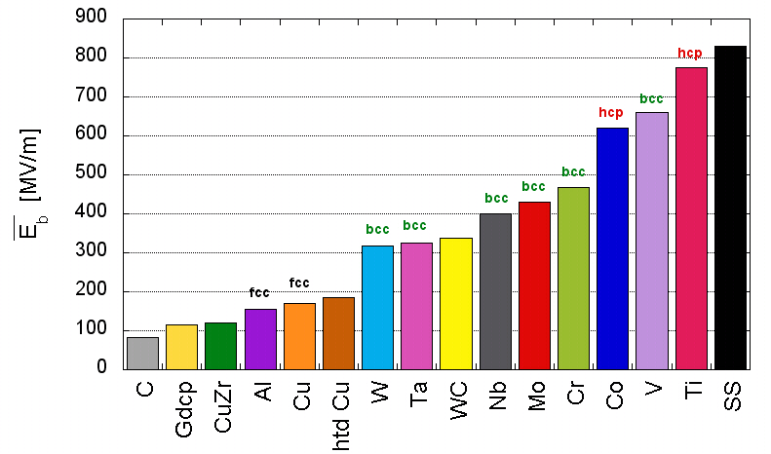
How we got there: heat treatment and material structure
TD18#3 at SLAC
TD18#2 at KEK
Stacking disks
Attempting to understand why it works.
Temperature treatment for high-gradient developed by NLC/JLC

Slide 6
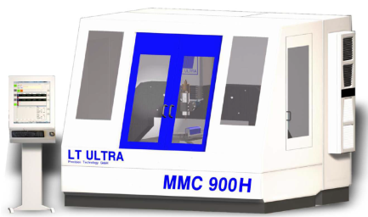
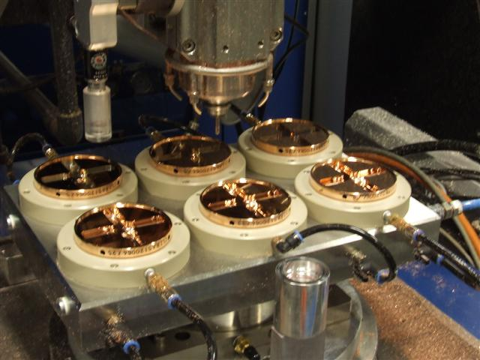
Micron precision turning and milling
Accelerating structure tolerances drive transverse wakefields and off-axis rf induced kicks which in turn leads to emittance growth – micron tolerances required.
Multi-bunch trains require higher-order-mode wakefield suppression – cells require milled features.
High-speed diamond machining also seems to be beneficial for high-gradient performance through minimizing induced surface stresses.
Development done “in industry”

Slide 7
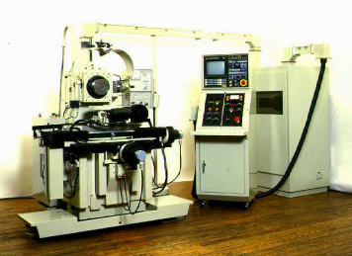
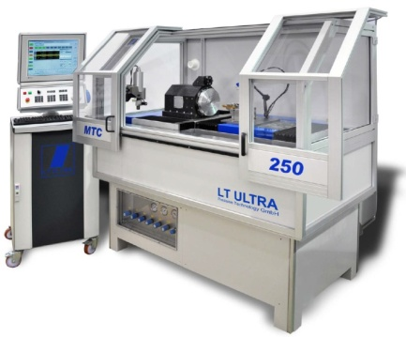
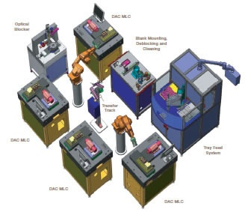
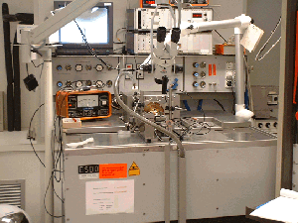
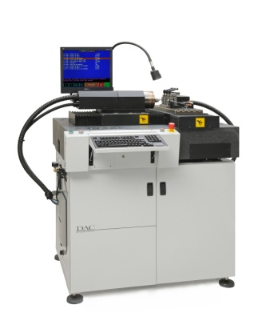
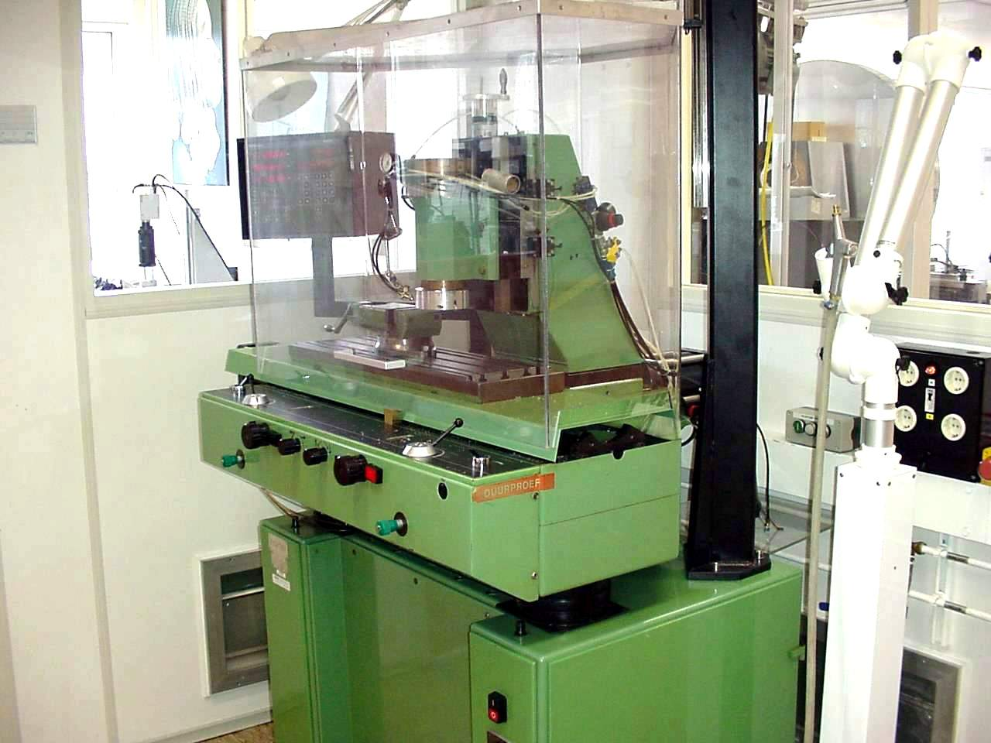
Evolution of machining capability
Single point diamond turning
Up to the 1980’s
1980’s - 1990’s
2000’s - 2010’s
Future ?
First machines at research institutes and universities
Start of industrialization
Optical recording
contact lenses
Larger machines
Multiple axis ( X/Y/Z and C)
Intelligent machines ?
  Robotisation ?
Ultra precision diamond milling (lagging more than a decade behind on turning)
Up to the 1990’s
1990’s - 2000’s
2010’s
Future ?
Limited to fly cutting
mirror optics
Laser scanner mirrors
Milling as add-on on lathes
Lens arrays
Intra ocular lenses
First proto type machines
Micro fluidics
Accelerator parts
Pallet machining?
  Robotisation ?

Slide 8
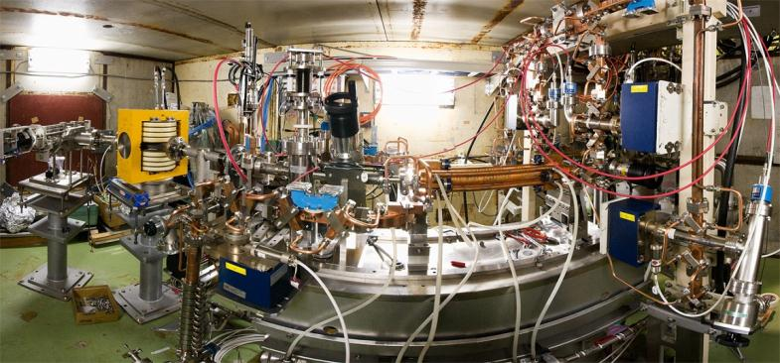
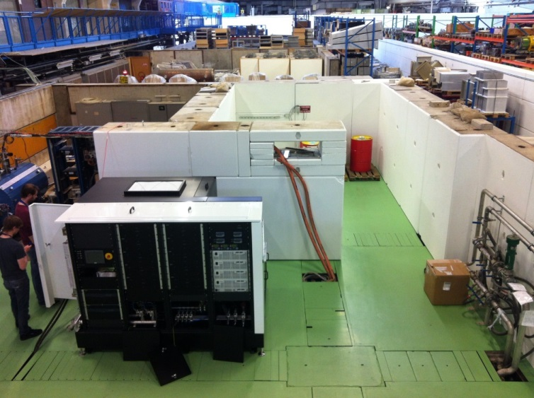
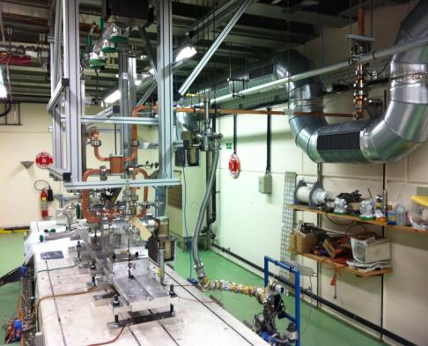
Klystron-based test stands for CLIC
NEXTEF at KEK
Xbox-1 at CERN
SLAC XL-5 50 MW
Xbox-2 at CERN based on CPI VKX-8311A 50 MW tube
Xbox-3 at CERN based on Toshiba 6 MW tube

Slide 9
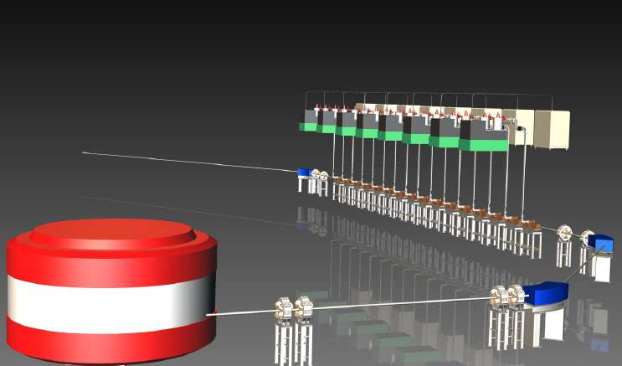

TERA program: development and construction of « cyclinacs »
HIGH REP RATE PULSED SPOT WITH FAST INTENSITY AND ENERGY MODULATION
many indipendent 3 GHz RF power sources
tumour target
to the patient
9-12 Units
pulsed source
100-300 Hz
4 microseconds
CYCLOTRON

Slide 10
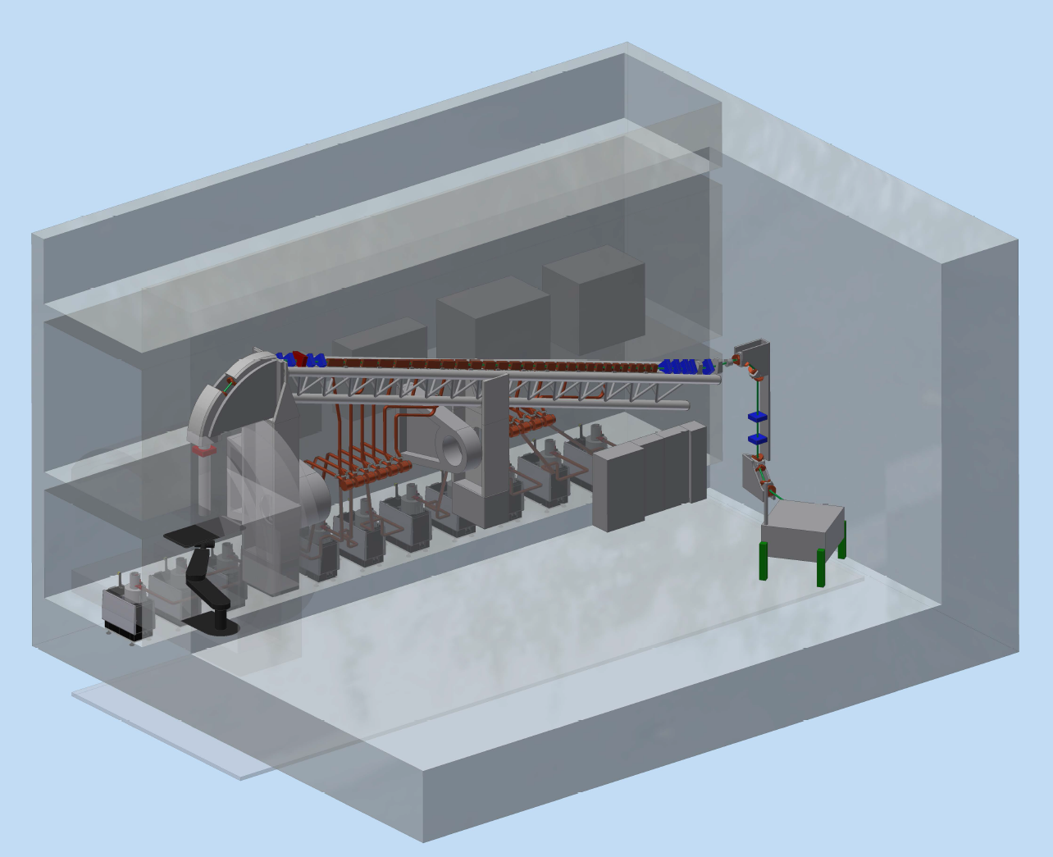
TULIP at 3 GHz and high gradients (E₀ = 30 MV/m)
TR24

Slide 11
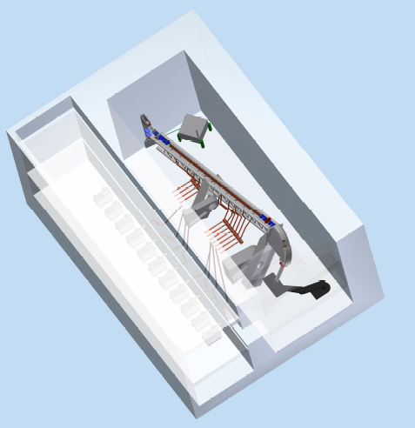
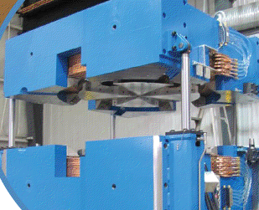
TULIP at 3 GHz and high gradients (E₀ = 30 MV/m)
17 m
1.7 m
TR24
24 m
TR24
24 MeV cyclotron
by
Advanced Cyclotron Systems
(Canada)
400 m²

Slide 12
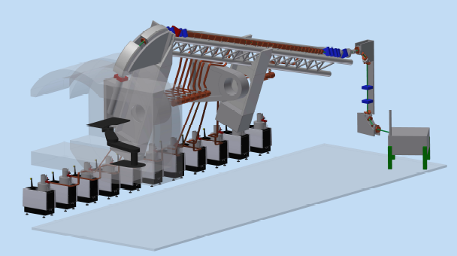
TULIP at 3 GHz and high gradients (E₀ = 30 MV/m)
Rotation: +-110° wrt the horizontal plane
≤230 MeV
24 MeV
patient access
eleven
10 MW klystrons
TR24

Slide 13
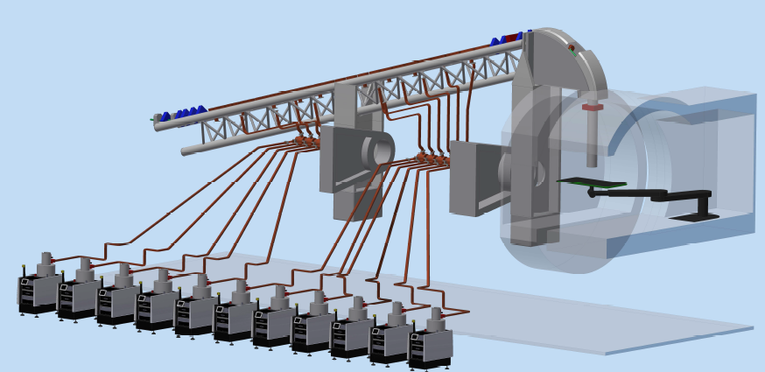
TULIP at 3 GHz and high gradients (E₀ = 30 MV/m)
patient access

Slide 14
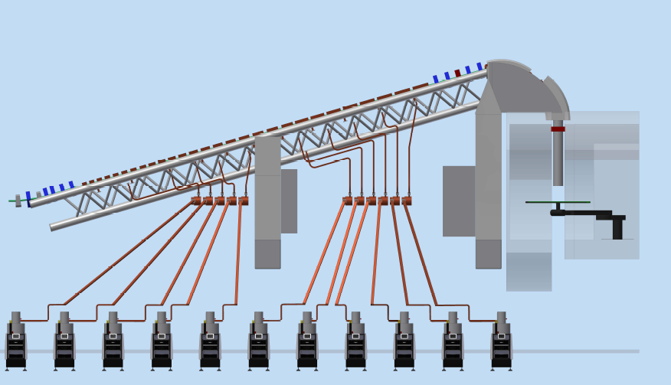
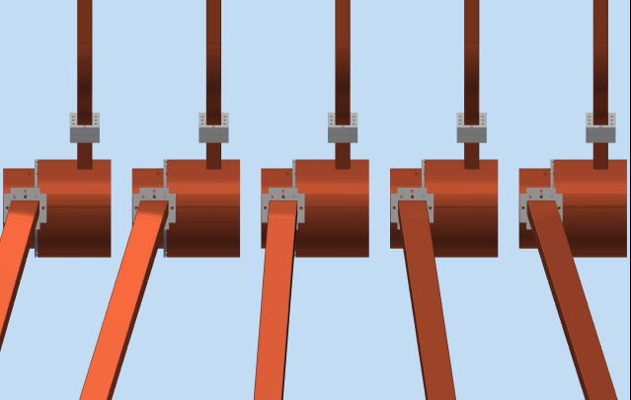
TULIP at 3 GHz and high gradients (E₀ = 30 MV/m)
RF rotatory joints
scanned area:
20x20 cm²

Slide 15
This project
The objective of this project is to design and build two accelerating structures for a compact proton accelerator as one might incorporate in TULIP, using the high-gradient technology developed for CLIC.
The proton energies we will design for are 76 and 213 MeV.
The primary challenge comes from the low velocity of the protons, which leads to a very different design rf structure compared to that for relativistic electrons.
We hope to be able to raise the accelerating gradient from the 27 MV/m of LIBO linac tanks up to the range of 50 MV/m.
Our sincere thanks to the KT department to making this project possible.

Slide 16
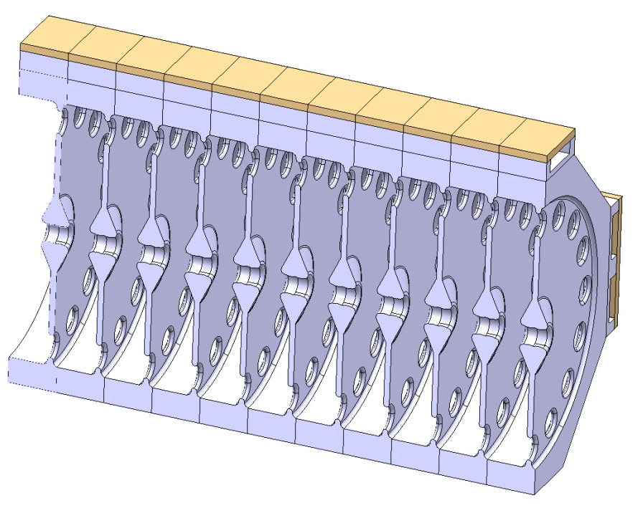
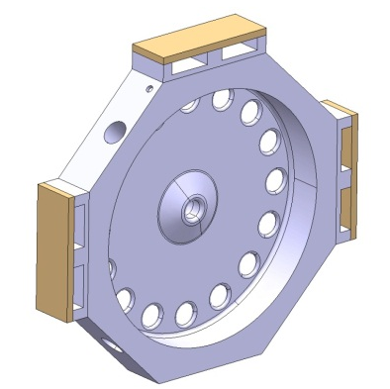
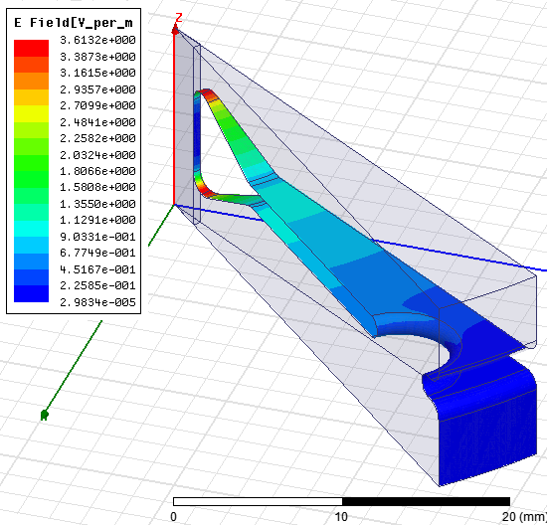
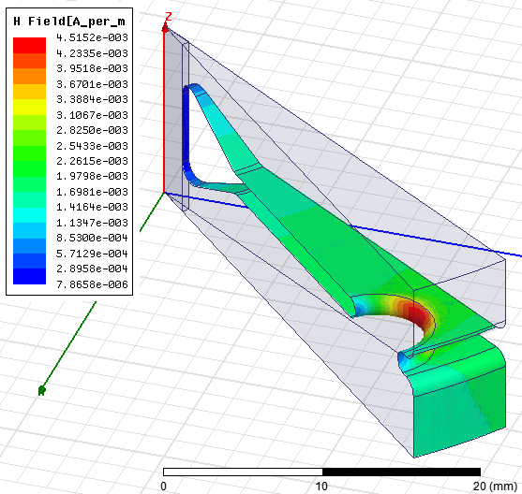
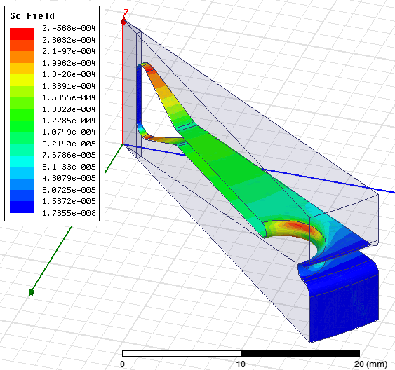
Backward wave high-gradient accelerating structure for proton acceleration based on CLIC technology

Slide 17
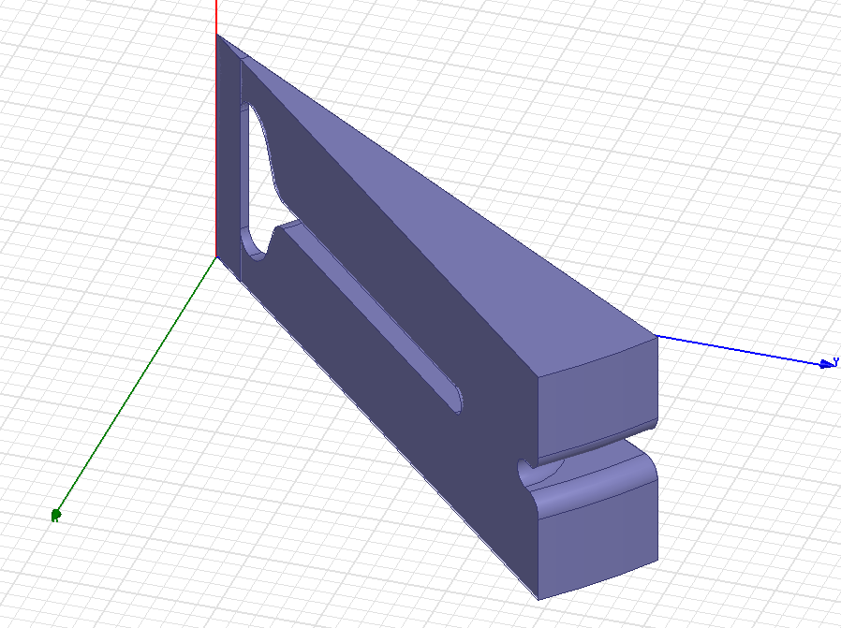
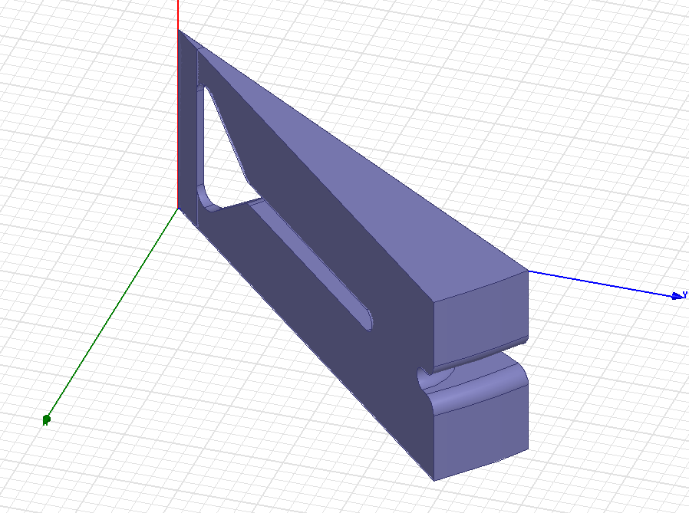
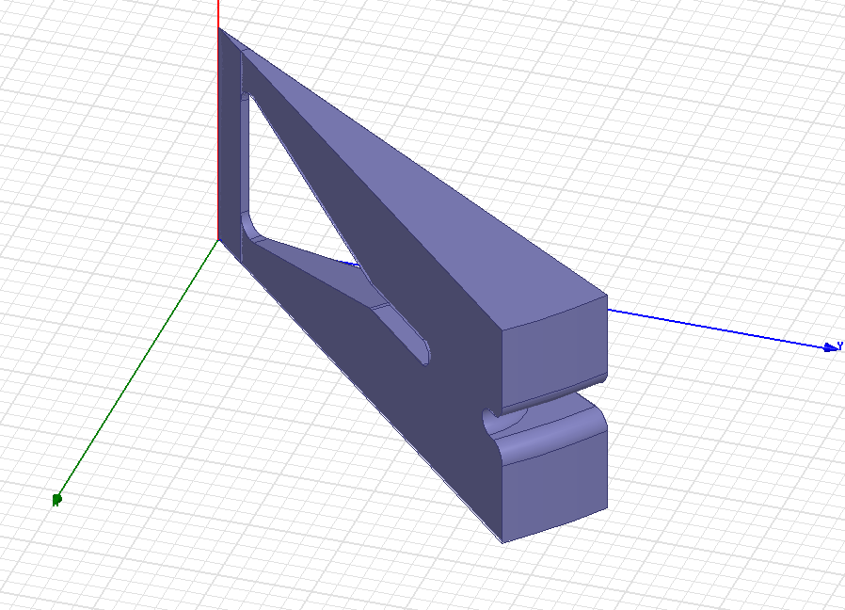
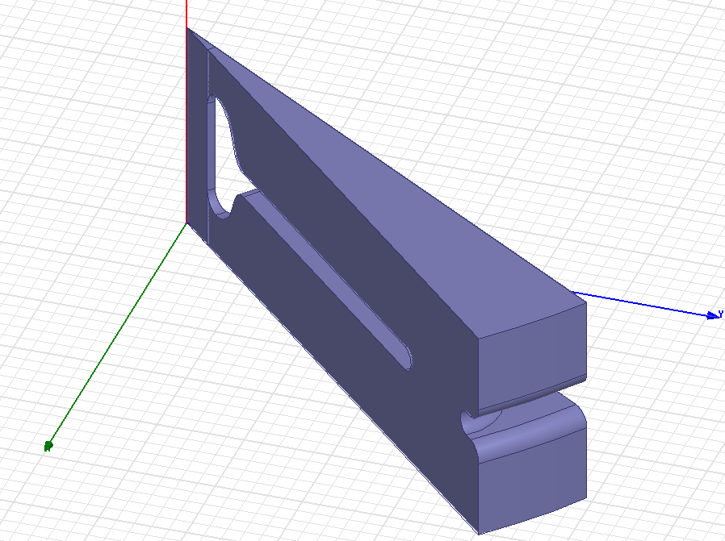
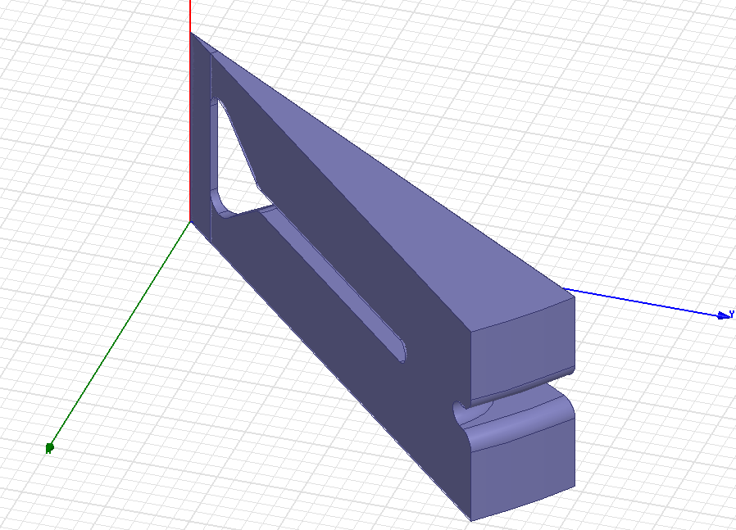
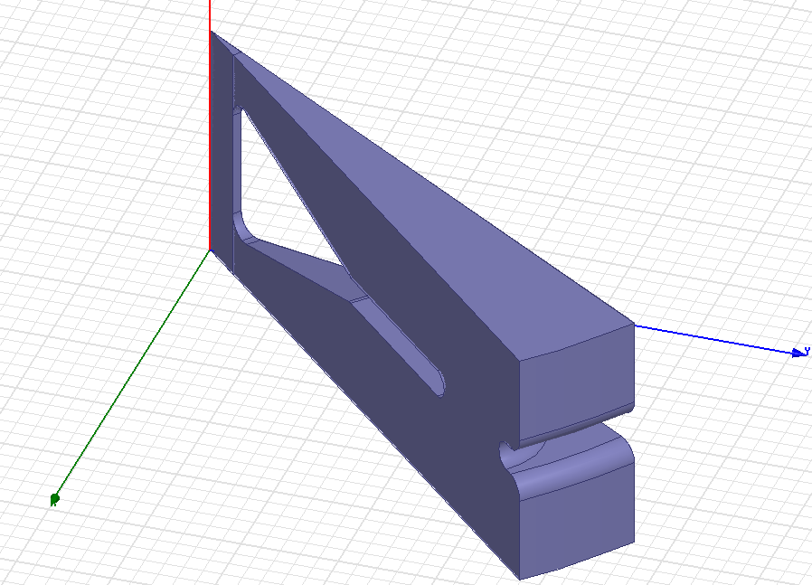
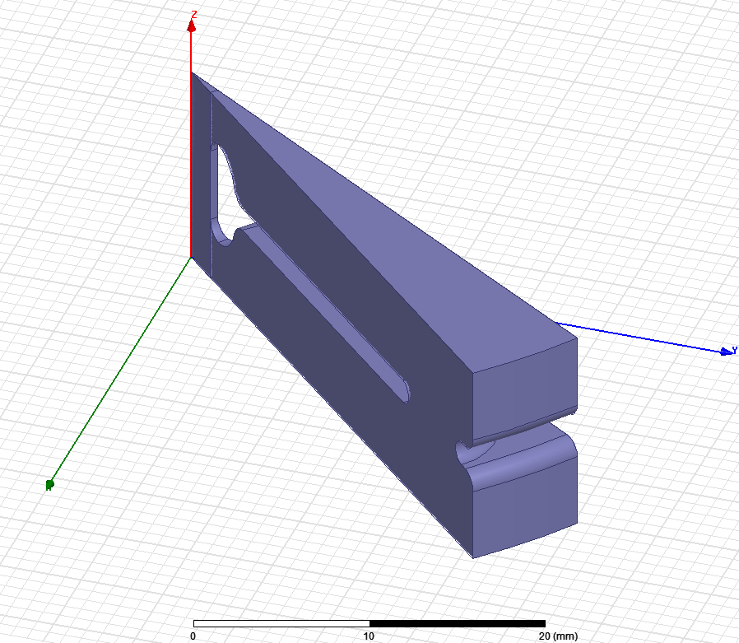

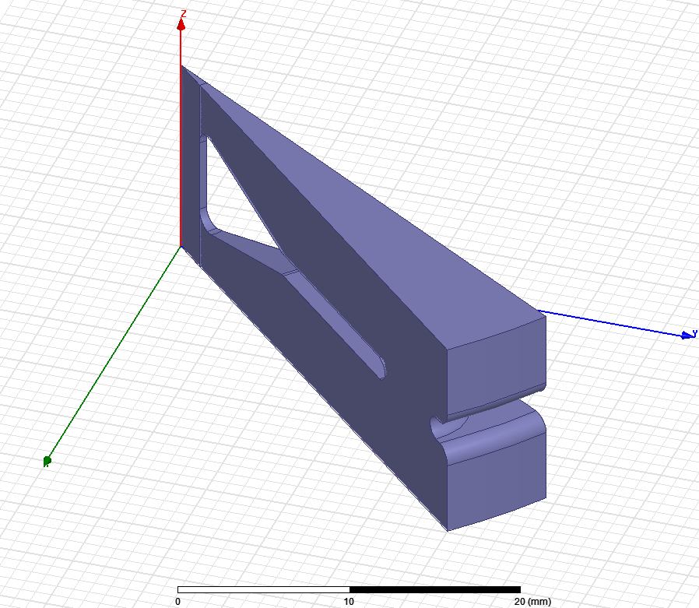
gap and angle scan – 120 deg
g4 a25
g4 a55
g4 a75
g5 a25
g5 a55
g5 a75
g6 a25
g6 a55
g6 a75

Slide 18
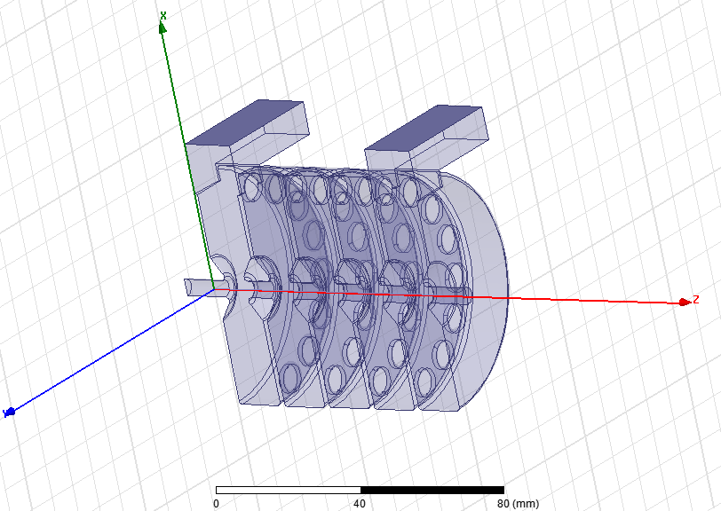
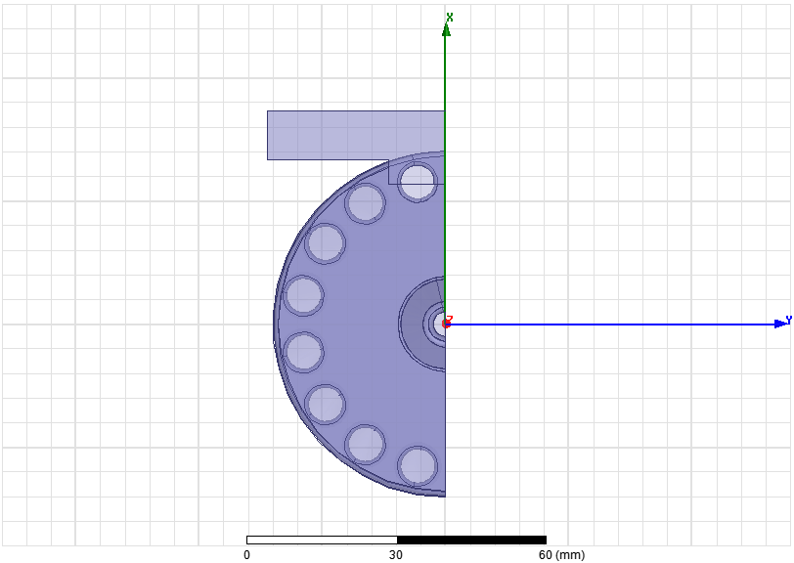
Coupling slot optimization
P_in
P_out
Goal: minimize the S₁₁ parameter
n
Cl
Optimization of the accelerating cell diameter for different number of cells (n=1:3), with Cl as parameter
The max S₁₁ among the three computed is considered
acD

Slide 19
Preliminary design for high gradient bTW linac
~15-16 MW
klystron
MKs
2 x 7.5 MW klystrons
MKs
1
load
load
3
load
load
3
2
2
T1
T2
T1
T2
Independent rotary joints
-3 dB recirculation
Small RF load compared to TW

Slide 20
SUMMARY | 120 deg |  | 150 deg |  | SCL base | SCL – HG
wall thickness (mm) | 1.5 |  | 1.5 |  | 3.0 | 3.0
gap (mm) | 5.5 |  | 7.0 |  | 5.1 | 9.5
nose cone angle (deg) | 65 |  | 55 |  | 25 | 55
length (mm) | 189.9 |  | 189.9 |  | 189.9 | 189.9
ncell | 15 |  | 12 |  | 10 | 10
Ea_avg (MV/m) | 25 |  | 25 |  | 25 | 25
Sc_nose (MW/mm2) | 0.149 |  | 0.185 |  | 0.486 | 0.188
t_pulse (ns) flat | 2500 |  | 2500 |  | 2500 | 2500
expected BDR (at given Ea and t_pulse) (bpp/m) based on Sc limit | 1.1 E-22 |  | 2.9 E-21 |  | 5.7 E-15 | 3.7 E-21
max Ea (for BDR of 10⁻⁶ bpp/m) (MV/m) | 85.2 |  | 76.3 |  | 47.1 | 75.7
Pin (MW) (w/o recirculation) | 2.70 | 5.19 | 2.49 | 5.10 | 1.75 | 2.26
Pout (MW) (w/o recirculation) | - | 2.90 | - | 3.02 | - | -
Q0 (first/last) | 6482/6721 |  | 7088/7545 |  | 8291 | 8250
vg (first/last) [%c] | 0.421/0.226 |  | 0.404/0.236 |  | - | -
R’/Q (first/last) [Ohm/m] | 7872/7847 |  | 7835/7794 |  | 8406 | 6355
time constant (ns) | 320 |  | 340 |  | 440 | 440
field rise time (time to reach 99% field) (ns) (w/o recirculation) | 750 | 204 | 800 | 204 | 1050 | 1050

Slide 21
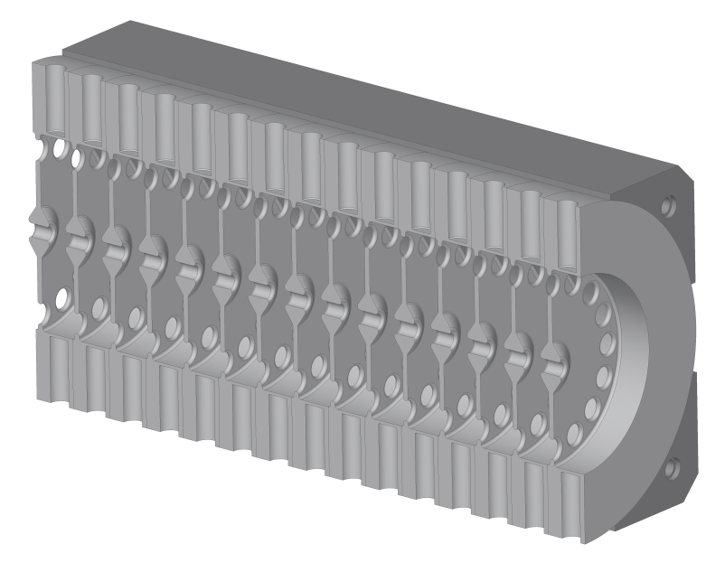
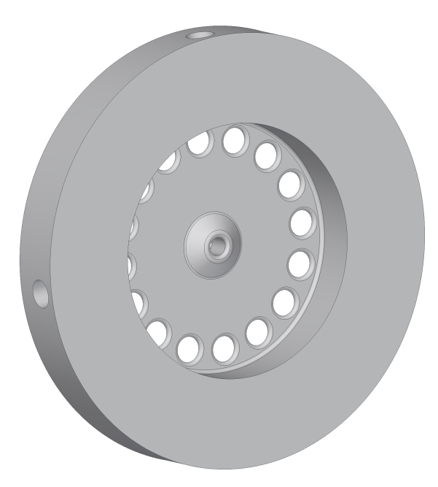
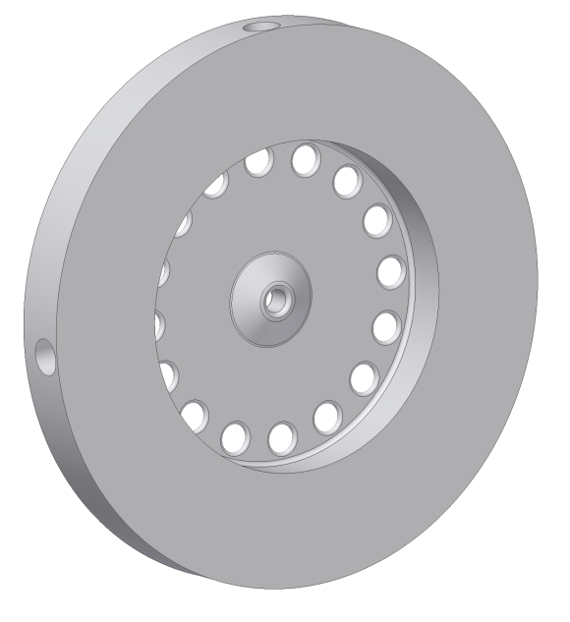
Accelerating elements
120° of phase advance
150° of phase advance
4 holes for dimpler tuners

Slide 22
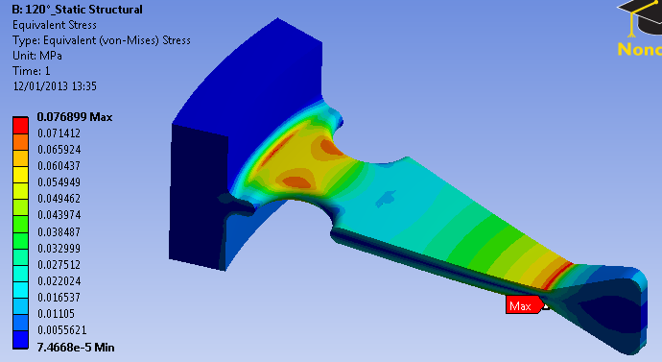
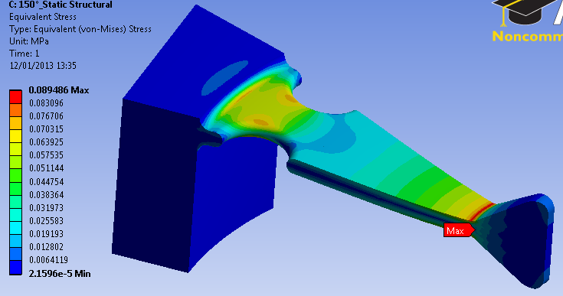


Evaluation of different cells structural performance
120° of phase advance
150° of phase advance
g
Load: gravitational force
g
$$σ_{max}=0.077 [MPa]$$
$$f_{max}=8.9∙{10}^{−5} [mm]$$
$$σ_{max}=0.090 [MPa]$$
$$f_{max}=9.1∙{10}^{−5} [mm]$$

Slide 23

120°
Field [MV/m] | Espected max T [°C] | Power per cell [W]
100 | 102.8 | 573.9
50 | 43.7 | 143.5
25 | 28.9 | 35.9
Coherent with theoretical values

Slide 24


