Slide 1

Electron cloud build-up in the inner triplets (IP1-5)
G. Iadarola, G. Rumolo
Many thanks to:
H. Bartosik, N. Mounet, B. Salvant, L.Tavian, R. Tomas, C. Zannini
Electron cloud meeting – 10/09/2013

Slide 2
Outline
  Introduction
  Simulating the inner triplets in PyECLOUD
  Simulation results
  Machine observations (heat load)
  Some considerations on e⁻ - beam interaction
  Endoscopy observations

Slide 3
Outline
  Introduction
  Simulating the inner triplets in PyECLOUD
  Simulation results
  Machine observations (heat load)
  Some considerations on e⁻ - beam interaction
  Endoscopy observations

Slide 4
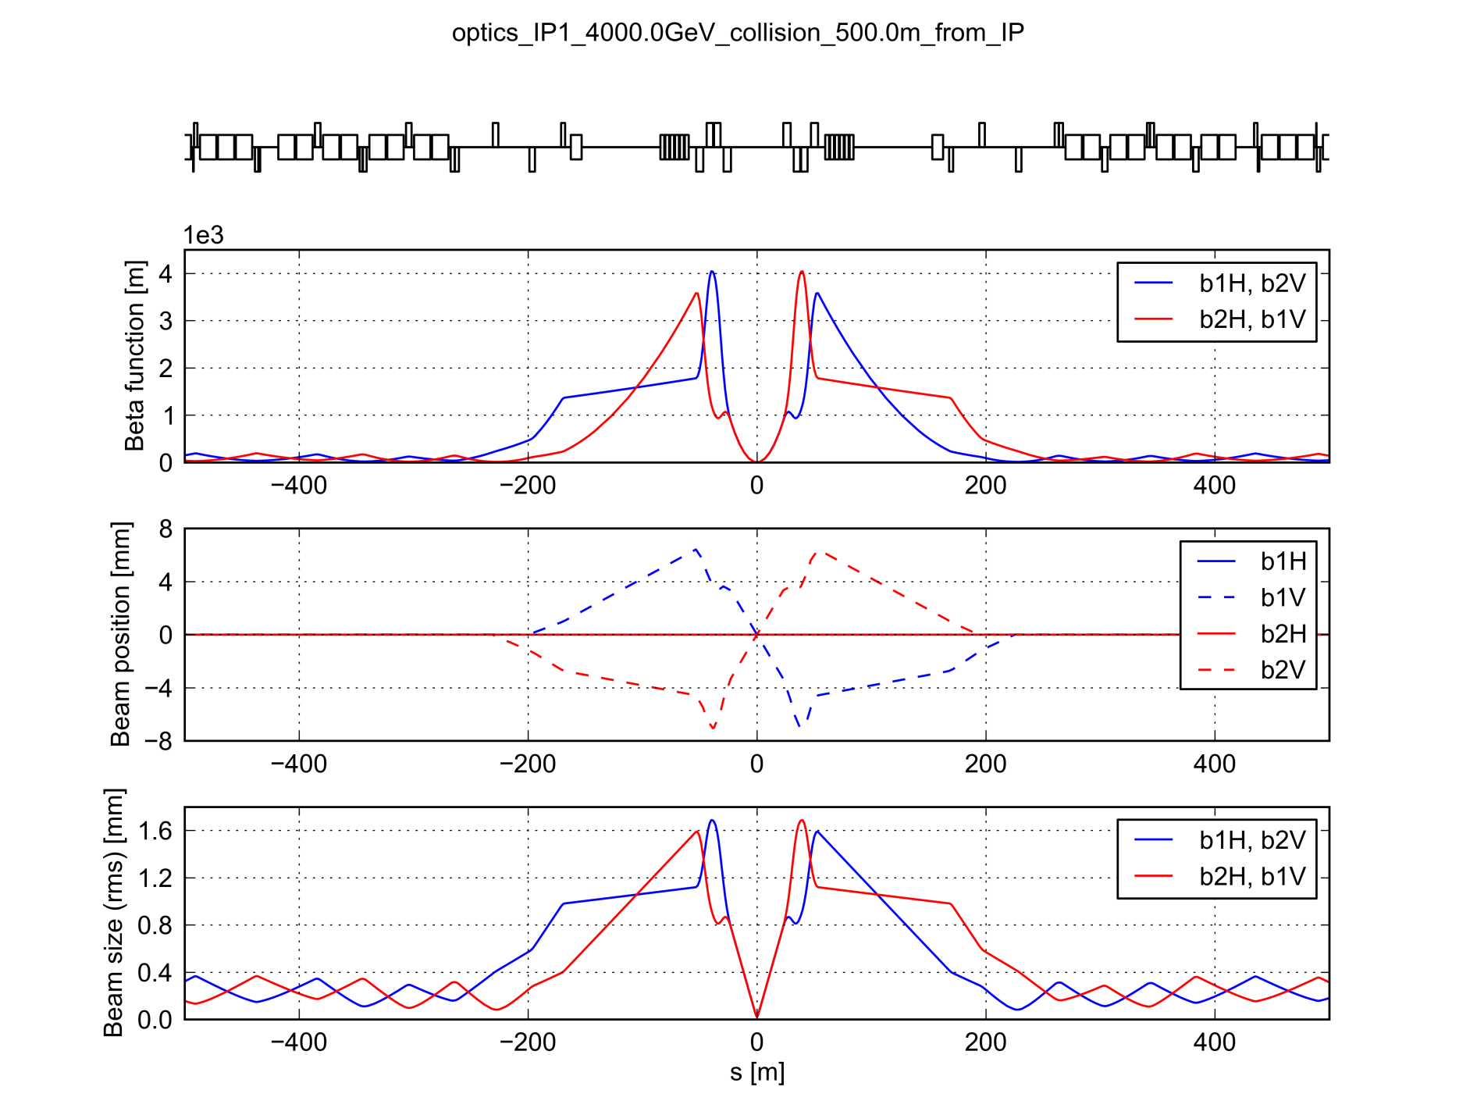
Machine layout and optics near IP1
  Separated beam pipes
  Common beam pipe
  Separated beam pipes
  IP1
  IP1, 4 TeV, β* = 0.6 m

Slide 5
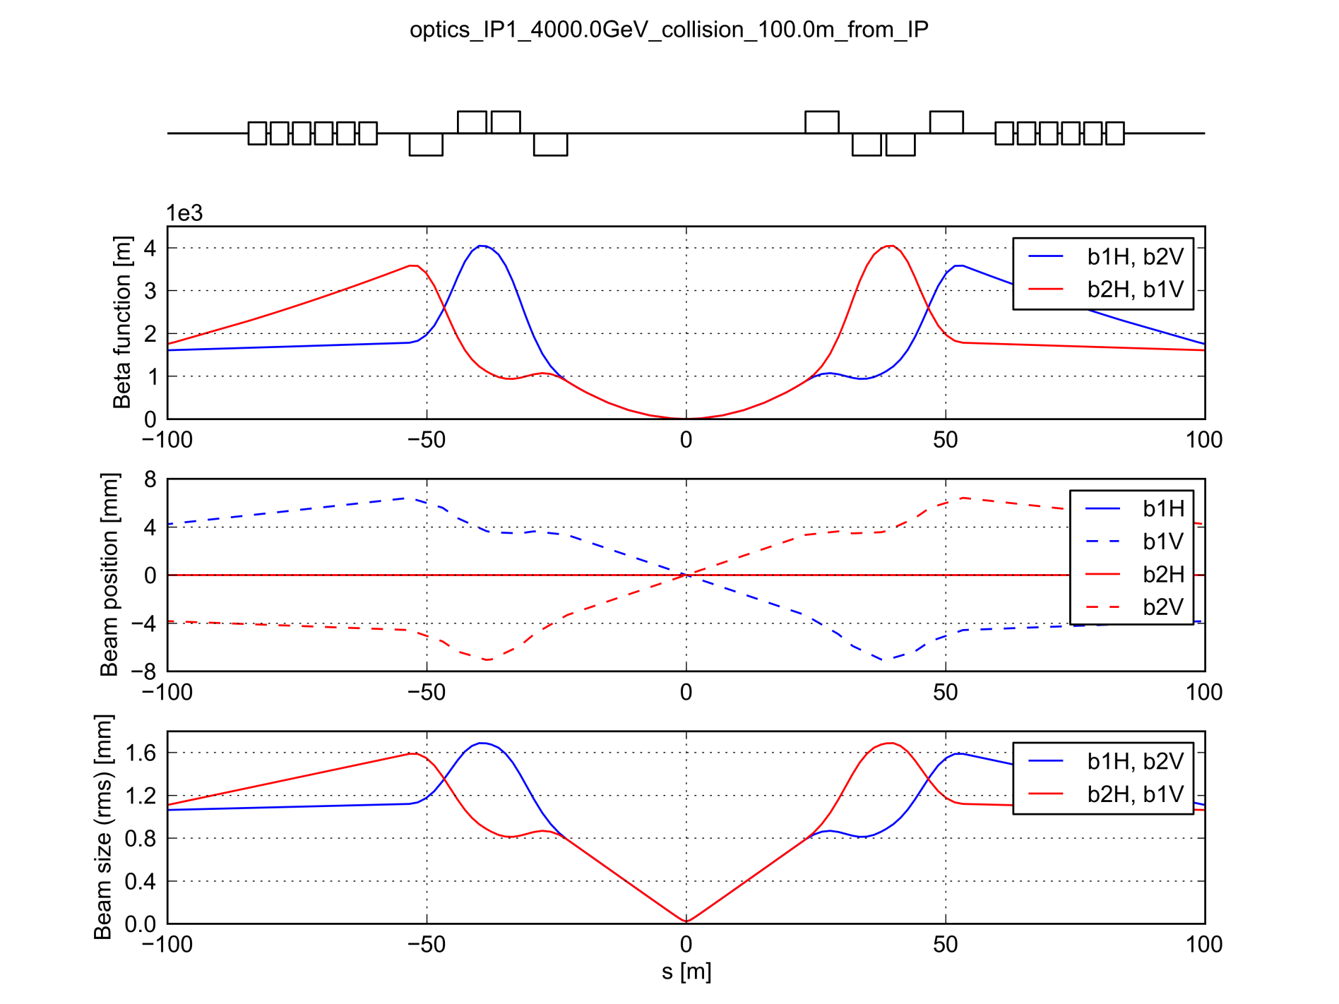
Machine layout and optics near IP1
B2L1
A2L1
1R1
3R1
3L1
1L1
  IP1
A2R1
B2R1
  IP1, 4 TeV, β* = 0.6 m

Slide 6
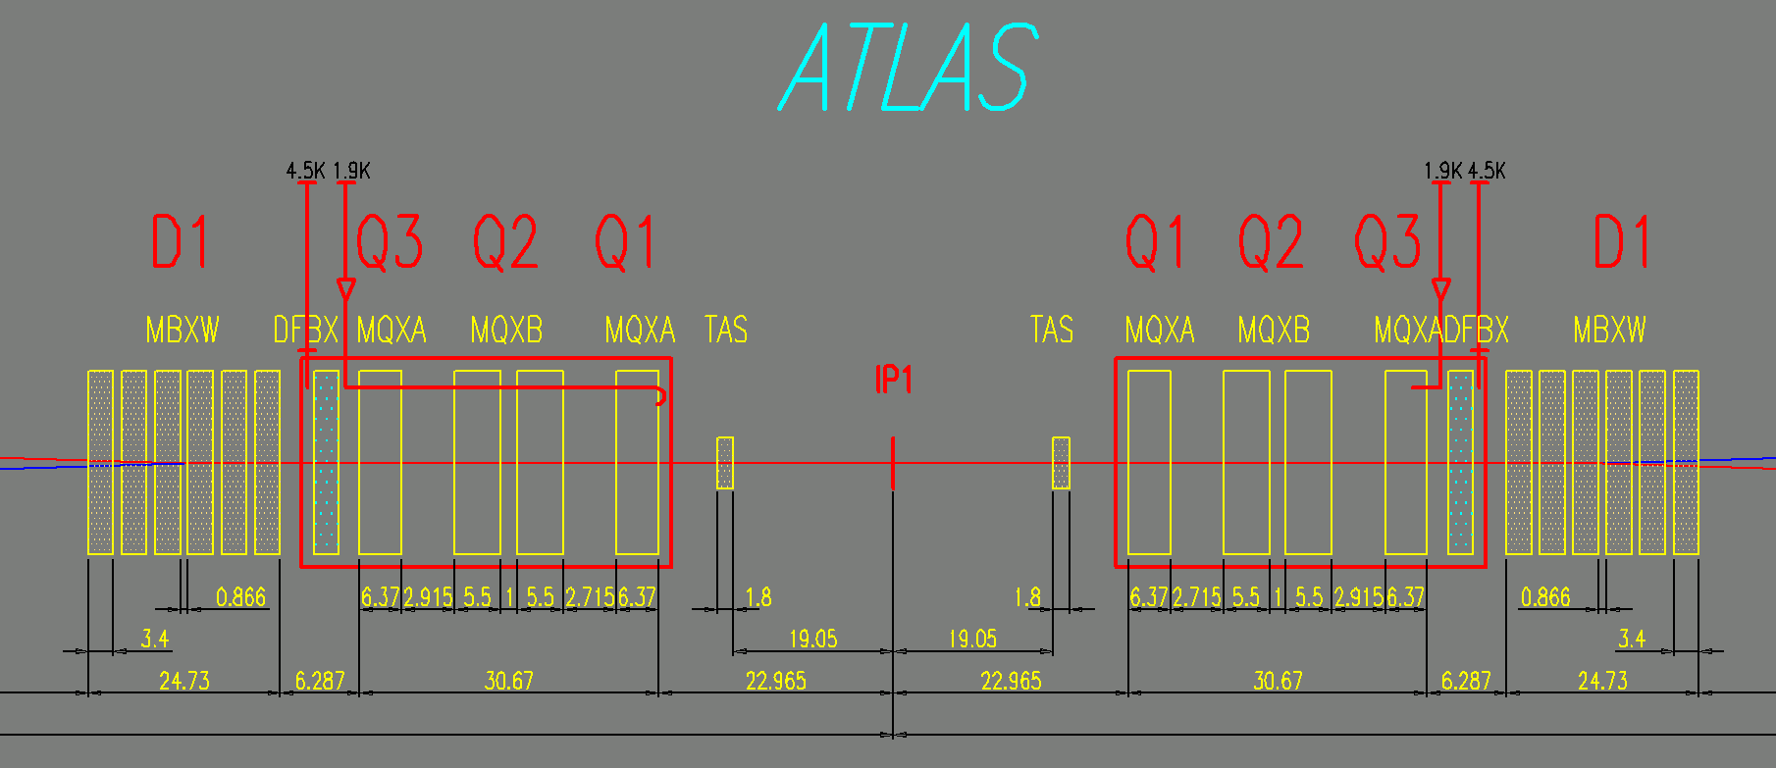
Machine layout and optics near IP1
B2L1
A2L1
1R1
3R1
3L1
1L1
  IP1
A2R1
B2R1
  IP1, 4 TeV, β* = 0.6 m

Slide 7
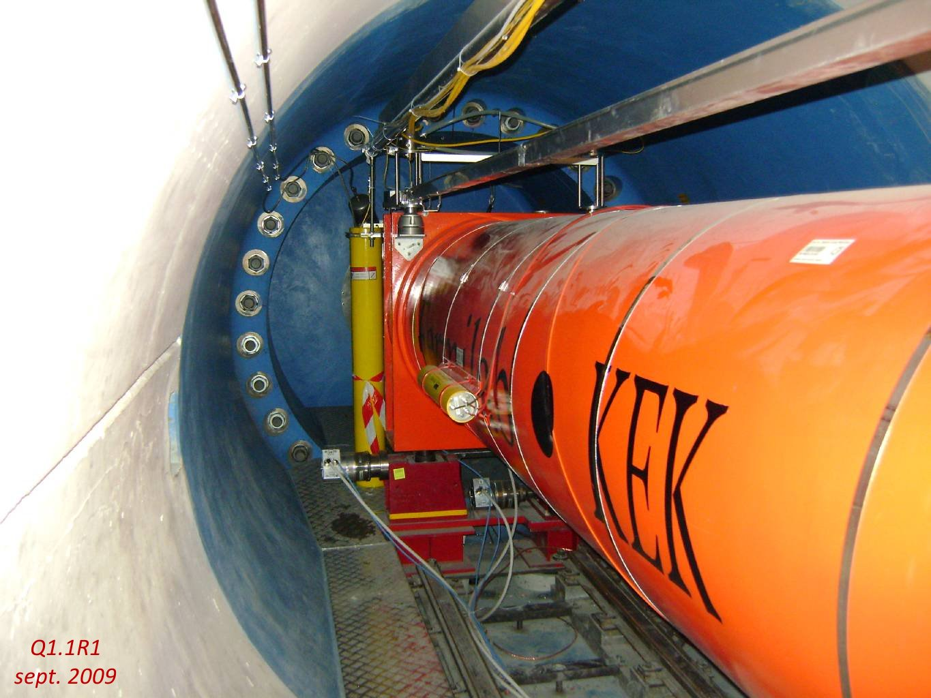
Machine layout and optics near IP1
B2L1
A2L1
1R1
3R1
3L1
1L1
  IP1
A2R1
B2R1
  IP1, 4 TeV, β* = 0.6 m

Slide 8
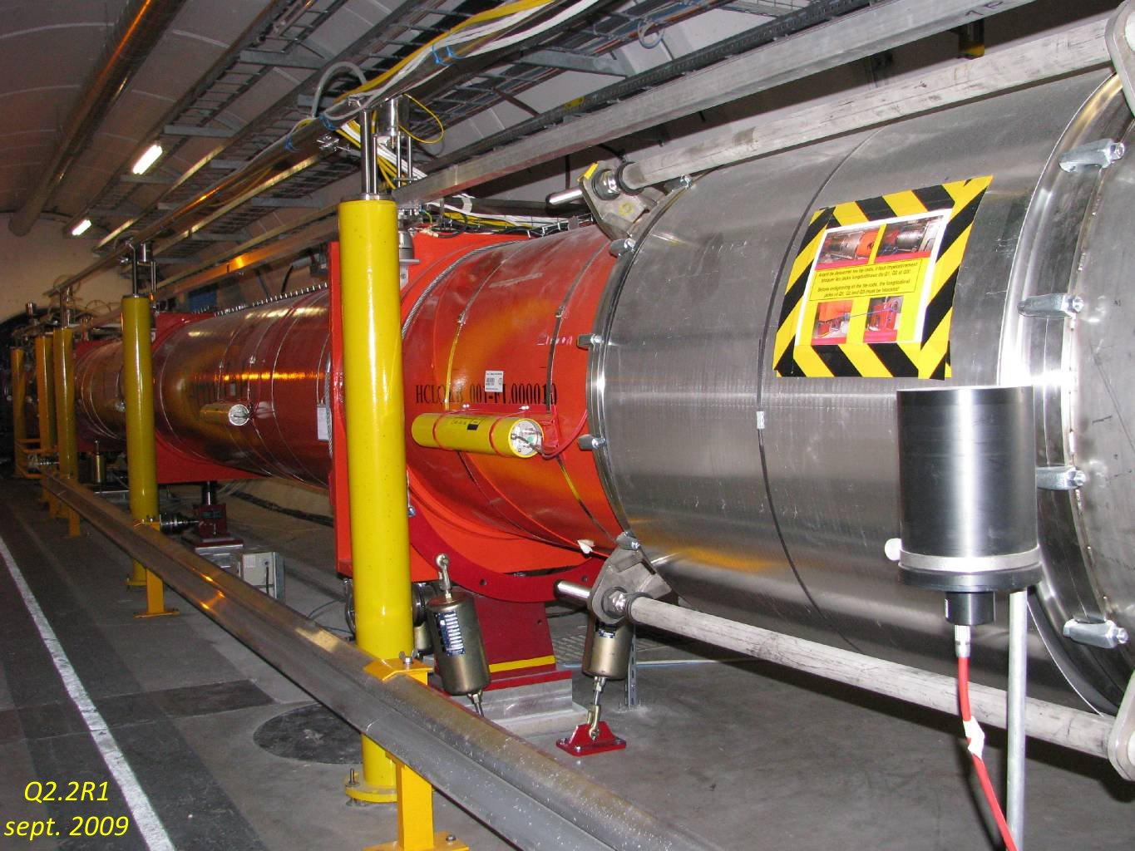
Machine layout and optics near IP1
B2L1
A2L1
1R1
3R1
3L1
1L1
  IP1
A2R1
B2R1
  IP1, 4 TeV, β* = 0.6 m

Slide 9
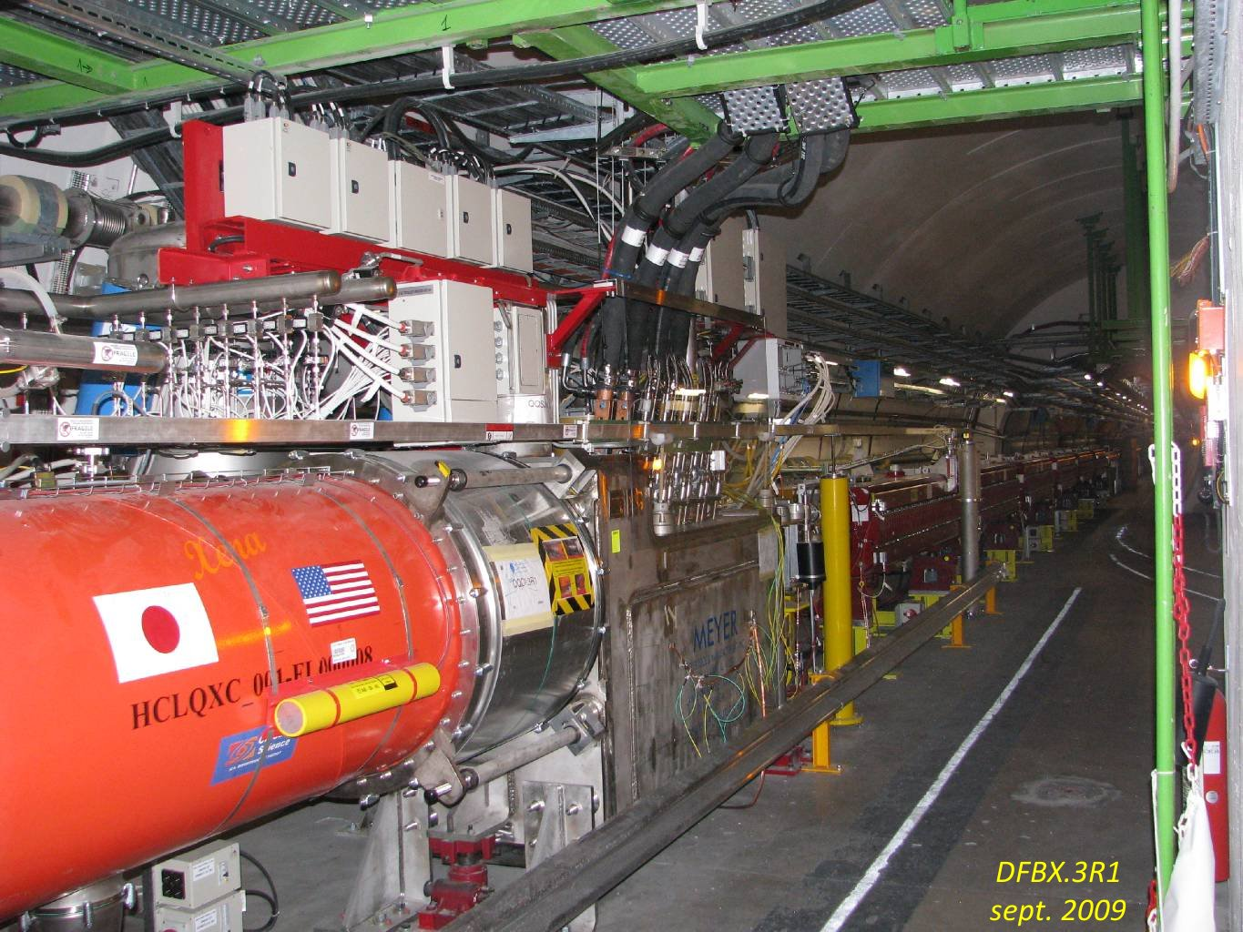
Machine layout and optics near IP1
B2L1
A2L1
1R1
3R1
3L1
1L1
  IP1
A2R1
B2R1
  IP1, 4 TeV, β* = 0.6 m

Slide 10
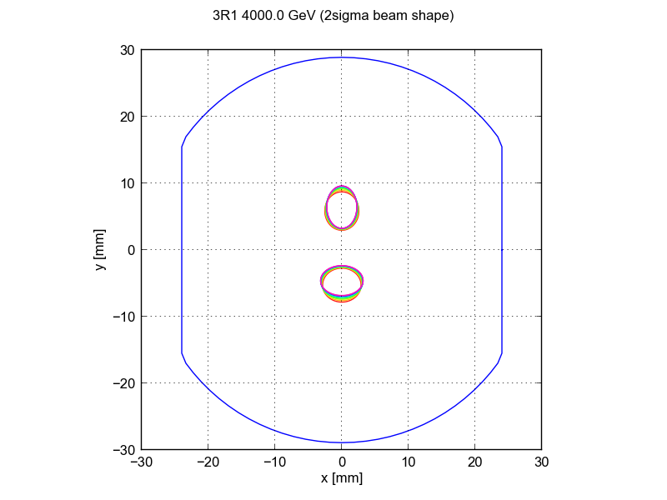
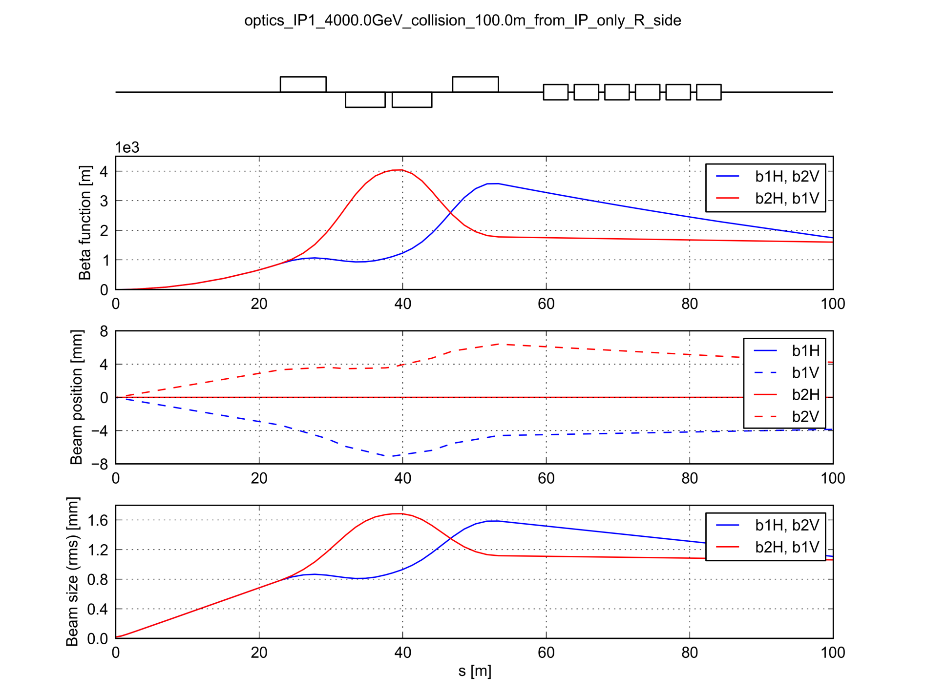
Machine layout and optics near IP1
  IP1
1R1
3R1
A2R1
B2R1
  IP1, 4 TeV, β* = 0.6 m

Slide 11
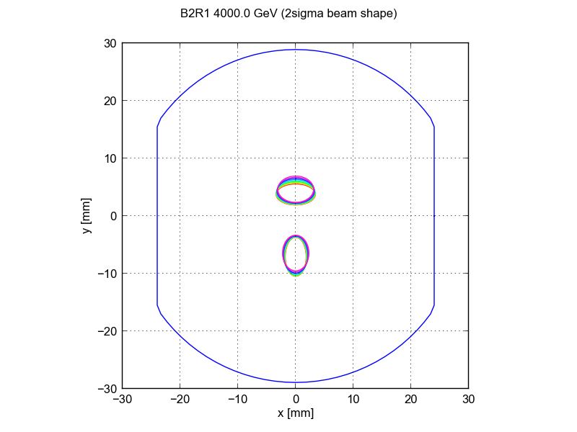
Machine layout and optics near IP1
  IP1
1R1
3R1
A2R1
B2R1
  IP1, 4 TeV, β* = 0.6 m

Slide 12
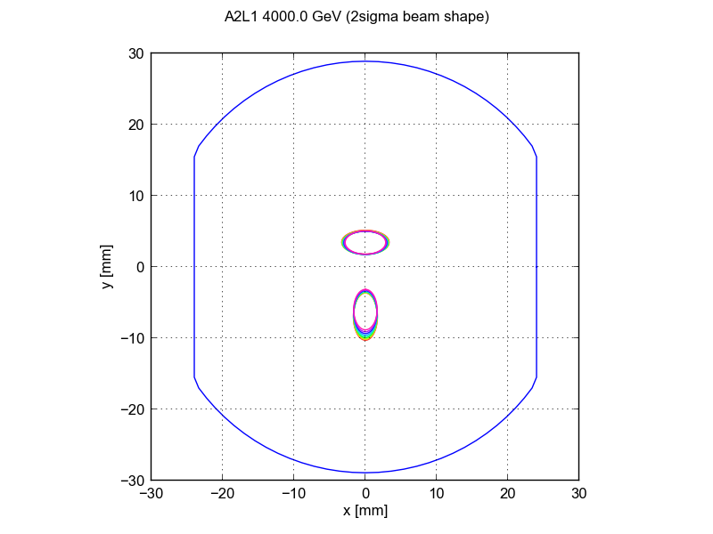
Machine layout and optics near IP1
  IP1
1R1
3R1
A2R1
B2R1
  IP1, 4 TeV, β* = 0.6 m

Slide 13
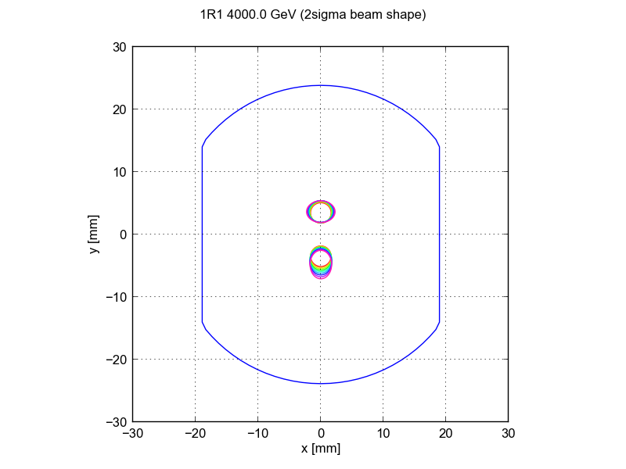
Machine layout and optics near IP1
  IP1
1R1
3R1
A2R1
B2R1
  IP1, 4 TeV, β* = 0.6 m

Slide 14

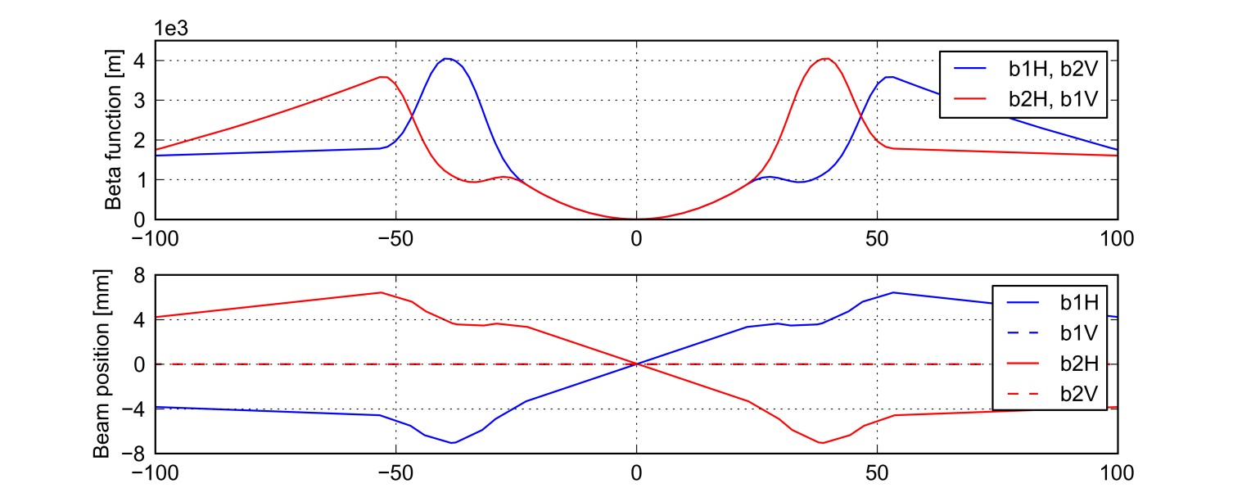
IP1 vs. IP5
  IP1, 4 TeV, β* = 0.6 m
  Due to symmetry considerations it is sufficient to study only one of the inner triplets
  Crossing angle in the V plane
  IP5, 4 TeV, β* = 0.6 m
  Crossing angle in the H plane

Slide 15
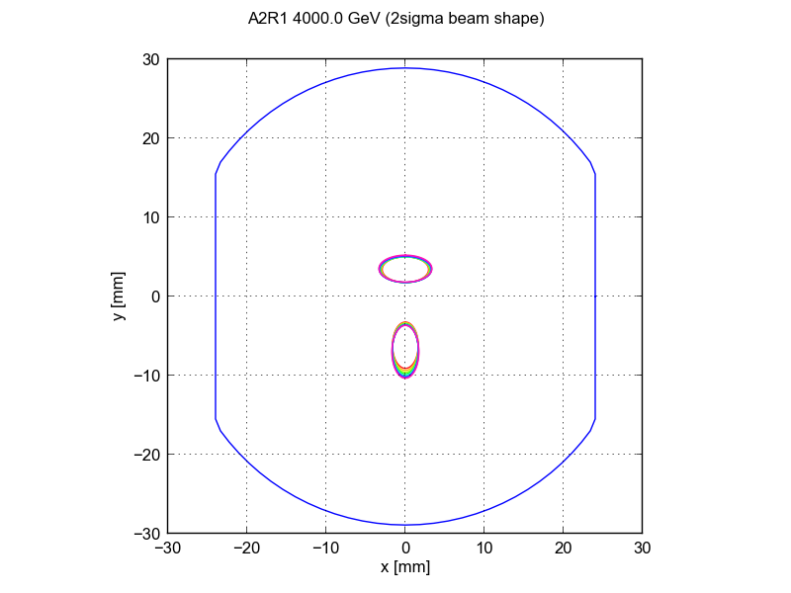
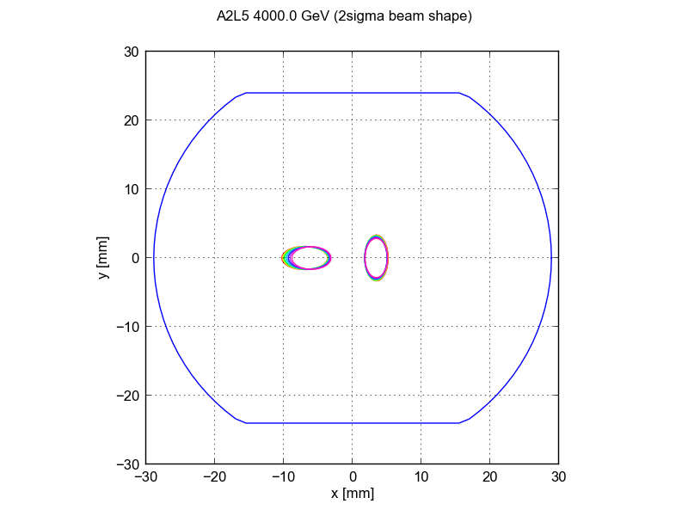
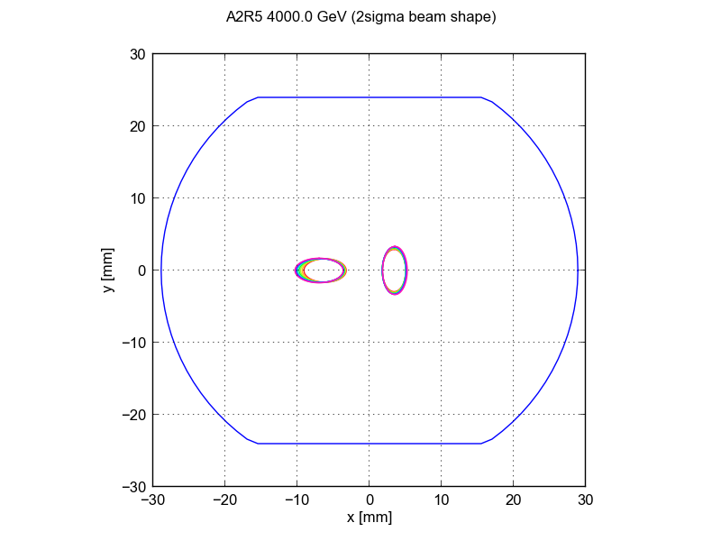
IP1 vs. IP5
  Due to symmetry considerations it is sufficient to study only one of the inner triplets
B1
B2
B2
B1
B1
B2
B2
B1

Slide 16
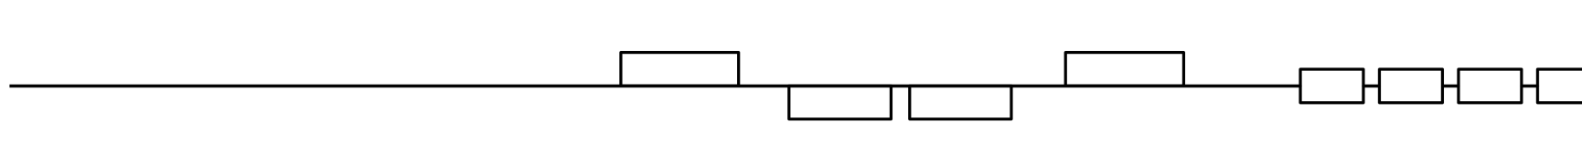
The longitudinal direction
  The delay between two following bunch passages changes along the machine elements
  Locations of long range encounters spaced by half the bunch spacing
  IP1
7.5 m
Beam 1
  25 ns spac.
Beam 2

Slide 17
The longitudinal direction
  The delay between two following bunch passages changes along the machine elements
  Locations of long range encounters spaced by half the bunch spacing
  IP1
7.5 m
Beam 1
  25 ns spac.
Beam 2

Slide 18
The longitudinal direction
  The delay between two following bunch passages changes along the machine elements
  Locations of long range encounters spaced by half the bunch spacing
  IP1
7.5 m
Beam 1
  25 ns spac.
Beam 2

Slide 19
The longitudinal direction
  The delay between two following bunch passages changes along the machine elements
  Locations of long range encounters spaced by half the bunch spacing
  IP1
7.5 m
Beam 1
  25 ns spac.
Beam 2

Slide 20
The longitudinal direction
  The delay between two following bunch passages changes along the machine elements
  Locations of long range encounters spaced by half the bunch spacing
  IP1
7.5 m
Beam 1
  25 ns spac.
Beam 2

Slide 21
The longitudinal direction
  The delay between two following bunch passages changes along the machine elements
  Locations of long range encounters spaced by half the bunch spacing
  IP1
7.5 m
Beam 1
  25 ns spac.
Beam 2

Slide 22
The longitudinal direction
  The delay between two following bunch passages changes along the machine elements
  Locations of long range encounters spaced by half the bunch spacing
  IP1
7.5 m
Beam 1
  25 ns spac.
Beam 2

Slide 23
The longitudinal direction
  The delay between two following bunch passages changes along the machine elements
  Locations of long range encounters spaced by half the bunch spacing
  IP1
7.5 m
Beam 1
  25 ns spac.
Beam 2

Slide 24
The longitudinal direction
  The delay between two following bunch passages changes along the machine elements
  Locations of long range encounters spaced by half the bunch spacing
  IP1
7.5 m
Beam 1
  25 ns spac.
Beam 2

Slide 25
The longitudinal direction
  The delay between two following bunch passages changes along the machine elements
  Locations of long range encounters spaced by half the bunch spacing
  IP1
7.5 m
Beam 1
  25 ns spac.
Beam 2

Slide 26
The longitudinal direction
  The delay between two following bunch passages changes along the machine elements
  Locations of long range encounters spaced by half the bunch spacing
  IP1
7.5 m
Beam 1
  25 ns spac.
Beam 2

Slide 27
The longitudinal direction
  The delay between two following bunch passages changes along the machine elements
  Locations of long range encounters spaced by half the bunch spacing
  IP1
7.5 m
Beam 1
  25 ns spac.
Beam 2

Slide 28
The longitudinal direction
  The delay between two following bunch passages changes along the machine elements
  Locations of long range encounters spaced by half the bunch spacing
  IP1
15 m
Beam 1
  50 ns spac.
Beam 2

Slide 29
Outline
  Introduction
  Simulating the inner triplets in PyECLOUD
  Simulation results
  Machine observations (heat load)
  Some considerations on e⁻ - beam interaction
  Endoscopy observations

Slide 30
PyECLOUD simulations for the inner triplets
  A quite challenging simulation scenario:
  Two beams with:
    Different transverse position (off center)
    Different transverse shape
    Arbitrarily delayed with respect to each other (no real bunch spacing)

Slide 31
PyECLOUD simulations for the inner triplets
  A quite challenging simulation scenario:
  Two beams with:
    Different transverse position (off center)
    Different transverse shape
    Arbitrarily delayed with respect to each other (no real bunch spacing)
  Quadrupolar magnetic field
  Non elliptical chamber

Slide 32
PyECLOUD simulations for the inner triplets
  A quite challenging simulation scenario:
  Two beams with:
    Different transverse position (off center)
    Different transverse shape
    Arbitrarily delayed with respect to each other (no real bunch spacing)
  Quadrupolar magnetic field
  Non elliptical chamber
Required the introduction of new features in PyECLOUD

Slide 33
PyECLOUD simulations for the inner triplets
  A quite challenging simulation scenario:
  Two beams with:
    Different transverse position (off center)
    Different transverse shape
    Arbitrarily delayed with respect to each other (no real bunch spacing)
  Quadrupolar magnetic field
  Non elliptical chamber
Required the introduction of new features in PyECLOUD
  Beam properties (delay, position, size) changing along the structure:
  Simulated 10 slices per magnet
  SEY = 1.0, 1.1, … , 2.0
  50 ns and 25 ns

Slide 34
PyECLOUD simulations for the inner triplets
  A quite challenging simulation scenario:
  Two beams with:
    Different transverse position (off center)
    Different transverse shape
    Arbitrarily delayed with respect to each other (no real bunch spacing)
  Quadrupolar magnetic field
  Non elliptical chamber
Required the introduction of new features in PyECLOUD
  Beam properties (delay, position, size) changing along the structure:
  Simulated 10 slices per magnet
  SEY = 1.0, 1.1, … , 2.0
  50 ns and 25 ns
~1000 simulations,
~48 h for two bunch trains,
~120 GB of sim. data

Slide 35
PyECLOUD simulations for the inner triplets
  Features available in PyECLOUD 3.06 or later:
  Optional input to specify secondary beam parameter files
# SIMULATION PARAMETERS
machine_param_file='machine_parameters.input'
secondary_emission_parameters_file='secondary_emission_parameters.input'
beam_parameters_file='beam1.beam'
secondary_beams_file_list = ['beam2.beam']
logfile_path = './logfile.txt'
progress_path = './progress.txt'
Dt=25e-12 #s (no effect if long. profile is imported from file)
t_end=1e-9; #s (no effect if long. profile is imported from file)
lam_th=1.e2 #e-/m
Dx_hist=1.e-3 #m
r_center=2.e-3 #m
Dt_En_hist = 25e-9 #s
Nbin_En_hist= 100
En_hist_max= 1000. #eV
...
  simulation_parameters.input

Slide 36
PyECLOUD simulations for the inner triplets
  Features available in PyECLOUD 3.06 or later:
  Optional input to specify secondary beam parameter files
# SIMULATION PARAMETERS
machine_param_file='machine_parameters.input'
secondary_emission_parameters_file='secondary_emission_parameters.input'
beam_parameters_file='beam1.beam'
secondary_beams_file_list = ['beam2.beam']
logfile_path = './logfile.txt'
progress_path = './progress.txt'
Dt=25e-12 #s (no effect if long. profile is imported from file)
t_end=1e-9; #s (no effect if long. profile is imported from file)
lam_th=1.e2 #e-/m
Dx_hist=1.e-3 #m
r_center=2.e-3 #m
Dt_En_hist = 25e-9 #s
Nbin_En_hist= 100
En_hist_max= 1000. #eV
...
  The main beam file is the one that gives timings during the simulations (steps, spacings for macroparticle cleaning and regeneration, length of the simulation → add empty buckets if other beam is longer!)
  simulation_parameters.input

Slide 37
PyECLOUD simulations for the inner triplets
  Features available in PyECLOUD 3.06 or later:
  Beam size and position can be defined for each beam
# BEAM PARAMETERS
energy_eV= 4000e9 #eV
nemittx = 2.4e-6
nemitty = 2.4e-6 #m
betafx = 9.454233e+02
betafy = 9.595226e+02
x_beam_pos = 5.915084e-11
y_beam_pos = -3.478057e-03
beam_field_file =-1
Dh_beam_field=0.5e-4
#save_beam_field_file_as = 'beam1field.mat'
b_spac = 50e-9
fact_beam = 1.65e+11
flag_bunched_beam = 1 # 1: bunched beam 0:load profile from file
# to be filled in case of bunched beam
sigmaz = 0.097 #1.3ns
t_offs = 2.5e-9 + 2.*2.389798e+01/299792458.
filling_pattern_file = 2*(4*(36*[1.]+4*[0.])+15*[0.])
  beam2.beam

Slide 38
PyECLOUD simulations for the inner triplets
  Features available in PyECLOUD 3.06 or later:
  The electric field of the beam can be calculated using the embedded Poisson solver
# BEAM PARAMETERS
energy_eV= 4000e9 #eV
nemittx = 2.4e-6
nemitty = 2.4e-6 #m
betafx = 9.454233e+02
betafy = 9.595226e+02
x_beam_pos = 5.915084e-11
y_beam_pos = -3.478057e-03
beam_field_file =-1
Dh_beam_field=0.5e-4
save_beam_field_file_as = 'beam1field.mat'
b_spac = 50e-9
fact_beam = 1.65e+11
flag_bunched_beam = 1 # 1: bunched beam 0:load profile from file
# to be filled in case of bunched beam
sigmaz = 0.097 #1.3ns
t_offs = 2.5e-9 + 2.*2.389798e+01/299792458.
filling_pattern_file = 2*(4*(36*[1.]+4*[0.])+15*[0.])
  beam2.beam

Slide 39
PyECLOUD simulations for the inner triplets
  Features available in PyECLOUD 3.06 or later:
  The electric field of the beam can be calculated using the embedded Poisson solver
# BEAM PARAMETERS
energy_eV= 4000e9 #eV
nemittx = 2.4e-6
nemitty = 2.4e-6 #m
betafx = 9.454233e+02
betafy = 9.595226e+02
x_beam_pos = 5.915084e-11
y_beam_pos = -3.478057e-03
beam_field_file =-1
Dh_beam_field=0.5e-4
save_beam_field_file_as = 'beam1field.mat'
b_spac = 50e-9
fact_beam = 1.65e+11
flag_bunched_beam = 1 # 1: bunched beam 0:load profile from file
# to be filled in case of bunched beam
sigmaz = 0.097 #1.3ns
t_offs = 2.5e-9 + 2.*2.389798e+01/299792458.
filling_pattern_file = 2*(4*(36*[1.]+4*[0.])+15*[0.])
  Beam field can be dumped to file:
  beam2.beam

Slide 40
PyECLOUD simulations for the inner triplets
  Features available in PyECLOUD 3.06 or later:
  The electric field of the beam can be calculated using the embedded Poisson solver
# BEAM PARAMETERS
energy_eV= 4000e9 #eV
nemittx = 2.4e-6
nemitty = 2.4e-6 #m
betafx = 9.454233e+02
betafy = 9.595226e+02
x_beam_pos = 5.915084e-11
y_beam_pos = -3.478057e-03
beam_field_file =-1
Dh_beam_field=0.5e-4
save_beam_field_file_as = 'beam1field.mat'
b_spac = 50e-9
fact_beam = 1.65e+11
flag_bunched_beam = 1 # 1: bunched beam 0:load profile from file
# to be filled in case of bunched beam
sigmaz = 0.097 #1.3ns
t_offs = 2.5e-9 + 2.*2.389798e+01/299792458.
filling_pattern_file = 2*(4*(36*[1.]+4*[0.])+15*[0.])
  Crosschecked by taking the divergence
  beam2.beam

Slide 41
PyECLOUD simulations for the inner triplets
  Features available in PyECLOUD 3.06 or later:
  The electric field of the beam can be calculated using the embedded Poisson solver
  Warning: the beam region must be sampled correctly!
# BEAM PARAMETERS
energy_eV= 4000e9 #eV
nemittx = 2.4e-6
nemitty = 2.4e-6 #m
betafx = 9.454233e+02
betafy = 9.595226e+02
x_beam_pos = 5.915084e-11
y_beam_pos = -3.478057e-03
beam_field_file =-1
Dh_beam_field=0.5e-4
save_beam_field_file_as = 'beam1field.mat'
b_spac = 50e-9
fact_beam = 1.65e+11
flag_bunched_beam = 1 # 1: bunched beam 0:load profile from file
# to be filled in case of bunched beam
sigmaz = 0.097 #1.3ns
t_offs = 2.5e-9 + 2.*2.389798e+01/299792458.
filling_pattern_file = 2*(4*(36*[1.]+4*[0.])+15*[0.])
  Crosschecked by taking the divergence
  beam2.beam

Slide 42
PyECLOUD simulations for the inner triplets
  Features available in PyECLOUD 3.06 or later:
  An arbitrary delay can be added to the beam longitudinal profile
# BEAM PARAMETERS
energy_eV= 4000e9 #eV
nemittx = 2.4e-6
nemitty = 2.4e-6 #m
betafx = 9.454233e+02
betafy = 9.595226e+02
x_beam_pos = 5.915084e-11
y_beam_pos = -3.478057e-03
beam_field_file =-1
Dh_beam_field=0.5e-4
save_beam_field_file_as = 'beam1field.mat'
b_spac = 50e-9
fact_beam = 1.65e+11
flag_bunched_beam = 1 # 1: bunched beam 0:load profile from file
# to be filled in case of bunched beam
sigmaz = 0.097 #1.3ns
t_offs = 2.5e-9 + 2.*2.389798e+01/299792458.
filling_pattern_file = 2*(4*(36*[1.]+4*[0.])+15*[0.])
  beam2.beam

Slide 43
PyECLOUD simulations for the inner triplets
  Features available in PyECLOUD 3.06 or later:
  Compact form for filling pattern (usual load from file still available)
# BEAM PARAMETERS
energy_eV= 4000e9 #eV
nemittx = 2.4e-6
nemitty = 2.4e-6 #m
betafx = 9.454233e+02
betafy = 9.595226e+02
x_beam_pos = 5.915084e-11
y_beam_pos = -3.478057e-03
beam_field_file =-1
Dh_beam_field=0.5e-4
save_beam_field_file_as = 'beam1field.mat'
b_spac = 50e-9
fact_beam = 1.65e+11
flag_bunched_beam = 1 # 1: bunched beam 0:load profile from file
# to be filled in case of bunched beam
sigmaz = 0.097 #1.3ns
t_offs = 2.5e-9 + 2.*2.389798e+01/299792458.
filling_pattern_file = 2*(4*(36*[1.]+4*[0.])+15*[0.])
  beam2.beam

Slide 44
PyECLOUD simulations for the inner triplets
  Features available in PyECLOUD 3.06 or later:
  Arbitrarily define electron density probes
# SIMULATION PARAMETERS
machine_param_file='machine_parameters.input'
secondary_emission_parameters_file='secondary_emission_parameters.input'
beam_parameters_file='beam1.beam'
secondary_beams_file_list = ['beam2.beam']
logfile_path = './logfile.txt'
progress_path = './progress.txt'
Dt=25e-12 #s (no effect if long. profile is imported from file)
t_end=1e-9; #s (no effect if long. profile is imported from file)
...
el_density_probes = [\
{'x' : 5.915084e-11, 'y': -3.478057e-03, 'r_obs': 1e-3},
{'x' : -1.128269e-10, 'y': 3.452395e-03, 'r_obs': 1e-3}]
  beam2.beam

Slide 45
PyECLOUD simulations for the inner triplets
  Moreover:
  Synchrotron radiation seeding with uniform distribution needed to be implemented
  Macroparticle cleaning/regeneration thresholds had to be optimized in order to cope with very fast buildup
  Field lines parallel to the chamber’s wall found to create some problem to the backtracking algorithm (code resorting to “fallback” algorithm, less accurate but more robust)

Slide 46
Outline
  Introduction
  Simulating the inner triplets in PyECLOUD
  Simulation results
  Machine observations (heat load)
  Some considerations on e⁻ - beam interaction
  Endoscopy observations

Slide 47
Simulated scenarios
  25 ns beam – 1.15 x 10¹¹ ppb
72
8
72
8
72
8
72
38
72
8
72
8
72
8
72
38
  50 ns beam – 1.65 x 10¹¹ ppb
36
4
36
4
36
4
36
19
36
4
36
4
36
4
36
19
  Other beam parameters:
  Beam energy: 4 TeV
  Transverse emittance: 2.4 μm
  Bunch length: 1.3 ns
  Optics with β* = 0.6 m

Slide 48
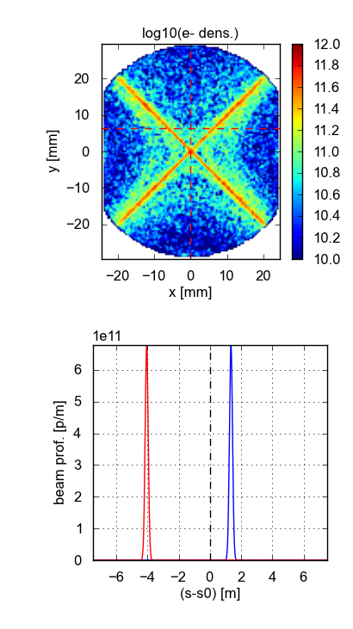

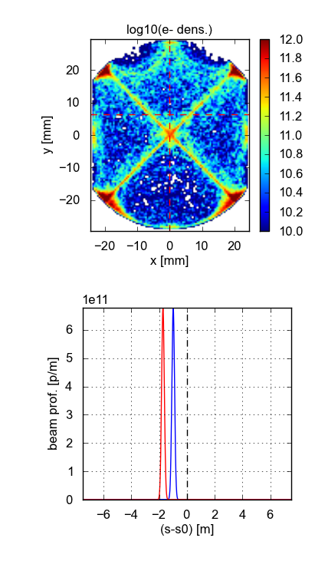
A look to the EC buildup
  Few snapshots of the electron distribution (see also beam2_50ns_pass0.avi)
Beam 1

Slide 49
A look to the EC buildup
  The presence of two beams enhances the multipacting efficiency, especially far enough from the locations of the long range encounters

Slide 50
A look to the EC buildup
  The presence of two beams enhances the multipacting efficiency, especially far enough from the locations of the long range encounters

Slide 51
A look to the EC buildup
  The presence of two beams enhances the multipacting efficiency, especially far enough from the locations of the long range encounters

Slide 52
A look to the EC buildup
  Similar behavior for 50 ns spacing

Slide 53
Heat load density along the triplet - 50 ns
1R1
A2R1
B2R1
3R1
  Locations of long range encounters
  Remarks:
  EC much weaker close to long range encounters
  Modules with the same beam screen behave very similarly

Slide 54
Heat load density along the triplet - 50 ns
1R1
A2R1
B2R1
3R1
  The presence of the two beams leads to an important lowering of the multipacting threshold w.r.t. the single beam case (dashed)
  Remarks:
  EC much weaker close to long range encounters
  Modules with the same beam screen behave very similarly

Slide 55
Heat load density along the triplet - 50 ns
1R1
A2R1
B2R1
3R1
  The presence of the two beams leads to an important lowering of the multipacting threshold w.r.t. the single beam case (dashed)
  Remarks:
  EC much weaker close to long range encounters
  Modules with the same beam screen behave very similarly

Slide 56
Heat load density along the triplet - 50 ns
1R1
A2R1
B2R1
3R1
  The presence of the two beams leads to an important lowering of the multipacting threshold w.r.t. the single beam case (dashed)
  Remarks:
  EC much weaker close to long range encounters
  Modules with the same beam screen behave very similarly

Slide 57
Heat load density along the triplet - 50 ns
1R1
A2R1
B2R1
3R1
  The presence of the two beams leads to an important lowering of the multipacting threshold w.r.t. the single beam case (dashed)
  Remarks:
  EC much weaker close to long range encounters
  Modules with the same beam screen behave very similarly

Slide 58
Heat load density along the triplet - 25 ns
1R1
A2R1
B2R1
3R1
  Locations of long range encounters
  Remarks:
  EC much weaker close to long range encounters
  Modules with the same beam screen behave very similarly

Slide 59
Heat load density along the triplet - 25 ns
1R1
A2R1
B2R1
3R1
  As in the other quardupoles in the LHC, the multipacting threshold is already quite low even for a single beam with 25 ns spacing
  Remarks:
  EC much weaker close to long range encounters
  Modules with the same beam screen behave very similarly

Slide 60
Heat load density along the triplet - 25 ns
1R1
A2R1
B2R1
3R1
  The presence of the two beams leads to an important lowering of the multipacting threshold w.r.t. the single beam case (dashed)
  Remarks:
  EC much weaker close to long range encounters
  Modules with the same beam screen behave very similarly

Slide 61
Heat load density along the triplet - 25 ns
1R1
A2R1
B2R1
3R1
  The presence of the two beams leads to an important lowering of the multipacting threshold w.r.t. the single beam case (dashed)
  Remarks:
  EC much weaker close to long range encounters
  Modules with the same beam screen behave very similarly

Slide 62
Heat load density along the triplet - 25 ns
1R1
A2R1
B2R1
3R1
  The presence of the two beams leads to an important lowering of the multipacting threshold w.r.t. the single beam case (dashed)
  Remarks:
  EC much weaker close to long range encounters
  Modules with the same beam screen behave very similarly

Slide 63
Average heat load density – 50 ns vs. 25 ns
  Remarks:
    Above threshold values are very similar → enhancement from hybrid spacings much stronger on the 50 ns than on 25 ns

Slide 64
Average heat load density – 50 ns vs. 25 ns
  For each triplet we get:
  Remarks:
    Above threshold values are very similar → enhancement from hybrid spacings much stronger on the 50 ns than on 25 ns

Slide 65
Outline
  Introduction
  Simulating the inner triplets in PyECLOUD
  Simulation results
  Machine observations (heat load)
  Some considerations on e⁻ - beam interaction
  Endoscopy observations

Slide 66
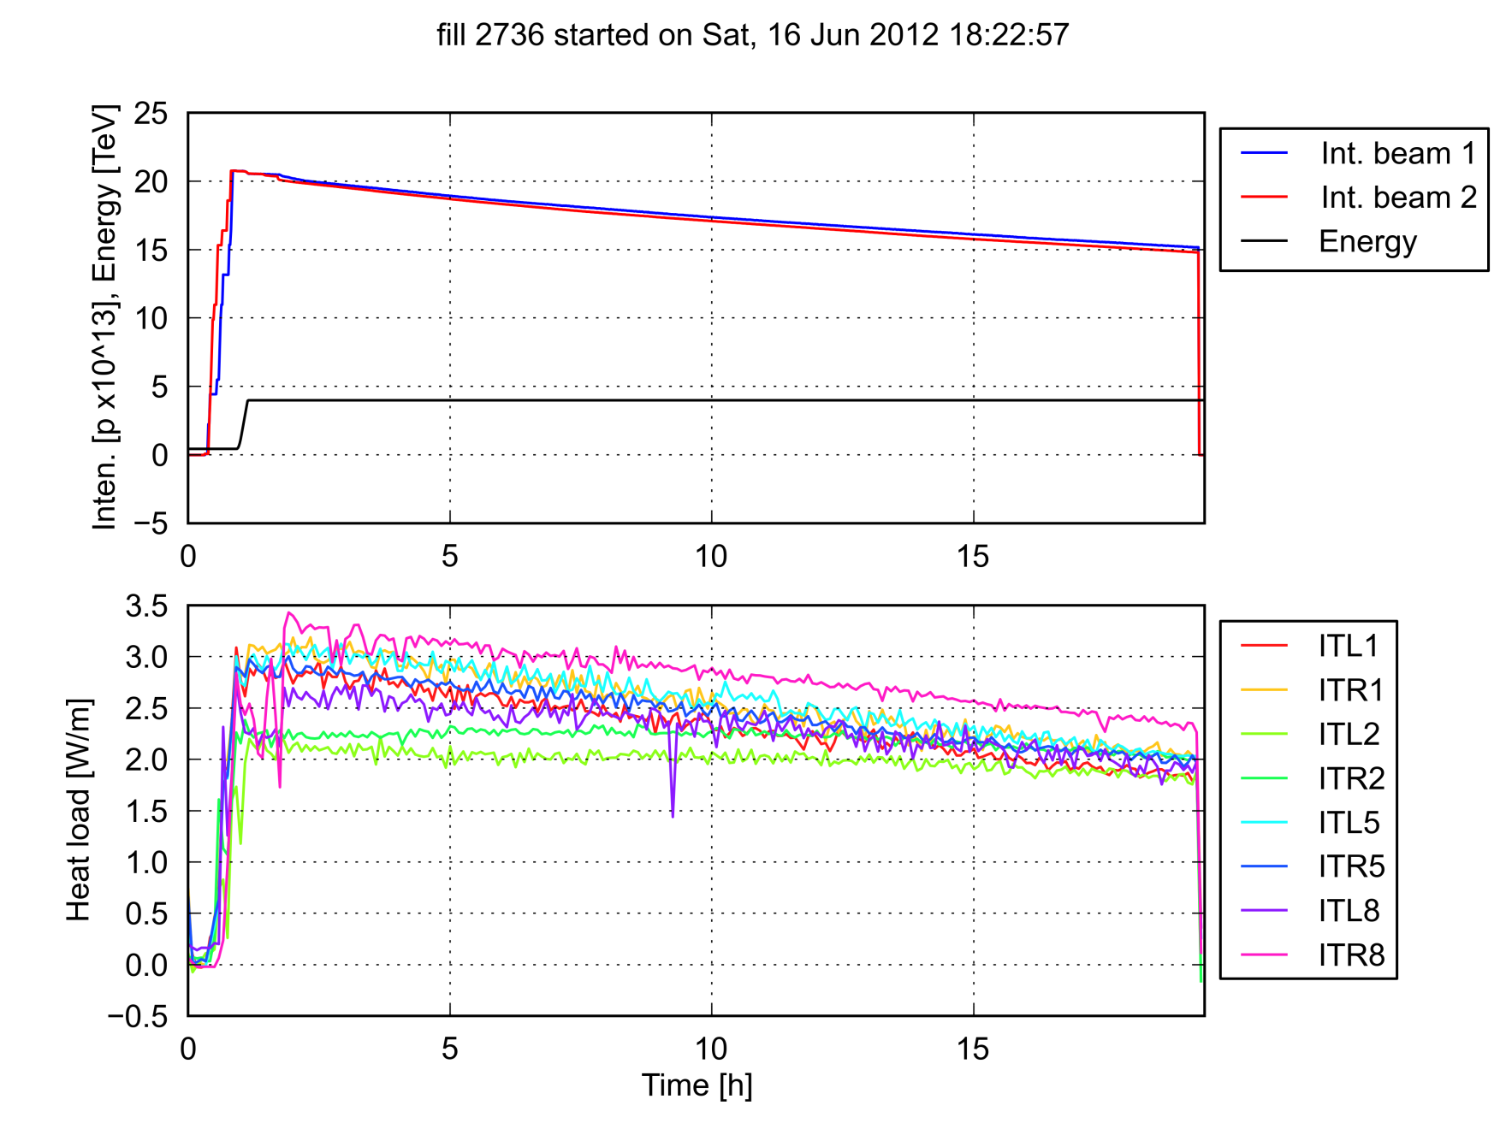
Machine observations – 50 ns
Data provided by L. Tavian
  No big change during ramp and squeeze

Slide 67
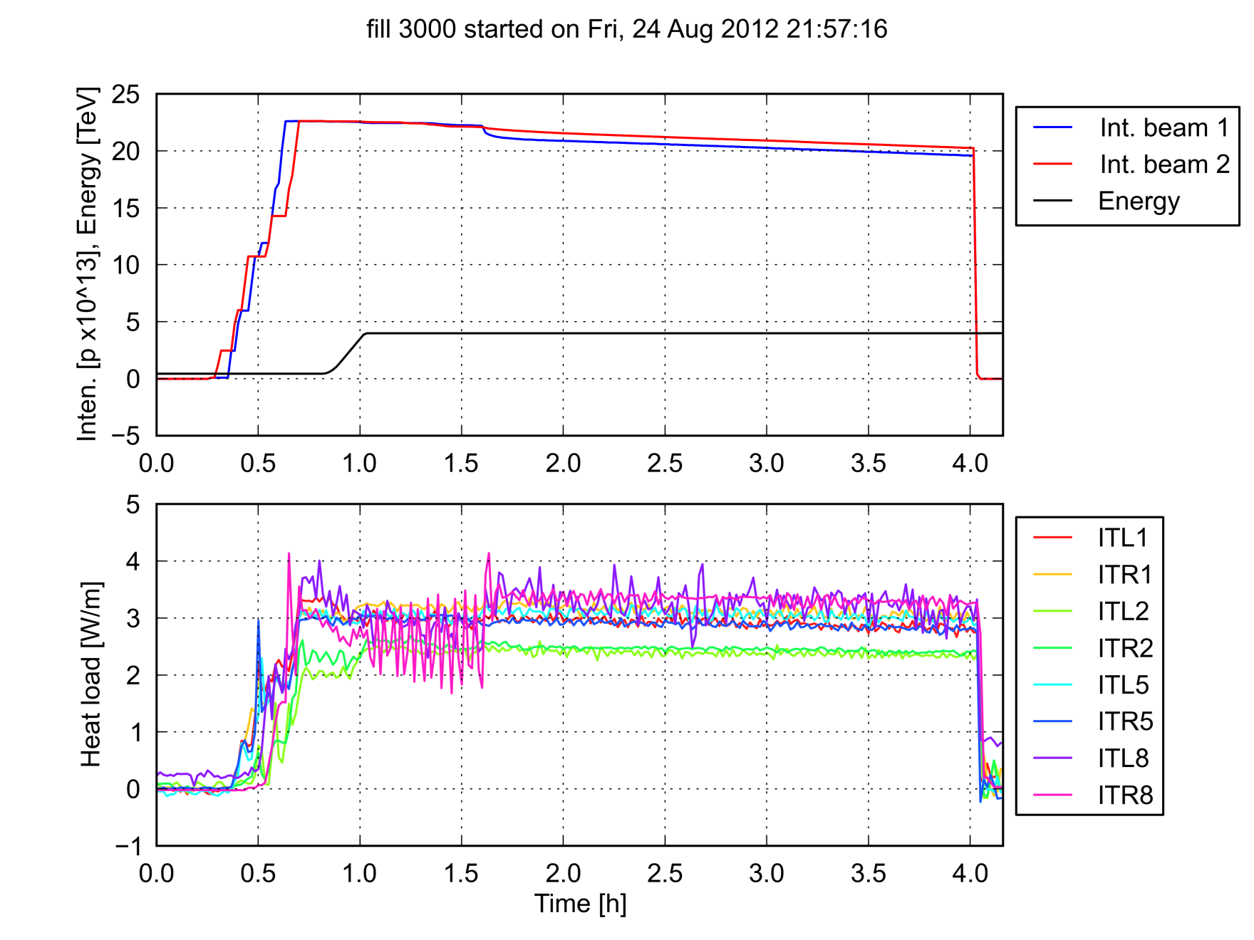
Machine observations – 50 ns
Data provided by L. Tavian
  No big change during ramp and squeeze

Slide 68
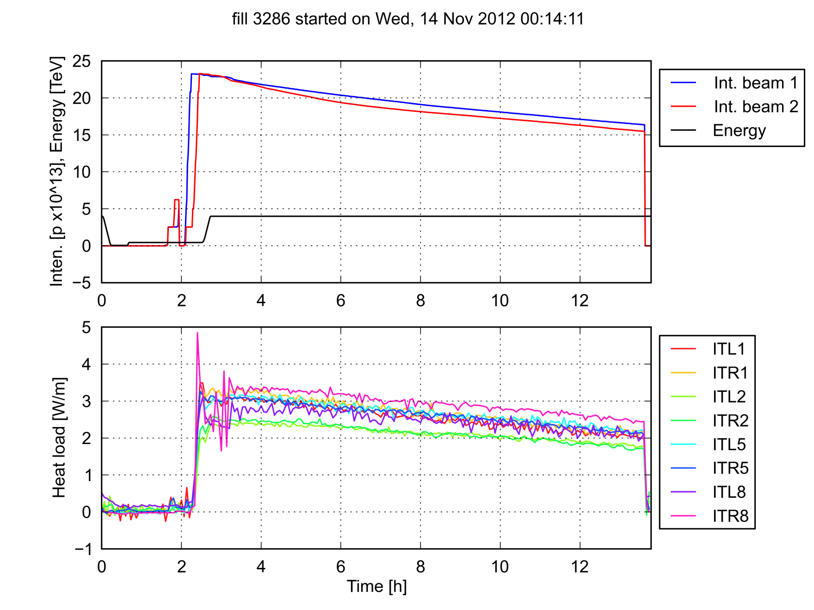
Machine observations – 50 ns
Data provided by L. Tavian
  No big change during ramp and squeeze

Slide 69
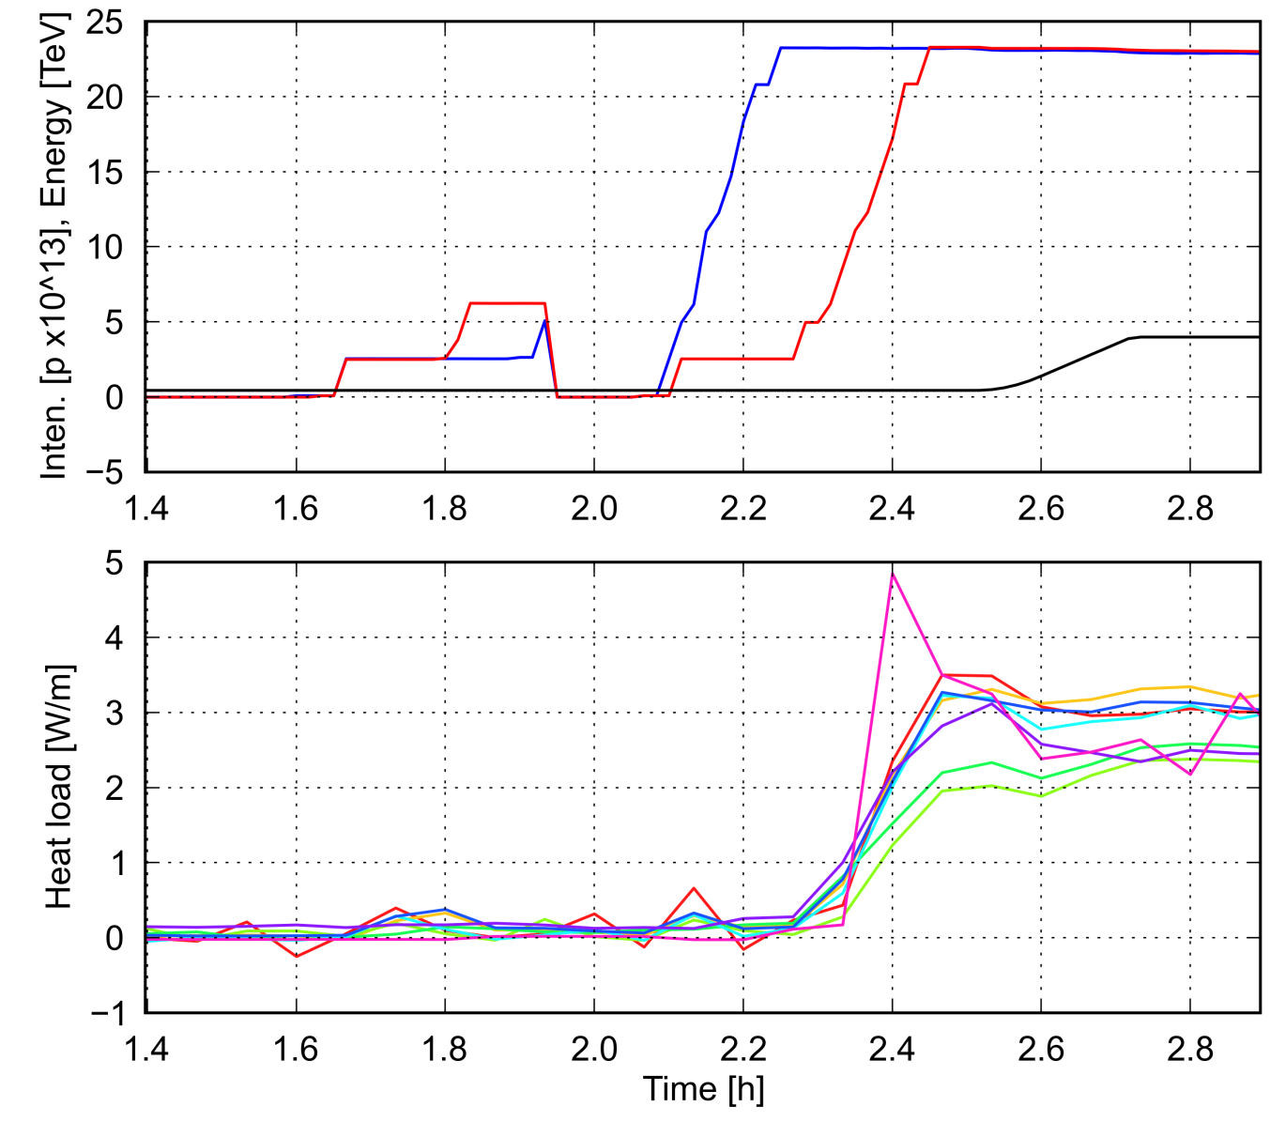
Machine observations – 50 ns
  No big change during ramp and squeeze

Slide 70
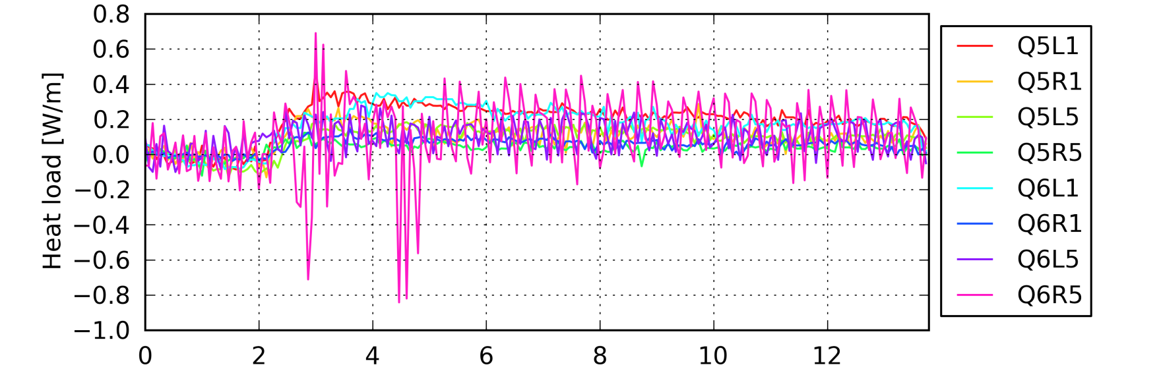
Machine observations – 50 ns
Data provided by L. Tavian
  Heat load much higher than in two-aperture qaudrupoles

Slide 71
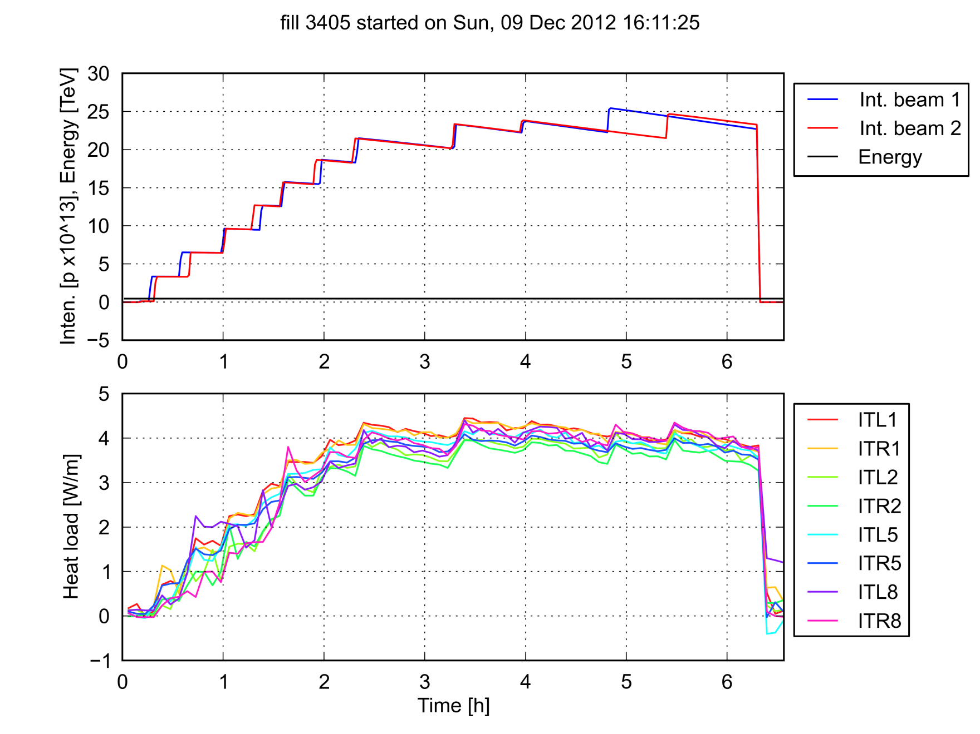
Machine observations – 25 ns (450 GeV)

Slide 72
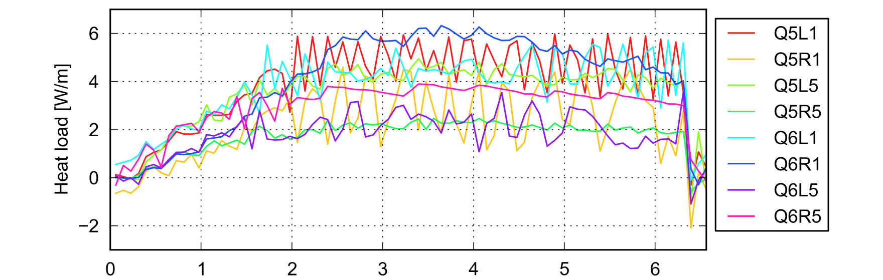
Machine observations – 25 ns (450 GeV)
  Heat load very similar to two-aperture qaudrupoles

Slide 73
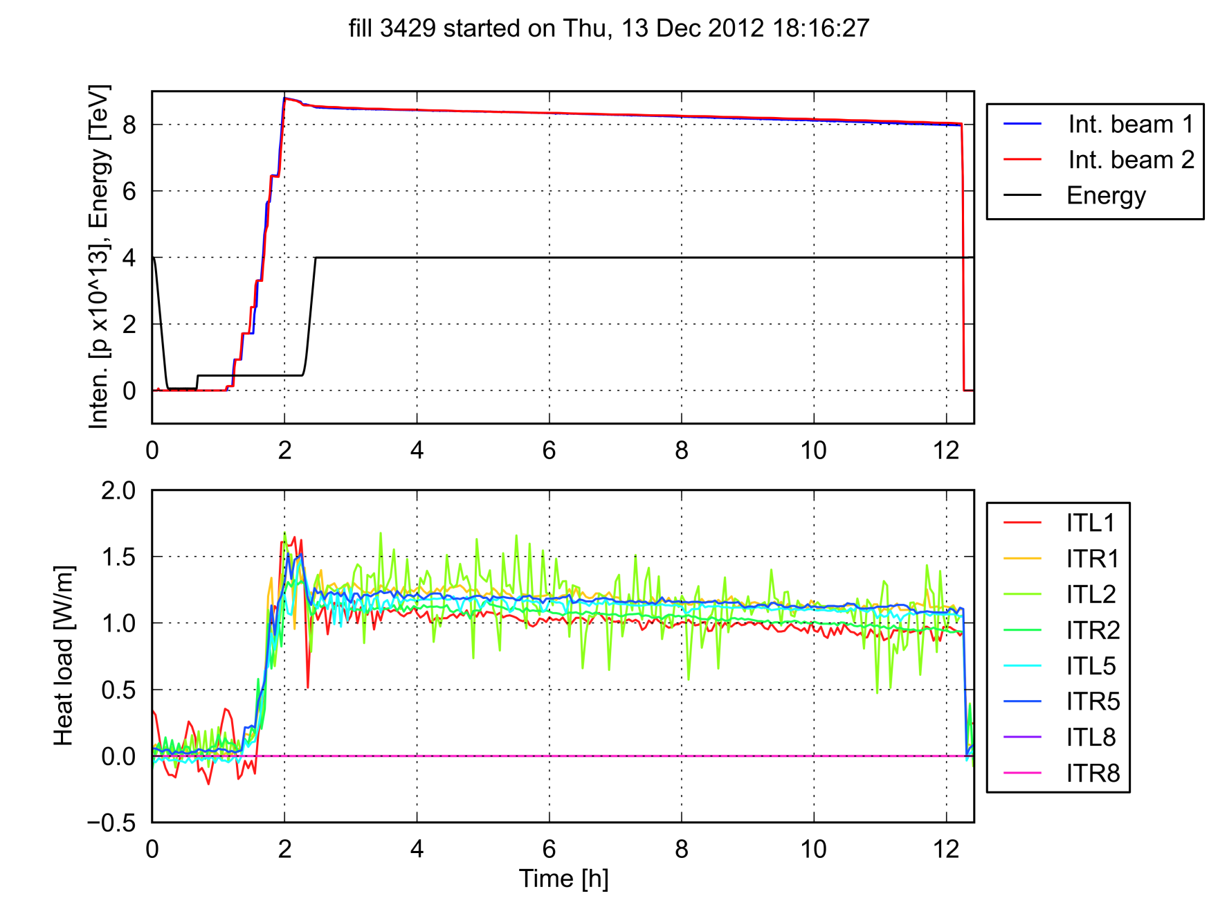
Machine observations – 25 ns (4 TeV)
  No big change during ramp and squeeze

Slide 74
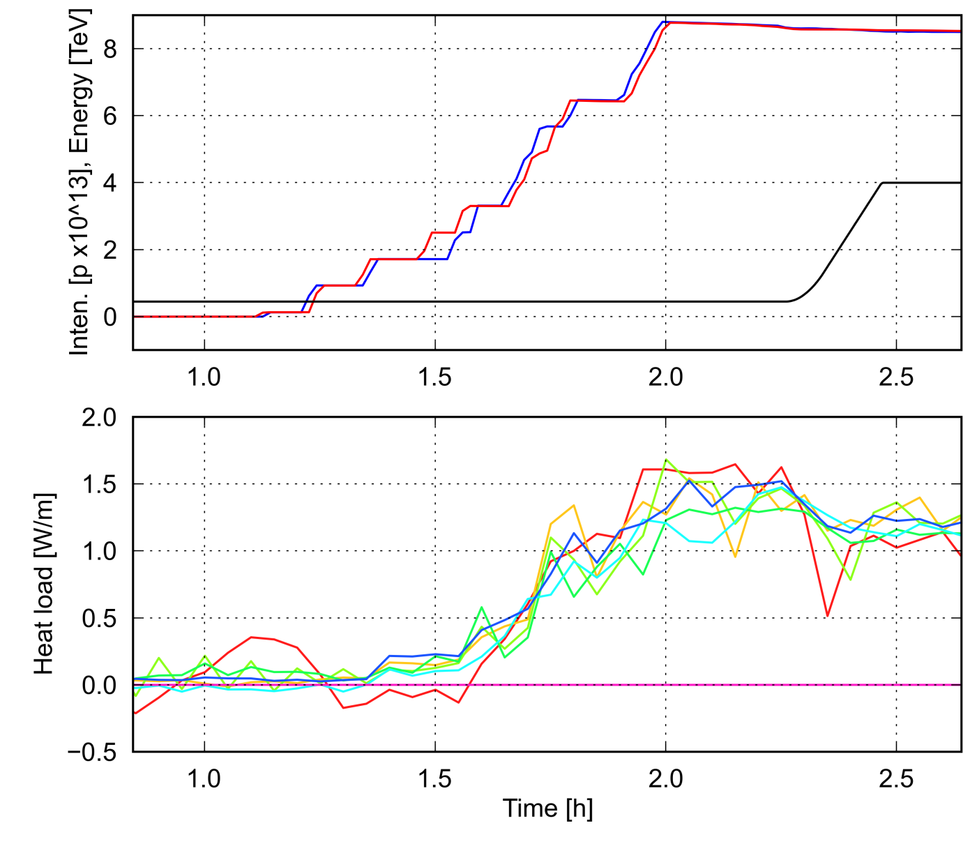
Machine observations – 25 ns (4 TeV)
  No big change during ramp and squeeze

Slide 75
Comparison against simulations
50 ns, 4 TeV
25 ns, 450 GeV
Fill 3286
Fill 3405
25 ns, 4 TeV
  1.2 < SEY_{max} < 1.3
  is compatible with the observations
Fill 3429

Slide 76
Crosscheck with single beam MDs
  For the estimated SEY value we do not expect nor observe EC in the triplets with only one beam with 50 ns spacing circulating in the LHC

Slide 77
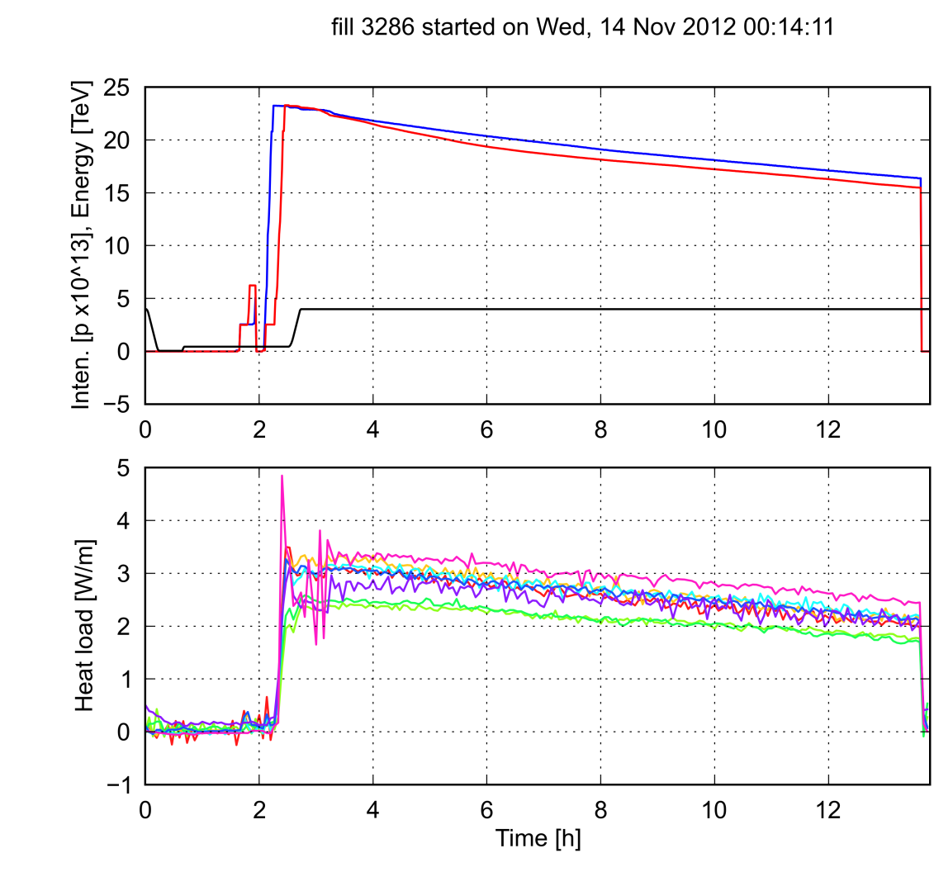
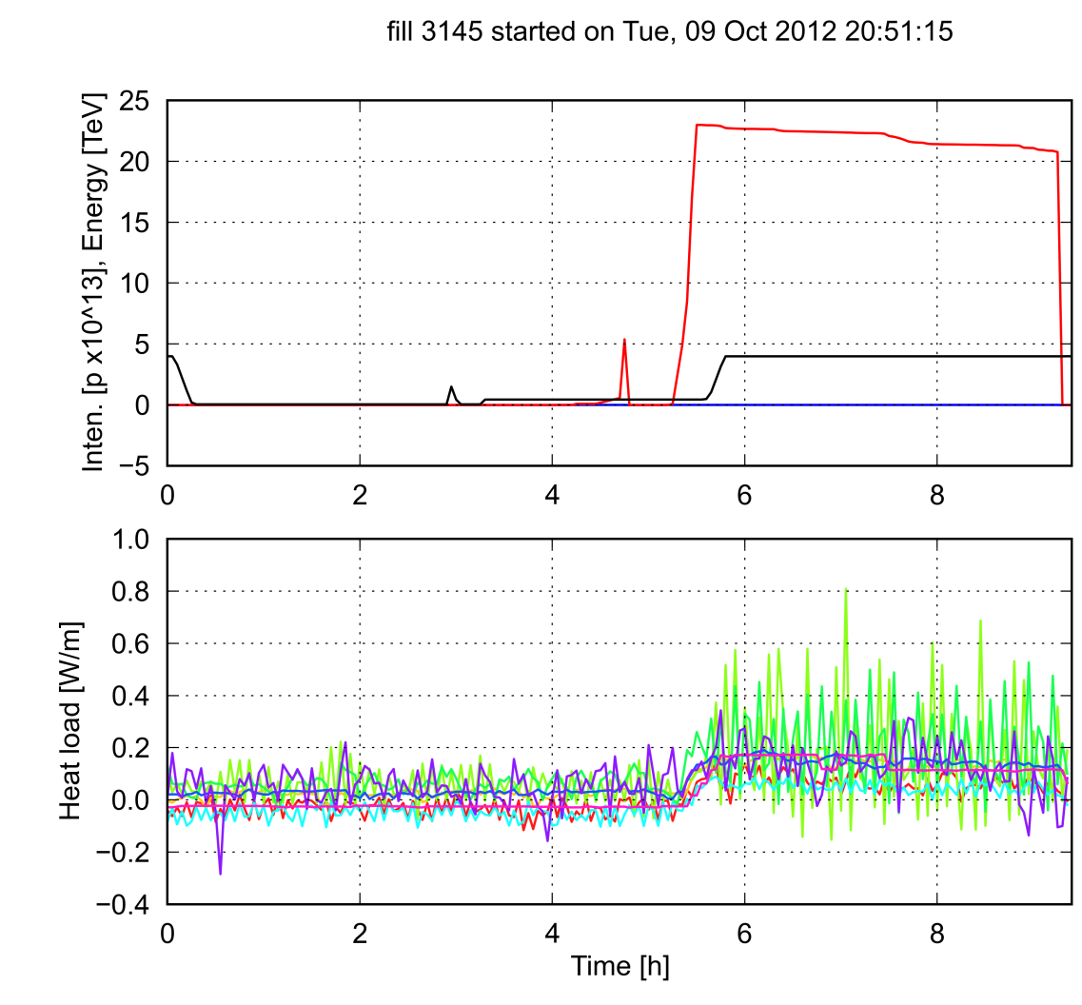
Crosscheck with single beam MDs
  For the estimated SEY value we do not expect nor observe EC in the triplets with only one beam with 50 ns spacing circulating in the LHC

Slide 78
Outline
  Introduction
  Simulating the inner triplets in PyECLOUD
  Simulation results
  Machine observations (heat load)
  Some considerations on e⁻ - beam interaction
  Endoscopy observations

Slide 79
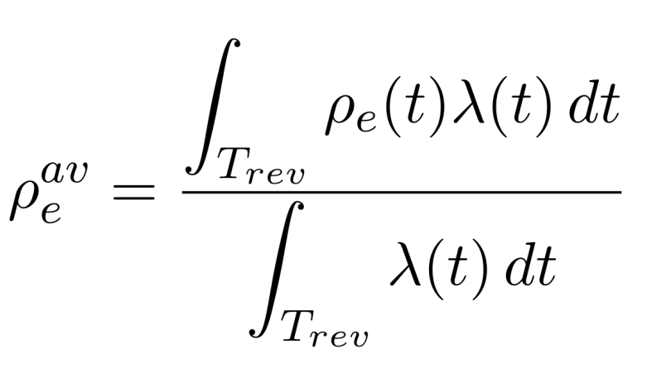
e- density at the two beam locations
  We are interested to the electron density “seen” by the beam. Therefore we compute the following weighted average density:
  In the transverse plane, the electron density is averaged over a circle of 1 mm radius

Slide 80
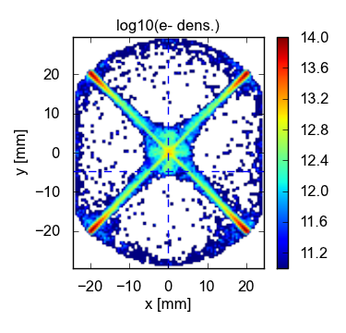
e- density at the two beam locations – 50 ns
  Strongly dependent on the beam position with respect to the e⁻ stripes
Beam 1
1R1
A2R1
B2R1
3R1
  IP1
1R1
3R1
A2R1
B2R1

Slide 81
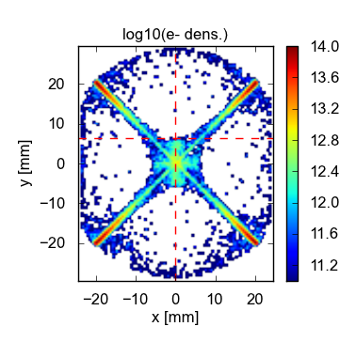
e- density at the two beam locations – 50 ns
  Strongly dependent on the beam position with respect to the e⁻ stripes
Beam 2
1R1
A2R1
B2R1
3R1
  IP1
1R1
3R1
A2R1
B2R1

Slide 82
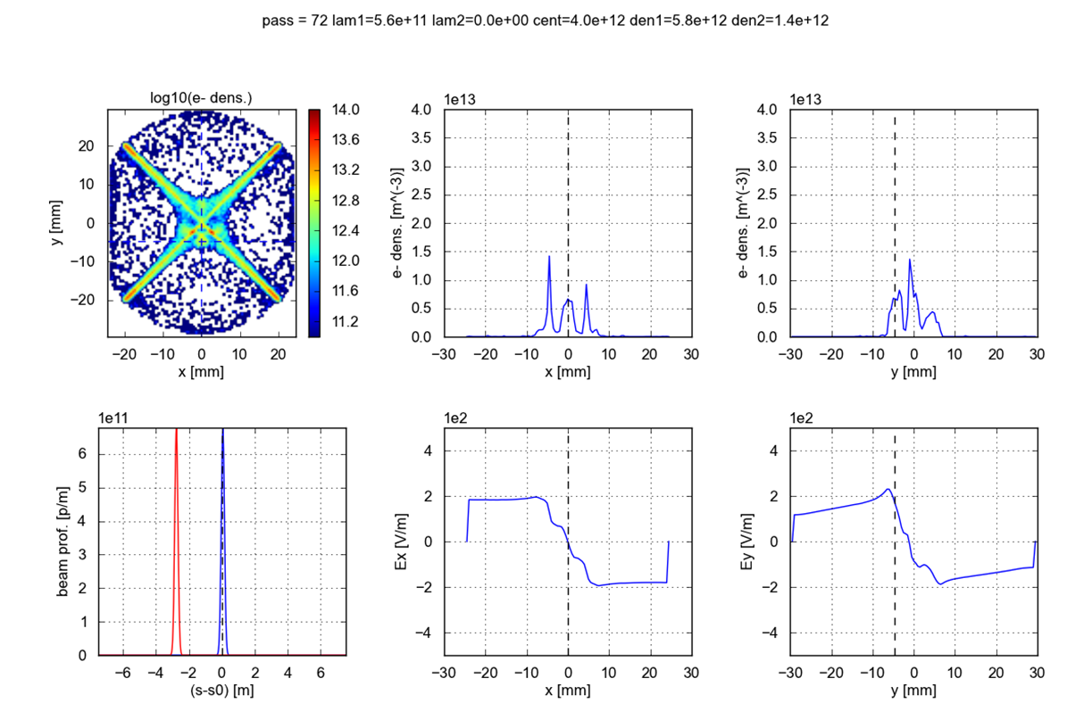
A closer look to a particular section
  The field at the beam location is determined by the whole distribution (not only by the local density)

Slide 83
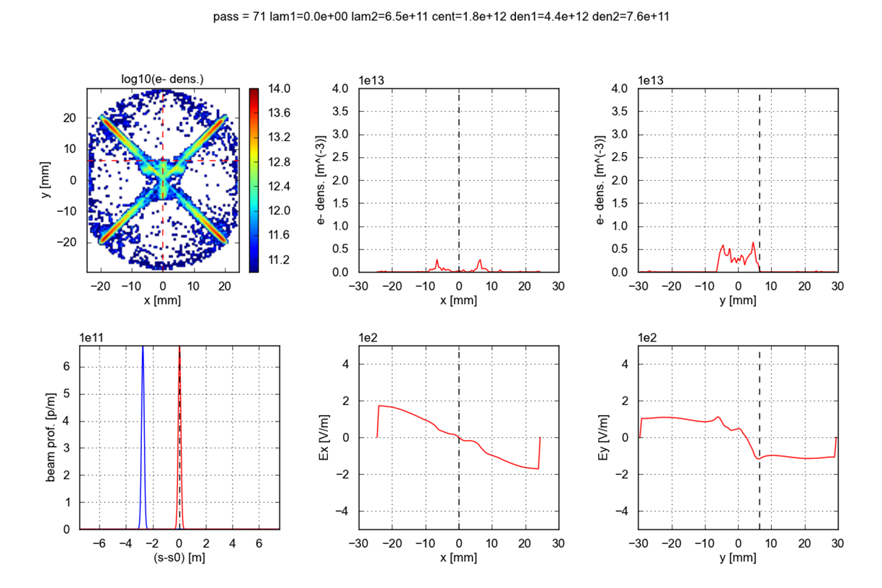
A closer look to a particular section
  The field at the beam location is determined by the whole distribution (not only by the local density)

Slide 84
Outline
  Introduction
  Simulating the inner triplets in PyECLOUD
  Simulation results
  Machine observations (heat load)
  Some considerations on e⁻ - beam interaction
  Endoscopy observations

Slide 85
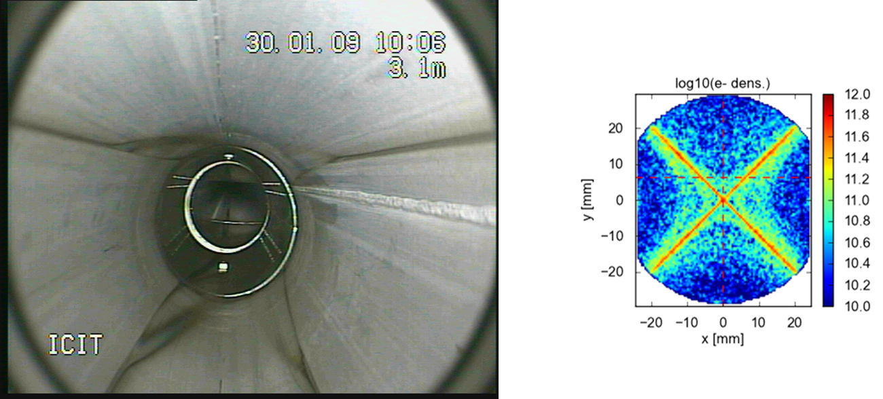
A picture from an SPS endoscopy
  Dark stripes in SPS quadrupoles seem to confirm the e- distribution we get in simulations
  A recent endoscopy of the LHC triplets does not show this kind of signs → are we sure the graphitization process still works in the LHC temperature/B field/vaccum conditions?!

Slide 86
Thanks for your attention!

Slide 87
e- density at the two beam locations – summary

Slide 88
e- density at the two beam locations – summary
  Average along the triplet

Slide 89
e- density at the two beam locations – summary
  Average between the two beams

