Slide 1
CLIC and XFEL study – information from SINAP
FEL projects and R&D status
XFEL plans and collaboration intention

Slide 2
FEL projects and R&D status
Facilities
  The SDUV-FEL facility
  The DCLS facility
  The SXFEL facility
The R&D of the key components/technologies

Slide 3
The SDUV-FEL facility
The Shanghai Deep Ultra Violet FEL facility is a test facility for various seeded FEL operation scheme.
First lasing of this facility was in 2009. HGHG (3~11 harmonics), cHGHG (2*2), EEHG(4, 10 harmonics), and polarizing controlled HGHG have been demonstrated.
The e beam parameters are:
  Emittance (Nor.), 2~3umrad
  Peak current (Max.), ~100A (~150pC, 3ps)
  Energy (Max), ~180

Slide 4
The DCLS facility
The Dalian Coherent Light Source facility is an FEL user facility.
This project started at 2012 and will open to the users at 2015.
The parameters are:
  FEL Wavelength, 50~150nm
  FEL pulse energy (max.), 100uJ
  FEL pulse length, 100fs, 1ps
  E beam emittance (nor.), ~2umrad
  E beam peak current (max.), ~300A (~500pC, 3ps)
  E beam energy, ~300MeV
  Repetition rate, 50Hz

Slide 5
The SXFEL facility
The Shanghai X-ray FEL is a test facility for the Hard X-ray FEL in China.
The project will start by end of this year and get lasing within 2~3 years.
The parameters are:
  FEL Wavelength, ~9nm
  FEL pulse power, ~100MW
  E beam emittance (nor.), ~2.5umrad
  E beam peak current (max.), ~500A (~500pC, 1ps)
  E beam energy, ~840MeV

Slide 6
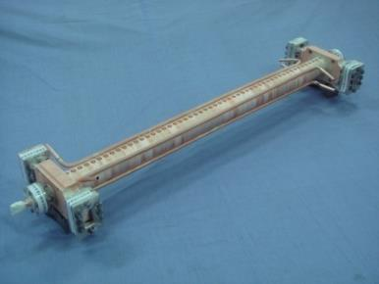
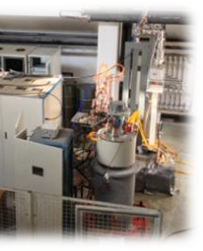
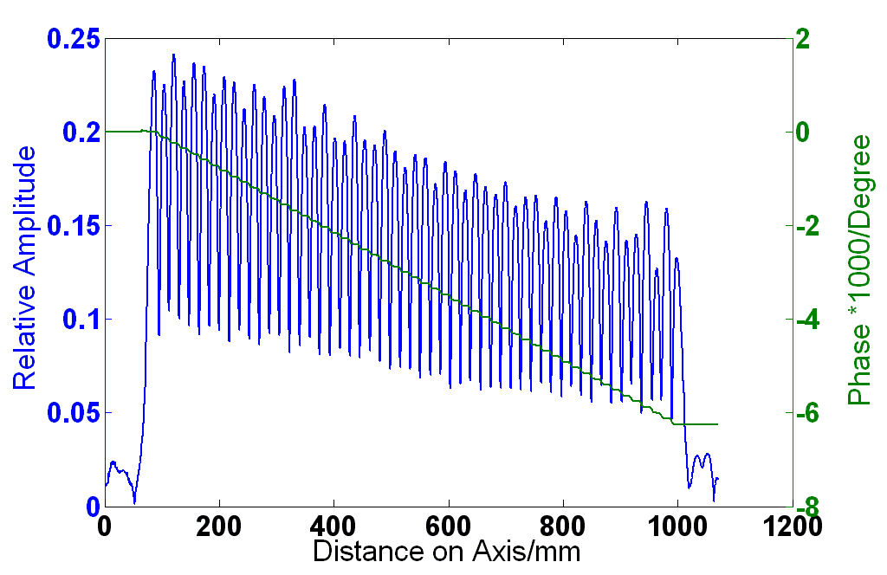
The R&D of the key components/technologies

Slide 7
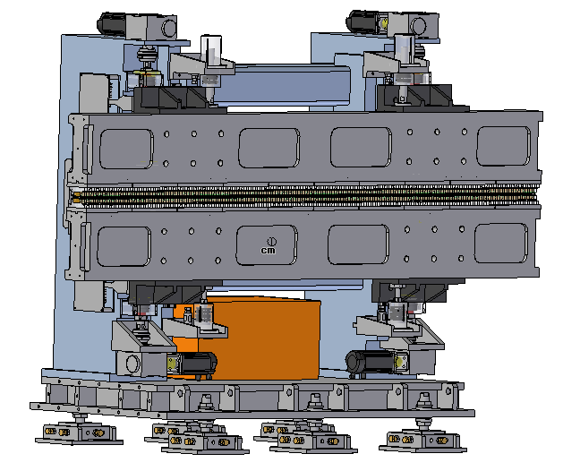
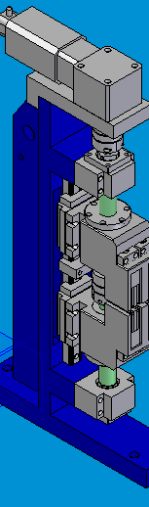
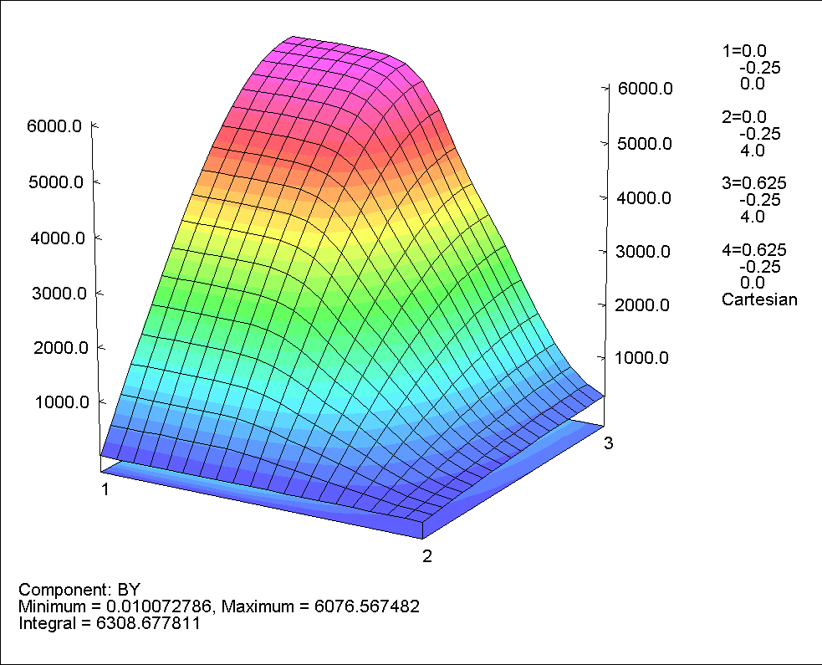
Undulator
λu (mm) | λres (nm) | K | Beff (T) | Length (m)
25 | 8.8 | 1.35 | 0.576 | 3
Proto types of cryogenic undulator and superconducting undulator are under developing

Slide 8
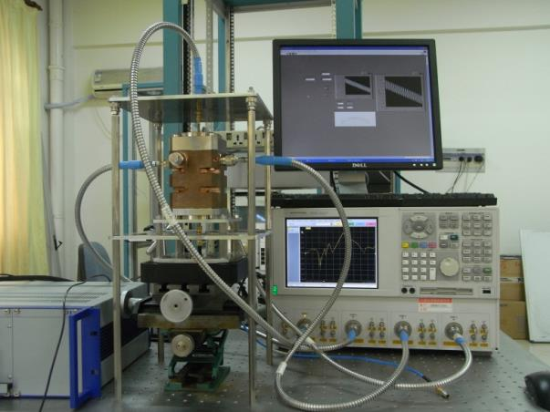
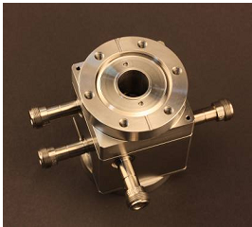
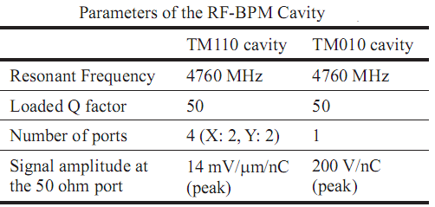
Cavity BPM

Slide 9
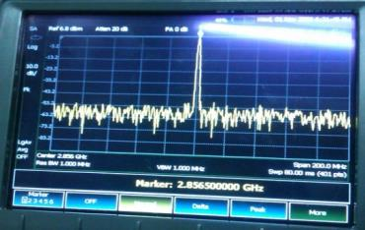
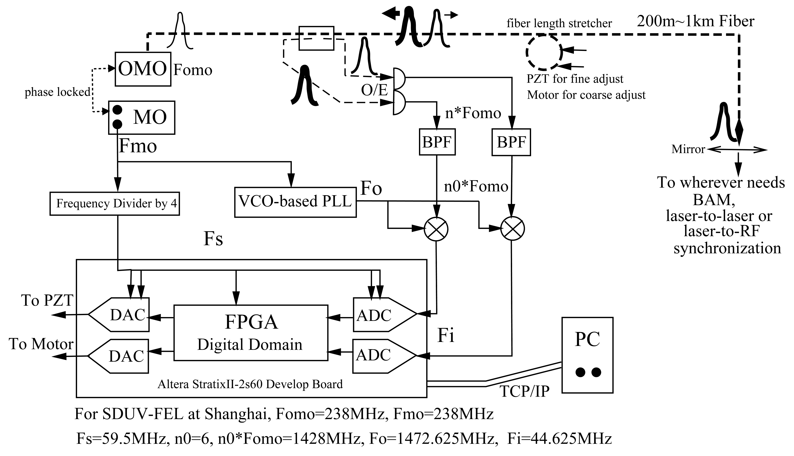
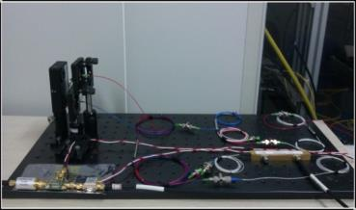
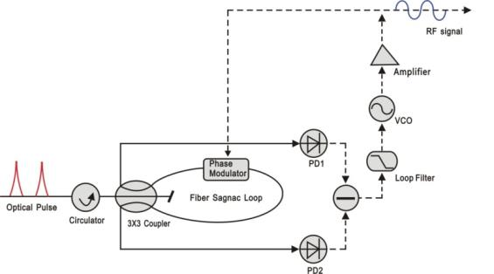
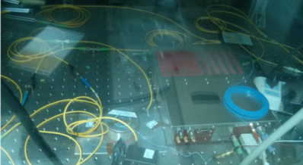
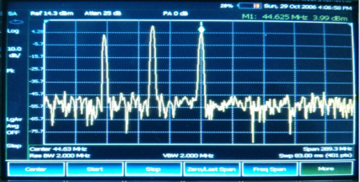
Signal distribution

Slide 10
XFEL plan and collaboration intention
The key features of the hard x-ray FEL
  Compact user facility, <600m
  FEL operation scheme, seeded
  FEL pulse wavelength, <0.1nm
  FEL pulse power, >10GW
  E beam energy, 6~8GeV
  E beam peak current, >3kA
  Repetition rate, >50Hz
Preliminary study has shown that 6GeV (0.1nm) could be achieved with the C band system within 300m long linac

Slide 11
Design
The accelerator
  Simulation tools: astra/impactT, litrack, elegant, MAD/transport
  Gun and injector: emmitance/peak current optimization, jitter analysis, dark current tracking
  Main accelerator: lattice, micro bunching instability, longitudinal jitter analysis, trajectory correction, emittance preservation, energy and peak current feedback
  E beam distribution: lattice, emittance preservation

Slide 12
The radiator
  Simulation tools: genesis
  Lasing scheme choosing, undulator parameters optimization, lattice, stability study (S2E), trajectory correction

Slide 13
RF system
Collaboration with CLIC on the X band system R&D including accelerating structure, waveguide components and high power test stand
The structure development
  By end of this year, a mini workshop with turning and milling machines, CMM, interferometer, surface treatment equipment, vacuum furnace will be ready and we could produce the structure in house
  Optimizing the accelerating structure to increase the RF to e beam energy efficiency and reduce the cost in case of FEL linac application

Slide 14
RF test stand
  The building for the SDUV-FEL facility with the tunnel and service area could be used for the high power test
  RF power combination and compression with high repetition rate
  We asked an EVD company in China to develop an X band klystron with 20MW RF power based on a collaboration agreement

Slide 15
E Beam test stand
Gun test stand
  The building for the SDUV-FEL facility with the tunnel, S band RF power source, drive laser system, and the beam instrumentation could be used for the gun test stand (with limited repetition rate)
Structure test stand with e beam
  The building for the SDUV-FEL facility with the tunnel, a 180MeV (max.) e beam from the linac could be used for the structure test (with limited repetition rate)

Slide 16
Thanks for your attention
Questions and comments please

