Slide 1
Increased trust, less confusion, added value
Kimmo Koski
CSC – IT Center for Science Ltd
Position statement, user forum November 18th, 2013

Slide 2
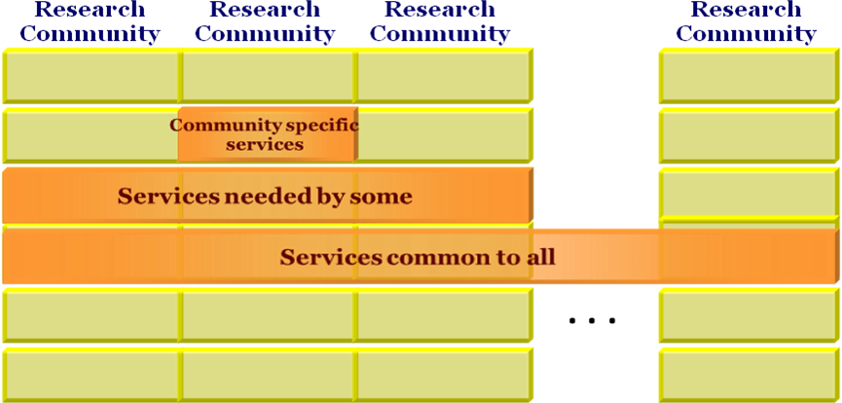
Trust in all levels
Trust between RI and e-infra
Trust between different Ris
Trust between different e-infrastructure initiatives
User-driven services, requirement for synergy
EVERY RI NEEDS TO DEAL
WITH e-INFRASTRUCTURE

Slide 3






































Any danger for confusion?

Slide 4
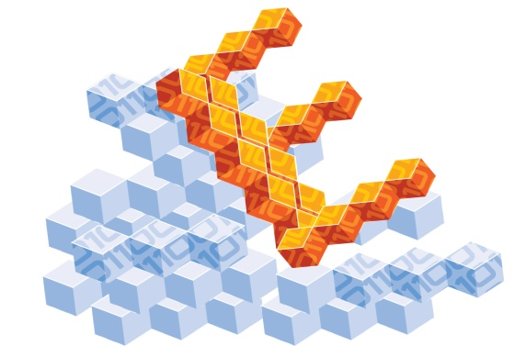




























Addressing users, building bridges (example: EUDAT user forums)
1st User Forum
7-8 March 2012, Barcelona

Slide 5
Potential for conflicts
What is the relation between this forum and others?
  Need to build on existing initiatives, not ”yet an another policy group”
Where is the point when collaboration potential converts to harmful politics?
  For example ”data intensive HPC” is today addressed also by PRACE
Networked models (”ecosystem”) instead of monoliths allows better inclusion or people
Clear and open criteria for choices
  Examples: who will provide each service and how those decisions are made etc.

Slide 6
Recommendations
Look for merging with other user forum activities and utilizing existing work
Include wider set of ”e-infrastructure acronyms” and try to make the interface less confusing to users
Promote open approach and clear selection criteria
  Choices and pilots based on clear criteria, not based on ”since it happens to be there”. Some pilots have a tendency to become permanent.
  Example from datacenter selection criteria: energy efficiency, environmental sustainability, running costs

