Slide 1



GridPP31
Planning for GridPP5
GridPP31
24th Sep 2013
Prof. David Britton
GridPP Project leader
University of Glasgow

Slide 2
Outline
Spending Review (CSR 2013) outcome.
STFC Programmatic Review (2012/13).
Evolution in Europe (EMI finished, EGI final year).
Evolution of the Computing Models.
Development of the UK e-ecosystem (ELC, PDG, SIGs etc).
Development of GridPP5 proposal.

Slide 3
CSR-2013
Announcement in June: Ring fenced flat-cash to BIS for operational science budget.
The art of Tucking (e.g. Talk of MRC funding being moved to Department of Health).
Negotiation/competition with/between Research Councils.
STFC budgets for 14/15 and 15/16 won’t be known until December (?)
GridPP5 scope can’t be fully defined until that point.

Slide 4
STFC Programmatic Review
Review has been performed.
Science Board met in May and June to review input from sub-groups and agree recommendations to Council.
Presented to Council in July (?)
The report is a contextualised report setting out long term priorities.
Meeting on Oct-14th has been repurposed.
  “We plan to publish the final Programmatic Review report once the STFC budget allocations arising from the Spending Review are known; we will then be able to understand how to apply these recommendations to the programme.”

Slide 5
EGI
EGI ends in April 2014.
Any new funding would not start for at least 6, and possibly 9, months.
Bridging extension being investigated (using underspend and subscriptions).
Vision of what is being bridged-to, is unclear because both EU-funding and subscription levels are unclear.
JISC aren't going to fund the UK EGI subscription after this year (which was partly funded by GridPP anyway).
RCUK are setting up a review of it in terms of its value for the UK.
Tucking ensues.

Slide 6

EU Funding
(Luis Busquets)
→ HORIZON 2020
Main action → WP 2014-2015 on European Research Infrastructures
E-infrastructures topics →unit mission
Expected Budget under discussion
Meeting with Member States:
  2 October 2013

Slide 7
Horizon 2020
Research Infrastructure
Draft Work Programme 2014-2015
CALL 1
Developing new
world class infrastructures
Support to the implementation of cross-cutting infrastructure services and solutions for cluster of ESFRI and other rilevant Reserach Infrastructure initiatives in a given thematic area
Design Studies
+
Support to
Preparatory Phase
of ESFRI projects
+
Support to the individual
implementation and operation
of ESFRI projects
+
CALL 2
Integrating and opening
research infrastructures
of pan-European interest
Integrating and opening existing national and reagional research infrastructures of
pan-Eutropean interest
CALL 3
e-Infrastructures
Managing, preserving and computing
with big reserach data
+
e-Infrastructures for Open Access
+
Towards global data
e-infrastructures
Research Data Alliance
+
Pan-European
High Performance Computing infrastructure and services
+
Centres of Excellence for Computing applications
+
Network of HPC
Competence Centres
for SMEs
+
Provision of
core services across
e-Infrastructures
+
Research and Education networking – GEANT
+
e-Infrastructures for virtual research environments (VRE)
CALL 4
Innovation potential of
research infrastructures
and human resources
Innovation support measures
+
Innovative procurement
pilot action in the field of
scientific instrumentation
+
Strengthening the human capital of research infrastructures
+
New professions
and skills
for e-Infarstructures
CALL 5
Policy measures and
international cooperation
for research infarstructures
Policy measures for Research Infrastructures
+
International Cooperation
+
Focus on e-Infrastructure policy development and international cooperation
+
Network of National Contact Points

Slide 8

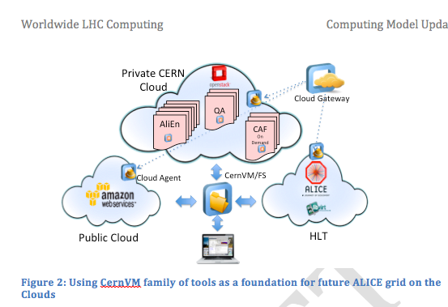
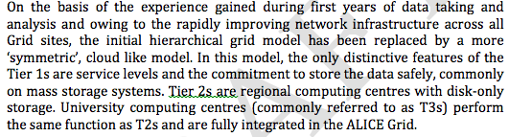
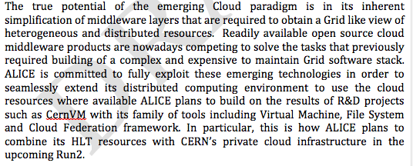
Evolution of Computing Models
E.g. ALICE

Slide 9
UK Eco-System
Figure showing Eco-system
The e-Infrastructure Special Interest Group is an industry-led activity sponsored by the Technology Strategy Board to build on UK strengths in the design and exploitation of high performance computing.
27-June: Big Data Workshop leading to Big Data SIG: To help to form a cross disciplinary research community whose activities are being enhanced through access to volumes of data that were previously impossible to acquire or process. This community will be formed both from researchers and from resource providers.
23-July: Cloud and Virtualisation Workshop.
24-July: JANET-led high-throughput networking SIG meeting.
Formation of the JANET-led AAAI working group encouraged by the RCUK e-infrastructure group (Cyber Security, Information Assurance and Access Working Group). This subsumes the UK3A proposal we wrote last year.
Education and Training strategies.

Slide 10
The e-Infrastructure Pipeline
Redacted

Slide 11
UK Eco-System
Figure showing Eco-system….
The e-Infrastructure Special Interest Group is an industry-led activity sponsored by the Technology Strategy Board to build on UK strengths in the design and exploitation of high performance computing.
27-June: Big Data Workshop leading to Big Data SIG: To help to form a cross disciplinary research community whose activities are being enhanced through access to volumes of data that were previously impossible to acquire or process. This community will be formed both from researchers and from resource providers.
23-July: Cloud and Virtualisation Workshop.
24-July: JANET-led high-throughput networking SIG meeting.
Formation of the JANET-led AAAI working group encouraged by the RCUK e-infrastructure group (Cyber Security, Information Assurance and Access Working Group). This subsumes the UK3A proposal we wrote last year.
Education and Training strategies.

Slide 12
GridPP and Big Data
“Data is the new oil.”
  “Data is the life blood of the knowledge economy and the elixir of innovation. It is magical because if you give me your car you no longer have it and no wealth is created, but if you give me your data then we both have it and can exploit it, and wealth is created.”
Big Data characteristics:
Volume – talking petabytes, or at least 100s terabytes.
Variety – Can be structured or unstructured or a a mixture.
Velocity – A big driver: need iterations in O(day).
Veracity – Accuracy… “dirty-data” is common but harder to handle.
Value – What is the information worth? Very much a driver of the technology.

Slide 13
GridPP and Clouds
No intention of throwing away our (brilliantly) working Grid. But, (in addition) a cloud interface to some of our Grid resources would;
could* allow us to offer a simplified experience to new user groups (academic and/or pre-commercial work with industry);
gain understanding of the cost and performance of commercial clouds;
match aspects of the developing experiment computing models.
*but not if it’s a clunky home-grown thing!

Slide 14


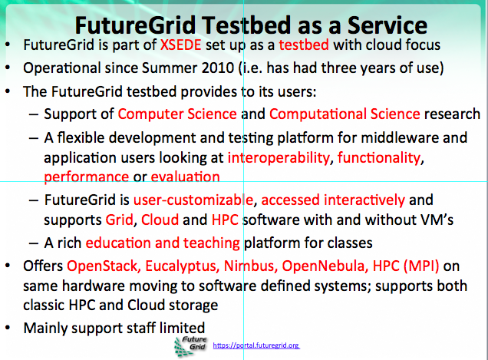
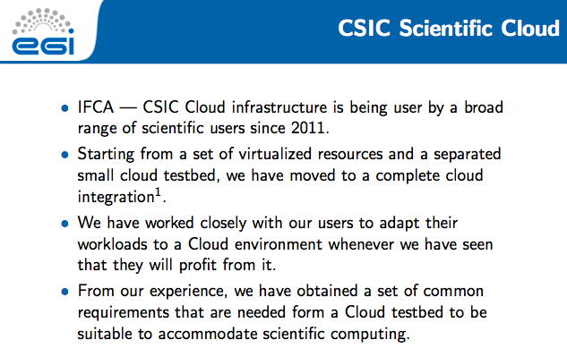
Clouds
Dave Colling has been leading the GridPP cloud investigations; Synergistic with CMS work to use HLT and linked into both the EGI federated cloud and the UK cloud SIG.
Despite the stage on the Hype-cycle (see GridPP30 talk) there is a lot going on around Clouds.

Slide 15


Cloud Use

Slide 16
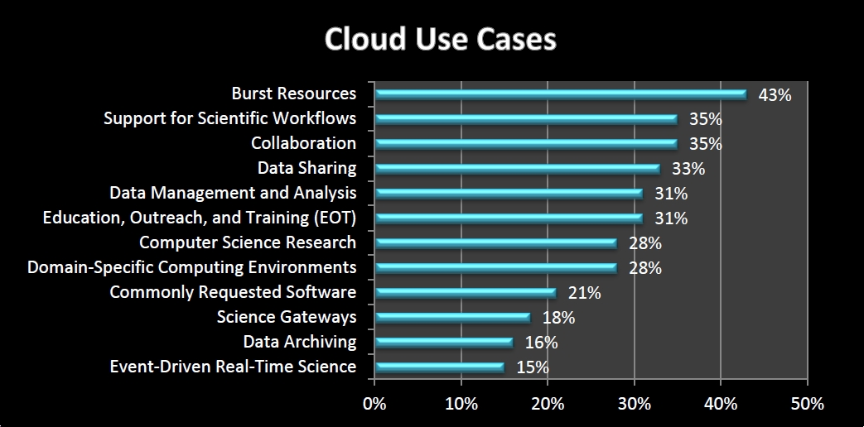
What cloud use cases are represented by your research or education project? Check all that apply.
Cloud Use
Notes:
Bursting resources was the predominant cloud use case cited by researchers and educators in our survey, with 43% saying their project involved bursting. This was followed by computing and data analysis support for scientific workflows, collaboration, data sharing, and data management and analysis. Education, outreach, and training (EOT) and Computer Science research are also important use cases.

Slide 17
Summary so far…
So:
We don’t know what CSR-2013 means for STFC.
We don’t know the outcome of the STFC programmatic review or what it means for GridPP.
We see an explosion of SIGs/forums/groups springing up around UK e-infrastructure – context is more complicated.
We don’t know how EGI will evolve or if/how UK involvement in EGI will continue.
We don’t know all the details about where the experimental computing models are going, or how quickly.
We do know we have to write a new GridPP proposal.
Good, lets get started…

Slide 18
GridPP31
Agenda Day-1
  Requirements (talks from experiments and vision from Ian Bird as to where CERN/wLCG are going).
  A discussion on the technology: How are we going to meet these requirements?
Agenda Day-2
  The case for the Tier-1: A look back at what we did and a look forward at what we need to do.
  The case for the Tier-2s: A discussion session on the Tier-2s. What are the strengths and weaknesses of the current arrangement?
  The additional services (security, accounting, CA, etc.).

Slide 19
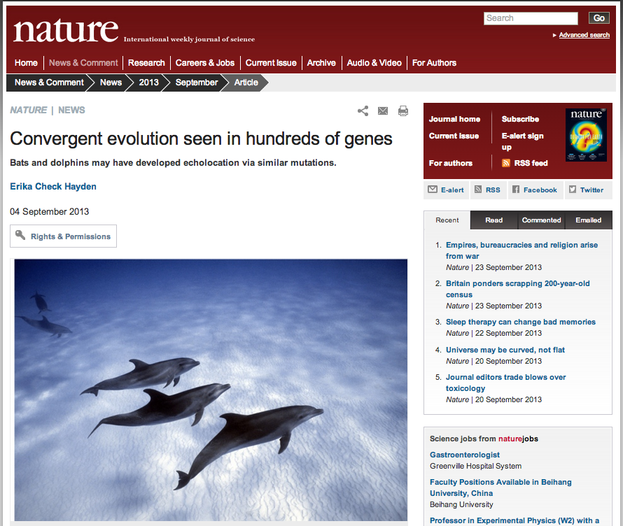
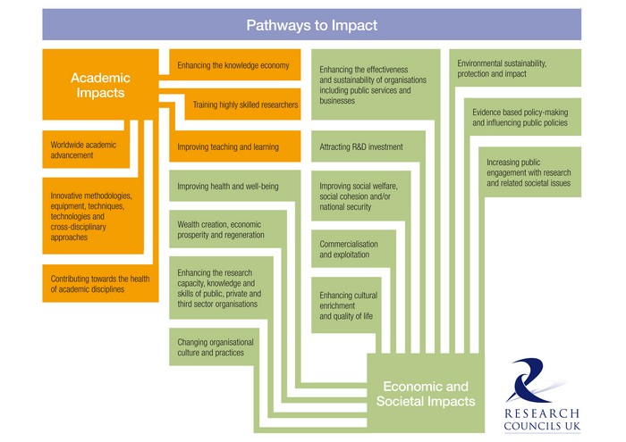
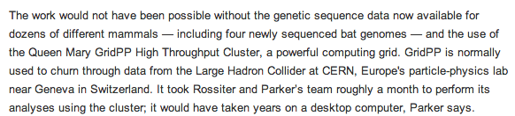
Dissemination
Replacement for Neasan is underway.
Transition from Dissemination to Impact.
Try to factorize out this part of the funding.

Slide 20
Tier-2 Hardware
Approximately £1.8m to spend on Tier-2 Hardware in the remainder of GridPP4.
Three institutes have asked for the funding this FY – STFC has agreed.
Propose to use accounting at the end of this month to determine the share for those three institutes.
Remainder of funding will be distributed in the new FY according to the accounting at that point (proposal).

Slide 21
Oversight Committee
GridPP Oversight Committee reconvenes after a 2.5 year hiatus, on Nov 1st.
  Project Status
  Resource Report
  Preliminary discussions on GridPP5 and the timetable.
Possibly another OC around February (?) 2014 to finalise GridPP5 project planning.
  STFC are aware of requirement to issue grants 6-months before end of GridPP4.

Slide 22
Pledges
Due next week.

Slide 23


GridPP32
Provisionally 26th and 27th March 2014 in Pitlochry (Scotland)
24th March 2013

