Slide 1




Spark system I update
Nick Shipman 17.09.2013

Slide 2
News
After a *lot* of emails and phone calls VG Scienta have finally assured me that the stepper motor has been shipped on the 12th of September. (A mere 3 months late on an order with a 1 month lead time).
Fairly extensive labview improvements have been carried out, it is much more useable and everything is automatically stored in a logical way.
Lots of experiments calibrations and recalibrations have been carried out. Unfortunately some of the data may not be particularly useful as I now believe the gap was set wrong. Looking at this in a positive light I would not have noticed this were it not for the pulse integrating method which is now used as standard on all experiments.
I aim to order the PCB by the end of this week now Alex is back from holiday.

Slide 3
Labview Improvements
1.Automatically generate experiment info file with all labview settings a user written description of the experiment as well as scope front panel settings
2.Choose just the directory on computer and scope then automatically create all filenames
-data is also saved to scope as a backup and so it is with the waveforms
This might not sound like much but now all experiments performed are extremely well documented automatically along with a description of the experiment. And every single labview control or scope tweak that was made at the time can be verified later.

Slide 4
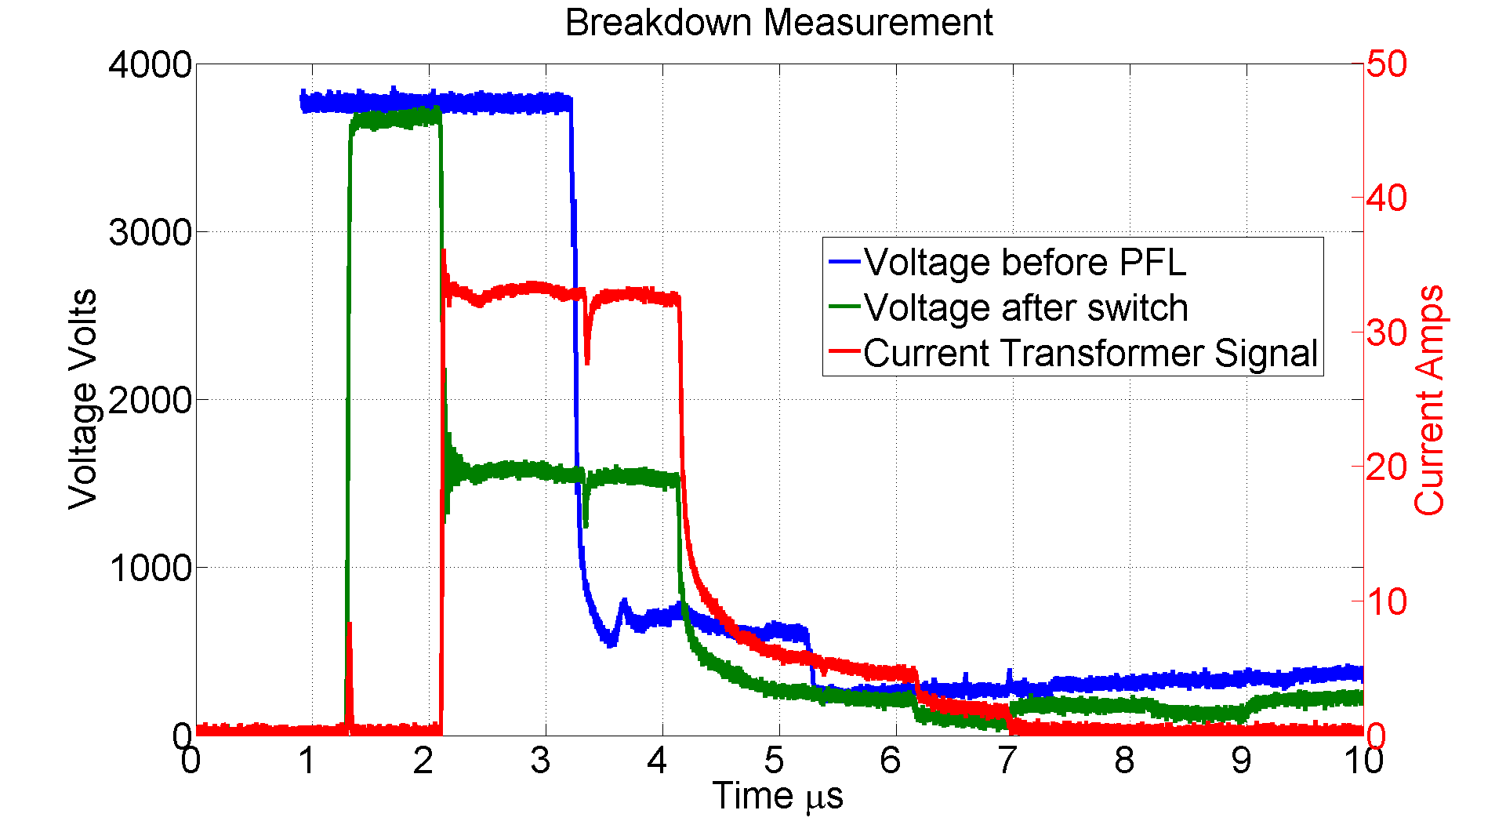
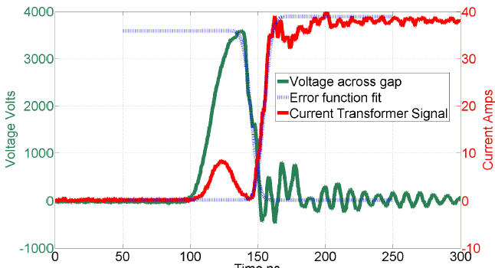
Upcoming Labview Improvements
There are three things we are interested in measuring with the scope that can’t be done (well) simultaneously on the same scope:-
1.Entire current and voltage waveforms –scope 1, timescale - us
2.Charging Pulse Integration –scope 2, timescale - ns
3.Rise times and burning voltages –scope 1, timescale –ns
However the pulse integration is only ever made when there is no BD and so the other measurements are not being made. So I’m going to see if it is possible to make one of the other measurements on scope 2 when it is not being used for pulse integration, this might be tricky though.
I will also need to incorporate the stepper motor control into my programs, but I am hoping I can draw on Tomoko and Anders considerable expertise in this area!

Slide 5
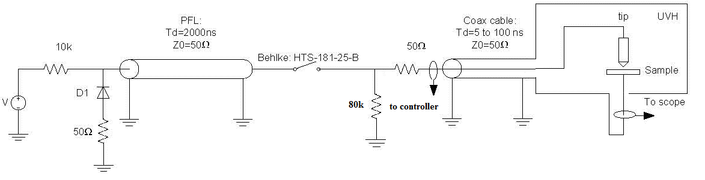
Pulse Integration Method
The pulse integration method is used to monitor the gap distance.
Current transformer 2 as shown in the circuit diagram is used to measure the transient current flow when the switch is closed. The area of this current pulse is dependent on the gap capacitance.
In this position the current transformer is insensitive to as much stray capacitance as possible
CT 2
The measurement used is an average of many pulses.

Slide 6
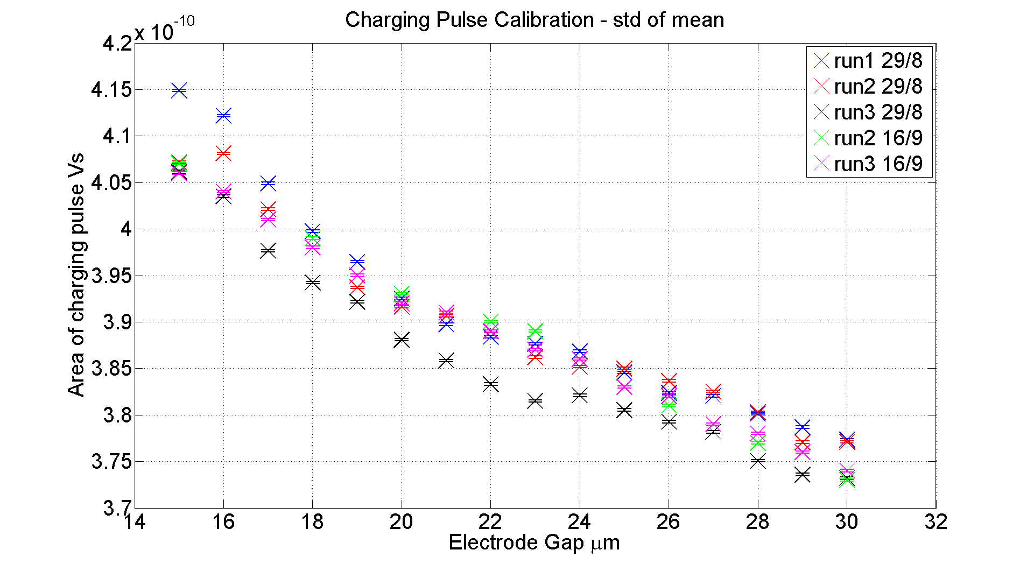
Calibration
The calibration is remarkably consistent even when made weeks apart.

Slide 7
How good is the measurement?
Average difference in area per μm @ 20μm – 2.83*10^-12
Standard Deviation Pulse to Pulse ~ 6.5*10^-12
==> +- 2.2μm
Precision can be easily improved by averaging multiple measurements.
Scope rate is ~100Hz ==> in one second standard deviation of mean is ~0.2μm
However repeatability of measurement is only ~3*10^-12 ==> 1μm
Possibly due to inaccuracy in initial contact position

Slide 8
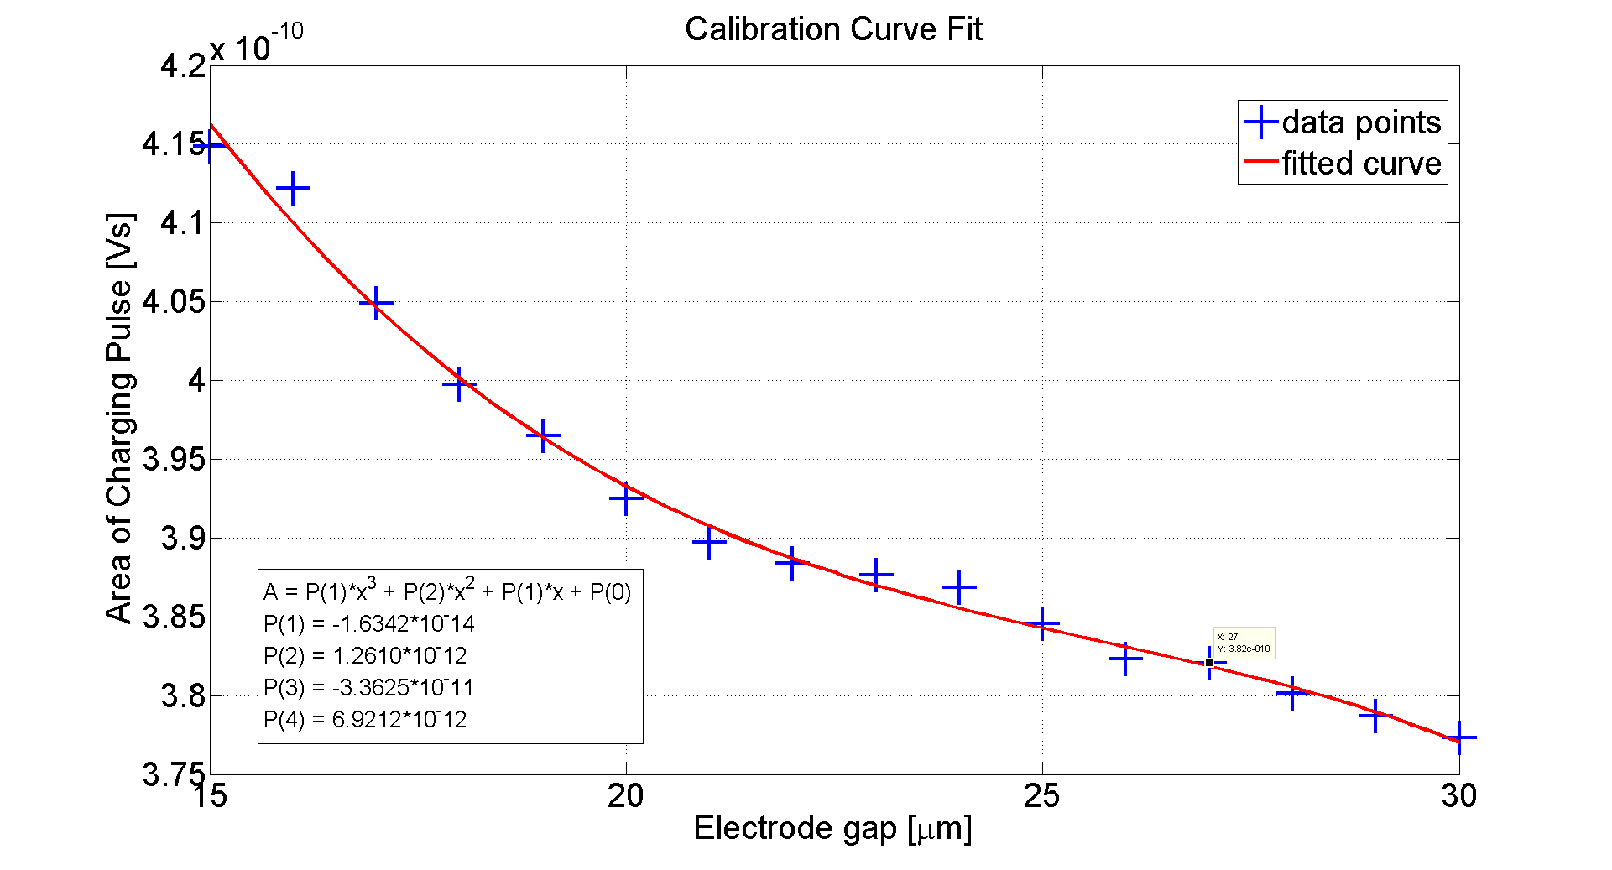
Calibration Curve

Slide 9
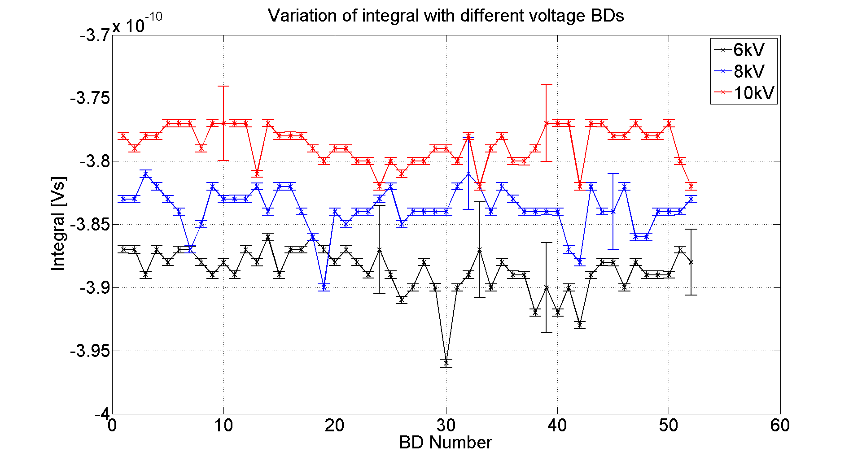
Gap change after BD
28um
21um
18um
Hypothesis that gap would change more with higher voltage → more damage to electrodes not proven. Sorry for lack of proper um scale.

Slide 10
Plans
1. Order PCB board.
2. Install stepper motor.
3. 40um BDR vs. E.
4. More data analysis.

