Slide 1
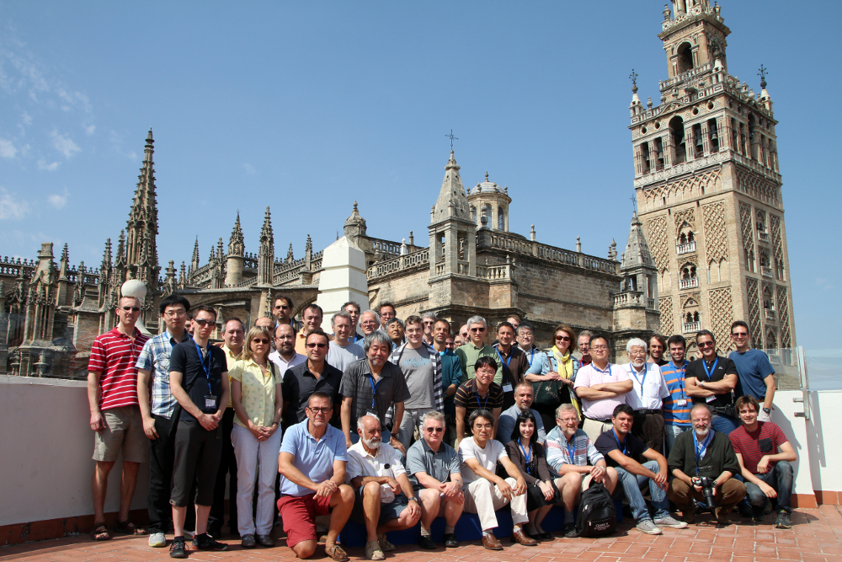
Highlights on the Geant4 Collaboration Meeting
Seville, 2013
Overview
Gabriele Cosmo, PH/SFT

Slide 2
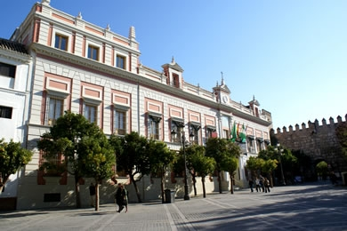
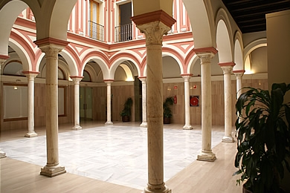
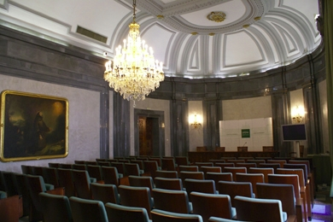
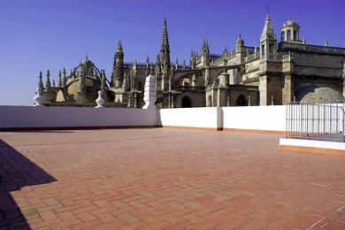
Meeting’s Venue
Hosted in “Casa de la Provincia” in the hearth of Seville

Slide 3
Meeting’s Program
The 18th Collaboration Meeting
  Organised by the University of Seville
5 days, Monday to Friday
  2 plenary sessions in then morning
  Parallel sessions in the afternoon
  Last morning dedicated to summaries from parallel sessions
1st plenary on Monday dedicated to open requirements
  HEP, material science, space & medical applications
  Reviewed requests for releases support from LHC experiments & short/medium term plans
    Asked support for release 9.6 up to mid-2016 (ATLAS)
    Plan to start adopting release 10.0 in 2014 (CMS)

Slide 4
Path to Geant4 release 10
Reviewed status for MT and performance measurements
  Confirmed excellent linear scaling vs. number of worker threads
  Improved memory footprint per thread and identified areas for further reduction; improved event reproducibility
  Defined strategy for documentation and migration of more examples and tests
  Reviewed next steps to take for the final release in December
Reviewed status of developments in the different areas
  Geometry, particles, event-biasing, visualization, UI, …
  Performance monitoring and physics validation
Status, developments & plans in EM and hadronic physics
  See Alberto’s slides

Slide 5
Highlights - 1
Geometry
  Status of AIDA Unified Solids library to be included in release 10
  Presented status and first measurements from vectorization of geometrical primitives in the Vector Prototype
Computing performance measurements
  Reduced performance gap vs. G3 in ALICE (improved by more than 1.6x)
  Reduced performance penalty from B-field in ATLAS (15% to 2%); identified hot spots (custom solid, low-energy photons/electrons)
  Expected improvements from use of fast math functions in CMS (standard math today counting for a total of 12%)
  Reviewed requirements for testing and benchmarking multi-threaded applications
Parallelism
  Presentations on Vector and GPU Prototypes, radiotherapy in CUDA, hybrid GATE
  More details in John’s summary

Slide 6
Highlights - 2
Progress on Physics Biasing
  Presented a “generic” biasing scheme to extend physics based biasing using wrapper and helper classes
    To be released in Geant4 10
  Reviewed existing EM biasing techniques
  Implementation of channeling effect
    Charged particles following the lattice planes in crystals due to the EM potential well. Used for beam collimation and extraction
Tools
  Aiming to converge on common aspects for tools used in physics validation at FNAL and GRID validation suite at CERN
  Integration of [more] physics tests in Ctest/CDash
  Use of Valgrind/DRD for MT testing
  Progress in addressing Coverity defects (now down to ~400)
General paper publication in 2014
  Defined organisation, timeline and paper’s high-level outline

Slide 7

2014: Okinawa!
Geant4 20th Anniversary Ceremony
  Candidate dates: September 29th to October 4th

