Slide 1
Geant4
Towards major release 10
Gabriele Cosmo, CERN PH/SFT
On behalf of the Geant4 Collaboration

Slide 2
Outline
Introduction of multi-threading for event-level parallelism
  Review of features
  Performance measurements
Highlights of new developments & features planned for 10.0
  For physics developments, see in the posters session:
    “Geant4 Electromagnetic Physics for LHC Upgrade”, V.Ivantchenko et al.
    “Recent Developments in the Geant4 Hadronic Framework”, W.Pokorski et al.
Conclusions & final considerations

Slide 3

Geant4 10.0
First major release since 2007
Important modifications introduced to most classes
  Adaptations to thread-safety for event-level parallelism
    Additional API for user-action classes
    Backwards compatible with old API in sequential mode
    Major revision of internal data initialisation in all areas
    Reviewed memory management
New and extended features
Removal of obsolete/deprecated code and interfaces
May imply changes/adaptation to user’s code

Slide 4
Multi-threading from prototype to production …
Capitalizing the work started back in 2009
  By X.Dong and G.Cooperman, Northeastern University
  Big effort brought to success
    10.0-beta announced on June 28th on schedule
    Final release expected for December 6th
Public release
All functionalities ported to MT
MT code integrated into G4
G4MT 9.4 (2011)
G4 10.0-beta (Jun. 2013)
G4 10.0 (Dec. 2013)
G4MT 9.5 (2012)
G4 10 series (2014+)
Proof of principle
Identify objects to be shared
First testing
API re-design
Examples migration
Further testing
First optimisations
Further refinements
Focus on further performance improvements

Slide 5
Multi-threading
10.0 features - 1/2
Event-level parallelism
Each worker thread proceeds independently
  Initializes its state from a master thread
  Identifies its part of the work (events)
  Generates hits in its own hits-collection
  Uses thread-private objects and state
  Shares read-only data structures (e.g. geometry, cross-sections, …)
  Has its own read-write part in a few ‘shared/split’ objects
Possibility to install/run Geant4 either in pure sequential or parallel (MT) mode
  Choice at configuration/installation time
  Sequential mode set as the default

Slide 6
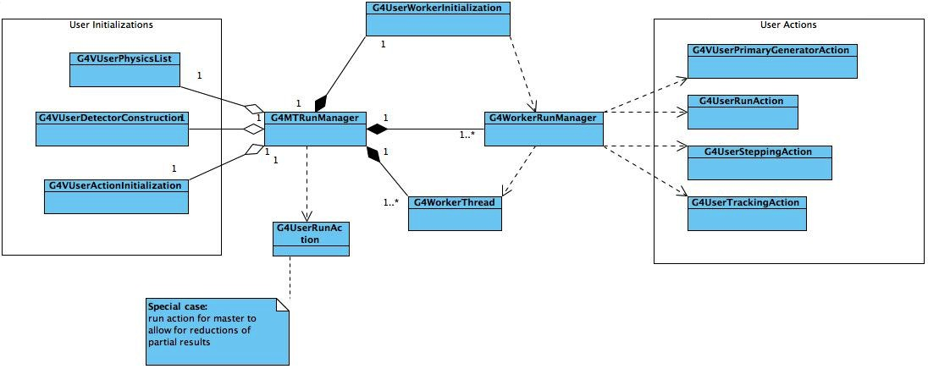
Multi-threading
10.0 features - 2/2
Design aimed to minimize changes in users code
  Keep API changes at minimum
  Allows for backwards compatibility
  Focus on “lock-free” code
  Metrics currently in use: linearity of speed-up (w.r.t. #threads)
  Enforce use of POSIX standards to allow for integration with user preferred parallelization frameworks (e.g. TBB, MPI, …)
  Absolute throughput optimisations are ongoing and will follow

Slide 7
Multi-threading
Porting applications …
Few changes needed in user code:
  Change main() to use G4MTRunManager – one line
  Create Sensitive Detector & Field in a new method
  Adapt to per-event RNG seeding (potential change)
  Check User ‘Action’ classes (Step, Track, Event)
Choice - handling Output: per thread or accumulate ?
  Geant4 automatically performs reductions (accumulation) when using scorers or G4Run derived classes
Testing
  Check output of runs – MT vs 1-thread vs Sequential
  See: https://twiki.cern.ch/twiki/bin/view/Geant4/Geant4MTForApplicationDevelopers

Slide 8
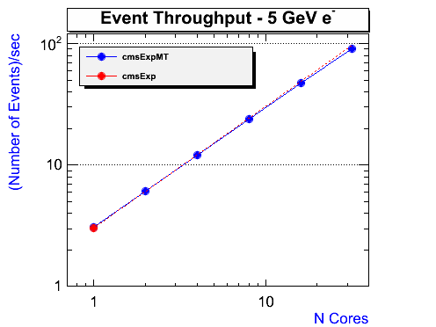
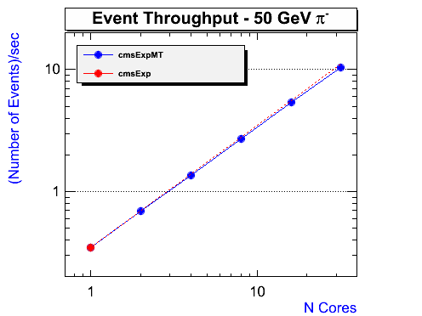
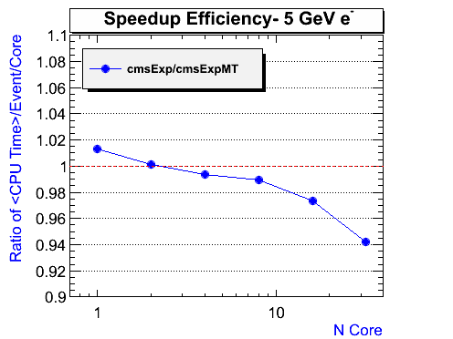
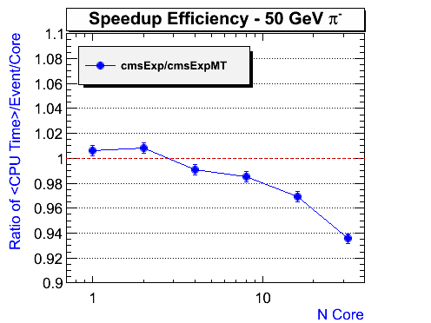
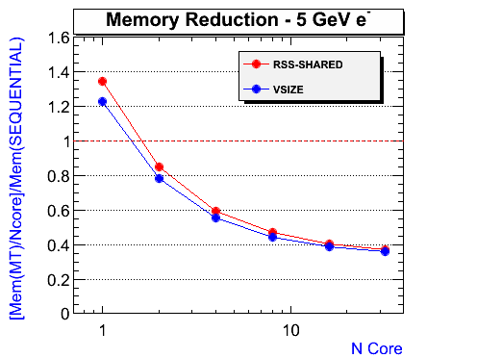
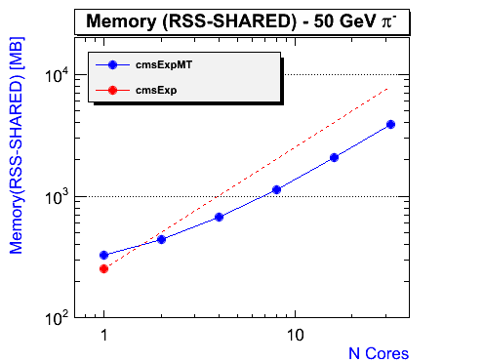
Multi-threading
Performance – 1/4
Showing good efficiency w.r.t. excellent linearity vs. number of threads (~95%)
  From 1.1 to 1.5 extra gain factor in HT-mode on HT-capable hardware
No measured CPU degradation vs. sequential runs (*)
(*) Based on performance analysis on full-CMS benchmark (last September development release, of Geant4)
by S.Yung Jun, FNAL on AMD Opteron™ 6128, 32 cores

Slide 9
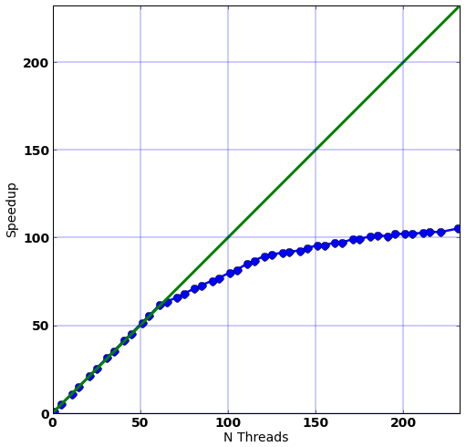
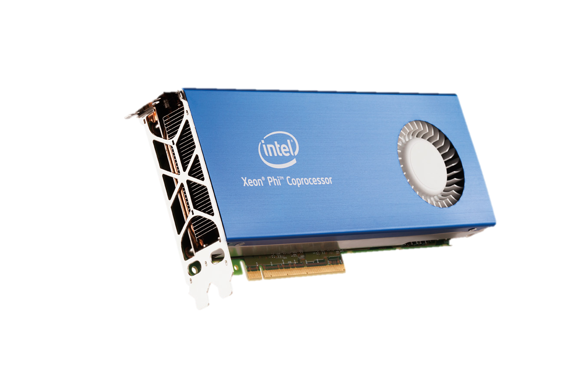
Multi-threading
Performance – 2/4
Intel® Xeon Phi™ coprocessor (MIC) (*)
  60 cores (4 HW threads each), 16Gb RAM
  Excellent results: additional factor ~2 in events produced w.r.t. host only
  Confirmed good scalability up to 240 threads
  Full physics: 50 GeV pions with B-field on
  Reduced use of memory
    (see next slide)
HT mode
(*) Analysis on full-CMS benchmark on latest September development release by A.Dotti, SLAC

Slide 10
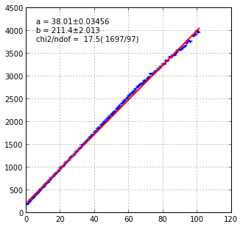
Multi-threading
Performance – 3/4
Intel® Xeon Phi™ coprocessor
  Using out-of-the-box 10.0-beta (i.e. no optimisations)
  ~40 MB/thread
    Baseline: Full-CMS benchmark; 200 MB (geometry and physics)
  Speedup almost linear with reasonably small increase of memory usage
Memory usage (MB)
Number of threads
(*) Analysis on full-CMS benchmark for release 10.0-beta by A.Dotti, SLAC

Slide 11
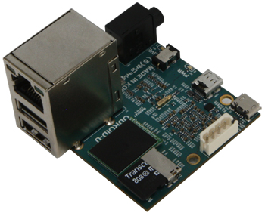
Multi-threading
Performance – 4/4
ARM Cortex A9
Exynos 4412 Prime quad-core Cortex-A9 @ 1.7GHz (*)
  Based on latest September development release
  Full-CMS benchmark with full physics (single pions @ 50GeV) with B-Field turned on
  Each thread processing 100 events
  Still good linearity vs. number of working threads
  See also presentation by P.Elmer et al.: “Explorations of the viability of ARM and Intel Xeon Phi for Physics Processing”
(*) Preliminary analysis on full-CMS benchmark (last September development release of Geant4) by A.Dotti, SLAC

Slide 12
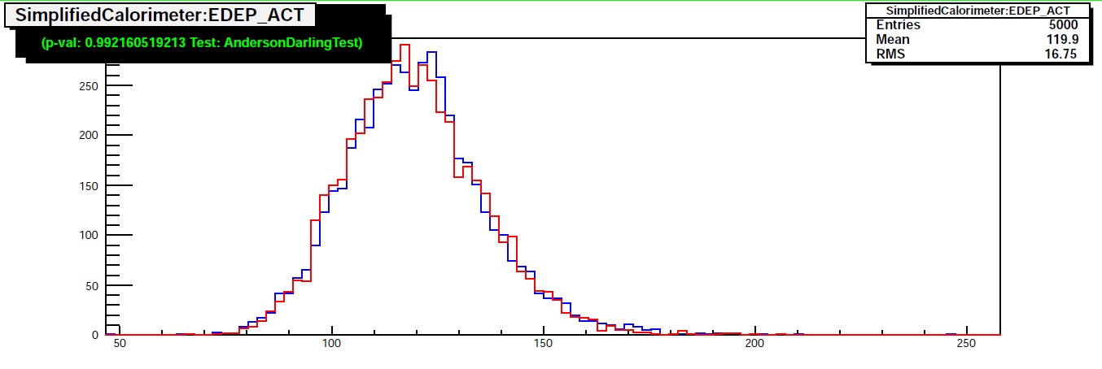
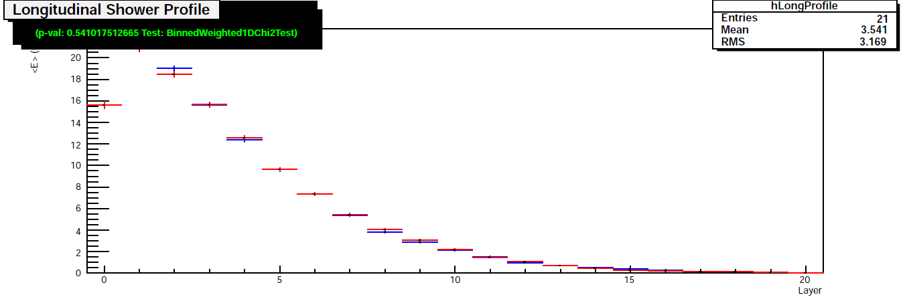
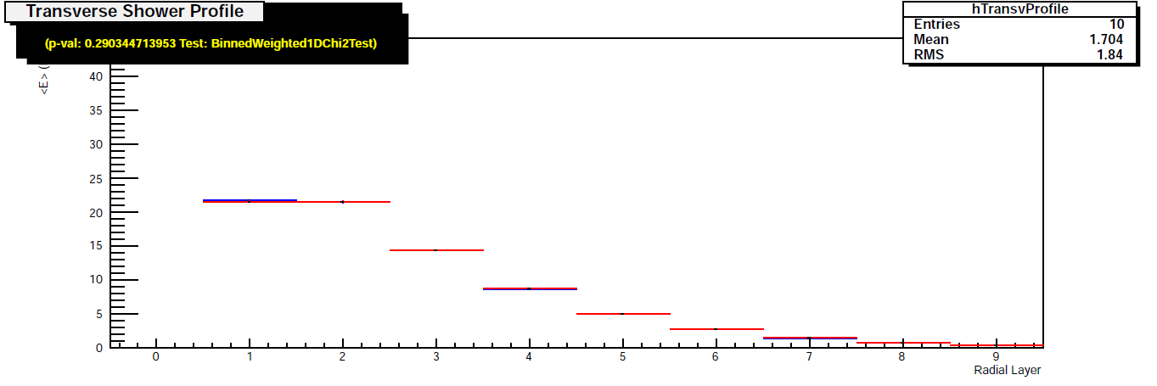
Multi-threading
Physics validation results…
20 Gev proton on W-Lar
  Full showers simulated
FTFP_BERT physics-list
Sequential: 5000 events
Multi-threaded: 20000 events
  4 threads; results for 1 thread shown
Aiming for perfect reproducibility vs. sequential

Slide 13
Multi-threading
Next to come … - 1
Review and further refinements to API
  Based on feedback from users and Beta testers
  Rationalisation and better modularisation of code for the initialisation of threads
  Further simplification for user-code migration
Further improve performance
  Identify and solve hotspots
  Investigate use of thread-private malloc (to remove hidden locks in new/delete)
  Improve event throughput (inter-algorithm parallelism)

Slide 14
Multi-threading
Next to come … - 2
Address and solve few limitations & problems affecting version 10.0-beta
  Improve testing coverage
Further investigations on task-based parallelism (TBB)
  TBB works already with Geant4-MT
  Provide one or two examples based on the new API
Study heterogeneous parallelism (MPI together with multi-threading)
  Use in hybrid systems (host + one [or more] MIC card)
  Adoption of check-pointing technique (DMTCP) to improve start-up time

Slide 15
Developments in release 10.0…
Highlights on kernel modules

Slide 16
Geometry
10.0-beta features
Replaced UI commands for geometry overlaps check
  Now based on built-in overlaps checking for random points generated on solids’ surfaces
  Now consistently working also for parameterised volumes
  Possibility to tune resolution for the test and set tolerances
  Possibility to define depth interval in geometrical tree
Introduction of gravity field and magnetic field gradient
Use of precise safety computation by default in navigation
Archived obsolete BREPs classes and module

Slide 17
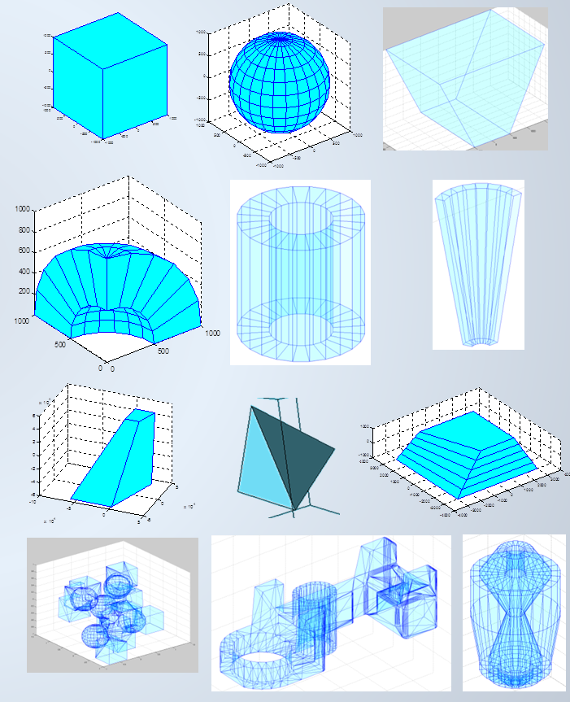
Geometry
Geometrical primitives
AIDA Unified Solids library integration
  As optional component, for replacing the original solids
Provides optimised implementation for a large number of geometrical primitives and constructs
  box, orb, sphere (+sphere section), tube (+cylindrical section), cone (+conical section), simple, generic & arbitrary trapezoid, tetrahedron, polycone, polyhedra, extruded solid, tessellated solid and new Multi-Union structure

Slide 18
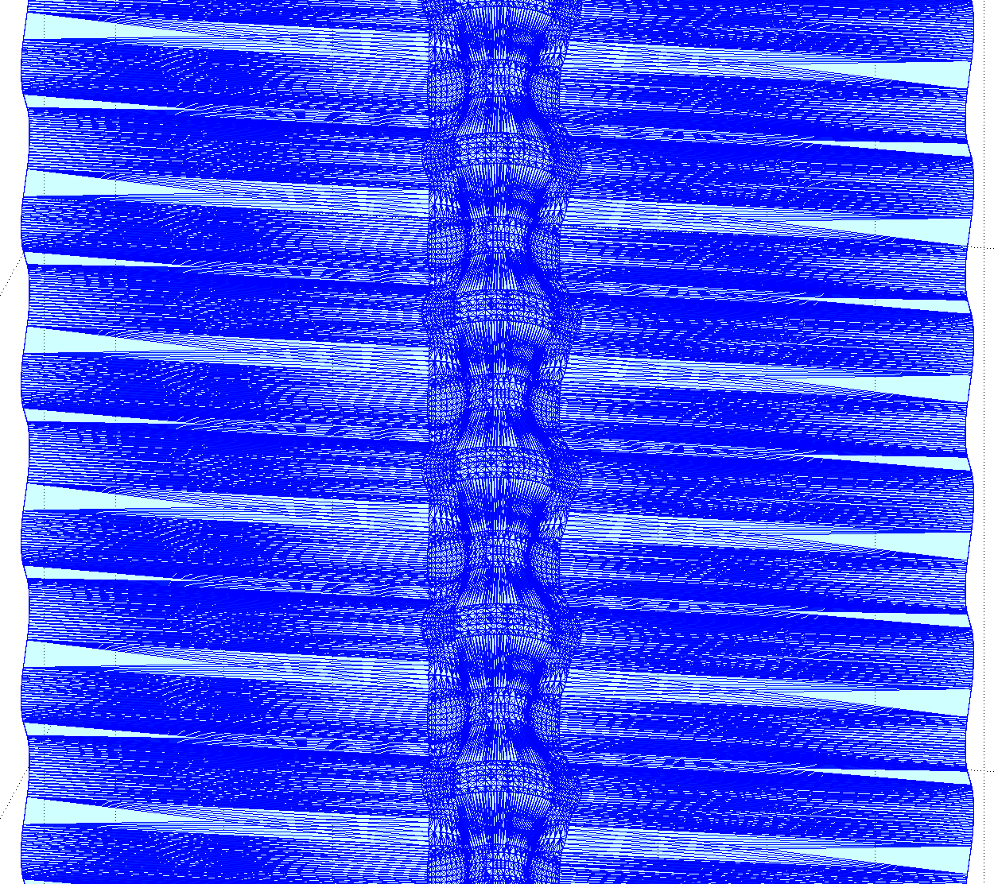
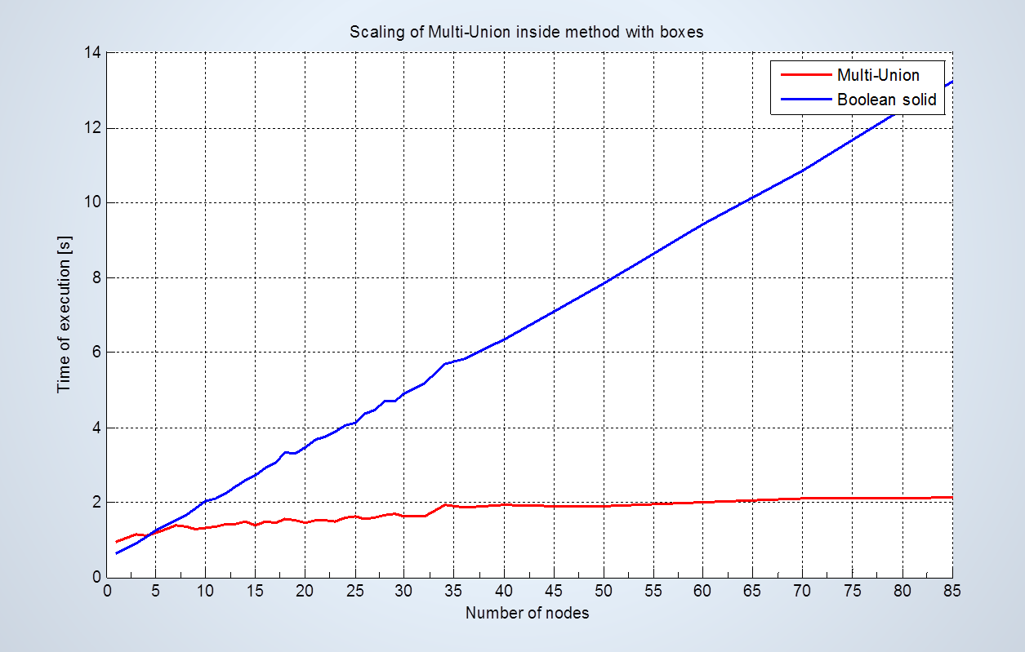
Geometry
Unified Solids Library performance – a couple of examples…
Significant speedup achieved for some shapes
  Tessellated shape: now making possible fine-grained tessellation
Method | Speedup
Inside | 2423x
DistanceToIn | 1334x
DistanceToOut | 1976x
Information | Value
Number of facets | 164.149
Number of voxels | 158.928
Memory saved compared with original Geant4 | 22% (51MB)
LHCb VELO RF-foil
  Multi-Union construct

Slide 19
More features …
Highlights
Adoption of fast mathematical functions for exp() and log()
  Extracted from VDT library (D.Piparo et al.) & adapted
  Expected CPU performance improvements
New framework for “generic” biasing for physics-based biasing
  Based on wrapper and helper classes
Automatically generating isotope vector with natural abundances (NIST materials)
Enhanced CMake build system
  Deprecated GNUMake based tools
Variables shadowing …
  Units & constants inclusion
Updated data sets
  Ability to treat compressed data for G4NDL library
Redesigned examples (basic & extended)
  Several examples migrated to support multi-threading

Slide 20
More features …
Visualization & Analysis
Improved Qt support & GUI
Ability to display in MT and sequential mode
GL with no graphics card
  To use for automated tests or launch GL graphics from batch
See also: “Geant4 application in a Web browser”, L.Garnier et al.
Redesigned interfaces for analysis/histogramming; multi-thread capable
  See poster: “Integration of g4tools in Geant4”, I.Hrivnacova et al.

Slide 21
Summary
Release 10.0 is going to introduce ‘optional’ event-level parallelism through use of independent working threads
  Excellent scalability vs. #threads up to O(100) threads with no performance penalty vs. sequential mode
  Physics validation tests done so far are positive
    Aiming to achieve exact event reproducibility vs. sequential mode
  Allowing for easy & smooth migration of users code
Lots of new features in all areas in view of the final release in December
  10.0-beta notes: http://geant4.cern.ch/support/Beta4.10.0-1.txt
  Work plan: http://geant4.cern.ch/support/planned_features.shtml

