Slide 1
perfSONAR-PS Update
Shawn McKee/University of Michigan
WLCG PS Deployment TF Co-chair
GDB Meeting
CERN
February 12th, 2014

Slide 2
Vision for perfSONAR-PS in WLCG
Goals:
  Find and isolate “network” problems; alerting in a timely way
  Characterize network use (base-lining)
  Provide a source of network metrics for higher level services
First step: get monitoring in place to create a baseline of the current situation between sites (see details later)
Next: continuing measurements to track the network, alerting on problems as they develop
Choice of a standard “tool/framework”: perfSONAR
  We wanted to benefit from the R&E community consensus
perfSONAR’s purpose is to aid in network diagnosis by allowing users to characterize and isolate problems. It provides measurements of network performance metrics over time as well as “on-demand” tests.

Slide 3
Plans for WLCG Operations
WLCG (Worldwide LHC Computing Grid) operations task-force for perfSONAR:
  Encouraging all sites to deploy and register two instances
  All sites to use the “mesh” configuration
  One set of test parameters to be used everywhere
  Detailed instructions at https://twiki.cern.ch/twiki/bin/view/LCG/PerfsonarDeployment
Simone presented at CHEP 2013 bringing perfSONAR-PS to an international audience
The current dashboard is a central source for network information. We also need to make sure we are gathering the right metrics and making them easily accessible
  We need to encourage discussion about the types of metrics our frameworks and applications would like concerning the network

Slide 4
Summary: Where Are We?
Newest release 3.3.2 of perfSONAR-PS released February 3, 2014. Improvements in security, minor bugfixes, improvements
Modular Dashboard project now “orphaned”. Code still in GitHub https://github.com/PerfModDash/PerfModDash
New prototype replacement of Modular Dashboard under evaluation (Uses OMD http://omdistro.org/start and MaDDash)
Tickets issued for perfSONAR-PS issues (see below)
About 85% of WLCG sites have perfSONAR-PS (at some level)
  15% are problematic and may need intervention from the experiments
Of the 85% with perfSONAR-PS we have some issues to resolve for a significant fraction:
  Firewalls are blocking services
  Sites are not using the mesh-configuration
  Versions are too old or not fully configured
  Nodes are down/crashed

Slide 5
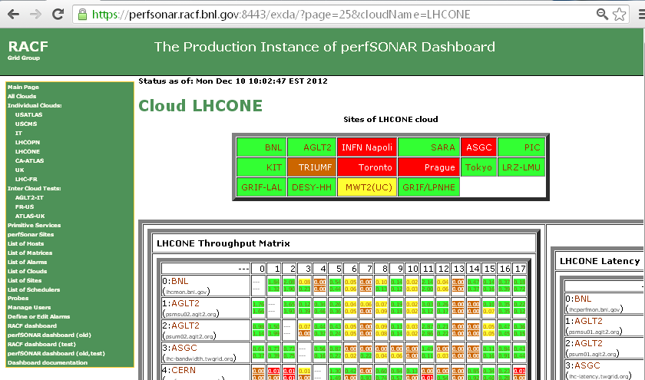
Old Modular Dashboard (Orphaned)
https://github.com/PerfModDash/PerfModDash

Slide 6
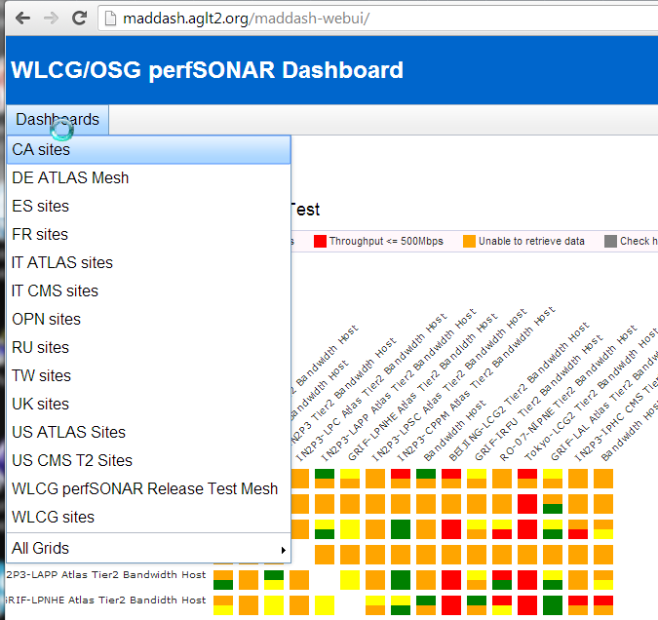
Modular Dashboard Replacement
MaDDash (Monitoring and Debugging Dashboard) is a perfSONAR-PS project developed and maintained by ESnet.
It is easy to install, provides drill-down capability and will be supported for the foreseeable future. (Install details at https://twiki.cern.ch/twiki/bin/view/LCG/MadDashWLCG )
It doesn’t provide any primitive service monitoring nor the ability to create/edit meshes via the GUI.

Slide 7
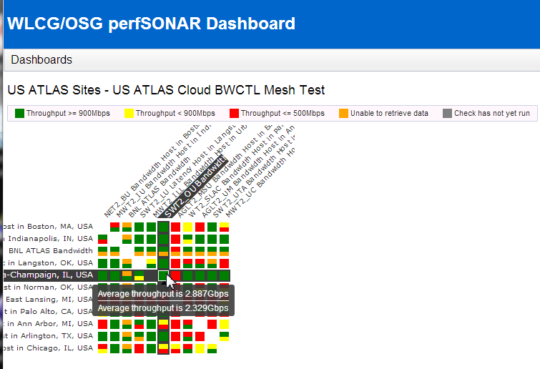
Example Throughput Mesh
Colors denote defined ranges of throughput (using default from ESnet for now)
Hovering provides results from both Measurement Archives(MAs) involved in the test
Clicking allows you to drill down

Slide 8
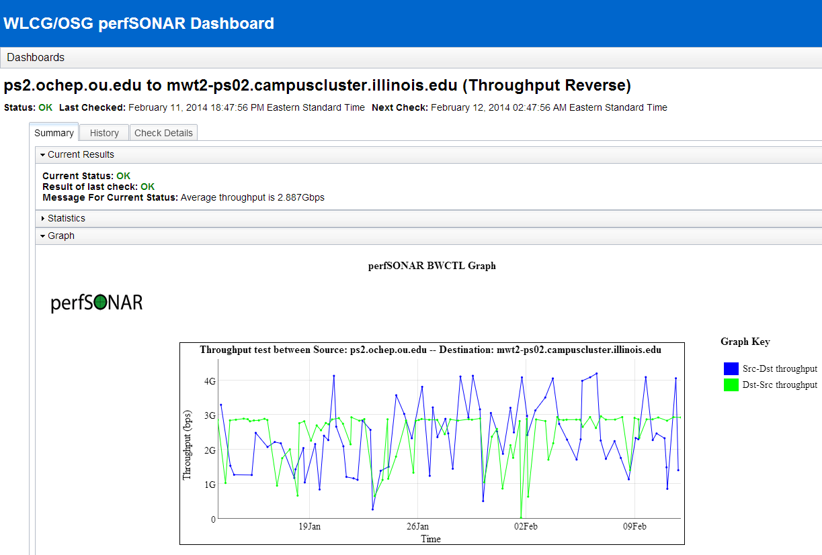
MaDDash Drill-down to Graphs

Slide 9
OMD Description and Capabilities
OMD (Open Monitoring Distribution) was selected to complement MaDDash and replicate the service testing component present in the Modular Dashboard.
  OMD bundles Nagios/Icinga/Shinken with various tools in a single RPM. Easy to deploy and configure; provides nice features.
For those familiar with Nagios there is a low barrier to use.
The Check_MK (rule-based configuration) is a very powerful component we can leverage.
Installation via yum by : ‘yum install omd-1.10’ (once repo setup)
Currently prototype for WLCG evaluation is running at: https://maddash.aglt2.org/WLCGperfSONAR/omd

Slide 10
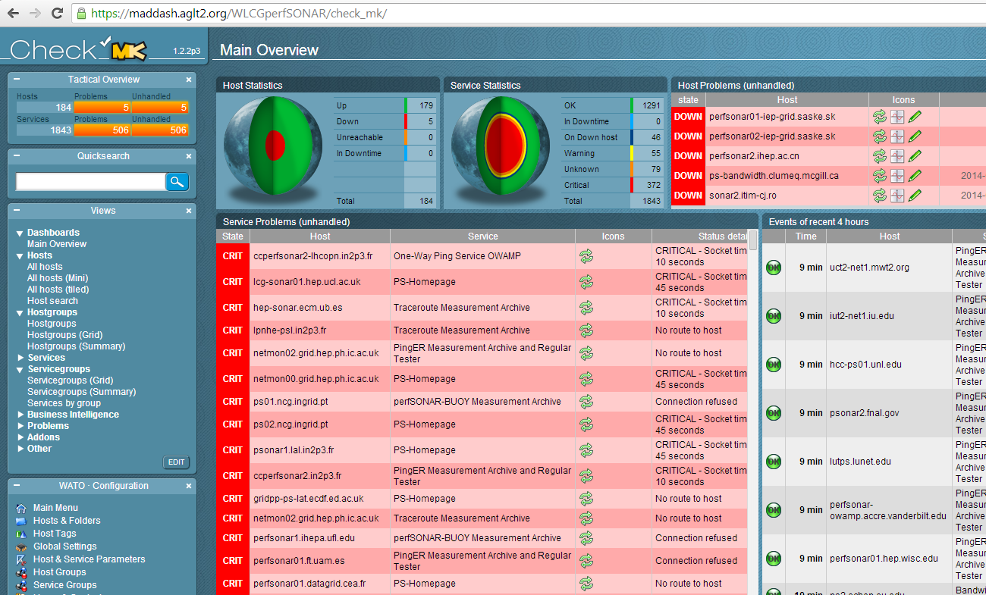
WLCG OMD Check_MK Mainpage

Slide 11
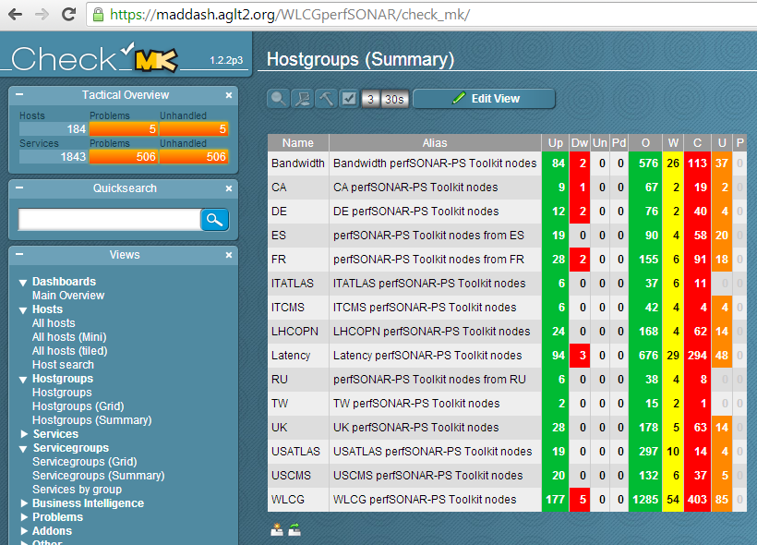
Grouping By Hosts
Check_MK rules were used to setup host groups
Easy to track Regional/VO cloud status this way
Can also organize by perfSONAR node type
The “Name” column is a link you can use to drill-down to host lists

Slide 12
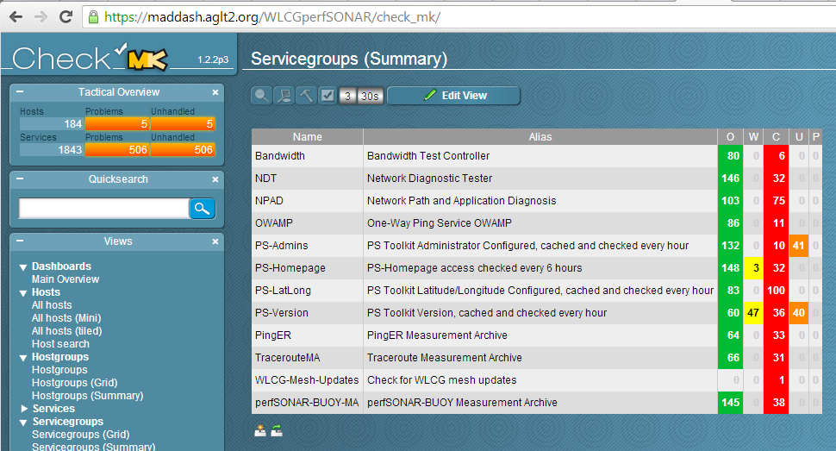
Grouping By Service
We can also group by service type, allowing us to quickly check service status by grouping. Name column is clickable. Note we check needed PS services but don’t yet have a good check of sites mesh-configuration (use dashboard for now)

Slide 13
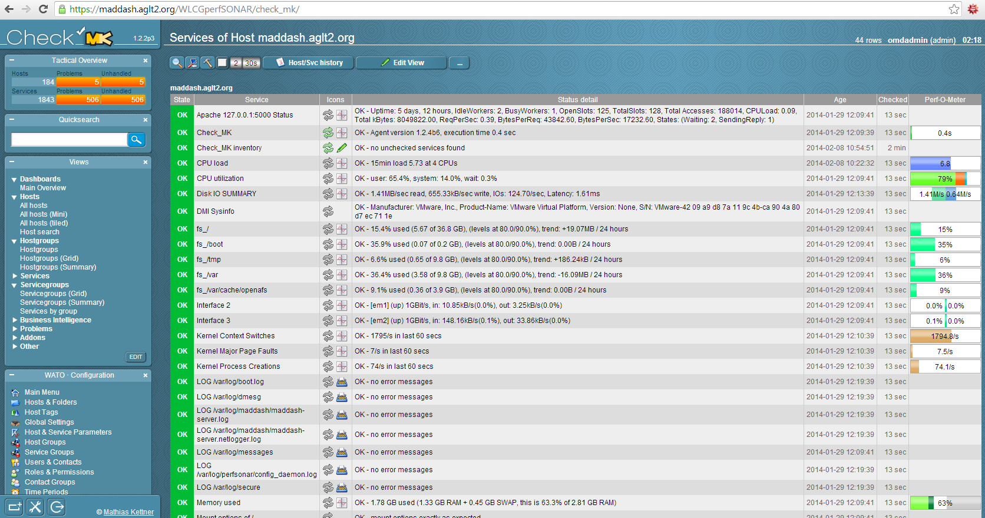
Example of Detailed Host Monitoring
Individual hosts can be monitored in detail by installing check_mk-agents
See https://twiki.cern.ch/twiki/bin/view/LCG/WLCGperfSONARMonitoring

Slide 14
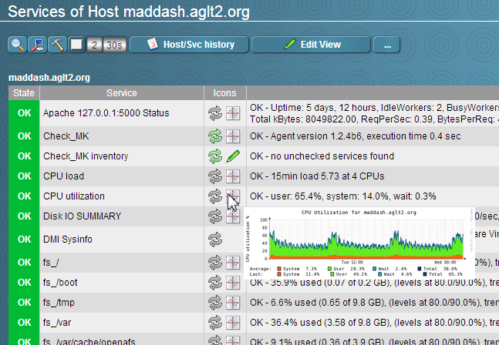
Feature: Graphs Automatically Created
Graphs are created automatically where checks provide performance data.
Hovering over the “graph” icon shows a thumbnail. Clicking takes you to a page will larger graphs sequenced by timescale (RRD).

Slide 15
Mesh-Config Comments and Status
One of the lessons learned from LHC use of perfSONAR-PS was that setting up and maintaining scheduled tests for the perfSONAR-PS toolkit instances was a challenge.
As sites changed, joined or left, every other site needed to update their configuration to change, add or remove tests.
  Labor intensive, slow to get all updates in place and gets worse as we increase the size of the deployments!
Aaron Brown/Internet2 provided a solution: the “mesh” configuration which allows sites to track a central configuration and update themselves when it changes:
http://www.usatlas.bnl.gov/twiki/bin/view/Projects/PerfSONAR_PS_Mesh
perfSONAR-PS 3.3.x has all functionality for the mesh built-in
We plan to automate the generation of the required WLCG meshes using OIM/GOCDB registration + some “metadata”

Slide 16
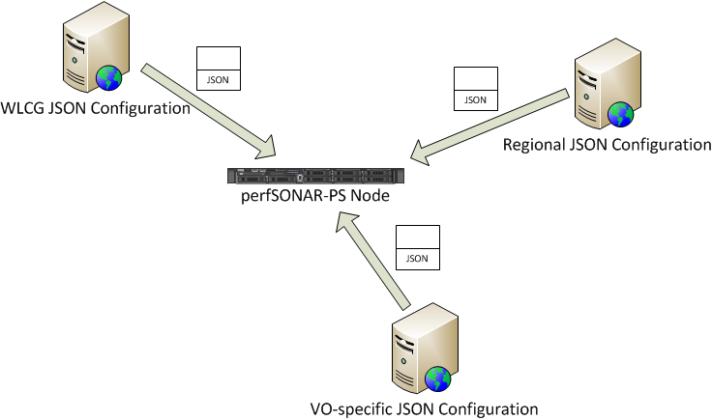
perfSONAR-PS Mesh Example
perfSONAR-PS toolkit instances can get their configuration information from a URL hosting an suitable JSON file
An agent_configuration file on the PS node defines one or more URLs
The perfSONAR-PS instances can participate in more than one configuration (WLCG, Tier-1 cloud, VO-based, etc.) + manually added tests.
The WLCG mesh configurations are centrally hosted at CERN and exposed through HTTP
https://grid-deployment.web.cern.ch/grid-deployment/wlcg-ops/perfsonar/conf/central/

Slide 17
WLCG Deployment Details
Sites are organized in regions
  Based on geographical locations and experiments computing models
  All sites are expected to deploy a bandwidth host and a latency host
Regular testing is setup using a set of centralized (“mesh”) configurations
  Bandwidth tests: 30 seconds tests
    every 6 hours intra-region, 12 hours for T2-T1 inter-region, 1 week elsewhere
  Latency tests; 10 Hz of packets to each WLCG site
  Traceroute tests between all WLCG sites each hour
  Ping(ER) tests between all site every 20 minutes

Slide 18
Using perfSONAR-PS Metrics
Throughput: Notice problems and debug network, also help differentiate server problems from path problems
Latency: Notice route changes, asymmetric routes
  Watch for excessive Packet Loss
On-demand tests and NPAD/NDT diagnostics via web
Optionally: Install additional perfSONAR nodes inside local network, and/or at periphery
  Characterize local performance and internal packet loss
  Separate WAN performance from internal performance
Daily Dashboard check of own site, and important peers

Slide 19
Debugging Network Problems
Using perfSONAR-PS we (the VOs) identify network problems by observing degradation in regular metrics for a particular “path”
  Packet-loss appearance in Latency tests
  Significant and persistent decrease in bandwidth
  Currently requires a “human” to trigger.
Next check for correlation with other metric changes between sites at either end and other sites (is the problem likely at one of the ends or in the middle?)
Correlate with paths and traceroute information. Something changed in the routing? Known issue in the path?
In general NOT as easy to do all this as we would like even with the current perfSONAR-PS toolkit

Slide 20
Network Monitoring Challenges
Getting hardware/software platform installed at all WLCG sites
Dashboard development: Need additional effort to produce something suitable quickly and ensure it meets our needs…
Managing site and test configurations
  Testing and improving “centralized” (VO-based?) configurations
  Verifying the right level of scheduled tests for a site, e.g., Tier-2s test to other same-cloud Tier-2s (and Tier-1)?
  Address 10G vs 1G tests that give misleading results
Improve path monitoring (traceroute) access within the tool
Alerting: A high-priority need but complicated:
  Alert who? Network issues could arise in any part of end-to-end path
  Alert when? Defining criteria for alert threshold. Primitive services are easier. Network test results more complicated to decide
Integration with VO infrastructures and applications (ongoing)

Slide 21
Improving perfSONAR-PS Deployments
Based upon the issues we have encountered we setup a Wiki to gather best practices and solutions to issues we have identified: http://www.usatlas.bnl.gov/twiki/bin/view/Projects/LHCperfSONAR
This page is shared with the perfSONAR-PS developers and we expect “fixes” will be incorporated into future releases (current list already addressed in v3.3.2)
Improving resiliency (set-it-and-forget-it) a high priority. Instances should self-maintain and the infrastructure should be able to alert when services fail (OMD tests)
Disentangling problems with the measurement infrastructure versus problems with the measurements…
PS Roadmap at https://code.google.com/p/perfsonar-ps/wiki/RoadMap

Slide 22
My perfSONAR-PS Wishlist
Continued reliability/resiliency improvements
  Must be “set-it-and-forget-it” to meet the needs of the bulk of our users
Topology/path diagnosis support
  Traceroute sensitive to ECMP (“Paris” traceroute)
  Tools/gui to:
    visualize route
    show router port usage
    show drops/errors
    Identify perfSONAR-PS instances along the path
  Path comparison/correlation tools using metrics coupled + traceroutes (identify “bad” paths via multiple measurements)
Alerting and alarming
  Support for configuring notification to alert users to network problems
    NAGIOS support exists but not well matched to multidomain issues
  Alarms targeted at most likely problem domain
Handle NIC speed mismatches
  10GE testing to 1GE “overruns” and provides misleading information
Support for additional tests (Iperf variants, new tools, etc)

Slide 23
Future Use of Network Metrics
Once we have a source of network metrics being acquired we need to understand how best to incorporate those metrics into our facility operations.
Some possibilities:
  Characterizing paths with “costs” to better optimize decisions in workflow and data management (underway in ANSE)
  Noting when paths change and providing appropriate notification
  Optimizing data-access or data-distribution based upon a better understanding of the network between sites
  Identifying structural bottlenecks in need of remediation
  Aiding network problem diagnosis and speeding repairs
  In general, incorporating knowledge of the network into our processes
We will require testing and iteration to better understand when and where the network metrics are useful.

Slide 24
WLCG perfSONAR Considerations
Getting a WLCG network service with suitable data-store in production in OSG is a high priority
  OSG has offered to host a “Network Service” for WLCG
  Need to exercise the API and start testing use of metrics
We will need to plan for IPv6 monitoring. As sites move to using IPv6 we have to be ready to test the potentially different paths and performance
  Duncan Rand has done some nice work in this direction already.
The test definitions and resulting metrics will need to be evaluated for their effectiveness
  Are tests providing useful information?
  Are the test parameters optimized for our use-cases?
  What are the appropriate OK, WARN and CRIT levels?
  Do we need to add new tests/metrics?

Slide 25
Closing Remarks
perfSONAR dashboard is critical for “visibility” into networks. We can’t manage/fix/respond-to problems if we can’t “see” them.
Our assumption is that perfSONAR (and the perfSONAR-PS toolkit) is the de-facto standard way to get network metrics and will be supported long-term
  Especially critical that R&E networks agree on its use and continue to improve and develop the reference implementation. This is the case
Having perfSONAR-PS fully deployed should give us some interesting options for better management and use of our networks
Need to get some “network service” operating in OSG for WLCG.

Slide 26
Discussion/Questions
Questions or Comments?

Slide 27
Relevant URLs
WLCG perfSONAR-PS deployment URL: http://twiki.cern.ch/twiki/bin/view/LCG/PerfsonarDeployment
perfSONAR-PS site http://psps.perfsonar.net/
perfSONAR-PS Install/configuration guide: http://code.google.com/p/perfsonar-ps/wiki/pSPerformanceToolkit33
MaDDash Dashboard: http://maddash.aglt2.org/maddash-webui
Tools, tips and maintenance: http://www.usatlas.bnl.gov/twiki/bin/view/Projects/LHCperfSONAR
OSG networking pages https://www.opensciencegrid.org/bin/view/Documentation/NetworkingInOSG
OMD prototype for WLCG perfSONAR-PS Monitoring: https://maddash.aglt2.org/WLCGperfSONAR/

