Slide 1
Underground Visits
September 11th, 2013

Slide 2
General Information

Slide 3
Planning
Being finalized
Marie will contact you in case
of information need

Slide 4
Information / Communication
Flyer
  ~82000 copies
    Swiss towns
    Pays de Gex
    Haute Savoie
  ~30000 copies
    Meyrin Border Station

Slide 5
How to access sites?
Several roads will be closed
  Route de Meyrin
  Route de l‘Europe
  D35
Access only with sticker
  Please let us have asap the
  needs for CERN cars.
  Volunteers will get the
  sticker with their package.

Slide 6
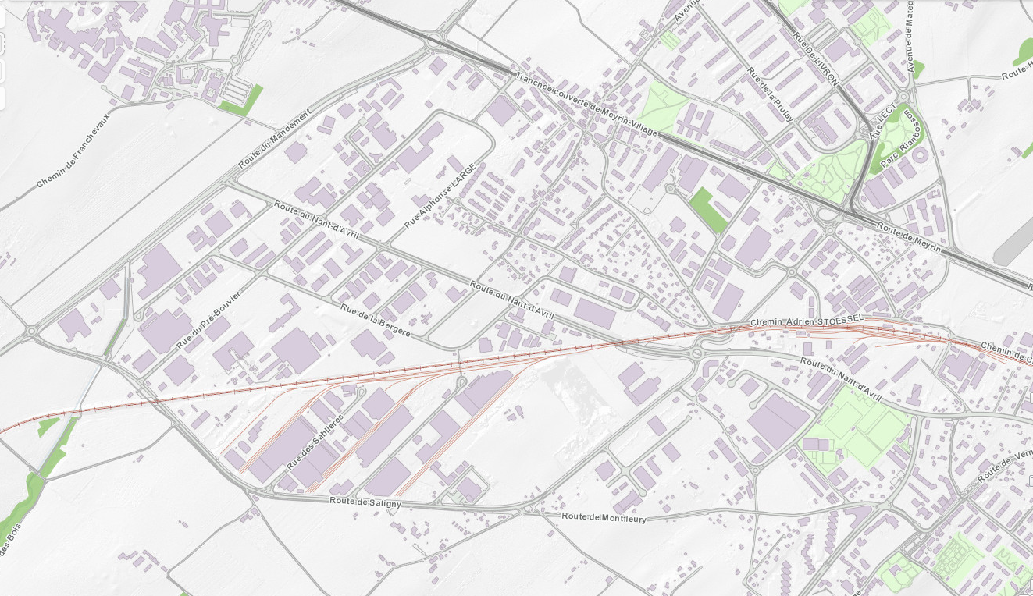




St.-Genis
Thoiry

Slide 7
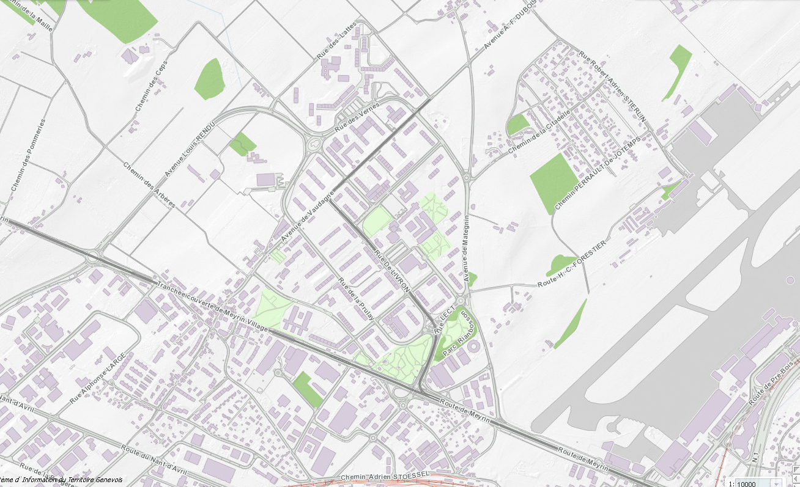
St.-Genis
Thoiry
St.-Genis
Thoiry

Slide 8
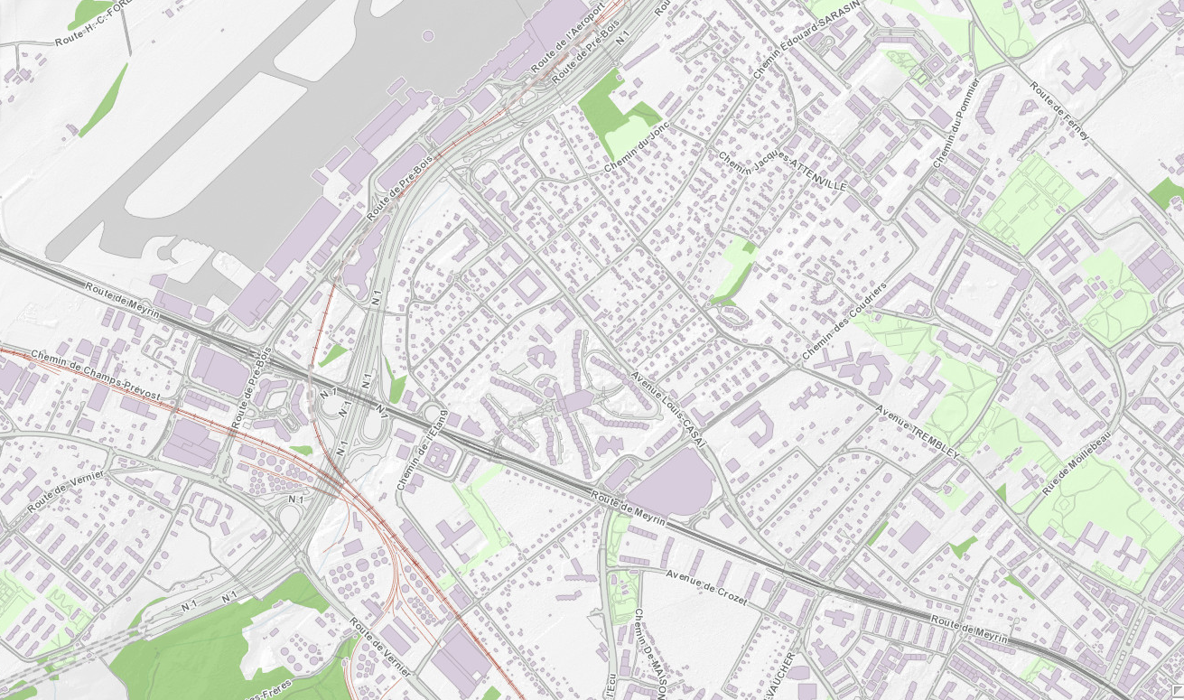
St.-Genis
Thoiry
Suivre Ferney
St.-Genis
Thoiry

Slide 10
es

Slide 11
Budget

