Slide 1
HTCondor scheduling policy
All kinds of mechanisms

Slide 2
Overview of Condor Architecture
Central
Manager
Schedd A
Schedd B
Flocking
Greg Job1
Greg Job2
Greg Job3
Ann Job1
Ann Job2
Ann Job3
Greg Job4
Greg Job5
Greg Job6
Ann Job7
Ann Job8
Joe Job1
Joe Job2
Joe Job3
Central
Manager
Usage
History
worker
worker
worker
worker
worker
worker

Slide 3
Schedd Policy: Job Priority
Set in submit file with
JobPriority = 7
… or dynamically with condor_prio cmd
Users can set priority of their own jobs
Integers, larger numbers are better priority
Only impacts order between jobs for a single user on a single schedd
A tool for users to sort their own jobs

Slide 4
Schedd Policy: Job Rank
Set with
RANK = Memory
In condor_submit file
Not as powerful as you may think:
  Remember steady state condition

Slide 5
Concurrency Limits
Another Central manager
In central manager config
FOO_LIMIT = 10
In submit file
concurrency_limits = foo

Slide 6
Rest of this talk:
Provisioning, or Scheduling
schedd sends all idle jobs to the negotiator
Negotiator picks machines (idle or busy) to match to these idle jobs
How does it pick?

Slide 7
Negotiator metric: User Priority
Negotiator computes, stores the user prio
View with condor_userprio tool
Inversely related to machines allocated (lower number is better priority)
  A user with priority of 10 will be able to claim twice as many machines as a user with priority 20

Slide 8
What’s a user?
Bob in schedd1 same as Bob in schedd2?
If have same UID_DOMAIN, the are.
Prevents cheating by adding shedds
We’ll talk later about other user definitions.
Map files can define the local user name

Slide 9
User Priority (2)
(Effective) User Priority is determined by multiplying two components
Real Priority * Priority Factor

Slide 10
Real Priority
Based on actual usage
Starts at 0.5
Approaches actual number of machines used over time
  Configuration setting PRIORITY_HALFLIFE
  If PRIORITY_HALFLIFE = +Inf, no history
  Default one day (in seconds)
Asymptotically grows/shrinks to current usage

Slide 11
Priority Factor
Assigned by administrator
  Set/viewed with condor_userprio
  Persistently stored in CM
Defaults to 100 (DEFAULT_PRIO_FACTOR)
  Used to default to 1
Allows admins to give prio to sets of users, while still having fair share within a group
“Nice user”s have Prio Factors of 1,000,000

Slide 12
condor_userprio
Command usage:
condor_userprio –most
Effective Priority
User Name Priority Factor In Use (wghted-hrs) Last Usage
---------------------------------------------- --------- ------ ----------- ----------
lmichael@submit-3.chtc.wisc.edu 5.00 10.00 0 16.37 0+23:46
blin@osghost.chtc.wisc.edu 7.71 10.00 0 5412.38 0+01:05
osgtest@osghost.chtc.wisc.edu 90.57 10.00 47 45505.99 <now>
cxiong36@submit-3.chtc.wisc.edu 500.00 1000.00 0 0.29 0+00:09
ojalvo@hep.wisc.edu 500.00 1000.00 0 398148.56 0+05:37
wjiang4@submit-3.chtc.wisc.edu 500.00 1000.00 0 0.22 0+21:25
cxiong36@submit.chtc.wisc.edu 500.00 1000.00 0 63.38 0+21:42

Slide 13
A note about Preemption
Fundamental tension between
  Throughput vs. Fairness
Preemption is required to have fairness
Need to think hard about runtimes, fairness and preemption
Negotiator implementation preemption
(Workers implement eviction: different)

Slide 14
Negotiation Cycle
Gets all the slot ads
Updates user prio info for all users
Based on user prio, computes submitter limit for each user
Foreach user, finds the schedd, gets a job
  Finds all matching machines for job
  Sorts the jobs
  Gives the job the best sorted machine

Slide 15
Sorting slots: sort levels
NEGOTIATOR_PRE_JOB_RANK =
RemoteOwner =?= UNDEFINED
JOB_RANK = mips
NEGOTIATOR_POST_JOB_RANK =
(RemoteOwner =?= UNDEFINED) * (KFlops - SlotID)

Slide 16
If Matched machine claimed, extra checks required
PREEMPTION_REQUIREMENTS and PREEMPTION_RANK
Evaluated when condor_negotiator considers replacing a lower priority job with a higher priority job
Completely unrelated to the PREEMPT expression (which should be called evict)
16

Slide 17
PREEMPTION_REQUIREMENTS
MY = busy machine
TARGET = candidate job
If false will not preempt machine
  Typically used to avoid pool thrashing
  Typically use:
    RemoteUserPrio – Priority of user of currently running job (higher is worse)
    SubmittorPrio – Priority of user of higher priority idle job (higher is worse)
PREEMPTION_REQUIREMENTS=FALSE

Slide 18
PREEMPTION_REQUIREMENTS
Only replace jobs running for at least one hour and 20% lower priority
StateTimer = \
(CurrentTime – EnteredCurrentState)
HOUR = (60*60)
PREEMPTION_REQUIREMENTS = \
$(StateTimer) > (1 * $(HOUR)) \
&& RemoteUserPrio > SubmittorPrio * 1.2
NOTE: classad debug() function v. handy

Slide 19
PREEMPTION_RANK
Of all claimed machines where PREEMPTION_REQUIREMENTS is true, picks which one machine to reclaim
Strongly prefer preempting jobs with a large (bad) priority and a small image size
PREEMPTION_RANK = \
(RemoteUserPrio * 1000000)\
- ImageSize

Slide 20
MaxJobRetirementTime
Can be used to guarantee minimum time
E.g. if claimed, give an hour runtime, no matter what:
MaxJobRetirementTime = 3600
Can also be an expression

Slide 21
Partitionable slots
What is the “cost” of a match?
  SLOT_WEIGHT (cpus)
What is the cost of an unclaimed pslot?
  The whole rest of the machine
  Leads to quantization problems
By default, schedd splits slots
“Consumption Policies”
  Still some rough edges

Slide 22
Accounting Groups (2 kinds)
Manage priorities across groups of users and jobs
Can guarantee maximum numbers of computers for groups (quotas)
Supports hierarchies
Anyone can join any group

Slide 23
Accounting Groups as Alias
In submit file
  Accounting_Group = “group1”
Treats all users as the same for priority
Accounting groups not pre-defined
No verification – condor trusts the job
condor_userprio replaces user with group

Slide 24
Prio factors with groups
condor_userprio –setfactor 10 group1.wisc.edu
Condor_userprio –setfactor 20 group2.wisc.edu
Note that you must get UID_DOMAIN correct
Gives group1 members 2x resources as group2

Slide 25
Accounting Groups w/ Quota
Must be predefined in cm’s config file:
GROUP_NAMES = a, b, c
GROUP_QUOTA_a = 10
GROUP_QUOTA_b = 20
And in submit file:
Accounting_Group = a
Accounting_User = gthain

Slide 26
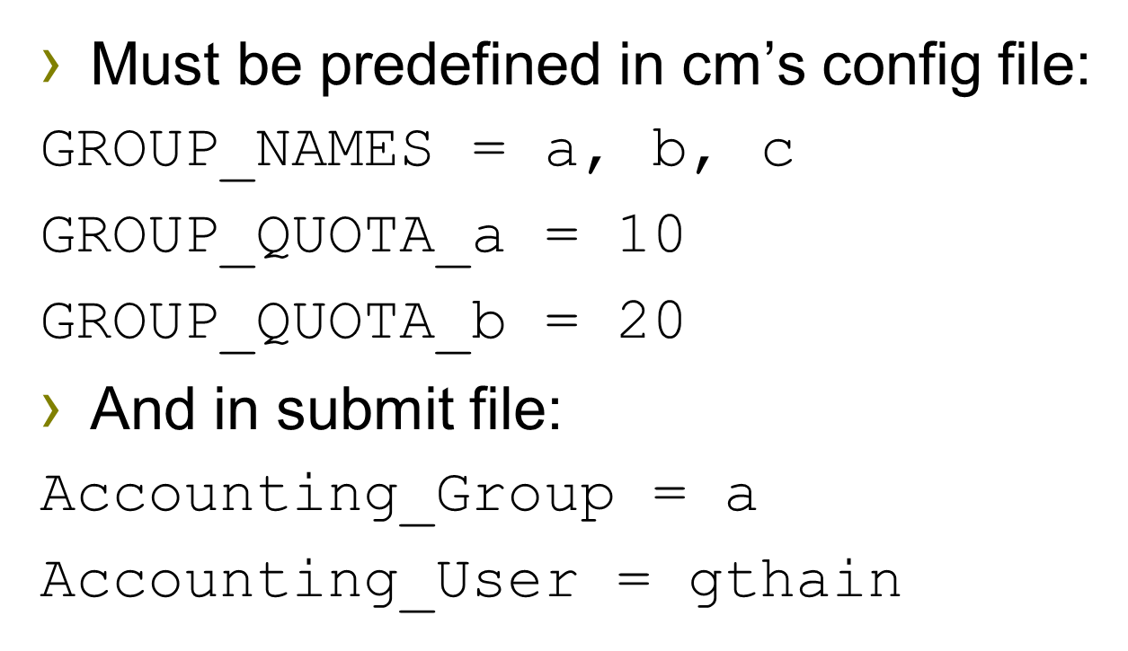
Strict quotas then enforce
“a” limited to 10
“b” to 20,
Even if idle machines
What is the unit?
  Slot weight.
With fair share of uses within group

Slide 27
GROUP_AUTOREGROUP
Allows groups to go over quota if idle machines
“Last chance” round, with every submitter for themselves.

Slide 28
Hierarchical Group Quotas
700
200
physics
CompSci
100
500+100
100
100
string theory
particle physics
architecture
DB
200
200
100
CMS
ATLAS
CDF

Slide 29
Hierarchical Group Quotas
700
GROUP_QUOTA_physics = 700
GROUP_QUOTA_physics.string_theory = 100
GROUP_QUOTA_physics.particle_physics = 600
GROUP_QUOTA_physics.particle_physics.CMS = 200
GROUP_QUOTA_physics.particle_physics.ATLAS = 200
GROUP_QUOTA_physics.particle_physics.CDF = 100
physics
100
500+100
string theory
particle physics
group.sub-group.sub-sub-group…
200
200
100
CMS
ATLAS
CDF

Slide 30
Hierarchical Group Quotas
700
Groups configured to accept surplus will share it in proportion to their quota.
physics
100
500+100
string theory
particle physics
Here, unused particle physics surplus is shared by ATLAS and CDF.
200
200
100
CMS
ATLAS
CDF
2/3 surplus
1/3 surplus
GROUP_ACCEPT_SURPLUS_physics.particle_physics.ATLAS = true
GROUP_ACCEPT_SURPLUS_physics.particle_physics.CDF = true

Slide 31
Hierarchical Group Quotas
700
Job submitters may belong to a parent group in the hierarchy.
physics
100
500+100
string theory
particle physics
1/4 surplus
Here, general particle physics submitters share surplus with ATLAS and CDF.
200
200
100
CMS
ATLAS
CDF
2/4 surplus
1/4 surplus

Slide 32
Hierarchical Group Quotas
700
Quotas may be specified as decimal fractions.
physics
100
600
string theory
particle physics
Here, sub-groups sum to 1.0, so general particle physics submitters get nothing.
0.40
0.40
0.20
CMS
ATLAS
CDF
0.40*600=240
0.40*600=240
0.20*600=120
GROUP_QUOTA_DYNAMIC_physics.particle_physics.CMS=0.4

Slide 33
Hierarchical Group Quotas
700
Quotas may be specified as decimal fractions.
physics
100
600
600-180-180-90=150
string theory
particle physics
Here, sub-groups sum to 0.75, so general particle physics submitters get 0.25 of 600.
0.30
0.30
0.15
CMS
ATLAS
CDF
0.30*600=180
0.30*600=180
0.15*600=90

Slide 34
Hierarchical Group Quotas
700
Static quotas may be combined with dynamic quotas.
physics
100
600
600-200-200-100=100
string theory
particle physics
Here, ATLAS and CDF have dynamic quotas that apply to what is left over after the CMS static quota is subtracted.
200
0.5
0.25
CMS
ATLAS
CDF
0.5*(600-200)=200
0.25*(600-200)=100

Slide 35
Preemption with HQG
By default, won’t preempt to make quota
But, “there’s a knob for that”
PREEMPTION_REQUIREMENTS = (SubmitterGroupResourcesInUse < SubmitterGroupQuota) && (RemoteGroupResourcesInUse > RemoteGroupQuota) && ( RemoteGroup =!= SubmitterGroup

Slide 36
Group_accept_surplus
Group_accept_surplus = true
Group_accept_surplus_a = true
This is what creates hierarchy
  But only for quotas

Slide 37
Gotchas with quotas
Quotas don’t know about matching
Assuming everything matches everything
Surprises with partitionable slots
Preempting multiple slots a problem
May want to think about draining instead.

Slide 38
Summary
Many ways to schedule

