Slide 1
Two Beam Module
Thermo-mechanical tests
Elena Daskalaki
Alex Vamvakas
Athanasios Zelios
30.07.2014

Slide 2
Tasks summary
Hardware
Add and re-organize temperature sensors
Add, connect and calibrate flow meters
Add real-time power sensors
Software
Update/modify LabVIEW
Tests
Water only tests
PID tuning
Transients
Preparation for next module

Slide 3
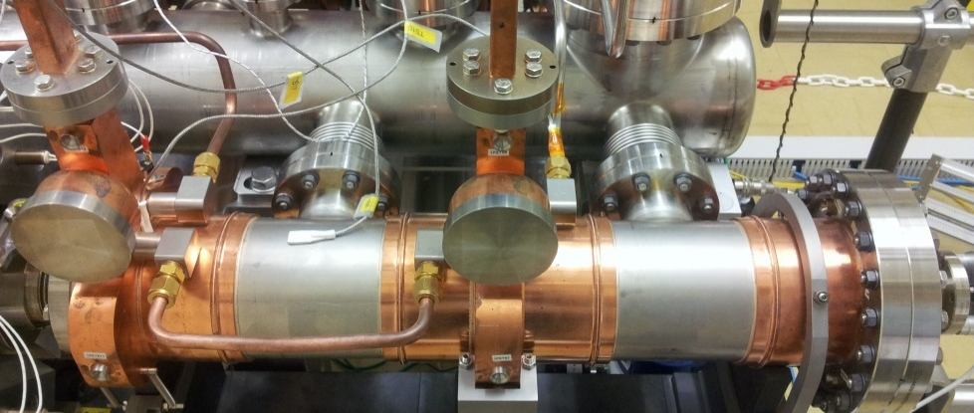

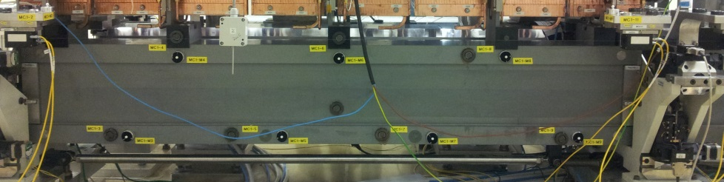
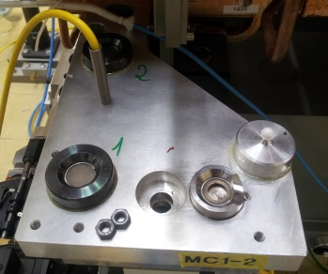
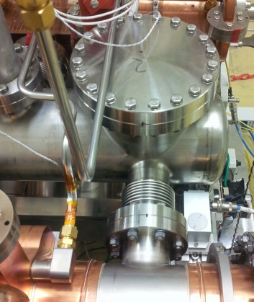
Hardware
Temperature sensors
PETS
  Reorganize sensors (put all on copper)
  Put sensor inside each PETS (total: 2)
Girders
  Add three sensors at each girder (total: 6)
Cradles
  Add sensor on cradles close to the girder displacement sensors (total: 4)
Calibration of new RTD sensors using high precision calibration bath
Vacuum tank
  Add two thermocouples inside (total: 2)

Slide 4
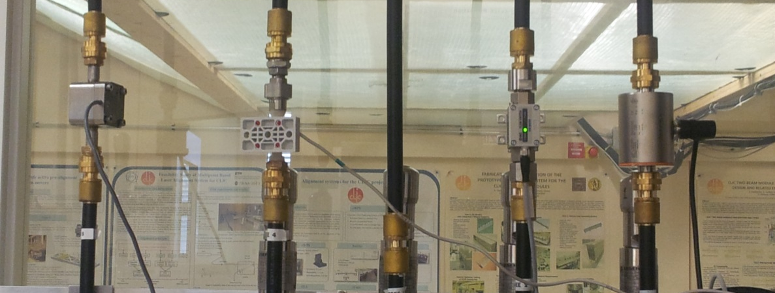
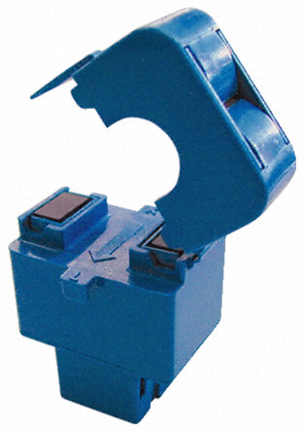
Hardware
Flow meters
Add one flow meter at each cooling channel
Test flow meters based on the highly accurate Siemens MASS 6000
Real-time power measurement
Current sensor to measure the current of the AS and PETS heaters
Calculation of heaters’ power in real-time

Slide 5
Software
LabVIEW
Update software to increase usability
Add new components (sensors, flow meters, power measurement)
Alarms
Real-time statistics (min, max, steady-state)
Automation of inputs (heaters’ power, water flow)
Interface to host two or more modules

Slide 6
Tests
Water tests
Test all flow meters range and accuracy
Choose the best flow meter for SAS and PETS
Thermal/thermo-mechanical tests
Finalize PID for the control of flow rate
Verify real-time power measurement
Study the module’s transients

Slide 7
Transients
To find the time constant of each component as a function of:
Power applied
Water flow
Component mass
Ambient conditions
Aim

Slide 8
Transients
Test the module under all possible combinations of various modes for the
i) thermal power, ii) water flow and iii) ambient temperature
Mode | Component | Power (W) | Water flow (m³/h) | Ambient temperature (ºC)
1 | SAS | 410 | 0.04 | 20
 | PETS | 220 | 0.01
2 | SAS | 820 | 0.068 | 30
 | PETS | 440 | 0.03
3 | SAS | 1230 | 0.09 | 40
 | PETS | 660 | 0.05

Slide 9
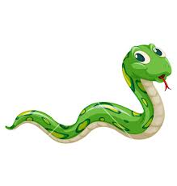
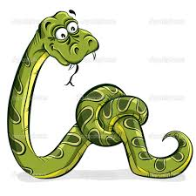
Transients
Start
P1
F1
T1
P2
F1
T1
P1
F1
T2
P1
F2
T1
P3
F1
T1
P2
F1
T2
P1
F1
T3
P2
F2
T1
P1
F2
T2
P3
F1
T2
P2
F1
T3
P1
F3
T1
P3
F2
T1
P2
F2
T2
P1
F2
T3
P3
F1
T3
P2
F3
T1
P1
F3
T2
P3
F2
T2
P2
F2
T3
P3
F3
T1
P2
F3
T2
P1
F3
T3
P3
F2
T3
P3
F3
T2
P2
F3
T3
P3
F3
T3
End

Slide 10
Planning
What | When
Finalize HW/SW | 08.08.2014
Finalize PID | 12.08.2014
Start transients tests | 01.09.2014

Slide 11
Questions
DT=10 ºC: Which temperatures does it refer to?
What is the target DT of components? Effect on transients
Water/components temperature variation? 0.1 ºC? (ref. EUROTeV-Report-2008-081)
  PID tuning depends on this condition
  Sensors’ accuracy currently 0.1 ºC
  Sensors’ position?
Correlation among lab module, CLEX, CLIC…
Demineralized water

