Slide 1
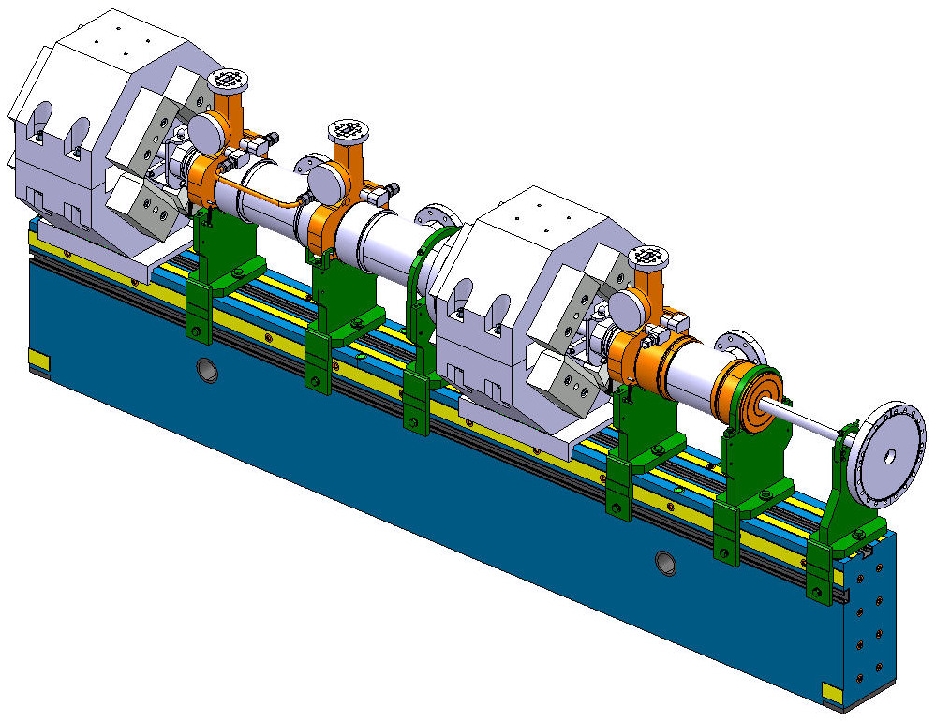
Adjustable V-shaped support
for TM1 Drive Beam girder
Design review
V. Soldatov, BE-RF-MK
03.12.2014

Slide 2
General requirements
TM1 layout
PETS compact coupler
Drift tube
DB Quad
DB Quad
PETS
Short PETS
EPUCRET Girder
Totally 5 types of clamping:
- 2 different fixed clamps;
- 3 different sliding clamps.
Sliding
support
Fixed
support
V. Soldatov, BE-RF-MK

Slide 3
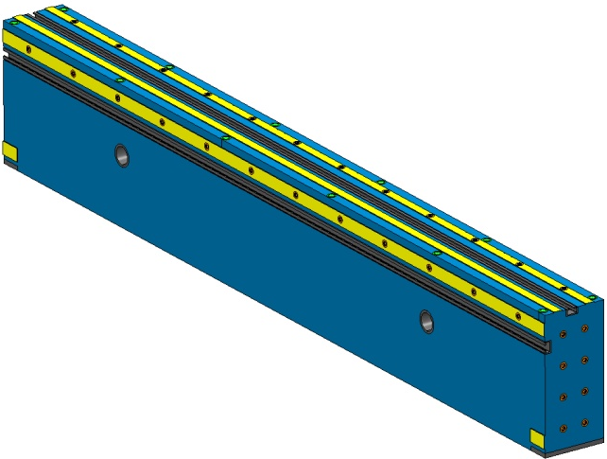
General requirements. Tolerances
70
DB axis
0.01 A B
PETS
210
Ø 0.01
Tolerances on the girder
Ref. surface A
Perpendicularity of surfaces A and B (see picture on the left):
0.02 mm
Flatness of the contact surfaces:
0.01 mm
Roughness of the contact surfaces:
0.2 µm
EPUCRET Girder
Ref. surface B
V. Soldatov, BE-RF-MK

Slide 4
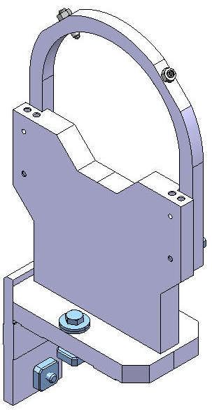
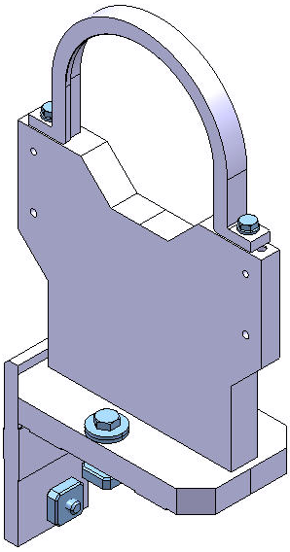
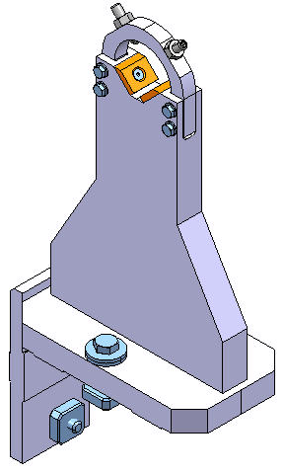
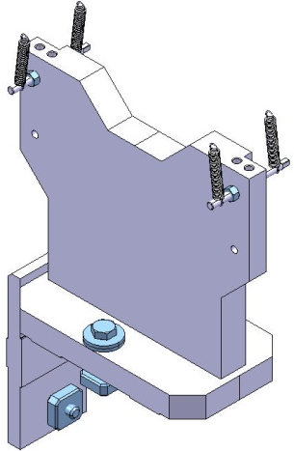
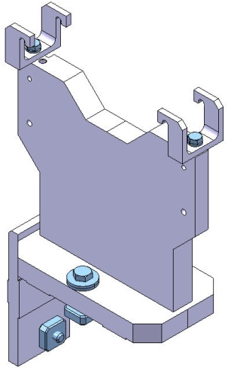
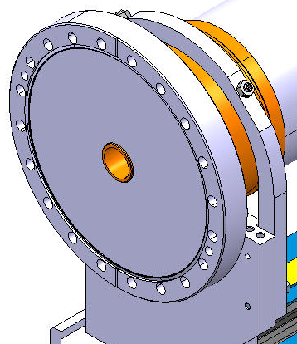
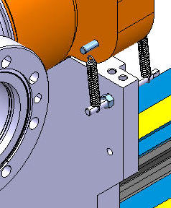
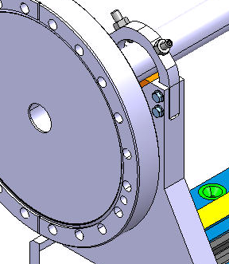
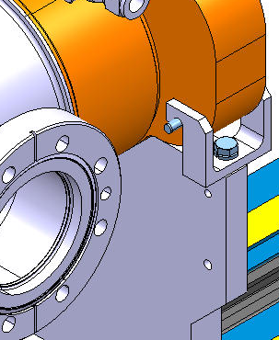
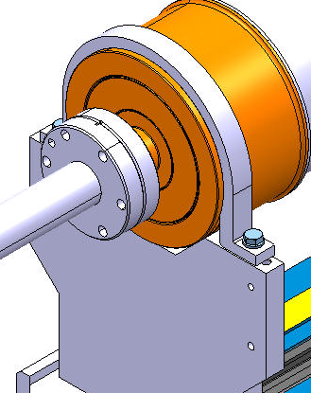
Current solution (non-adjustable)
Clamping. Sliding type.
Clamping. Fixed type.
Type A. Strap with ball-head screws
Type B. Spring
Type C. Strap with ball-head screws
Type D. Bracket
Type E. Strap
V. Soldatov, BE-RF-MK

Slide 5
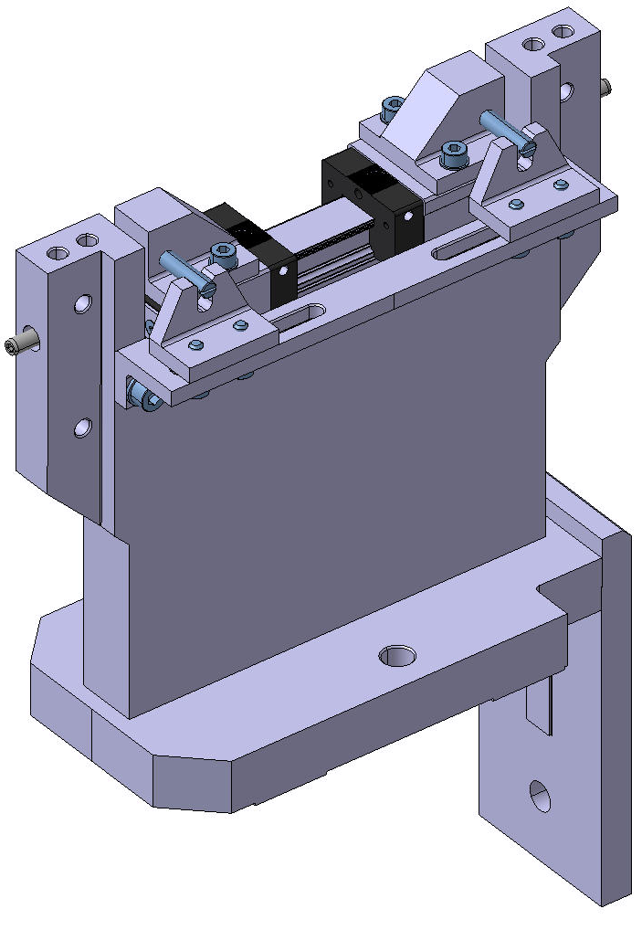
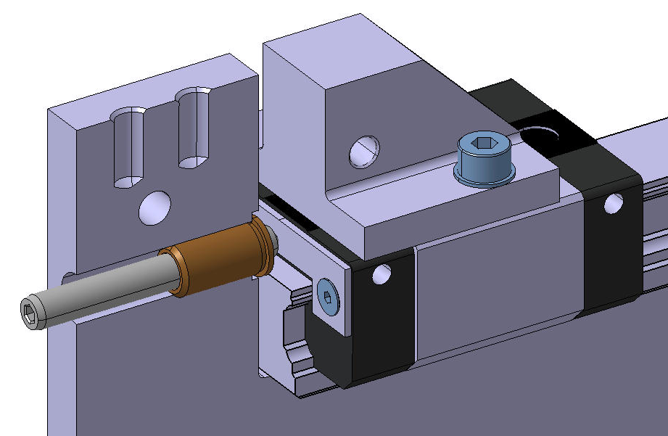
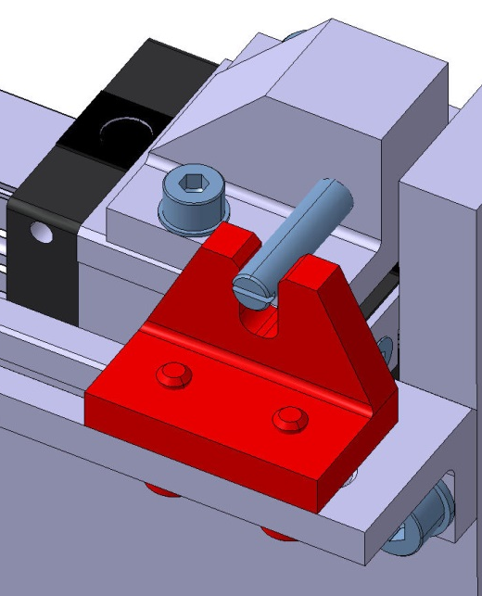
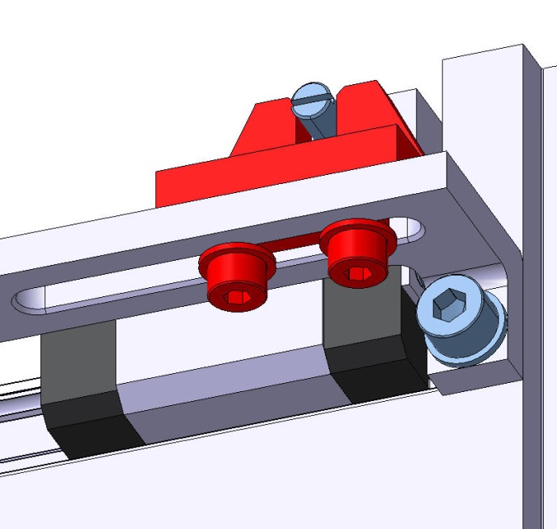
Adjustable solutions #1 “Rail”
Adjustment screw
45˚ wedge
Adjustment
Rail
Runner
Pin
Blocking
Jaw
V. Soldatov, BE-RF-MK

Slide 6
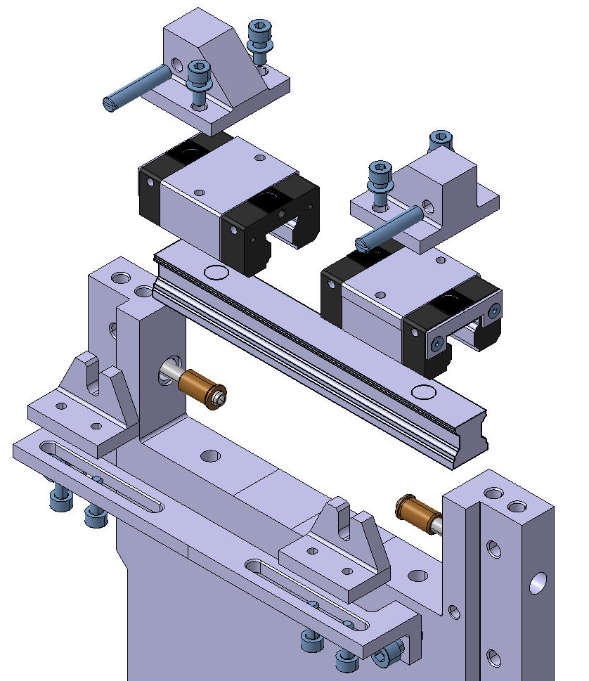
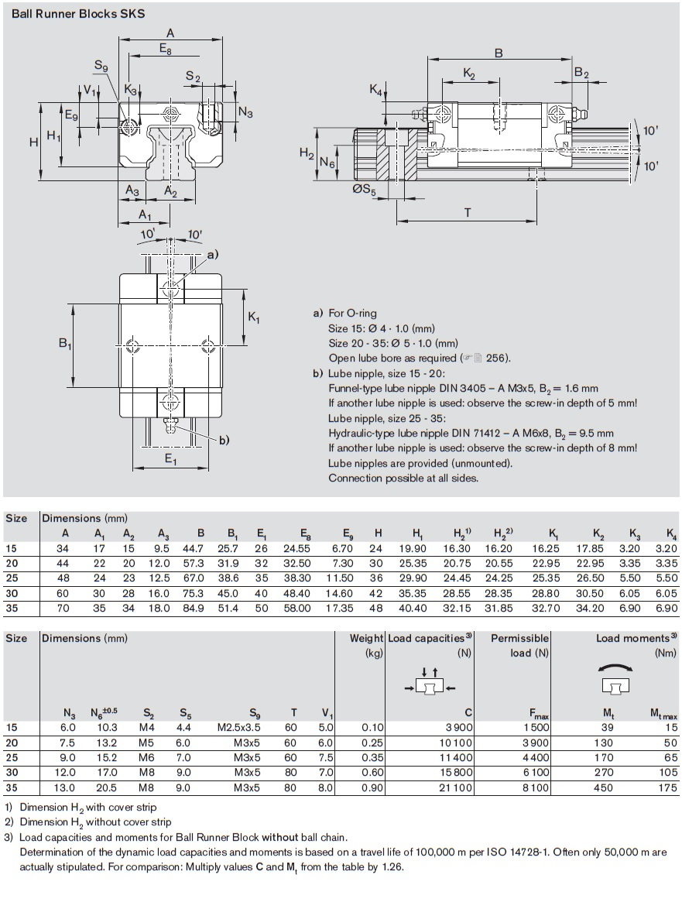
Adjustable solutions #1: Rail
Assembly
About Bosch Rexroth Ball Rail System
V. Soldatov, BE-RF-MK

Slide 7
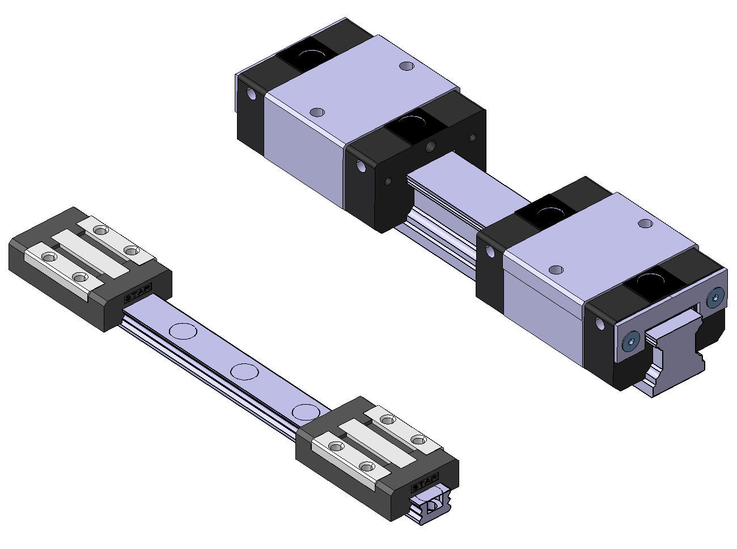
Adjustable solutions #1: Rail
Sizing options
 | Size 9 | Size 15
Static load capacity | 2100 N | 3900 N
Stat. torsional moment load | 9.6 Nm | 39 Nm
Size 15
Size 12
Size 9
V. Soldatov, BE-RF-MK

Slide 8
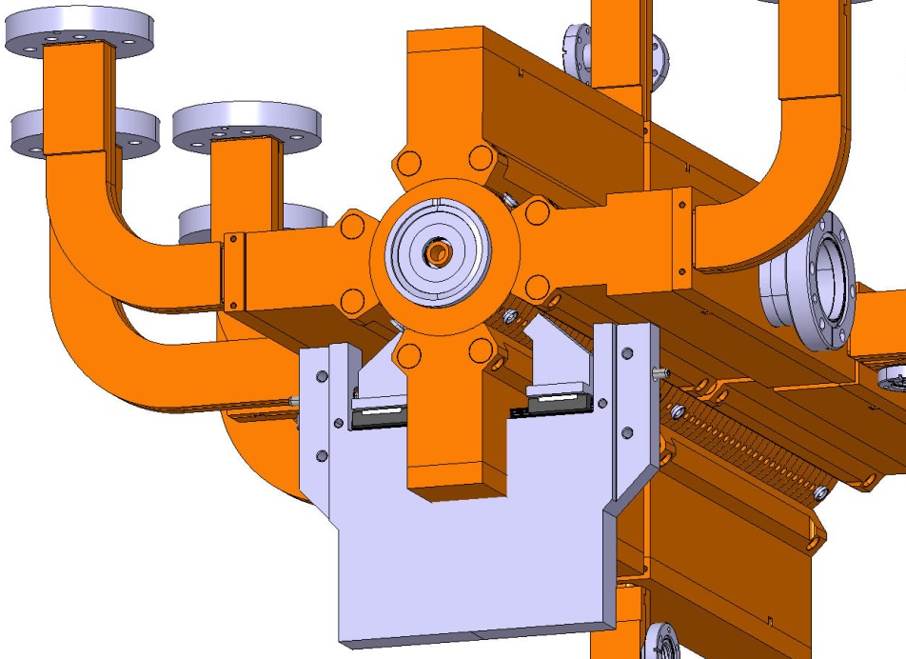
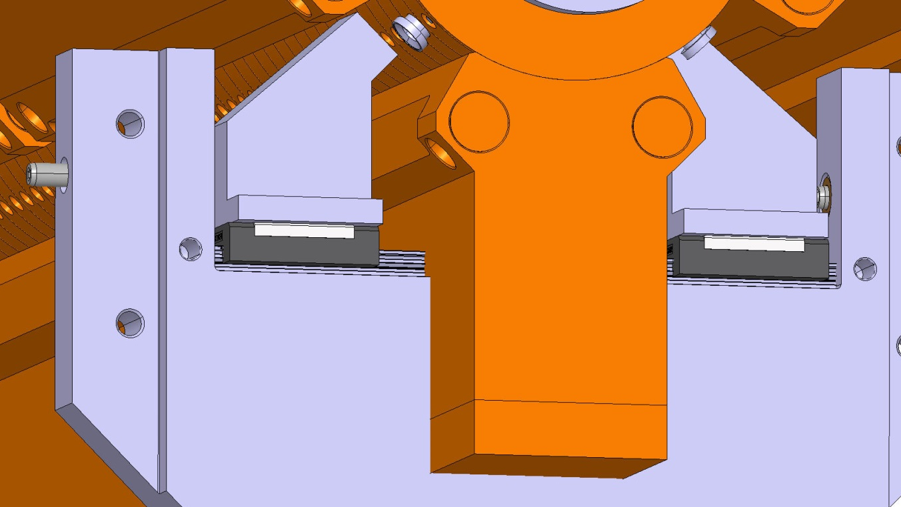
Adjustable solutions #1: Rail
Estimation of using the solution #1
together with SAS

Slide 9
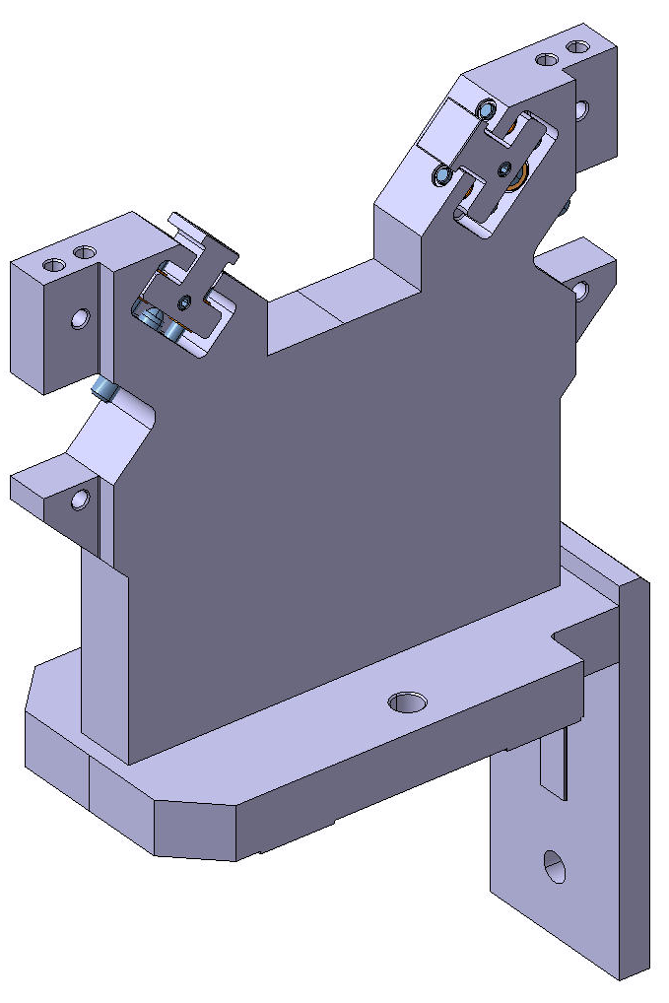
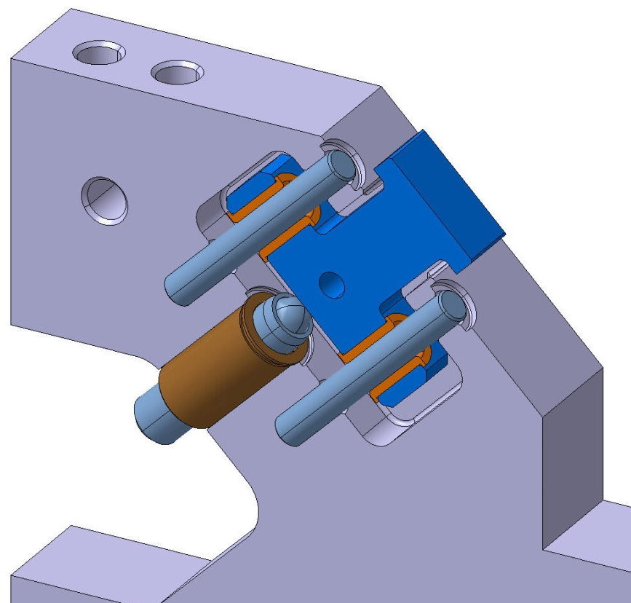
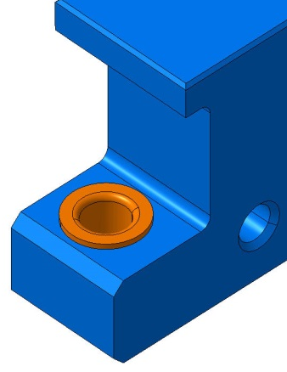
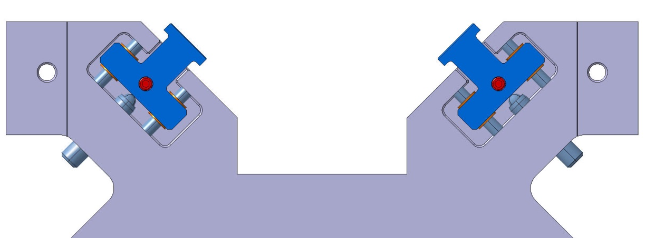
Adjustable solutions #2 “Plunger”
Plunger
Adjustment
304L
Cu hub
for low friction
Guide (Pin, standard)
Adjustment screw
Set screw M4
for blocking
V. Soldatov, BE-RF-MK

Slide 10
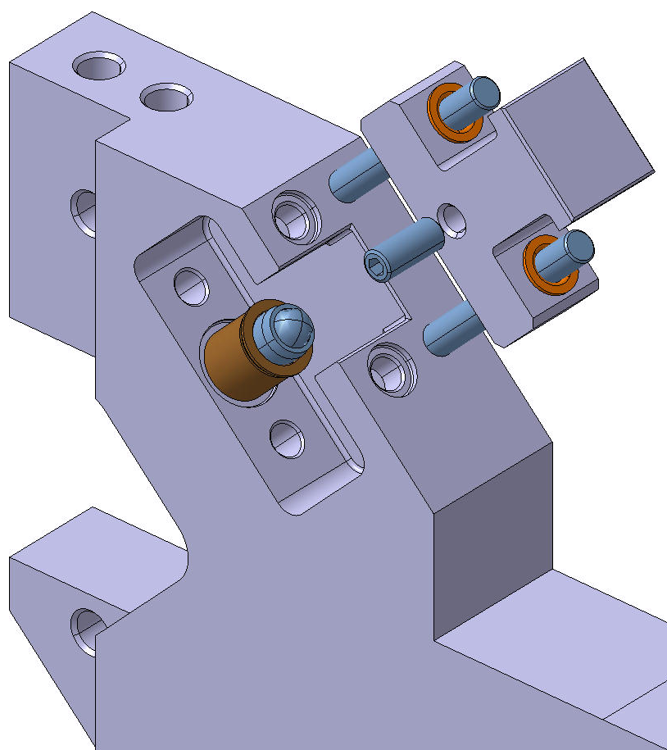
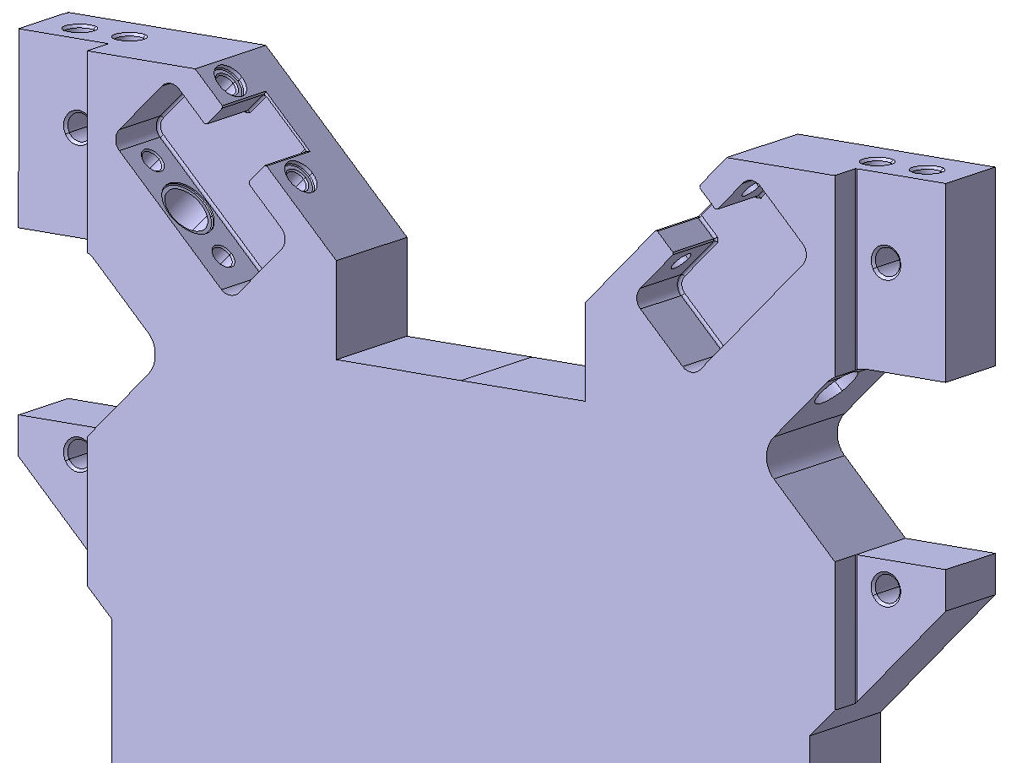
Adjustable solutions #2 “Plunger”
Assembly
Single piece machined support
V. Soldatov, BE-RF-MK

Slide 11
Pros and Cons
#1 Rail | #2 Plunger
The resolution of adjustment is the same (by order of magnitude): 254 μ/rev
Smooth reliable movement (due to ind. solution) | Comparatively easy assembly, less parts
Heavy duty capability | Need no maintenance
Maintenance (nominal at given conditions) | Almost all the load is taken by the adjustment screw. The load capacity limit is 90 N.
Comparatively complex assembly | Comparatively complex machining
V. Soldatov, BE-RF-MK

Slide 12
Versions history

Slide 13
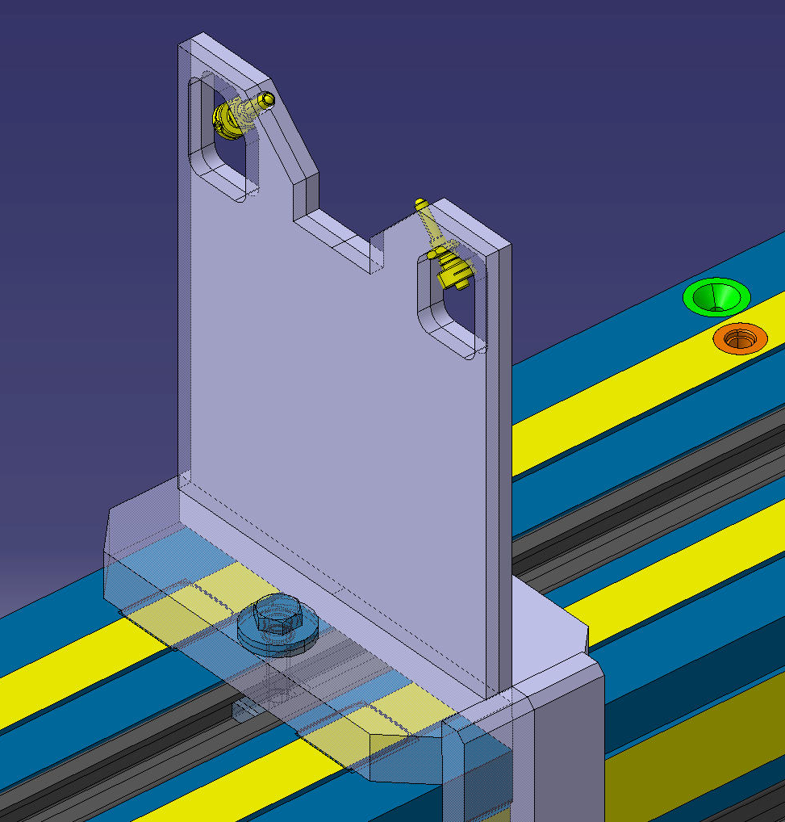
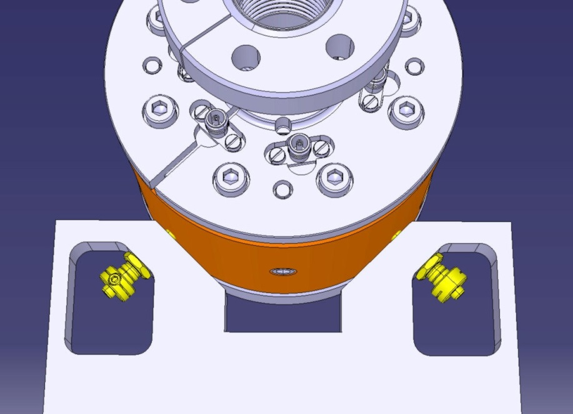
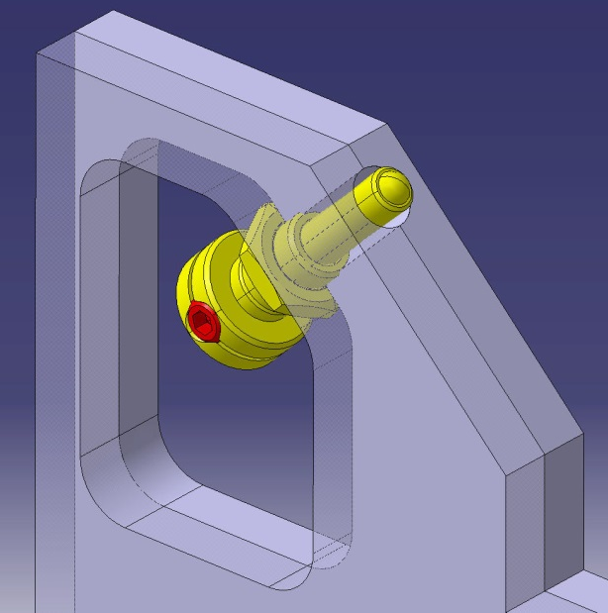
Adjustable V-shaped Support for BPM
Ball head
Side lock
V. Soldatov, BE-RF-MK

Slide 14
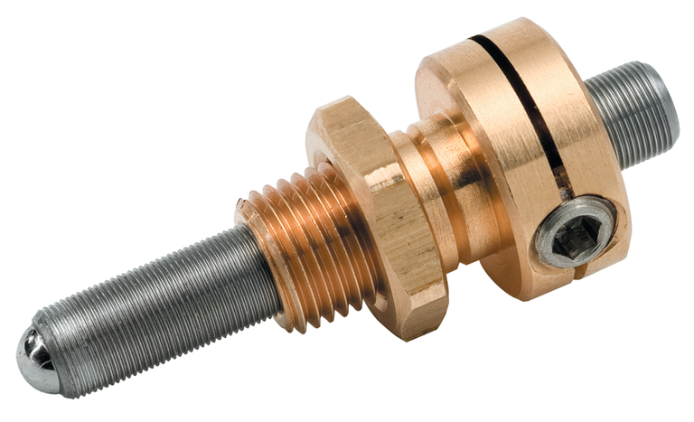
Adjustment Screw
Newport Miniature Adjustment Screws
Model | AJS8-100-0.5H | AJS254-0.5H-NL
Adjustment Screw Thread | 100 TPI (254 u/rev) | 254 TPI (100 u/rev)
Drive Type | Hex | Hex
Travel | 0.50 in. ( 12.7 mm) | 0.50 in. ( 12.7 mm)
Load Capacity | 10 lb ( 45 N) | 20 lb ( 90 N)
Lock | Side Lock | Side Lock
AJS8-100-0.5H
V. Soldatov, BE-RF-MK

