Slide 1
Cold mass assembly and procurement status
COIL & ASSEMBLY READINESS REVIEW, 23- 24 SEPT 2013
D. Smekens

Slide 2
OUTLINE
Schedule, a magnet for Christmas ?
Recall on pole loading concept
Assembly sequence
Part procurement

Slide 3
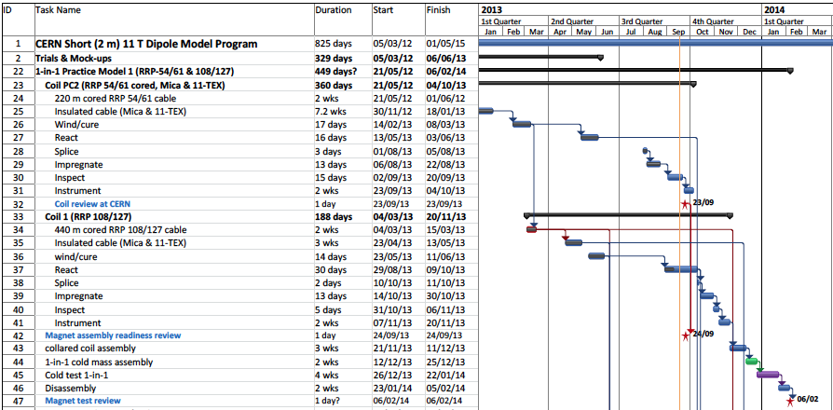
Mikko’s schedule

Slide 4
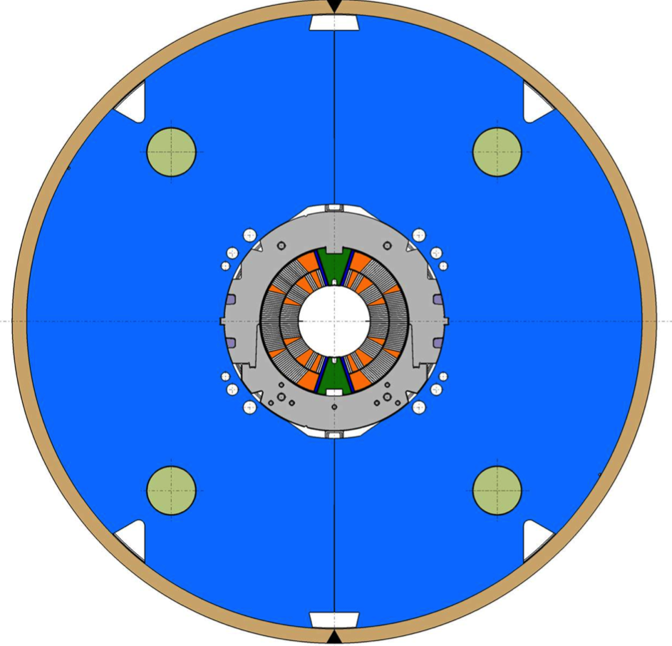
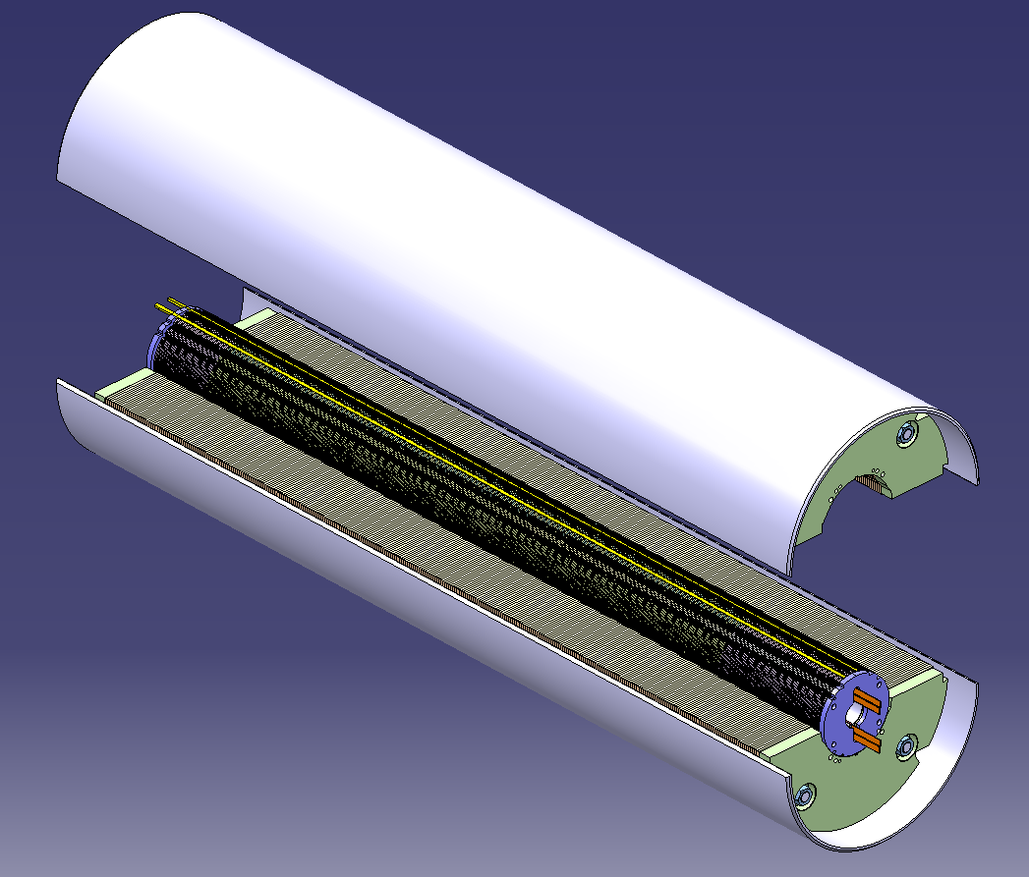
For Christmas this year…

Slide 5
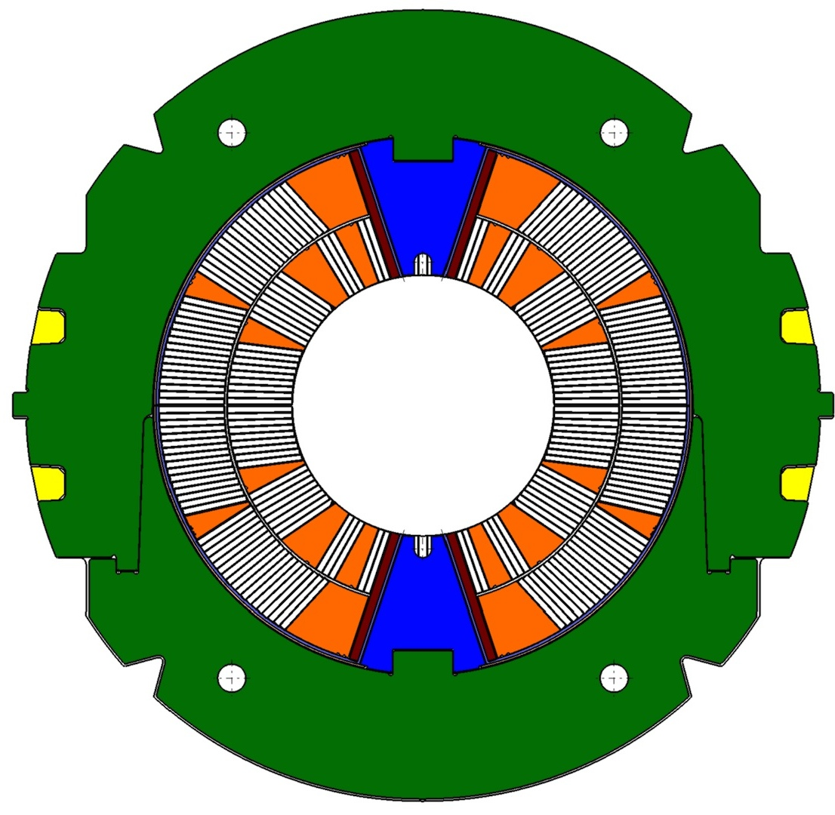
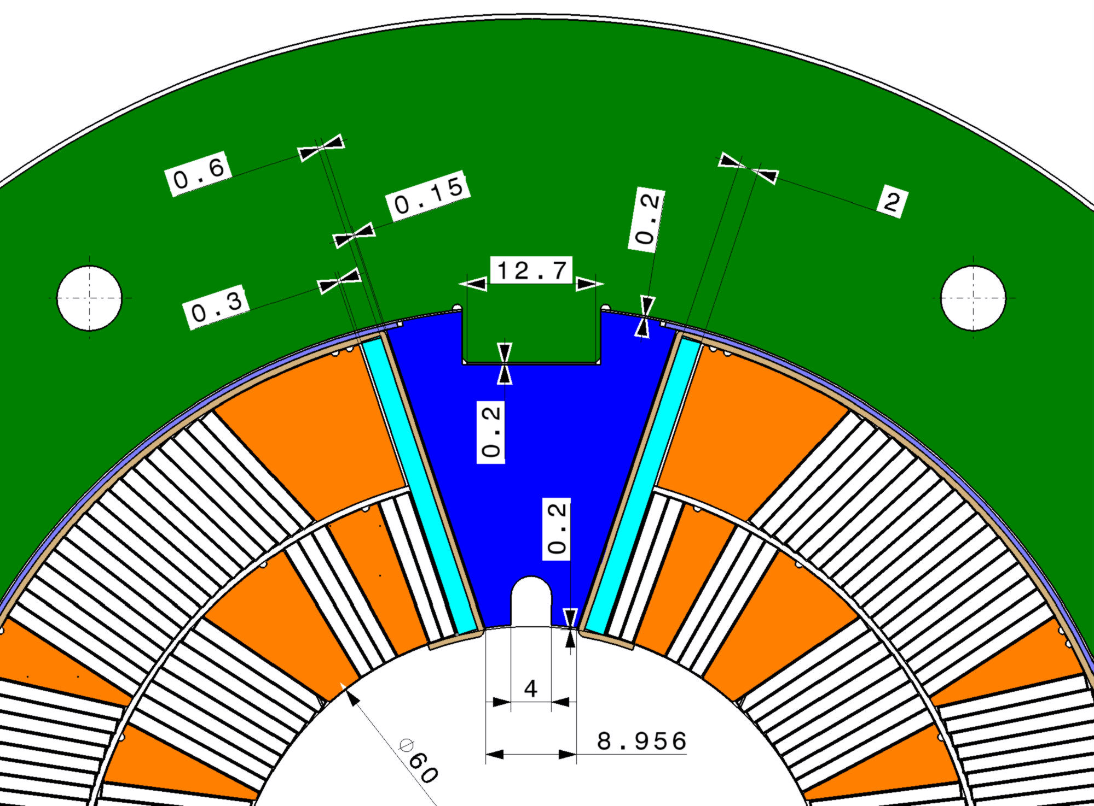
Pole Loading Concept
Shim
Loading plate
Filler
wedge
Pole wedge

Slide 6
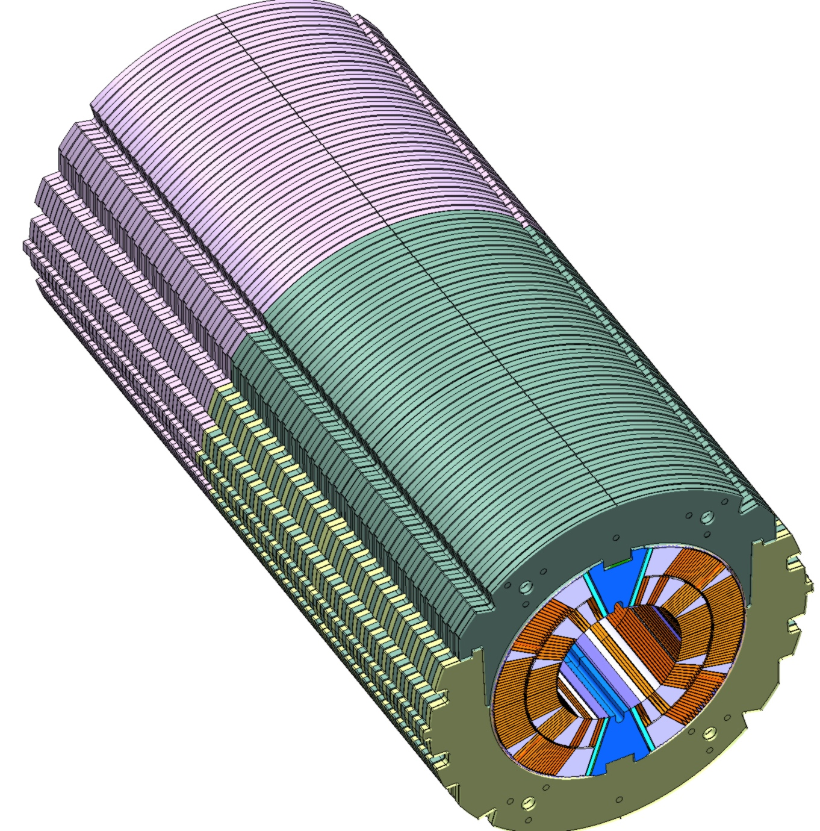
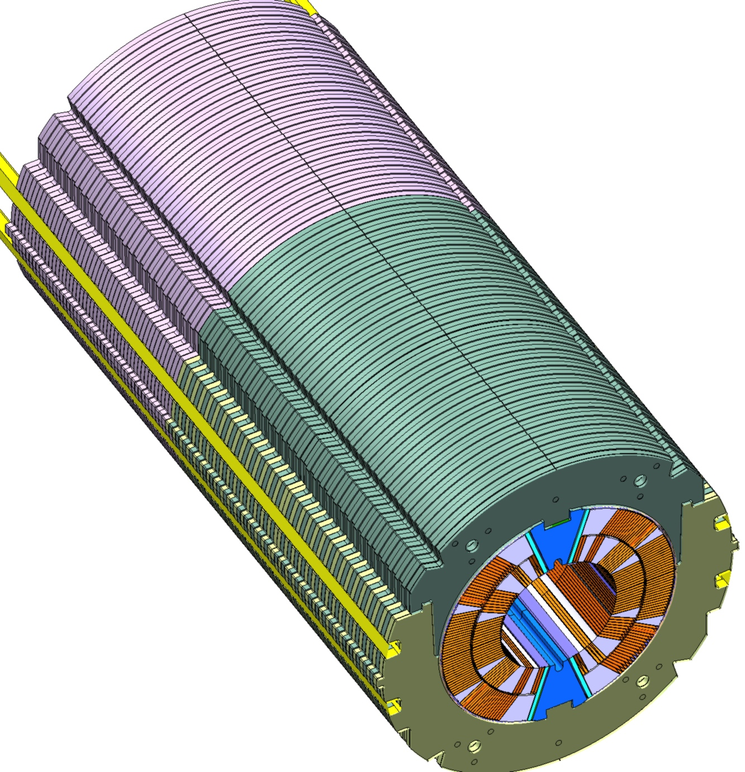
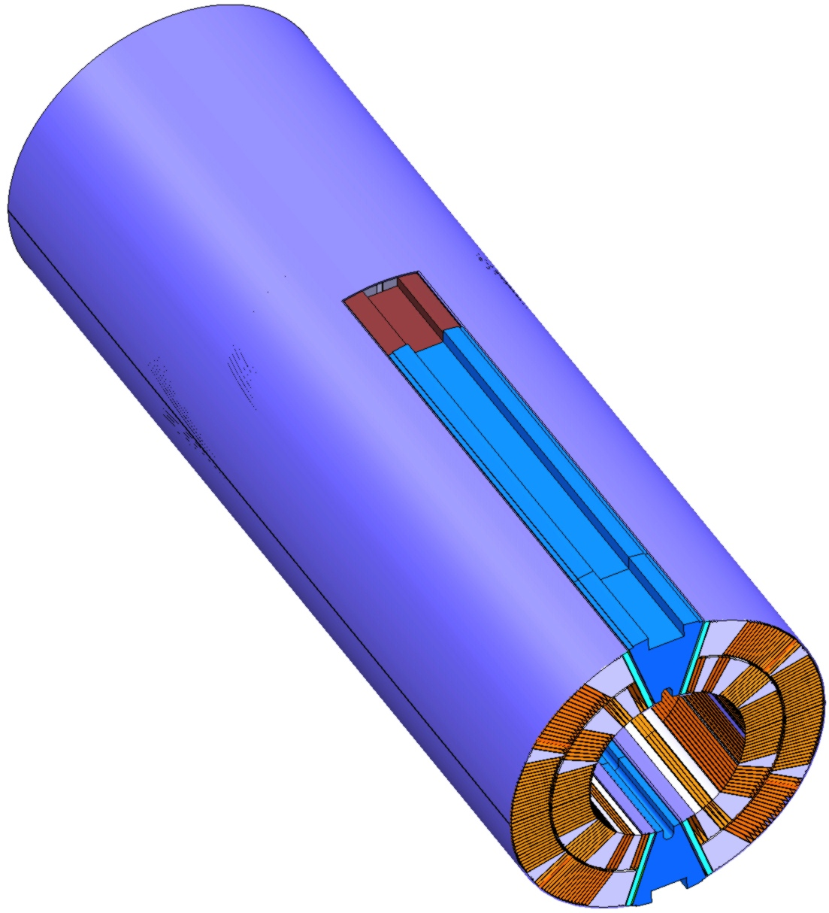
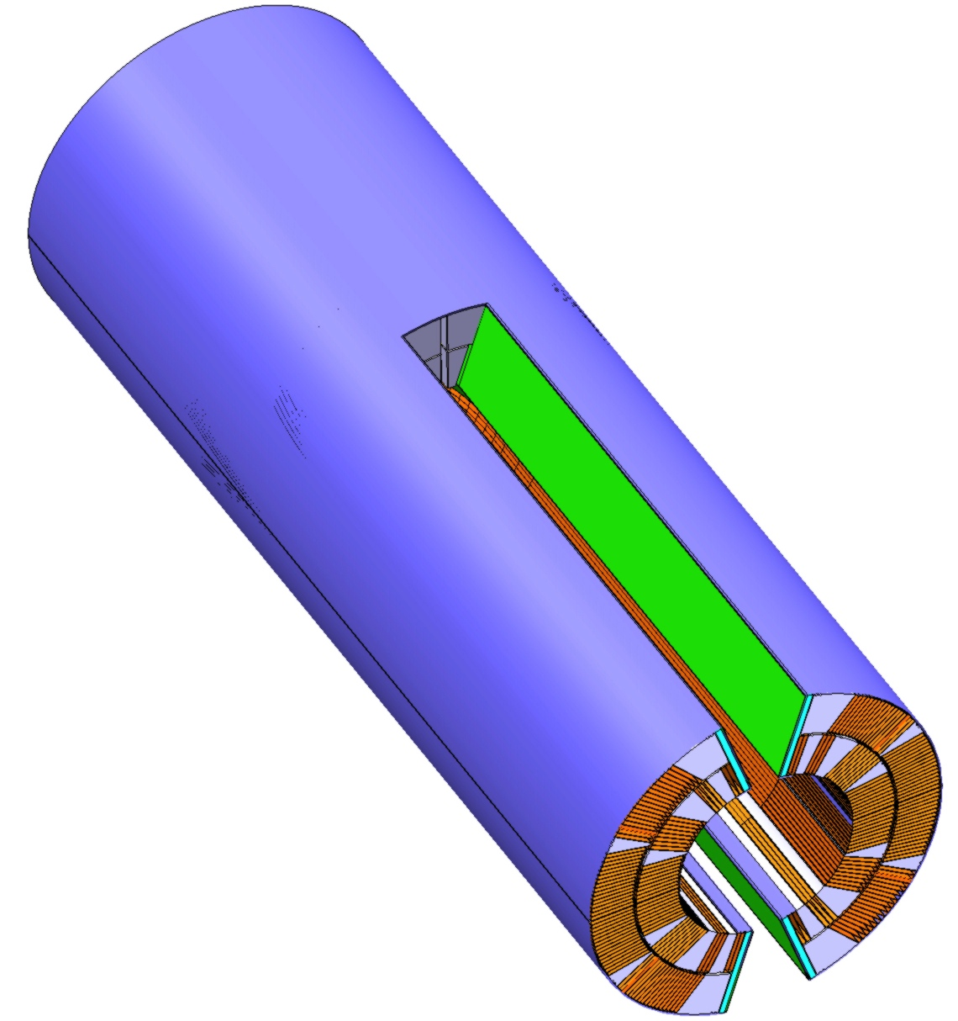
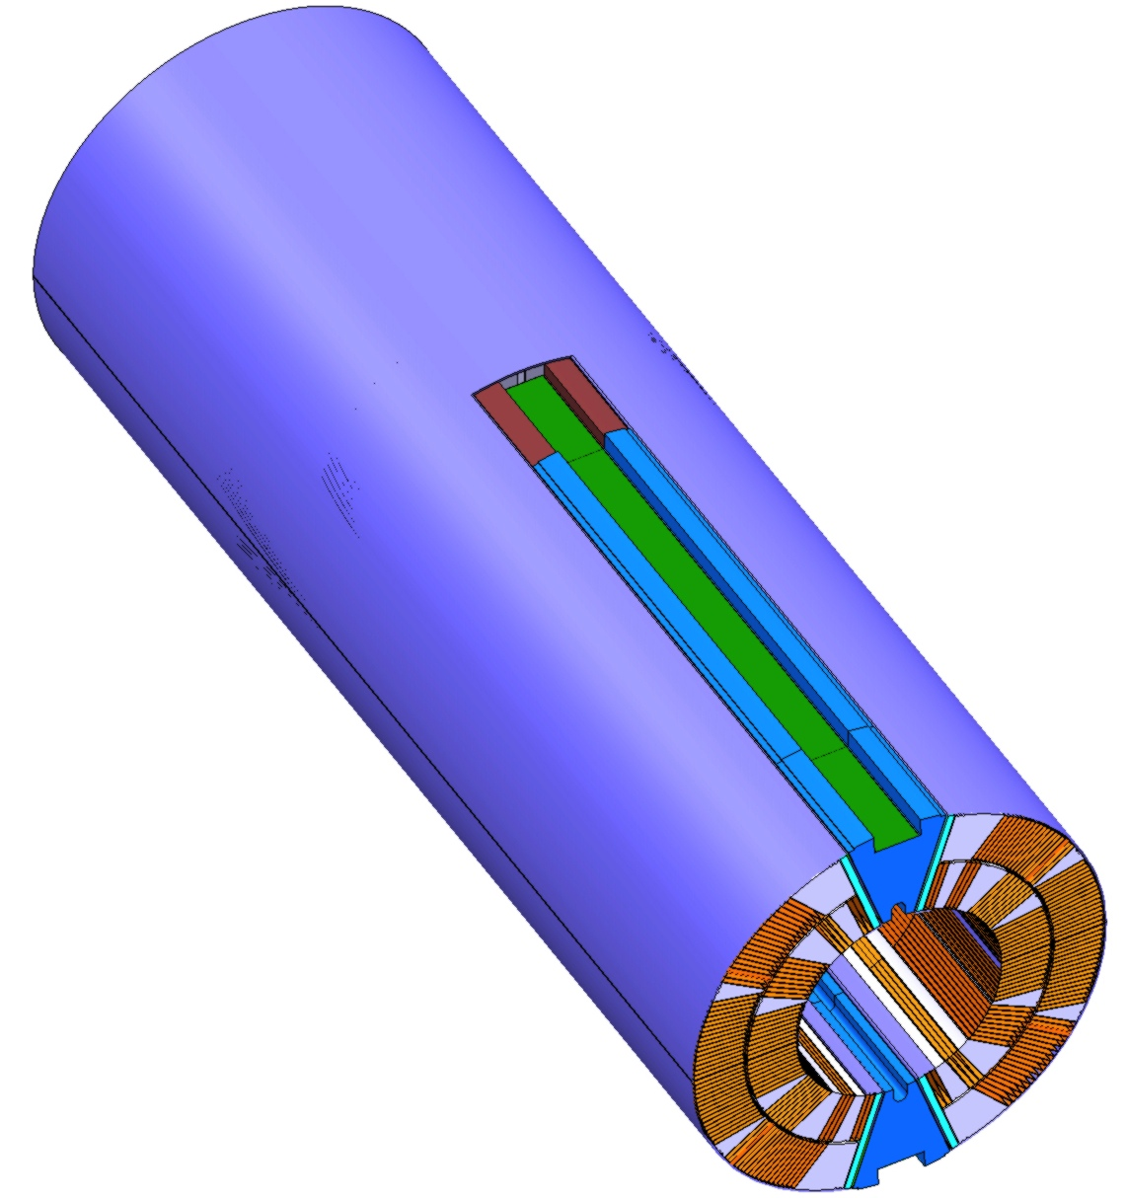
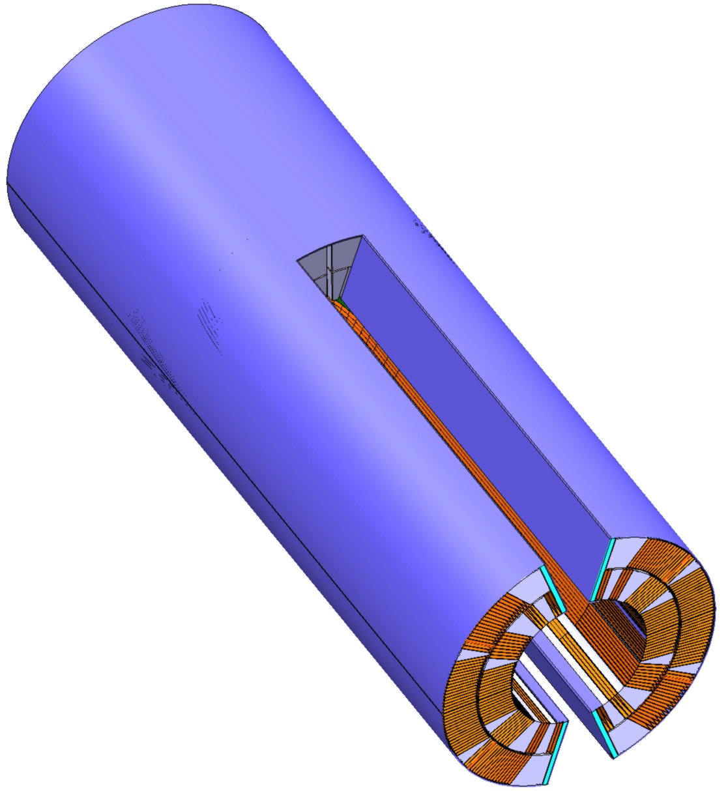
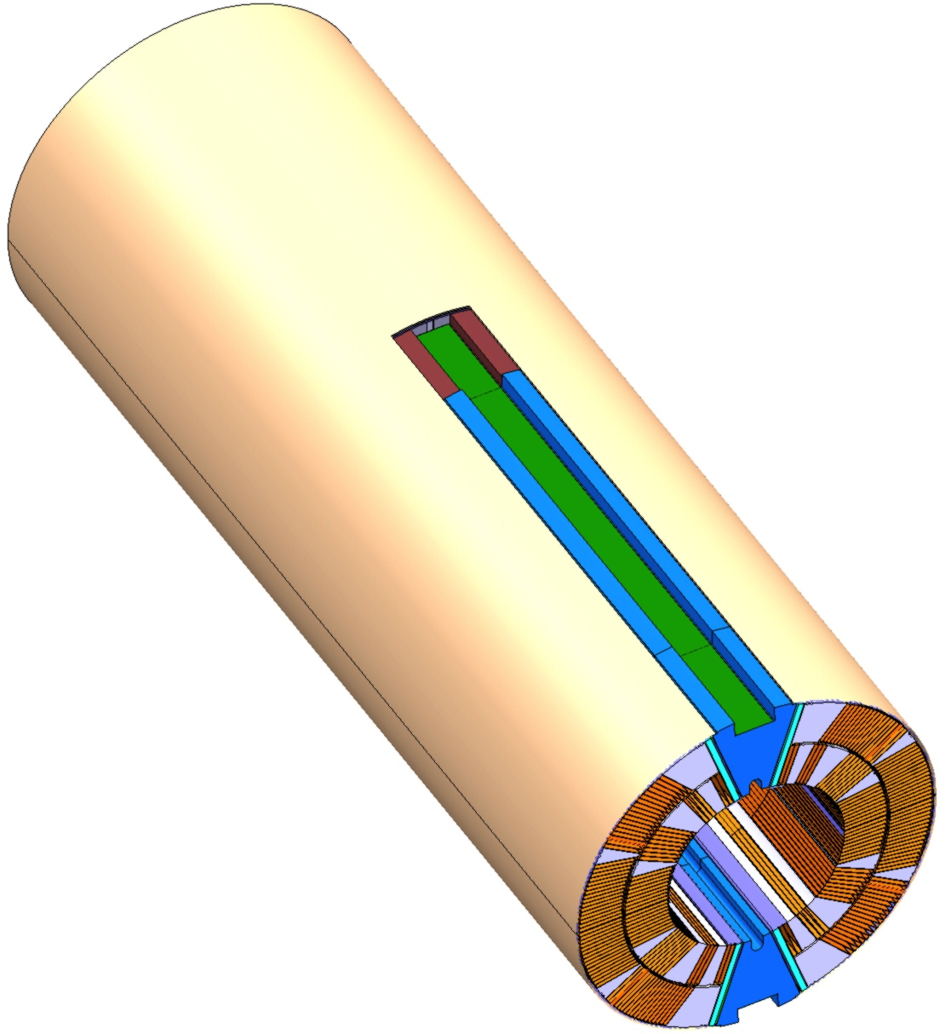
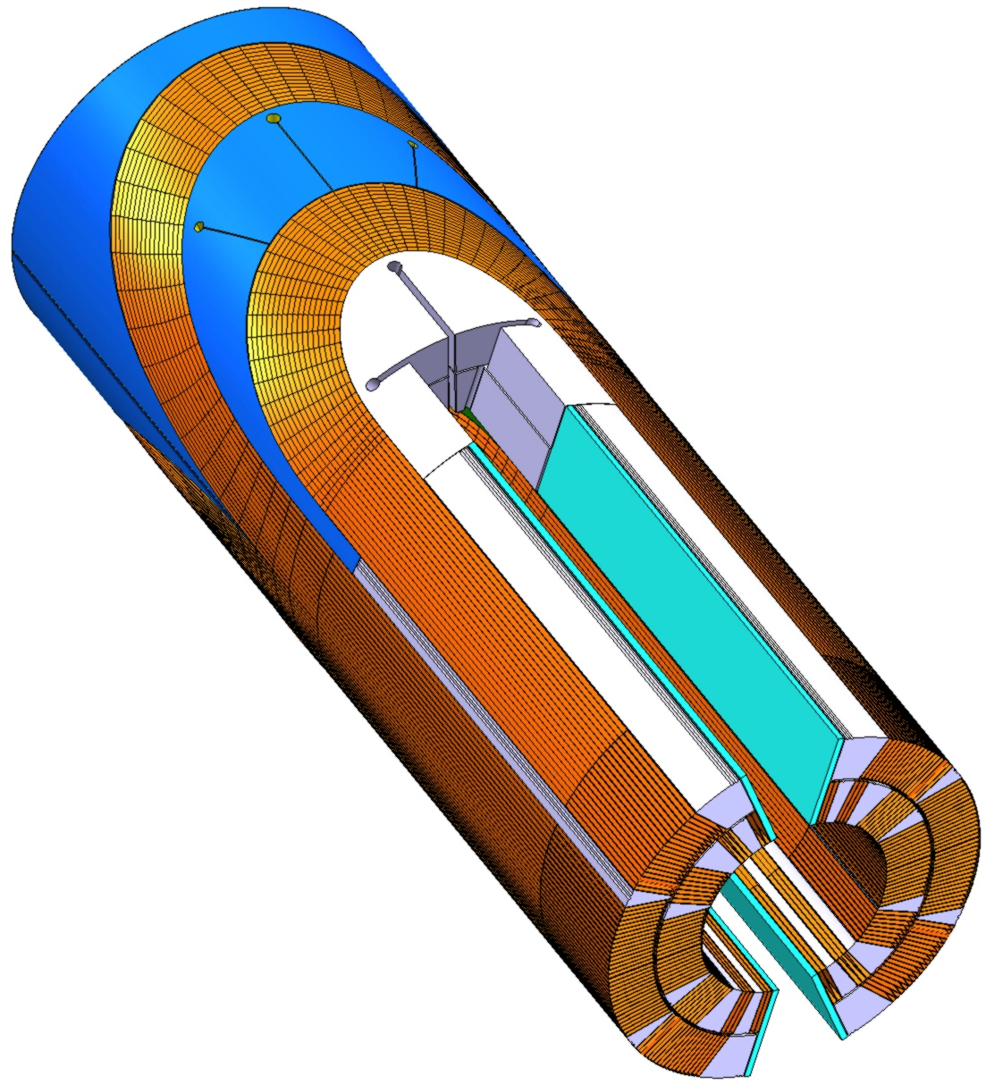
Collared Coil Assembly
1. Paired Coils
2. Traces + Gr.Insul.
3. Lateral shimming (glued to poles)
4. Loading poles (Ti)
5. Main Shimming
6. Collaring shoes
7. Collar packs
8. After collaring, keys in position

Slide 7

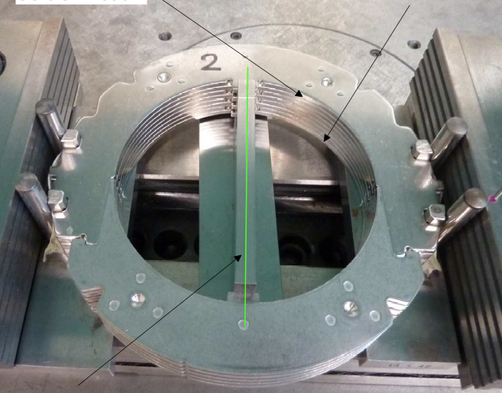
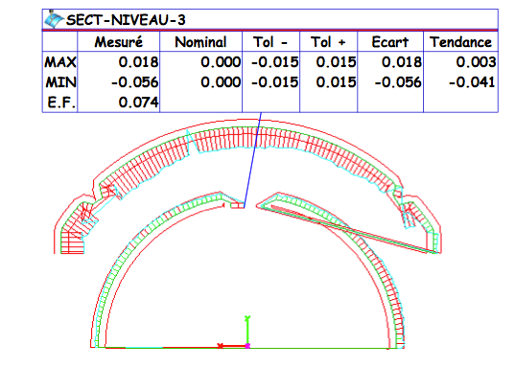
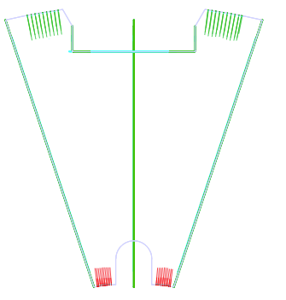
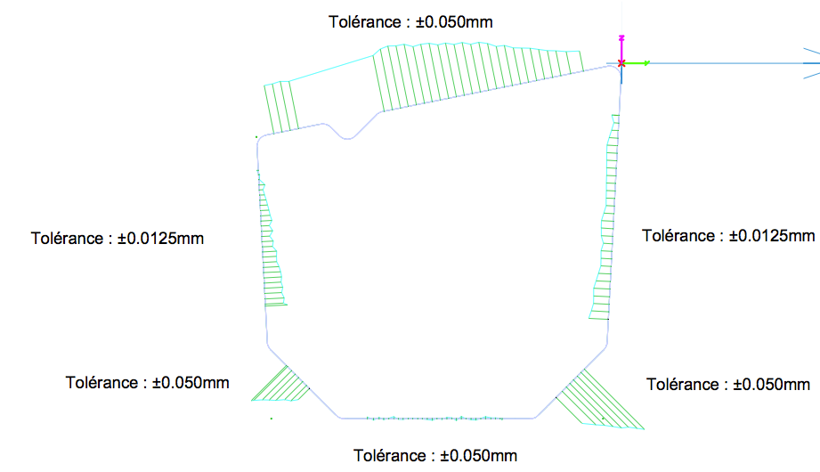
Collared Coil Assembly, Parts look good
Collars, 1 aperture, EDM, very nice
on the way: Collars, 4 apertures, fineblanking
Poles, 1 aperture, very nice
Keys, 7 apertures, good
Collaring shoes, received, to check
Instrumented collar pack made, need final calibration of gauges

Slide 8
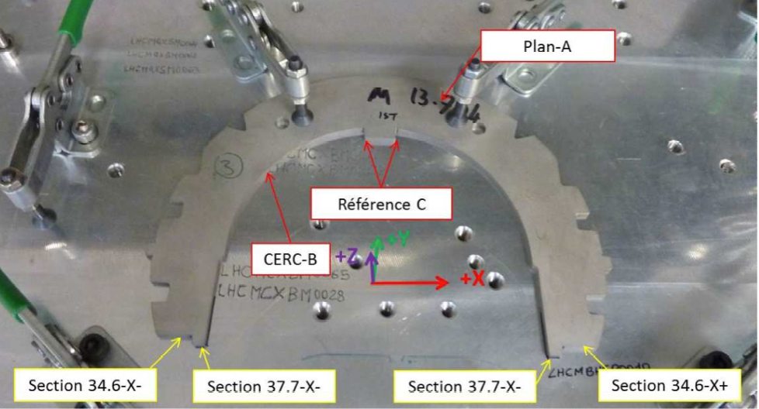
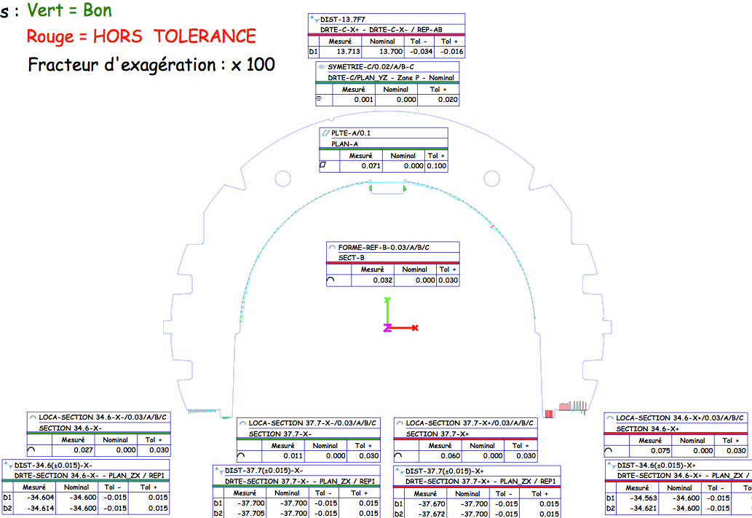
Aperture 1: EDM collars

Slide 9
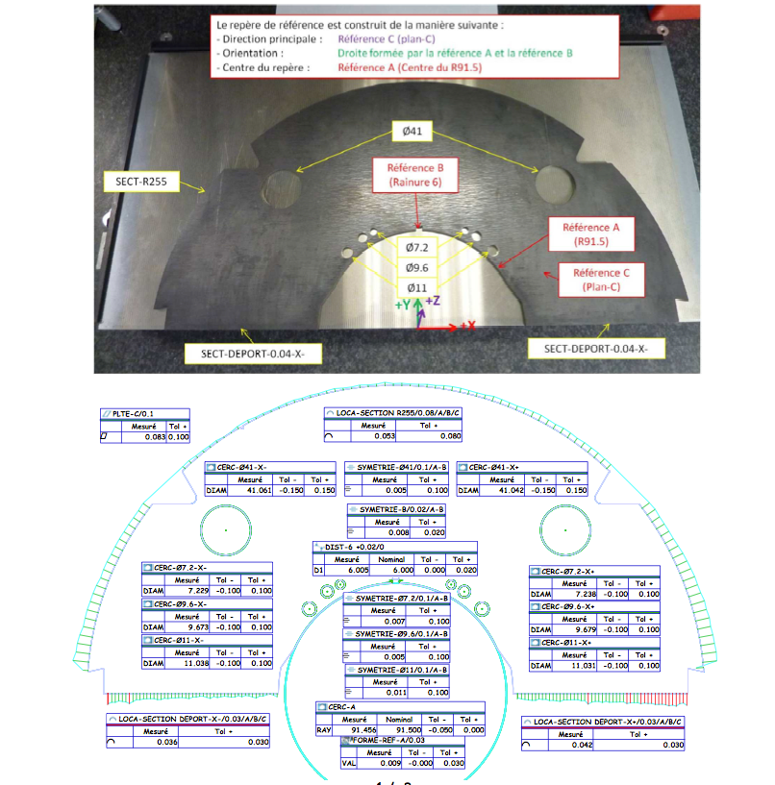
EDM 1-in-1 laminations

Slide 10

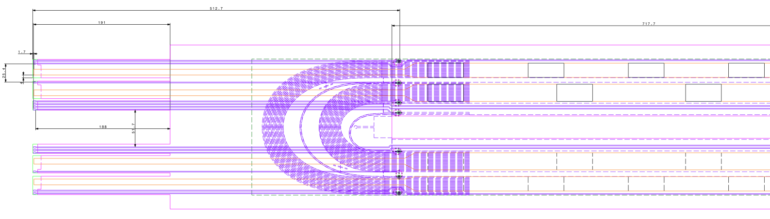
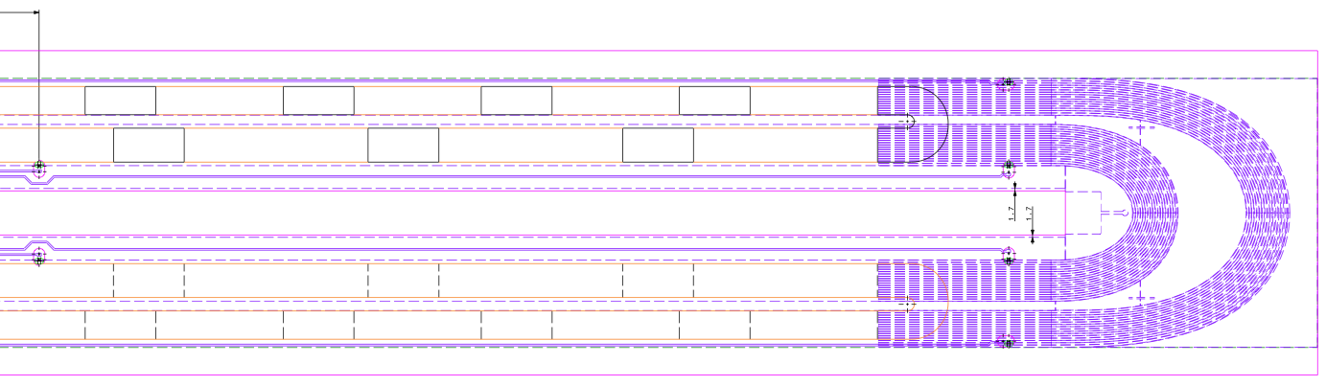
Instrum., traces and GI: many things to do
New instrumentation scheme
IL: wires – after impregnation
OL: External Traces with QHs
  Design just finalized
  Traces to produce
Ground insulation scheme to modify with these new traces
Instrumenting such coils needs practicing
More instrumentation may be required in future (spot heaters, thermometry)
Notes:
Still hard work ahead.
Essential

Slide 11
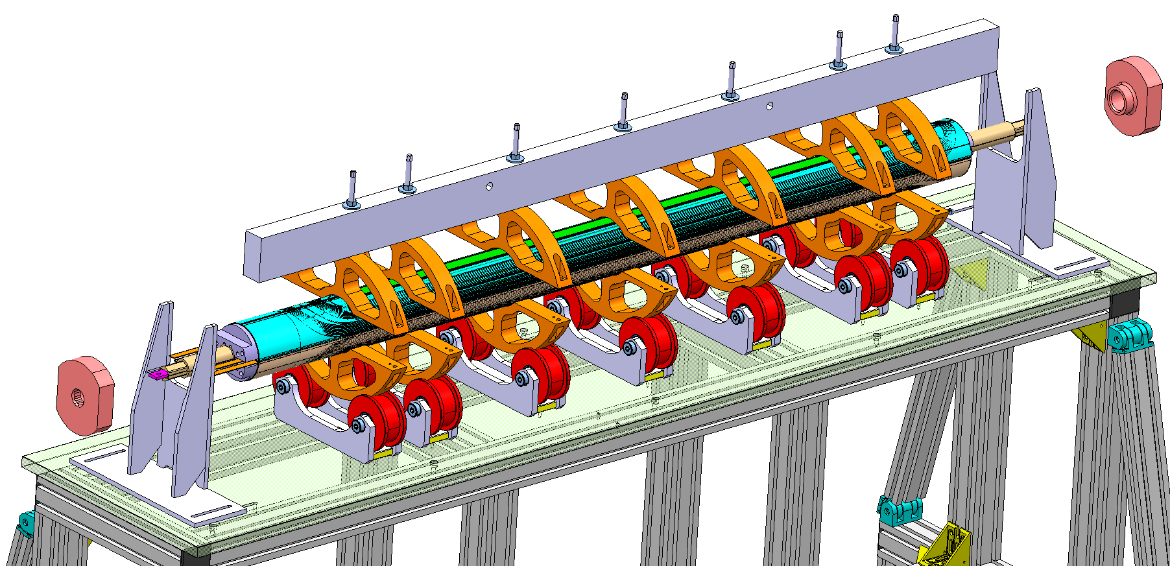
Collared coils: assembly, should start now
Tooling designed and procured
Most parts, still “in the box”
Needs commissioning
Needs practicing
Notes:
Still hard work ahead.
Essential

Slide 12
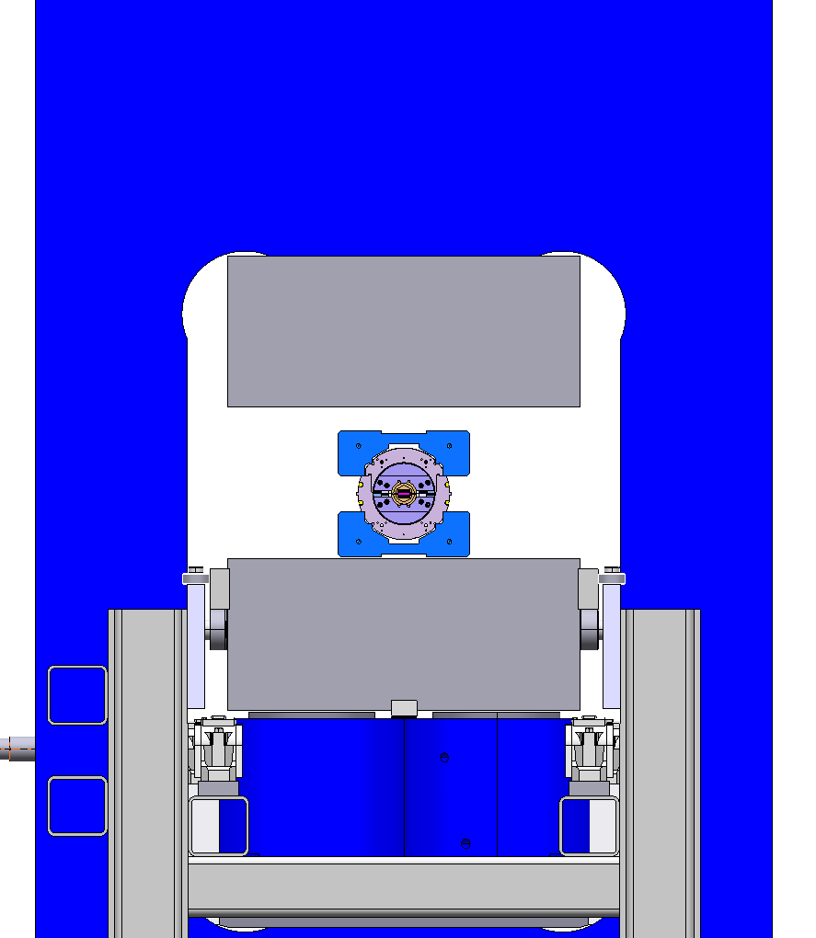
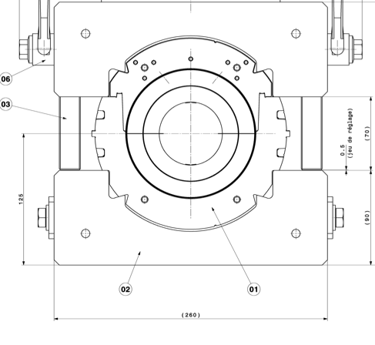
Collaring, monster press being tested
Press needs re-commissionning
Instrumentation to be implemented Needs trials
Notes:
Still hard work ahead.
Essential

Slide 13
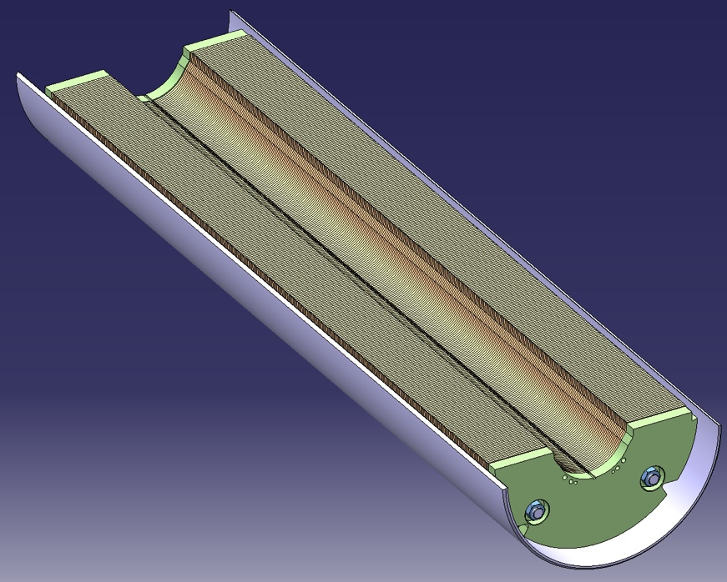
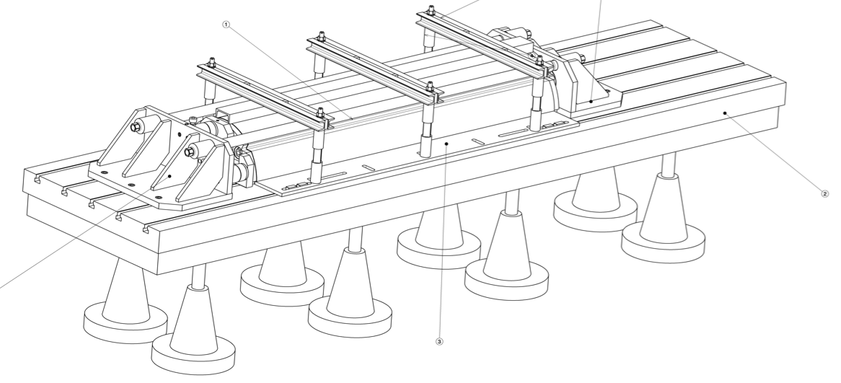
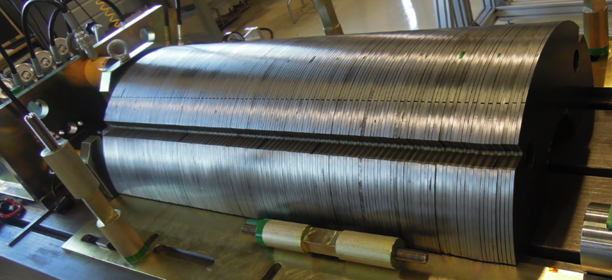
Yoking: need to try harder to reach quality
yoking tool just being commissioned
Laminations alignment tolerance is critical, not reached yet
Everything ready, but needs trials

Slide 14
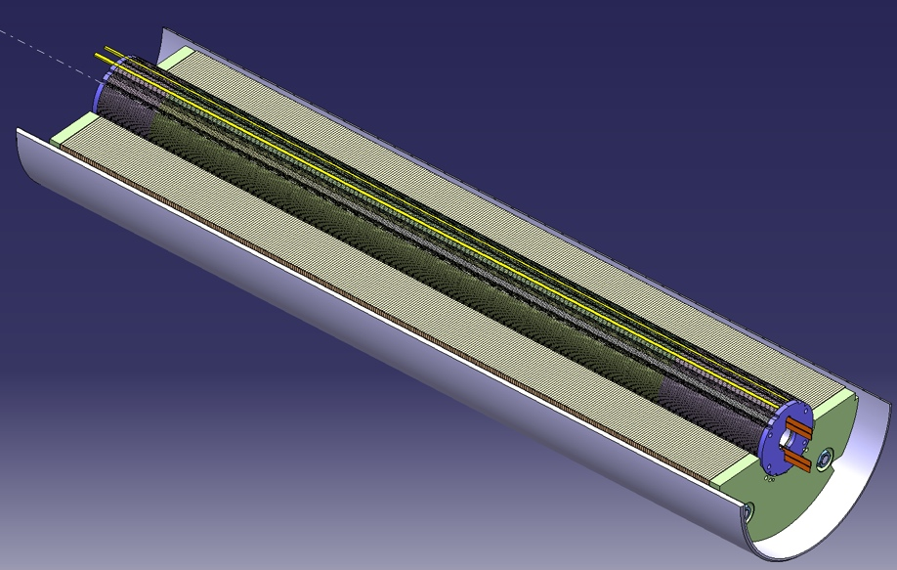
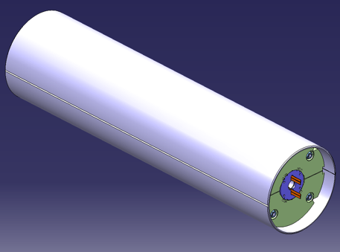
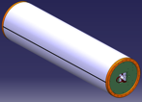
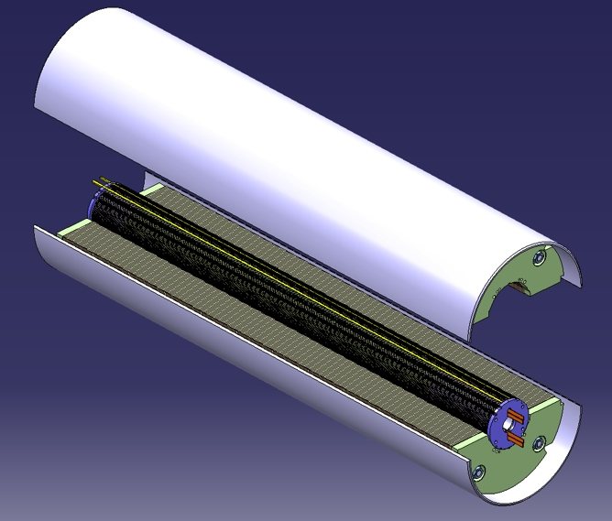
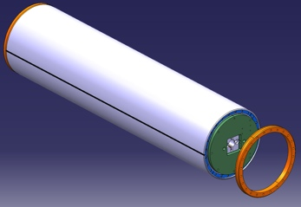
Shell to supply, magnet to assemble, weld,…
Welding trials carried out by LMF section
Final shells still to be supplied
Once every sub-assembly ready, ship the baby to LMF for final assembly
simplistic, not yet thoroughly planned…

Slide 15
Conclusion
Many Needs:
To work out instrumentation on coils
To work out the shimming plan for paired coils from CMM data
To have a close look to details before production of remaining small parts (routing of wires, connection box, …); tens of drawings to check, sign, …
To commission many tools and re-commission many others to reach the required quality
To interact with LMF to prepare for the assembly and the welding
Record all this for Q/A and document procedures
  Too many “needs”, … need help?

