Slide 1

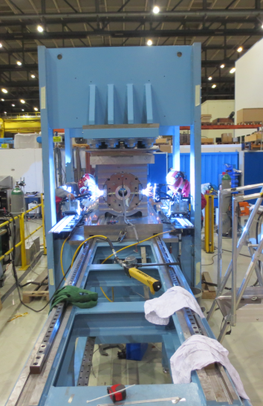
11 T Dipole informal coil and assembly readiness review
Welding trials
F. Lackner, Sept. 24th, 2013
This presentation includes work contributions from many colleagues from both inside and outside CERN:
B. Auchmann, N. Dalexandro, A. Gauthier Pastre, A. Gerardin, M. Guinchard, S. Izquierdo Bermudez, M. Karppinen, J. Murtomäki, J. Perez, D. Perez, A.-M. Piguiet, F. Savary, D. Smekens, P. Voisin
& the LMF and EWM team for all the trial weldings.

Slide 2
Outline:
Available tooling and operational status;
Welding technology, LHC and 11T;
Welding mockup assembly and shimming iterations;
Welding tests and results;
Further steps;
Conclusion.

Slide 3
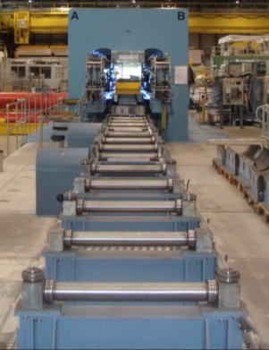
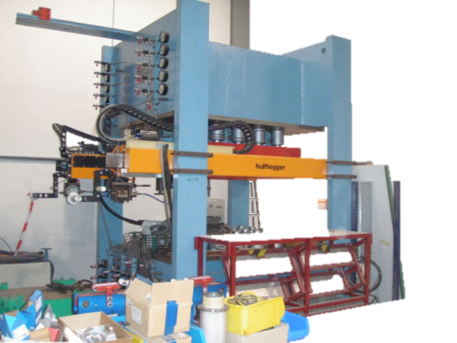
Available tooling in the LMF
….LMF is covering the welding operation for sample and full scale magnets !
Large LMF welding press, previously operated at Babcock Noell
Length capacity | 16000 mm
Nominal hydraulic pressure | 600 bar
LHC dipole welding | 400 t/m
Press capacity | 500 kN/m – 12 MN/m
Widow size (closed position) | Width: 2200 mm Height: 1600 mm
Stroke | 100 mm
Adaptive laser tracking system
Currently: STT & MIG welding system
Short mockup welding press (Fjellman skinning press):
Length capacity | 2500 mm
Nominal hydraulic pressure | 700 bar
Press capacity | Up to 750 t
Widow size (closed position) | Width: 1700 mm Height: 1250
Stroke | 30 mm
On short term no adaptive laser tracking system is foreseen
Welding system selection ongoing

Slide 4
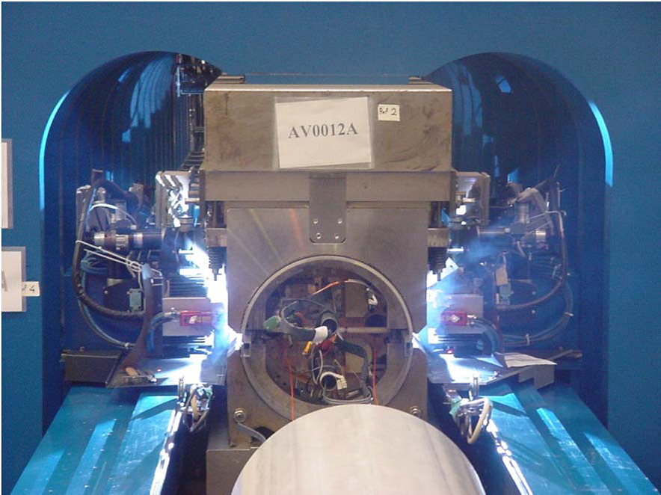
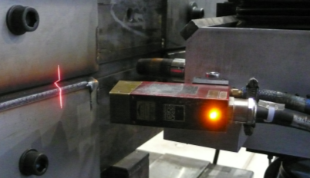
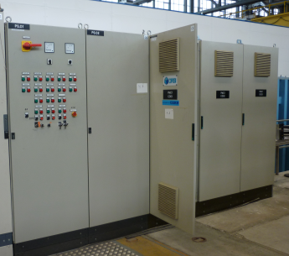
LHC dipole welding press
Servo robot seam tracking
Welding of LHC dipole 2194 end of 2012
Control system
Status:
Implemented hydraulic sectorization allows welding of magnets from 5 m up to 15 m;
Commissioning of the welding press was successfully finalized by the welding of a 15 m long LHC dipole magnet;
Many issues with obsolete hardware but improved knowledge on the controls and required welding process towards a system update.

Slide 5
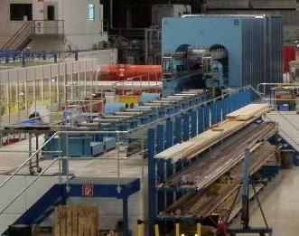
Change of main tasks for the welding press
Future task’s
Reparation and maintanance of LHC magnets (MB + MQ)
Small series production
Welding of prototype magnets (short and evt. long samples)
Required improvement towards a (small) series production:
Minimizing the risk of hardware errors of all components (>15 year old hardware);
Bringing flexibility to the new tasks of the welding press;
Staying compatible with welding of the LHC main magnets.
In detail:
Implementing new welding system and seam tracking system;
Simplifying the control complexity and hierarchy adequate to the new tasks of the welding press;
Separation of hydraulic and welding unit;
Bringing possibilities for faster adaptation of hydraulic and welding parameters.

Slide 6
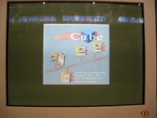
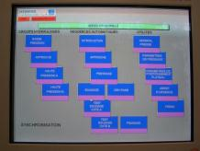
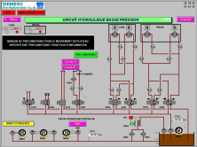
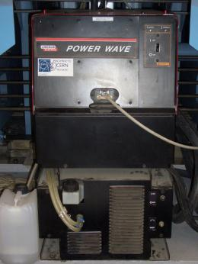
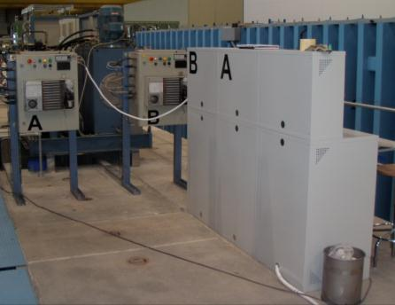
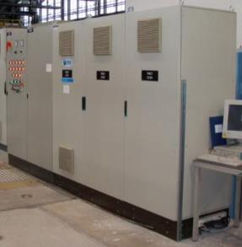
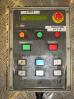
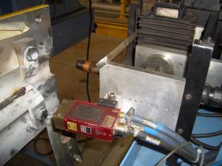
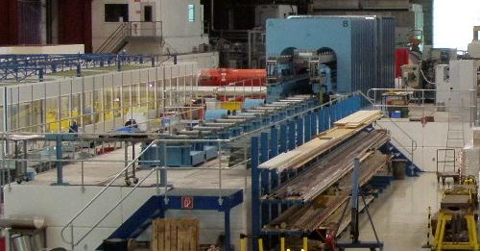
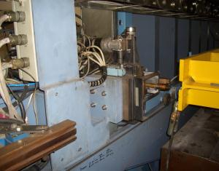
Welding press – control chain complexity:
Minimizing the hardware interfaces
Siemens - ORSI
Implementation of a flexible and user friendly welding system (either manual or automated)
Hydraulic system and convoyeur
Safety relevant hardware
Further systems:

Slide 7
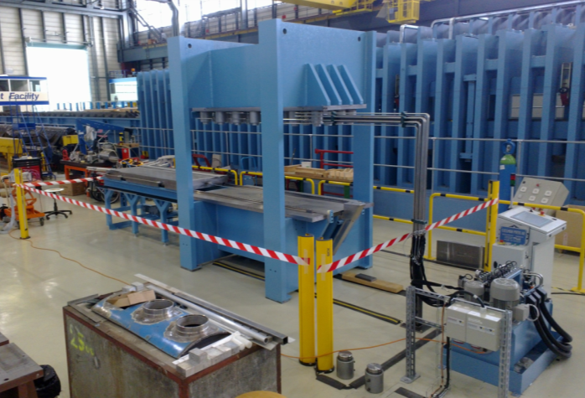
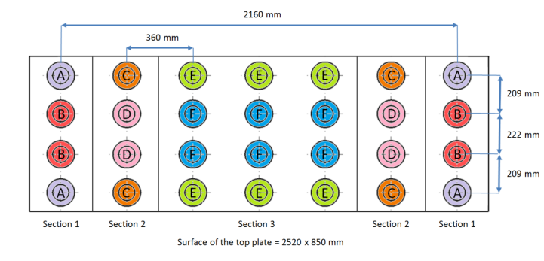
The refurbishment of the short sample press
Extension of the main frame to 2500 mm;
Maintenance of the hydraulic cylinders;
Change of hydraulic peripheries;
New sectorisation;
Control system automated/manual mode;
Automated introduction system;
Increasing safety aspects;
1 m long cradles received capable to weld also based on 15 mm thick shells, requires therefore shimming for the selected 12 mm shell;
8 x 350 mm cradles are ordered;
CE certification.
Extension
Conveyor
Control
Hydraulic group
Refurbishment was finalized, press operational

Slide 8
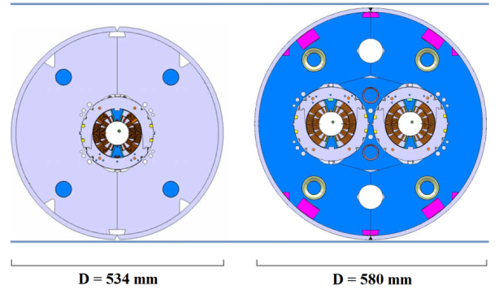
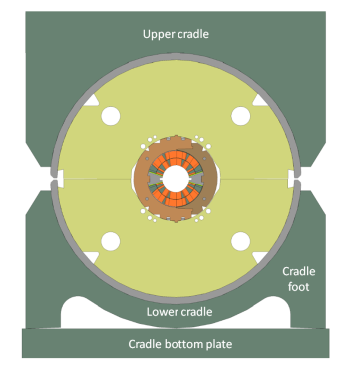

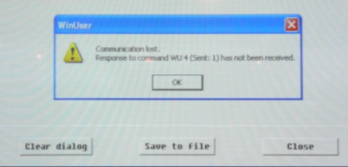
Welding, why not using welding technology from LHC ?
Geometry
Assembly
Technology
Geometrical reasons;
Requirement for a high mechanical pre-stress in shell >LHC;
Upgrade on available welding and seam tracking system required, resulting in a robust process;
Technology aspects;
However, requires compatibility with LHC welding tasks.

Slide 9






Companies added to our list of interest:
LHC dipole welding, has not shown interest in the new project
Previous contacts, developed new welding program for CERN
LMF/MME, specific meeting was held in 2012
No previous experience, specific meeting was held in 2012
No experience, no feedback
LS1/MME, 2nd meeting this afternoon in 180

Slide 10
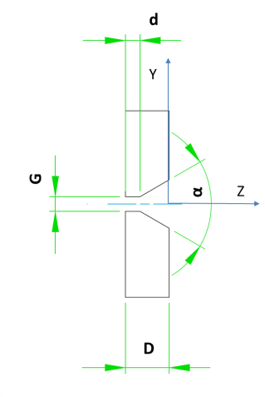
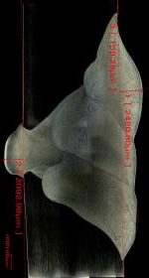
LHC Technology, Lincoln:
STT
Metallography of
test welding, EDMS 1218626
Parameter
G | 2.5 < G < 4.5
d | 0.2 < d < 0.5
D | 10 mm
α | 60˚
Passes | STT + 3xMIG
Stress | 150 MPa
Root pass:
Surface Tension Transfer (STT) welding is a GMAW (Gas metal arc welding), controlled short circuit transfer (Lincoln). STT uses current controls to adjust the heat independent of wire feed speed.
Filling pass:
3x MIG filling layers.

Slide 11
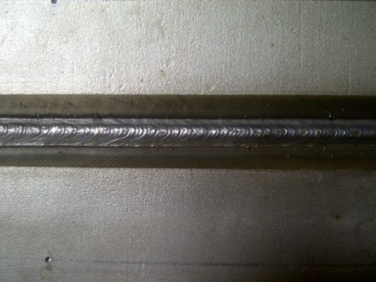
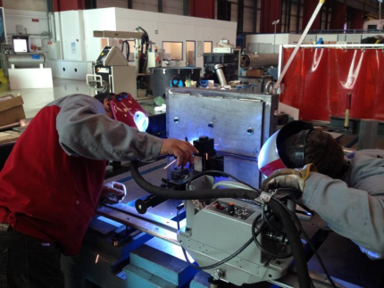
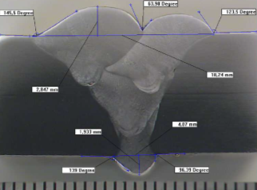
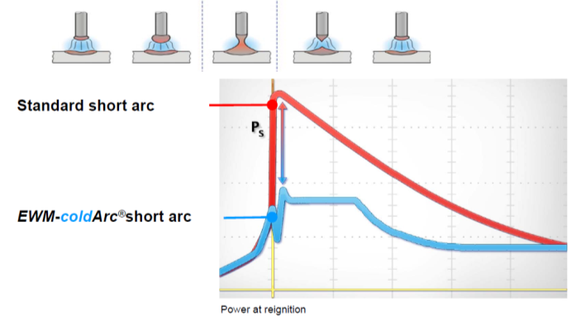
Development of new welding technology, EWM:
First welding trials performed with EWM and based on their COLD ARC technology (Variant of MIG/MAG process based on cyclical change between the arc and short circuit phases);
1st iteration was focusing on building up high thermal contraction;
Results were promising -> further tests were launched.
Metallurgical Laboratory Tampere (FI)
2012: First 500 mm welding trials based on test bench
Root pass
Original idea to reduce introduced heat;
Modified process conform with requirements
Short arc is regulated in the energy source only;
Very fast digital process regulation;
Drastic reduction of the power peak on re-ignition of the arc;
Significant reduction of the heat input during the melting phase.

Slide 12
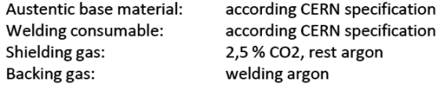
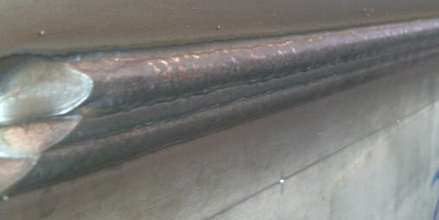
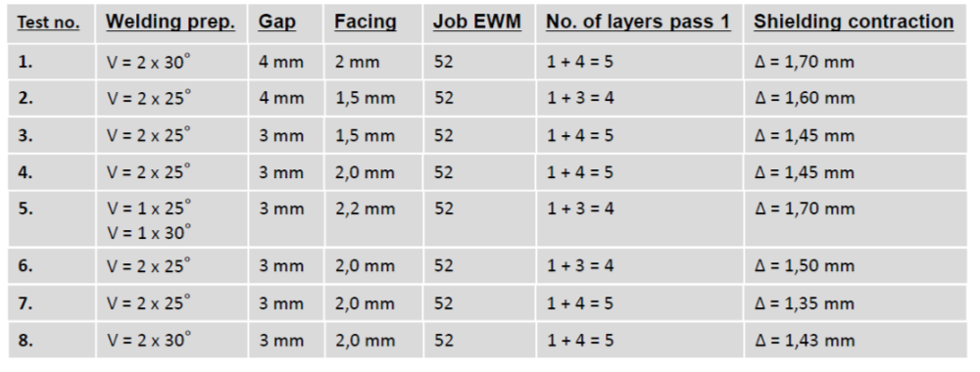
Results from 1st in-house sample welding, feedback EWM:
Result of 1st welding
After optimizing the welding parameters we are 100 % sure to have the awaited results for CERN on this special application
Specification: - V-preparation = 50° - Facing = 2 mm - Gap = 3 mm - No. Of welding passes = root + 4 passes, slightly changes after further tests @ EWM
It is very difficult to give a definitive quotation about the contraction
When the test plates are welded and screwed
When the backside fixation plate with 50mm thickness takes influence on the heat input
We think, that we are able to reach 1,5 mm up to 1,7 mm

Slide 13

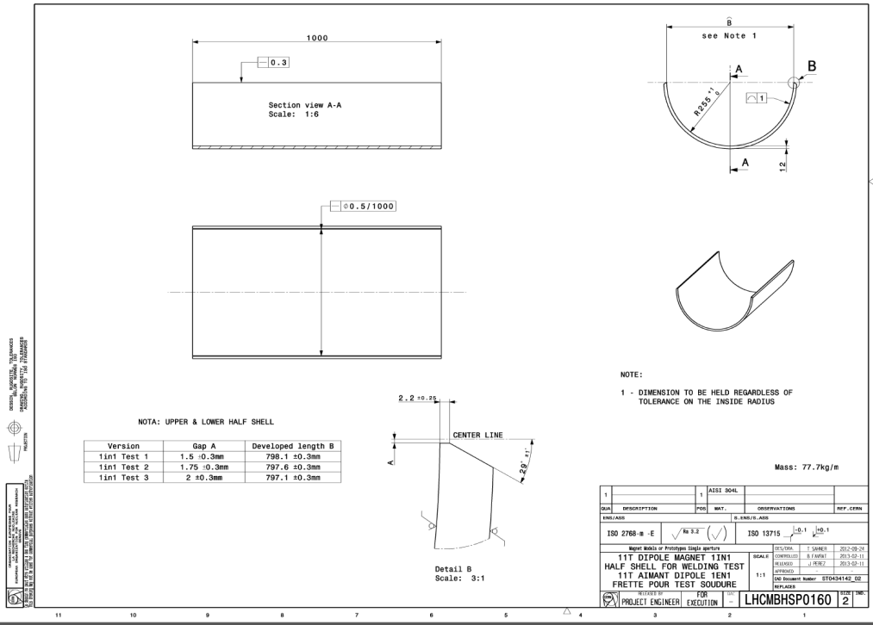
EWM, geometrical requirements and shell selection:
12 mm shell, three sets were delivered to CERN from JAPROTEK.
Full geometrical QC was performed on all sets.
Parameter
G | 3.5 < G < 4.1 mm
d | 2.0 < d < 2.2 mm
D | 12 mm
α | 60˚
Passes | CA root + 4 fills
Normal stress in the shell | About 200 MPa
Requirement developed length: L_{dev} = 797mm – 2mm = 795 mm
Another pressing iteration foreseen for confirmation based on a final yoke, test can be launched next week. Yokes already delivered to LMF

Slide 14
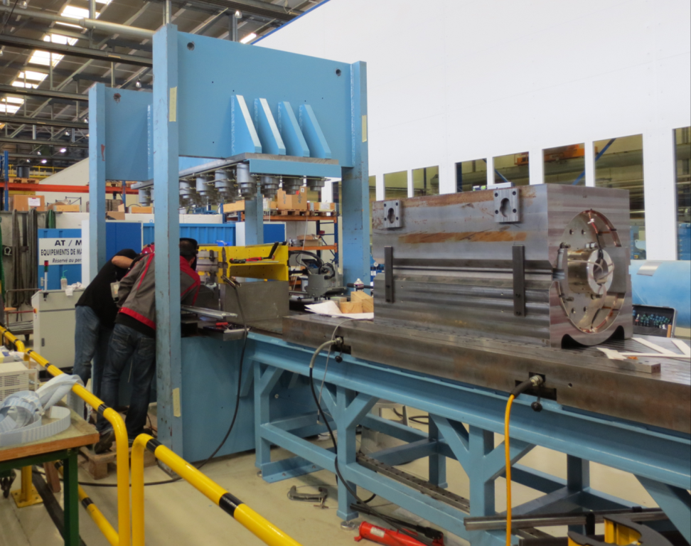
The mockup test welding assembly & instrumentation:
back
front
A
B
Assembly
CTF yoke
Al dummy coil
Test welding girder
Transfer table & assembly bench
CTF yoke and dummy coil required specific shimming in order to provide
the required yoke gap; The assembly work was performed in several iteration
in order to reach the geometrical welding requirements.

Slide 15
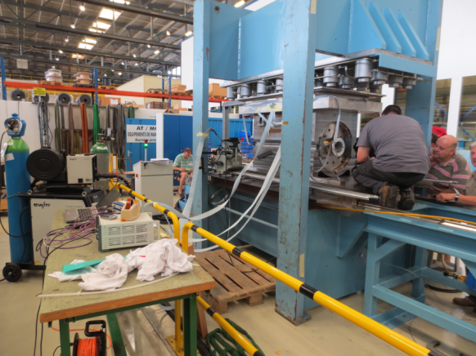
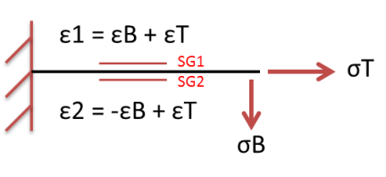
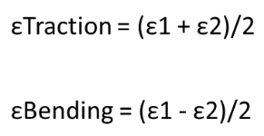
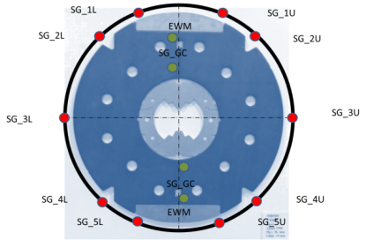
Assembly consists of 2x500 mm long dummy yokes (CTF version):
Schell stress and yoke gap closure instrumentation:
48 strain gages
Welding and yoke gap:
Feeler gage
Calipers
Instrumented on inner and outer shell surface:
X
8 gages / gap closure
X
Z
Y
Weld shrinkage 20 gages
Weld shrinkage 20 gages

Slide 16
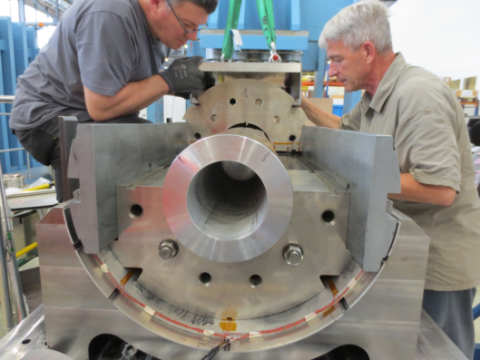
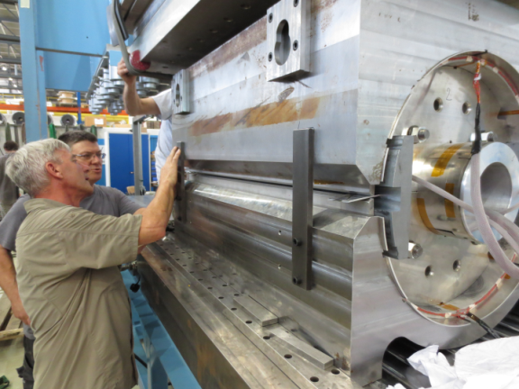
Assembly approach:
Assembly | Yoke shimming Inside [mm] | Yoke shimming Outside [mm] | Al cylinder | Weld gap (0 t/m) | Weld gap
1 | 0 | 0 | 0.5 mm (radius) | 3.5 | 2.6 (200 t/m)
2 | 1.6 | 1.5 | 1 mm (radius) | 4.6 | 3.5 (250 t/m)
inside
outside
Welding gap was reduced by 1 mm after closure of the yoke gap.
The assembly approach:
Trial assemblies (3 times):
Pressurizing up to 250 t/m
Welding gap control after each load step;
Shimming iteration to achieve required welding and yoke gap.
Additional sample welding's in parallel:
Test welding's based on sample plates were performed with a 3.2 mm, 3.5 mm, 4 mm welding gap.

Slide 17
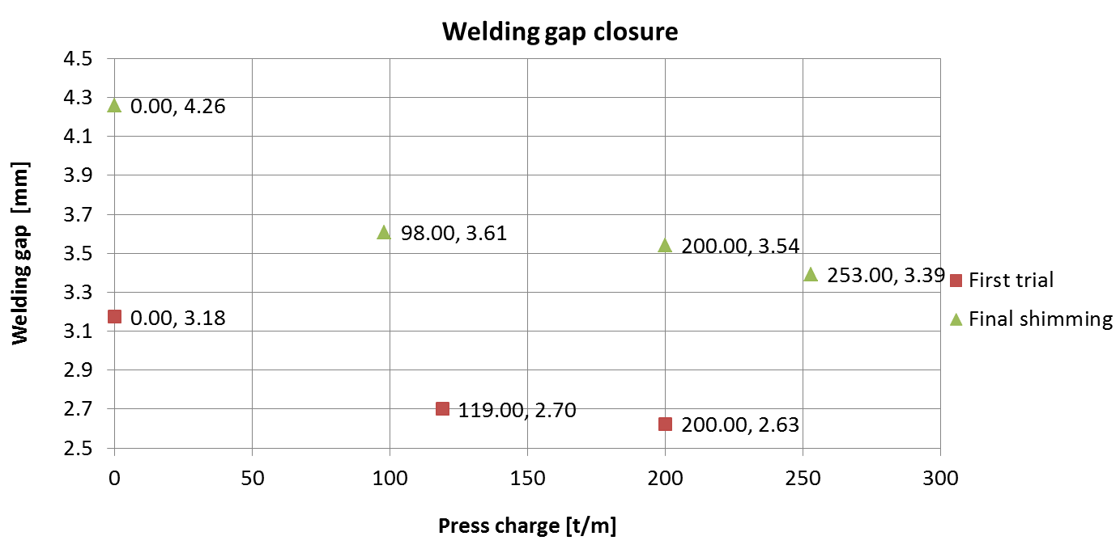
Welding gap dimensions vs. pressure cycle
Trial assembly;
Welding gap control, parallelism and size;
New shimming to achieve required welding gap and shimming;
Pressurizing to close yoke gap;
Dismounting on conveyor;

Slide 18
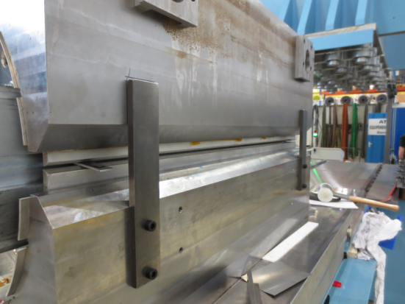
Welding gap dimensions, three positions per side
Non uniform welding gap closure:
Improvement of assembly strategy;
First mockup assembly was performed with reduced recourses;
Shimming and gap measurements to be improved in foreseen test;
New gap instrumentation to be developed (MME).
Assembly guiding
M
F
B
Front
Wedge to close weld gap uniformly

Slide 19
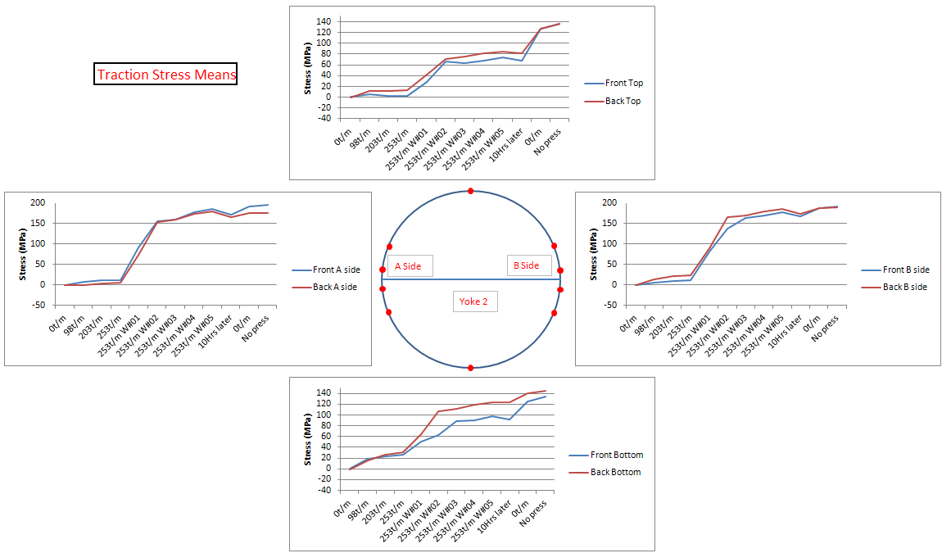
Traction Measurements : Means and longitudinal coherence
Excellent longitudinal behaviour
Slide taken from the summary presentation given by M. Guinchard and A. Gauthier Pastre

Slide 20
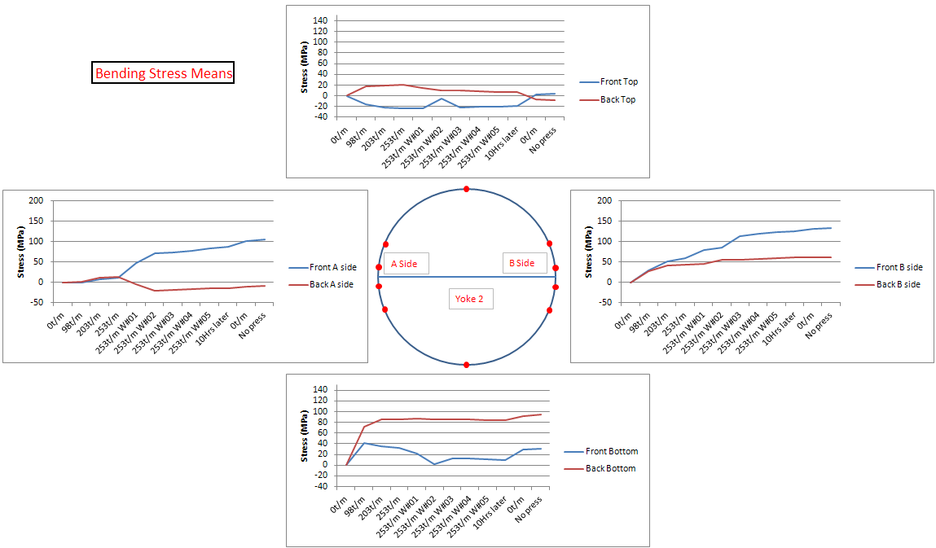
Bending Measurements : Means and longitudinal coherence
The two sides don’t behave in the same way which is simply due to the difference in gaps
Slide taken from the summary presentation given by M. Guinchard and A. Gauthier Pastre

Slide 21
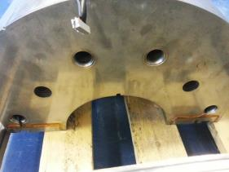
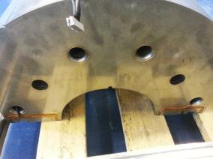
Strain Measurements : Contact at Yokes 1 and 2
1
J1
J2
Y
J3
J4
2
J.5
J.6
J.7
J.8
We measure both traction and bending strains !
Simply to indicate if the Yokes are in contact
Added: Gap closure monitoring requires the development of different metrological approach.
Slide taken from the summary presentation given by M. Guinchard and A. Gauthier Pastre

Slide 22
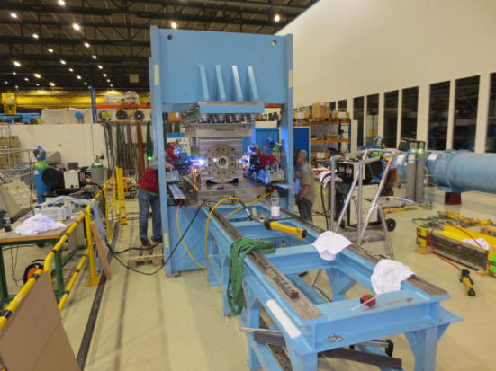
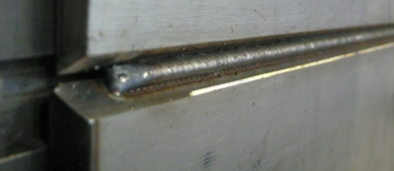
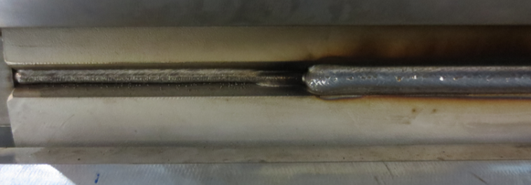
Welding process quality:
First welding pass was not started synchronous (Bside delayed by about 7s);
Some issues due to welding interruption in the second filling pass Aside (related to the welding wire spool);
Filling passes on the Bside were started in position 120, 140 and 160 mm from.
A
B
Amount of weld projections should be reduced
Filling passes on Bside started in different positions

Slide 23
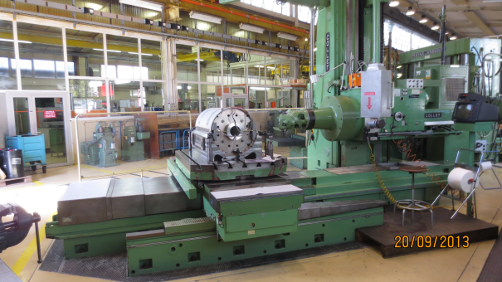
Analysis and further steps:
Destructive and non destructive tests foreseen:
Cutting of mockup foreseen next week, used during open day exhibition;
Inverse stress measurement will be performed to confirm once more the achieved shell stress, instrumentation is ready;
Analysis of side wall fusion;
Tensile test;
X-ray already performed;
Metallographic analysis of specific regions foreseen.
Next steps:
Confirming once more the shell dimensions based on final yoke (next week);
Discussing alternative solutions, with respect to the amount of investment and the CERN procurement rules;
Writing specifications for the seam tracking and the evt. upgrade of the control system system for the 15 m long welding press;
Improving assembly strategy by implying final hoisting devices and shimming approaches.
Launching the order for (ideally 4) welding posts and the related seam tracking system;

Slide 24
Conclusion:
Sample welding press was refurbished and is operational (First mockup welded);
Welding technology successfully developed with the company EWM;
Mockup test welding has shown that the required shell stress can be built up;
Metallurgical analysis performed after cut opening;
Discussions with alternative supplier ongoing;
Further work required to bring large welding press online, staying compatible with the LHC dipole welding

Slide 25
Additional slide :
Welding gap - Yoke gap closure (0 t/m – 250 t/m):

