Slide 1
11 T Dipole Project Status
M. Karppinen on behalf of CERN-FNAL collaboration
“Demonstrate the feasibility of Nb₃Sn technology for the DS collimation upgrade with an accelerator quality 5.5-m-long twin-aperture 11 T prototype dipole by 2015”

Slide 2
Contributions & Acknowledgements
FNAL:
N, Andreev, G. Apollinari, E. Barzi, R. Bossert, G. Chlachidze,
J. Coghill, J. DiMarco, D. Mitchel, F. Nobrega, I. Novitski, G. Wilson, A. Zlobin,...
CERN:
B. Auchmann, A. Ballarino, A. Bonasia, S. Bermudez,
N. Bourcey, A. Cherif, S. Clement, A. Gerardin, M. Guinchard, L. Bottura, C. Kokkinos, B. Favrat, L. Favre, C. Fernandes, P. Fessia, R. Gauthier, B. Holzer, S. Izquierdo Bermudez, G. Kirby, F. Lackner, T. Lyon, G. Maury, J. Mazet, N. Mena, R. Moron-Ballester, J-M. Mucher, J. Murtomaki, L. Oberli,
J-C. Perez, L. Rossi, T. Sahner, F. Savary, J.-M. Scigliutto, L. Remandet, S. Russenschuck, S. Sgobba, E. Todesco, D. Tsirigkas,…

Slide 3
Outline
DS upgrade
Design challenges
Magnetic design
Mechanical design
Pole loading concept and CERN coil design
Model program status and plans:
  FNAL
  CERN
Summary

Slide 4
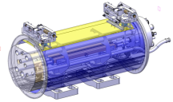
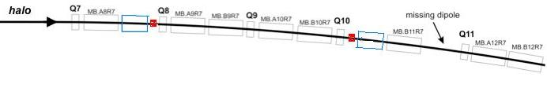
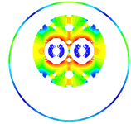
DS Upgrade
Create space for additional collimators by replacing 8.33 T MB with 11 T Nb₃Sn dipoles compatible with LHC lattice and main systems.
119 Tm @ 11.85 kA
(in series with MB)
MB.B8R/L
MB.B11R/L
11 T Nb₃Sn
15,66 m (IC to IC plane)
LS2 : IR-2
  2/4 MB => 4/8 x 5.5 m CM + spares
LS3 : IR-1,5 and Point-3,7
  4 x 4 MB => 32 x 5.5 m CM + spares
5.5 m Nb₃Sn
5.5 m Nb₃Sn
3 m Collim.
5.5 m Nb₃Sn
5.5 m Nb₃Sn
3 m Collim
Joint development program between CERN and FNAL underway since Oct-2010.

Slide 5
11 T Nb₃Sn Dipole Design Challenges
Iron saturation effects
  Modified MB Yoke
  Cross-talk between apertures
Transfer function matching with MB
  More turns (56 vs. 40)
  Iron saturation
Dynamic effects
  Strand development
  Cored cable
Coil fabrication
  Cable development
  Electrical insulation
  Nb₃Sn specific tooling and fabrication process
  Reproducibility & Handling
Quench protection
  Heater development
  Instrumentation
Mechanical structure
  Forces almost 2 X MB
  First 2-in-1 Nb₃Sn magnet
Thermal
  Resin impregnated coils
Integration
  Optics
  Cold-mass
  Collimator
  Machine systems

Slide 6
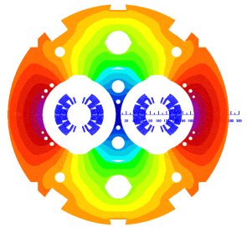
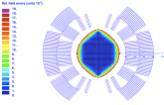
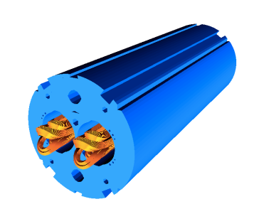
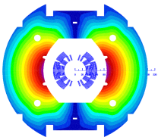
Magnetic design: Coil Optimization
B₀(11.85 kA) = 11.25 T
B₀(11.85 kA) = 10.86 T
11.25 T at 11.85 kA with 20% margin at 1.9 K in
60 mm bore and straight 5.5-m-long coldmass
Systematic field errors below the 10⁻⁴ level
6-block design, 56 turns (IL 22, OL 34)
14.85-mm-wide 40-strand Rutherford cable, no internal splice
Coil ends optimized for low field harmonics and minimum strain in the cable

Slide 7
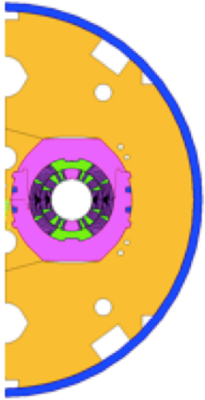
11 T Model Dipole Magnetic Parameters
Notes:
Twin-aperture of two flavours

Slide 8
Mechanical Design Choices & Goals
Separate collared coils
  Most of the coil pre-stress obtained by collaring
  Symmetric loading
  Better control of pre-stress
  Testing of collared coils in 1-in-1 structure
Vertically split yoke
  Assembly process less influenced by friction (vs. horizontal split)
  Closed gap at RT and up to 12 T to provide rigid support for the collared coil
  Better controlled (collared) coil deformation
Welded stainless steel skin
Coil pre-stress
  Within 0..-165 MPa at all times
  Minimal elliptic deformation
  Minimal stress gradient in the coils
  Easy tuning of pre-loading by shimming
  Minimize discontinuous loading and shear stress (end regions)

Slide 9
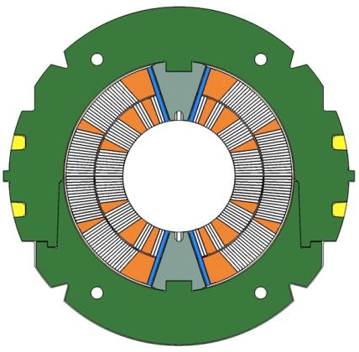
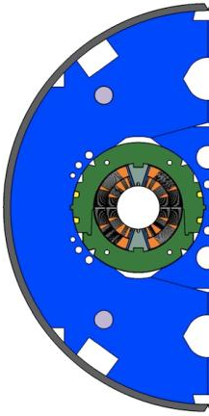
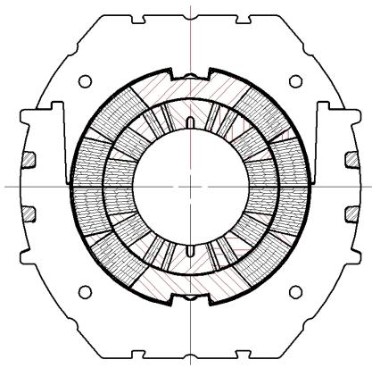
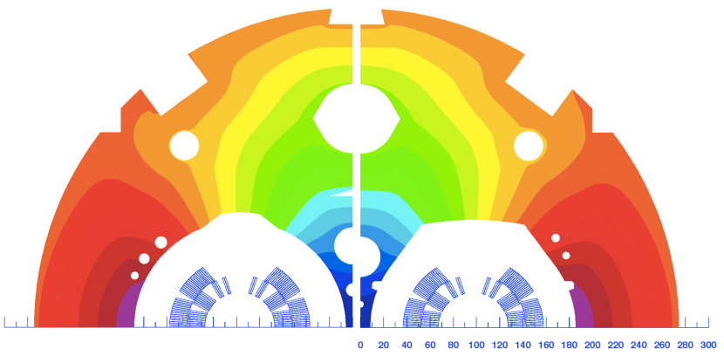
Mechanical Design Concepts
CERN FNAL
Pole loading design
Integrated pole design

Slide 10
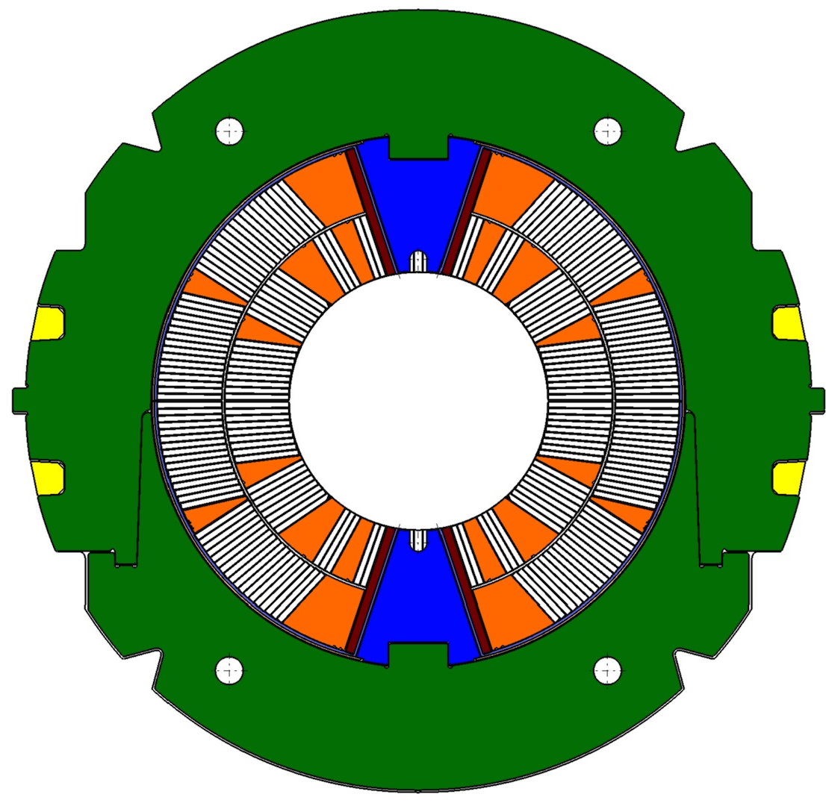
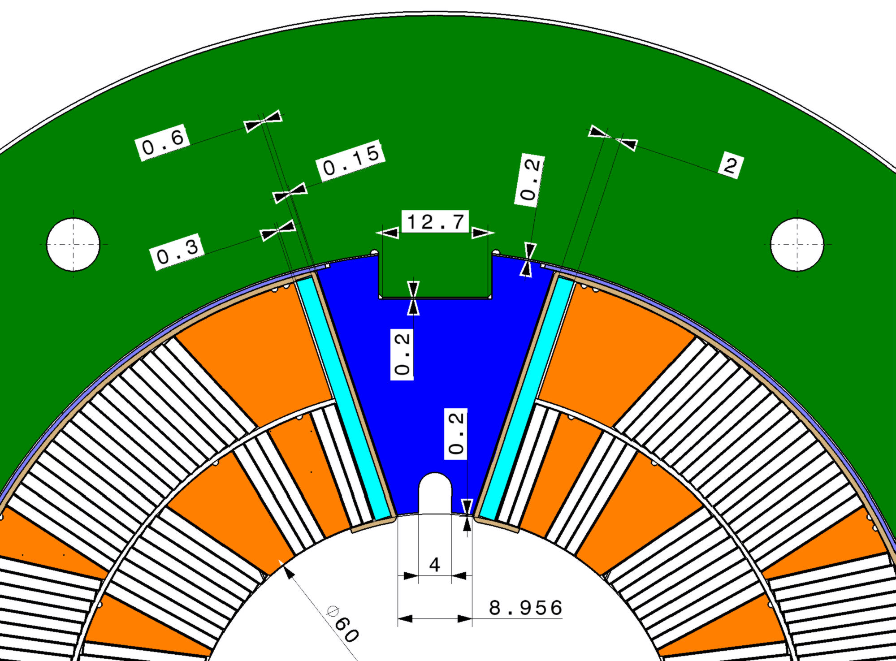
Pole Loading Concept
Shim
Loading plate
Filler
wedge
Pole wedge

Slide 11
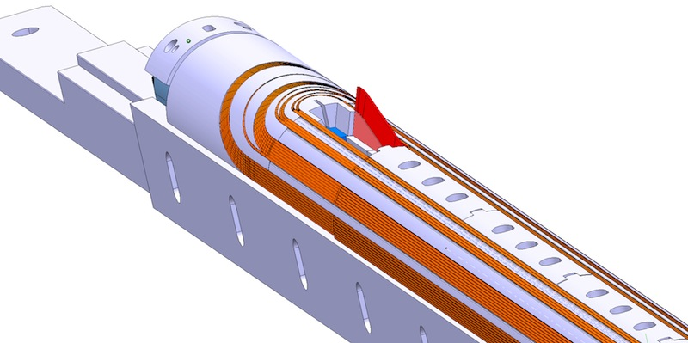
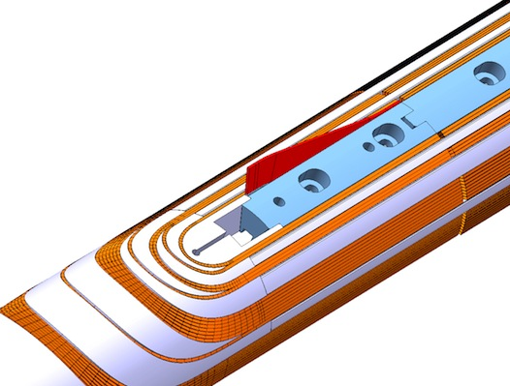
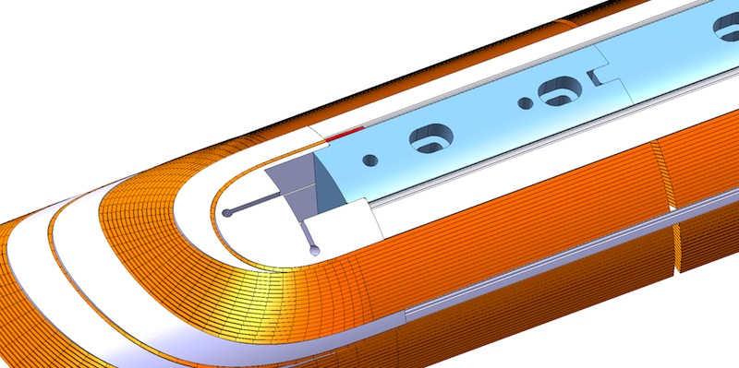
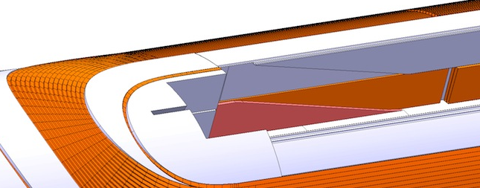
Pole Loading Concept:
Lead End Winding
Inner layer winding pole
Ceramic filler piece
Filler wedge
Outer layer winding pole
Layer-jump region with cable removed

Slide 12
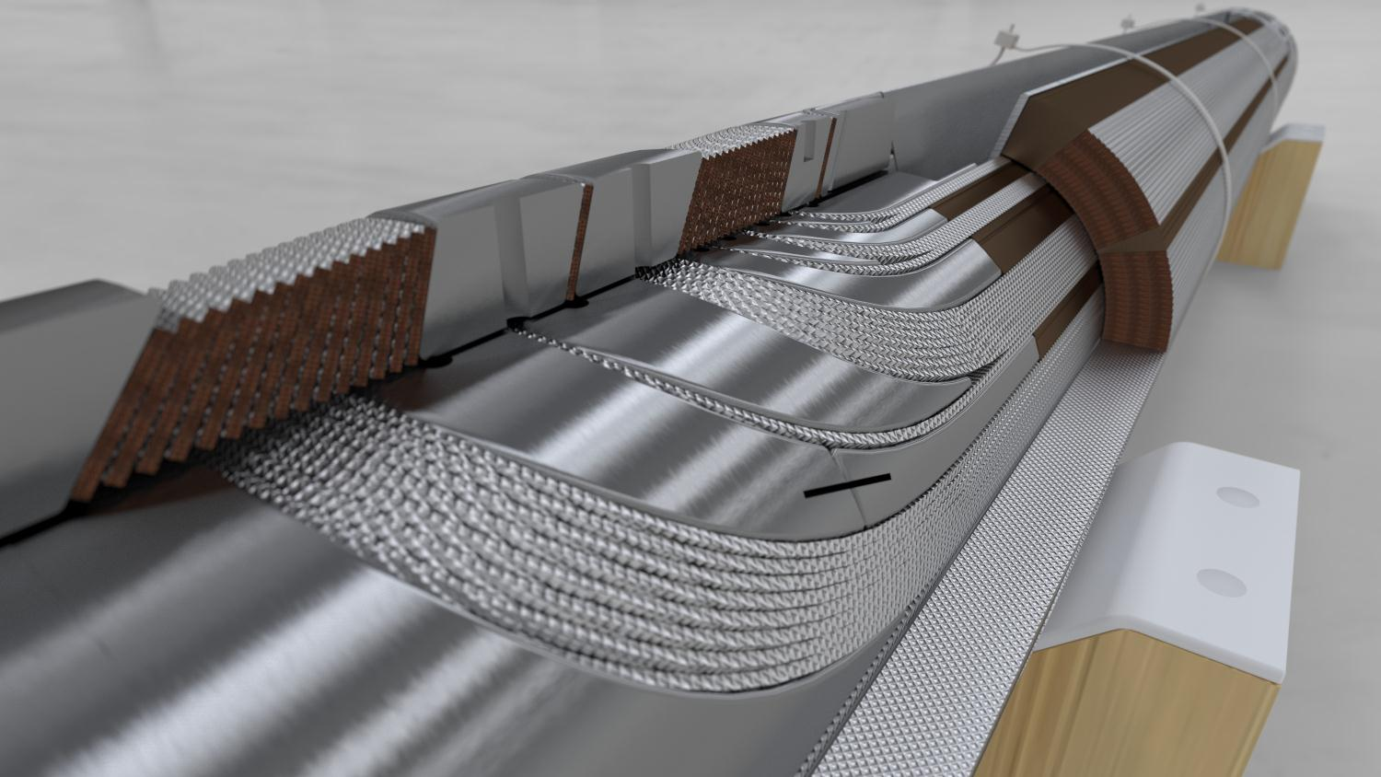
CERN 11 T Dipole Coil
Loading plate
2 mm 316LN
SLS End Spacers
with “springy legs”
ODS Cu-alloy
Wedges
Braided 11-TEX S2-glass
on “open-C” Mica sleeve
Interlayer protection
heater R&D
Courtesy of D. Mitchell, FNAL

Slide 13
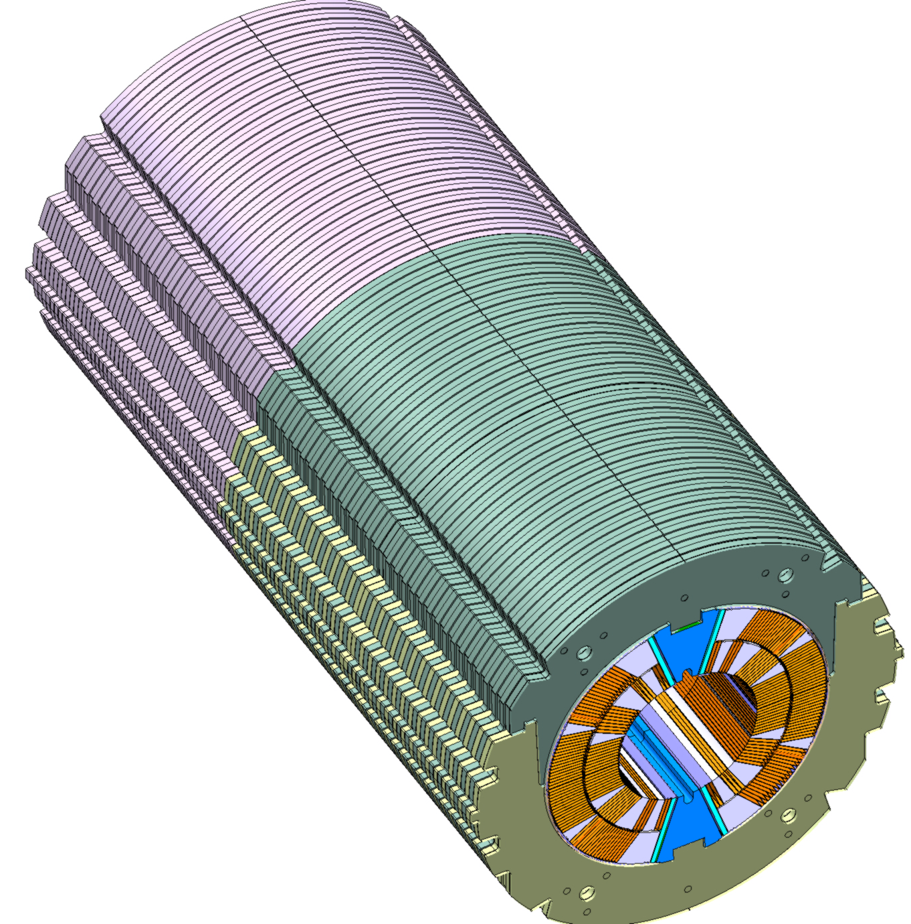
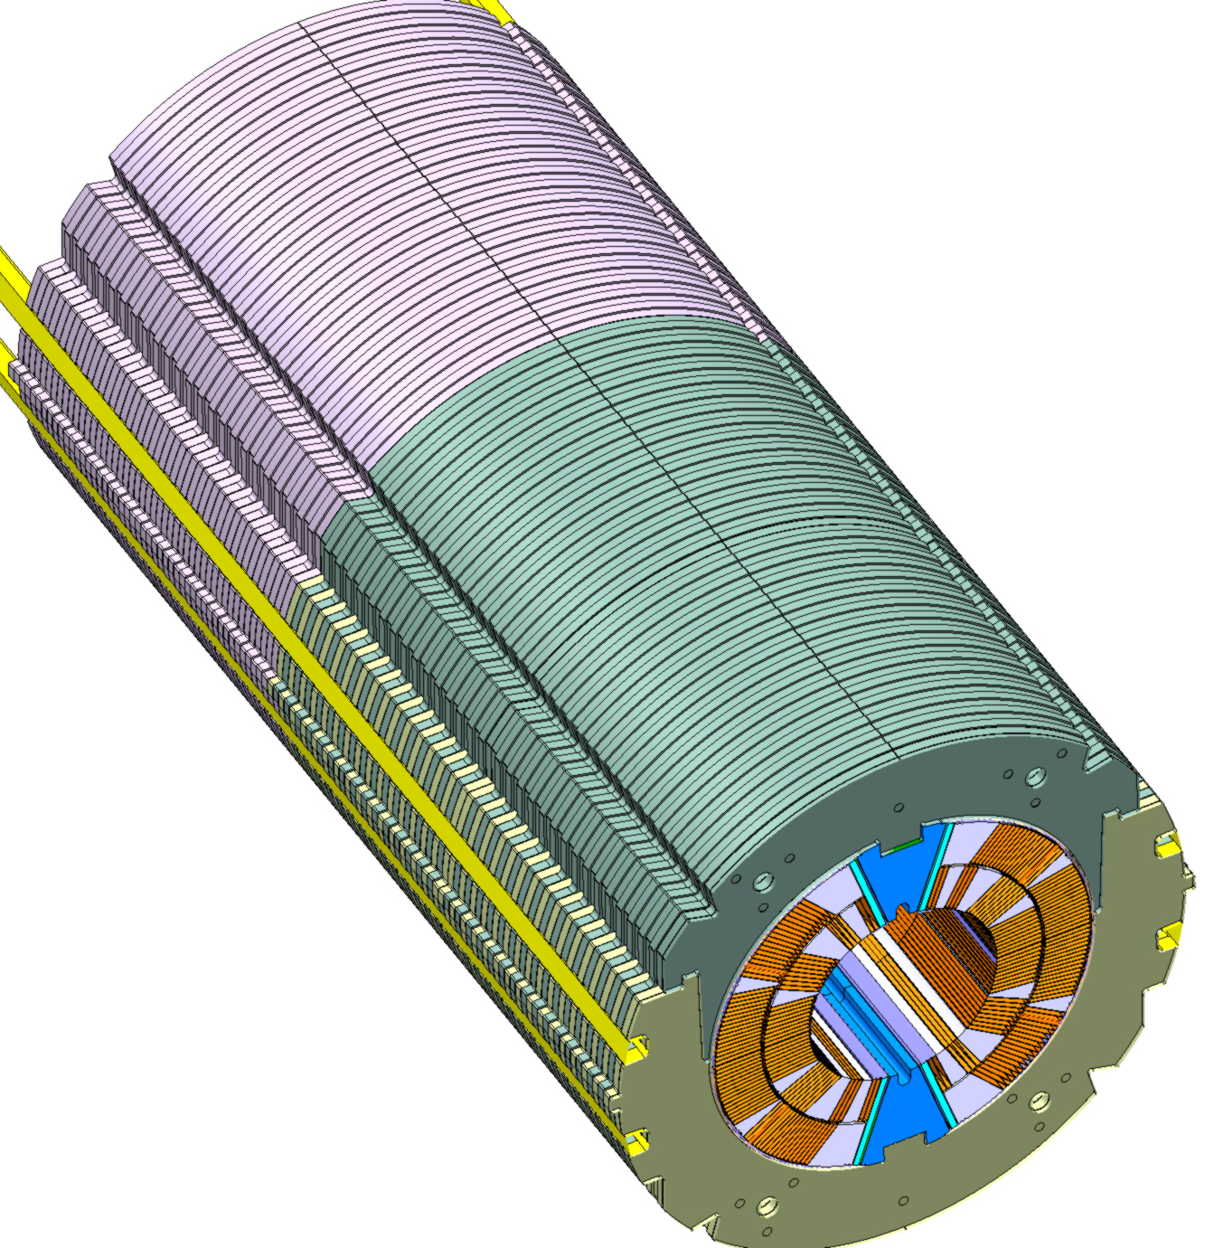
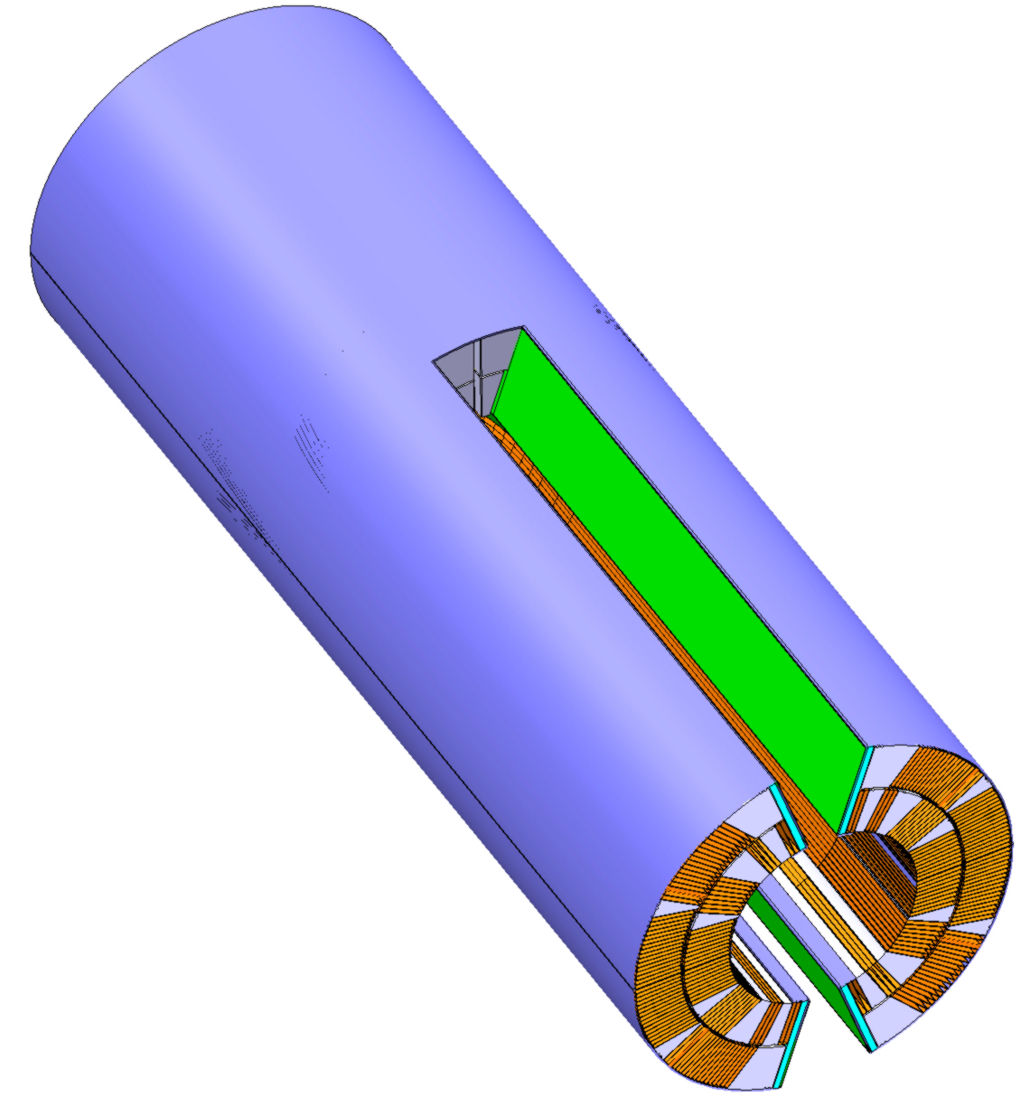
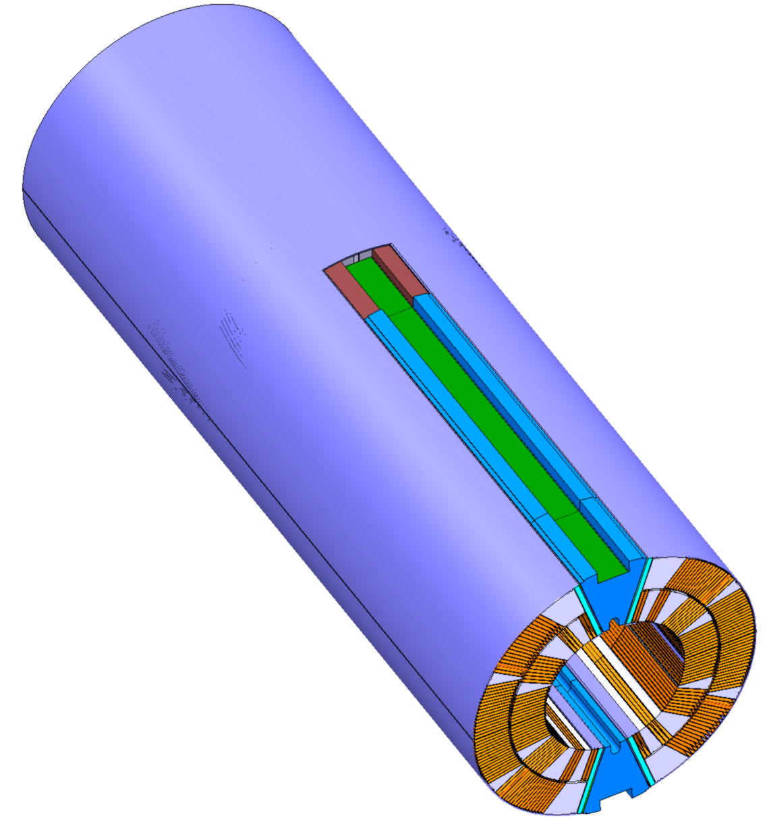
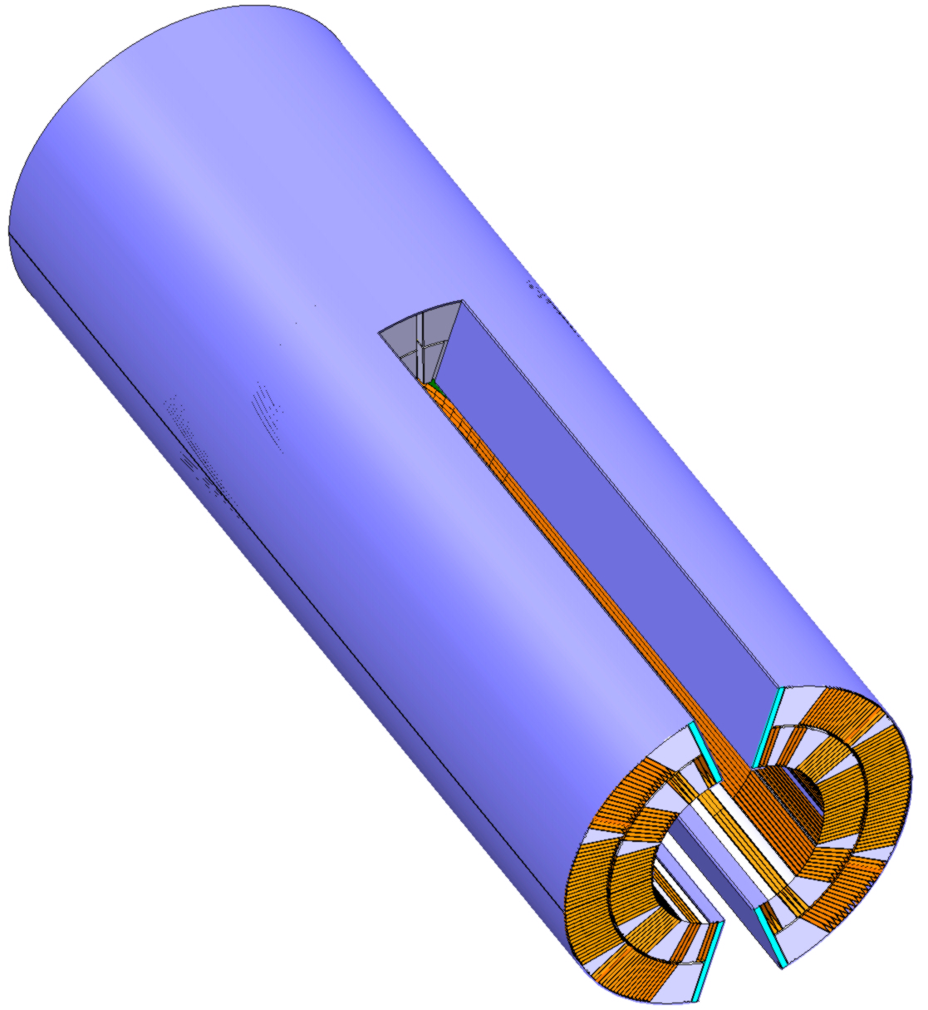
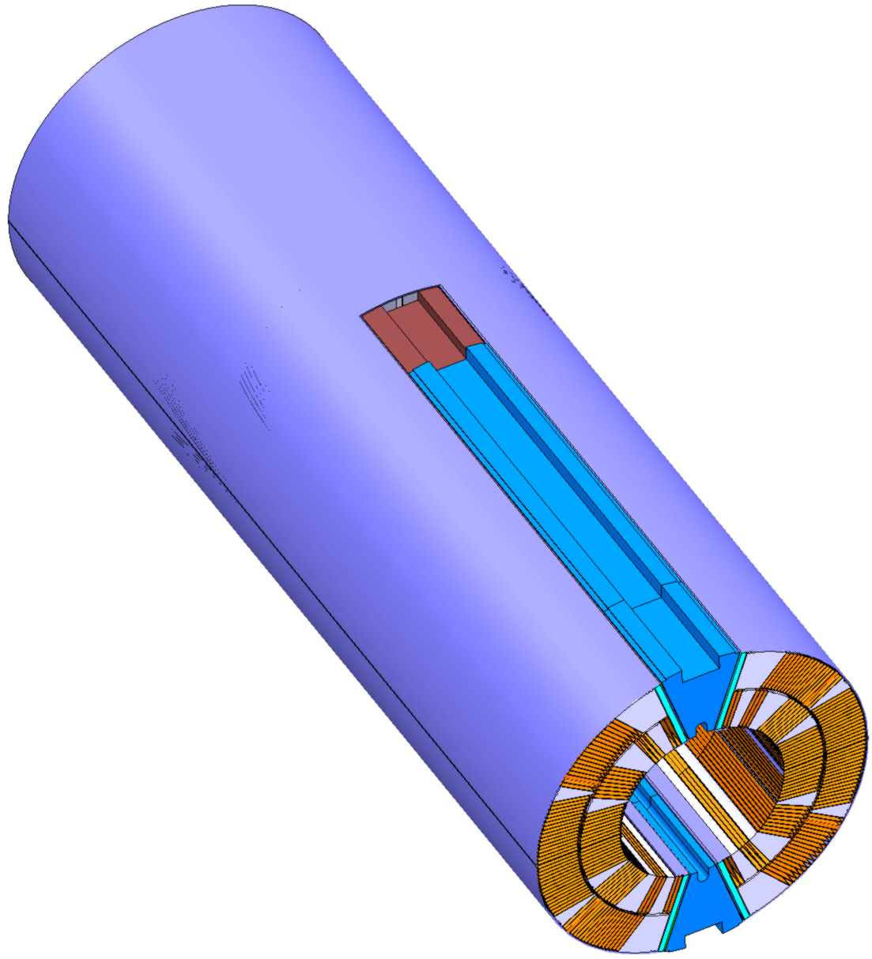
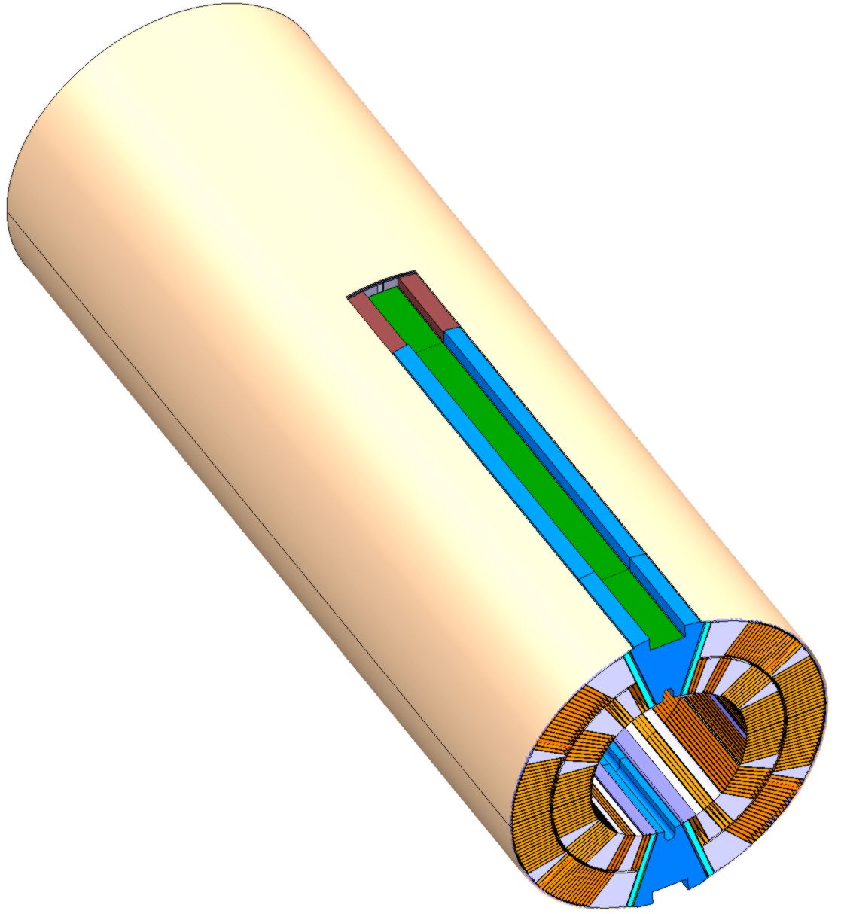
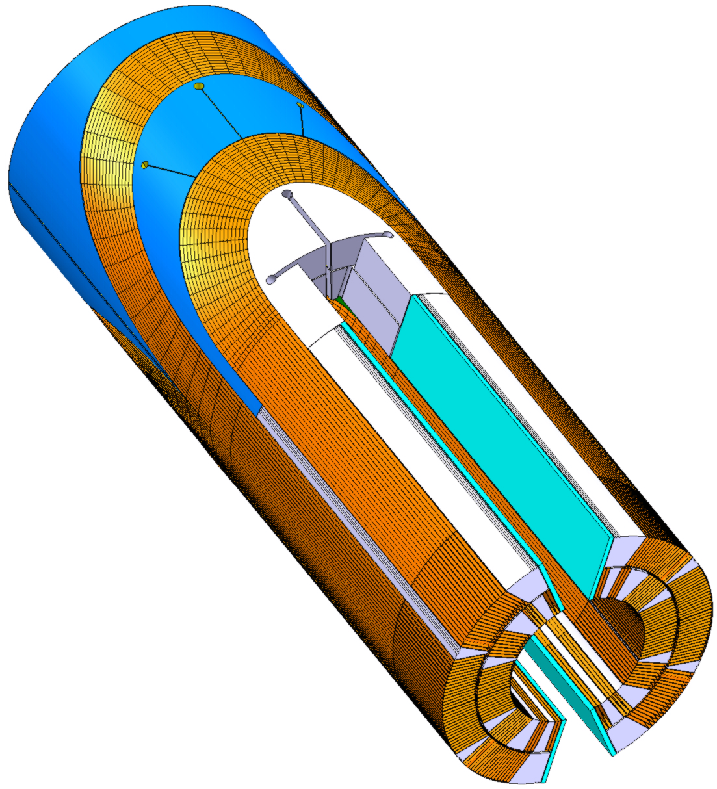
Collared Coil Assembly

Slide 14
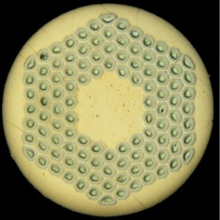
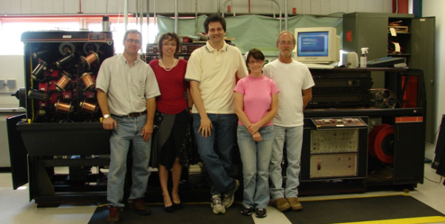

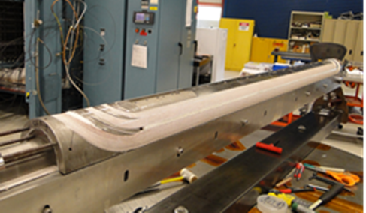
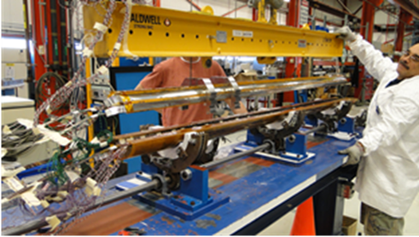
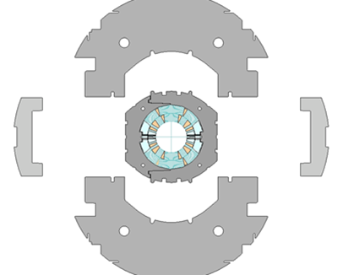
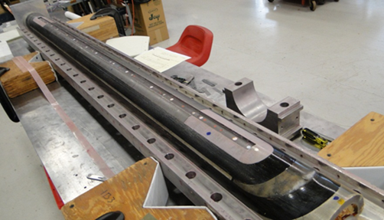
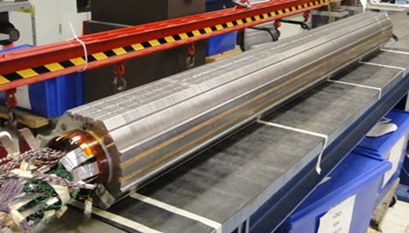
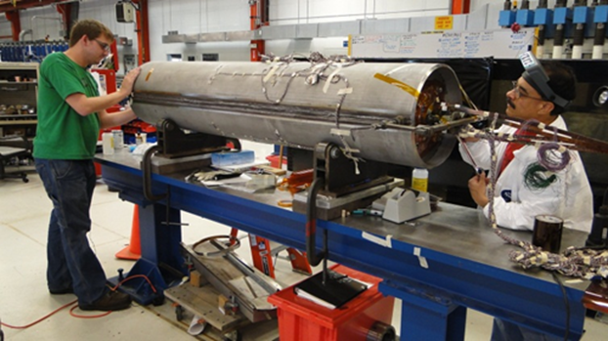
FNAL MBHSP01
1-in-1 Demonstrator (2 m)
40-strand cable produced with FNAL cabling machine
OST RRP-108/127
Coil fabrication
Collared coil assembly
Cold mass assembly
Magnet development and fabrication was done in record time – 18 month!

Slide 15
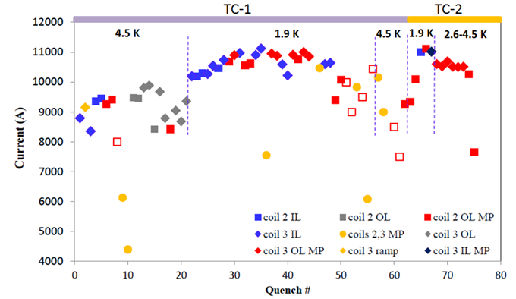
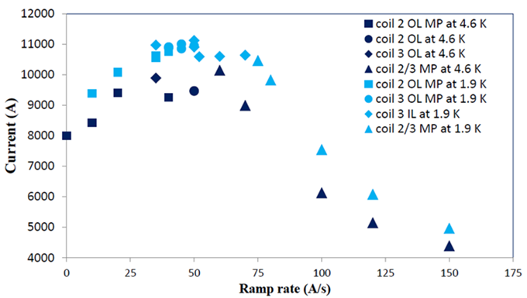
MBHSP01 Quench Performance
Design goal:
  B_{nom}=11 T with 20% margin
Limited quench performance
  B_{max}=10.4 T at 1.9 K and 50 A/s (78% of SSL)
  long training
  conductor degradation
  irregular ramp rate dependence
Quench performance was limited by conductor degradation in coil OL mid-plane blocks and leads
  lead damage during reaction - confirmed by autopsy
Appropriate improvements implemented in MBHSP02
A.V. Zlobin et al., ASC2012, Sept 2012
Quench history
Ramp rate dependence

Slide 16
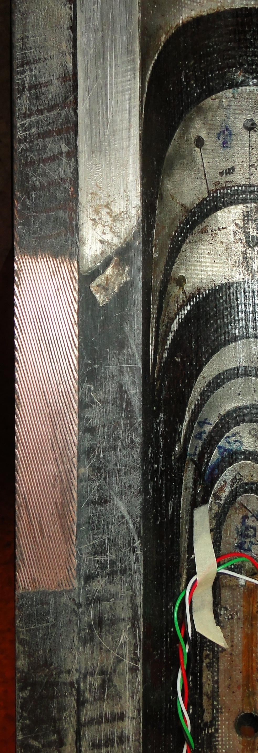
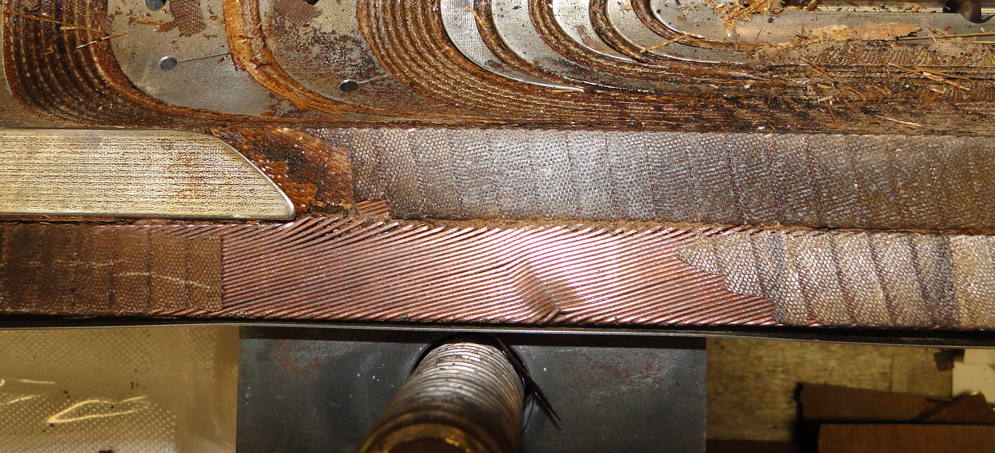
MBHSP01 Autopsy
Coil #3
Used in MBHSP01
Strand spacing!
Cable width!
Coil #4
(scrapped)

Slide 17
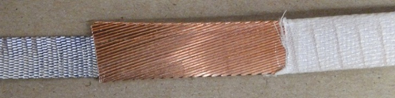
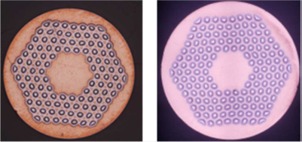
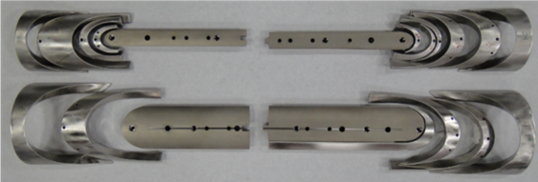
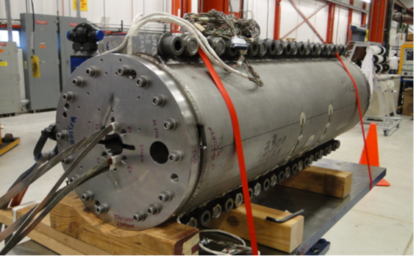
MBHSP02-03 - 1 m Versions of MBHSP01
40-strand cored cable
RRP 108/127
RRP150/169
Goals: demonstrate new R&D strand, cored cable, improved process and reproducibility
Strand (ø0.70 mm):
  MBHSP02 – R&D RRP-150/169 strand
  MBHSP03 – baseline RRP-108/127
Cable: both models use 40-strand cable with 12-mm-wide and 0.025-mm-thick stainless steel core
Coil: optimized end parts and process
Structure:
  MBHSP02 – modified MBHSP01 collar
  MBHM01 – mirror magnet (with bolt on skin)
  MBHSP03 – new collar (with bolt on skin)
MBHSP02 fabrication - 6 months!
Optimized end parts
MBHSP02 cold mass
MBH09 coil winding

Slide 18
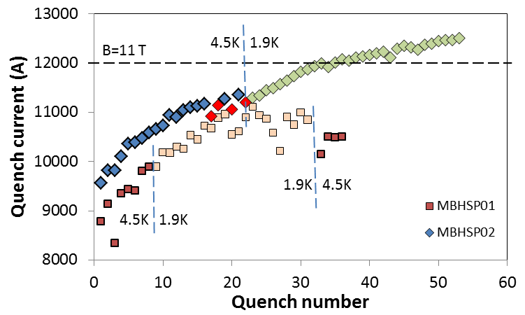
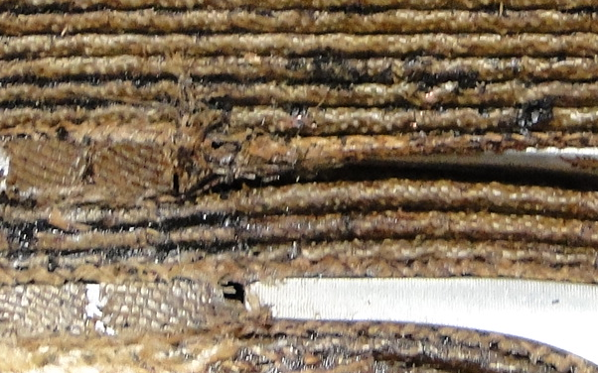
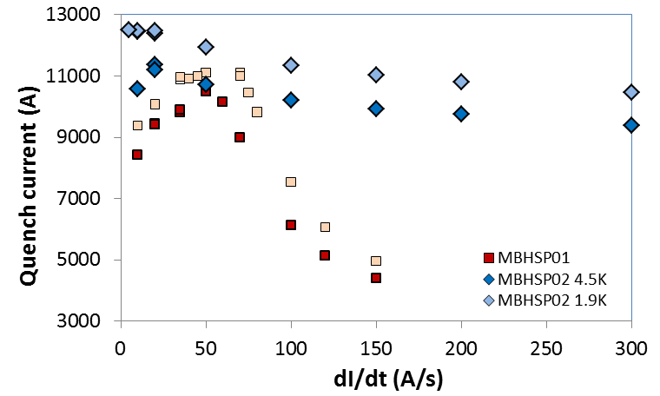
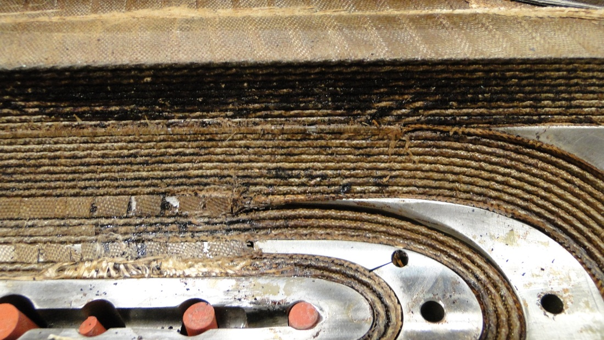
MBHSP02 Quench Performance
Improved quench performance
  B_{max}= 11.7 T – 97.5% of design field B=12 T (78% of SSL at 1.9 K)
Issues to be addressed
  Long training
  Some conductor degradation
  Negative ramp rate dependence at dI/dt<20 A/s and 4.5 K
Magnet training
Ramp rate dependence

Slide 19
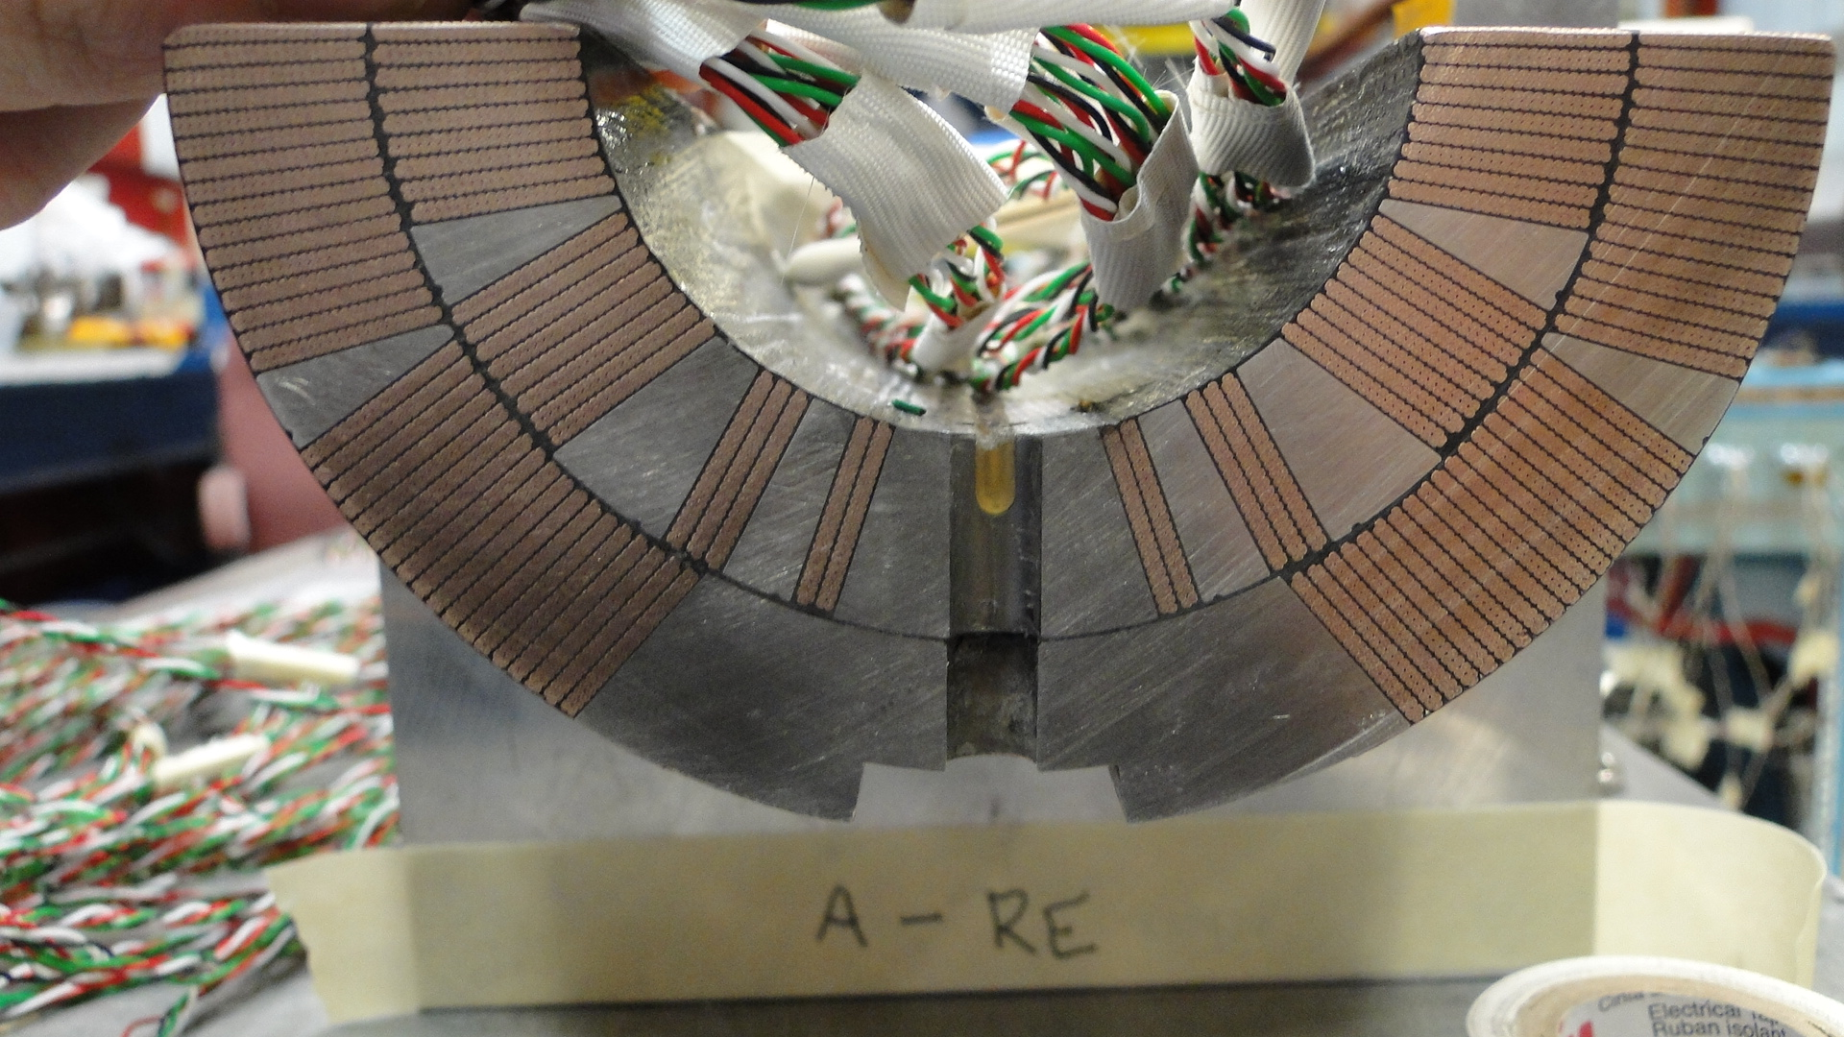
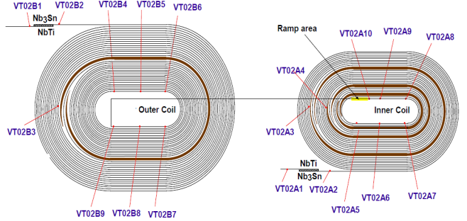
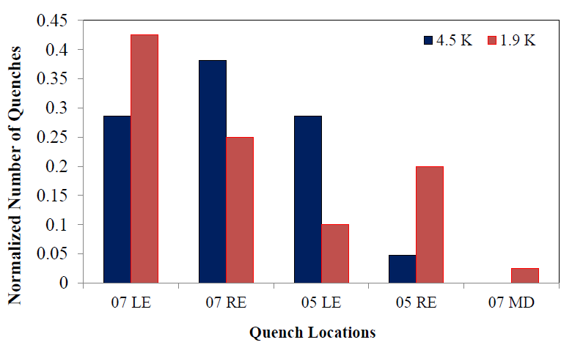
MBHSP02 Quench Locations
Most training quenches in winding blocks 2 & 3 of coils #5 and #7 both at 1.9 K and 4.5 K
Quench locations moved to the mid-plane area (block 5) of coil #7 at the end of 4.5 K training
All holding quenches in outer layer mid-plane area of coil #7
Practically all quenches in the end regions
4
6
3
2
5
1
Quench Antenna
Voltage tap location

Slide 20

FNAL Short Model Program
MBHSP01 (2 m) and MBHSP02 (1 m) have been tested.
Coil #8 will be tested in Mirror, MBHSM01. Assembly in progress. Test Oct-2013
Assemble and test MBHSP03 (1 m, 1-in-1) using coils #9-10, Dec-2013
Assemble and test the MBHDP01 (1 m, 2-in-1) using collared coils from MBHSP02 and MBHSP03, Feb-2014
Assemble and test MBHSP04 (1 m, 1-in-1) using coils #11-12, Apr-2014
Assemble and test MBHDP02 (1 m, 2-in-1) using collared coils from MBHSP04 and coils #13-14, Jul-2014
Courtesy of D. Mitchell, FNAL

Slide 21



CERN Construction Status
Coil fabrication tooling:
  Winding, curing, and reaction operational
  Vacuum impregnation system commissioned
Practice coil fabrication
  PC-#1-2 (Cu-cable) reacted and impregnated
  PC #3 Nb₃Sn (low-Jc WST strand) scrapped
  Nb₃Sn (RRP-54-61) CMM done, to instrument
Magnet R&D:
  Cable insulation (braided S2-glass & Mica)
  ODS (oxide dispersion strengthened) wedges
  Selective laser sintering (SLS) end spacers
  Coil pre-loading concept (“pole-loading”)
  Magnet protection (inter-layer heater)
Coil reaction
Coil impregnation
Reacted Nb₃Sn (RRP-54/61) coil

Slide 22
CERN Construction Status..
Coil fabrication:
  MBHSP104 (RRP-108/127 #1) ready to react
  MBHSP105 (RRP-108/127 #2) wound and cured
  MBHSP106 (RRP-108/127 #3) wound and cured
  Winding trials underway with trial lengths of cable with reduced keystone angle to assess the mechanical stability.
Cold mass:
  Collars (EDM) for the 1st aperture assembled in packs.
  Fine-blanking of collars for AP-2..5 underway
  Laminations (EDM) for two 1-in-1 yokes in stock
  Laminations (EDM) for one 2-in-1 yokes in stock
  End plates for two 1-in-1 magnets in stock
  Welding trials for 1-in-1 cold mass carried out
  12-mm-thick 304 L shells for 1-in-1 models in production
  15-mm-thick 316 LN shell for 2-in-1 models ordered and welding trials planned.
  Tooling in commissioning

Slide 23
CERN Short (2 m) Model Program
  Assemble RRP-54/61 coil with RRP-108/127 coil #1 as a practice model to validate the assembly process and tooling. Ideally carry out WMM and short cold test Dec-13 . This is the present Plan A
OR
  Assemble and test the RRP-54/61 (or RRP-108/127 coil #1) coil as single coil assembly (MBHSS101) using existing collars, yoke, welded outer shell, and end plates. Plan B
Two RRP-108/127 coils to assemble and test the 1st 1-in-1 model (MBHSP101) Feb-14
Two RRP-132/169 coils to assemble and test the 2nd 1-in-1 model (MBHSP102) May-14
Collared coils from MBHSP101 & 102 to assemble and test the 1st 2-in-1 model (MBHDP101) Aug-14
Idem for PIT-cable: 2 x 1-in-1 model (MBHSP103-4) to have tested collared coils for the 2nd 2-in-1 model (MBHDP102). Mar-15, May-15, Jul-15

Slide 24





CERN Single Coil Assembly
Courtesy of C. Kokkinos & T. Lyon CERN TE-MCS
Aftrer assembly at 293 K
At 1,9 K, 11.02 T, 14.1 kA
Azimuthal coil stress (Mpa)
Azimuthal coil stress (Mpa)

Slide 25

CERN Practice Model Schedule
Reaction furnace
Impregnation tank

Slide 26

CERN 1st 2-in-1 Model Schedule
Mar-Apr 2014
Jun-Jul 2014
1-in-1 #1 Test
Aug-Sep 2014
1-in-1 #2 Test
2-in-1 #1 Test

Slide 27

CERN 2nd 2-in-1 Model Schedule
Apr - 2015
Jun - 15
Aug -15
1-in-1 #3 Test
1-in-1 #4 Test
2-in-1 #2 Test

Slide 28
CERN Prototype (5.5 m) Schedule
Start with winding trials using Cu-cable:
  simplified trials
  coil with bare cable
  first practice coil with insulated Cu-cable to react and pot (PC-1).
First Nb₃Sn practice coil with possibly low-performance (cheaper) cable (PC-2)
First “real” coil (PC-3) to cold test as a single coil (mirror?)
Four (or eventually more..) more coils for 2 collared coils to construct the full-scale proto and test it around Mid-2016.
the 5.5 m schedule is compatible with the present LMF plans including the major procurements
Additional coil production lines will be required for series magnets
It is also vital to get the industry on board during the prototype construction to be ready for the series units

Slide 29

CERN 5.5 m Prototype Schedule
May-June 2015
July-August 2016
Single coil Qualification Test
5.5-m-long 2-in-1 Prototype Test

Slide 30
Summary
Two 1-in-1 model magnets have been constructed and tested at FNAL reaching 10.5 T and 11.7 T. Reasons for conductor degradation under investigation
Two 1-m-long 2-in-1 magnets scheduled at FNAL by Mid-14
FNAL coil fabrication technology has been transferred to CERN and the first Nb₃Sn coil has been completed
Commissioning of infrastructure longer than expected
First CERN 2-m-long 1-in-1 magnet test expected in Mar-13
Several R&D topics are being investigated as part of CERN 11 T magnet development serving also the interest of other HFM programs
Two short 2-in-1 magnets scheduled by the end of 2015
Work on the 5.5-m-long tooling is underway and the first 5.5-m-long 11 T prototype dipole is expected by Mid-2016

