Slide 1
Fabrication and performance of the cables
for the first short CERN’s model
Luc Oberli
Outline:
Main parameters of the 11 T dipole cable for the short model.
Dimensions of the produced cables.
Performances of the cables determined by Ic and RRR measurements on extracted strands.
Stability measurements on extracted strands.
Conclusion

Slide 2
Main parameters of the 11 T dipole cable
 | Initial dimensions | Nominal dimensions
Width | 14.7 mm | 14.7 mm
Number of strands | 40 | 40
Mid-thickness | 1.269 mm | 1.250 mm
Thin edge | 1.168 mm | 1.149 mm
Thick edge | 1.370 mm | 1.351 mm
Keystone angle | 0.79º | 0.79º
t/2d thin edge | 83.4 % | 82.5 %
t/2d thick edge | 97.8 % | 96.5 %
Compaction factor | 86 % | 87.3 %
Transposition pitch | 100 mm | 100 mm
Notes:
I would like to recall the main parameters of the 11 T dipole cable and to underline that the total compaction of the cable is quite high for a Nb3Sn cable.

Slide 3
Dimensions of the 3 unit lengths fabricated for the first short CERN’s model
Cable ID | Run ID | Length | Width | Mid-thickness at 50 MPa | Sigma | Keystone angle
H15OC0127A | 86A | 237 m | 14.715 mm | 1.2498 mm | 0.001 | 0.78º
H15OC0127B | 86A | 235 m | 14.717 mm | 1.2491 mm | 0.0006 | 0.78º
H15OC0137A | 96A | 218 m | 14.706 mm | 1.2499 mm | 0.003 | 0.78º
The dimensions of the 3 unit lengths are very close.
The value of the mid-thickness is corrected at 50 MPa.
Notes:
I would like to outline that the value of the mid-thickness is corrected at a pressure of 50 MPa.

Slide 4
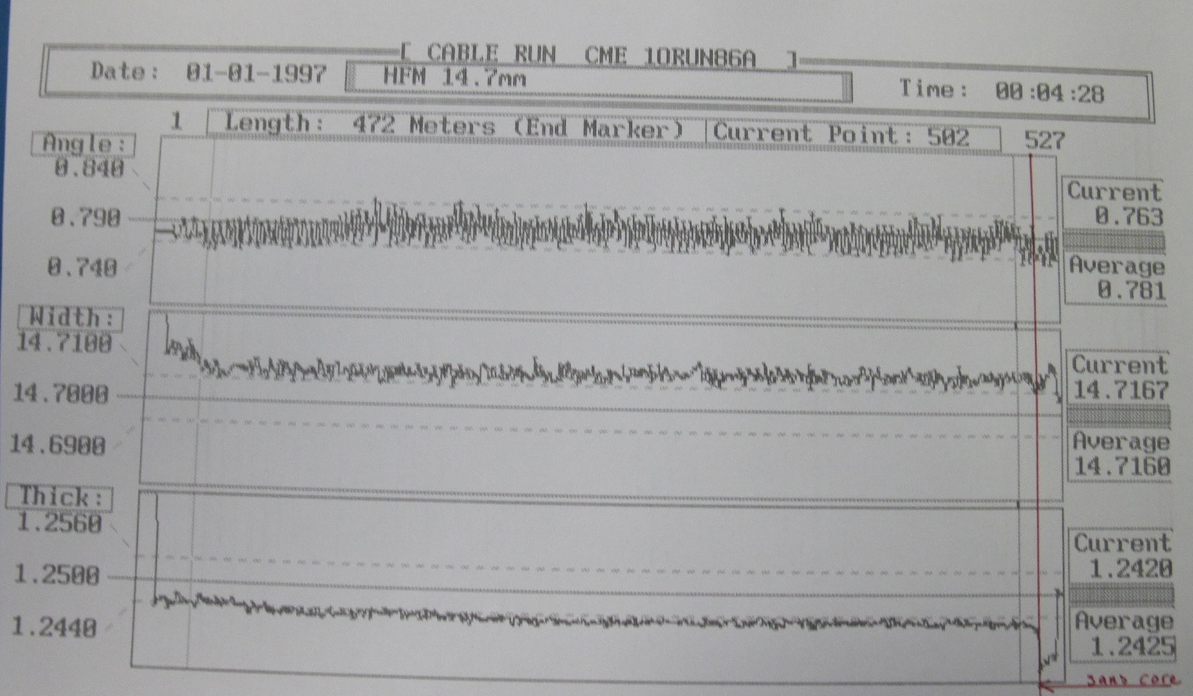

Slide 6
Degradation of the critical current of the cables produced for the first short CERN’s model.
Cable from run 86A
Cable from run 96A
Average Ic degradation is 1.3 % for the cable 86A
Average Ic of the extracted strands at 12 T : 384 A at 4.3 K => Ic^{cable} (12T) = 15460 A
Average Ic degradation is 1.0 % for the cable 96A
Average Ic of the extracted strands at 12 T : 425 A at 4.3 K => Ic^{cable} (12T) = 17000 A
Both cables have a similar degradation.
Notes:
18 strands with Ta doped and 22 strands with Ti doped.
Ti doped strands have much higher critical current than Ta doped strand for 50 h at 640 C. (10% higher)

Slide 7
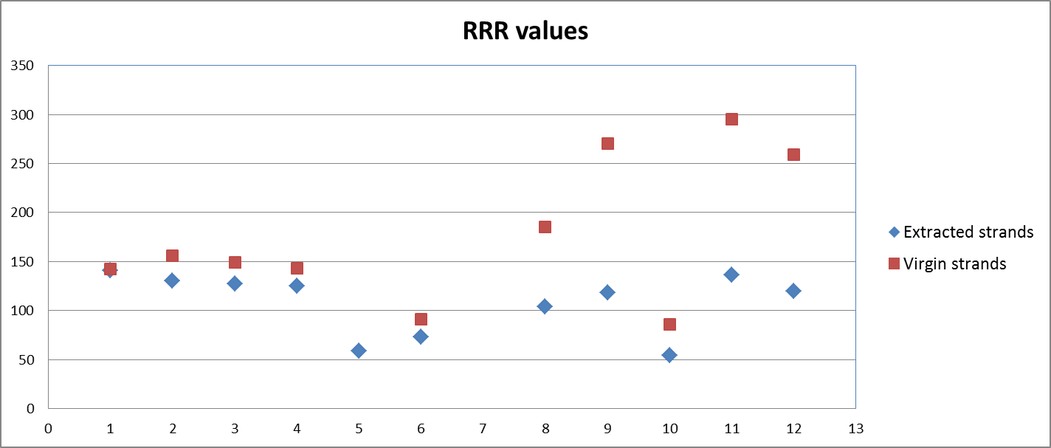
Degradation of the RRR for the cables fabricated with RRP 108/127 strands
A significant drop of the RRR values has been seen for the cable 96 A, even though both cables have the same dimensions and could be considered as real twins.
Same heat treatment for both cables : 48h/210C + 48h/400C + 50h/640C
Cable from run 96A
Cable from run 86A

Slide 8
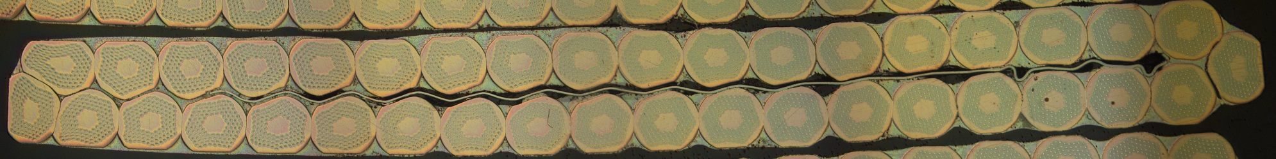
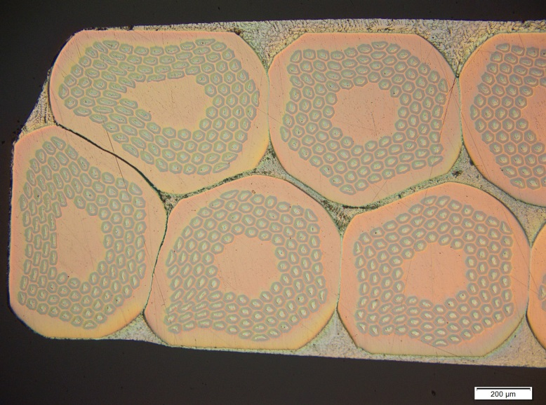
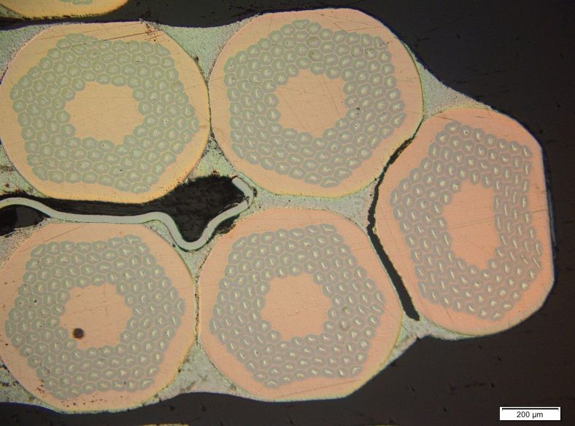
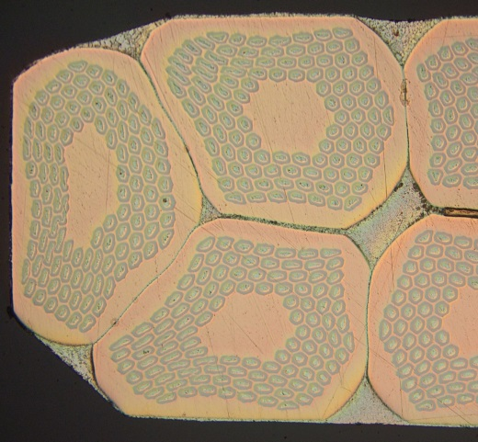
Cross-section of the cable 86 A fabricated with RRP 108/127 strands
The total compaction is quite high (87.3 %), specially at the thin edge of the cable where the filaments are severely distorted by shear stress.
(t/2d = 82.5 %)

Slide 9
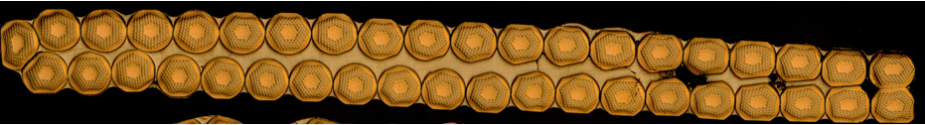
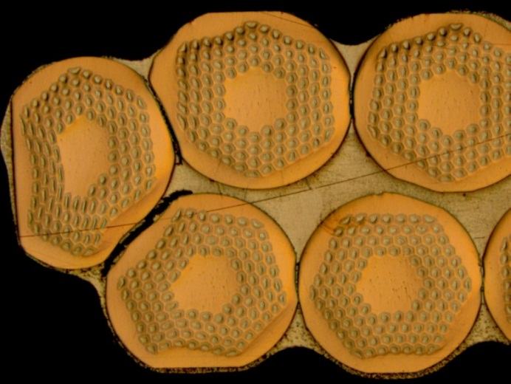
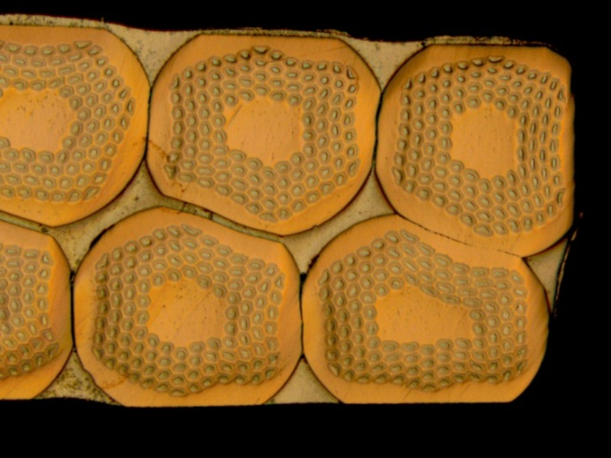
Fabrication of the 1st long cable (Run 62B) for the demonstrator built at Fermilab
Average Ic degradation is 1.5 %
(result obtained on 5 extracted strands)
for the HT 48h/210C, 48h/400C, 50h/665C
3.9 %, 2.1 %, - 0.5 %, 0.4 %, 1.5 %
RRR : 27, 34, 34, 38, 47, 49 with 50h/665C
RRR : 133, 168, 158 with 50h/640 C
Cable fabricated without a core
Cable mid-thickness 1.254 mm
Keystone angle 0.75º

Slide 10
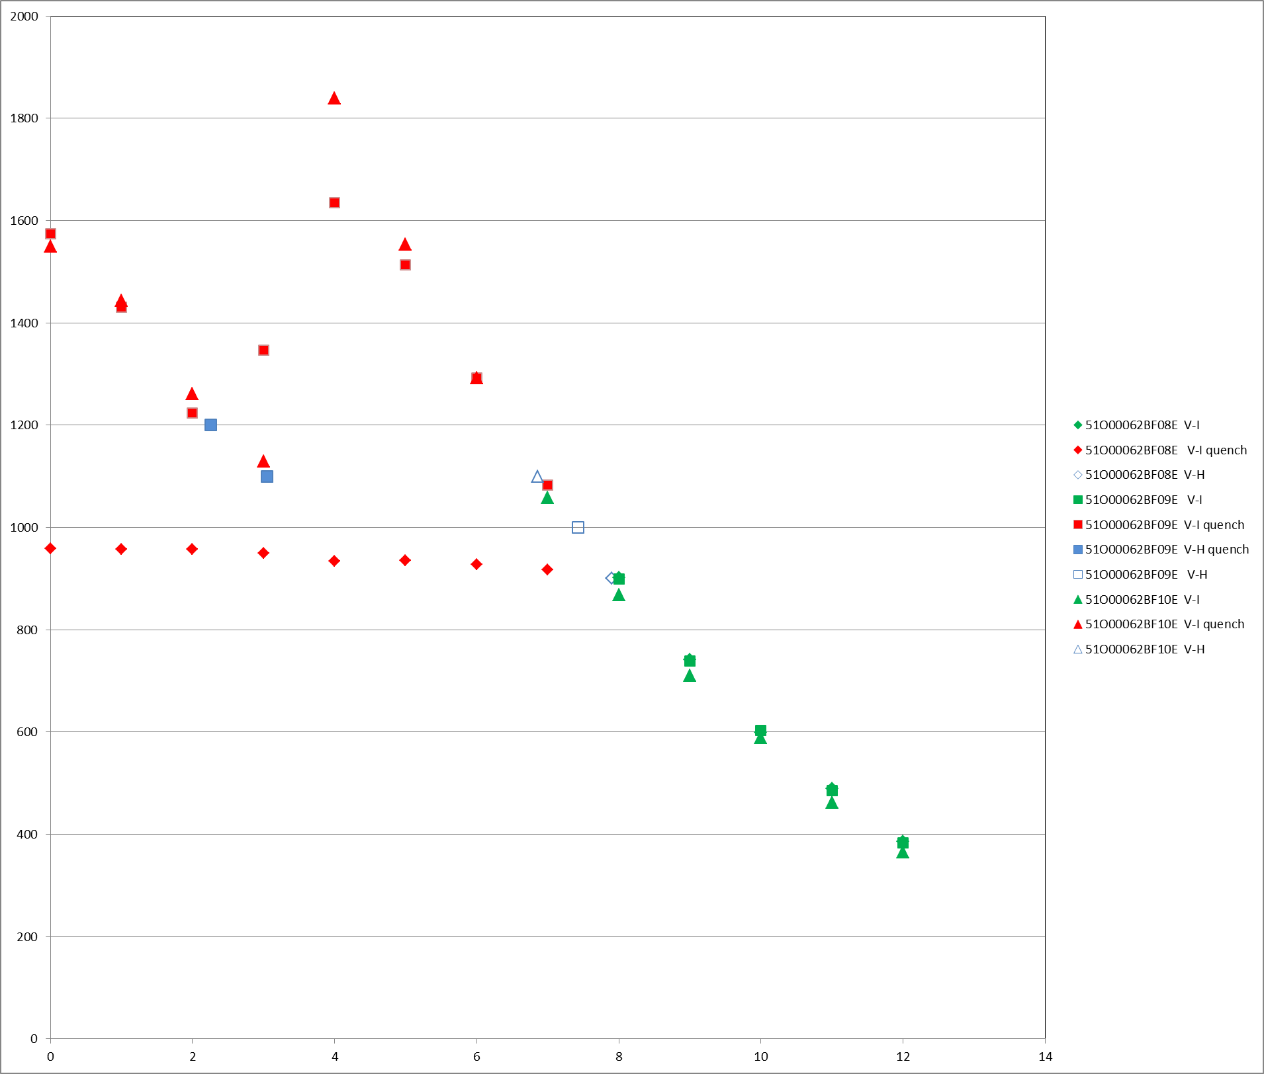
Stability Current Is measured by V-H tests on the cable 62B
T = 4.3 K RRR = 133, 158, 168 for the HT 48h/210C, 48h/400C, 50h/640C
Is = 900 A
a value more than 3 times higher than the value of the current defined by the intersection of the magnet load line with the critical current curve

Slide 11
Degradation of the critical current of the cables produced with PIT strands
Run 85 B: 14.6 mm wide cable , keystone angle 0.71º, mid-thickness 1.25 mm
average degradation 8.5 %
Thin edge ratio (t/2d) = 82.8%
Run 95 B: 14.7 mm wide cable , keystone angle 0.61º, mid-thickness 1.25 mm
average degradation 4.6 %
Thin edge ratio (t/2d) = 83.7 %
14.7 mm wide cable, keystone angle 0.61º, mid-thickness 1.26 3 mm
average degradation 1.5 %
Thin edge ratio (t/2d) = 85.1 %

Slide 12
Conclusion
Small values of Ic degradation were obtained on the cables fabricated with RRP strands: around 1.2 % even though the cables have a thin edge with a high compaction (t/2d = 82.5%)
but
the filaments are quite distorted by shear stress.
Stability current is nevertheless > 900 A at 4.3 K by reducing the temperature of the last plateau to 640 C, and should have a similar value at 2.0 K as measured for the same cable but with a temperature of 665 C for the last plateau.

