Slide 1
COIL MANUFACTURING
Part I: PROCESS & COMPONENTS
COIL & ASSEMBLY READINESS REVIEW, 23- 24 SEPT 2013
D. Smekens

Slide 2
OUTLINE
Coil Design and manufacturing process with removable poles
Technology transferred from LARP program
Coil Curing, reaction and impregnation
Coil Components
  Insulated cable
  Wedges & Spacers
  Saddles-Splice Blocks
  Ceramic Binder
Internal Splice
Conclusion

Slide 3
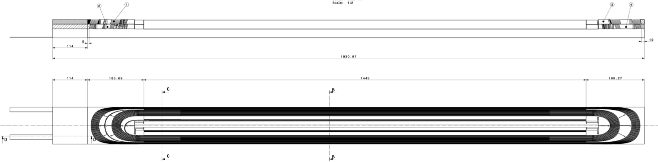
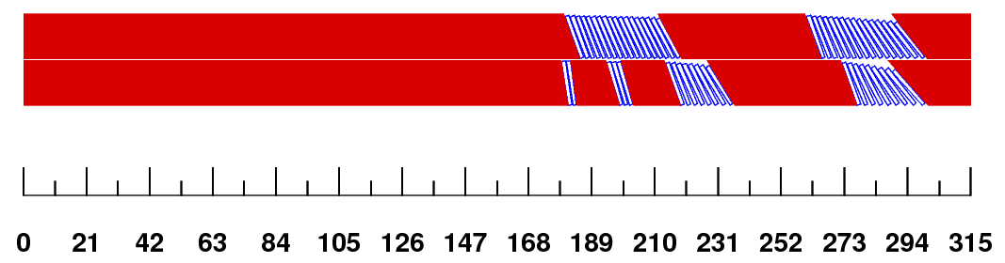
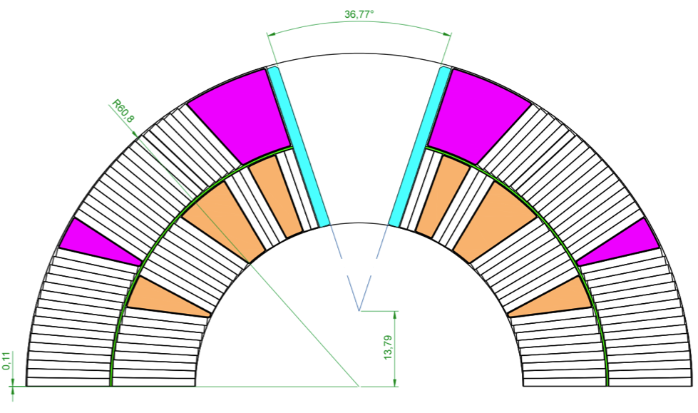
Coil design
CERN coil design & optimization(ROXIE)
Developed based on LARP experience (layer jump, splice region, inter-layer, …)
Several iterations of spacers (ROXIE ; min hardway, upright, reduced torsion ->v8 versions)
Adapted to LARP experience in terms of Nb3Sn cable expansion, insulation thickness, …
Adapted to LARP tooling concept

Slide 4
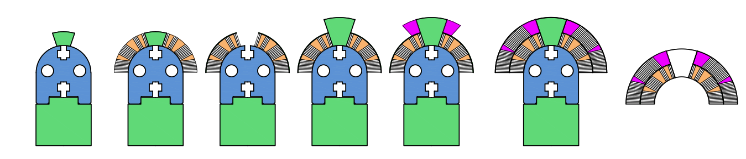
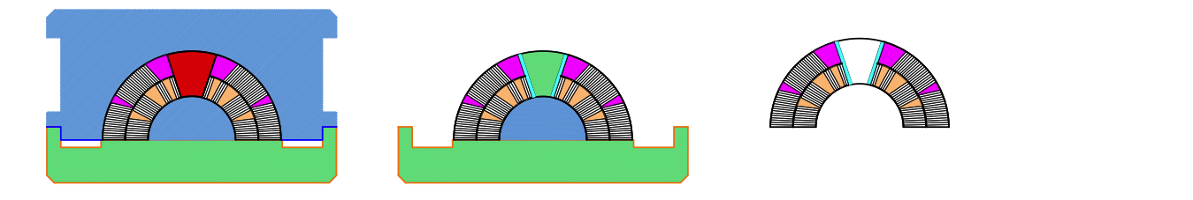
Coil Process: brief summary
Wind IL → Cure -> Place interlayer, OL poles → Wind OL, cure & transfer
& filler wedges
Install in reaction fixture → Open, Splice, place → Impregnate & demould
& react reinforcement & plates, build mould around coil

Slide 5
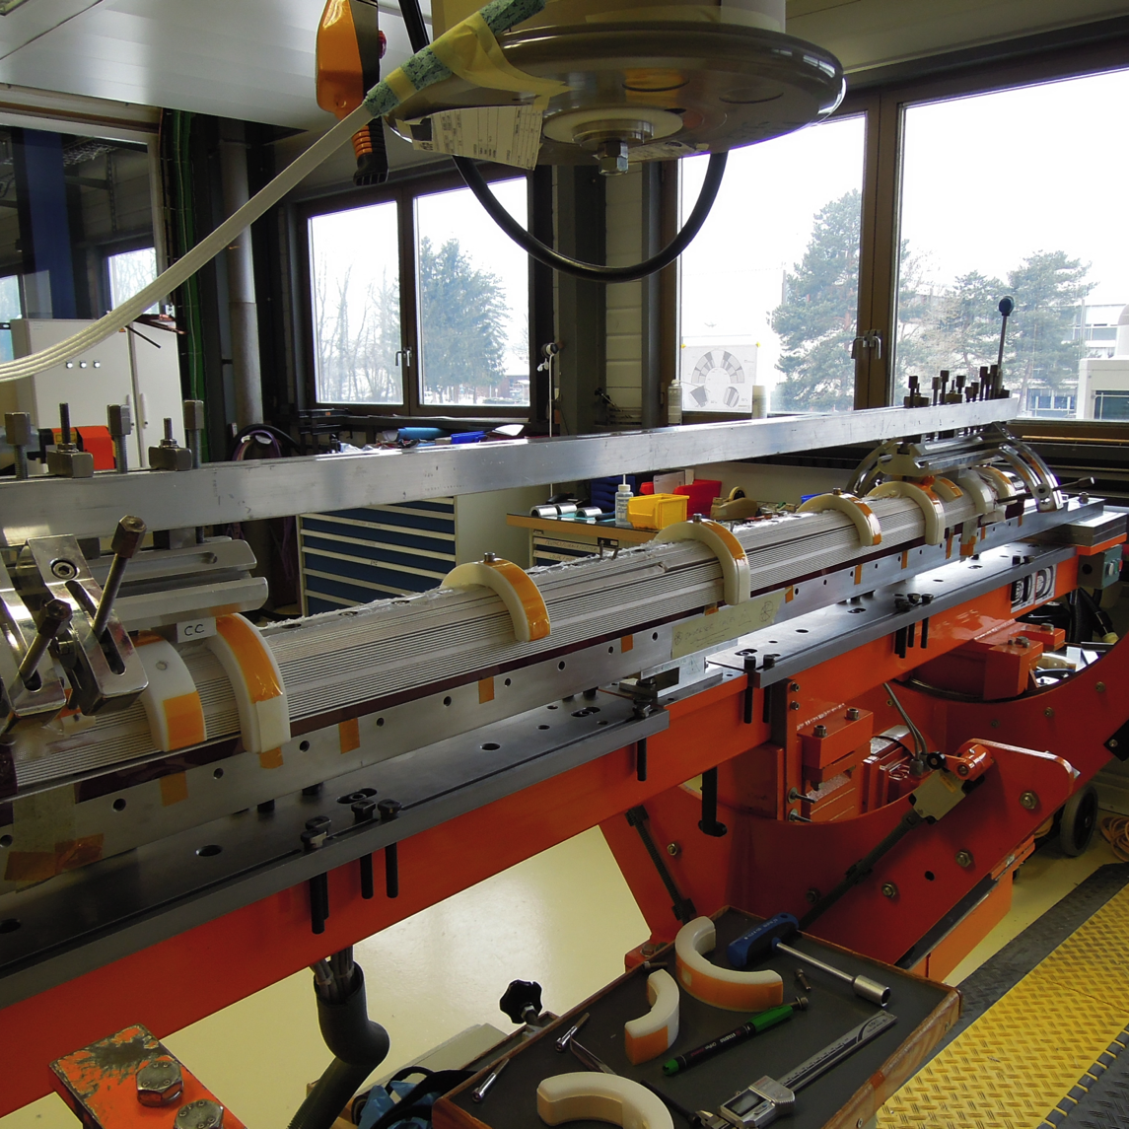
Winding Inner Layer
The coil has no internal splice (one unique length of cable for both layers)
The winding tools and techniques are similar to those in use at FNAL, at the difference that the mandrel is equipped with winding poles
IL winding tension: ~ 350 N
OL winding tension: ~ 250 N
Notes:
The coil has no internal splice (one unique length of cable for both layers)
The first layer (IL: inner layer) is wound on a Kapton foil fixed on the mandrel
The cable length for the outer layer is “in reserve” over the winding machine.
The winding tools and techniques are similar to those in use at FNAL, at the difference that the mandrel is equipped with winding poles

Slide 6
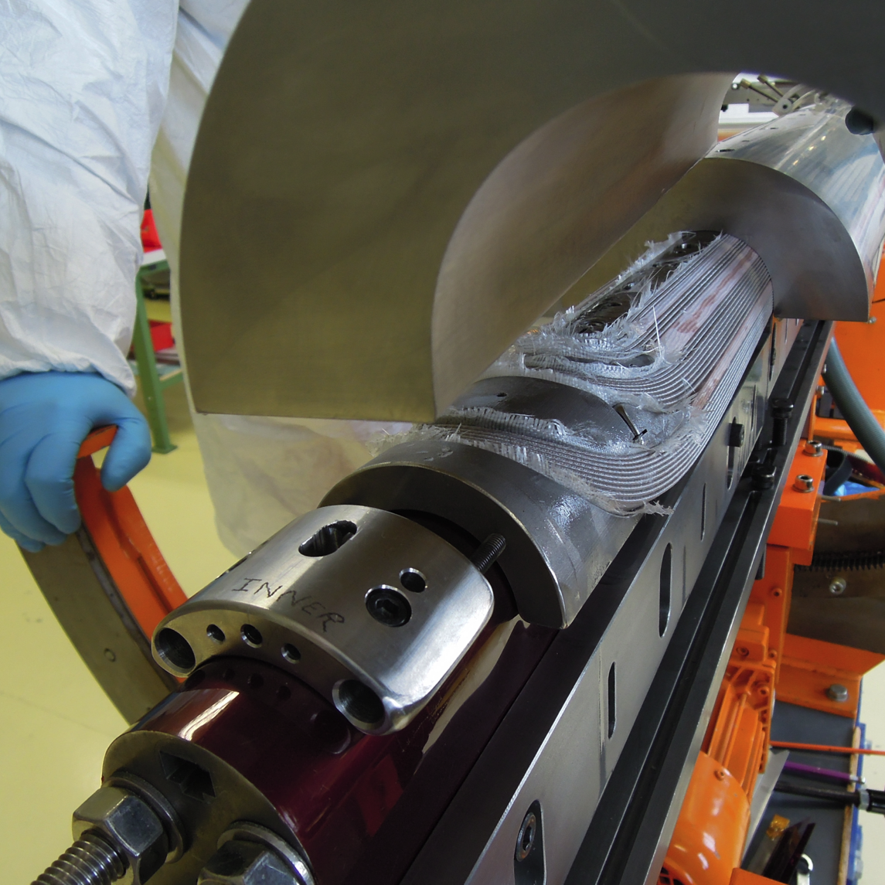
Curing Inner Layer
After inner layer winding is completed, a ceramic binding agent is applied on the cable
The straight section of the coil is set loose (only the heads are kept clamped). Curing shells are placed on the coil, lateral pushers and shims are placed beneath the coil.
Once the straight section is clamped by the shells and the pushers, shells are placed on the heads
The same curing technique is used at FNAL, only the compression is set lower at CERN – thinner shims -

Slide 7
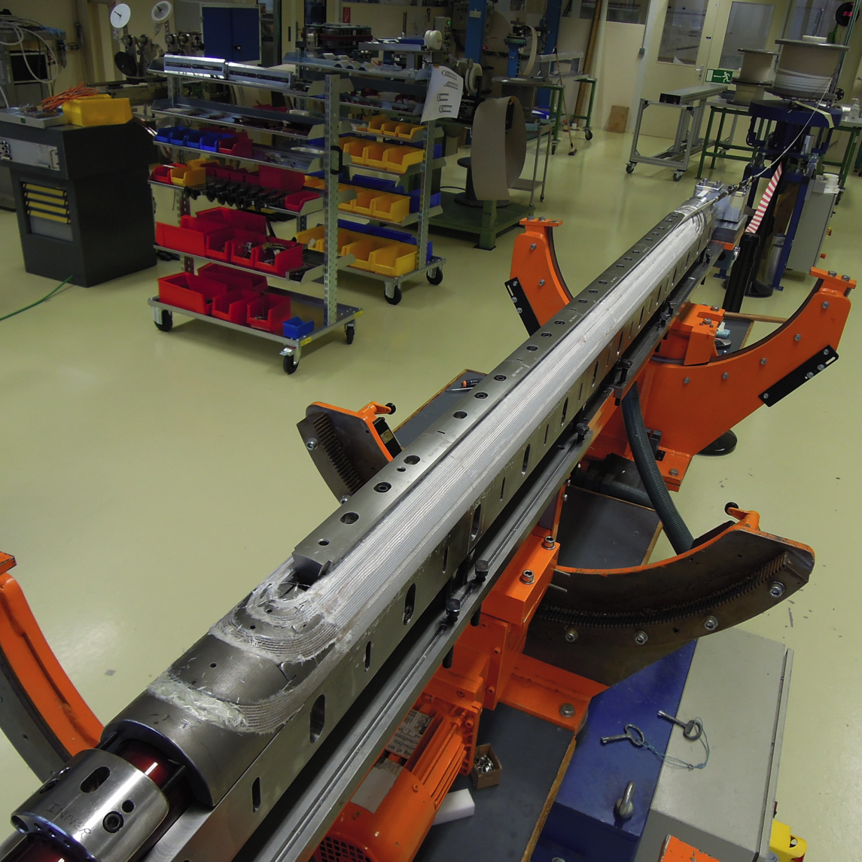
Inner Layer Cured
After curing the winding poles are removed and the first turn and the layer jump are inspected.
The coil blocks are filled with crushed fibres and ceramic binder
The use of:
removable poles
specific spacer “keys” (first turn spacer)
is the most noticeable divergence from FNAL coil process

Slide 8
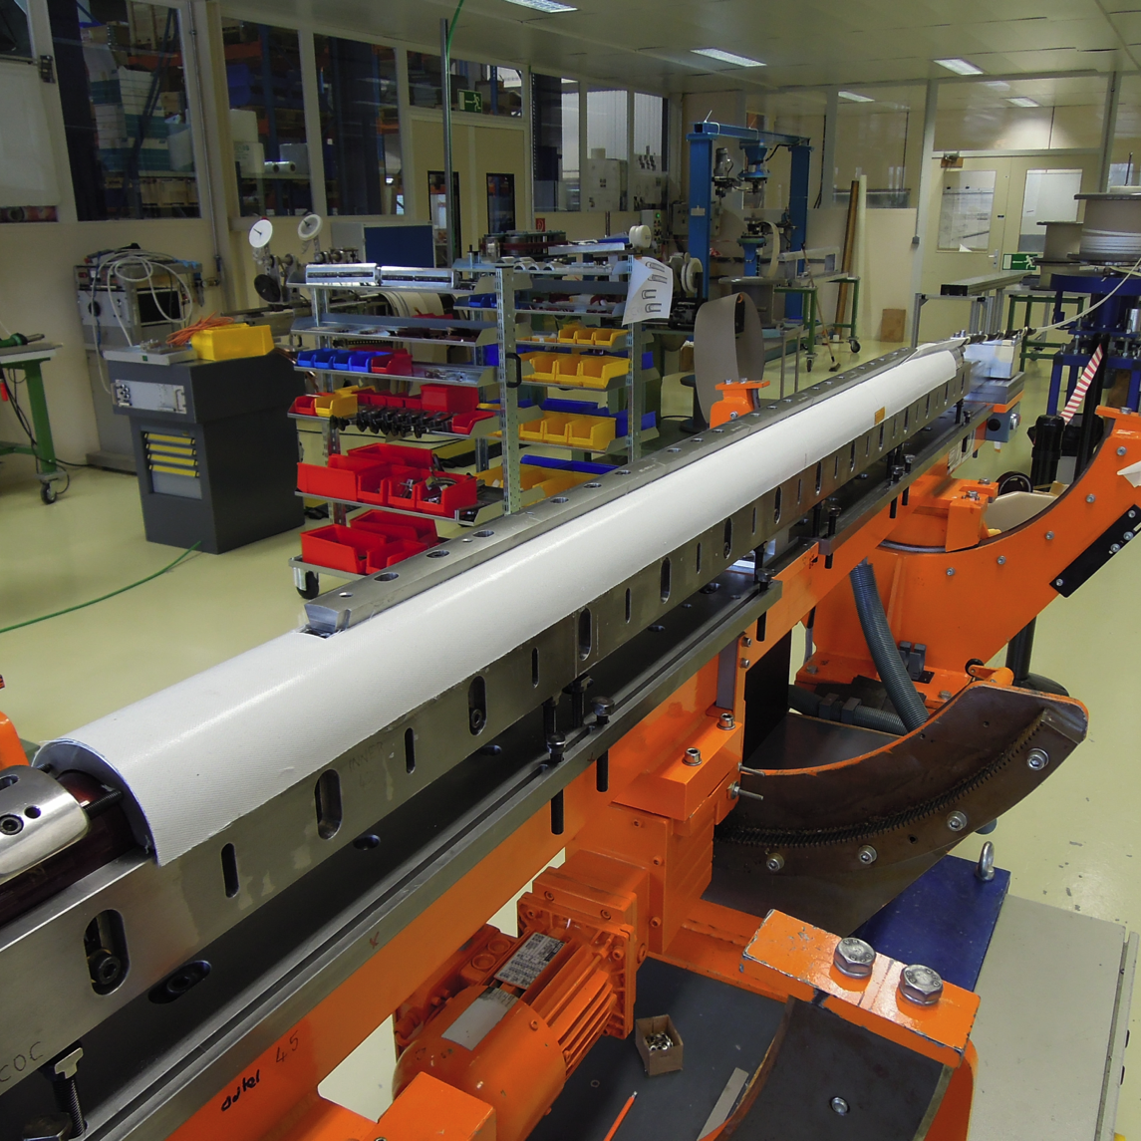
Inter-Layer
Before the coil outer layer starts to be wound , an inter-layer is placed on the inner layer.
The inter-layer is is composed of 2 layers if fibreglass, impregnated and cured pre-formed with the ceramic binder agent
Notes:
If possible replace with the same picture showing the keys as well

Slide 9
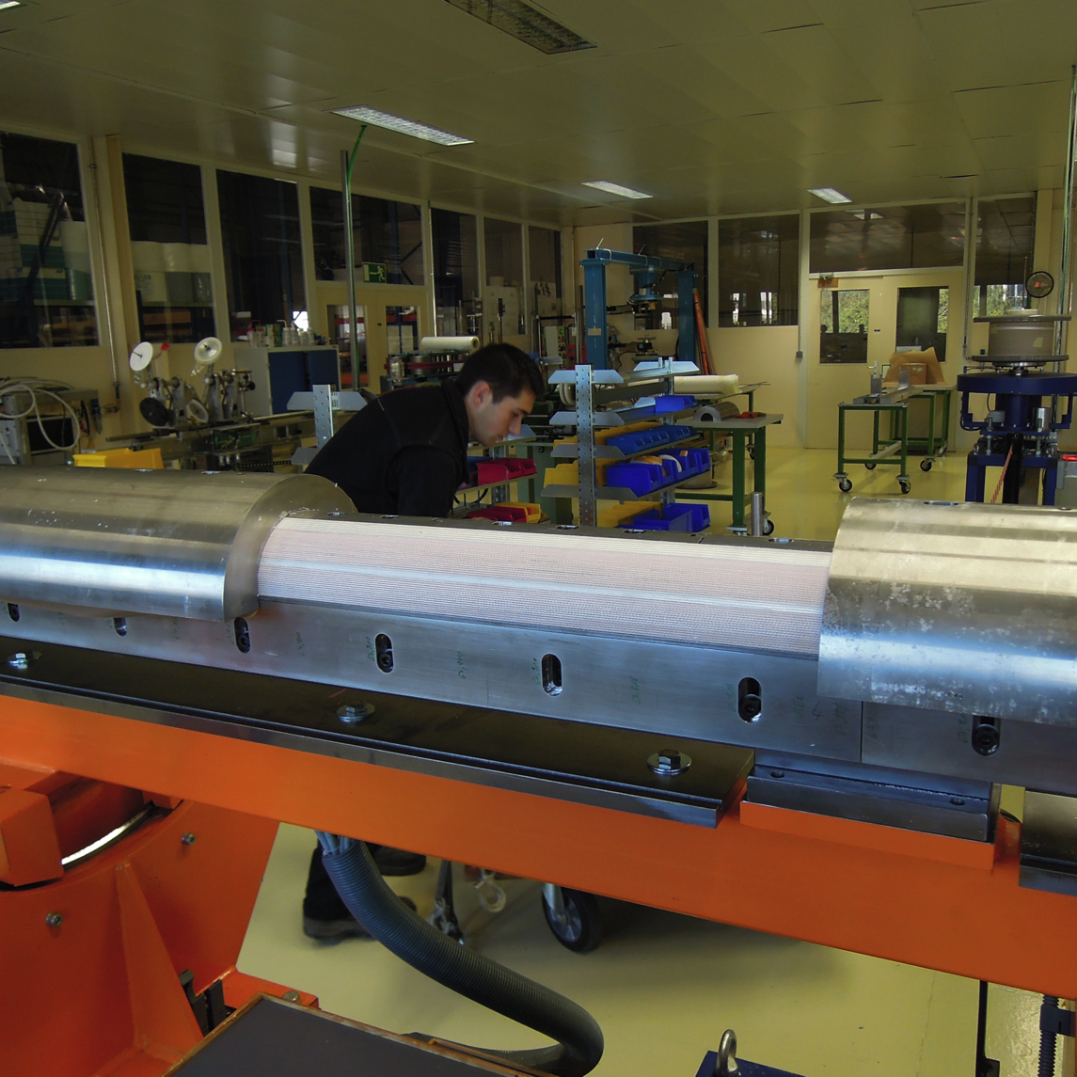
OL winding-curing
Processing the outer layer is similar to the IL operations.
The picture shows the coil finished, out of curing press, first central shell removed.

Slide 10
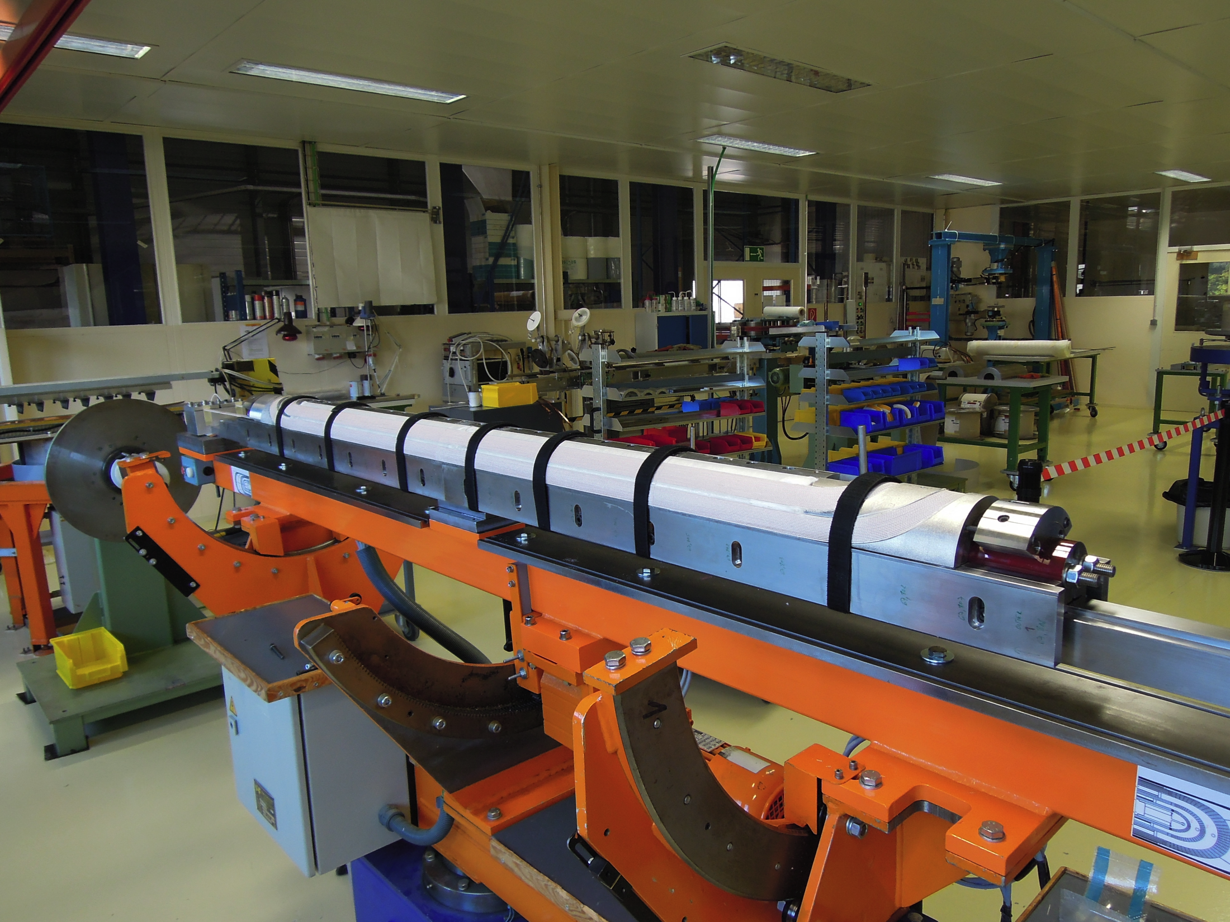
Finished coil, fully cured. Straps in place to avoid distortion over time (coil internal tensions)

Slide 11
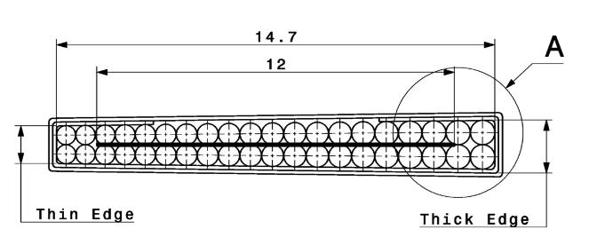
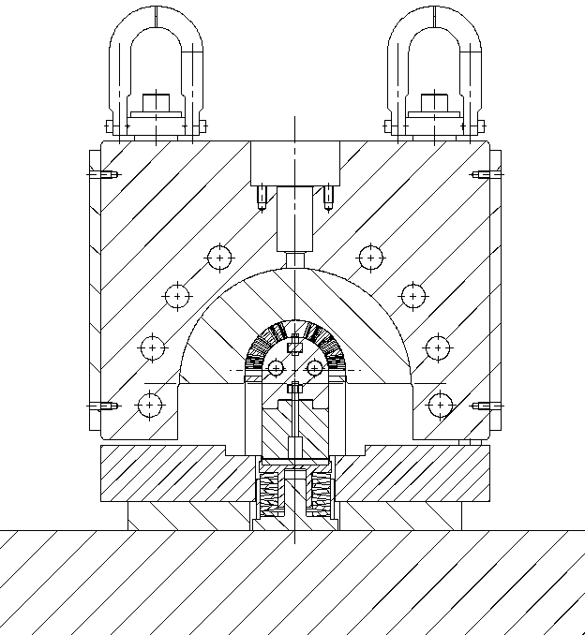
Curing Tool - Shimming
CERN Curing tool: the cavity is designed for the dimension of “reacted coil”
Coil 54-61: tool could not be closed even in excess of 35MPa in the coil
With 108/127 #1, #2, #2 Tool closes at ~700 kN per layer ; ~10…15 MPa max
FNAL compress the coil 3% (azimuthal) more than the “reacted coil” geometry
 | Unreacted | Reacted
Width | 14.715 | 14.847 * | + 1%
Mid-thickn. | 1.25 | 1.306 * | + 4.5%
Keystone [°] | 0.78 | 0.81 *
 | @ rest | @ 30 MPa
Insul. thickn. | ~ 0.155 mm | 0.115 (10 stack)
* Values based on LARP exp.

Slide 12
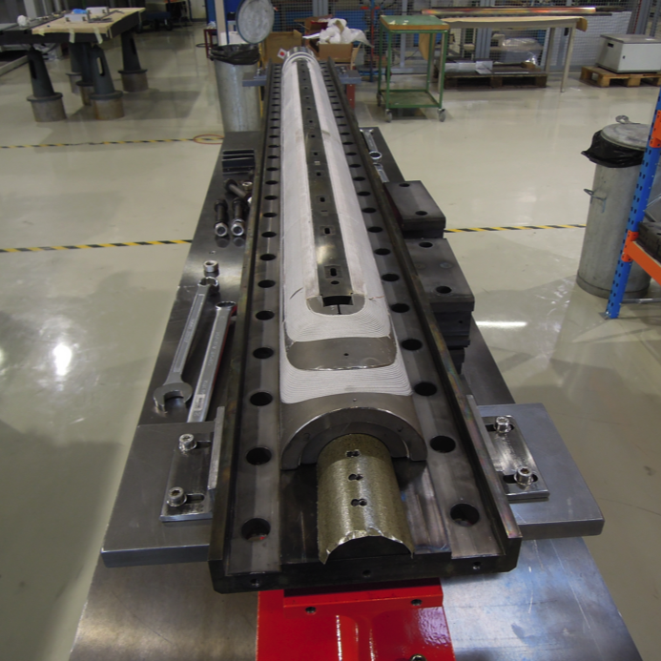
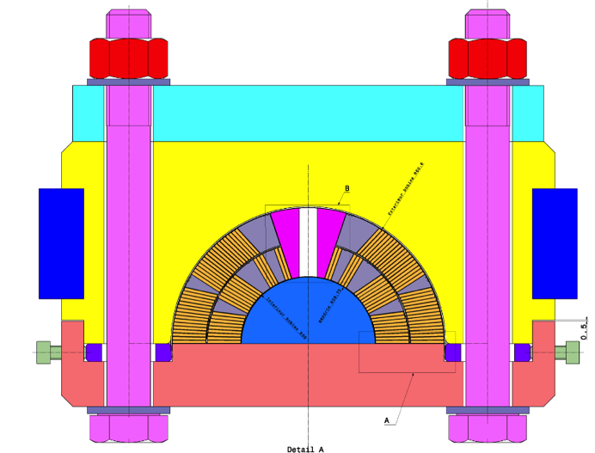
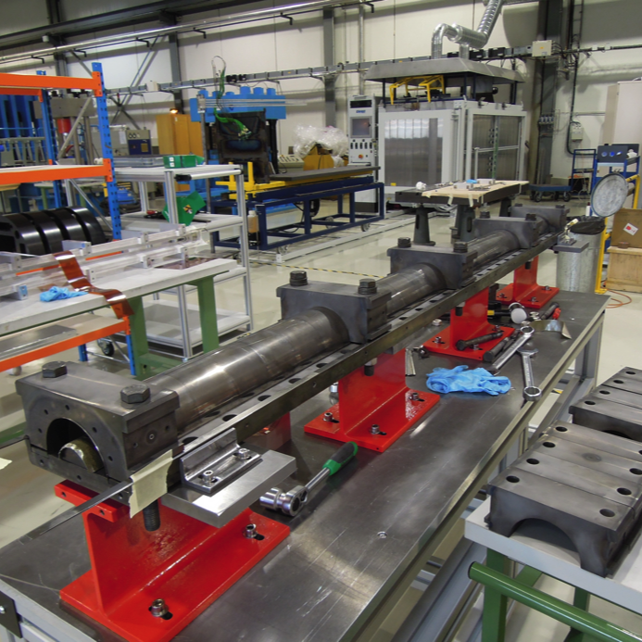
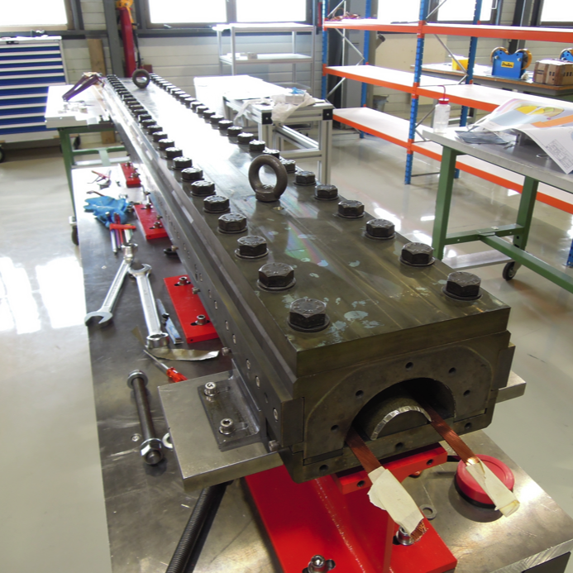
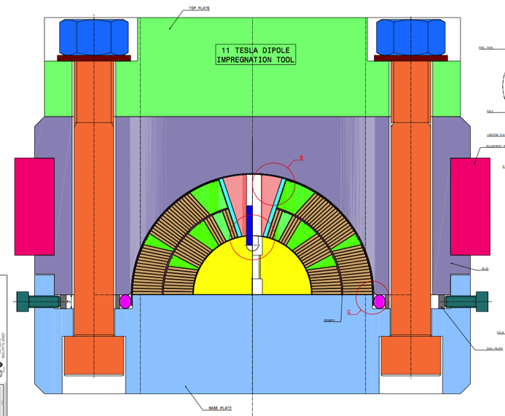
Reaction&Impreg
The coil is encased in a reaction fixture:
Coil on baseplate + reaction mandrels
Sealing foil in place + few blocks
All blocks installed
“All” as at FNAL
1
2
3

Slide 13
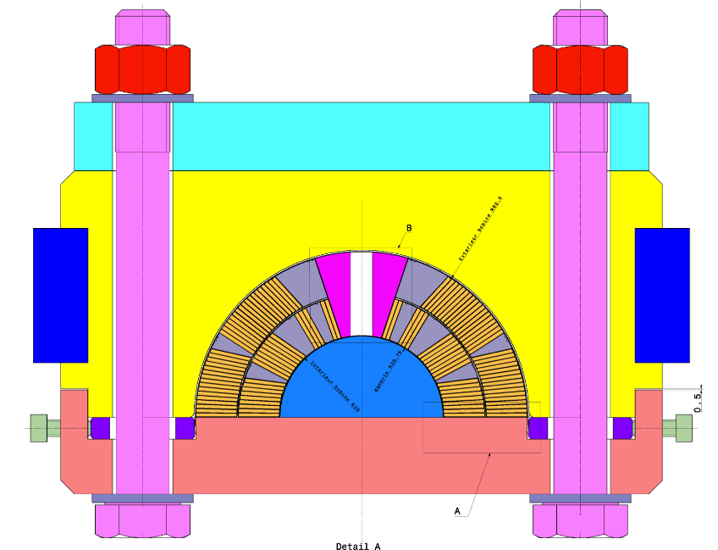
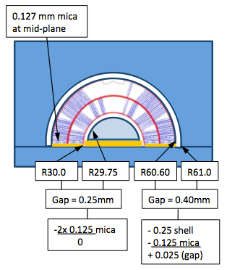
Reaction Tool – Cavity Size
X-section CERN tool
R30.0
R29.75
Coil R60.6
Block R61.25
0.125 mm mica at mid-plane
Gap = 0.25mm
Schematic view of FNAL reaction tool
Gap | 0.65
shell | - 0.5 | - 0.3 | - 0.3
mica | -0.125 | - 0.25 | - 0.125
Assy gap | 0.025 | 0.1 | 0.225
2x 0.125 mica
0
Notes:
CERN tool is a duplicate from FNAL tool, taking into consideration issues faced at FNAL when coil is slightly oversized. The cavity in the CERN tooling has been enlarged and several combinations of metal and mica sheets (0.125, 0.25, 0.3 mm and 0.5 mm) allow to change the outer diameter of the cavity. The extremely good quality of manufacture of this tool allows to use efficiently these possibilities.
On the contrary, the impregnation tool was manufactured slightly out of tolerance with a slightly too narrow cavity, the possibility to enlarge the cavity was used to correct for this error.

Slide 14
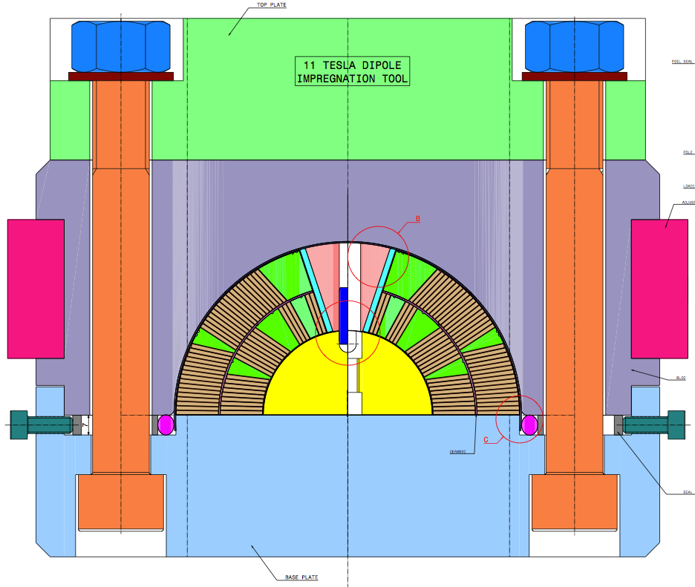
Impregnation Tool – Cavity Size
Coil R60.8
Block R61.425
Gap | 0.625
shell | - 0.5 | - 0.3
film | -0.11 | - 0.11
Assy gap | 0.015 | 0.215
Notes:
0.2 mm oversize only to be used for coil rescue

Slide 15
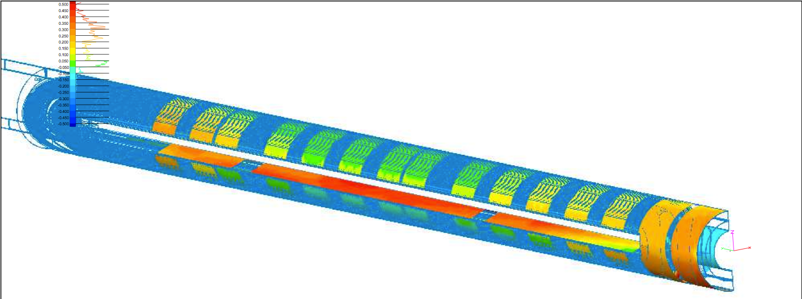
After Impregnation, coil metrology → next talk
Copper Dummy Coil #102
Now, components…

Slide 16
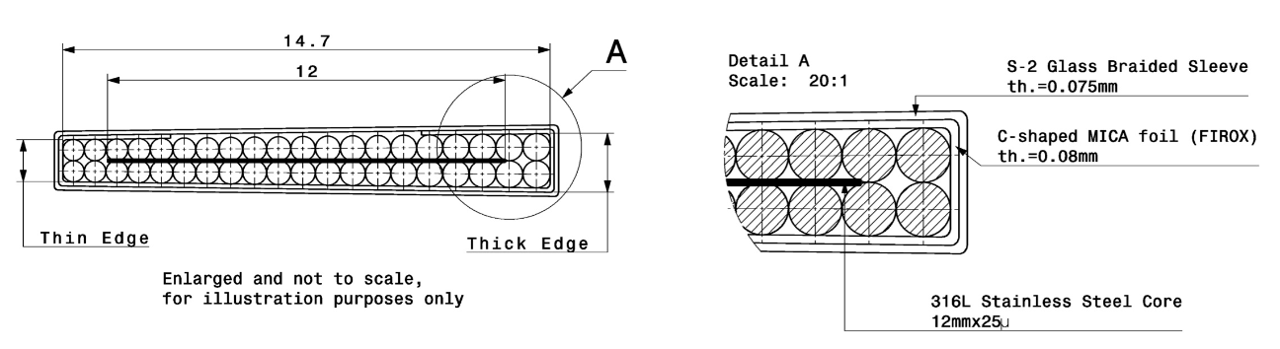
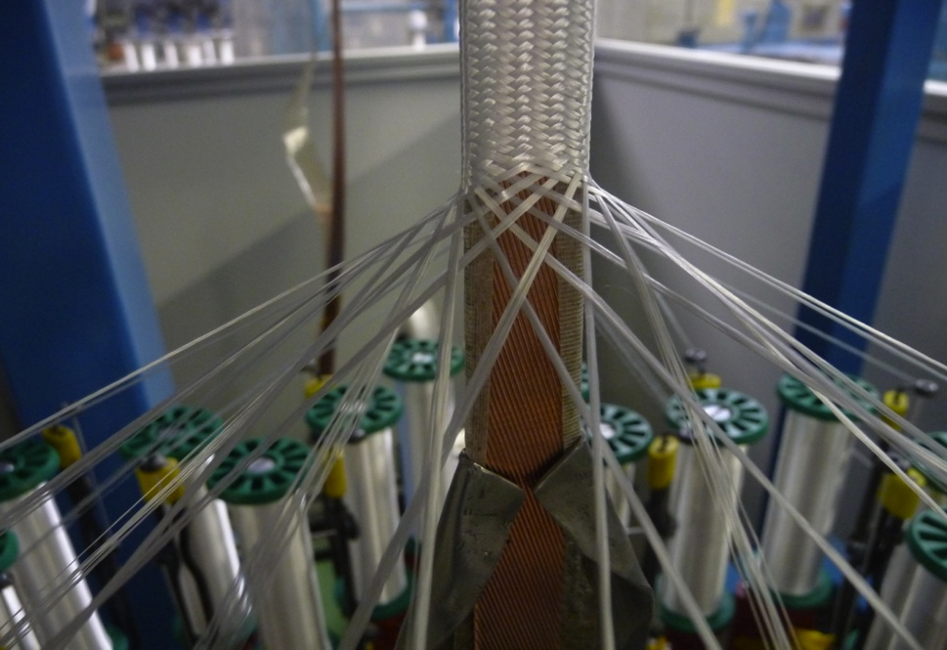
Components: insulated cable
Direct braiding, with mica insert
Oversized insulation thickness due to wrong braiding parameters went unnoticed on 3 batches of cable (WST #1, WST #2 and RRP54/61)
Coil 103 (WST) had to be rejected
Coil 104 (54/61) could be completed but coil oversized

Slide 17
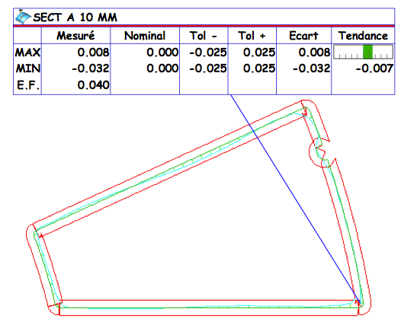
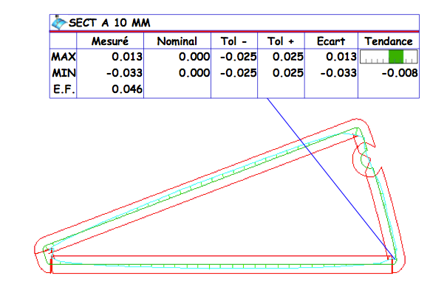
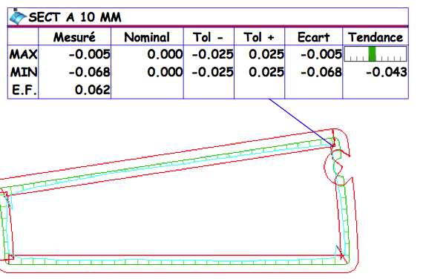
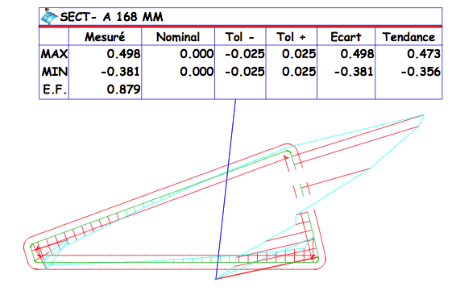
Components: Wedges
Material: ODS Copper (UNS C15715)
Successful R&D with LUVATA and CEP
New alloy / new process (Discup) characterized by EN/MME with results complying to data in literature
Geometry within 0.05 mm
Still important internal stress leading to strong twist/bend of the profile but X-section is respected.
Issue with the geometry of wedge 4 (defective tool, confirmed)
Metallic wedges are difficult to insulate (extremities)
R&D required on inorganic coatings to insulate the wedges.
"Characterization of DISCUP C3/30 ODS”
https://edms.cern.ch/document/1216580/1
Notes:
Price high but comparable to high end stainless steel and other nickel superalloys
From previous review (at the pre-series stage) : Objective: replace 316L SS machined wedges by cold drawn profiles made of ODS copper alloy (Oxide Dispersion Strengthened)
Copper based alloy, closer to coil material behaviour. Thermo contraction at 4.2K: 3.07mm/m
Better temperature resistance than any other bronze (incl. CuBe and CuZr)
Cold drawn smooth profiles with rounded corners
Possibly better heat conduction and enthalpy ? (elec. conductivity: 91 % IACS)
In development at Luvata (FI) and ECKA (D)since 2011.

Slide 18
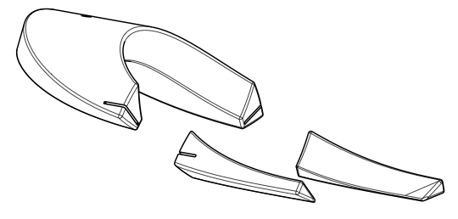
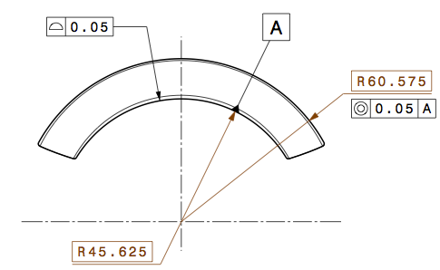
Components: Metallic Spacers (SLS)
Direct CAD->CAM->production
Cost-effective, minimum delays
Still very rigid, risk of shorts during winding
⬄shorts need repairs
⬄repairs need unwinding
⬄unwinding is incompatible with unstable cables
R&D required on inorganic coatings to insulate these metallic spacers.
Sintered material not yet characterized (residual stress, porosities, magnetic susceptibility ?)
Produced by Selective Laser Sintering
Flex-hinge design (detached legs)
Notes:
Much more to see in Jacky’s presentation.
Principle works effectively. Still some risk of shorts during winding.
! Flex hinge proved to work well, but such design may only be compatible with SLS, not with machining ⬄need to ensure that SLS is fully compatible with accelerator quality series magnets

Slide 19
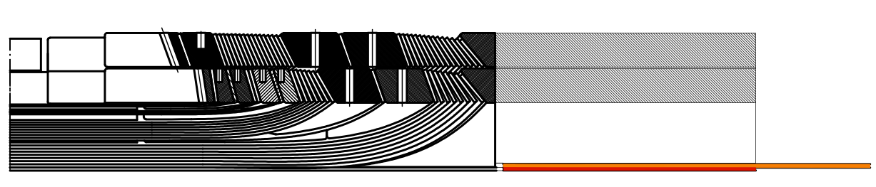
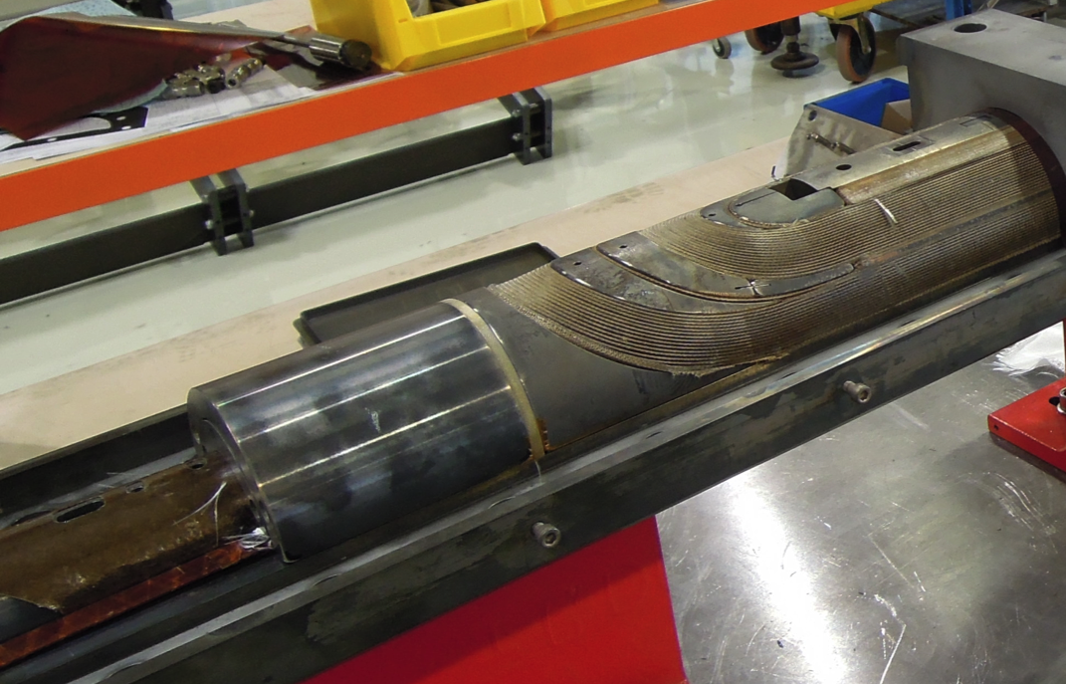
Components: Saddle-Splice Block region
All metal saddle
All metal splice block
very rigid to collar, all stress located in the splice region
Risk of shear stress on the reacted cable due to weal interface between saddle and splice block
Risk a solder migrating to the saddle and creating short
→plan: G11 Saddle-splice-block, instrumentation post impregnation oustide the splice
Notes:
The saddle is the last spacer at the extremity of the coil.
The lead end saddle is connected to a removable stainless steel part called splice block. This part covers and protect the splice region, transition where the Nb3Sn coil terminal is soldered to the Nb-Ti cable (bus)

Slide 20
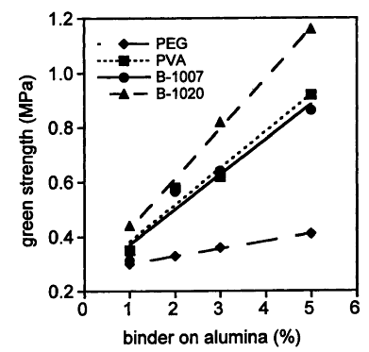
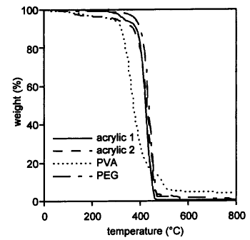
Components: Binding Agent (Ceramic Binder)
Ceramic Matrix CTD-1202 is used as a binder to agglomerate the coil turns. During reaction the ceramic fuses the fibre glass filaments together. Fibres lose all mechanical properties.
Is there alternatives to CTD-1202 ?
PVA was evaluated at CERN. Short potlife, 4% burnout residues.
Acrylics (DOW Duramax B-1022) to be evaluated (0.6% burnout residues)
Minimum peeling strength for LHC Pixeo tape: 0.5N/mm2
TGA of binder in nitrogen
Source:
Materials and Equipment - Whitewares:
Ceramic Engineering and Science Proceedings, Volume 18, Issue 2 -p. 425
Notes:
Currently: Ceramic Matrix CTD-1202 is used as a binder to agglomerate the coil turns in order to wind the 2d layer, to handle the coil before reaction.
The CTD-1202 is curable organo-mineral compound. Ceramic industry facing similar problems: burnout residues from green cure binder after ceramic sintering in inert atmosphere
PVA was tested: fibre remains strong (not measured). Pyrolysis leaves burnout residues. Too short potlife (cures at room temperature by evaporation: water solvant)

Slide 21
Internal Splice
Each layer wound, cured, reacted and impregnated then assembled together with an internal splice
Possibility to place quench heaters between layers
Shorter Cable Unit Length to produce (per layer)
No reserve spool over winding machine during IL winding
Possible to manufacture coil with separate layers with the existing tooling (minor modifications) and well adapted to 5.5m coil production
Most of the development required is the splice itself:
  Splice could be similar to MSUT type
  Splice could be based on HTS tape
  …

Slide 22
Conclusion
Good progress on coil winding, curing and reaction. Impregnation went relatively well too.
  Protocols and techniques well documented (drawings, photos) over 7 coils wound and cured; 2 of which were reacted and impregnated
Team well trained
In terms of “Accelerator quality”, developments frozen:
  Insulation (cable, wedges, spacers), Work on inorganic coatings
  Binder (alternatives)
Nota: possibility to use the existing tools and technology to produce separate layers and to test internal splice in case IL-QH are required

