Slide 1
COIL MANUFACTURING
Part II: Tooling & Infrastructure
COIL & ASSEMBLY READINESS REVIEW, 23- 24 SEPT 2013
D. Smekens

Slide 2
OUTLINE
Winding & Curing Tools
Reaction Tooling & Furnaces
Impregnation Tooling & Impregnation Tank
Conclusion

Slide 3
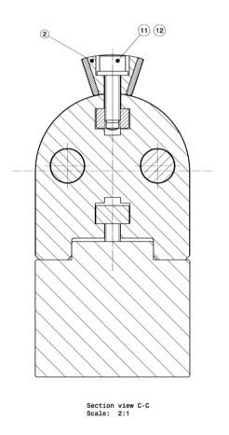
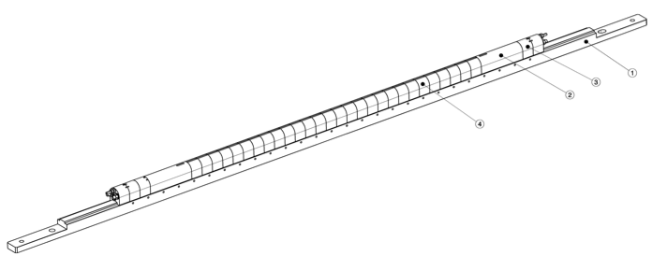
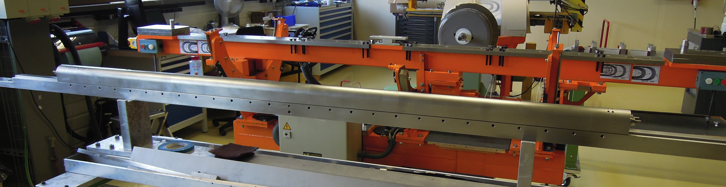
Winding Mandrel: FNAL Design + removable winding poles
Notes:
The mandrel is the first tool “imported”from FNAL
CERN concept was to add winding poles on which are atteched the coil “Keys”. To wind the coil inner layer (IL); IL winding poles are used. After curing these poles are replaced by OL winding poles, twice higher.

Slide 4
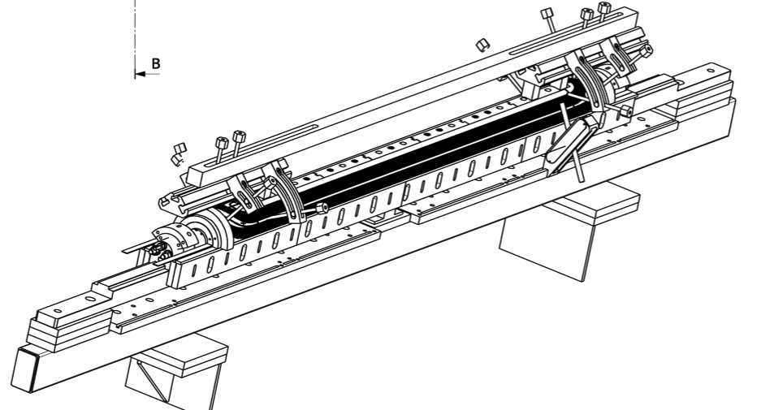
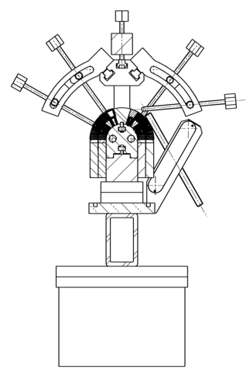
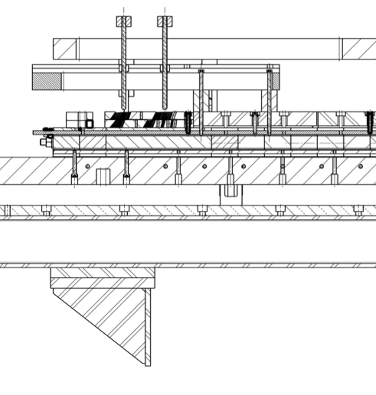
Winding Mandrel Details
Stress concentration in the supporting structure for the clamping of the heads
Notes:
One can see on this view the complete assembly with winding accessories. Only a few clamps and pushers are represented in this view. In reality, each coil spacers is clamped by pusher screws and the coil is kept in place by pushers and plastic former (see photograph hereafter). The large forces required to press on the spacers tend to bend the supports. To palliate this problem, a stiffener bar has been installed on top of the mandrel. It is very satisfactory, but incompatible with a 5.5 m long winding mandrel. In case all forces have to be taken by the clamping supports, stronger alloys for the mandrel should be used. Larger screws and deeper groove in the mandrel to avoid deformation of the mandrel

Slide 5
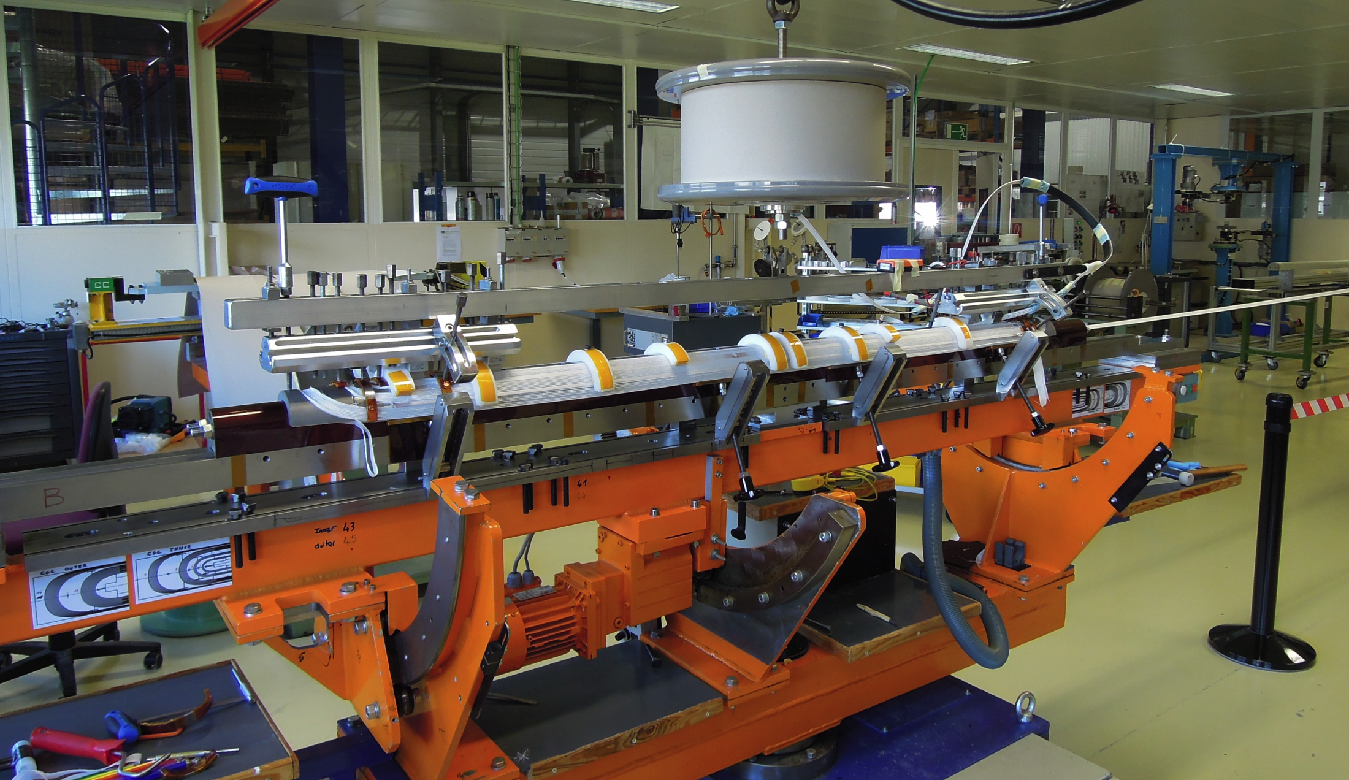
Notes:
Although a Kapton foil is used, residues of ceramic binder may penetrate inside the mandrel and glue the accessories. We had the inside parts completely stuck after the first 2 coils due to excesisve use of ceramic binder and absence of release agents on threads

Slide 6
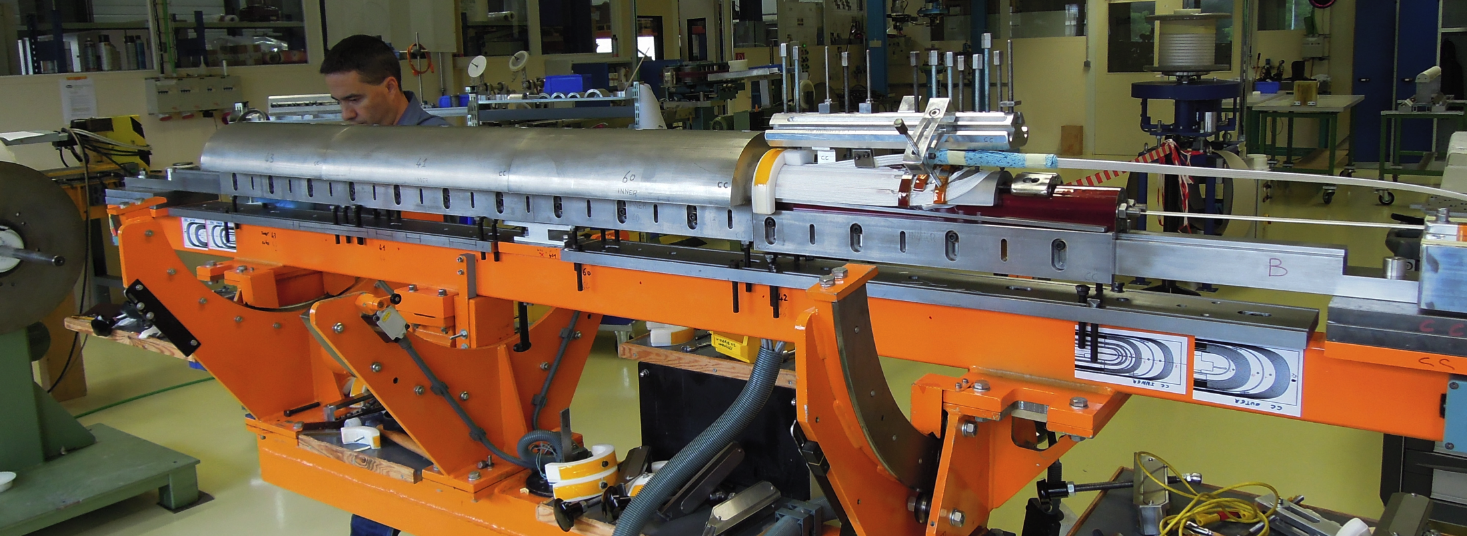
Curing Shells / Lateral Pushers
Performs well
Design OK for 5.5m (TBC)
Lateral pushers divided in many sections to avoid segments of wedges 3 and 4 to flip and get blocked between shell and mandrel
Notes:
Curing shell design is mostly dictated by the existing curing press.
More importantly, the division of shells and of pushers along the coil sections is critical, in order to clamp the middle part strongly enough to allow to declamp the heads without the coil turns collapsing.
We noticed a possible issue during the installation of IL shells in the straight part: once the turns are loose, the wedge 3 (segmented and of sharp triangular shape) may flip (turn) and may not come back at closing, interfering between shell and mandrel) (see Jacky’s talk). The pushers are now in 4 separate pieces on each side of the coil to maintain the coil clamped at all time and avoid loosening the turns too much

Slide 7
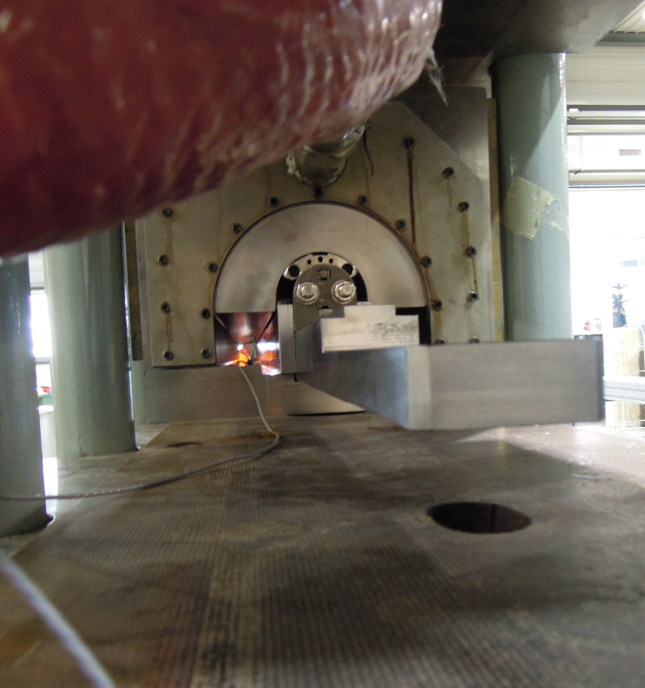
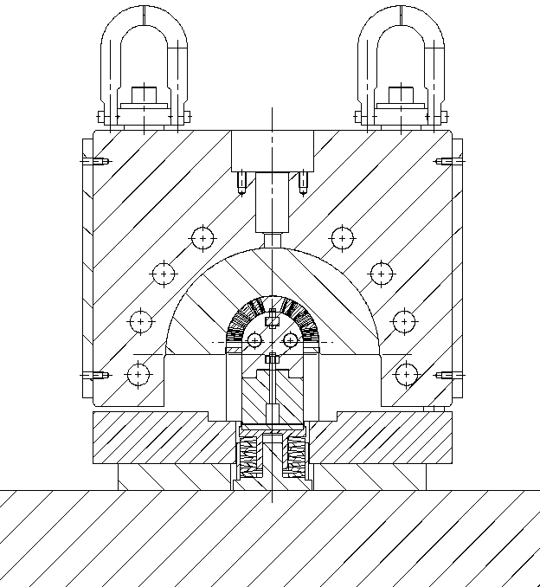
Notes:
The impact of the shimming is yet to be evaluated. FNAL is using oversized shims to compact more the coil; CERN is currently using nominal shimming. How much should the coil be compacted during the curing stage.

Slide 8
Infrastructure for winding and curing
Conventional & Scalable
  Braiding insulation is subcontracted
  Re-spooling unit
  Winding machine (with reserve for OL cable)
  Curing press
  Handling beam for the mandrel from winding to curing unit
Notes:
Conventional (and recuperated / adapted from recuperated LHC magnet production). Only the braiding requires an industry equipped for this task.
The winding machine shall be adapted with sensitive low force tensioning system

Slide 9
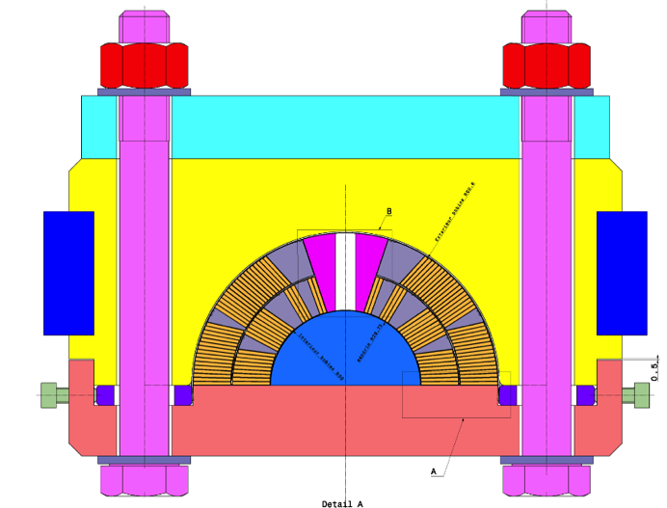
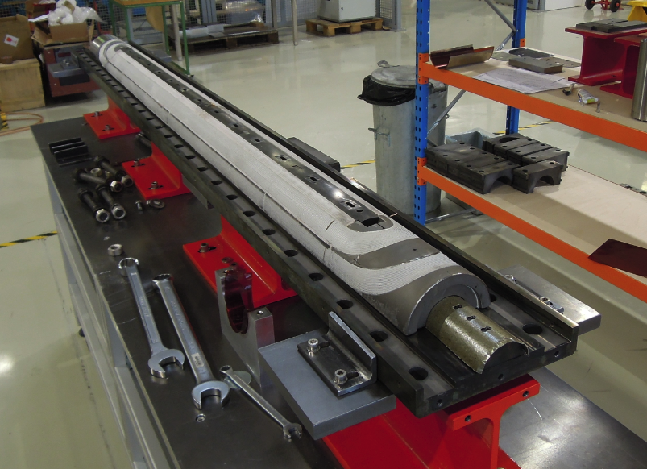
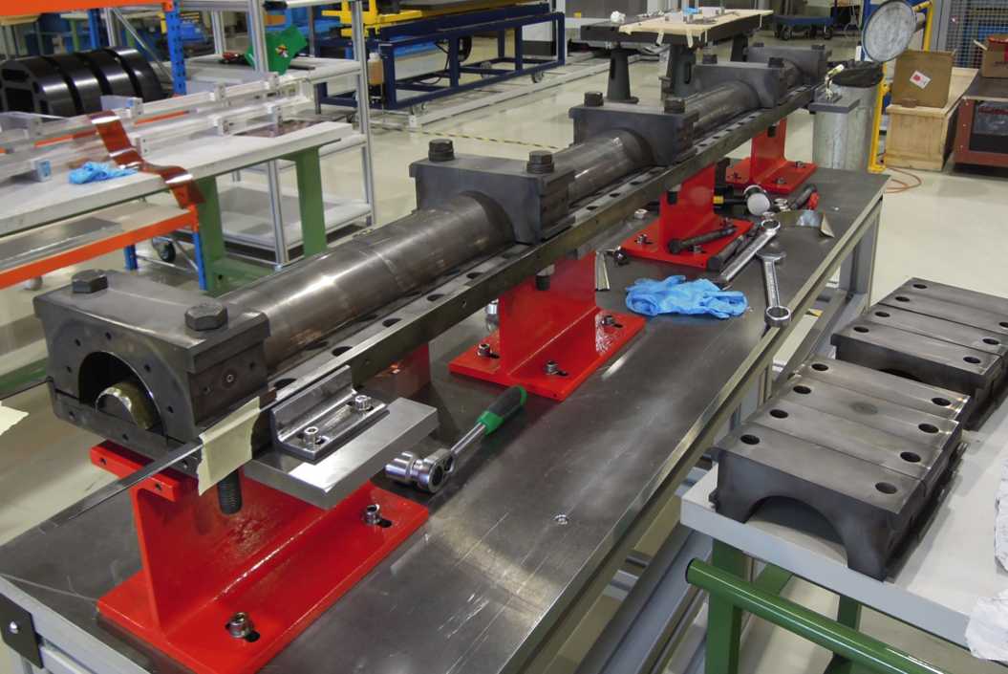
Reaction: FNAL design + reaction poles
FNAL tool replica (slightly enlarge cavity)
Works fine, can be manufactured up to 6 meters.
2d 2.2 m long tool being made
Notes:
Reaction tool works fine. Would merit a slightly larger design to allow for a larger impregnation tool (larger impregnation tool can house more easily the required rubber seals, current impregnation tool a bit too narrow at present)
Can be made up to 6 meters. Caution: to avoid distorsions, the parts of this tool have been heat treated in vacuum at > 1000 Celsius. This might not be possible for long tool (baseplate)
CERN uses silver plates screws and bolts (FNAL uses boron nitride paste).
Important: a second tool has been manufactured and is being delivered

Slide 10


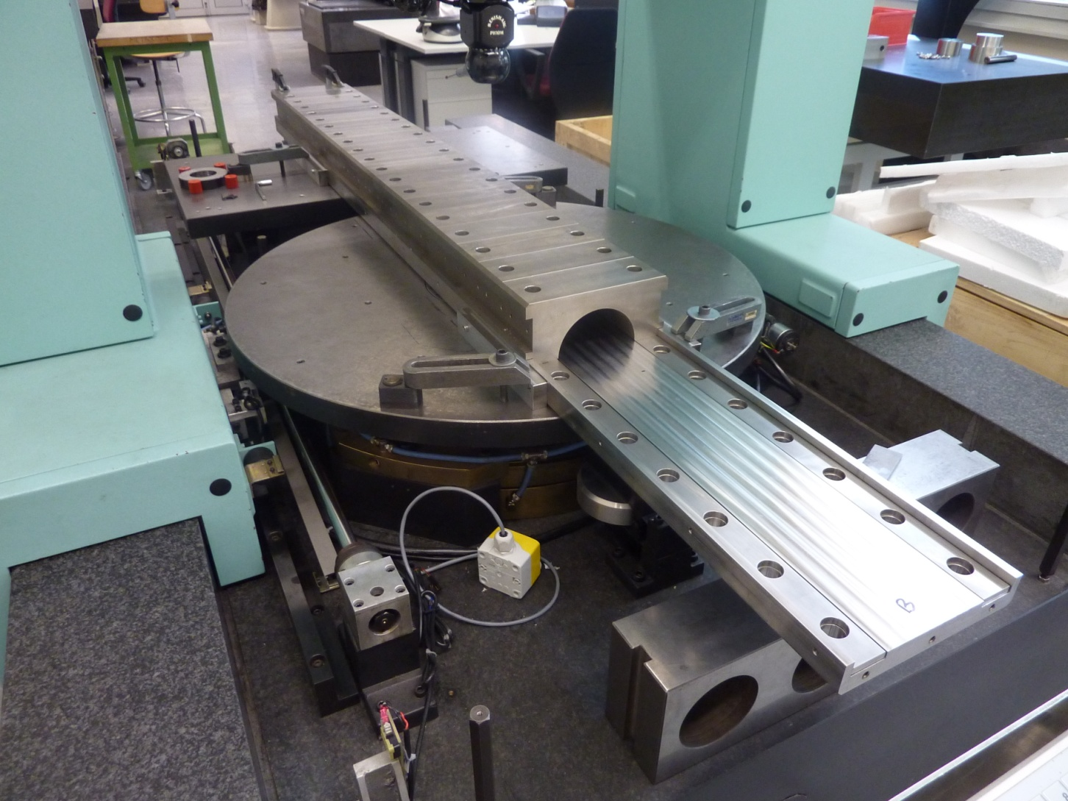
Reaction tool: Metrology report
Y+
Z+
Y+
X+
Repère coté B
Z+
X+
Plan A
Repère coté B
Droite médiane B
L’ axe principal Z est la normale au plan A
L’axe secondaire Y est la droite médiane B

Slide 11
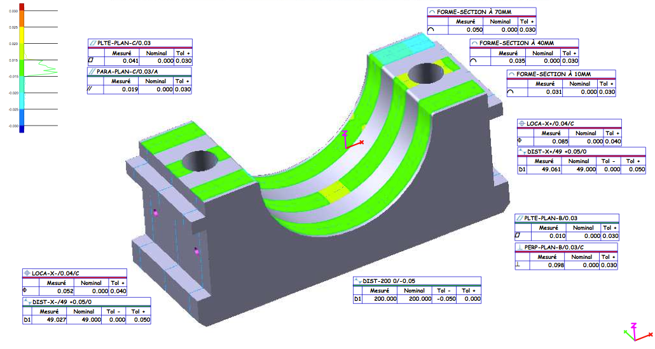
Reaction tool : metrology report
Notes:
Very competent supplier
Can manufacture up to ~ 4.5 m long base plate in one operation (not moving the part); guarantees 6 meters can be done with minimum loss of accuracy
Heat treatment proved to be very successful: full solution at > 1000 Celsius under vacuum. This might not be available for 6 m long parts but up to 450 Celsius no problem

Slide 12
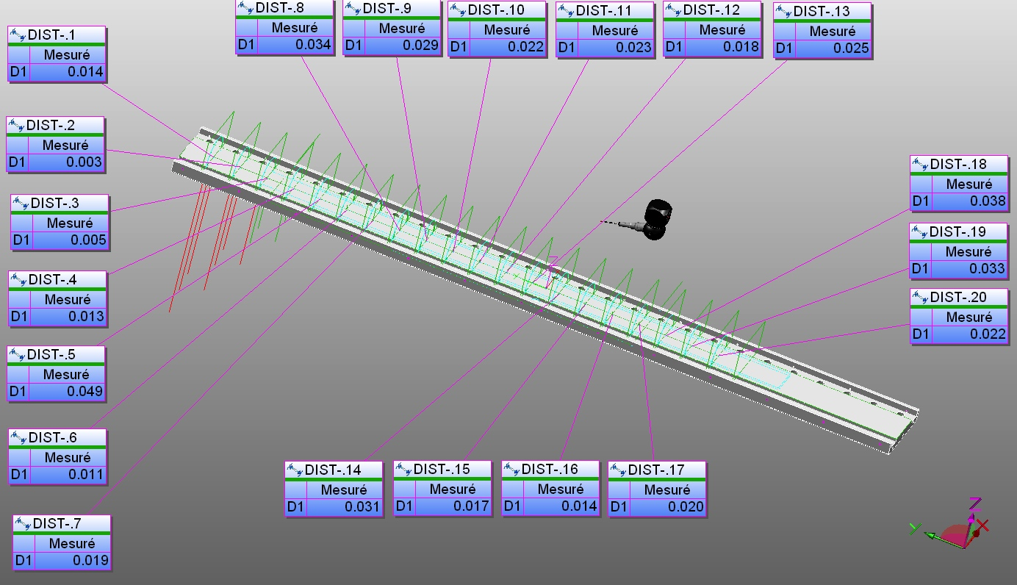
Base plate
Distance locale entre le plan A et le centre Ø122.5 de chaque bloc

Slide 13
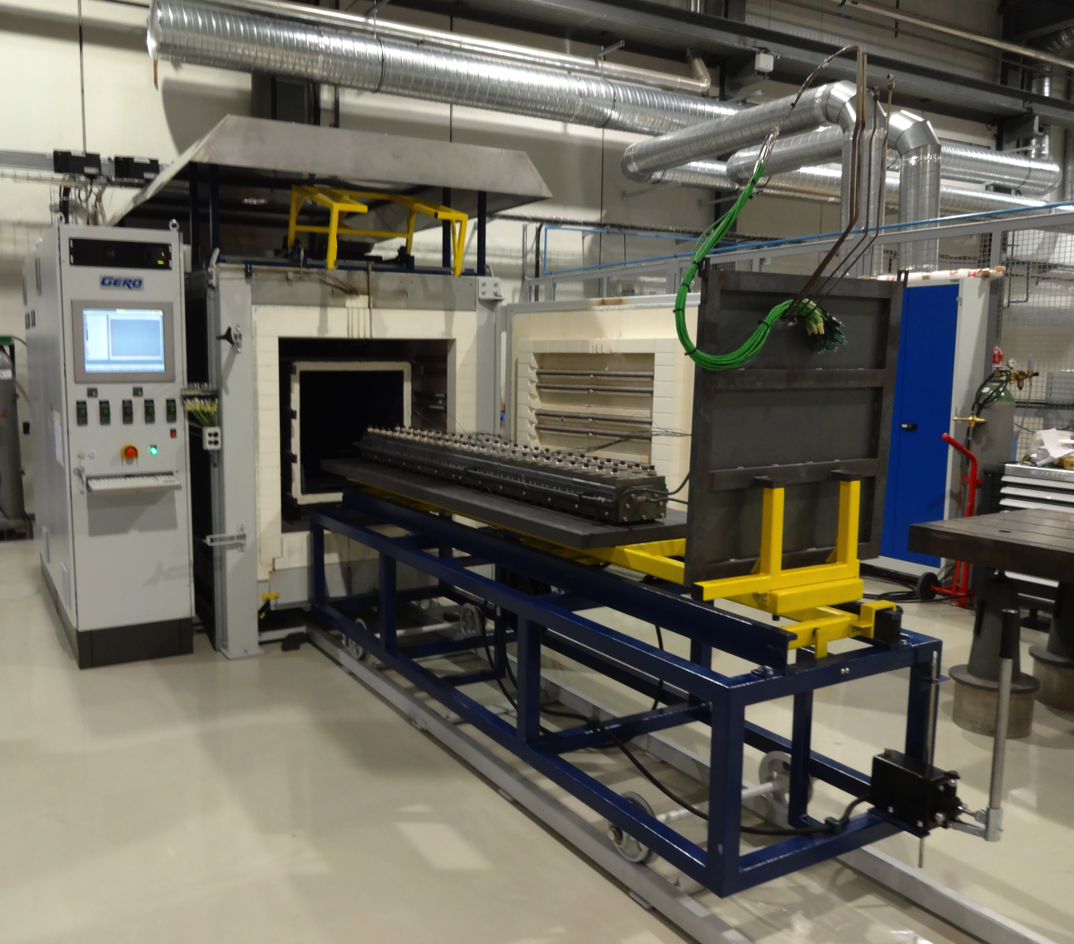
Reaction furnace(s)
Designed by GERO
Non air-tight retort
Non pumpable retort
Large inertia (lags on ramps at low temperature)
Higher oxygen content than an all welded retort
Pollution from reaction
Recurrent problems with O2 Analyzer, cooling of fans, tightness of the retort
Notes:
Non air tight: Door sealed by compression on a fibre gasket, and argon circulation fan inside the retort (shaft goes throughout the retort)
Large inertia, see next slide
Oxygen content see slide +2
Pollution: oily compound(from fume condensation?) has damaged the O2 sensor twice over <10 heating cycles; it is uncertain if the whole pollution was during the commissioning and oil got trap; or if each coil generates pollution

Slide 14
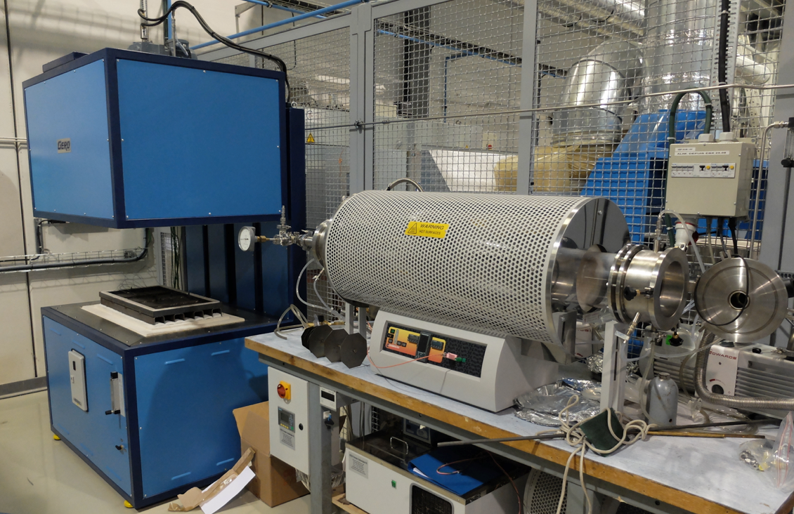
Other furnaces
Not yet fully commissioned
Requires operators
Requires Data Analysis
Notes:
Non air tight: Door sealed by compression on a fibre gasket, and argon circulation fan inside the retort (shaft goes throughout the retort)
Large inertia, see next slide
Oxygen content see slide +2
Pollution: oily compound(from fume condensation?) has damaged the O2 sensor twice over <10 heating cycles; it is uncertain if the whole pollution was during the commissioning and oil got trap; or if each coil generates pollution

Slide 15
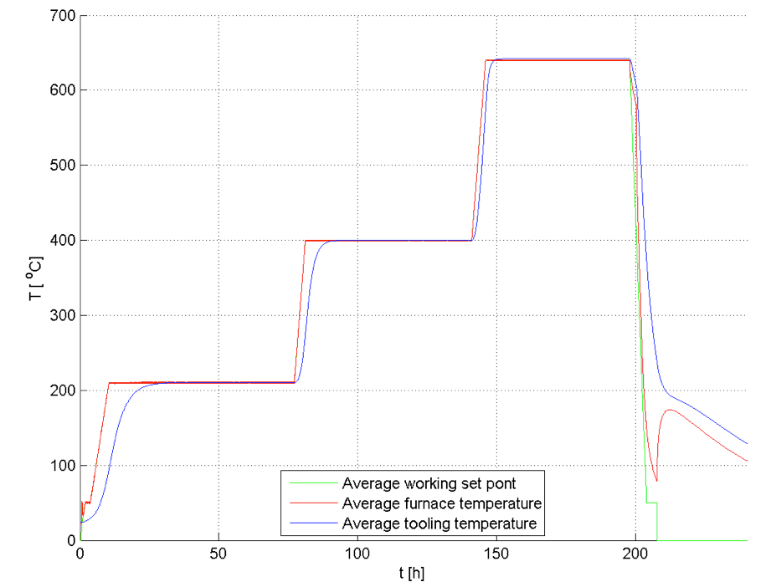
Temperature profiles for coil #104 (54/61)
16 hours delay to 210C
8.5 hours delay to 400C
2.6 hours delay to 640C

Slide 16
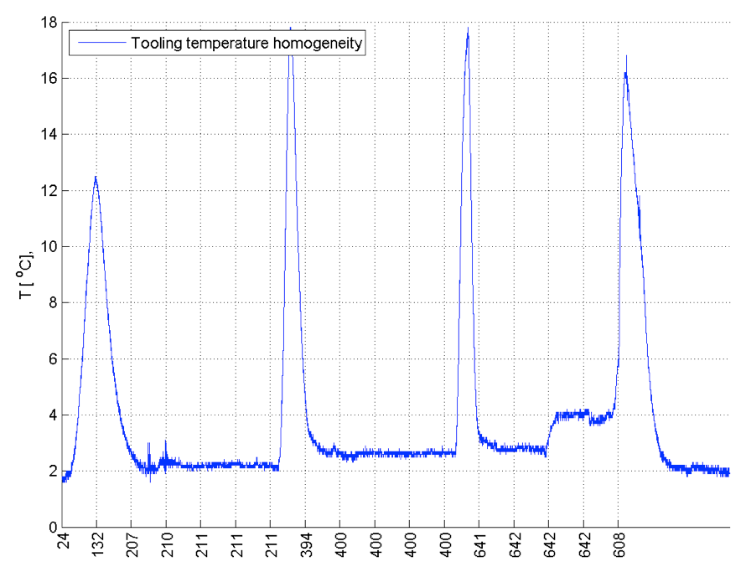
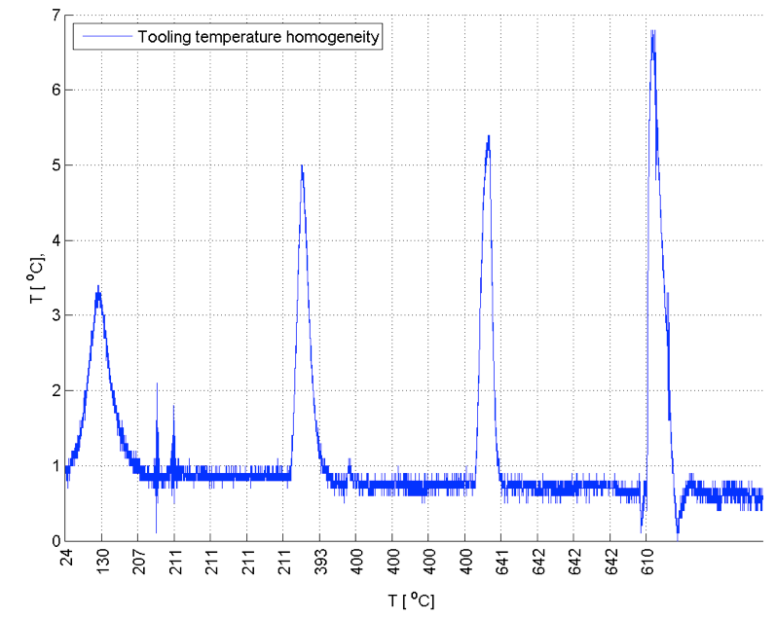
Temperature homogeneity for coil #104 (54/61)
Tool extremity
Tool Center
Notes:
Excellent !

Slide 17
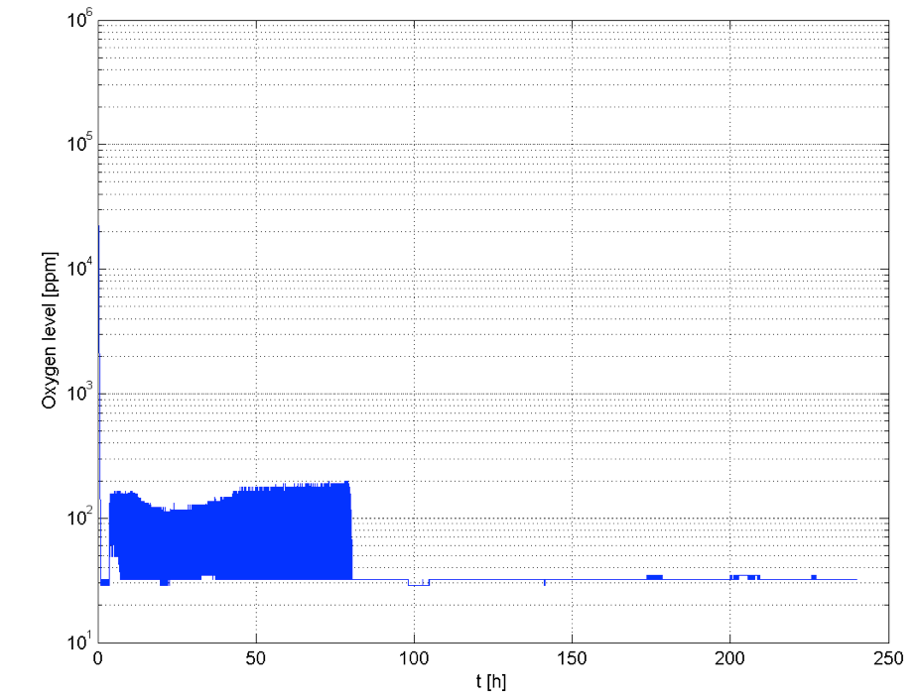
Oxygen monitoring for 54/61
1 analyzer monitoring both the retort atmosphere and the tooling atmosphere, toggling every 5 minutes.
Settings:
retort @ 1000 NL/h
Tool @ ?
Notes:
What to say ? Is this real values ? Dodgy analyzer !

Slide 18
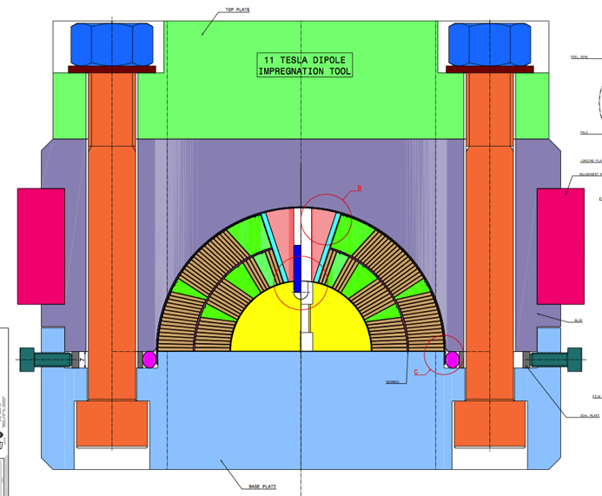
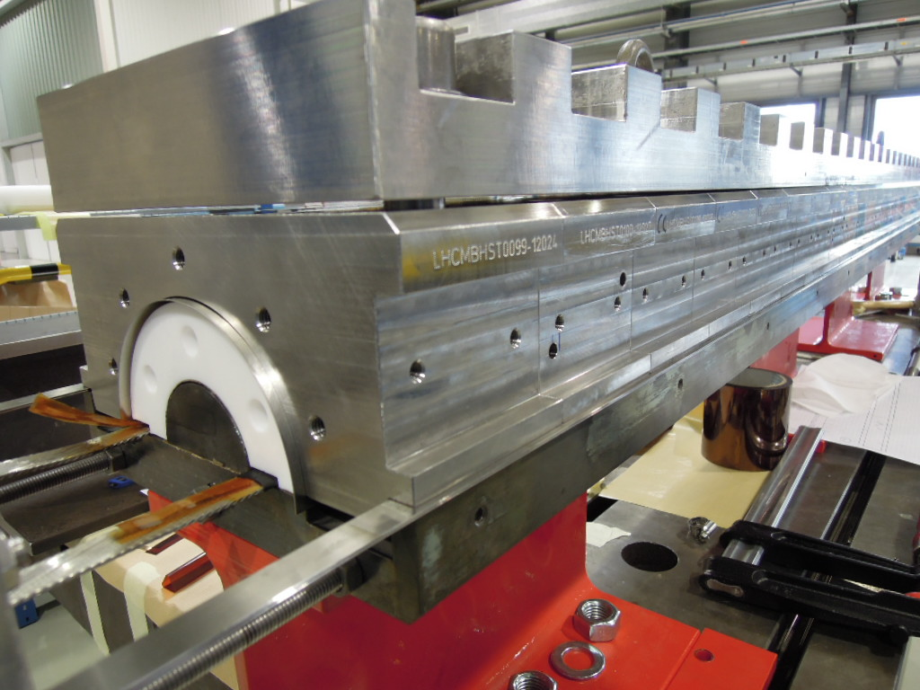
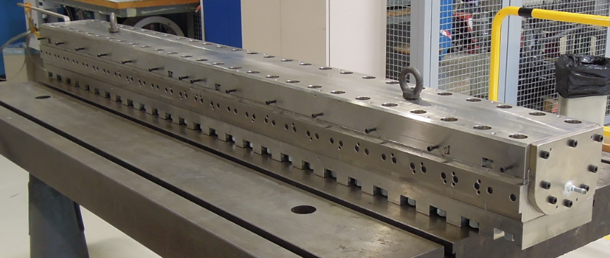
Impregnation: FNAL design + impreg. poles
FNAL tool replica
Can be manufactured up to 6 meters.
2d 2.2 m long tool being ordered
Notes:
Reaction tool works fine. Would merit a slightly larger design to allow for a larger impregnation tool (larger impregnation tool can house more easily the required rubber seals, current impregnation tool a bit too narrow at present)
Can be made up to 6 meters. Caution: to avoid distorsions, the parts of this tool have been heat treated in vacuum at > 1000 Celsius. This might not be possible for long tool (baseplate)
CERN uses silver plates screws and bolts (FNAL uses boron nitride paste).
Important: a second tool has been manufactured and is being delivered

Slide 19
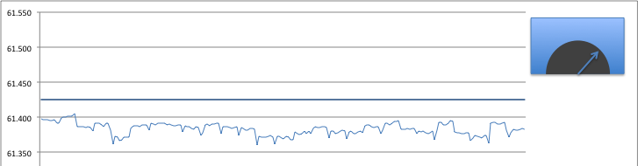
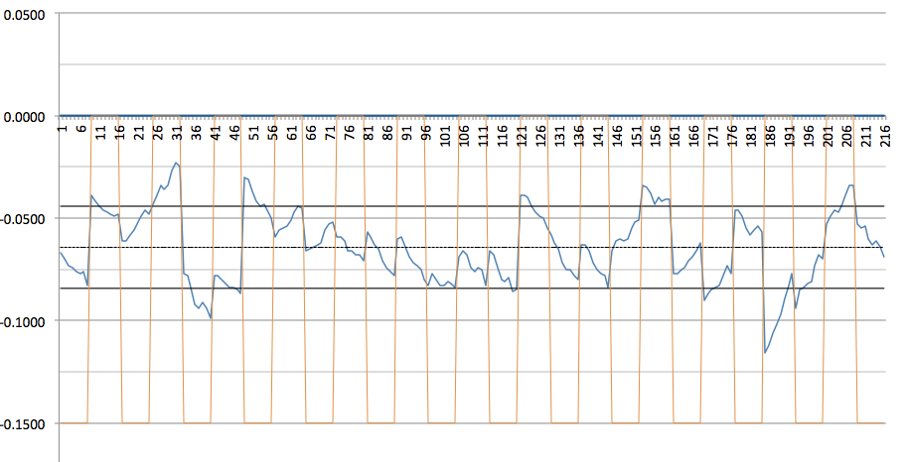
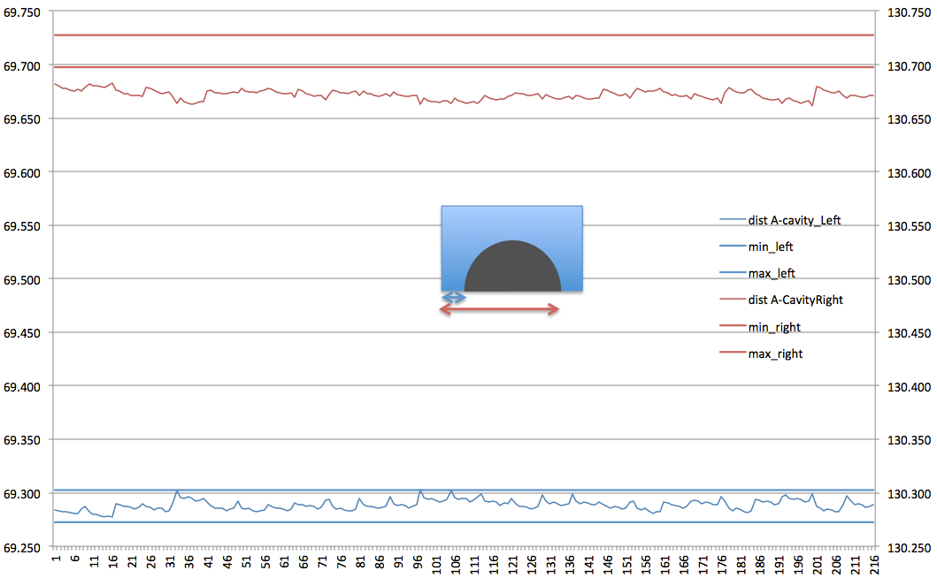
Impregnation: metrology
not as good as reaction tooling:
Coil cavity radius
Coil cavity vertical position on baseplate
Coil cavity lateral centering on baseplate
1
3
2
Notes:
Reaction tool works fine. Would merit a slightly larger design to allow for a larger impregnation tool (larger impregnation tool can house more easily the required rubber seals, current impregnation tool a bit too narrow at present)
Can be made up to 6 meters. Caution: to avoid distorsions, the parts of this tool have been heat treated in vacuum at > 1000 Celsius. This might not be possible for long tool (baseplate)
CERN uses silver plates screws and bolts (FNAL uses boron nitride paste).
Important: a second tool has been manufactured and is being delivered

Slide 20
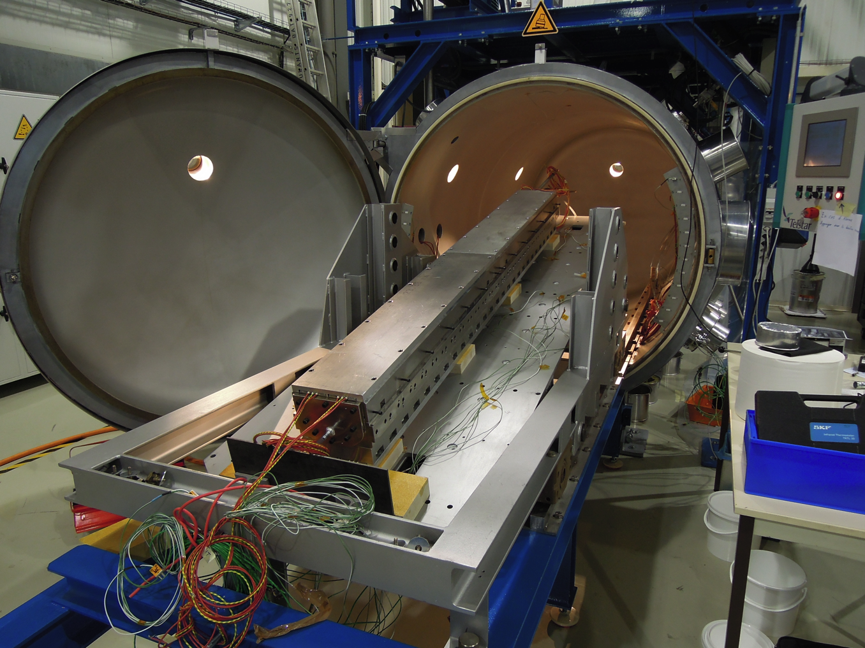
Impregnation Tank
Designed by TELSTAR
strenusous commissionning
Still many issues to be solved
However 1x copper dummy coil and 1x 54/61 coil potted successfully
Shrinkles on the coil surface due to problem with release film inside the impregnation tool
Notes:
Dual heating system (Infra-red lamps inside the vacuum tank + electrical feed-through to power heater cartridges)
Issues: reachable vacuum ~10E-2 <-> bad vacuum for electrical insulation, many breakdowns due to flashovers in the feedthrough at 400VAC
Infra-red tend to cure the resin in the hoses and might block the impregnation process
Several failure of the vacuuming system. Defective or not optimally designed instrumentation
Complex system “all-inclusive”: vacuum-heating-mixing-impregnation-cleaning system
Not possible to purge the circuit from air completely. Sequence not copied on FNAL protocol
System deisgned for large quantities of resin (level sensors are blind when less than 2 kilos of resin are left in the mixing tank <-> alarm will lock all valve and stop impregnation
Windows badly placed, cannot “see” the qty of resin left.
Injection valve is ON/OFF difficult to tune for slow injection (11T at FNAL ~400 ml per hour –TBC-) <-> need to keep the mixing tank under vacuum and slightly let pressure increase in the mixing tank to moderate the injection speed

Slide 21
Conclusion
Tooling for coil production:
  All tools are in operation and perform very satisfactorily
  Second set of tools for reaction and impregnation under production
  Protocols and techniques are well documented
  Team being trained, good progress
“Old” Infrastructure (winding/ curing)
  Tools in operation for many years and performing satisfactorily
New infrastructure (3 furnaces and Impreg. Tank)
  Many projects in parallel require the same new infrastructure (SMC, RMC, Fresca, MQXF, R&D on fibres, stacks, …)
  strenuous commissioning
  Monopolize important resources and/or induce large delays (due to breakdown, unavailability of trained staff, …)
  Would require more resources

