Slide 1
11T Dipole REVIEW, 23- 24 SEPT 2013
Producing a coil
From the beginning to now
-Glass fiber braiding
-Cable
-End spacer
-Wedges
-Interlayer
-Vtaps
-Popped strands
-Reaction
-Splicing
-Vacuum impregnation
J.MAZET

Slide 2
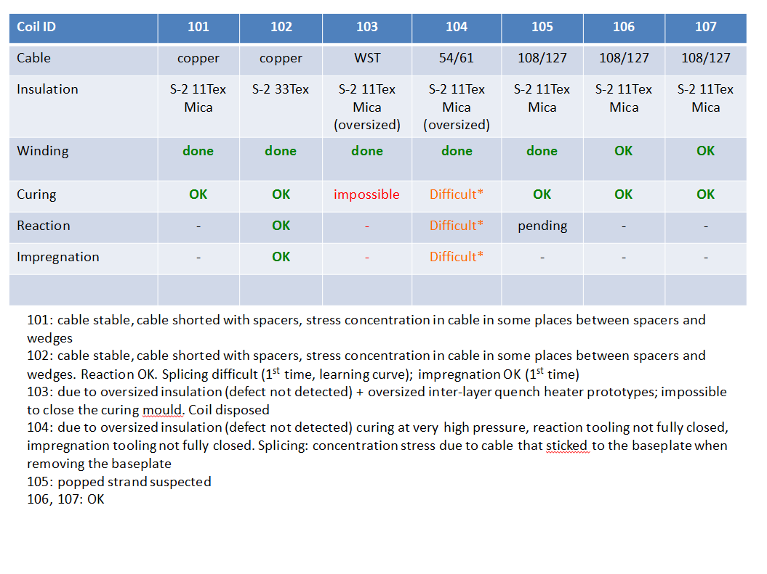
Summary of manufacture

Slide 3
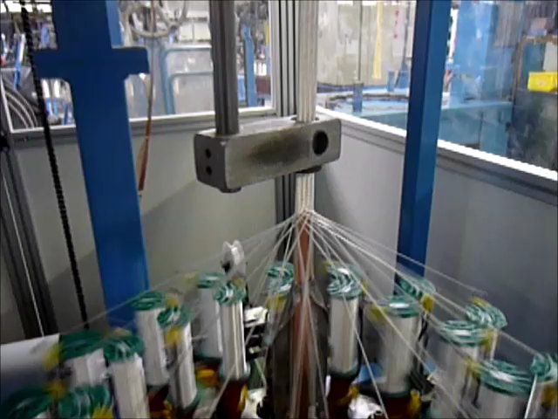
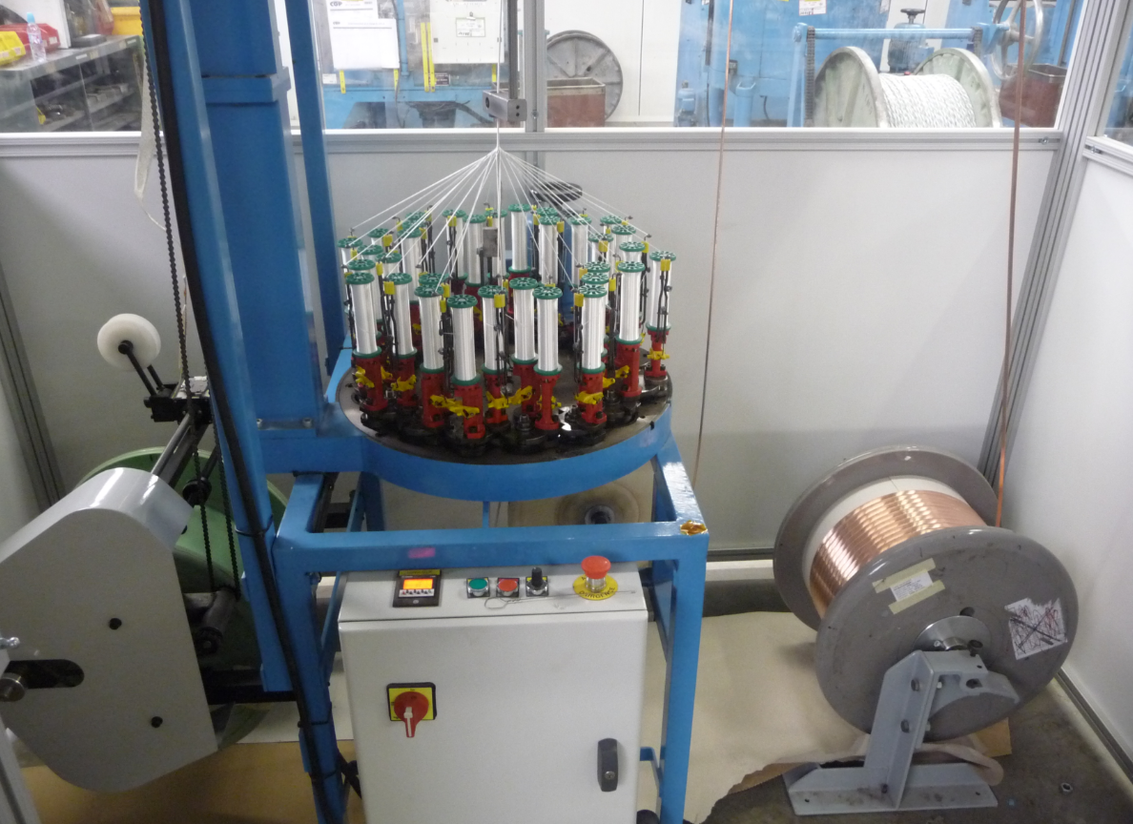
Braiding 11TEX +MICA cable Nb3Sn 11T Dipole

Slide 4
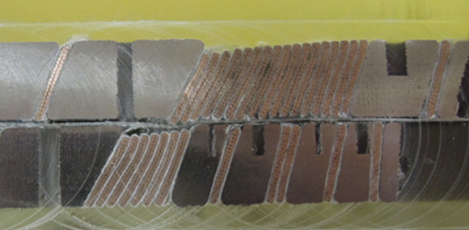
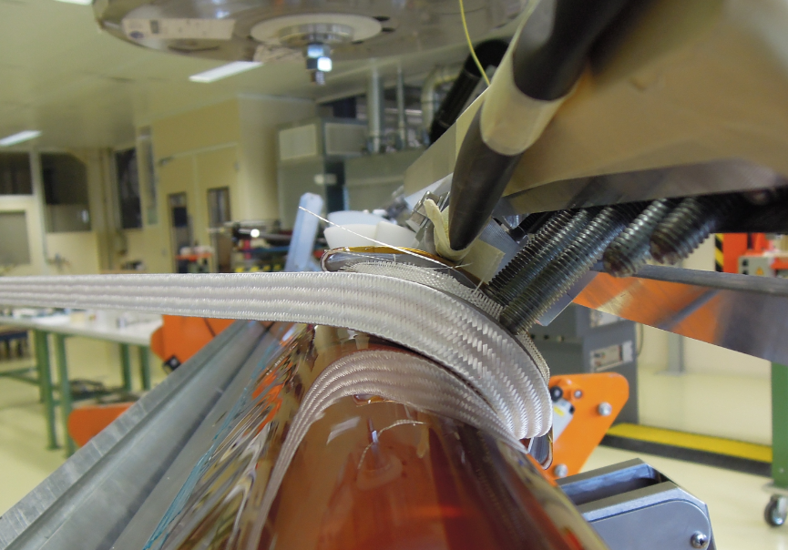
Cable Cu, WST (ITER), RRP-54/61
Stable cable
Winding 3 days/layer
Winding tension 30 kg

Slide 5
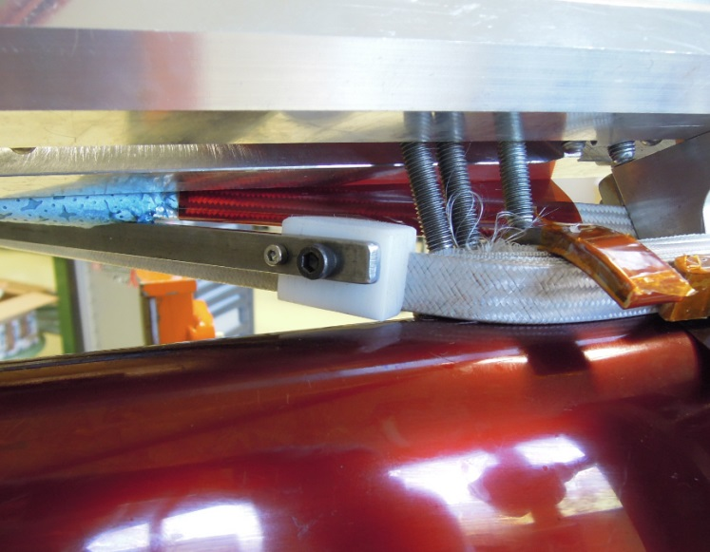
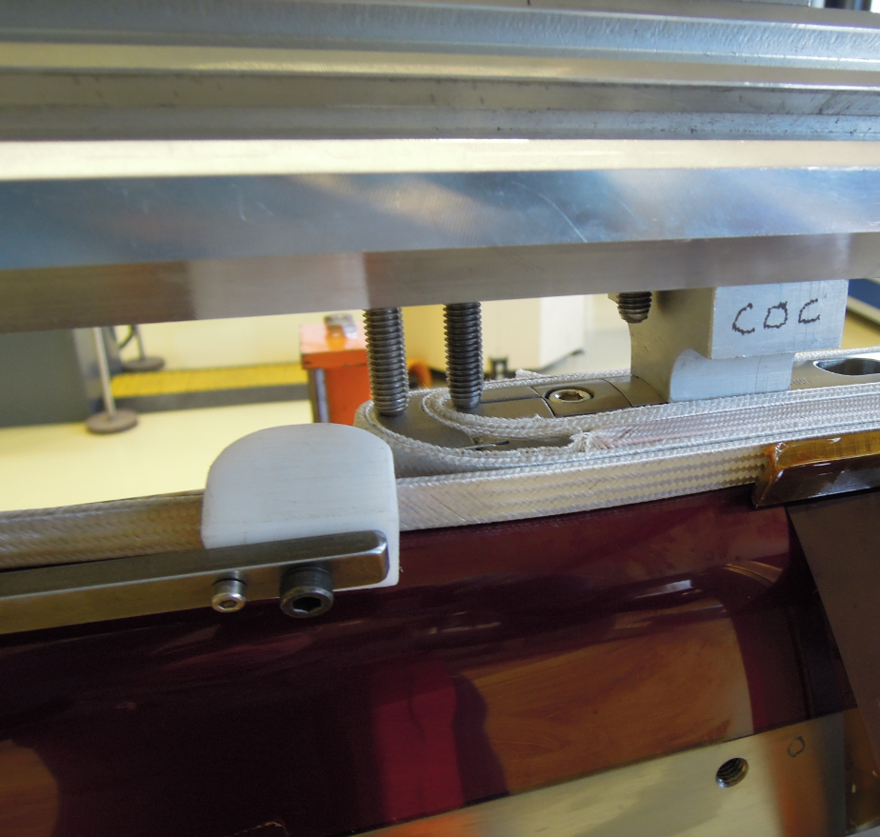
Câble RRP-108/127
Discovery of a popped strand in the internal winding radius
after unwinding.
Cable unstable
Winding 6 days/layer
Winding tension 20 Kg
Temporary solution:
-Bond fiber glass whith ceramic
binder.
-Use a special tool.
Disadvantage:
Difficult to control.
Curred binder stiffens cable.

Slide 6
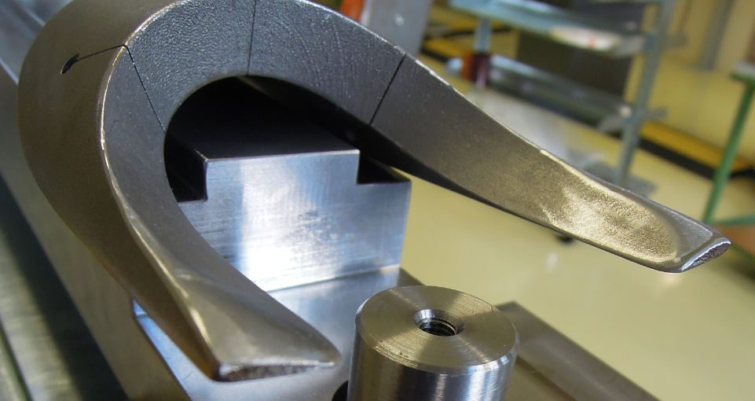
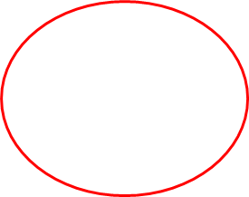
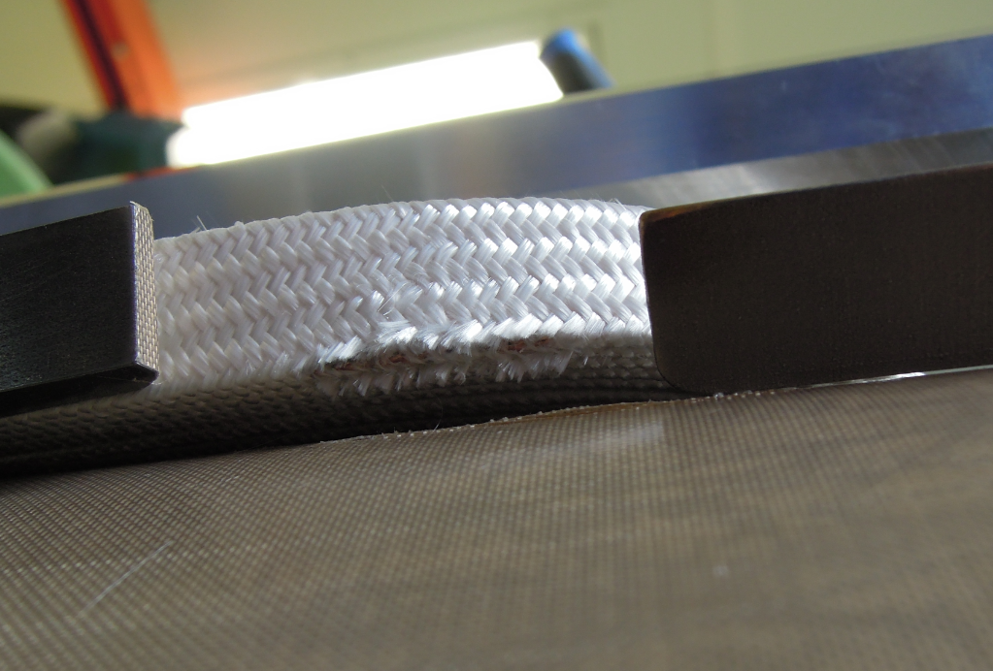
End spacers
End spacer in one part
Implementation difficult.
Damages the cable insulation .
Modification of the spacer geometry necessary.(!)

Slide 7
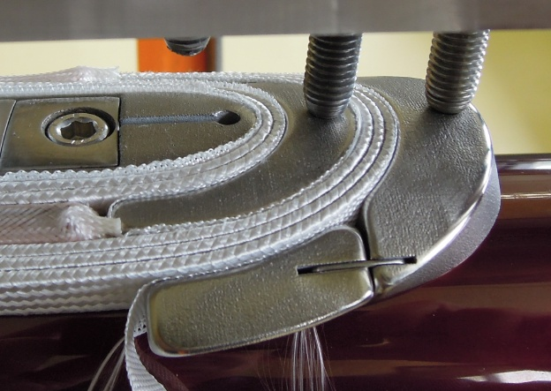
End spacer with springy leg
Implementation easy.
Minimize deterioration of cable insulation .

Slide 8
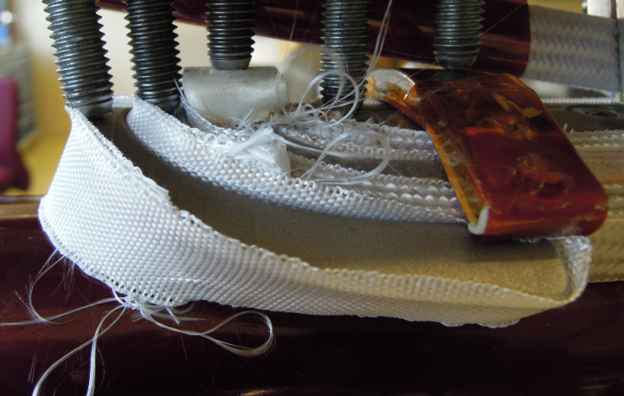
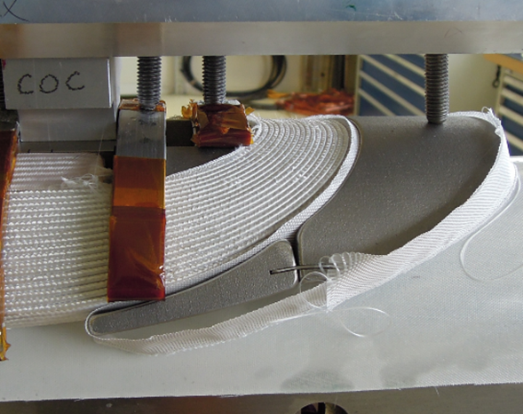
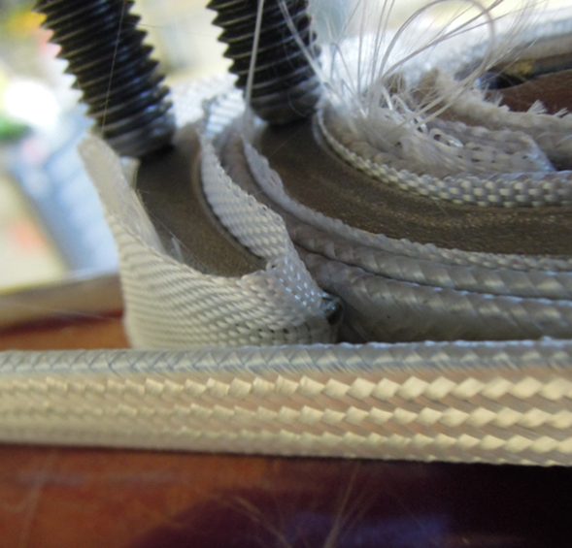


Electrical insulation of spacers
Tapes of Sglass 16 mm*0.15 mm insulating the spacer from the cable .
Disadvantage:
No certainty to cover the total surface of the spacer in contact with the cable.
During clamping /de clamping of the coil , the leg of the spacer moves (rotates)
and may damage the insulation of the cable .
Risque de CC.

Slide 9
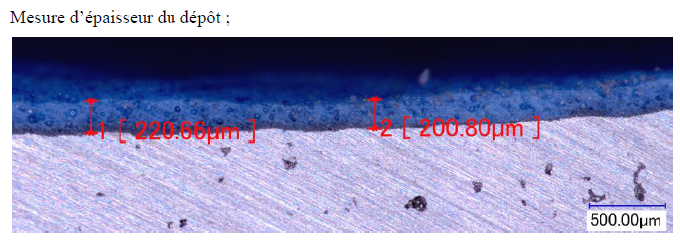
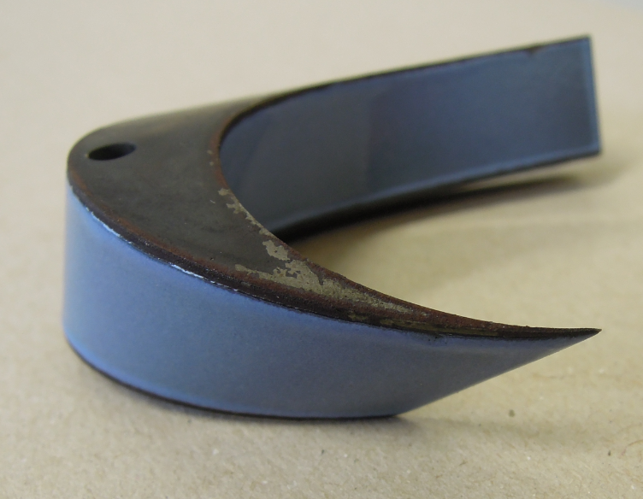
Electrical Insulation of Spacers
Alternative:
Coating with vitreous enamel
Good mechanical properties at 77K
Maximum operating temperature ≥ 750°C
Radiation resistant.

Slide 10
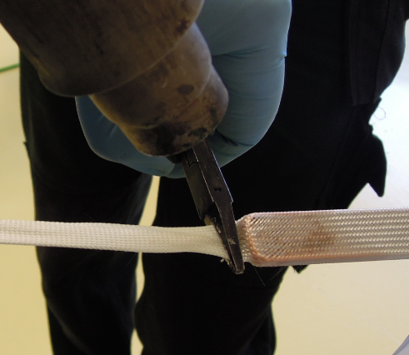
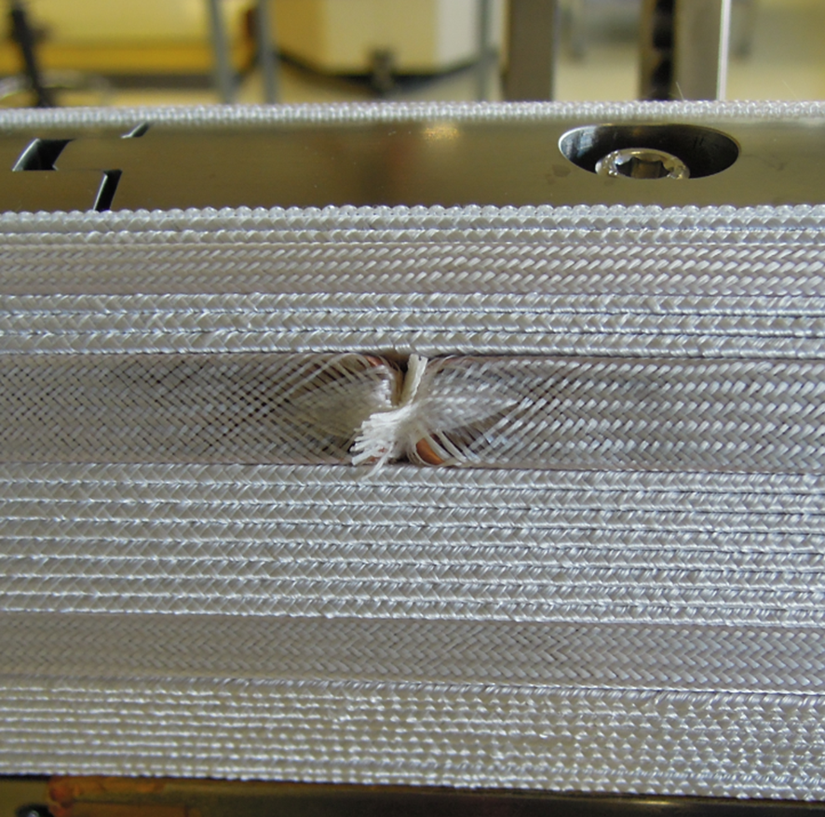
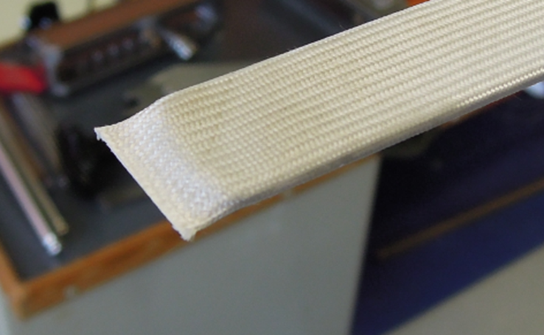
Insulation of wedges
The extremities of the fibreglass sleeving is glued with ceramic binder.
The mechanical behaviour of this gluing does not allow the correct
insulation of the extremity of the wedge.
Risk of shorts.

Slide 11
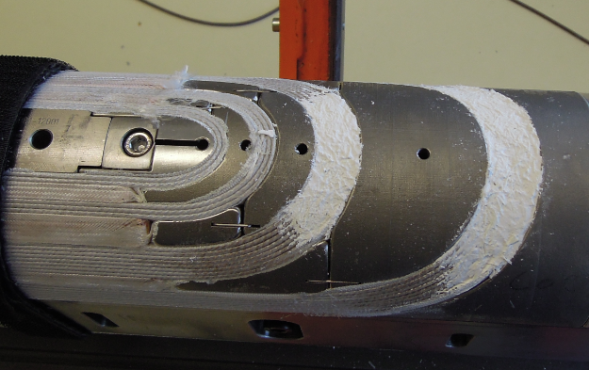
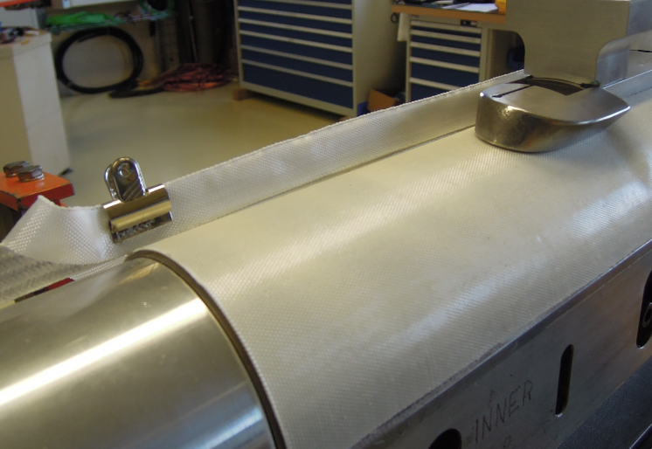
INNER LAYER
Filling of the gaps over the coil blocks in the heads, by means of a ceramic liquid mixed with cruched fibres, before installing the inter layer.
Inter layer
2 layers of fibreglass (S glass).
Total thickness: 0.5mm

Slide 12
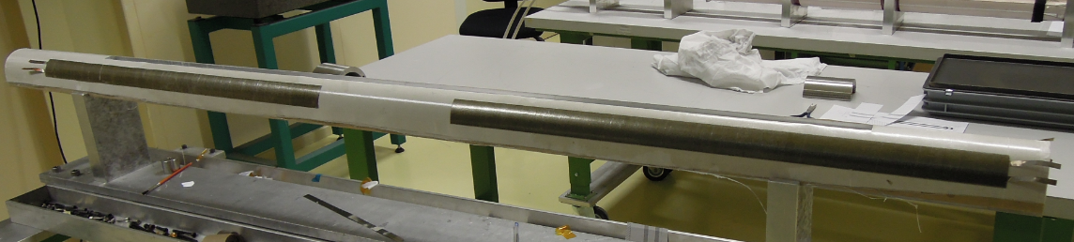
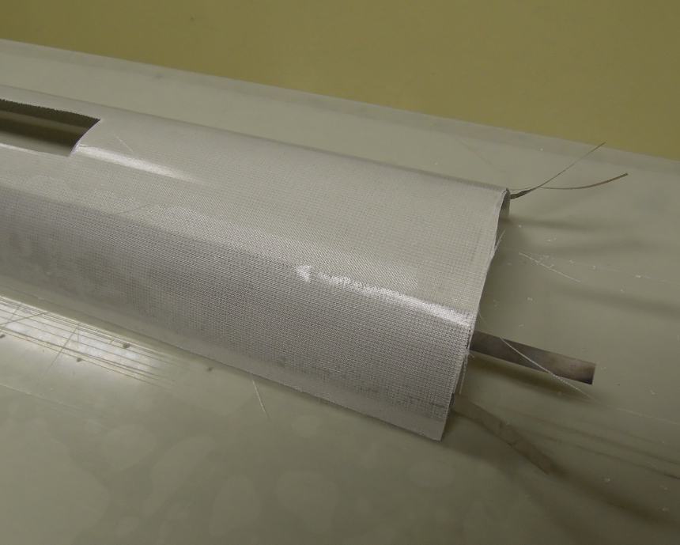
Inter layer with quench heater
Thickness 0.7mm
High voltage resistance measurement > 8G Ω
Trials inside the coil #103 (WST) was not successful due to a problem with the thickness of the cable
Insulation (oversized)

Slide 13
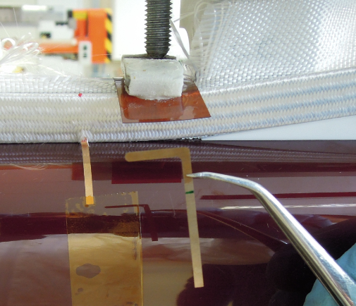
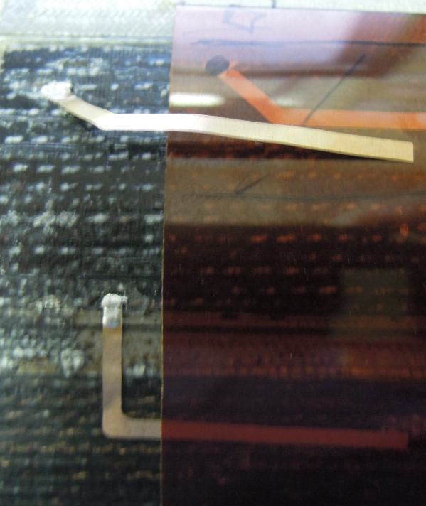
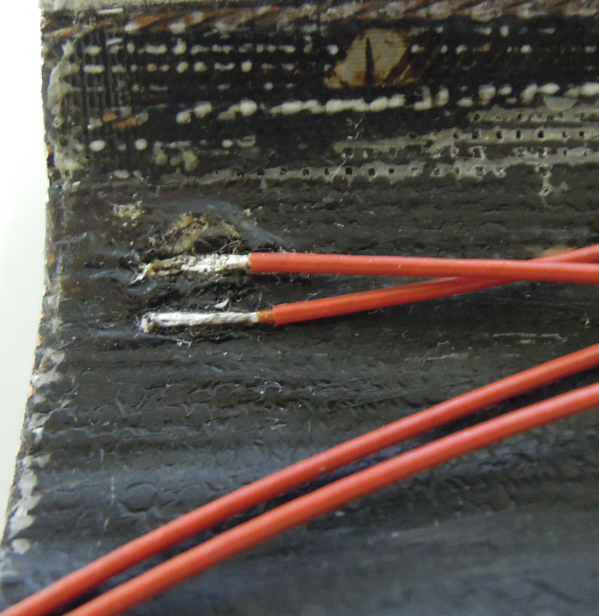
VTAPS
Installing Vtaps during coil winding is possible on the outer layer.
On the inner layer, there is a risk to pinch the vtaps between
2 turns due to the clamping/declamping of the coil turns during the winding.
For our coils to be instrumented, the voltage taps will be basd on the FNAL technique: soldering after coil impregnation

Slide 14
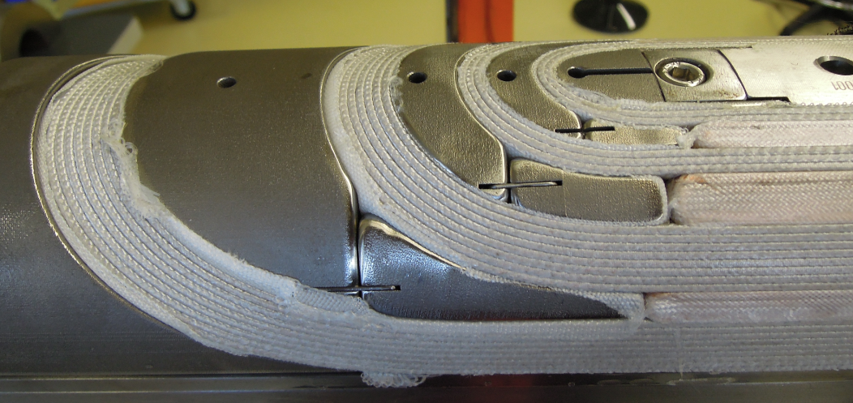
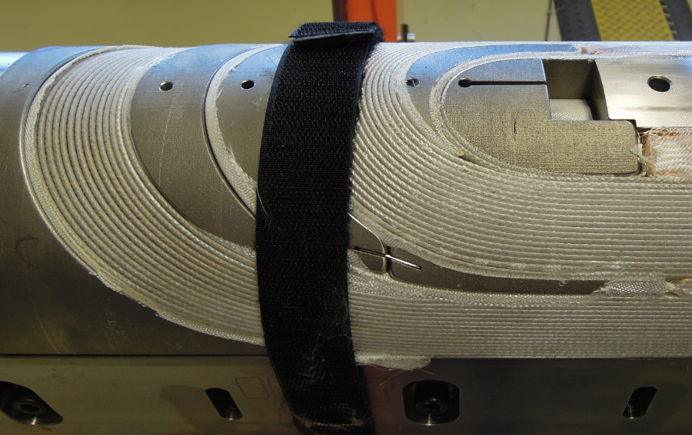
Coil Nb3Sn 108/127
After curing
The springy legs of the spacers have moved in correct position and are well aligned
Note: no gap filling with ceramic putty on top of the coil blocks for the coil outer layer

Slide 15
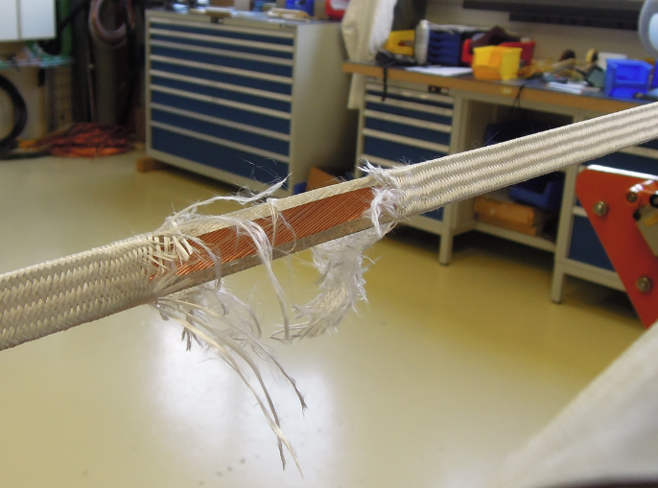
Popped strand on Coil 108/127 #002

Slide 16
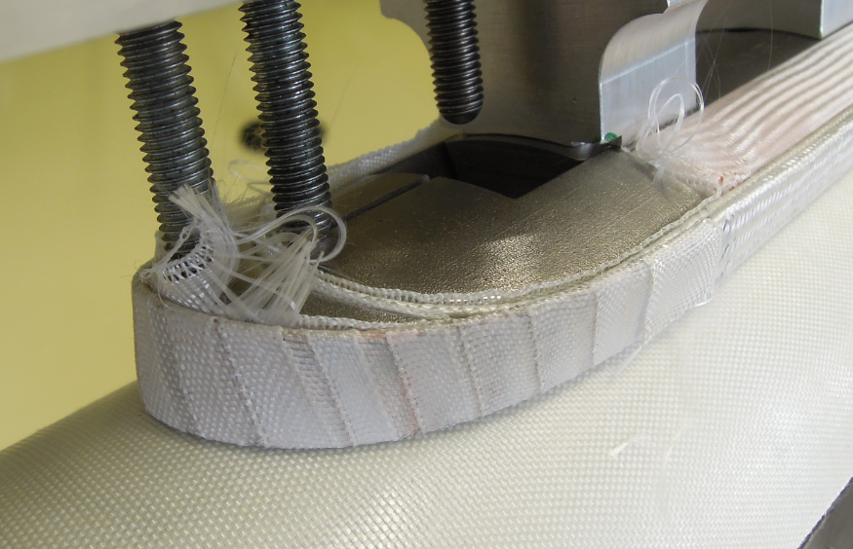
Repair of Popped strand on Coil 108/127 #002

Slide 17
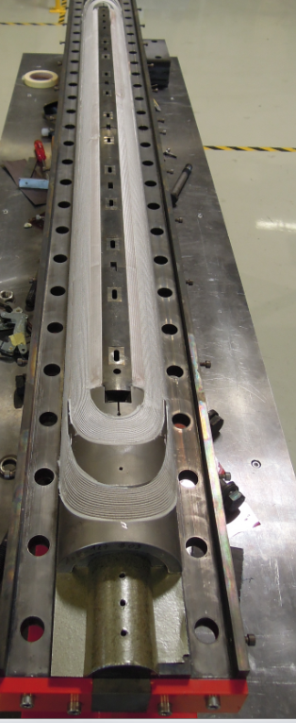
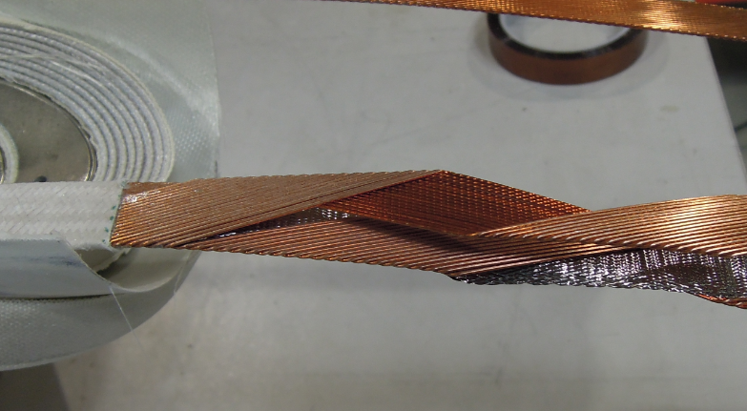
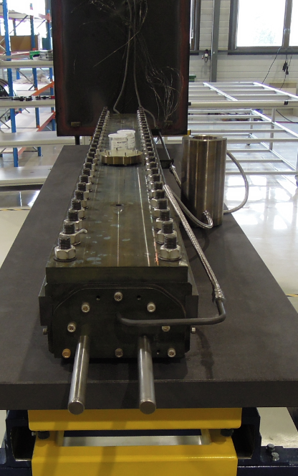
Reaction
Cutting of the ‘’core ‘’
Reaction poles are aligned by means of keys and
Pinned to the mandrels.
Closing the tool and preparation of the strand samples (VAMAS).
Piping for the circulation of Argon gaz inside the tool.

Slide 18
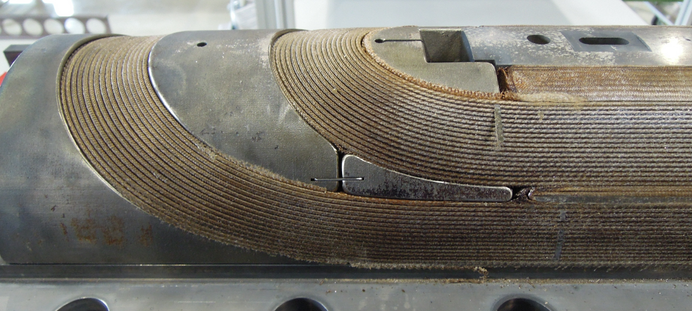
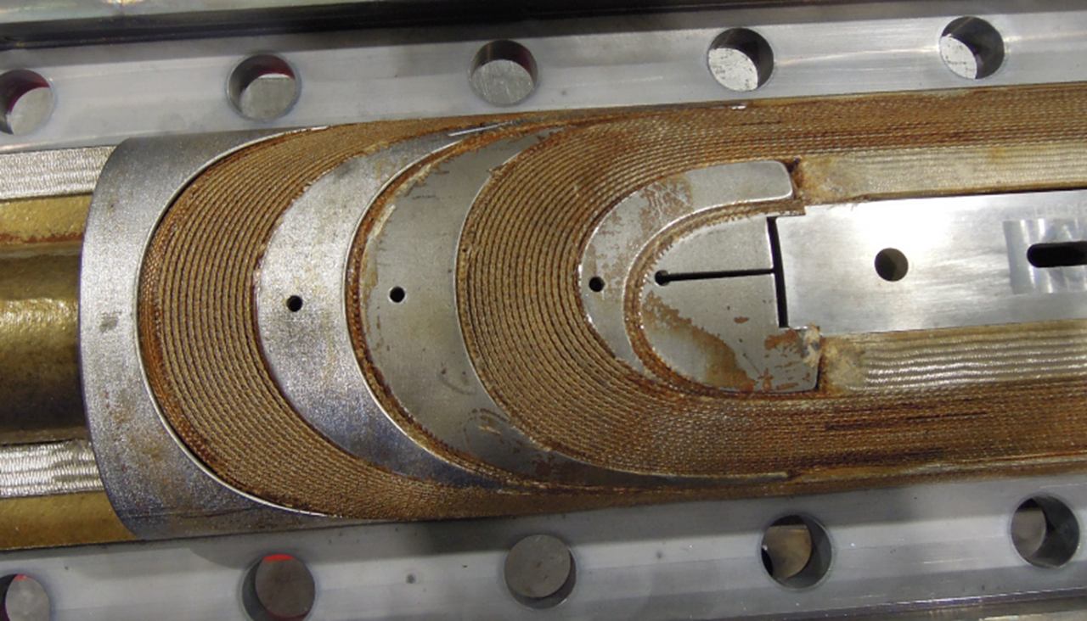
After reaction

Slide 19
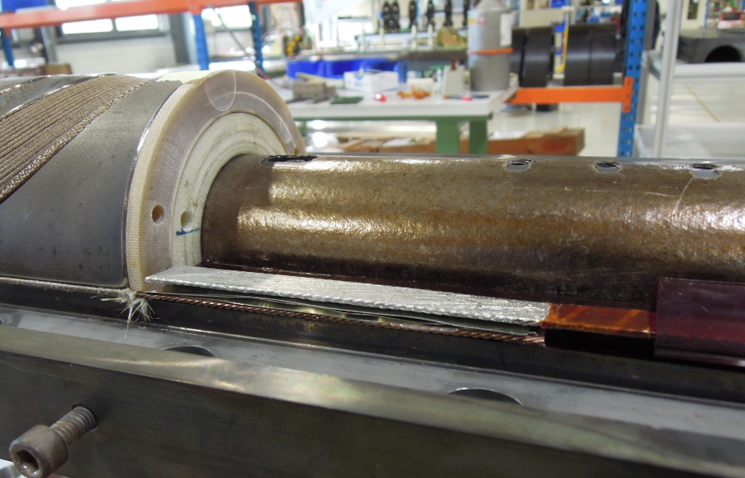
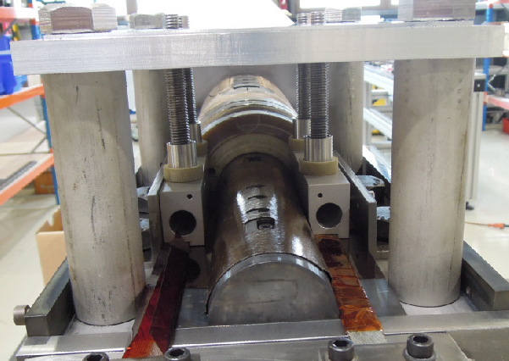
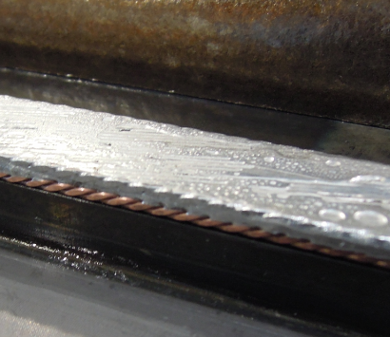
Splicing
Splicing procedure
Nb-Ti busbar is pre-tinned
Top surface of the Nb3Sn cable is cleaned
Soldering of the Nb3Sn/Nb Ti junction
‘’C’’-shape wrapping of kapton for insulation
Disadvantage:
No control of the migration of the Tin solder through the Nb3Sn cable
(Bonding of the bottom strands hazardous)

Slide 20
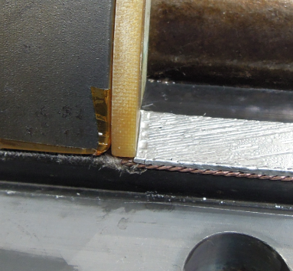
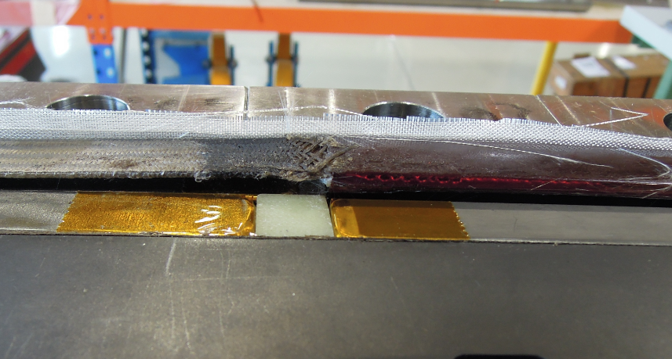
Risk of short
The flux sticks to the tooling baseplate, and pull the splice when the baseplate is removed
The flux migrates by capillarity inside the fibreglass and pollutes locally the impregnation

Slide 21
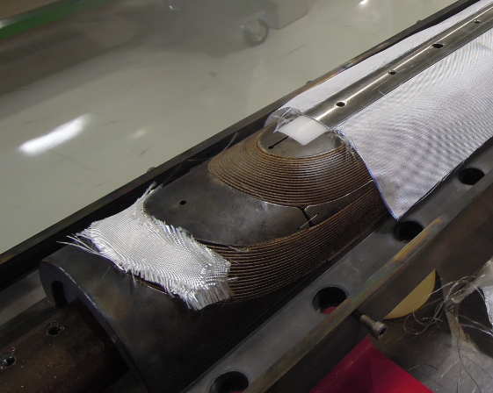
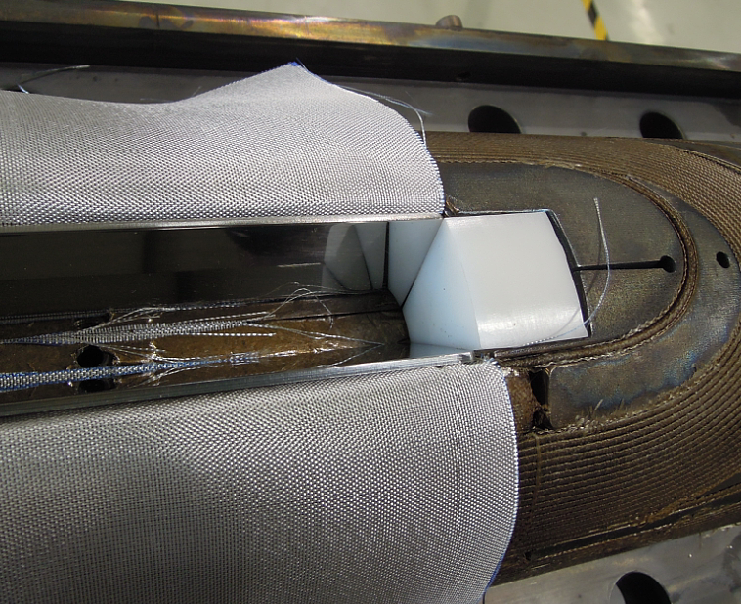
Transfert Reaction Tooling
Impregnation tooling
Filling all gaps
Installing fibreglass cloth
Installing the loading plates
Aligning the impregnation poles with keys

Slide 22
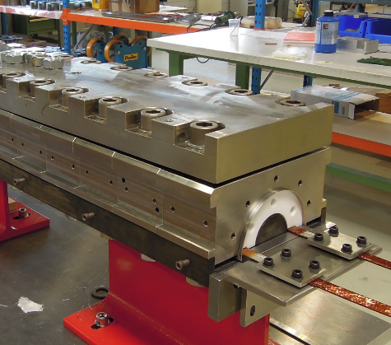
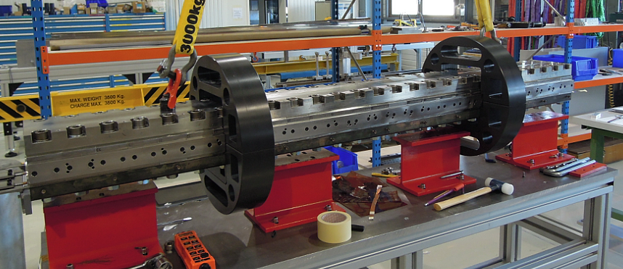
Installing the top part of the impregnation tooling
Preparation for the rotation of the tooling

Slide 23
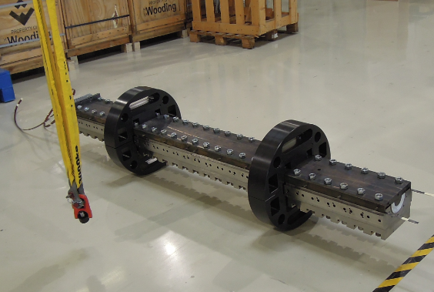
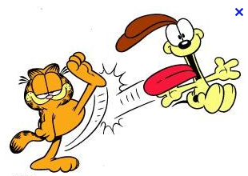

Slide 24
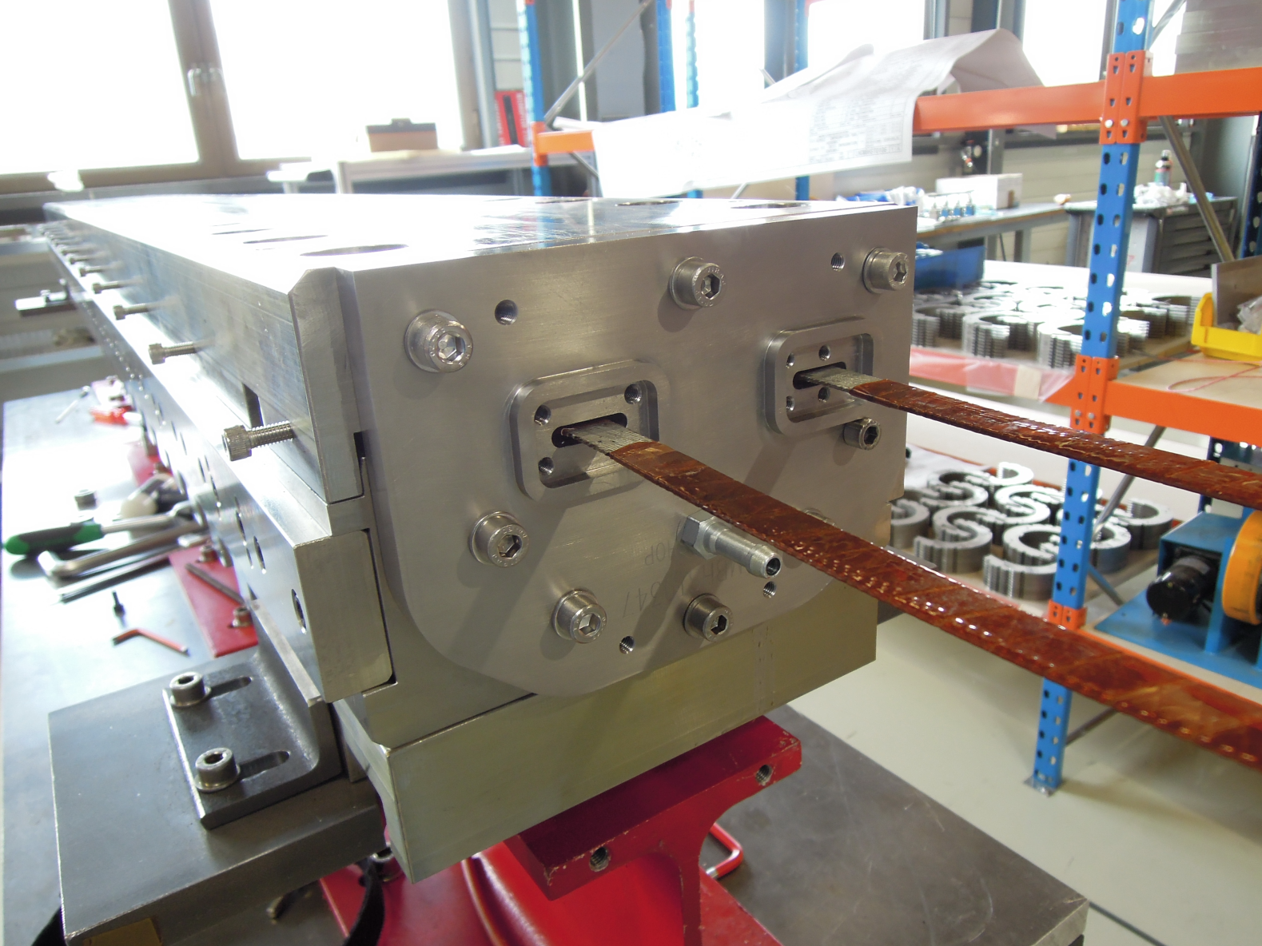
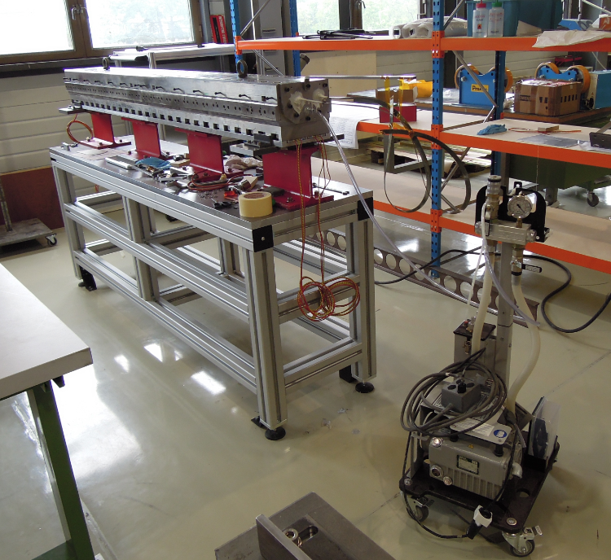
Closing the extremities of the tooling
Vacuuming the tooling to test tightness

Slide 25
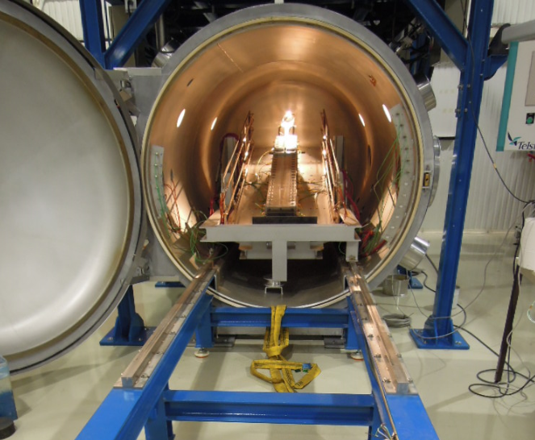
Polymerisation

Slide 26
