Slide 1
Coil Metrology and Acceptance Tests
COIL & ASSEMBLY READINESS REVIEW, 23- 24 SEPT 2013
D. Smekens

Slide 2
OUTLINE
Metrology of coil #104 (54/61) (and of FNAL MBH08 for comparison)
Monitoring and acceptance tests during coil production

Slide 3
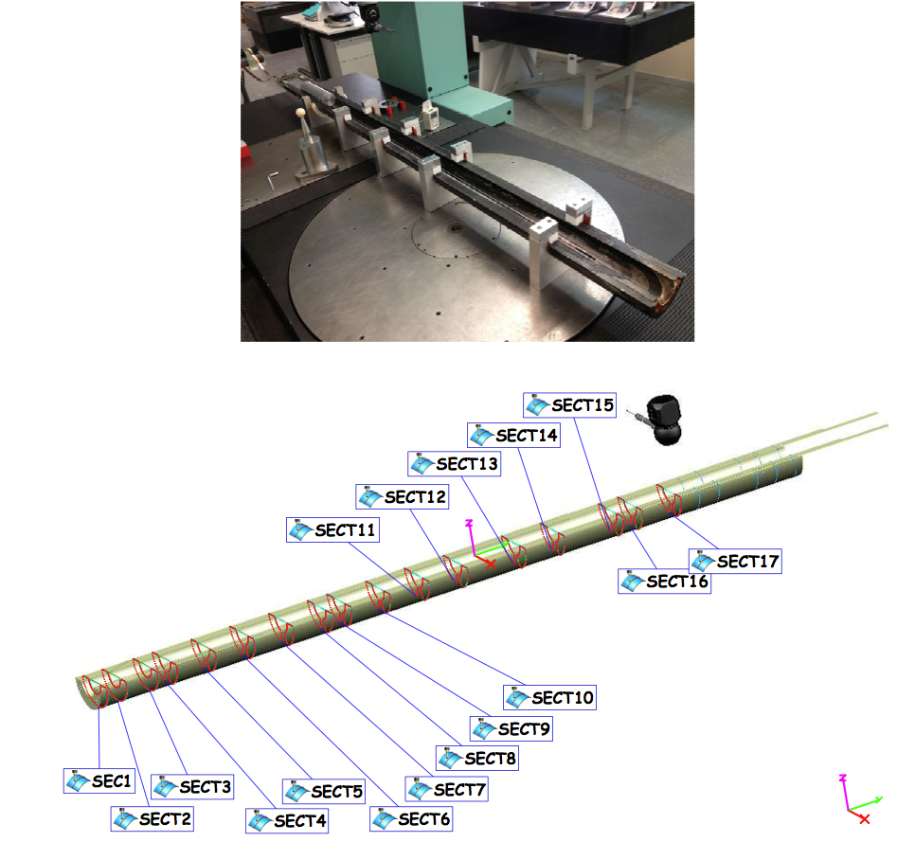
Metrology of Coil #104 (54/61)
Cable 54/61 was braided with oversized insulation thickness:
  Tools could not be completely closed
  Radius of cavity was set 0.2 mm larger for impregnation
Metrology report not finalized yet
https://edms.cern.ch/document/1314712/1

Slide 4
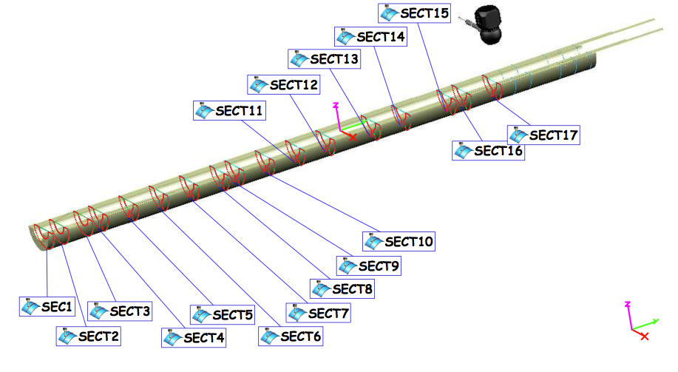
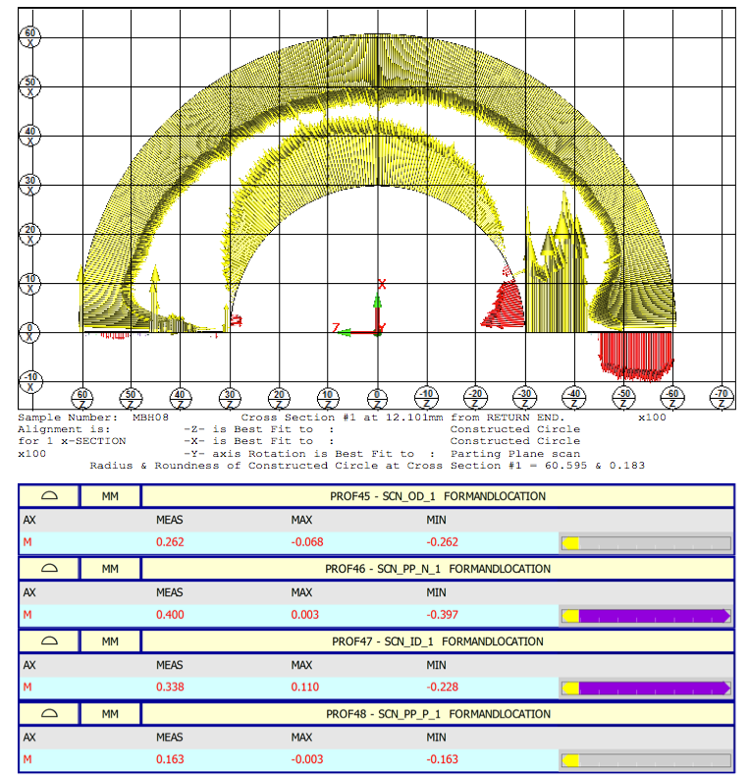
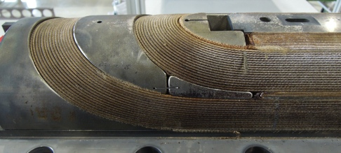
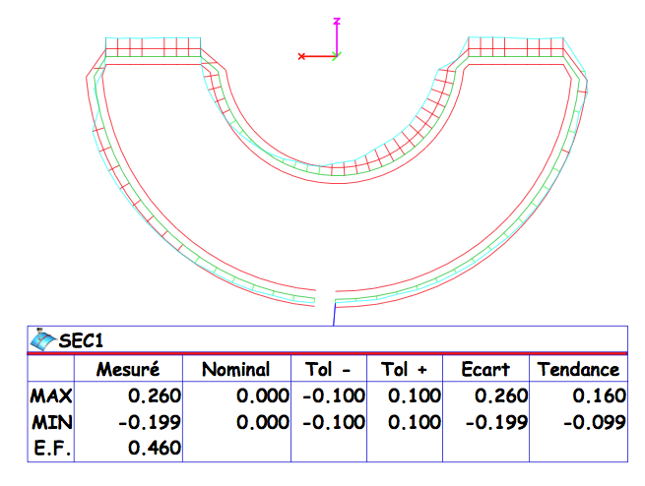
CERN #104 (54/61): over RE saddle
FNAL MBH08
Notes:
Each scanned section(2D) has its own reference. Scanned sections are not correlated to a global reference system.
This allows to work out the shimming plan for the collaring.
It does not give any idea about the sag, the bend or the torsion of the coil over its entire length
The reconstruction of the clould of points is as follows: for a given section, the OD is scanned. The best fit of these points allows to determine a circle. The center of this circle is then located on the center of the CAD Coil X-section. The rotation is “blocked by a best fit of the scanned mid-plane onto the mid-plane of the CAD model

Slide 5
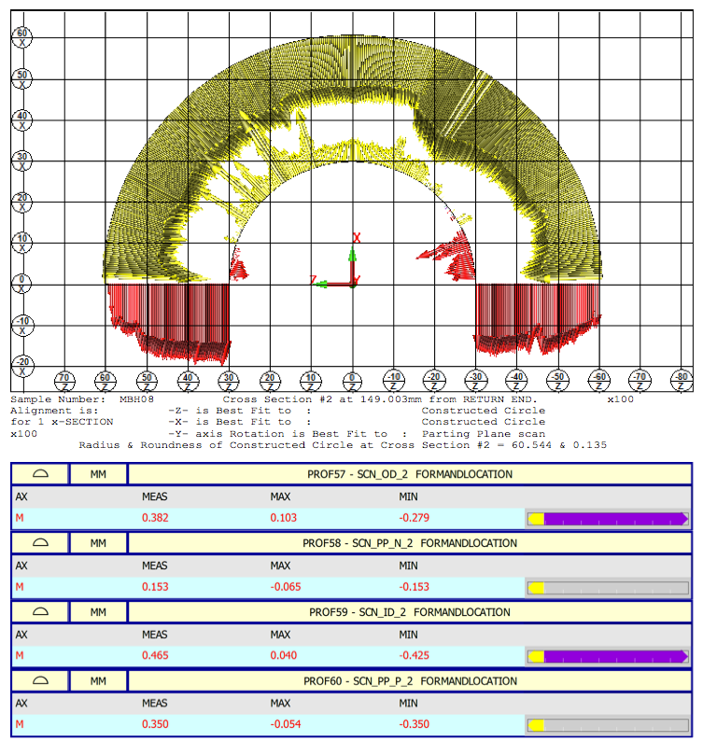
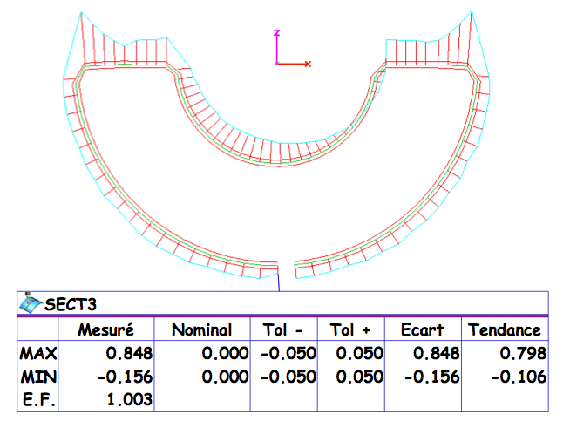
CERN #104 (54/61): RE region
FNAL MBH08
Notes:
Each scanned section(2D) has its own reference. Scanned sections are not correlated to a global reference system.
This allows to work out the shimming plan for the collaring.
It does not give any idea about the sag, the bend or the torsion of the coil over its entire length
The reconstruction of the clould of points is as follows: for a given section, the OD is scanned. The best fit of these points allows to determine a circle. The center of this circle is then located on the center of the CAD Coil X-section. The rotation is “blocked by a best fit of the scanned mid-plane onto the mid-plane of the CAD model

Slide 6
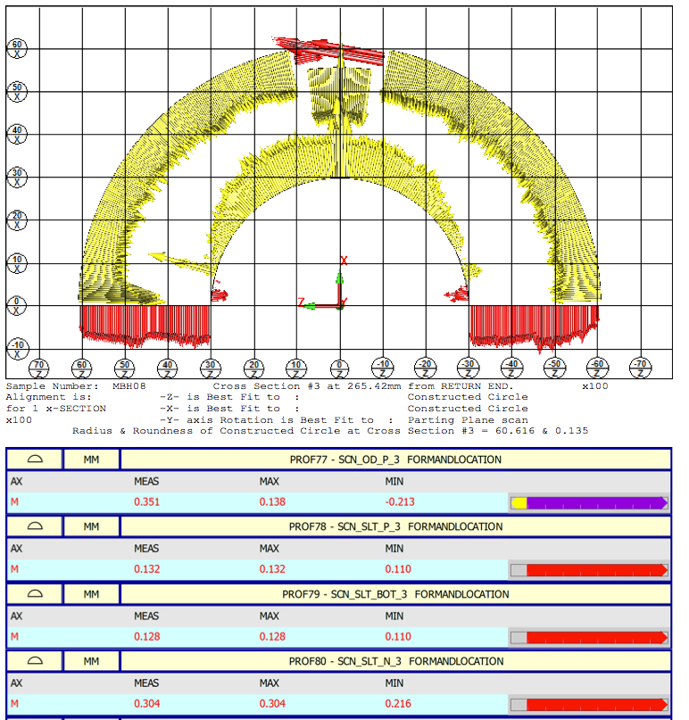
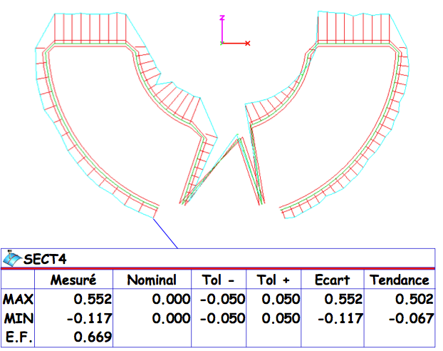
CERN #104 (54/61): from RE region to straight section
FNAL MBH08
Notes:
Each scanned section(2D) has its own reference. Scanned sections are not correlated to a global reference system.
This allows to work out the shimming plan for the collaring.
It does not give any idea about the sag, the bend or the torsion of the coil over its entire length
The reconstruction of the clould of points is as follows: for a given section, the OD is scanned. The best fit of these points allows to determine a circle. The center of this circle is then located on the center of the CAD Coil X-section. The rotation is “blocked by a best fit of the scanned mid-plane onto the mid-plane of the CAD model

Slide 7
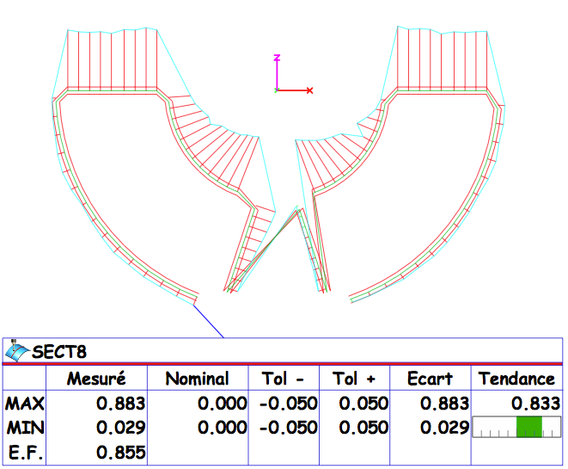
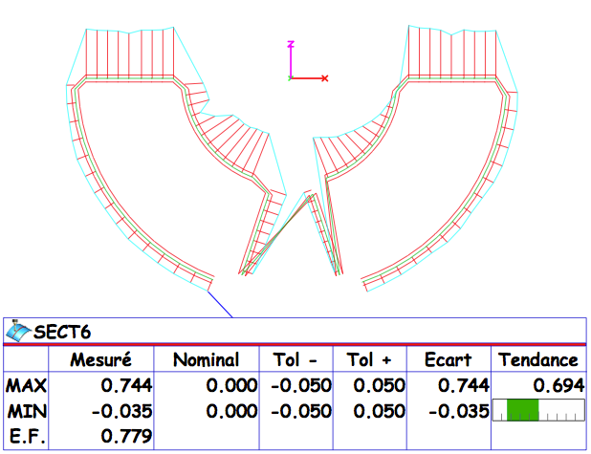
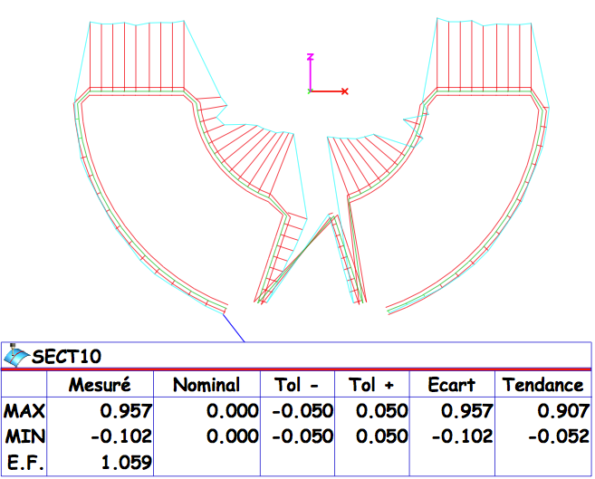
CERN #104 (54/61): straight section
from RE to middle
Notes:
Each scanned section(2D) has its own reference. Scanned sections are not correlated to a global reference system.
This allows to work out the shimming plan for the collaring.
It does not give any idea about the sag, the bend or the torsion of the coil over its entire length
The reconstruction of the clould of points is as follows: for a given section, the OD is scanned. The best fit of these points allows to determine a circle. The center of this circle is then located on the center of the CAD Coil X-section. The rotation is “blocked by a best fit of the scanned mid-plane onto the mid-plane of the CAD model

Slide 8
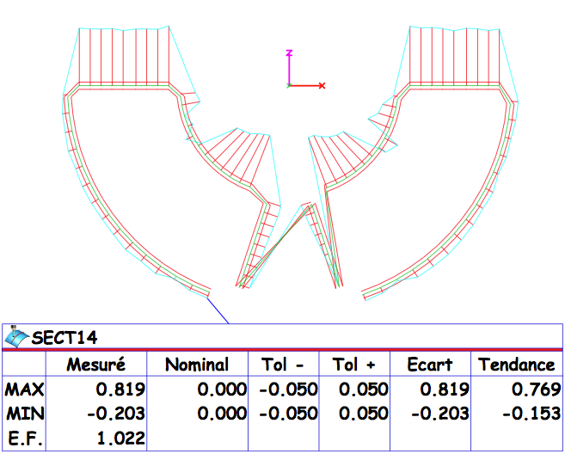
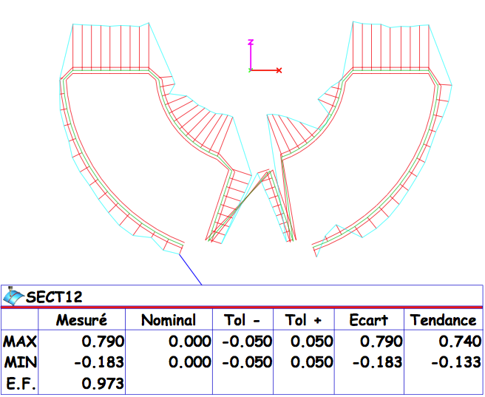
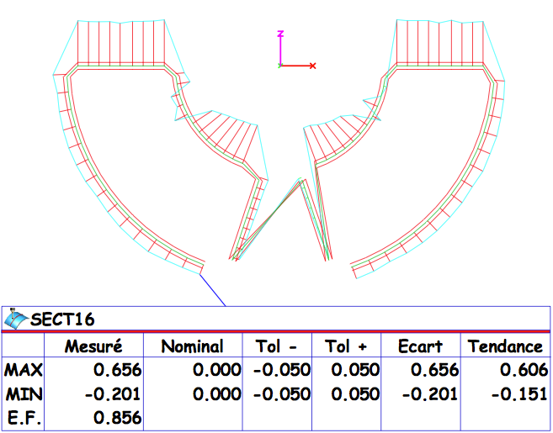
CERN #104 (54/61): straight section
From middle to LE
Notes:
Each scanned section(2D) has its own reference. Scanned sections are not correlated to a global reference system.
This allows to work out the shimming plan for the collaring.
It does not give any idea about the sag, the bend or the torsion of the coil over its entire length
The reconstruction of the clould of points is as follows: for a given section, the OD is scanned. The best fit of these points allows to determine a circle. The center of this circle is then located on the center of the CAD Coil X-section. The rotation is “blocked by a best fit of the scanned mid-plane onto the mid-plane of the CAD model

Slide 9
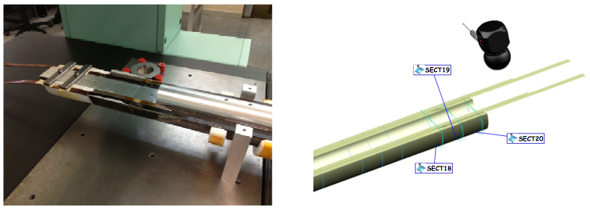
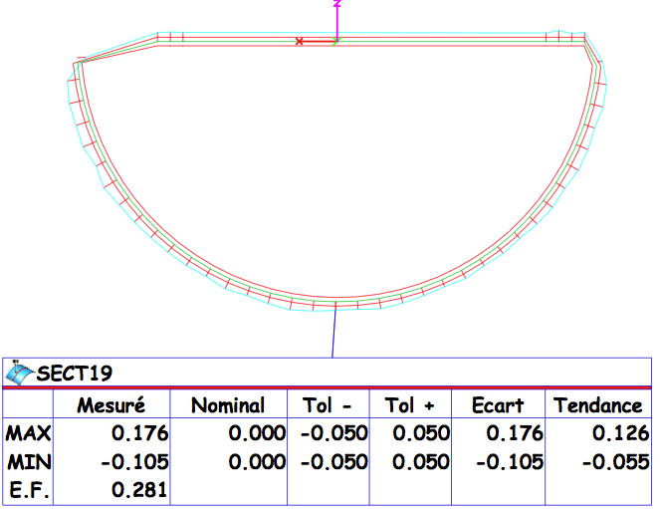
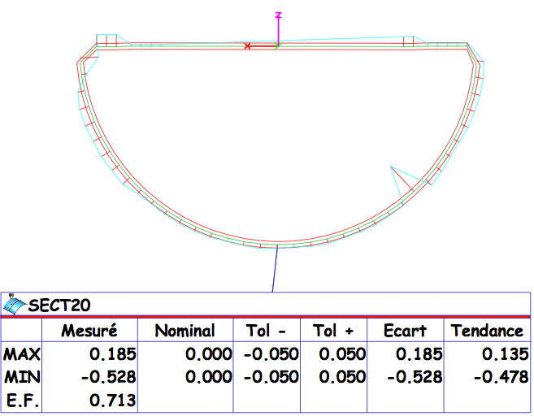
CERN #104 (54/61): Splice region
Notes:
Each scanned section(2D) has its own reference. Scanned sections are not correlated to a global reference system.
This allows to work out the shimming plan for the collaring.
It does not give any idea about the sag, the bend or the torsion of the coil over its entire length
The reconstruction of the clould of points is as follows: for a given section, the OD is scanned. The best fit of these points allows to determine a circle. The center of this circle is then located on the center of the CAD Coil X-section. The rotation is “blocked by a best fit of the scanned mid-plane onto the mid-plane of the CAD model

Slide 10
First results from 54/61 in CMM
Azimuthal length: oversized as expected
Good symmetry left/right coil branches in the straight section
OD seems also to show a constant oversized radius 0.2 mm (corresponding to the oversized cavity)
“Nice” geometry over the Splice region
Good prospects for the future 108/127s coils with nominal insulation

Slide 11
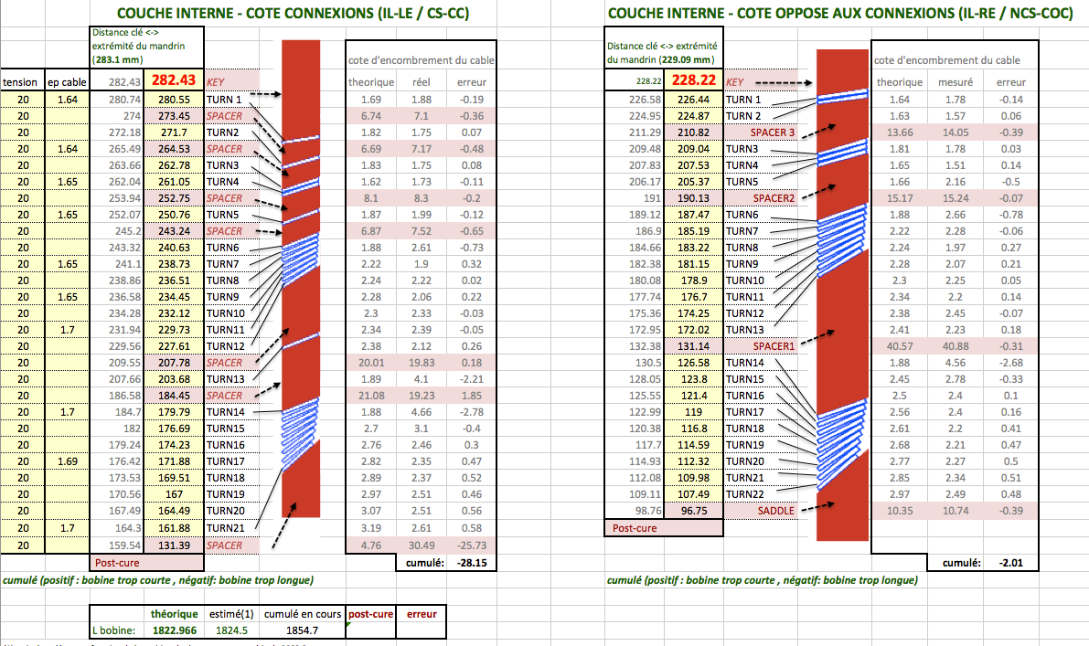
Geometry – Z axis (during IL winding)

Slide 12
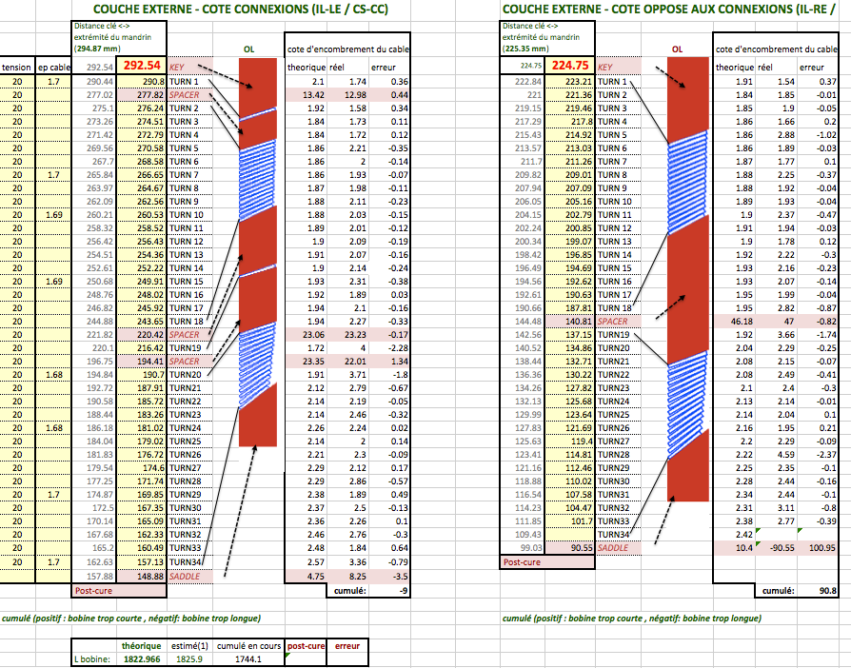
Geometry – Z axis (during OL winding)

Slide 13
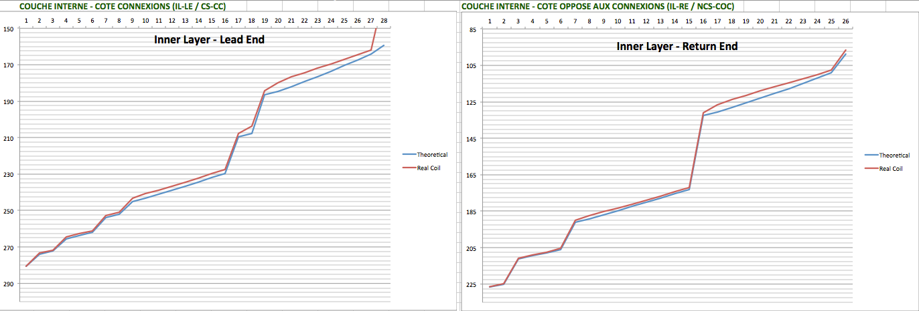
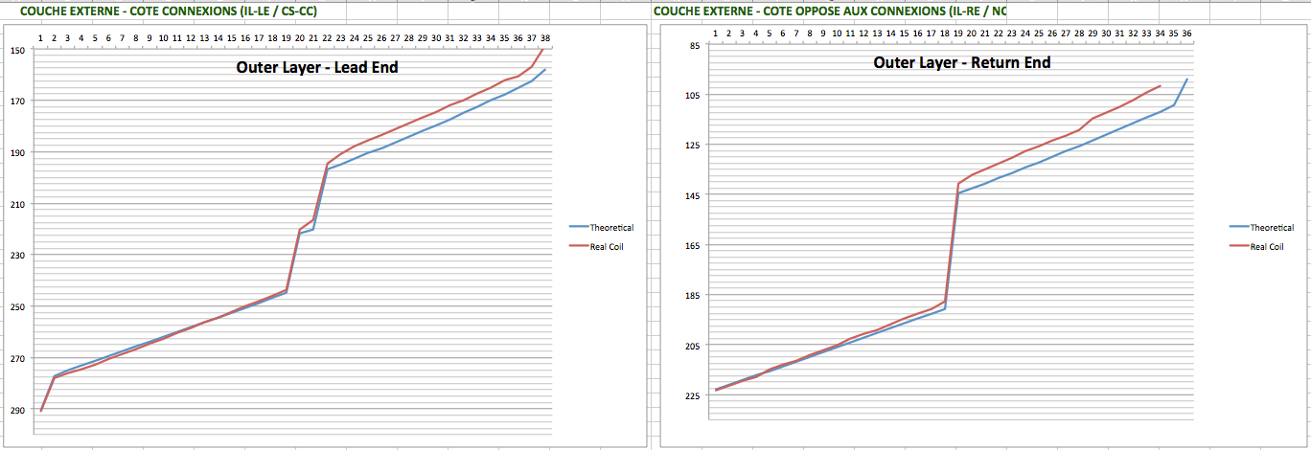

Slide 14
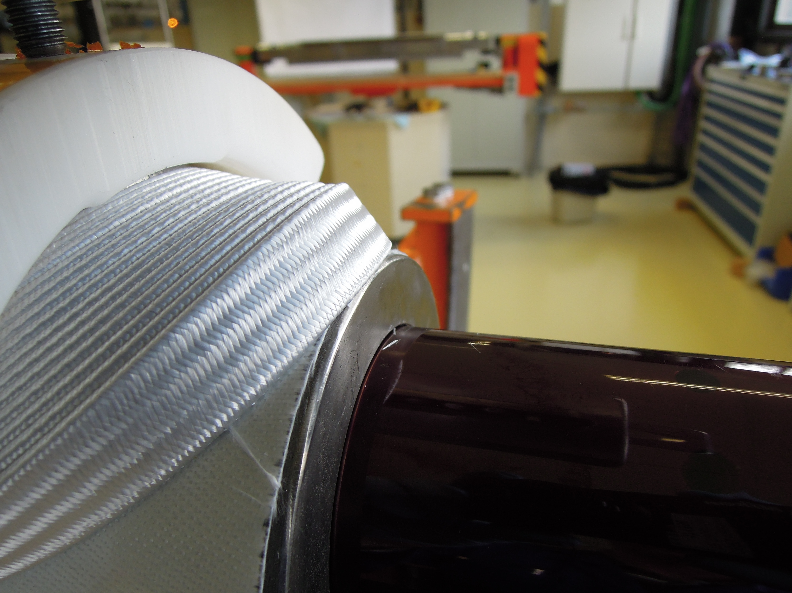
Geometry Z-axis: Outer layer winds long

Slide 15
Acceptance Tests
Insulated cable
  Control of the thickness (by supplier and by CERN)
Winding/curing
  Electrical integrity to ground (spacers/ poles)
  Visual inspections and Z-length monitoring
  No RLC measurements
Reaction
  Geometry: control of the correct closing of the tool
  Electrical integrity to ground before/after reaction (spacers/poles)
  No RLC measurements
  Coil length variation not yet determined
Splicing
  Electrical integrity to ground (splice block, saddle) & Visual inspection
  No other test determined yet
Impregnation
  Geometry: control of the correct closing of the tool
  Geometry: CMM coil
  RLC measurements
Instrumentation and QH
  No tests implemented yet
Collared coil and mag. Assy
  No tests implemented yet

Slide 16
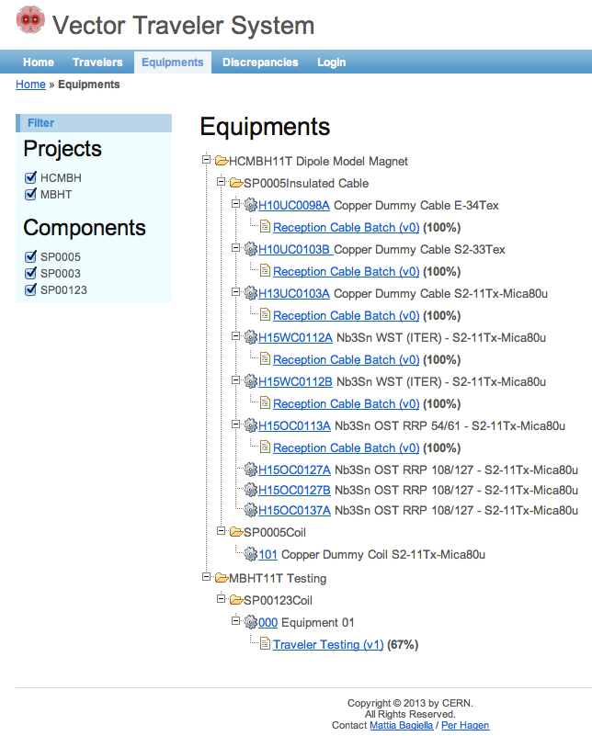
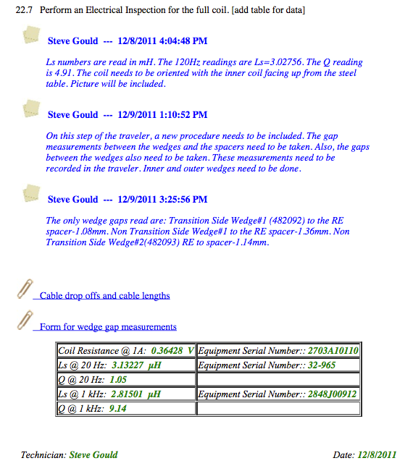
Q/A: importing VECTOR
Interactive Logbook at FNAL
VECTOR
Imported from FNAL
And Operational at CERN
with a new pilot interface (June 2013)
!
Usable for any kind of projects
Notes:
VECTOR is a kind of interactive log book, which provides a sequence of detailed instructions (steps) that the operator shall follow
The operator logs all the results for a given step; he can upload files, pictures, and more importantly leave comments to improve the process
In comparison, at CERN MTF is an assembly database, mostly focussed on recording extremely summarized information and treating non-conformities and what is not good or wrong (NEGATIVE PROSPECT)
VECTOR is oriented to the education and how to do the things right, and to let the operator express its views on how to improve the process (POSITIVE PROSPECT, it is a vector of information toward somebody else).
It is closer to the CERN operation logbooks than to MTF or EDMS in this respect, as logbooks in operation aim at informing the next shift of operators (also a vector of information)

Slide 17
Conclusion
CMM of 54/61 shows that a good geometry is reachable for 108/127 (correct OD, good symmetry)
Acceptance tests:
  Good monitoring of geometry during coil production
  electrical tests need to be more systematic
  an efficient and simple-to–use tool exists to store protocols and test data: VECTOR
    Very good tool for knowledge transfer ( 2m → 5.5m)
    Available now, free of charge

