Slide 1
11 T Dipole informal coil and assembly readiness review
Long coil and fabrication tooling development
status and plans
September 22nd, 2013 – F. Savary with contributions from N. Dalexandro,
L. Deparis, M. Karppinen, F. Lackner, V. Letellier, S. Luzieux, R. Moron Ballester, C.Y. Mucher, T. Sahner, and the short model crew in B927

Slide 2
Outlook
The Large Magnet Facility
Overall plan & milestones
Winding
Binder curing
Reaction furnace
Impregnation
Welding press
Conclusions

Slide 3
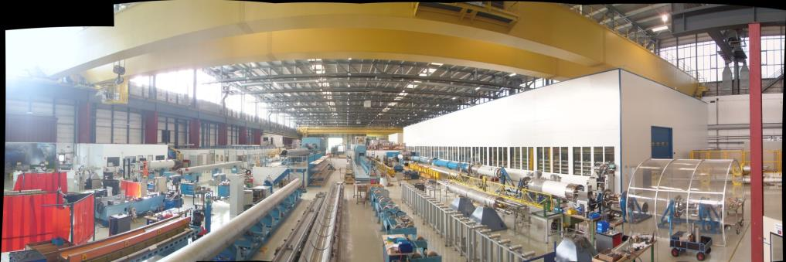
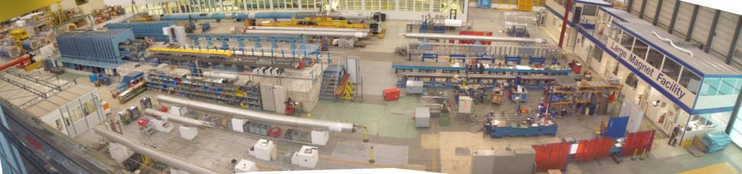
The Large Magnet Facility
180
Winding House

Slide 4
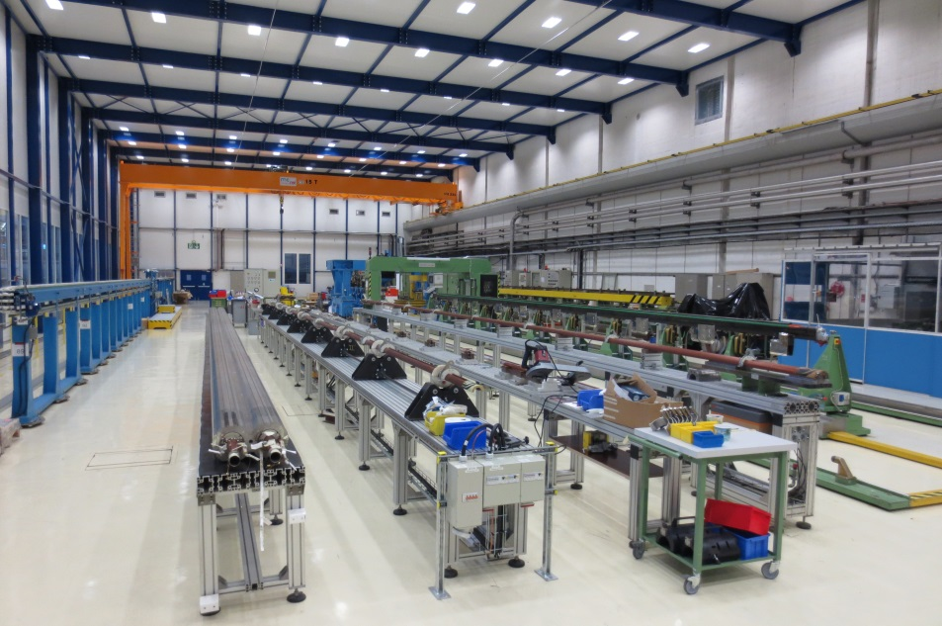
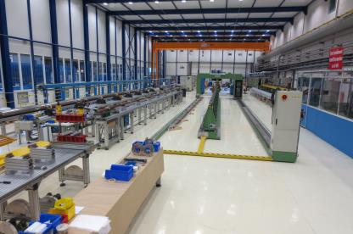
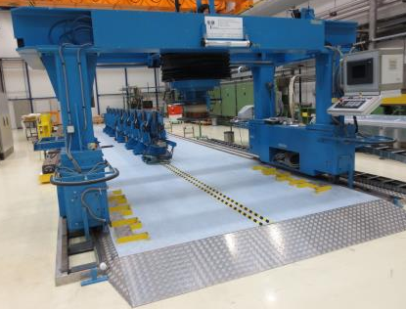
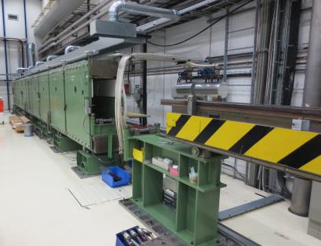
The Winding House

Slide 5
Overall plan & milestones
 | Year | 2013 |  |  |  |  |  | 2014 |  |  |  |  |  |  |  |  |  |  |  | 2015
 | Month | J | A | S | O | N | D | J | F | M | A | M | J | J | A | S | O | N | D | J | F | M | A | M | J | J | A | S | O | N | D
ACTIVITIES | Wind trial coil/pole 2, Cu cable, bare
 | React trial pole 2, Cu cable, bare
 | Wind practice coil C1, Cu cable, insulated
 | React practice coil C1, Cu cable, insulated
 | Impregnate practice coil C1, Cu cable, ins.
 | Wind practice C2, Nb₃Sn
 | React practice C2, Nb₃Sn
 | Impregnate practice C2, Nb₃Sn
 | Wind practice C3, Nb₃Sn (RRP)
 | React practice C3, Nb₃Sn (RRP)
 | Impregnate practice C3, Nb₃Sn (RRP)
 | Wind, react, and impregnate coil C4
 | Wind, react, and impregnate coil C5
 | Wind, react, and impregnate coil C6
 | Wind, react, and impregnate coil C7
6 months
8 months
12 months
Trial sc cable 1
Trial sc cable 2
Sc cable 3

Slide 6
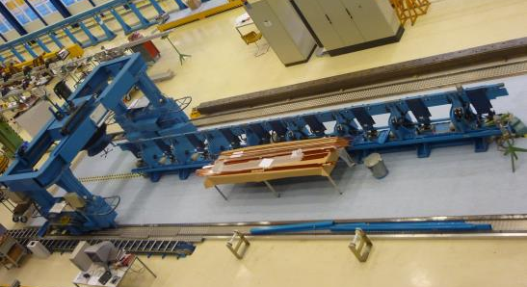
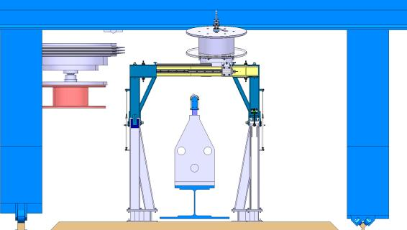
Winding, 1
Shorten the winding machine from 10 to 6 m
  By the end of 2013
Integrate a support frame for the outer layer spool
  PE launched
  Installation by the end of January 2014
Revamp the control system
  Order launched
  Installation and commissioning scheduled in March 2014, and completion expected by the end of March

Slide 7
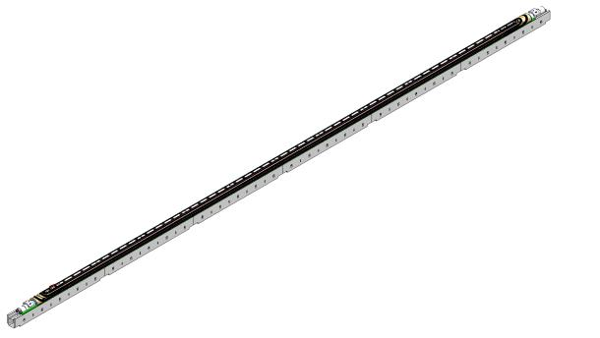
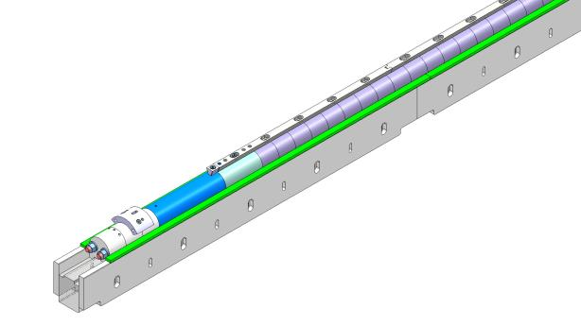
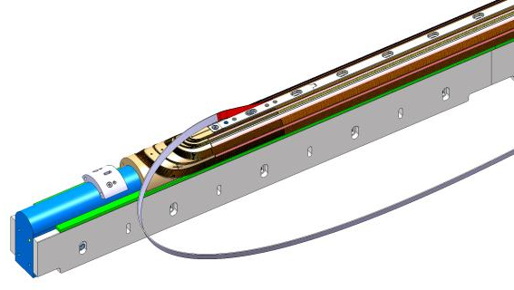
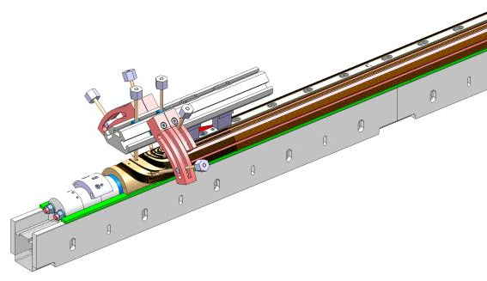
Winding, 2
Fabricate winding mandrel
  2 options
    Full-length mandrel
    Assembly of short
    elements
  PE launched
  Delivery expected by
  the end of February 2014
Coil head restraints
  Design nearly finished
  Delivery expected by the end of February 2014

Slide 8
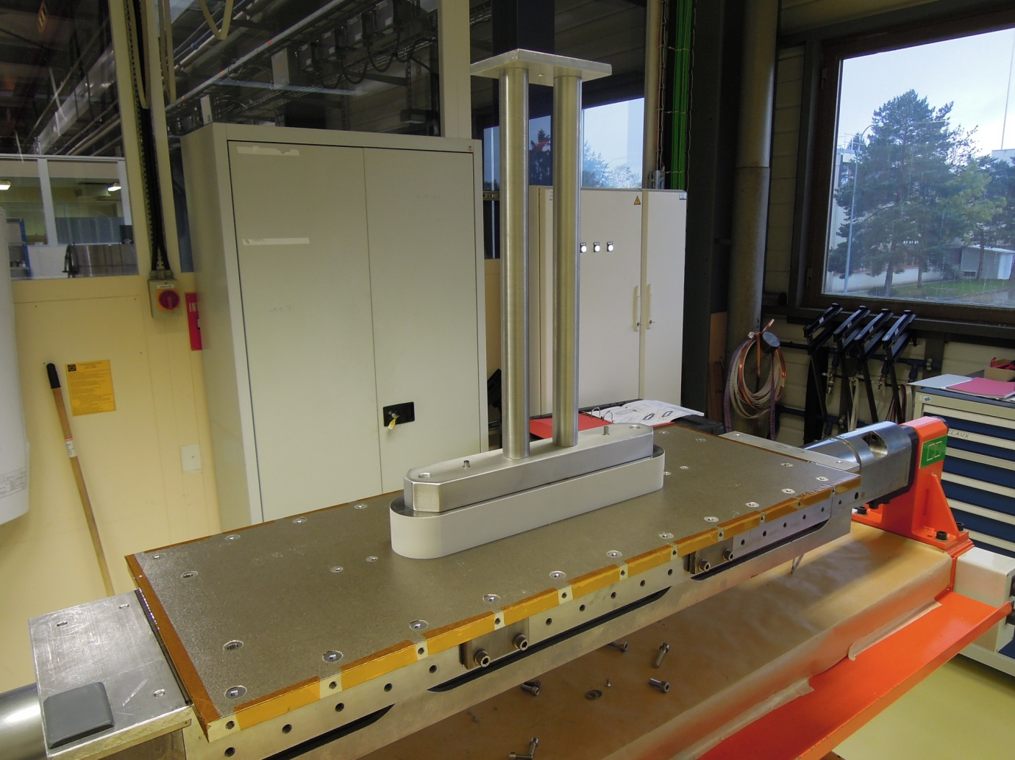
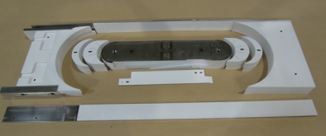
Winding, 3
Will start with making (a few turns of) a long racetrack coil (pictures show parts and tooling of a short one)
  To train staff, who need to learn how to use the winding machine
  Scheduled in February 2014, preparation work to be done before

Slide 9
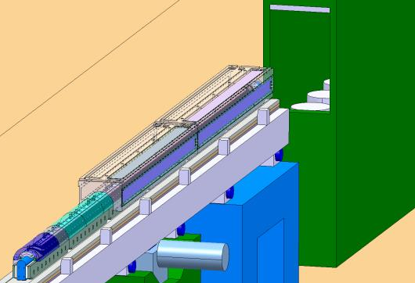
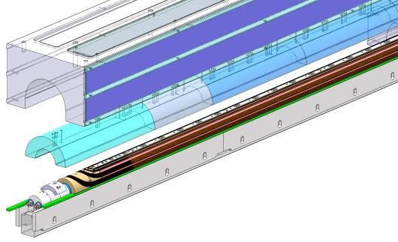
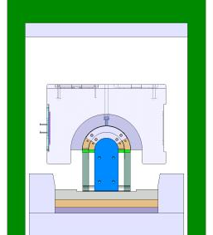
Binder curing
Curing press available
15-m long, sectorized
Study to implement resistance heaters in lieu of the oil heating system on-going, decision to be taken by the end of September
Learn the system, and implement changes as needed, scheduled in Nov.-Dec. 2013
Model and drawings of the curing mold exist, and are to be reviewed

Slide 10
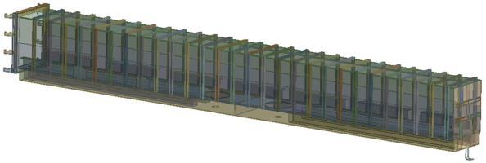
Reaction furnace
Contract on-going
  CD 5199861 dated 27-02-2013
  Contractor GERO in Germany
Final design file, manufacturing & inspection plan by the contractor to be delivered to CERN this week
Procurement of raw materials started
Acceptance tests at the contractor premises scheduled in the beginning of February 2014
Delivery to CERN expected by the end of Feb. 2014
Commissioning, and training of CERN staff, by the end of March 2014

Slide 11
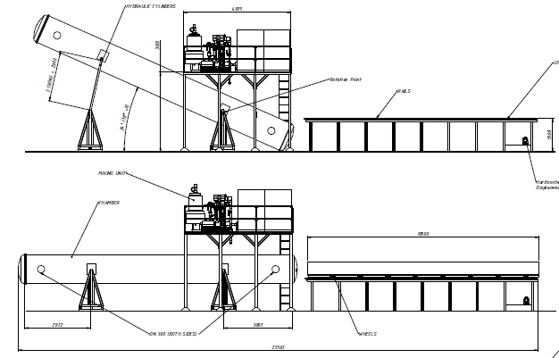
Impregnation
Contract for the vacuum impregnation system just signed
  F629/TE
  Contractor Telstar in Spain
Kick-off meeting soon, within 2 weeks
Delivery expected by the end of May 2014

Slide 12
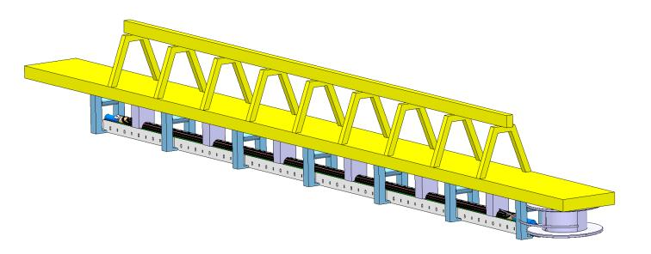
Handling tools
Have to be designed, and fabricated
Preliminary design study of a handling girder for the inner layer with the winding mandrel, and the outer layer spool, which need to be moved together to the curing press

Slide 13
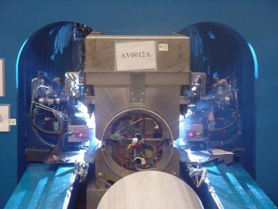
Welding press
See presentation by F. Lackner
Assembly and welding process demonstrated with satisfactory results
in terms of induced
pre-stress, and weld
quality
Short welding press ready
available

Slide 14
Resources
CERN staff
  1 technician + another one part time till the end of LS1, thereafter, more t.b.d.
  2 academic engineers (1 fellow) part time till the end of LS1, thereafter, more t.b.d.
FSU’s as needed, only after LS1, i.e. September 2013 t.b.c.
Service contracts with specialized firms (initial duration ~2 years)
  Academic engineer, technical engineer, draftsman, and experienced practitioner
  To anticipate technology transfer towards industry at an early stage
  To take into account, also at an early stage, constraints due to industrial production
Work package | Description | Firm | Effort [FTE] | Start [* t.b.c.]
WP1 | Cable insulation, winding, and binder curing | Alstom Power Systems | ~ 1.8 | 2013-09-02
WP2 | Reaction heat treatment, coil instrumentation, impregnation | Babcock Noell | ~ 2.2 | 2014-01-06
WP3 | Construction of the collared-coil dipole | ASG Superconductors | ~ 1 | 2015-05-04*
WP6 | Active part construction for collared-coil dipole | ASG Superconductors | ~ 1 | 2015-11-02*
WP9 | Finishing of the cold mass assembly | Alstom Power Systems | ~ 0.7 | 2016-03-01*

Slide 15
Conclusions
Work plan established, possible but quite ambitious
Contracts for major tooling on-going
Contracts for tooling ancillaries to be launched
Personnel plan established
  CERN staff
  Service contracts with experienced contractors
  And later (after LS1), FSU’s

