Slide 1
ALICE data access
WLCG data WG revival
4 October 2013

Slide 2
Outline
ALICE data model
Some figures & policies
Infrastructure monitoring
Replica discovery mechanism

Slide 3
The AliEn catalogue
Central catalogue of logical file names (LFN)
  With owner:group and unix-style permissions
  Size, MD5 of files, metadata on sub-trees
Each LFN has a GUID
Any number of PFNs can be associated to an LFN
  Like root://<redirector>//<HH>/<hhhhh>/<GUID>
    HH and hhhhh are hashes of the GUID

Slide 4
ALICE data model (2)
Data files are accessed directly
  Jobs go to where a copy of the data is – job brokering by AliEn
  Reading from the closest working replica to the job
All WAN/LAN i/o through xrootd
  while also supporting http, ftp, torrent for downloading other input files
  At the end of the job N replicas are uploaded from the job itself (2x ESDs, 3xAODs, etc...)
Scheduled data transfers for raw data with xrd3cp
  T0 -> T1

Slide 5
Storage elements and rates
60 disk storage elements + 8 tape-backed (T0 and T1s)
  28PB in 307M files (replicas included)
2012 averages:
  31PB written (1.2GB/s)
    2.4PB RAW, ~70MB/s average raw data replication
  216PB read back (8.6GB/s) - 7x the amount written
  Sustained periods of 3-4x the above

Slide 6
Data Consumers
Last month analysis tasks (mix of all types of analysis)
  14.2M input files
  87.5% accessed from the site local SE at 3.1MB/s
  12.5% read from remote at 0.97MB/s
  Average processing speed ~2.8MB/s
Analysis job efficiency ~70% for the Grid average CPU power of 10.14 HepSpec06
=> 0.4MB/s/HepSpec06 per job

Slide 7
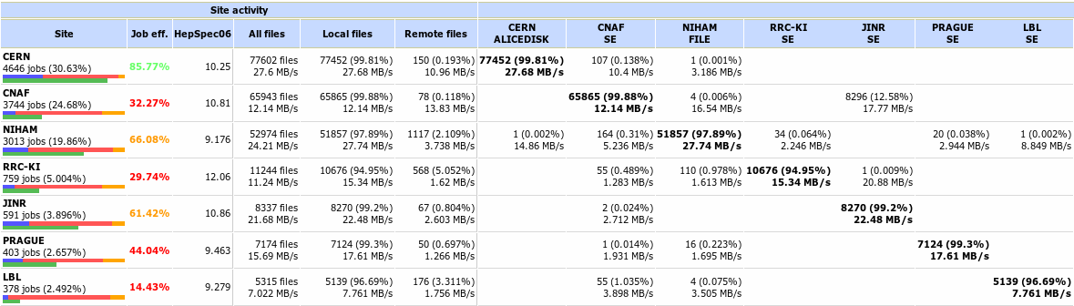
Data access from analysis jobs
Transparent fallback to remote SEs works well
  Penalty for remote i/o, buffering essesntial
The external connection is a minor issue …
IO-intensive analysis train instance

Slide 8
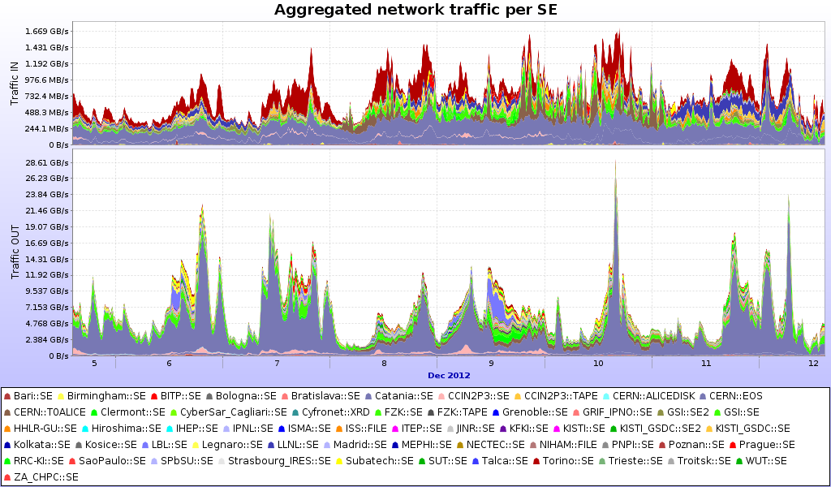
Aggregated SE traffic
Period of the IO-intensive train

Slide 9
Monitoring and decision making
On all VoBox-es a MonALISA service collects
  Job resource consumption, WN host monitoring …
  Local SEs host monitoring data (network traffic, load, sockets etc)
VoBox to VoBox network measurements
  traceroute / tracepath / bandwidth measurement
Results are archived and used to create network topology of all-to-all

Slide 10
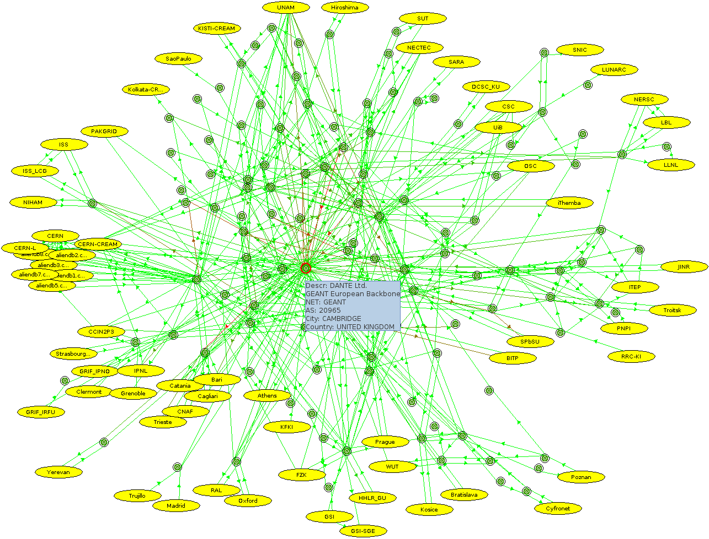
Network topology view in MonALISA

Slide 11
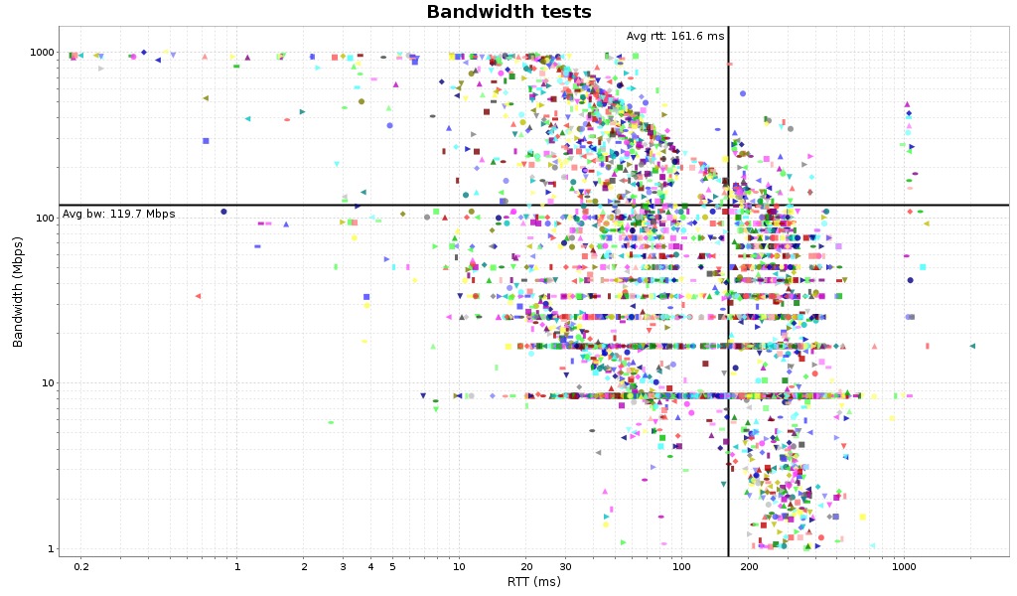
Available bandwidth per stream
Suggested larger-than-default buffers (8MB)
Funny ICMP throttling
Discreet effect of the congestion control algorithm on links with packet loss (x 8.3Mbps)
Default buffers

Slide 12
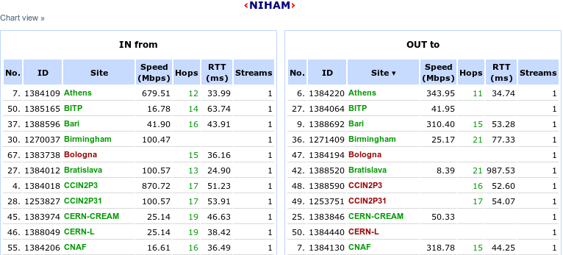
Bandwidth test matrix
4 years of archived results for 80x80 sites matrix
http://alimonitor.cern.ch/speed/

Slide 13
Replica discovery mechanism
Closest working replicas are used for both reading and writing
  Sorting the SEs by the network distance to the client making the request
  Combining network topology data with the geographical one
  Weighted by reliability test results
Writing is slightly randomized for more ‘democratic’ data distribution

Slide 14
Plans
Work with sites to improve local infrastructure
  Eg. tuning of xrootd gateways for large GPFS clusters, insufficient backbone capacity
Provide only relevant information (too much is not good) to resolve uplink problems
  Deploy a similar (throughput) test suite on the data servers
  (Re)enable icmp where it is missing
  (Re)apply TCP buffer settings …
We only see the end-to-end results
  Complete WAN infrastructure not yet revealed

Slide 15
Conclusions
ALICE tasks use all resources in democratic way
  No dedicated SEs or sites for particular tasks
    With the small exception of RAW reco@T0/T1s
The model is adaptive to the network capacity and performance
Uniform use of xrootd
  Tuning needed to accommodate better i/o hungry analysis tasks – this is the largest consumer of disk and network
  Coupled with site storage and network tuning of every individual site
  The LHCONE initiative has already shown positive effect

