Slide 1
Progress on the RF report from a Visit @ Mainz^{*)}
Erk Jensen, Ofelia Capatina
^{*)} Institut für Kernphysik, Univeristät Mainz (JG|U), 12-Aug-2013

Slide 2
Goal of the visit
After encouragement of CERN management to establish collaboration with JG|U^{*)}, we need to
  understand what we expect from each other and
  identify areas of synergy.
At CERN, we have a mandate to perform a “light” Design Study of an ERL test facility.
JG|U have the MESA project.
^{*)}: Johannes Gutenberg Universität

Slide 3
Status of the MESA project
MESA stands for
Mainz Energy recovering Superconducting Accelerator
A small superconducting accelerator for particle and nuclear physics
MESA is supported by :
State of Rhineland Palatinate
German university excellence initiative:
PRISMA-Cluster of excellence
German Science foundation (DFG): SFB 1044
German Ministry of science & ed. (BMBF ):
-PCHB- Consortium (Photocathodes for high brillance beams)
-HOPE- Consortium (Hochbrillante Photoelektronenquellen)

Slide 4
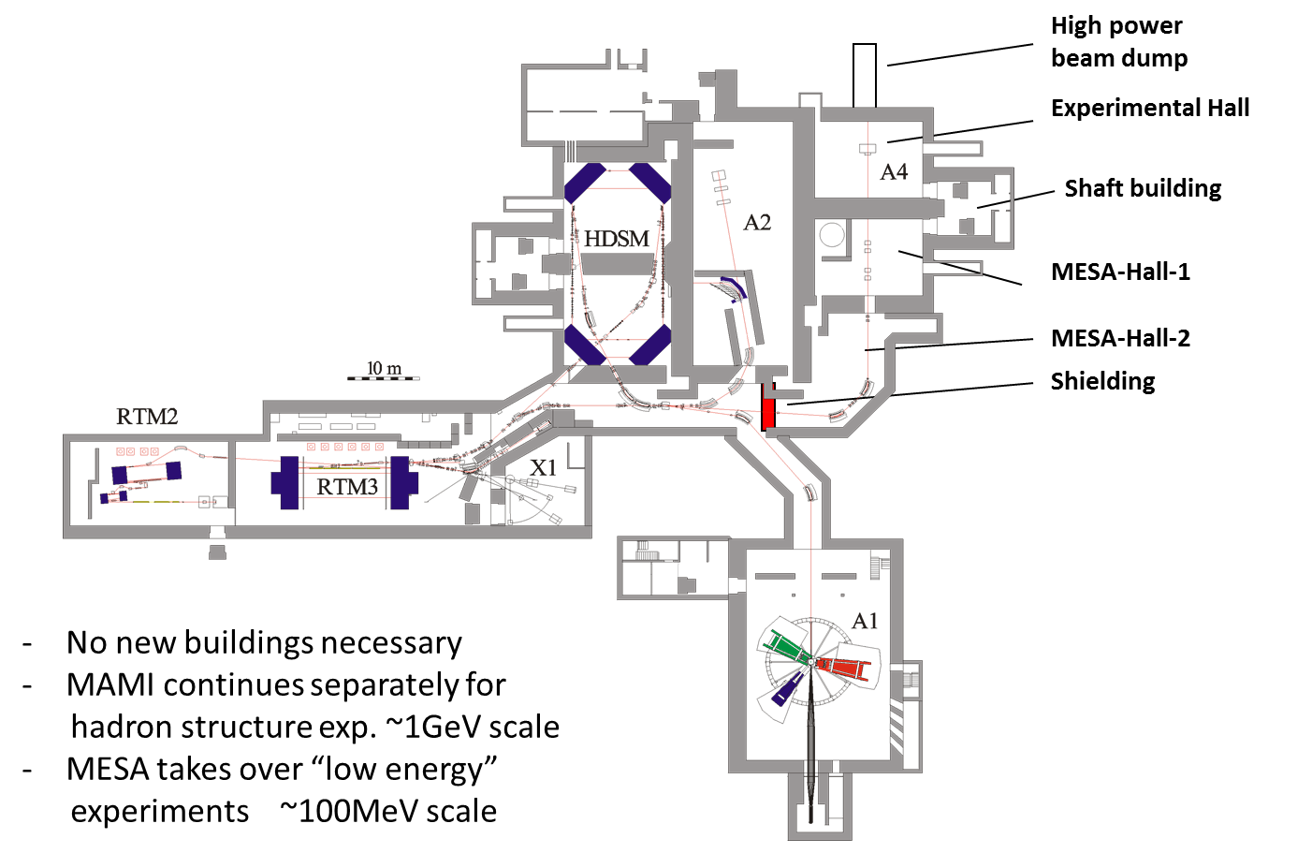
MESA real estate conditions

Slide 5
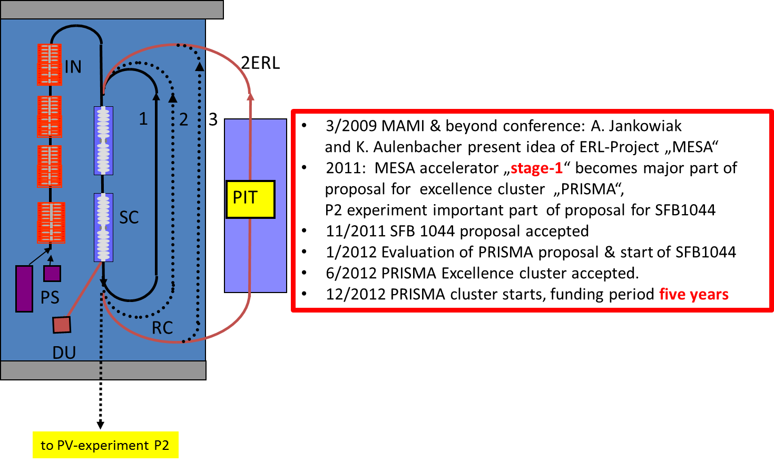
MESA concept and history

Slide 6
MESA parameters – stages 1 (2)
Beam Energy EB/ERL [MeV] | 155/105 (205/105)
Operation mode | c.w.
Electron-sources | Stage-1 : NEA GaAsP/GaAs superlattice , 100keV Stage-2: additional unpolarised KCsSb, 200keV
Bunch Charge EB/ERL [pC] 7.7pC = 10mA@1300MHz | 0.12/0.77 (0.12/7.7)
Norm. Emittance EB/ERL [μm] | 0.1/<1 (0.1/<1)
Spin Polarisation ( EB-mode only) | > 0.85
Recirculations | 2 (3)
Beampower at Exp. EB/ERL [kW] | 22.5/100 (30/1050)
R.f.-Power installed [kW] | 140 (180)
EB: External Beam: PV experiment “P2”
ERL: use with PIT (Pseudo Internal Target)

Slide 7
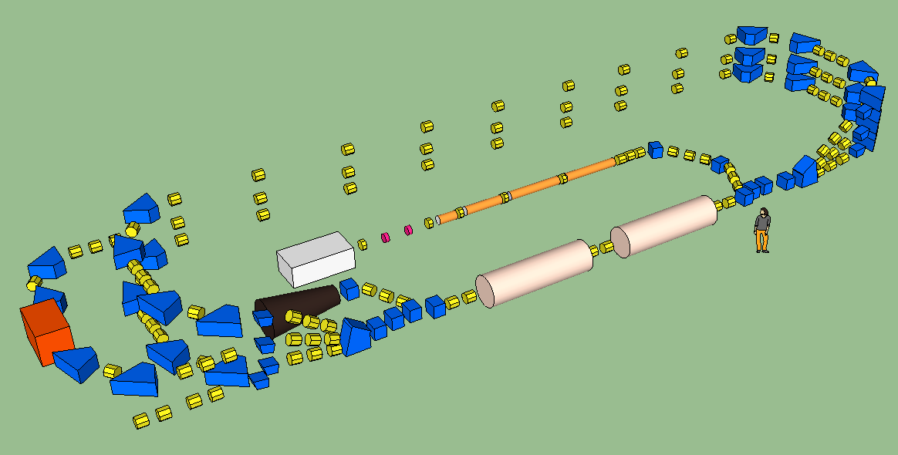
MESA initial layout (Ralf Eichhorn)

Slide 8
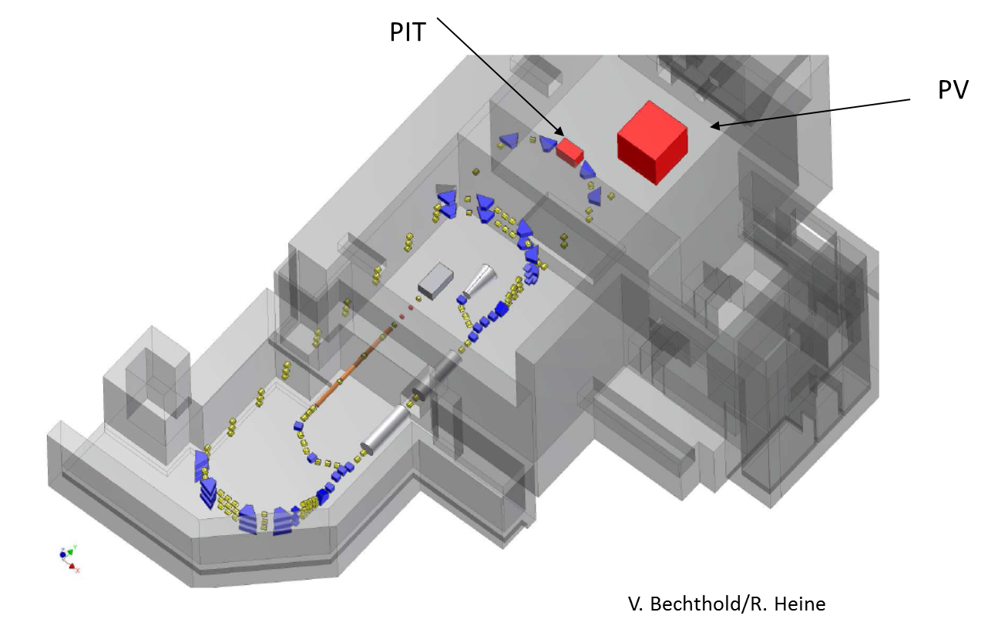
MESA Integration in existing IS:

Slide 9
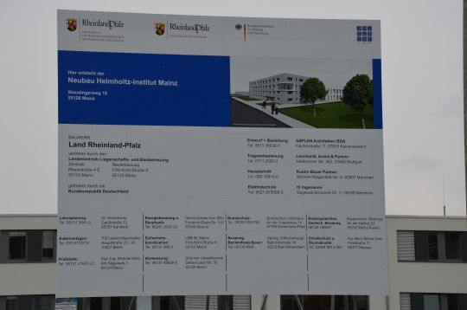
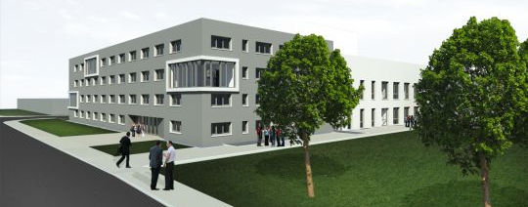
New SRF Infrastructure: HIM^{*)}
HIM resides on campus of JGU, at the moment partly in rooms of the Institute for Nuclear Physics (KPH)
A 20M€ research building next to KPH to be built soon (ground-breaking Oct/2013)
Building will have office space, lecture hall, laboratories and an experimental hall available.
Planned to be ready for use in 2016
^{*)}: Helmholtz Institute Mainz
© ASPLAN

Slide 10
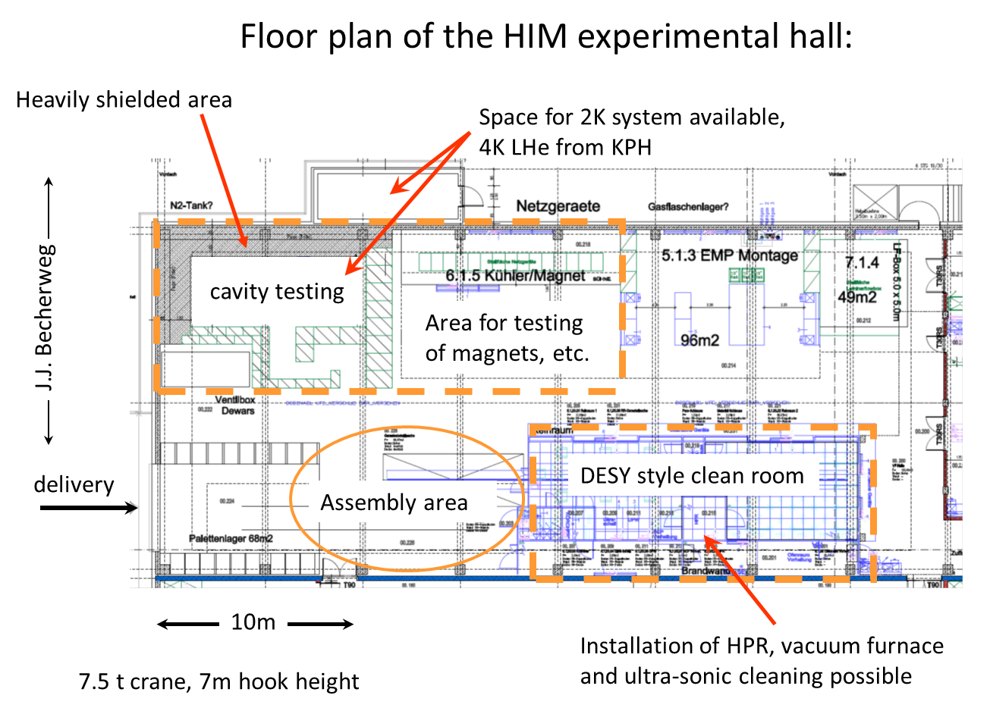
HIM floor plan:

Slide 11
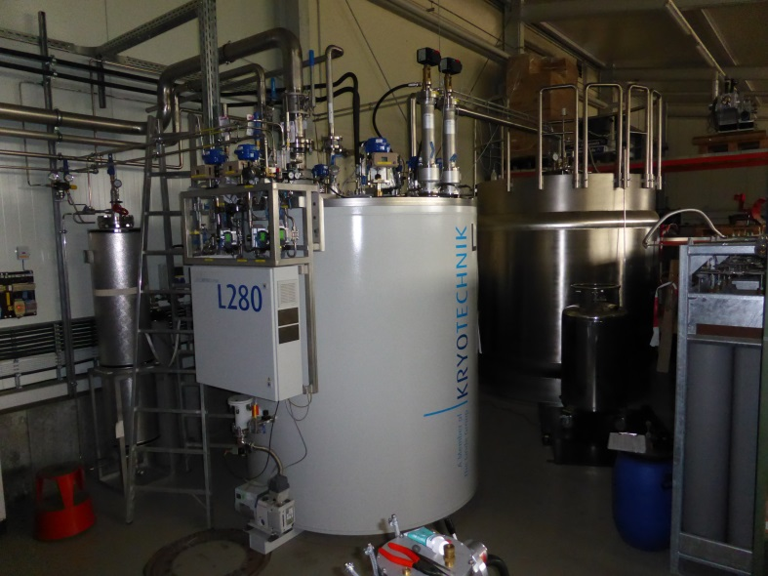
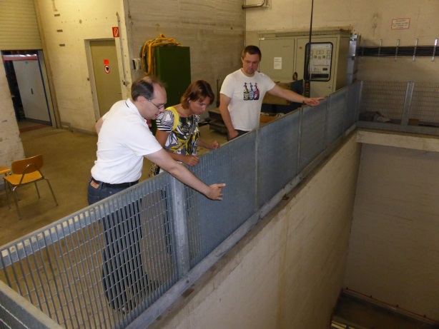
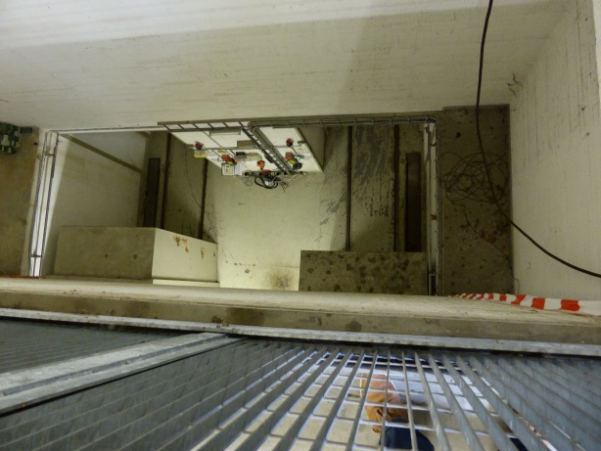
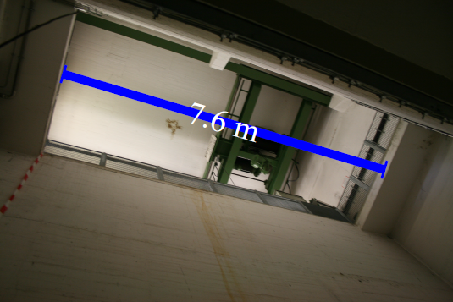
Constraints:
Existing Cryoplant:
  too small: <100 W @ 2 K
Access Shaft dimensions
Limited available space! (see integration above)

Slide 12

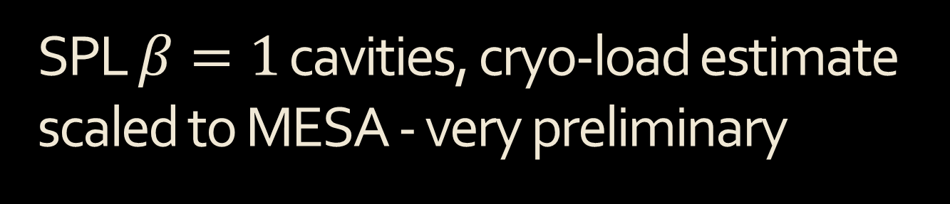
SPL $β=1$ cavities, cryo-load estimate scaled to MESA - very preliminary
Conclusion: since $heat load∝{\left(energy gain\right)}^{2}$:
reduce gradient to meet severe cryo-capacity limitations.
Significant upgrade potential with new cryo-plant!

Slide 13
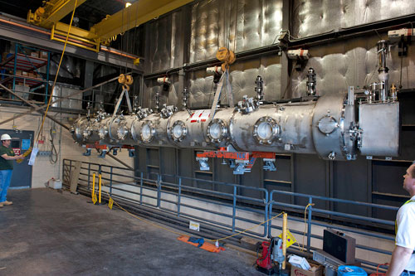
Mainz options for CM’s
TESLA/X-FEL 1.3 GHz: known design, but low current.
“8-seater” from JLAB or Daresbury 1.5 GHz –
good for higher current,
but: 12m long:
doesn’t fit,
neither shaft nor hall!
CERN collaboration 802 MHz. Common design for us and them. CERN prototypes within ERL Design Study!

Slide 14
What would this encompass?
Must have support from CERN management!
Possible contributions from JG|U:
  Manpower (Post-docs, PhD students)
  Investments (all material for their prototypes)
  Infrastructure (new HIM building from 2016)
Possible contributions from CERN:
  Cavity, HOM, Coupler design, EM and mechanical
  CM design
  Project coordination, management
  the CERN brand name.

Slide 15
MESA Project timeline
End 2013: Decision Cryomodule
Spring 2014: Decision Lattice
Summer 2014: Infrastructure modifications
End 2014: Start Injector assembly
2015/16: Injector commissioning, Assembly Lattice, Cryoplant ready.
End 2016: Delivery Cryomodule
2017: Commissioning Cryomodule
End 2017: MESA commissioning

Slide 16
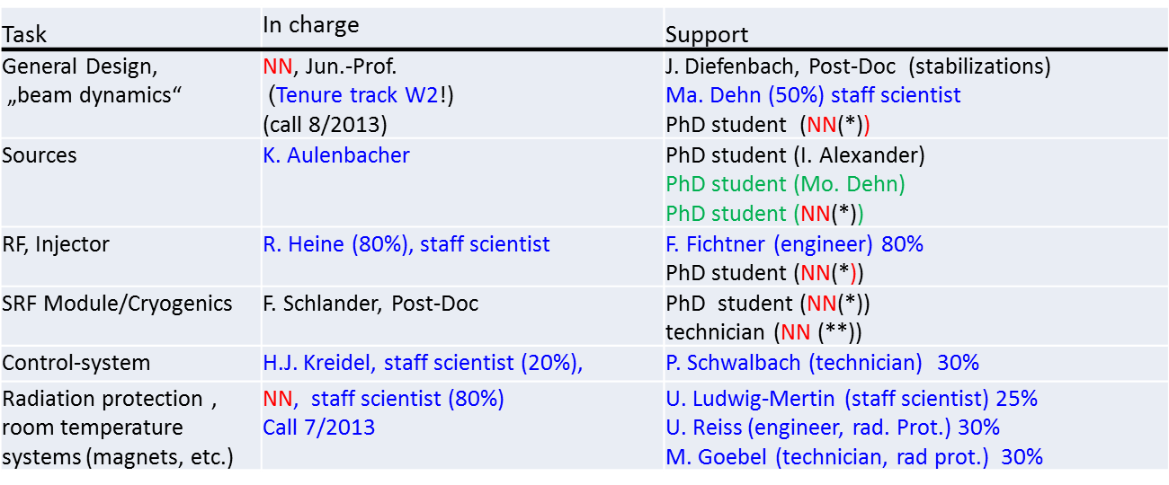
MESA staffing
Black: PRISMA-personel/Blue: KPH-staff, Percentage: work fraction devoted to MESA/Green: BMBF-personnel

Slide 17
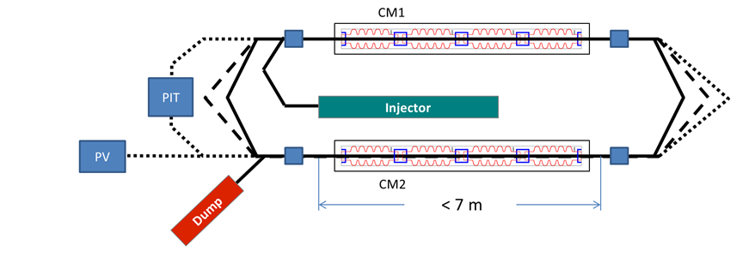
Findings:
Taking into account the possibilities, goals and functional specifications, constraints and synergies we agreed on this initial configuration (similar to CERN’s ERL-TF):

Slide 18

“Party-line” parameters
Two cryomodules (CM) of approximately 7 m length, to be installed in two opposite straight sections of the racetrack ERL.
Each CM contains 4 cavities, operation frequency 801.59 MHz; each cavity consists of 5 “elliptical” cells. The cavities would be operated at 2 K.
The nominal operational parameters are $Q_{0}={10}^{10}$ at$14 MV/m$, which results in an acceleration of $13.2 MV$ per cavity or 105 MV per pass. The ERL would be designed for two passes, thus could nominally reach$210 MeV$ in ERL mode. For this operation, the dissipated power at $2 K$ was estimated to exceed$200 W$.
The constraint of the presently installed cryogenic power however would not allow this operation initially; operation at half the gradient ($6.6 MeV$ per cavity or $26.4 MeV$ per CM) seems consistent with the present cooling capacity of $80 W$ at$2 K$. It could reach $105 MeV$ in ERL mode. However it could reach the specified energy for EB mode only with a) increased cryogenic capacity or b) a third recirculation pass (as indicated in the sketch above).
The values above result in little margin left for cryogenic capacity; cavities performance estimates are however conservative; it is not unreasonable to assume that a larger $Q_{0}$ can be obtained.

Slide 19
CERN-JG|U collaboration:
Possible rough schedule:
October 2013: Sign agreements (draft sent)! (conditio sine qua non!)
Jan/14 → Jun/14: RF cavity electromagnetic design (shape, field distribution, HOM content, MP). This would need initial expertise from CERN to help getting it started and to train some colleagues from JGU-KPH to take over. Simulation software necessary (HFSS, MWS, GdfidL or ACE-3P)!
Jul/14 → Dec/14: Cavity mechanical design work at CERN.
Jul/14 → Dec/14: HOM damper design. This would be the natural follow-up of 1; it is assumed that now the personnel at JGU-KPH have gained experience and that the CERN support could decrease to consultancy level.
Jan/14 → Dec/15: Cryostat design by CERN. This is mechanical design work at CERN, starting from SPL and initially making some assumptions on the cavity and He-vessel. Coordinated with 1, 2 and 3.
Jan/14 → Dec/15: Coupler design. Some RF, but primarily mechanical design. Starting from SPL, initially with some assumptions, to be well-coordinated with 1 and 4. For the second half of 2014, it would also look at the couplers for HOMs (ref. 3).
Jul/14→Dec/14: He-tank design. Redesign from SPL to account for CW operation.
Jan/15→Jun/16: CM assembly design and tooling procurement, based on the outcome of all of the above.
Oct/14→Mar15: Start procurement Nb sheets and other material needed for 9 below.
Mar/15: Cavity tendering for 8 cavities starts with industry. Coordination by CERN, contracts by JGU-KPH, delivery starts Oct/15 and ends Feb/16;
Jan/15→Jun/16: Fabrication of 2 CMs, 8 He-tanks and their ancillaries (at CERN or guided by CERN).
Oct/15→June/16: Cavity reception, processing, CR assembly into He-tanks and testing of 8 cavities. This work requires two facilities for processing, assembly and testing to operate in parallel!
July/16→Dec/16: assembly of cavities in CM at HIM (Helmholtz Institute Mainz) which is scheduled to be ready for operation from early 2017.

