Slide 1
Ceph Storage in OpenStack
Part 2
Jens-Christian Fischer
jens-christian.fischer@switch.ch
@jcfischer
@switchpeta
openstack-ch, 6.12.2013

Slide 2

Ceph
Distributed, redundant storage
Open Source Software, commercial support
http://inktank.com

Slide 3

https://secure.flickr.com/photos/38118051@N04/3853449562

Slide 4
Ceph Design Goals
Every component must scale
There can be no single point of failure
Software based, not an appliance
Open Source
Run on commodity hardware
Everything must self-manage wherever possible
http://www.inktank.com/resource/end-of-raid-as-we-know-it-with-ceph-replication/

Slide 5
Different Storage Needs
Object
  Archival and backup storage
  Primary data storage
  S3 like storage
  Web services and platforms
  Application Development
Block
  SAN replacement
  Virtual block devices, VM Images
File
  HPC
  Posix compliant shared file system

Slide 6
Ceph
Ceph Object Storage
Ceph Gateway
Objects
Ceph Block Device
Virtual Disks
Ceph File System
Files & Directories

Slide 7
Storage in OpenStack
Glance
  Image and volume snapshot storage (metadata, uses available storage for actual files)
Cinder
  Block Storage that is exposed as volumes to the virtual machines
Swift
  Object Storage (think S3)

Slide 8
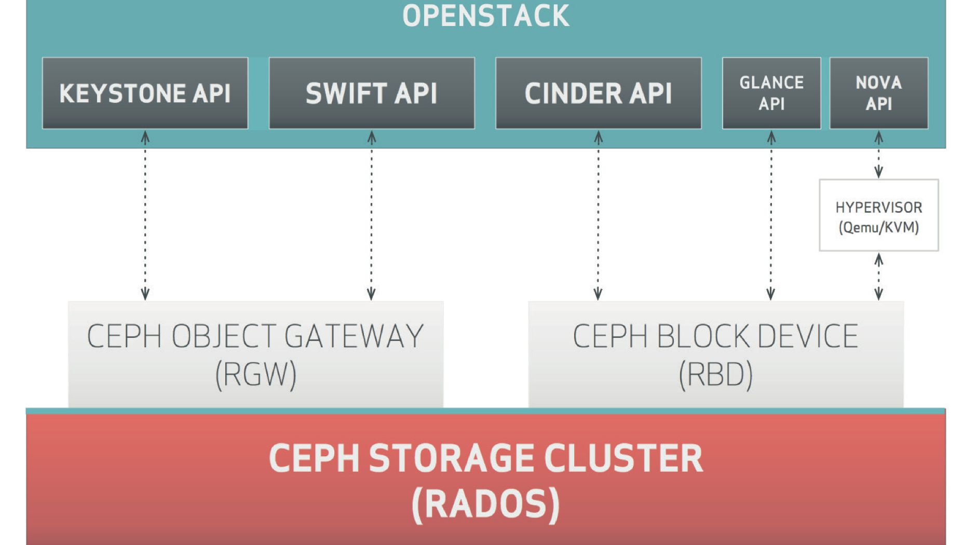
Ceph as Storage in OpenStack
http://www.inktank.com/resource/complete-openstack-storage/

Slide 9

Block devices
Ceph @ SWITCH
Volumes for Virtual machines
Backed by RBD
Persistent (unlike VMs)
https://secure.flickr.com/photos/83275239@N00/7122323447

Slide 10
Cloud @ SWITCH
Serving the Swiss university and research community
4 major product releases planned
“Academic Dropbox” early Q2 2014
“Academic IaaS” mid 2014
“Academic Storage as a Service” and
“Academic Software Store” later in 2014
Built with OpenStack / Ceph

Slide 11
“Current” Preproduction Cluster
1 Controller Node
5 Compute Nodes (expected 8)
Total 120 Cores
640 GB RAM
24 * 3 TB SATA Disks: ~72 TB Raw Storage
OpenStack Havana Release
Ceph Dumpling

Slide 12
First Planned Production Cluster
Havana/Icehouse Release
Ceph Emperor/Firefly
2 separate data centers
Ceph cluster distributed as well (we’ll see how that goes)
Around 50 Hypervisors with 1000 cores
Around 2 PB of raw storage

Slide 13
Storage numbers
Dropbox: 50 – 250’000 users => 50 TB – 2.5 PB
IaaS: 500 – 1000 VMs => 5 TB – 50 TB
Storage as a Service: 100 TB – ?? PB
There’s a definitive need for scalable storage

Slide 14
OpenStack & Ceph
Glance images in Ceph
Cinder volumes in Ceph
Ephemeral disks in Ceph
Thanks to the power of Copy on Write
“Instant VM creation”
“Instant volume creation”
“Instant snapshots”

Slide 15
Ceph Support in Havana
Almost there – basic support for Glance, Cinder, Nova
  Edit config file, create pool and things work (unless you use CentOS)
Not optimized: “Instant Copy” is really
  download from Glance (Ceph) to disk
  upload from disk to Cinder (Ceph)
Patches available, active development, should be integrated in Icehouse

Slide 16
Object Storage
Use RadosGW (S3 compatible)
Current use cases:
A4Mesh: Storage of hydrological scientific data
SWITCH: Storage and Streaming of Video Data
Some weird problems with interruption of large streaming downloads

Slide 17
Shared Storage for VMs
Investigating NFS servers, backed either by RBD (Rados Block Device) or by Cinder Volumes
Not our favorite option, but currently a viable option.
Questions about scalability and performance

Slide 18
Block Devices
Cinder volumes
Boot from Volume
Nicely works for Live Migration
Very fast to spawn new volumes from snapshots

Slide 19
CephFS as shared instance storage
This page intentionally left blank
Don’t

Slide 20
CephFS for shared file storage
Be careful about Linux kernel versions (3.12 is about right)
Works under light load
Be prepared for surprises
Or wait for another 9 months (according to word from Inktank)

Slide 21
Experience
Ceph is extremely stable and has been very good to us
Except for CephFS (which for the time being is being de-emphasized by Inktank)
Software in rapid development – some functionality “in flux” – difficult to keep up. However: Gone through 2 major Ceph upgrades without downtime
The Open{Source|Stack} problem: Documentation and experience reports strewn all over the Interwebs (in varying states of being wrong)

Slide 22
Would we do it again?
Yes!
Ceph is incredibly stable
  unless you do stupid things to it
  or use it in ways the developers tell you not to
Responsive developers, fast turnaround on features

Slide 23
Nitty gritty
http://ceph.com/docs/master/rbd/rbd-openstack/
https://github.com/jdurgin/nova/tree/havana-ephemeral-rbd
https://review.openstack.org/#/c/56527/
http://techs.enovance.com/6424/back-from-the-summit-cephopenstack-integration

