Slide 1
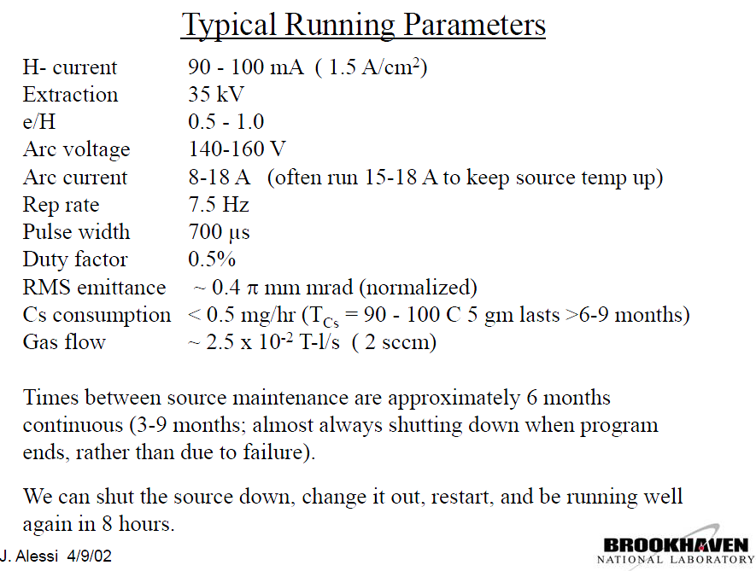
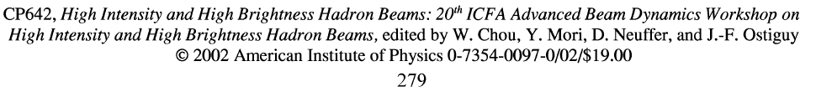
Why BNL’s magnetron ?
Circular aperture magnetron operated at BNL since 1989
Linac4
80 mA
45 kV
0.8-2.0 Hz
700 μs
0.07-0.14 %
0.25 π mm∙mrad
5-10 g/year
> 6 month
Ok

Slide 2
BNL’s Magnetron: Linac4 IS-03
June 2010, L4IS-review: BNL’ magnetron is the option for nominal current
September 2011, ICIS: Investigation of ISIS and BNL ion source electrodes after extended operation
April 2012: BNL’s drawings received, short test of the gas-pulse at BNL
September 2012, NIBS: Estimation of sputtering damages on a Magnetron H⁻ ion source induced by Cs ⁺ and H⁺ ions. Operation and thermal modelling of the ISIS H⁻ source from 50 to 2 Hz repetition rates
November 2012: 3D model and a set of components drawings available (metric and US), from them a Discharge chamber and Puller are produced at CERN.
Oct. 2013 CERN’s discharge chamber tested within BNL’s ion source at the Linac injection line → O(120 mA H⁻)
To be addressed:
Import technology
Impact of higher beam energy,
Dumping of co-extracted electron
Operation at low duty factor
Cs-handling
Emittance
The major contribution of D. Steyeart, the support from J. Alessi, T. Lehn, A. Zelenski, J. Ritter and the BNL ion source development team is thankfully acknowledged

Slide 3
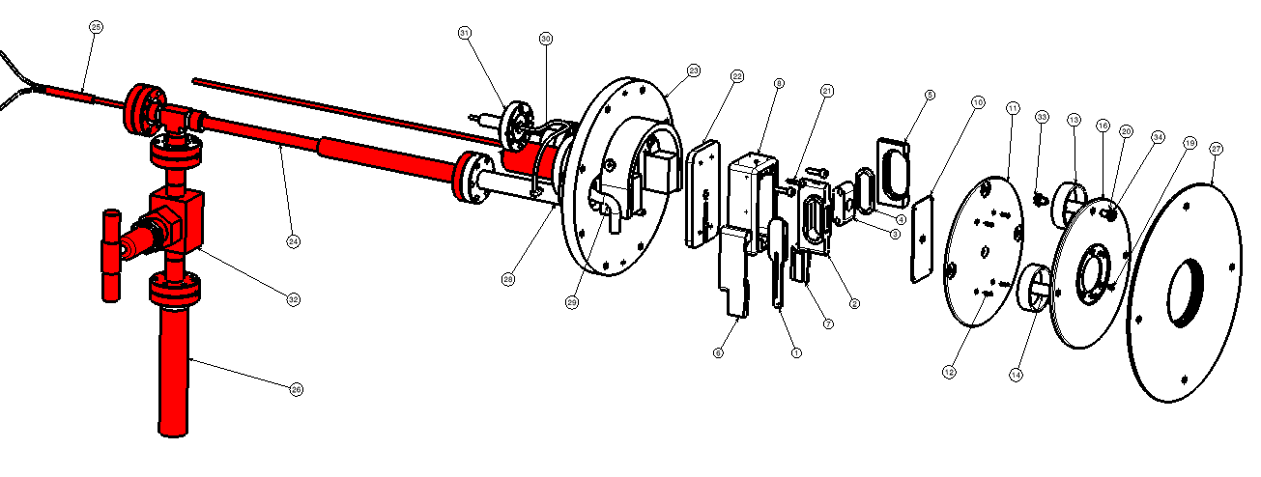
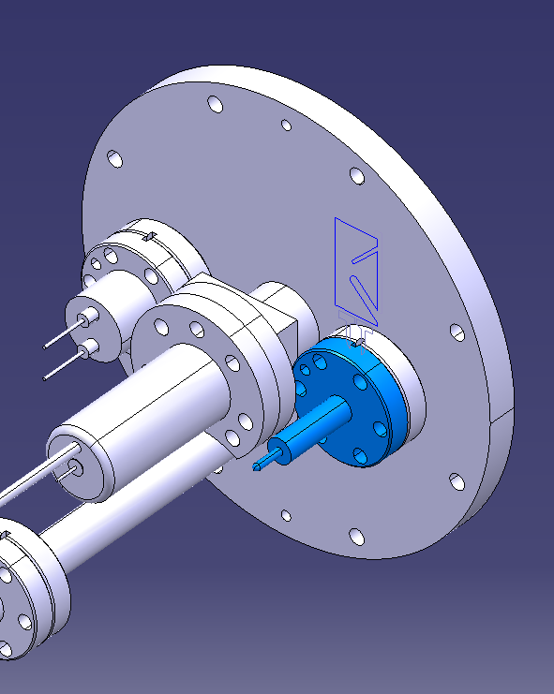
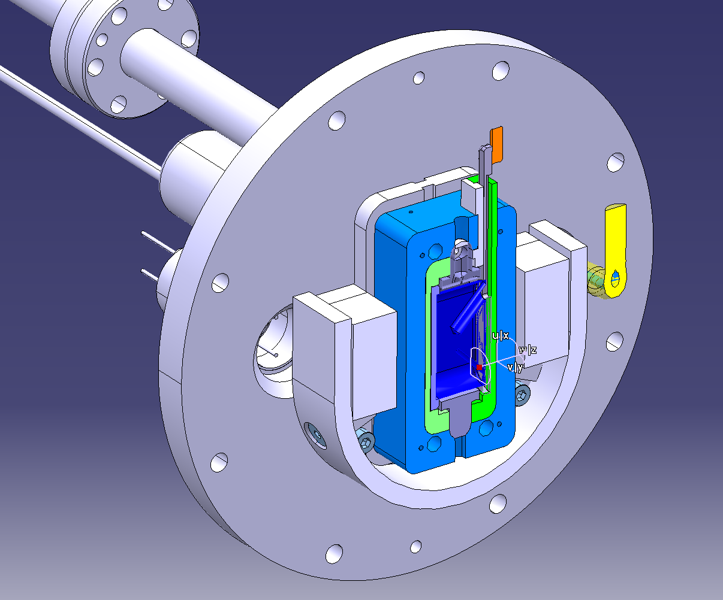
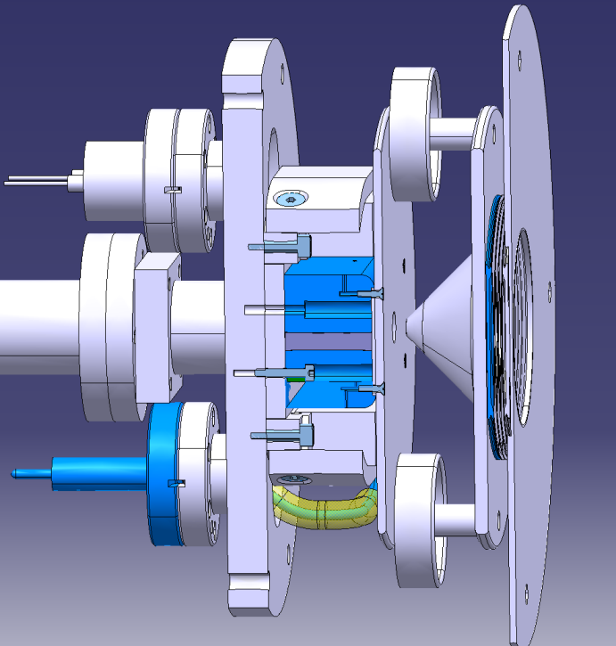
BNL’s Magnetron 3D model
Internally heated transfer line
D. Steyaert
EM-Valve
B
Cs-Oven
Produced at CERN for the test
Thermocouple feed through
Cathode
EM-Valve
Anode
Arc discharge feed through
Perm. Magnets
& yoke
Puller

Slide 4
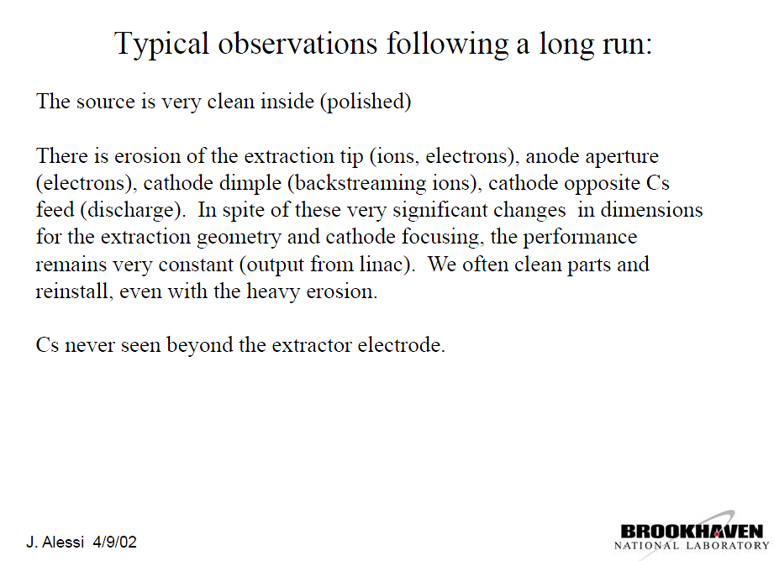

Slide 5
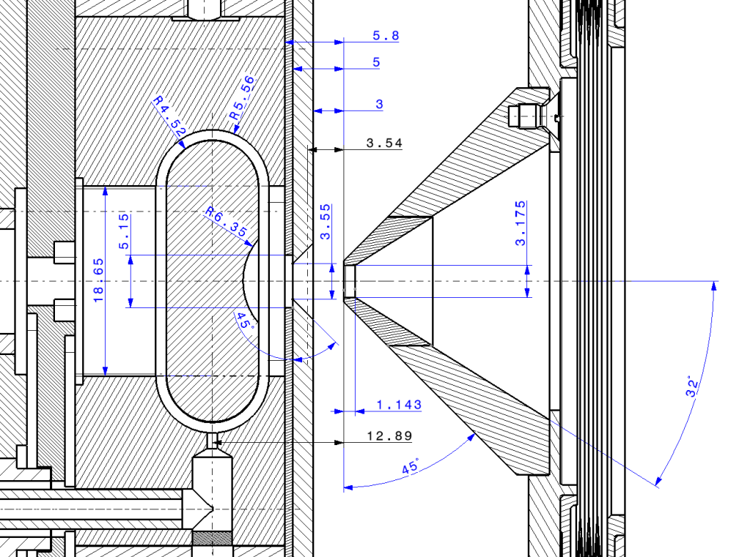
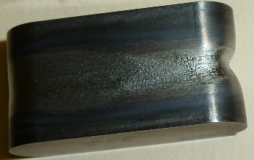
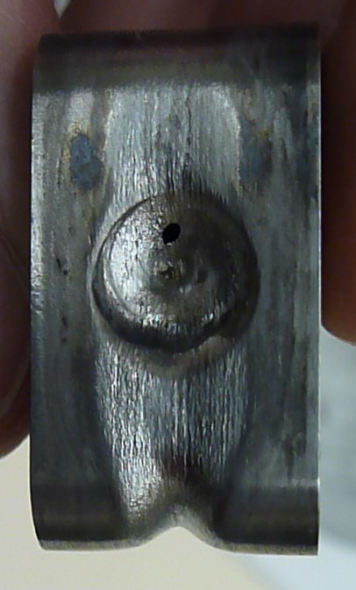
Ageing and Wear after 2 years operation
Cathode:
Cs⁺,H⁺ and
plasma effects
H₂
Cs

Slide 6
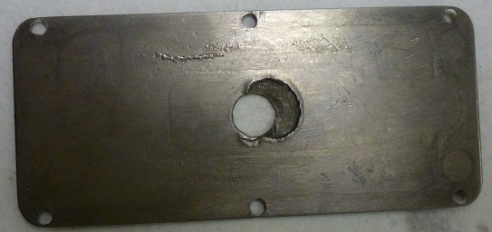

Ageing and Wear after 2 years operation
Inner front plate
Cs⁺,H⁺ plasma effects
H₂
Cs

Slide 7
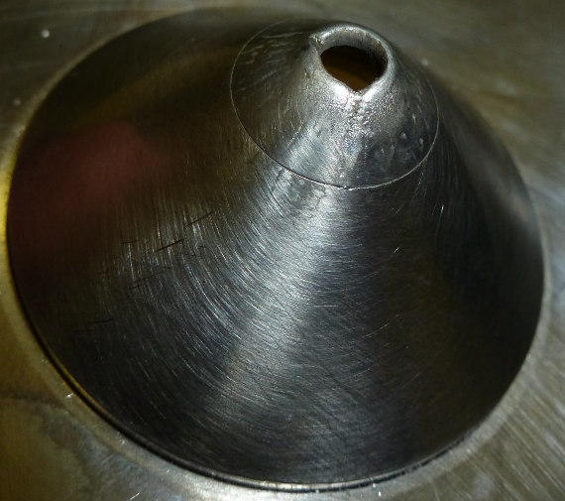
Ageing and Wear after 2 years operation
Puller: W-tip
Co-extr. Electrons
H⁻ ions ?
HV Sparks ?
H₂
Cs

Slide 8
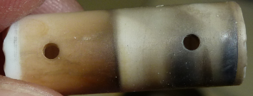
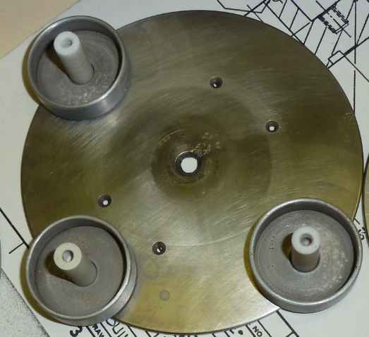
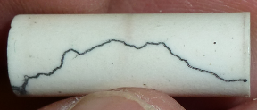
Ageing and Wear after 2 years operation
Al₂O₃ insulators
H₂
Cs
Field shaping plate facing puller
Cs⁺, H⁺ ions ?
HV sparks

Slide 9
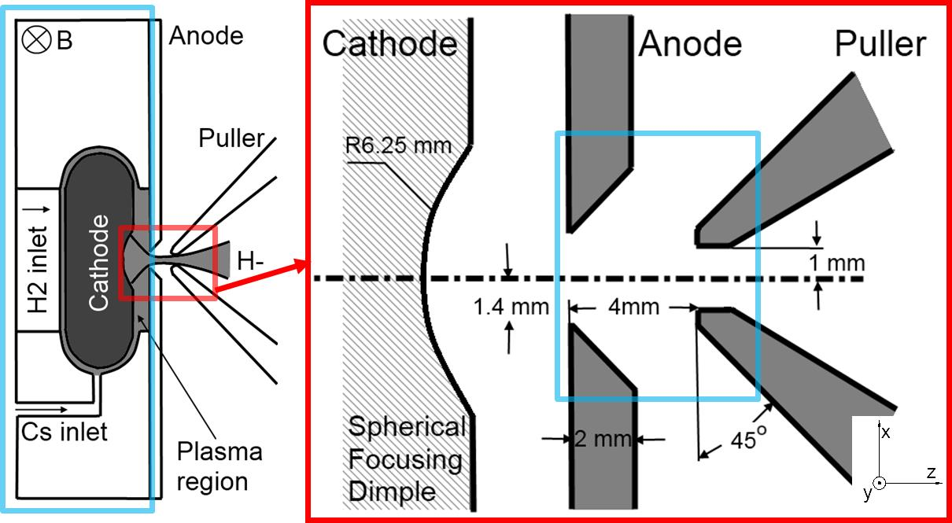
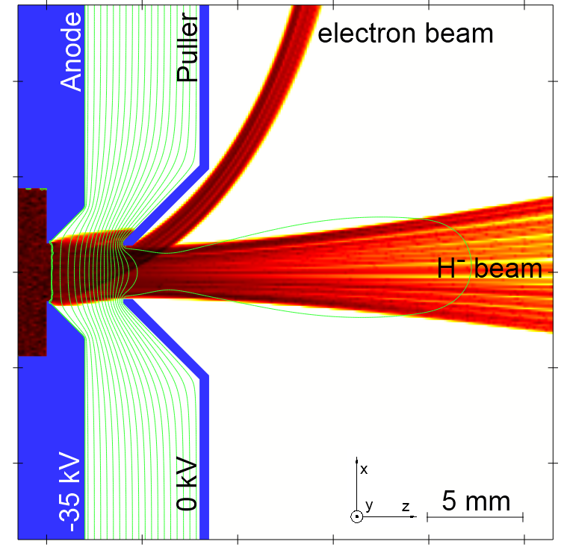
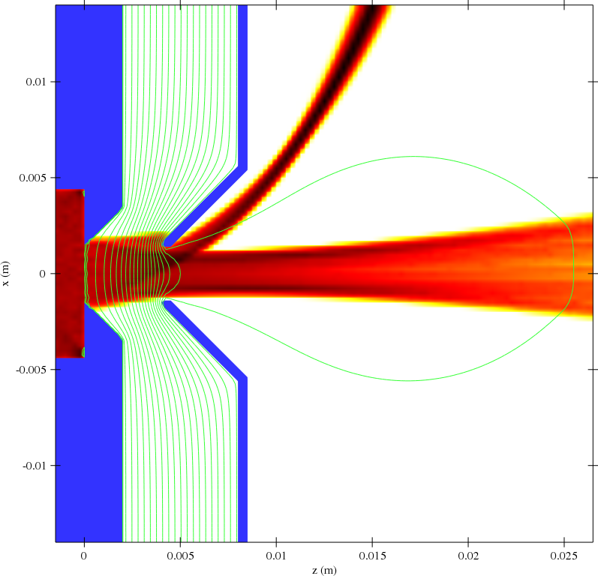
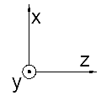
Simulation of BNL’s Magnetron with IBSimu
IBSimu settings:
H⁻ beam current density is set to 1.6 A/cm2, resulting in a current of 100 mA.
Electron to H⁻ ratio = ½ (50 mA)
A 3-D magnetic field map created in OPERA from the known magnet geometry and adjusting the field to a peak of 900 G.
Results:
The H⁻ beam is transported through the puller at close to 100% efficiency.
60 % of the co-extracted electrons (30mA), which trajectories are bent by the magnetic field, are dumped on the puller electrode tip.
20 mA e-beam passes the puller electrode.
-35 kV
-45 kV
e
J. Lettry, J. Alessi, D. Faircloth, A. Gerardin, T. Kalvas, H. Pereira, and S. Sgobba, Investigation of ISIS and BNL ion source electrodes after extended operation, Review of Scientific Instruments 83, 02A728 (2012).
H. Pereira, J. Lettry, J. Alessi and T. Kalvas, Estimation of Sputtering Damages on a Magnetron H⁻ Ion Source Induced by Cs⁺ and H⁺ Ions, AIP Conf. Proc. 1515 (2013) pp.81-88.
H⁻

Slide 10
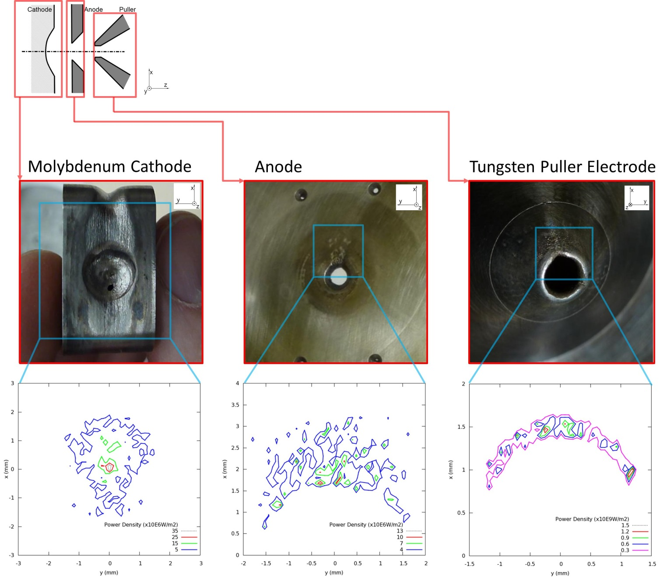
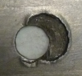
Ageing/wear mechanisms
Observation of erosion/damages on:
Mo-cathode: 1mm hole
  1-2 mm wear on circumference.
Anode plate facing puller
W-tip of the puller electrode.
IBSimu: creation & tracking of positive ions within the extraction region (electron and H⁻ beam induced ionization of Hydrogen gas and Cs vapor). The positive ions travel backwards in direction of the anode and Mo-cathode
IBSimu: H⁻,e-beams → power density on surface
Mo-sputtering via positive ions (H⁺ or Cs⁺) on cathode and anode.
30 mA of 35 keV electrons deposit a peak power above 1 kW/mm² on the W-tip of the puller electrode

Slide 11
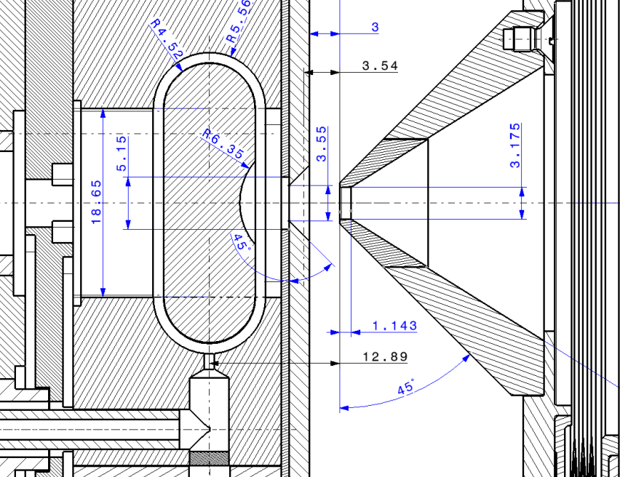
Ageing / wear summary
4
H₂
5
3
2
1
Cs

Slide 12
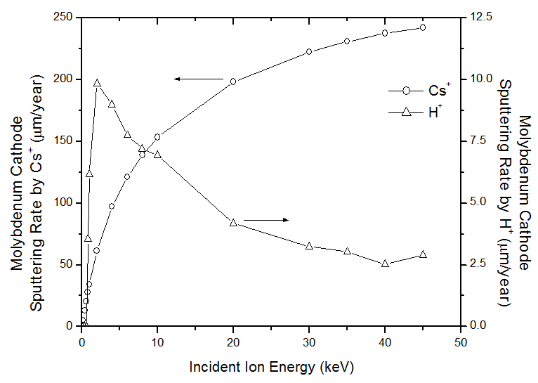
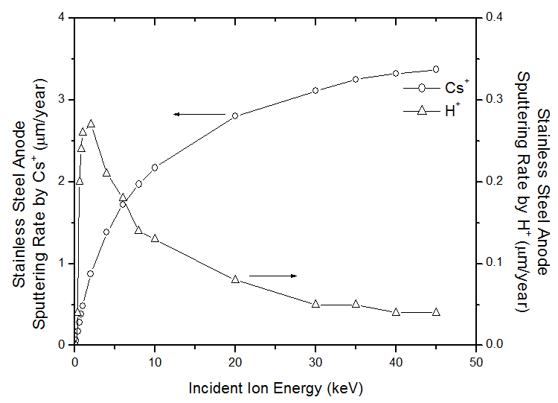
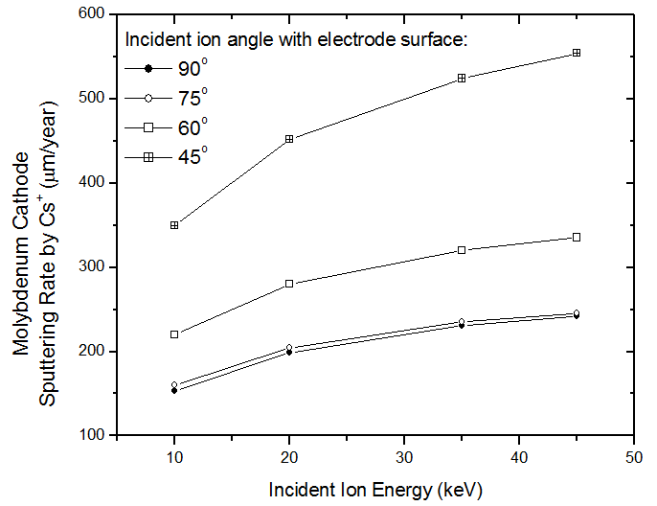
Estimation of Cs ⁺ and H⁺ sputtering rates
Within a few simplified assumptions (no sparking) & BNL’s duty factor of 0.5%:
Mo-cathode dominated by Cs-sputtering rate of O(200) μm/year.
SS-anode plate O(3) μm/year
Scales down with Linac4 duty factor (0.2%)
Effect of increased extraction voltage from BNL 35 → Linac4 45 kV:
  O(10%) Increased sputtering rate
  O(25%) increased energy density tbc. via IBSimu modeling of e,H⁻,p,Cs⁺ beams

Slide 13
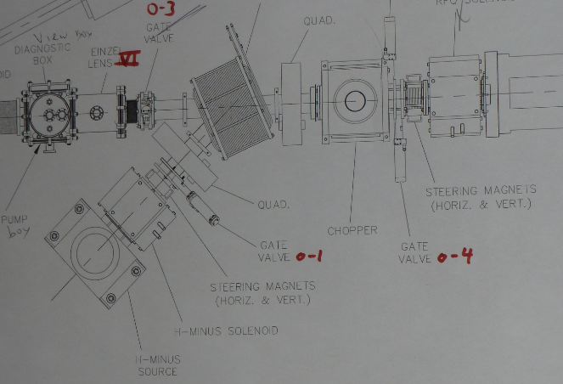
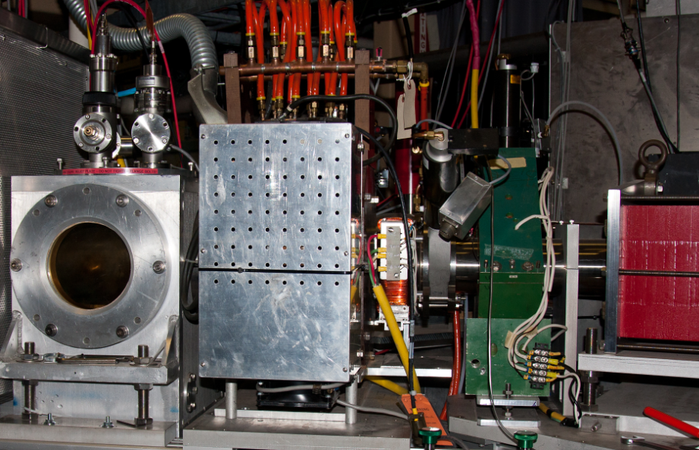
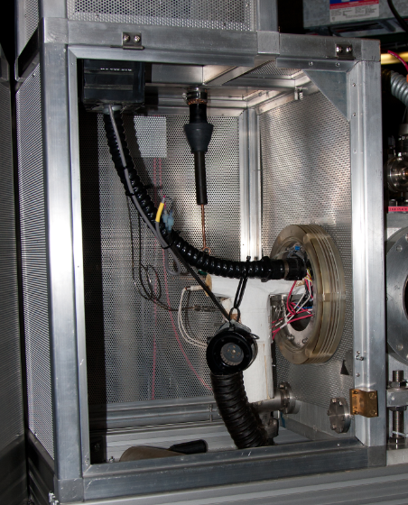
2013-10 Test location at BNL: Linac injector
Faraday cage
Cs-Oven
H2-feed line
H⁻ source housing, solenoid & steering magnet

Slide 14
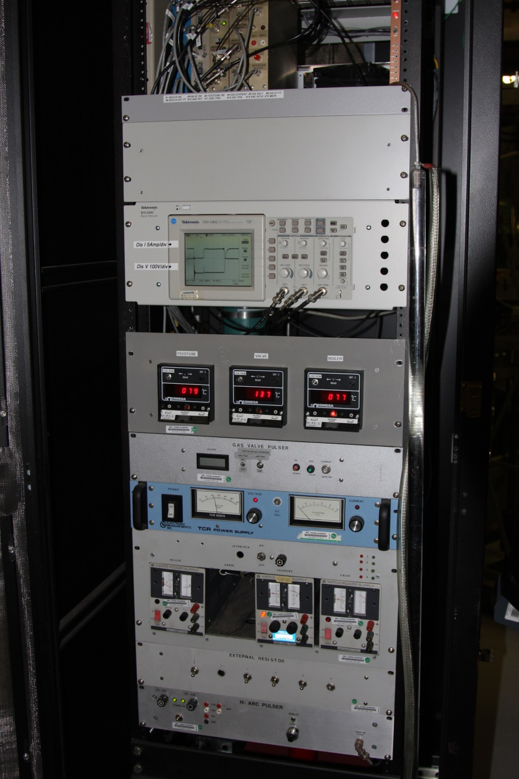
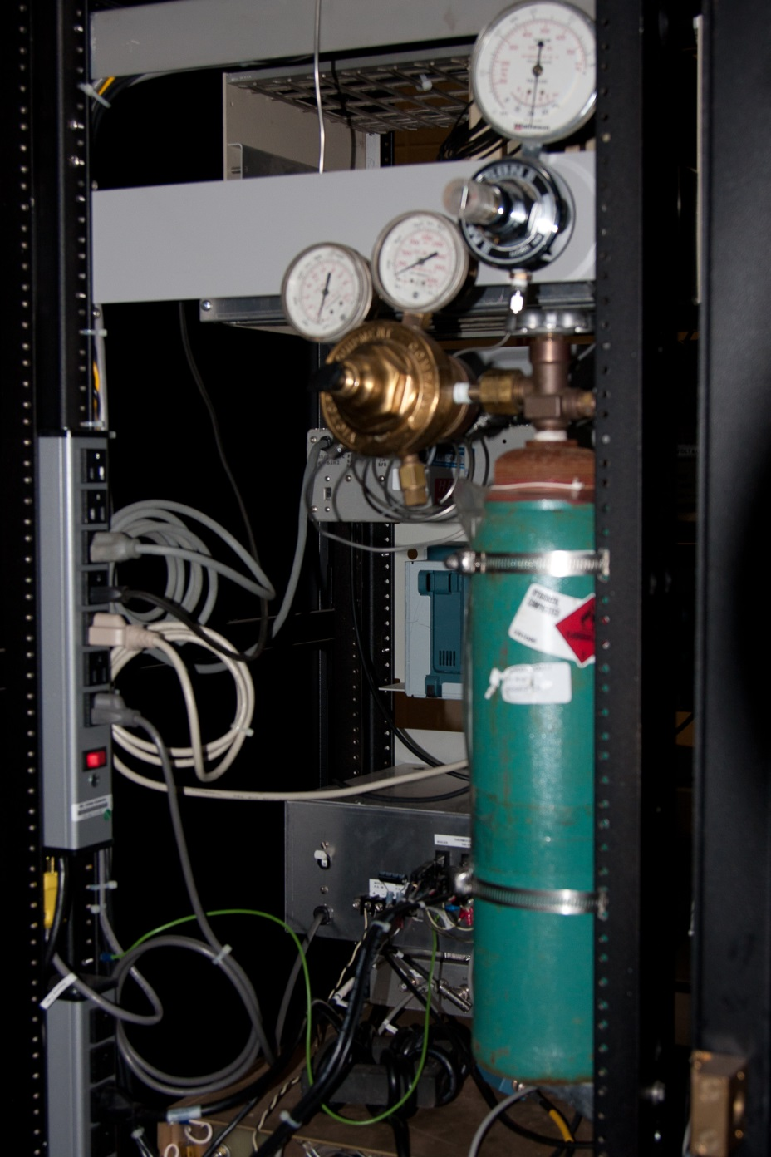
HV-rack
H₂ feed line pressure regulation
Arc discharge monitoring
T-control
Cs-Oven
H₂-pulser
Control: 20-30 V
15, +75 +10 μF
Heaters
Arc-discharge controller

Slide 15
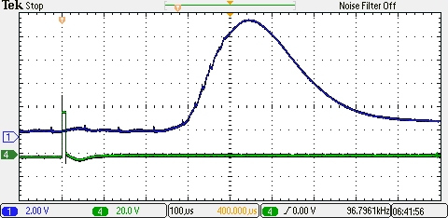
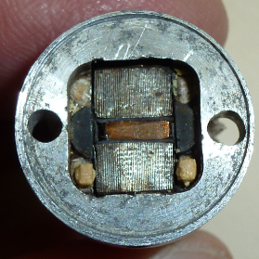
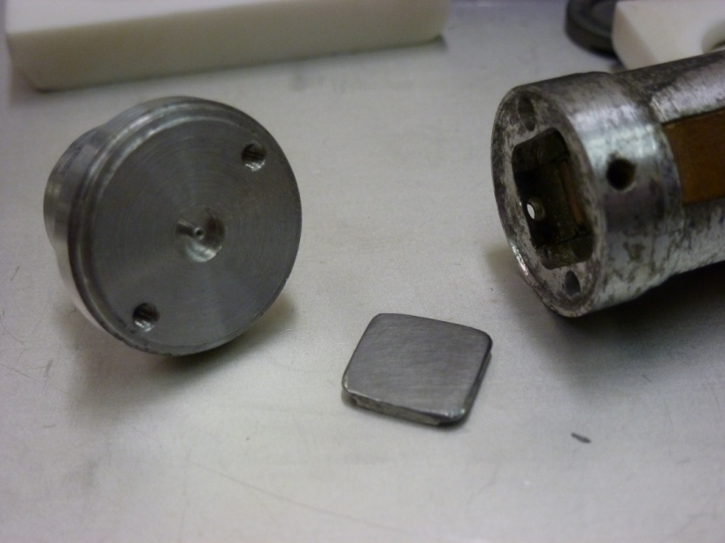
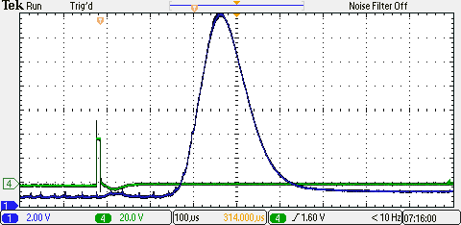
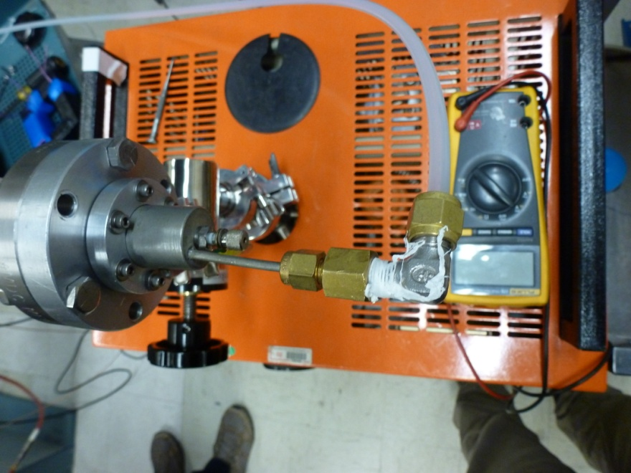
H₂ injection EM-valve Measurement 2011-04
1 bara air
Electro magnet
H₂
O-ring
Steel mobile plate
Gauge: mks , controller 937A, direct readout via a Tektronix oscilloscope
Control via pulse generator (square function)
Courtesy of J. Alessi, A. Zelensky and G. Aloian

Slide 16
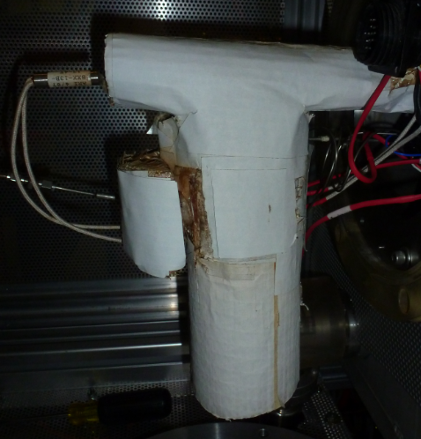
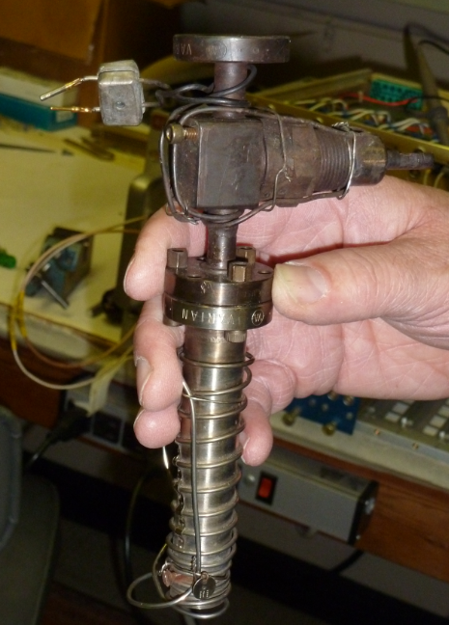
Cs-Oven ^& transfer line
TL: 300°
Valve; 300°
Cs-tank 100°
Transfer line Internal resistor heating

Slide 17
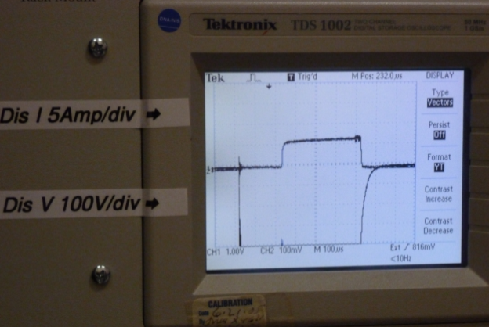
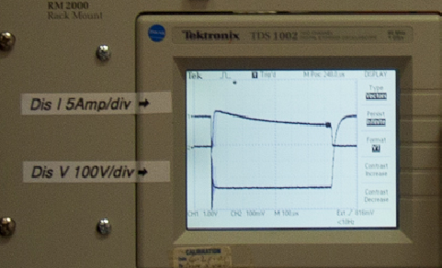
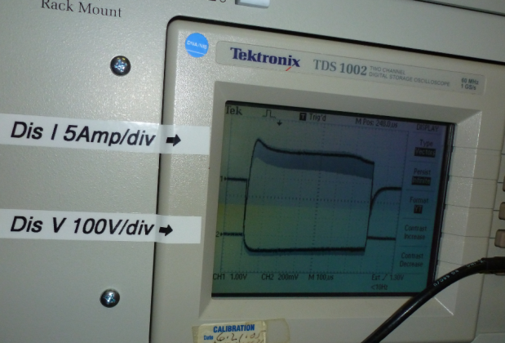
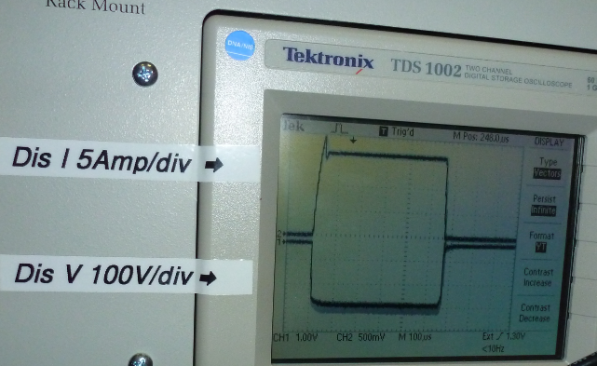
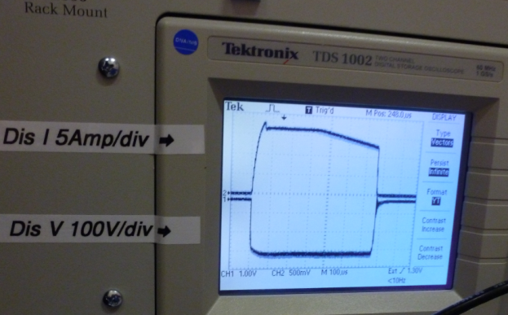
Commissioning of the cesiated Arc-discharge
BNL team disassembly-reassembly of CERN’s Magnetron, connection of BNL’s set of permanent magnets, connection of EM H₂ pulser valve, adaptation of W-tip of the puller and e-beam welded bellow HV flange.
Pumping down (2200 l/s) source and feed line, heating of Cs-transfer line (300°), start the arc discharge H₂ pulser with excess pressure on gas feed line and enhance capacitive discharge (20-30 V, 15, +75 +10 μF). Ramp up of the Cs-temperature to 100° then 120°.
Wait for cesiation tracked via a reduction of the Arc impedance from high resistance down to typically 10 Ohms (20 A for 200 V). Arc supply in current controlled mode.
Reduction of the H2 flow to 15+10 μF, tuning the H2 pulse timing. The arc current is by now only weakly depending on the voltage.
Ready to open the sector valve and to start HV (4-5 h)

Slide 18
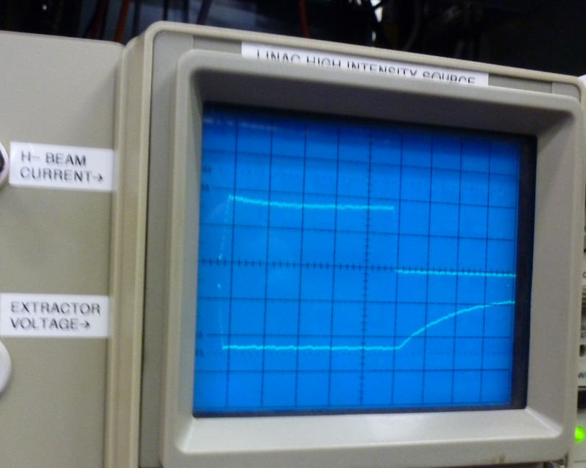
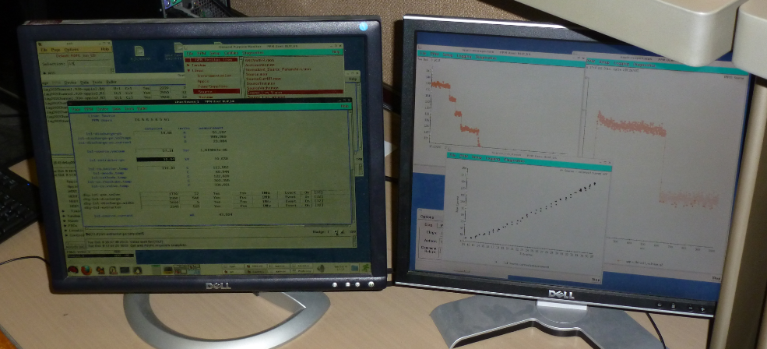
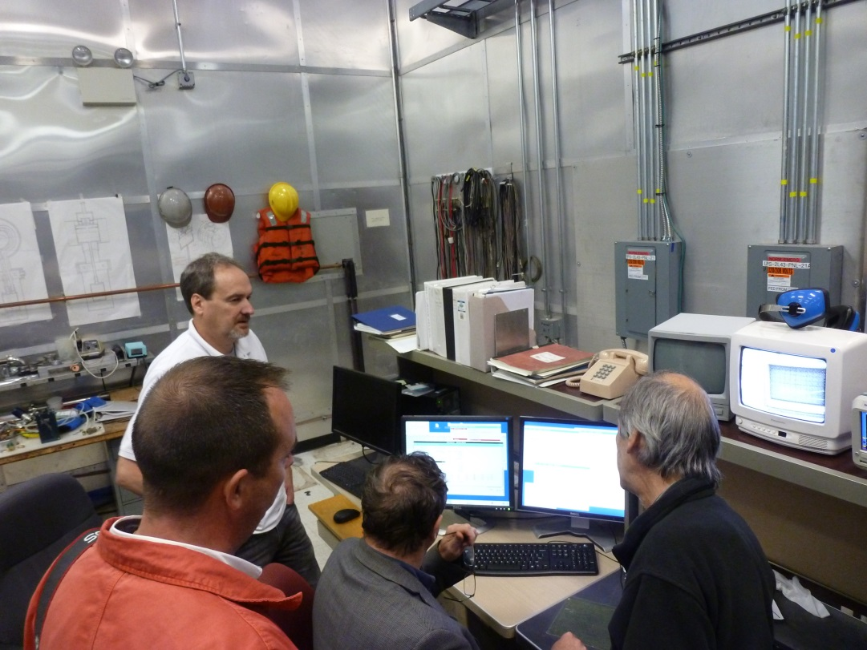
BNL’s IS local control room
H⁻ current
H⁻ pulse
Puller HV
H⁻ current vs. Puller HV
System operational @ 6.6 Hz ☺

Slide 19
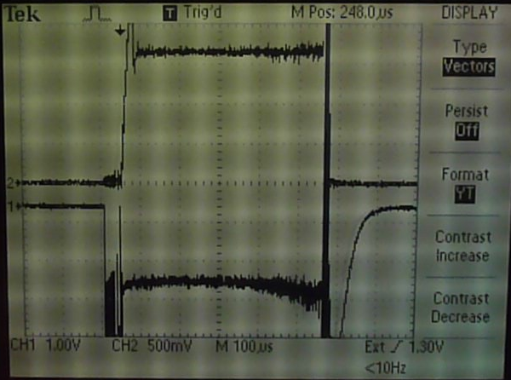
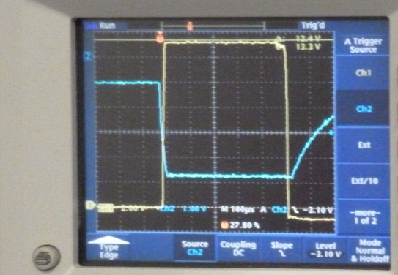
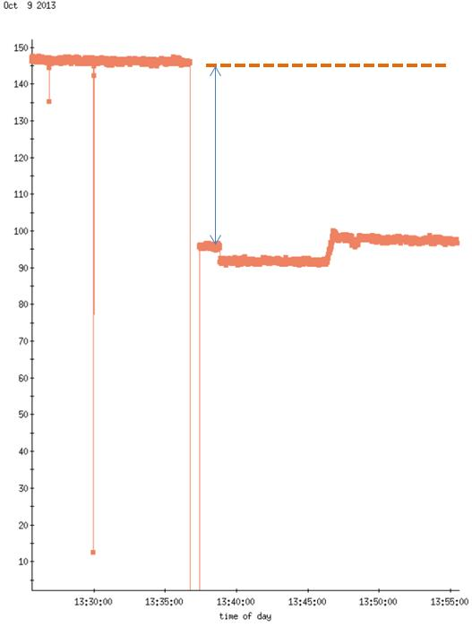
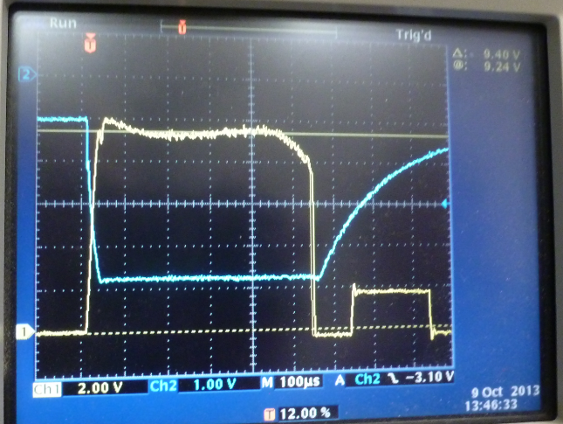
Operating at 2 Hz rep. rate
Arc current 18 A
Z_{Arc} = 10.5 Ω
H⁻ current
Arc voltage 190 V
Puller HV
Factor 2/3
Saturation of the H⁻ current acquisition ☺
New 2Hz I(H⁻) calibration was not implemented in the monitoring log.
H⁻ = 145 mA
H⁻ current monitoring pulse by pulse
Stability few mA/h (no stabilization time)
HV = -38 kV)
T-Oven = 104°
dI(H⁻)/dt = O(1) mA/h
Very responsive to H₂ pressure variation
Increase of T-Oven to 130° induces HV sparks
Peak H⁻ current 135mA @ 39.5 kV
After modification of the H⁻ current acquisition
from 20 mA/V to 30 mA /V

Slide 20
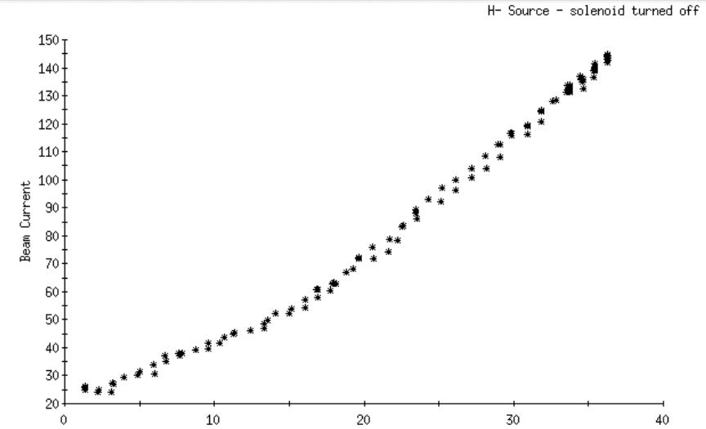



H⁻ beam yield
2013 6.6 Hz
2013 2.0 Hz (× 2/3)
Offset: 25 mA
2002 7.5 Hz
IS Ok @2 & 6.6 Hz

Slide 21



Cs-Atomic Oven: bright wall collimation model
Magnetron’s
anode plate
Puller
Assumption 20% of all Cesium travels through the puller
O(1) g/y through the puller (and into the LEBT)
O(25) mg/y into the RFQ (20 mm diam.at 2.3m dist.)
Master thesis J. Schindler Uni. Innsbruck, July 2011

Slide 22

Cs Vapour pressure

Slide 23

Cesium
Yearly consumption for a Cs-oven temperature of 100 °C: 4.5 g/year
Vapour pressure gradient at T₀ = 100° : dp/p₀/dT= 1 decade / 47°
Emission form an atomic oven → O(25) mg/year in the RFQ & 1g/y into LEBT
Negligible interaction of ¹³³Cs-atoms _{(T-cathode)} , r_{Cs}=2.60 Å with the H_{2 (room temp.)}, d_{H2}=0.74 Å
  Rest gas in the LEBT: mean free path (p₀) ~100 m at 1e-6 mbar
But: “Cs never seen beyond the
extraction electrode” at BNL
→ BNL’s magnetron
does not behave as a Cs-atomic Oven
Cs-related Risk scenarios:
Impact of steady state Cs-flux on RFQ operation not fully clarified; likely increase of e-emission due to lowering of cesiated surface work function
Maintenance of cesiated inner-surface of vacuum components
Operation of cesiated beam diagnostics (grids)
Cs-Oven overheating (Worst case 300° → Cs×1000)
  → Conditioning of the source with closed LEBT valve
  → Limitation of Cs-Oven heating to 130°
  → Single bending or dog legged bend in the LEBT or tilted source (> increased emittance)
  → Condensation of Cs-vapour

Slide 24
BNL Test of CERN's Magnetron: Summary
Linac4 specification:
80 mA within 0.25 π mm∙mrad
Meas. of emittance @45 kV
Beam intensity tuning via extraction voltage
45 kV pulsed transformer designed for 200 mA. Low energy e-dumping not realistic ?
Measurement of e/H
T-controlled cathode ?
Low temperature Cs-Oven operation would be an asset:
Measurement of Cs-flow
T-controlled magnetron’s body
Tilted source + Cs-condenser

Slide 25




Magnetrons with heated anode body
Avoiding a cold spot at the end of the Cs path: Improved start-up time
Potential impact of the warm anode body to be assessed:
  Reduction of overall Cs-consumption
  Reduction of the necessary arc discharge current
  Operation at 0.8 Hz
Mo-Cathode: Thermocouple location
Direct cathode heating to compensate low rep rate heating ?

Slide 26


Paschen discharge, e-emission, arc impedance
Arc impedance min: 10.5 Ohm
Arc power 3.4 kW
Av. conductivity: 0.15 S/m
Arc electron density of 10¹⁸ m⁻³,
H₂
Richardson current (Temp., Work fct.) extracted from the cesiated Mo cathode:
U_{discharge} < 400V, d = 1 mm
→ p(H₂) > 2 mbar, U_{min} = 320V
In clean H2, No Paschen discharge below 300 V
An estimation of the H₂ and Cs partial pressure and cesiated surface temperature in the arc region would be interesting.
AIP Conference Proceedings 111, 398 (1984); doi: 10.1063/1.34438
R. Witkover T-cathode bulk = ~380 °

Slide 27


ISIS Penning H⁻ IS, ageing and 2Hz operation
Results:
Once equipped with and additional heating circuit (mandatory below 12 Hz) the ISIS penning IS operates at 2Hz.
Cs⁺,H⁺ Sputtered Mo growth in a brittle layer on Mo-cathode.
J. Lettry, J. Alessi, D. Faircloth, A. Gerardin, T. Kalvas, H. Pereira, and S. Sgobba, Investigation of ISIS and BNL ion source electrodes after extended operation, Review of Scientific Instruments 83, 02A728 (2012).
H. Pereira, D. Faircloth and J. Lettry, Operation and thermal modeling of the ISIS H- source from 50 to 2 Hz repetition rates, AIP Conf. Proc. 1515 (2013) pp.114-120.

Slide 28
Conclusion, outlook: BNL’s Magnetron as Linac4 IS-03
2Hz duty cycle : Operation at 2 Hz already demonstrated, discharge commissioning at higher repetition rate (6-10 Hz), additional heating is an asset to start the ion source, it may be beneficial to limit the Cs-flow
0.8 Hz operation via 1 pulse out of 3
ISIS operation at 1.6 Hz demonstrated, R&D more in T-control less in Cs-handling
Operation at 45 kV: Beam optics mandatory for Electrons and H⁻,
Ageing: Marginal increase of the sputtering anticipated for Cs⁺ or H⁺ ions. Tracking of e-beam-power surface density mandatory
Emittance: Measurement at 45 kV mandatory, ~0.5 π∙mm∙mrad expected
H⁻ intensity: O(100) mA anticipated with O(80%) transmission through the RFQ.
H₂ injection: New valve and comparative measurement mandatory,
Arc discharge power supply: Achievable by the TE-team, 2015 ?
Design and production: New flange and external ceramic insulator required.
Cs-flow: Direct view to the RFQ for atomic beam between pulses, measurement required to confirm estimation of O(25) mg/y or clarify suppression mechanism.
Magnetron at CERN: No show stopper but mandatory 6 month testing the magnetron at the IS-test-stand prior to decision of operation. Design of a Cs-trap + tilted source or dog legged LEBT mandatory.
BNL’s Off-line test stand could be refurbished for Magnetron R&D
The support from J. Alessi, T. Lehn, A. Zelenski, J. Ritter, D, Faircloth and the BNL & ISIS ion source development teams is thankfully acknowledged

Slide 29

BNL: Nice place, Nice people, Thanks a lot to the ion source specialist team

Slide 30
IS03 WP summary
Remaining tasks towards testing the magnetron at the Linac4 IS –test stand
  Design an Arc discharge power supply and produce 3u + spare parts (TE)
  H₂ pulsed injection valve, (BE)
  Calculate Beam optics protecting the RFQ from IS’s Cs-flux (BE)
  Design and produce support flange, Cs-condenser and tilted extraction, (EN)
  Design and produce Ceramics insulator (EN)
  Emittance measurement. (BE)
  Learning phase on operation + >6 month measurement at the test stand
  Resources: 3 FTE + 100k CHF

