Slide 1
Linac4 source Control system
M. O’Neil (BE/ABP), J. Gil-Flores (BE/ABP),P. Andersson (BE/ABP),
I Kozsar (BE/CO),
J-L. Sanchez Alvarez (BE/OP).

Slide 2
Outline
Status
  Control architecture (INCA)
  WorkingSet (Knobs, Function Editor, Trim History)
  OASIS
  Logging Service
  Specific Application
    Logging Display
    Timing editor
    Synoptic : Vacuum and Gas delivery System
    General Source control
Resources needed to implement a magnetron source
Conclusion/outlook

Slide 3
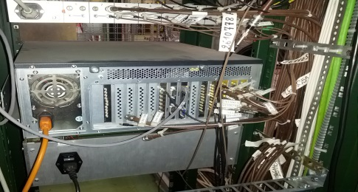
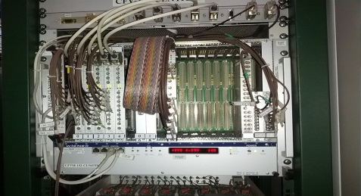

INjector Control Architechture
Based on 3-tier architecture
Control room
Top Tier
WorkingSet
Knobs, Function Editor, Trim History
OASIS
Viewer
Specific JAVA Applications
INCA (Applications Servers)
Middle Tier
CONTROL CORE LSA
AcqCore
Configuration Service
Logging Service
Front-End Computers
Lower Tier
FESA

Slide 4
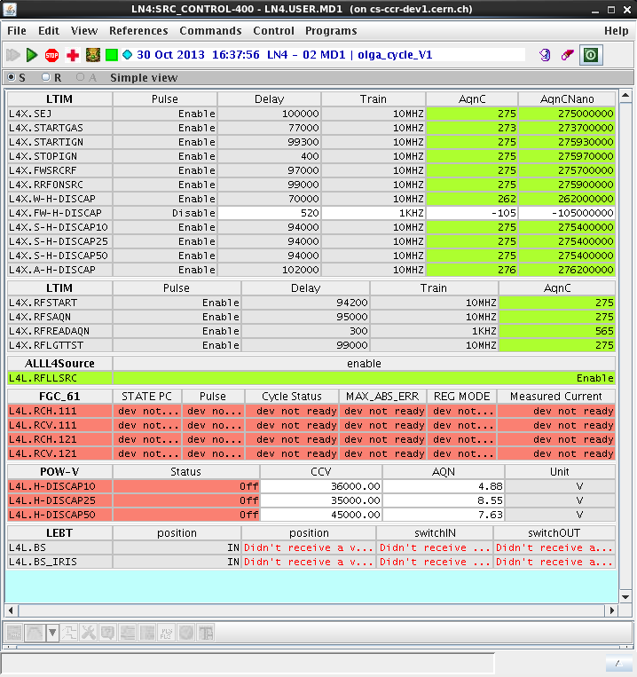
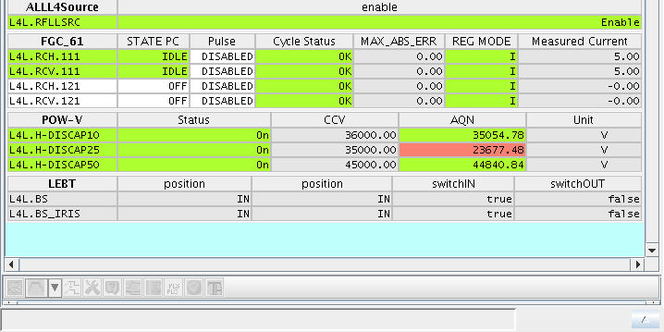
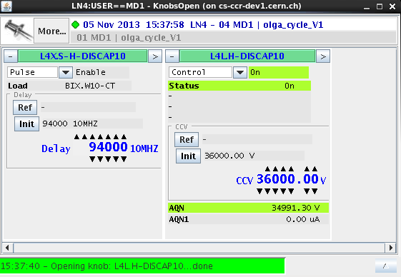
WorkingSet & Knobs
2 WorkingSets:
Control: - power supplies
- RF
- timings
- beam stopper
- faraday-cup
Monitoring: - pressures
- temperatures
- Waveforms

Slide 5
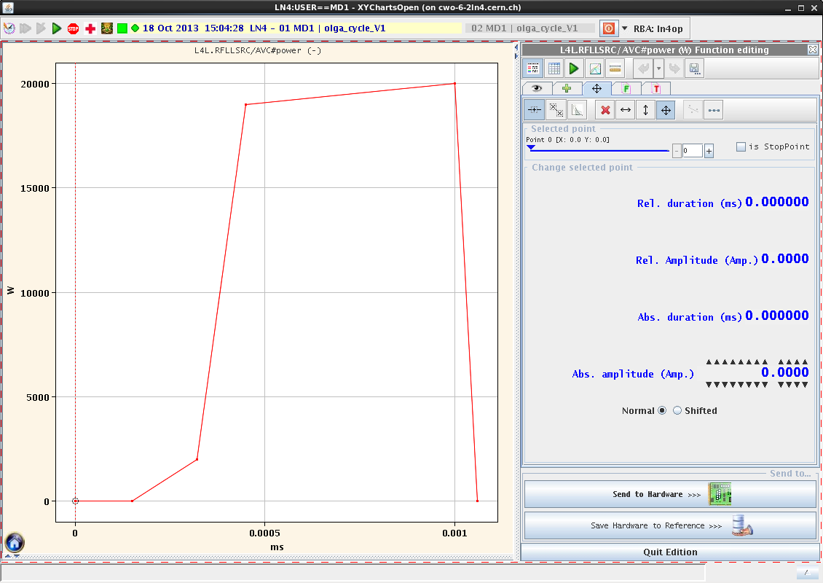
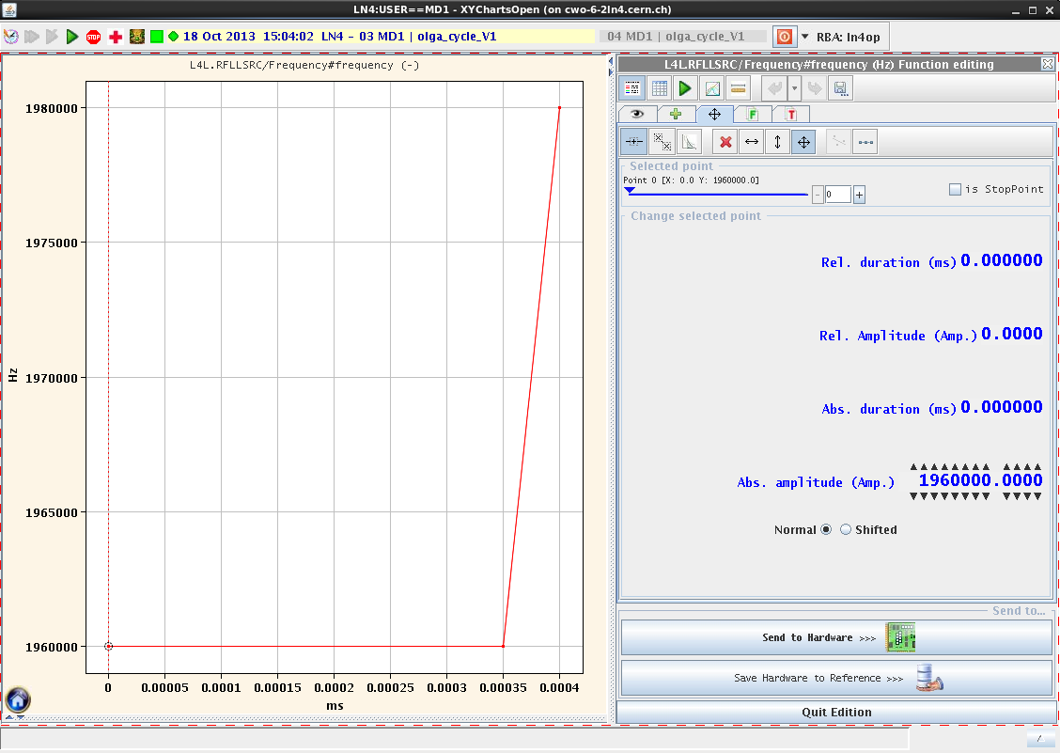
Function Editor
RF parameters
Power function
Frequency function

Slide 6
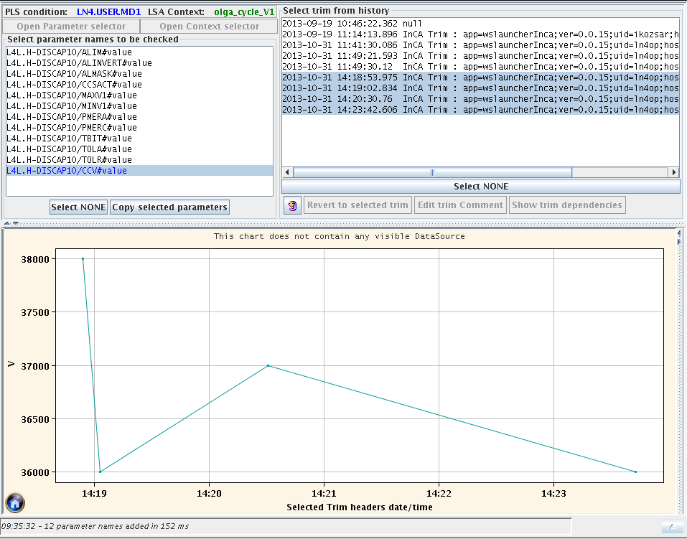
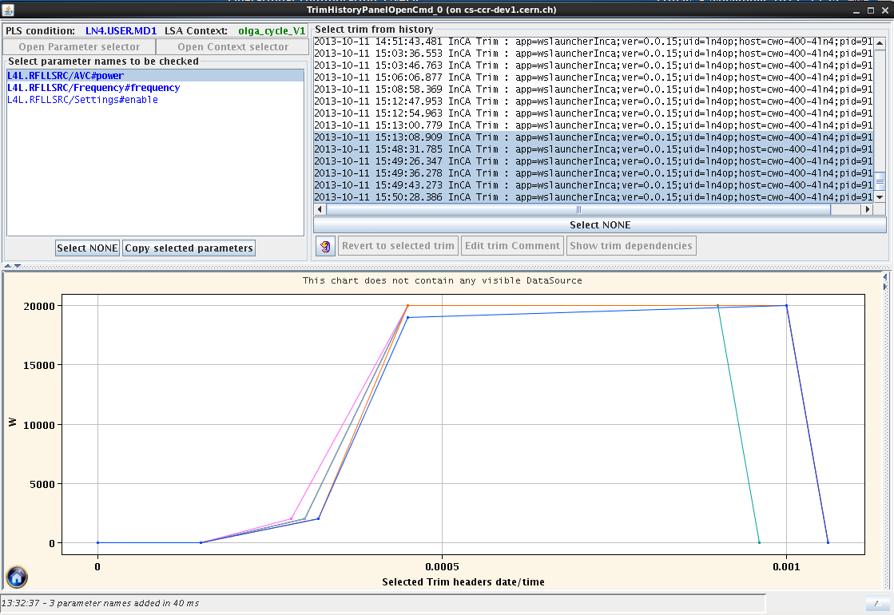
Trim History

Slide 7
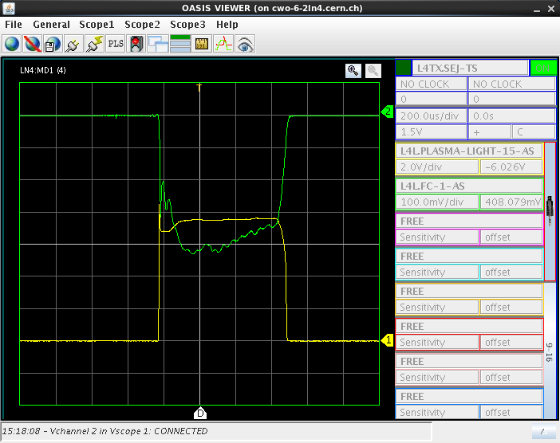
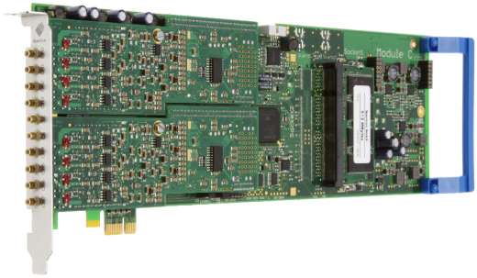
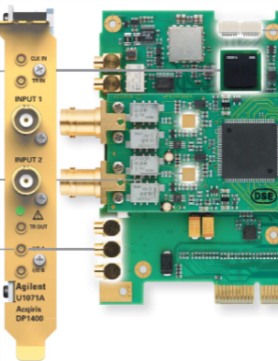
Open Analogue Signal Information System
System to acquire analogue signal from devices and display them in a graphical application. The signals are digitalized by oscilloscopes located in the front-end computers(FEC). The acquired data are sent through the Ethernet network , displayed on workstations running dedicated application and logged by the logging service
6 scopes in 2 FEC for linac4 and the same for the Test Stands.
48 signals are foreseen to be acquired by OASIS. (30% connected)

Slide 8
List of signals
Linac 4 Tunel | 3MeV Test Stand | Description
L4L.SOL-ANTENA-I-AS | L4LT.SOL-ANTENA-I-AS | RF antenna current
L4L.COLLAR-I-AS | L4LT.COLLAR-I-AS | Collar electrode current, SF 10, A
L4L.COLLAR-V-AS | L4LT.COLLAR-V-AS | Collar electrode voltage, SF 100
L4L.FC-1-AS | L4LT.FC-1-AS | Faraday cup 1 current, SF 0.1, A
L4L.PLASMA-LIGHT-0-AS | L4LT.PLASMA-LIGHT-0-AS | Ignition chamber light signal 0°
L4L.PLASMA-LIGHT-15-AS | L4LT.PLASMA-LIGHT-15-AS | Ignition chamber light signal 15°
L4L.PLASMA-LIGHT-30-AS | L4LT.PLASMA-LIGHT-30-AS | Ignition chamber light signal 30°
L4L.RF-P-REFL-AS | L4LT.RF-P-REFL-AS | RF reflected power
L4L.RF-P-FW-AS | L4LT.RF-P-FW-AS | RF forward power
L4L.GAS-PIEZO-V-AS | L4LT.GAS-PIEZO-V-AS | Piezo valve voltage, SF 100
L4L.IGN-V-AS | L4LT.IGN-V-AS | Ignition pulser voltage, SF 1000
L4L.IGN-I-AS | L4LT.IGN-I-AS | Ignition pulser current, SF 20, A
L4L.SOURCE-V-AS | L4LT.SOURCE-V-AS | HT power supply voltage
L4L.SOURCE-I-AS | L4LT.SOURCE-I-AS | HT power supply current
L4L.PULLER-V-AS | L4LT.PULLER-V-AS | Puller HT power supply voltage
L4L.PULLER-I-AS | L4LT.PULLER-I-AS | Puller HT power supply current
L4L.DUMP-V-AS | L4LT.DUMP-V-AS | Dump HT power supply voltage
L4L.DUMP-I-AS | L4LT.DUMP-I-AS | Dump HT power supply current
L4L.EINZEL-V-AS | L4LT.EINZEL-V-AS | Einzel HT power supply voltage
L4L.EINZEL-I-AS | L4LT.EINZEL-I-AS | Einzel HT power supply current
L4L.SRC-PRES-1-AS | L4LT.SRC-PRES-1-AS | Source Pressure
L4L.SRC-PRES-2-AS | L4LT.SRC-PRES-2-AS | Source Pressure
L4L.EINZ-PRES-AS | L4LT.EINZ-PRES-AS | Einzel pressure
L4L.LEBT-PRES-AS | L4LT.LEBT-PRES-AS | LEBT Pressure

Slide 9
LOGGING Service
Operational on the whole CERN accelerator
Aim : to capture and store any relevant accelerator data
Parameter list
Monitoring frequency
Storage frequency
Configuration in DB
Measurement DB (7 days)
Logging DB
Long term
Logging Core
Java API* for Parameter Control
JAPC Monitoring
Linac 4 devices
3 MeV Test Stand devices
* API = Application Programming Interface

Slide 10
List of parameter logged
Description of the working source (Type, Name, Polarity,…)
48 waveforms 5000pts(time window 1ms).
  Settings : sampling rate, cursors.
  Average, Standard Deviation
Others relevant parameter (Power Supplies acquisition, Pressures, Temperatures).
Monitoring frequency : 0.83Hz.
Storage frequency : every cycle in the short DB and on change in the long term database.
  Exception: Waveforms every hour in the long term database.

Slide 11
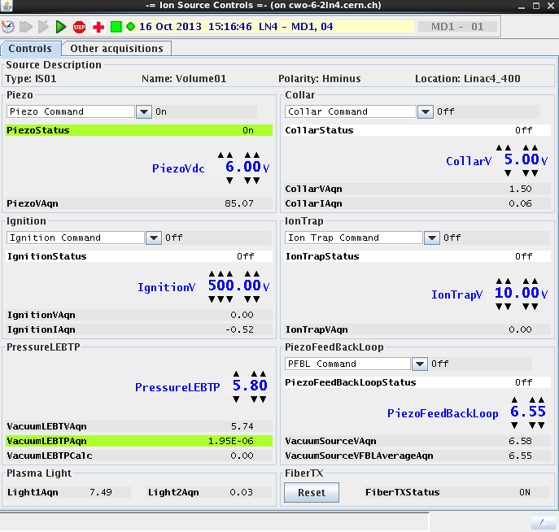
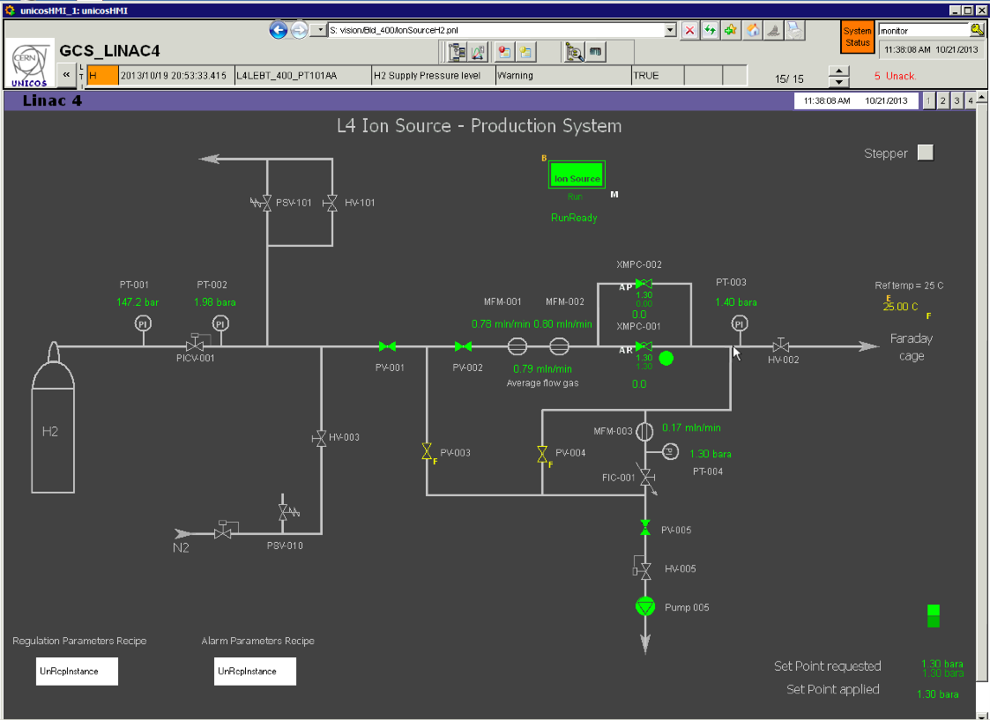
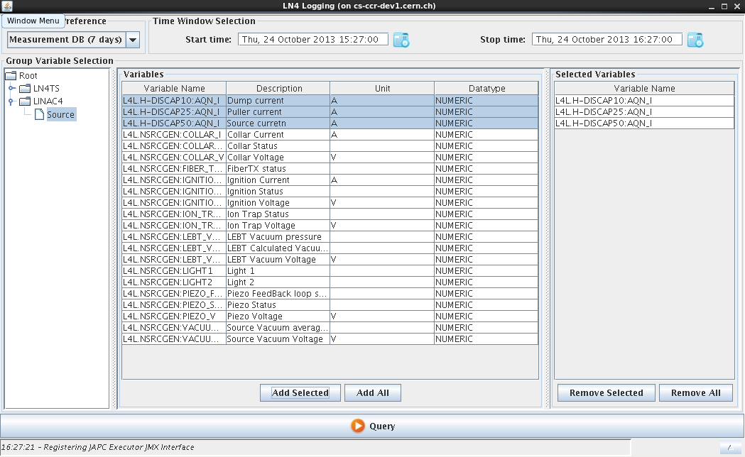
Specific Application

Slide 12
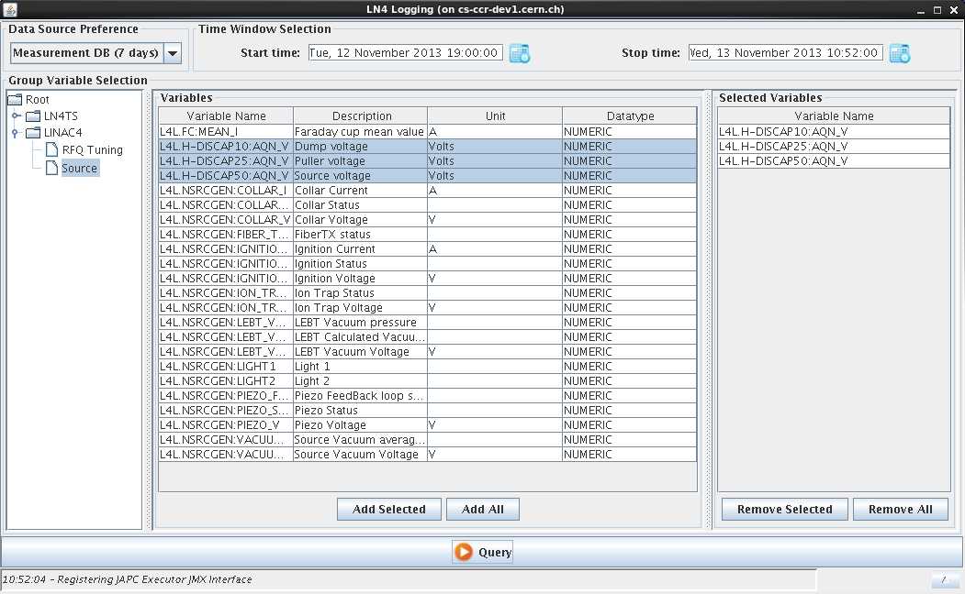
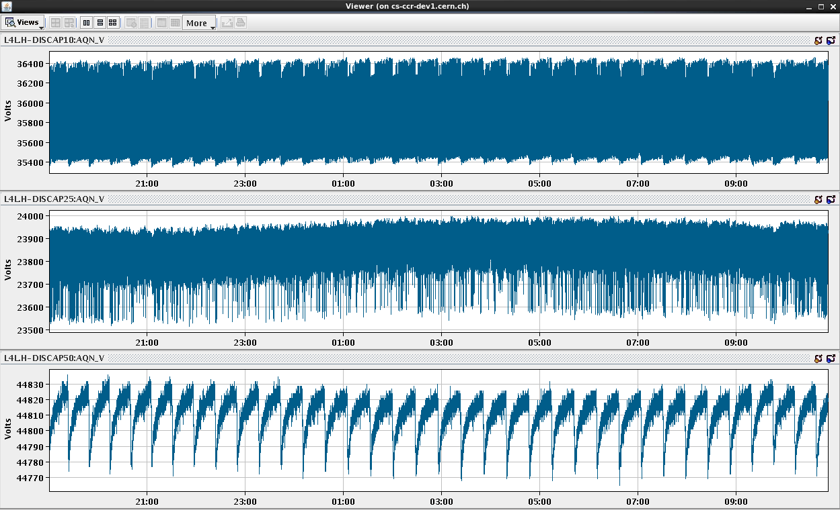
LOGGING display software
Logging Service offers a generic application to extract the data: “TIMBER”
The GUI of this application is not adapted to our requirements.
We developed a specific application with a user friendly interface to display the data
Dump Voltage
Puller Voltage
Source Voltage

Slide 13
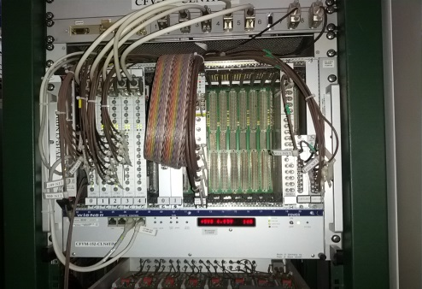
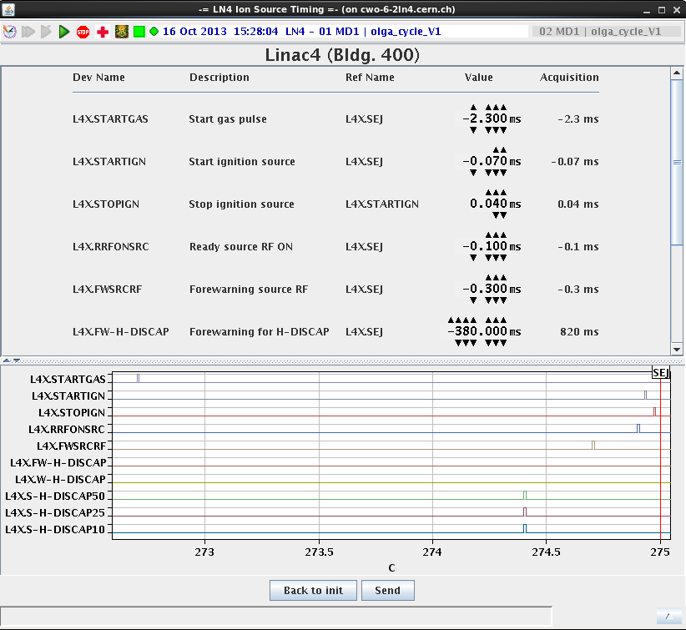
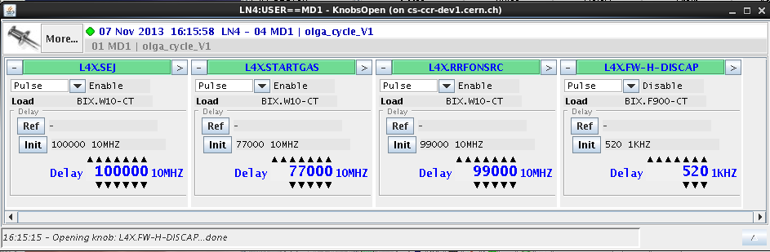
Timings editor
The purpose of this application is to adjust the timing without knowing the layout and configuration of timings.

Slide 14
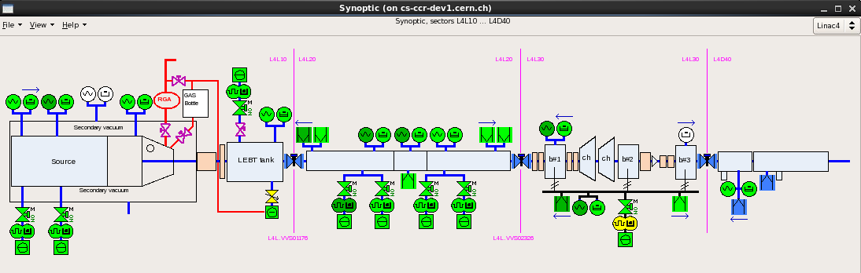
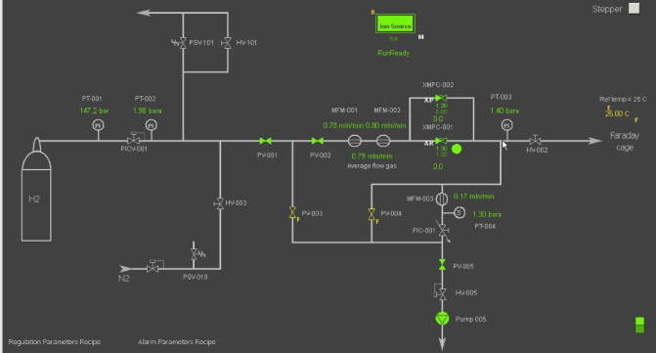
Synoptic:
Vacuum
The synoptic is based on the PVSS technology (Process visualization and control system). It’s a software package for field of automation engineering.
The application is furnished by the service group .
Red circuit/lines controlled by the Gas Delivery System
Source and LEBT

Slide 15
General Source Control

Slide 16
Resources needed to implement a magnetron source
Hardware (25kCHF, 0.5FTE)
  Timing card
  Cabling
  PLC
  Buffer cards
  Oscilloscope for OASIS
Software adaptation (0.5FTE)
  Timing editor
  General source control applications
  FESA classes
  Logging Service

Slide 17
Conclusion/outlook
The control system of the Ion Source is based on existing components and systems developed for the LHC and injectors accelerators (LSA, INCA, WS, Knobs, OASIS and Logging Service). BE-CO is responsible of the maintenance and the configuration is done by BE/OP
Java Operational applications will be maintain by BE-OP and BE-ABP
PH-DT and TE-VSC groups are responsible of their Specific application
Finalize the connection of the missing signal to OASIS + Logging settings 0.5FTE
1FTE and 25kCHF are needed to implement the Magnetron source in the current control system.

