Slide 1
Linac4 – LEBT
Linac4 – LEBT
R Scrivens
Ion Source Review, 14/11/2013

Slide 2
Linac4 – LEBT - Status
2 LEBTs are installed.
  The Linac4 LEBT is being hardware and beam commissioned.
  Presently the Ion Source Test Stand LEBT has the second half replaced with the Emittance Meter.

Slide 3
Linac4 – LEBT – List of Achievements
Magnets
  2x2 Solenoids. 2x2x2 Trajectory Correctors. All Installed and Commissioned.
  Solenoid field axis centred with vibrating wire technique + shims.
  Power converters installed. Controls (almost) finished.
Vacuum and LEBT gas injection
  2 LEBTs installed and leak tight.
  Gas injection commissioned (beam measurements still ongoing).
  Question of vacuum at 2Hz operation to be resolved.
Pre-chopper
  Deflection System redesigned to avoid insulator view of beam.
  Driver installed in the Linac4 tunnel.
  Briefly tested to >20kV in Linac4, with beam present. Permit system still to commission.
  Test stand driver still to be installed.

Slide 4
Linac4 – LEBT – List of Achievements
Beams Instrumentation.
  Faraday Cup – OK with ~20mA of H-.
  Beam Current Transformer – Working.
  SEMGrid (profile monitor). Secondary electron signal being understood.
  Emittance meter. 1 meter dedicated to source measurements – installed in the test stand.
Beam-stoppers.
  Only 1 set are required. They are moved to the Linac4 tunnel.
Ion trapping electrode.
  Item installed, but is left grounded.
Support and alignment.
  Girder support is aligned to reference axis.
  Each component has its mounting point toleranced to this reference.
  Follow up of alignment is the “LEBT bench” as a whole.

Slide 5
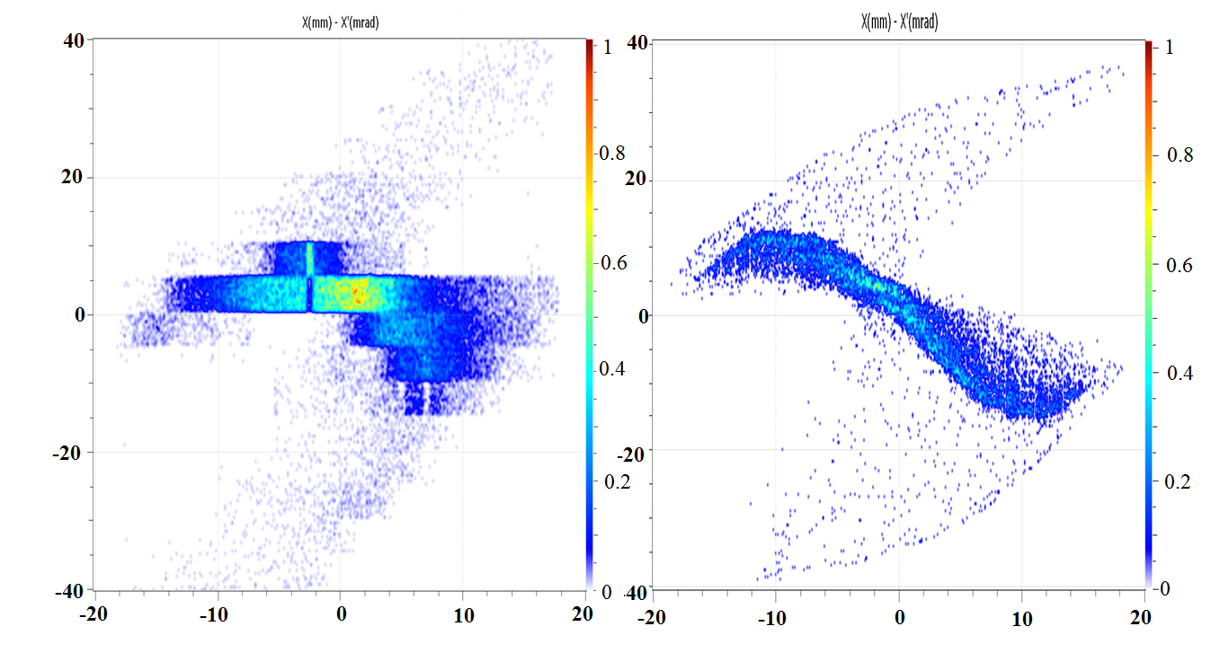
Linac4 – LEBT – Measurements
Comparison of measured and simulated H- in the LEBT.
Measurement is of phase space.
Simulation is from source extraction to emittance meter, with secondary particles providing compensation.
Measurement
Simulation

Slide 6
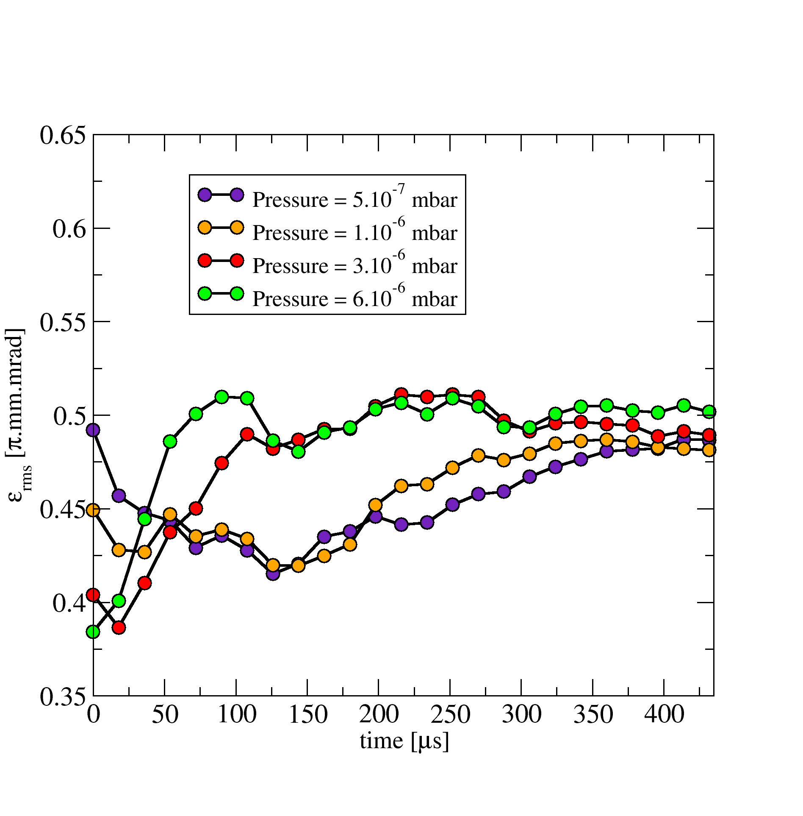
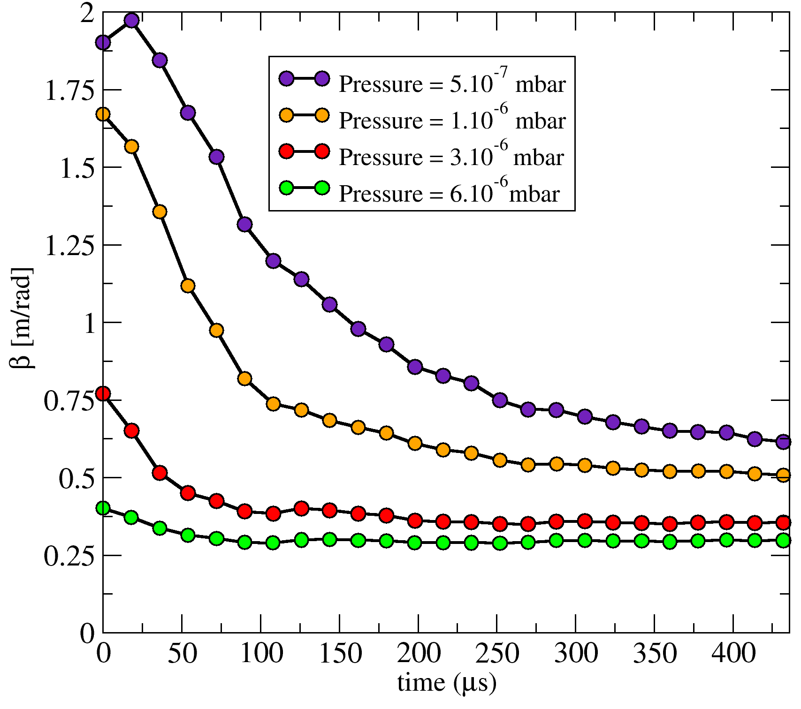
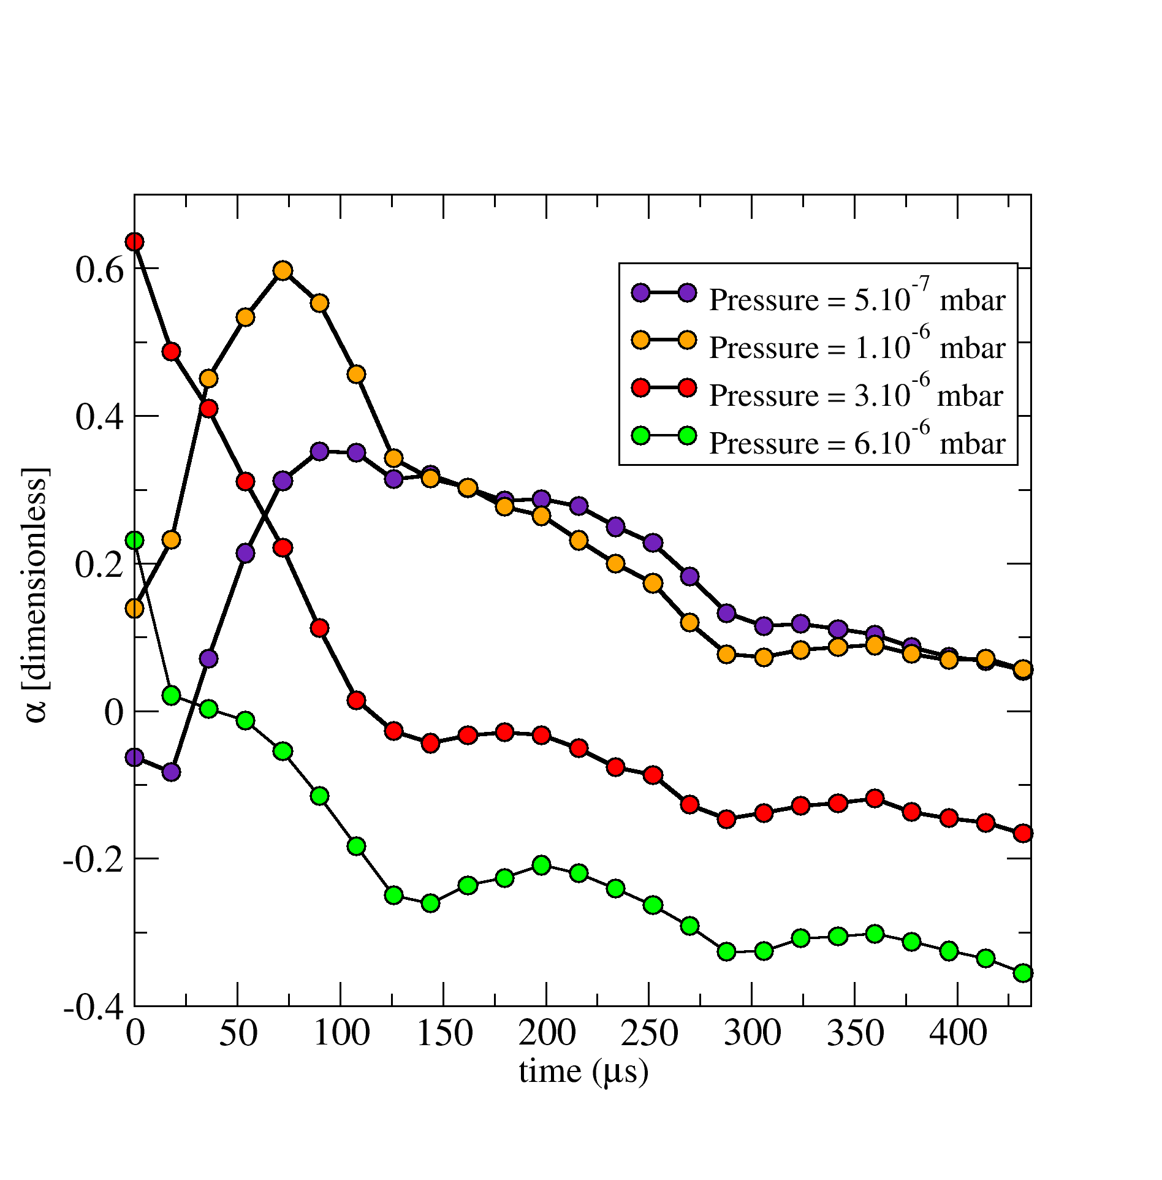
Linac4 – LEBT – Measurements
The LEBT is the beam measurement system for the source.
Emittance – Limited measurement time so far with H-, just ~2 weeks when the source was working with H-, and the RFQ was not connected.
Measured rms emittance parameters.
Space-charge compensation of the beam is clearly visible.
Establish stable conditions faster at higher pressure.
We do not know why the emittance is increasing with compensation (but a 10% effect).
Best RFQ transmission was at 1x10⁻⁶mbar (based on limited study).

Slide 7
Linac4 – LEBT – Still to be done (magnetron excepted).
Pre-chopper
  Drivers for test stand and spares need to be finished.
Space-charge compensation
  Additional gases to be tested.
Many beam measurements to make with IS02 and IS03.

Slide 8
Linac4 – LEBT – Maintenance
Magnets
  Test stand serves as spare.
Vacuum and LEBT gas injection
  See vacuum talk.
Pre-chopper
  Plates – Test stand serves as spare.
  Driver – Test stand, plus spare components foreseen, but needs to be implemented.
Beam Instruments
  Test stand serves as spares for hardware.
Beam Stoppers
Integration
  The “in-beam” integration is very tight, but ok.
  Cabling/adapters/amplifiers etc, hosted around the LEBT is very dense, not very well optimized. Constrictions of staying within a transport zone leads to lack of space.

Slide 9
Linac4 – LEBT – Resources needed to implement a magnetron
No specific modifications of the LEBT are foreseen for a magnetron.
Evaluation of this needs completion of beam dynamics study for extraction and transport.
Not fully excluded that some modifications will be included for cesium, if they cannot be hosted in the source.
Evaluation of gas load to be made.

Slide 10
Linac4 – LEBT – In a nutshell
LEBTs installed.
Commissioning being finished with beam.
Some spares and testing to be completed.

Slide 11
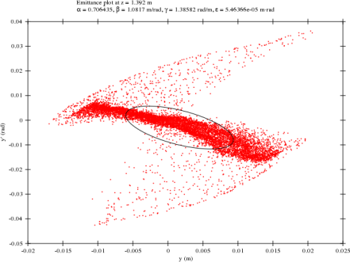
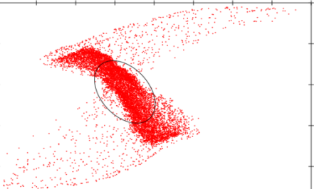
Linac4 – LEBT – Backups
Simulation with IBSimu, taking into account secondary ions causing spec charge compensation.
Evolution of the beam in time can be seen.
T=20us
0.05
0 Y(m)
-0.05
Solenoid
T=200us
0.05
0 Y(m)
-0.05
Particle trajectory from a simulation of the experimental setup and part of the Extraction system at 20µs an 200µs. H− beam [red] and the potential lines [green] .
Phase space rotation
Trajectories of secondary ions.

