Slide 1
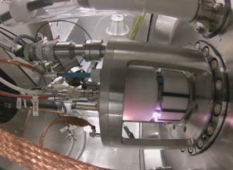
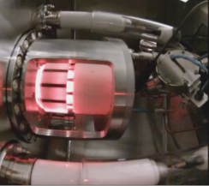
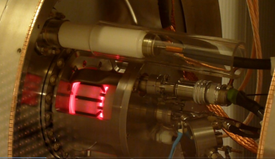
Plasma ignition and steady state simulations of CERN’s Linac4 H⁻ ion source
Stefano Mattei
BE-ABP-HSL
(on behalf of the CERN-KEIO collaboration)

Slide 2
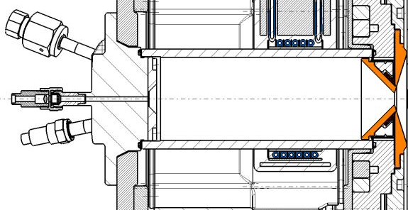
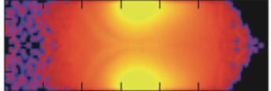
The Linac4 H⁻ ion source
Plasma chamber
L = 136 mm
Φ = 48 mm
RF coil
3 to 6 turns
2 MHz
100 kW peak power available
Pulsed operation
2 Hz rep. rate
500 μs pulses
Plasma newly ignited at each pulse
View ports
RF coil + Ferrites
External magnetic fields (cusp + filter) neglected
Simulate the RF-plasma coupling
Plasma ignition
Transition to steady state and stabilization during the pulse
Long term goal: optimization of the source geometry and operational parameters (e.g. coil position, number of turns, RF power, H₂ pressure)

Slide 3
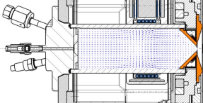
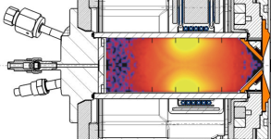
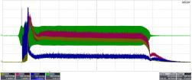
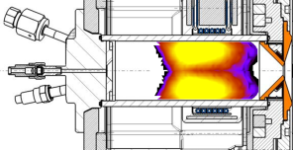
RF-plasma-light emission
Electromagnetic field simulations performed by Ansys HFSS
Field map
Plasma simulation
Electromagnetic
PIC-MCC
Courtesy of Alexej Grudiev
EEDF
Experimental verification by Optical Emission Spectroscopy and photometry
Collision-Radiative model
Courtesy of Takanori Shibata

Slide 4
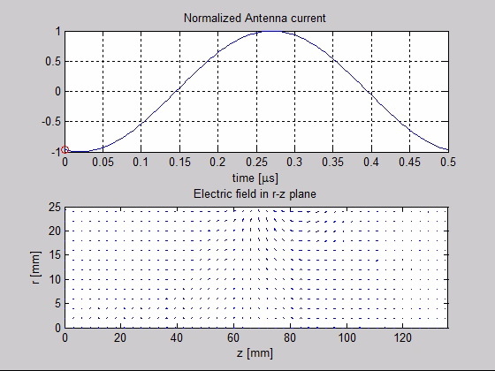

Input to the plasma simulation
Vacuum electric field
Courtesy of Alexej Grudiev

Slide 5
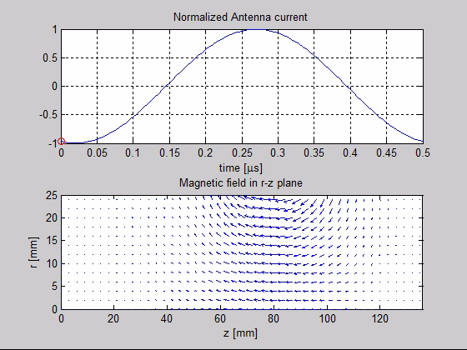
Input to the plasma simulation
Vacuum magnetic field
Courtesy of Alexej Grudiev

Slide 6
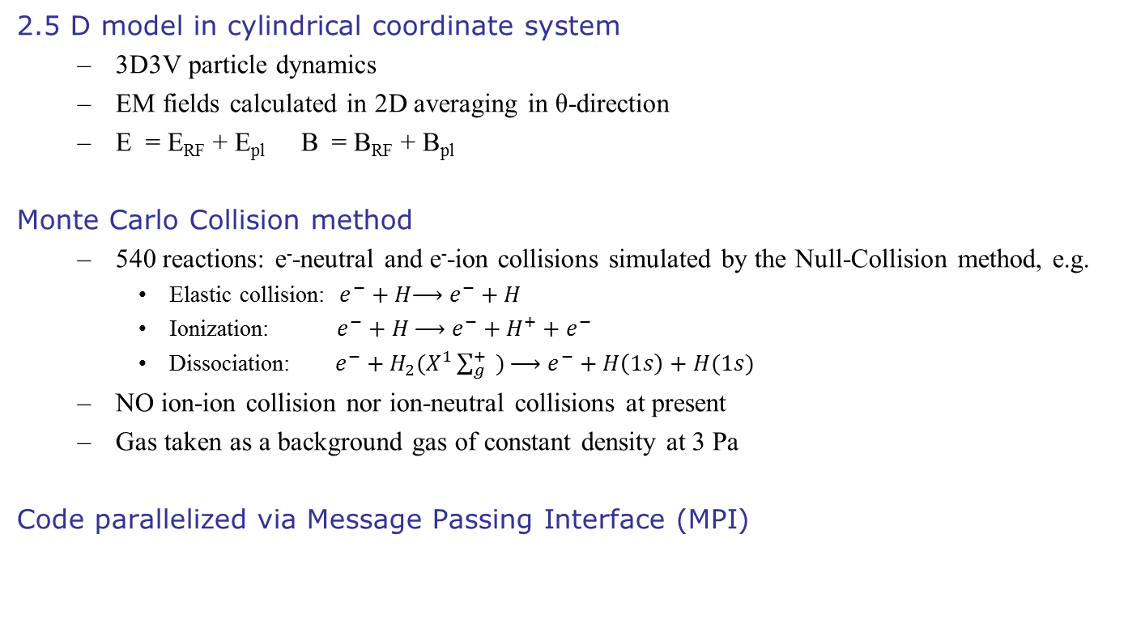
Electro Magnetic PIC - MCC
2.5 D model in cylindrical coordinate system
  3D3V particle dynamics
  EM fields calculated in 2D averaging in θ-direction
  E = E_{RF} + E_{pl} B = B_{RF} + B_{pl}
Monte Carlo Collision method
  540 reactions: e⁻-neutral and e⁻-ion collisions simulated by the Null-Collision method, e.g.
    Elastic collision: $e^{−}+H\underset{→}{ }$ $e^{−}+H$
    Ionization: $e^{−}+H \underset{→}{ }$ $e^{−}+H^{+}+e^{−}$
    Dissociation: $e^{−}+H_{2}(X^{1}\sum_{g}^{+}{ }) \underset{→}{ }$ $e^{−}+H\left(1s\right)+H(1s)$
  NO ion-ion collision nor ion-neutral collisions at present
  Gas taken as a background gas of constant density at 3 Pa
Code parallelized via Message Passing Interface (MPI)

Slide 7


Simulation parameters
Parameter | Ignition | Steady state
Initial particle number | 4800 | 24000
Specific weight | 5 × 10⁴ | 1 × 10⁷
Initial e⁻ density | 1 × 10¹² m⁻³ | 1 × 10¹⁵ m⁻³
Initial p⁺ density | 1 × 10¹¹ m⁻³ | 1 × 10¹⁴ m⁻³
Initial H₂⁺ density | 9 × 10¹¹ m⁻³ | 9 × 10¹⁴ m⁻³
RF power | 7 kW | 7 kW
Cell size | 1x1 mm | 1x1 mm
H₂ gas pressure | 3 Pa | 3 Pa
H₂ temperature | 300 K | 300 K
Initial e⁻ temperature | 15 eV | 1.5 eV
Time step | 10⁻¹² s | 10⁻¹² s
Collision time step | 10⁻¹⁰ s | 10⁻¹⁰ s
Simulation domain
Initial condition
Resources – EPFL cluster
2 nodes of 48 cores each – 96 cores
AMD Opteron 6176 (Magny-Cours) à 2.3 GHz
196 GB RAM per node – 392 GB
Simulation time – 400 cores day per μs

Slide 8
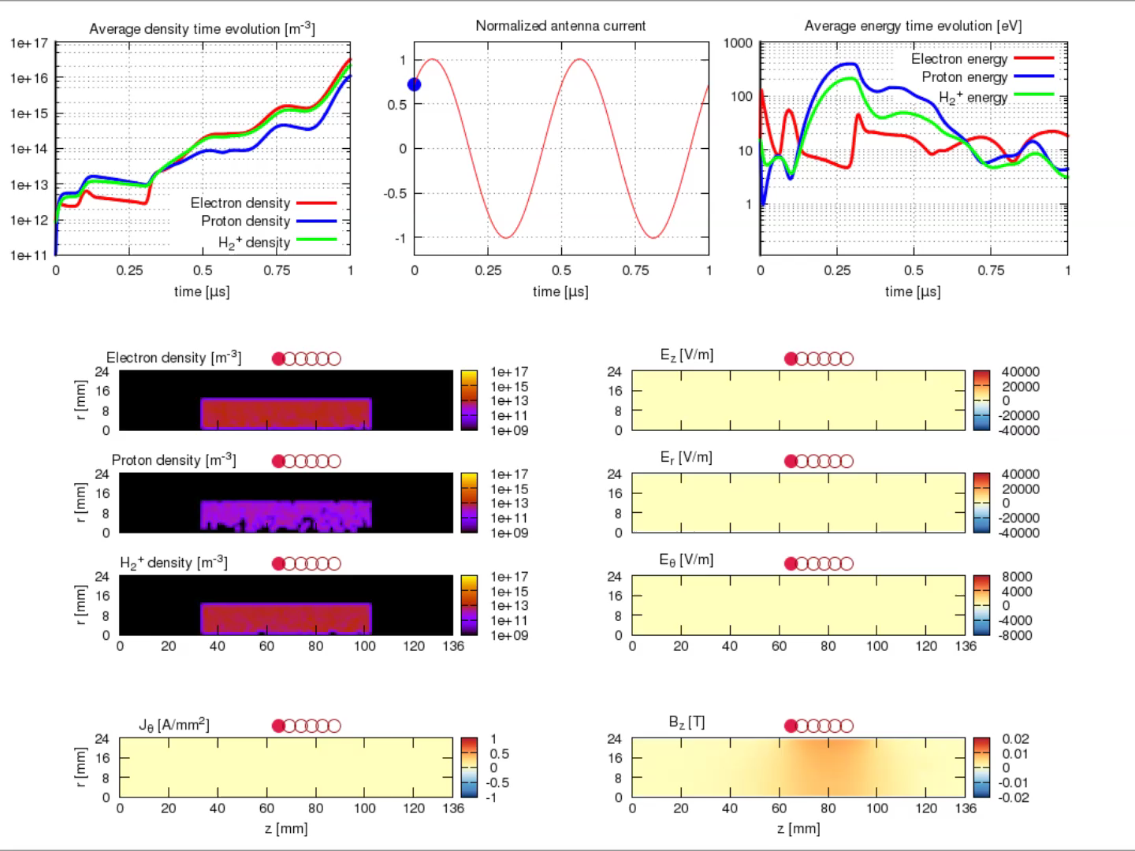
Capacitive plasma ignition

Slide 9
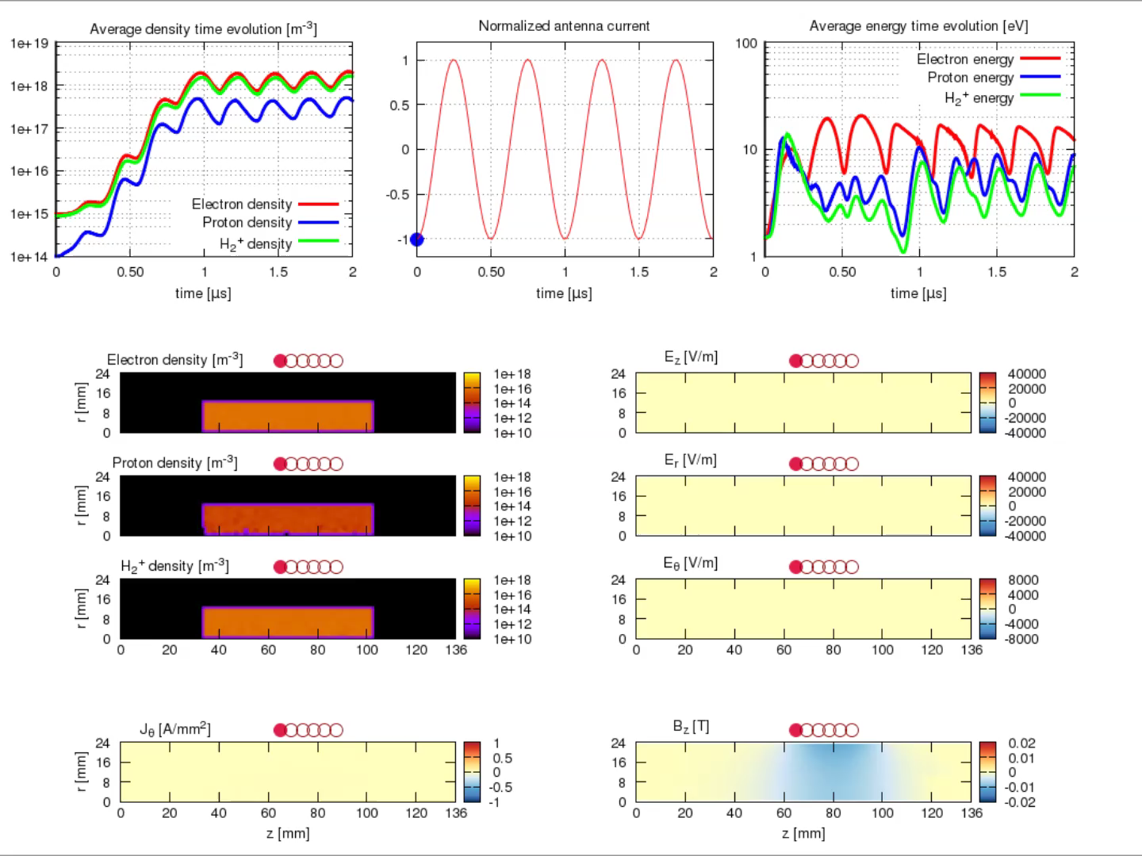
Inductive heating to steady state

Slide 10
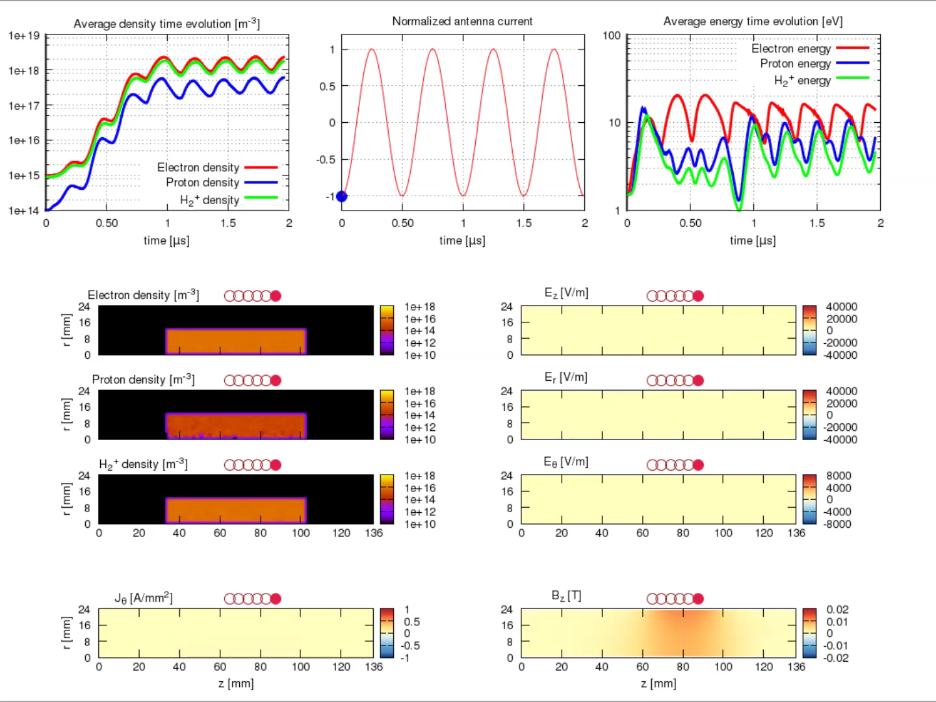
Inductive heating to steady state – Inverted polarity

Slide 11
Remarks
Plasma ignition
  Dominated by the capacitive coupling
  Low plasma density allows the RF fields to penetrate in the middle of the plasma chamber to induce a push-pull effect
  Protons and H₂⁺ less influenced by the external fields due to larger inertia
Steady state regime
  At higher density the plasma heating is dominated by the inductive coupling
  4 MHz ripple observed in the plasma e⁻/ion density and energy
  Hints into plasma waves in the azimuthal direction (investigation ongoing)
  RF high voltage polarity has a strong influence on the plasma parameters spatial distribution
  Equilibrium is the result of the balance of production vs. losses

Slide 12

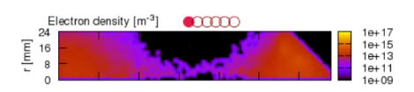
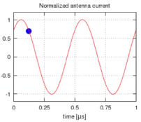

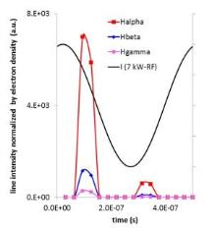
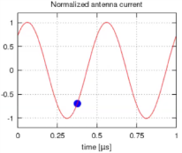

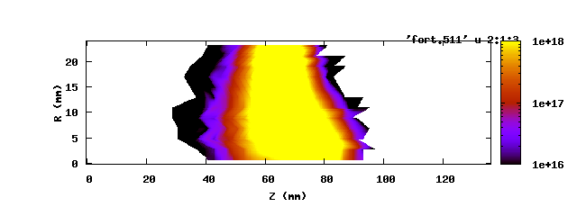
Collision Radiative model prediction
Preliminary results on 1 cycle during plasma ignition
H_{α} intensity
Integrated light central view port
H_{α} intensity
Courtesy of Takanori Shibata

Slide 13
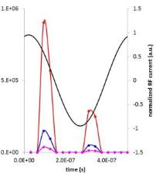
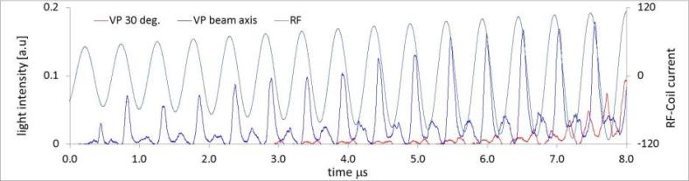
CR model vs. Photometry
CR model prediction
on-axis view port
30 deg. view port
Preliminary results
Correlation between measurements and simulations in 1 cycle during the plasma ignition transient
Hard work ahead…
Experiment and simulation shall now focus on steady state plasma (suitable for H⁻ beam production)
Courtesy of Takanori Shibata
Photometry measurements

Slide 14
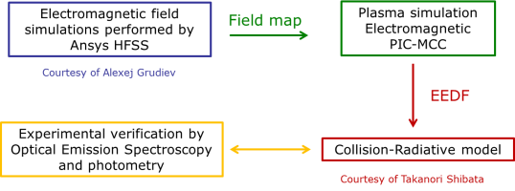
Conclusions and outlook
We have simulated the plasma ignition and the steady state regime in the Linac4 H⁻ ion source
Obtained first insights into the capacitive ignition and the transition to inductive heating mechanisms
Steady state reached at a plasma density of 10¹⁸ m⁻³
Compared results between CR model prediction and photometry measurements
Could lead to the simulation to the only observable during operation
Closed the loop for the first time

Slide 15
Outlook
Inclusion of new physics
H⁻ production mechanisms – surface + volume (1 year)
  Neutral transport
Ion collisions (3 months)
Coulomb collisions: e⁻-e⁻ (1 year)
  Electron thermalization
  Diffusion across the filter field
Wishful upgrade to fully 3D code to take into account the real magnetic field configuration
Informatics
Inclusion of new physics will result in a further computational cost
Code optimization – speedup
Hybrid parallelization
Sensitivity studies
Runs with variation of the source parameters (e.g. RF power, H₂ pressure)
Inclusion of average magnetic cusp field to get first insights
Experimental campaign
End 2013

Slide 16
Acknowledgements
Thanks to all of our collaborators
KEIO University (Japan)
  A. Hatayama, K. Nishida, M. Ohta, T. Shibata, T. Yamamoto, M.Yasumoto
CERN
  E. McIntosh
  M. Husejko, I. Agtzidis, N. Hoimyr (IT Dept.)
  A. Grudiev (BE Dept.)
  T. Pieloni (BE Dept.)
École Polytechnique Fédérale de Lausanne (EPFL)
  L. Rivkin

Slide 17
THANK YOU FOR YOUR ATTENTION

