Slide 1
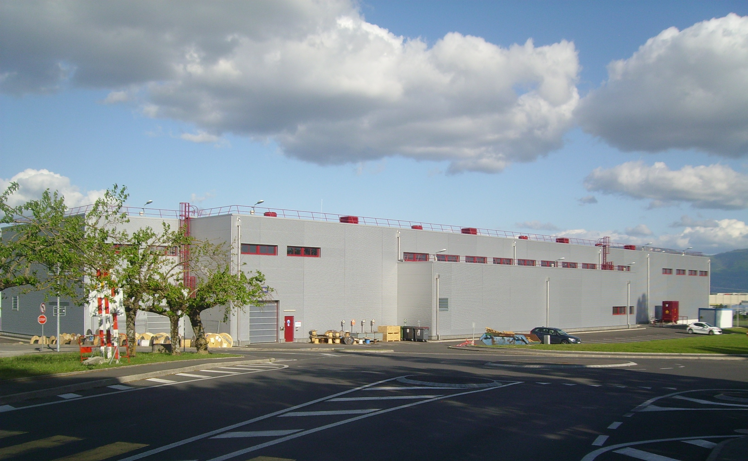
1
Linac4 Ion Source –
Safety Aspects HT, Gas, Cs, Electrical, Fire
A. Funken – J. Lettry
On behalf of the Ion Source team
L4 Ion Source Review
14.11.2013
CERN

Slide 2
Outline
Hazards inventory
Risk control measures
Safety documentation
Conclusion and outlook

Slide 3
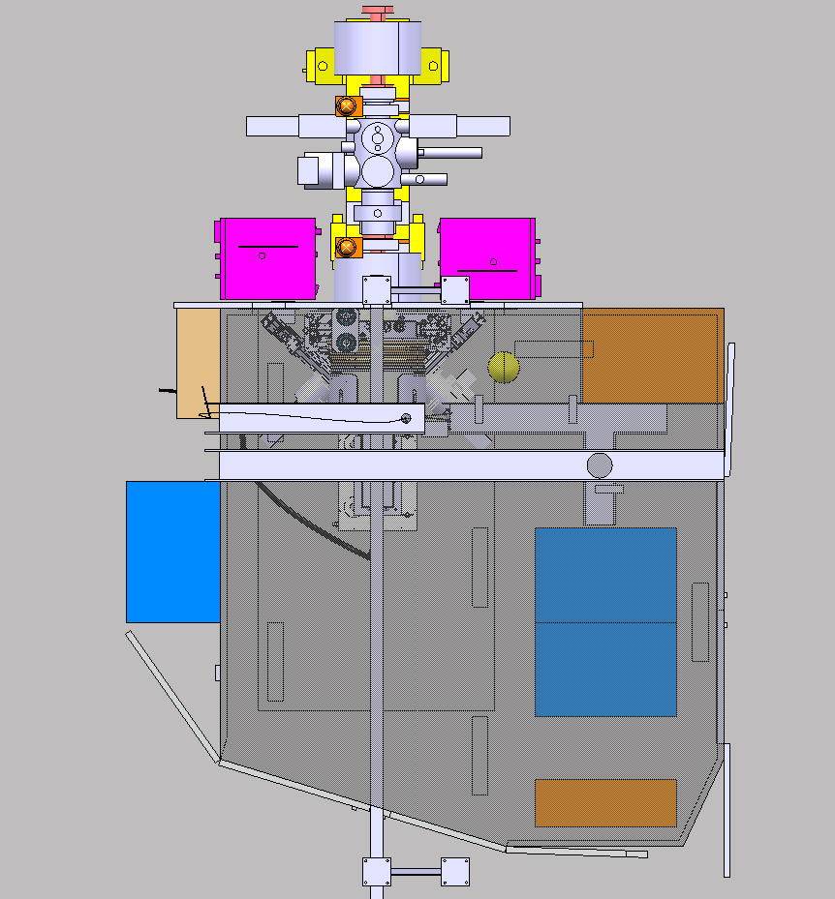
Hazards inventory
1
Electrical hazards:
High voltage (10kV to 50 kV)
Capacitor banks (20J/50 kV)
3
Electrocution, electrical shocks, fire
NJ01
5
4
2
NYTR
2
Non ionizing radiations:
High power RF 2 MHz (RF power amplifier in the Klystrons hall)
1
1
NY08
NY04
Electrical shocks, tissue burns
5
NY05
3
Flammable gas:
Hydrogen (2 x 10 liter 200 bar gas bottles)
NY03
Closed Faraday cage
Explosion, fire
4
Mechanical hazards:
Pressurized pipelines (0.5-3 bars H2)
5
Chemical hazards:
Oil
Caesium (with plasma Cs source)
Pollution
Equipment under vacuum (up to 10⁻⁷ mbars)
Release of gas, explosion; hearing loss, material projection
Fire, explosion, intoxication, chemical burns

Slide 4
Risk control measures
Based on HSE Launch Safety Agreement (equivalent to EDMS 1218116 for Linac4 ion source):
This document is an overview of the applicable Safety requirements for the ion source (based on the CERN Safety rules or if not existing, on Host States
regulations, European Directives, international standards and best practices).
Fields | Safety requirements
Electrical safety | Safety Code C1- Electrical safety code Safety Instruction IS24 – Regulation applicable to electrical installations
Non ionizing radiations (RF) | European Directive 2013/35/EU French Decret n˚2002-775 of 3 Mai 2002
Flammable gas (H2) | Explosive atmospheres (GS-C2)
Mechanical safety (Pressure, vacuum) | Safety Regulation on mechanical equipment (SR-M) General Safety Instruction (GSI-M2) – Standard pressure equipment
Chemical safety (Cs) | Safety Regulation on chemical agents (SR-C) General Safety Instruction (GSI-C1) on prevention and protection measures General Safety Instruction (GSI-C3) on monitoring of exposure to hazardous chemical agents in workplace atmospheres
Notes:
Measures taken to remove or mitigate the risks.

Slide 5


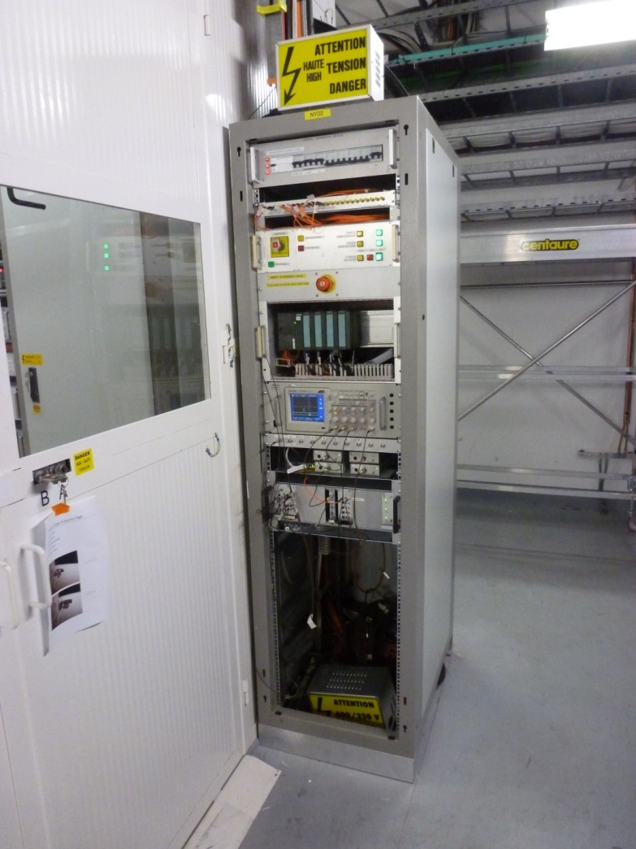
Risk control measures
Electrical safety and RF
Equipment are located inside the closed Faraday cage having a protection index IP3X according to IEC60529.
Faraday cage equipped with an access interlock system (EDMS 1212106), PLC-based.
In case of access, the high-voltage power converters and the 2 MHz RF generator are disabled. Racks automatically grounded. Warning signs posted on the doors indicating that access is restricted to specialists.
Faraday cage equipped with AUL (local emergency stop)
Linac4 tunnel equipped with AUG (general emergency stop)

Slide 6


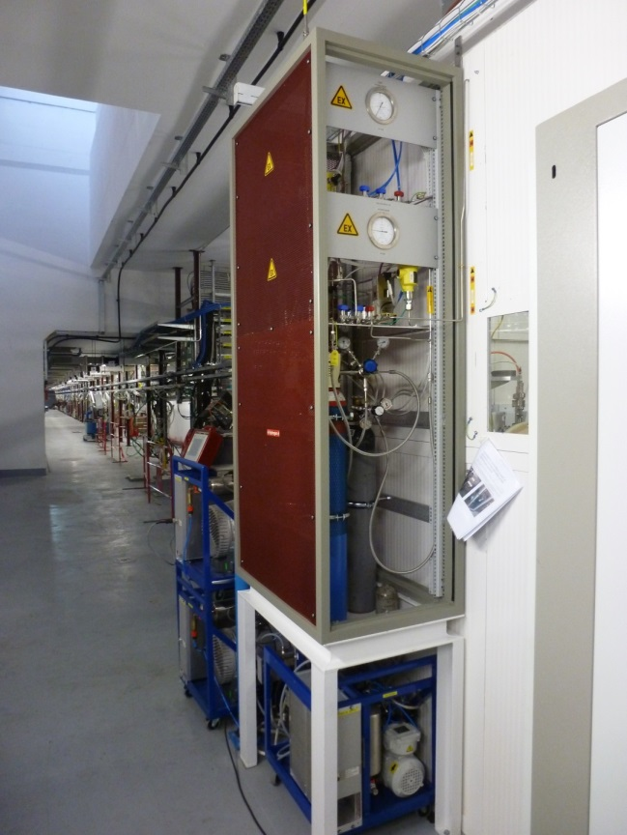
Risk control measures
Flammable gas safety
Explosion risk assessment: EDMS 1261469
The gas rack itself is classified as ATEX zone 2, in line with Safety Guideline C-2-0-3.
The maximum volume of a hydrogen leak is 2 m3 with one gas bottle (the full content of one 10 liter, 200 bar bottle).
In case of a gas leak: the ventilated volume around the ion source is considered as large enough (2’500 m³) so that no explosive hazards can arise outside the rack. Hence, gas detection system is not necessary.
The ventilation system is supervised from the CCC.
In case a failure of the ventilation system, the standby service is called (specific written procedures).
The gas distribution system can be fully vented with clean nitrogen so that no flammable gas will remain in the system at the operational state “Stop”.
Notes:
Zone 2: A hazardous area in which an explosive atmosphere consisting of a mixture with air of flammable substances in the form of gas, vapour or mist is not likely to occur in normal operation but, if it doe
Here, ‘not likely to occur in normal operation, but if it does occur, will persist for a short period only’, is taken to mean a few times per year, of a duration of about 30 minutes each time (< 10 hours per year in total). s occur, will persist for a short period only.

Slide 7
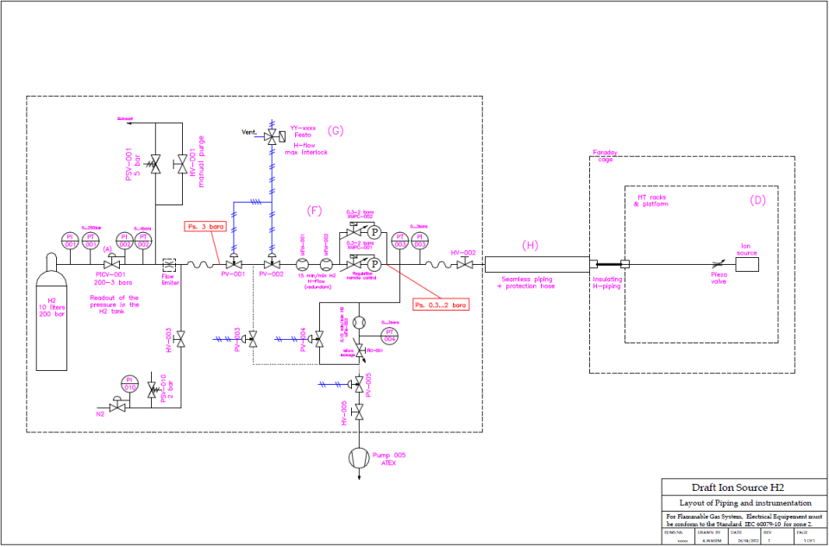
Risk control measures
Mechanical safety
Pressurized pipelines
All the components and the assembly of the gas system are made and tested according to the General Safety instruction GSI-M2 for standard pressure equipment, EDMS 875610.
The pipe work is tested to 1.5 times the nominal pressure.
All sections of the pipe work are protected by safety relief valves (relief pressure: 5 bar), with exhaust into the tunnel, which are subjected to periodic tests by the HSE.
Flow rate measures by two redundant flow meters which, in case of abnormal flow rate automatically, will close two pneumatic safety valves.
Extract from the Explosion risk assessment file,
EDMS 1261469
Equipment under vacuum
EN-MME design

Slide 8
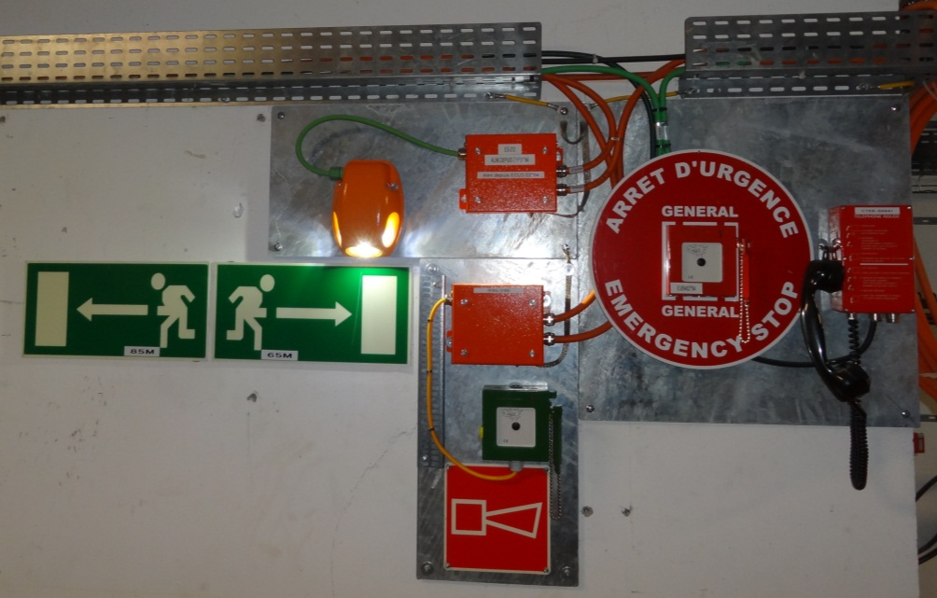
Risk control measures
Fire safety
Tunnel
Fire detection system : activation of one detector triggers a level-3 alarm and the intervention of the fire brigade
Fire alarm (evacuation) in case of activation of two fire detectors
Interlocks with the ventilation system
Smoke extraction system (started by the fire brigade)
Faraday cage
Fire detection system + Fire alarm
Evacuation plans posted on site
Fire extinguishers and
fire-fighting system (RIA)

Slide 9
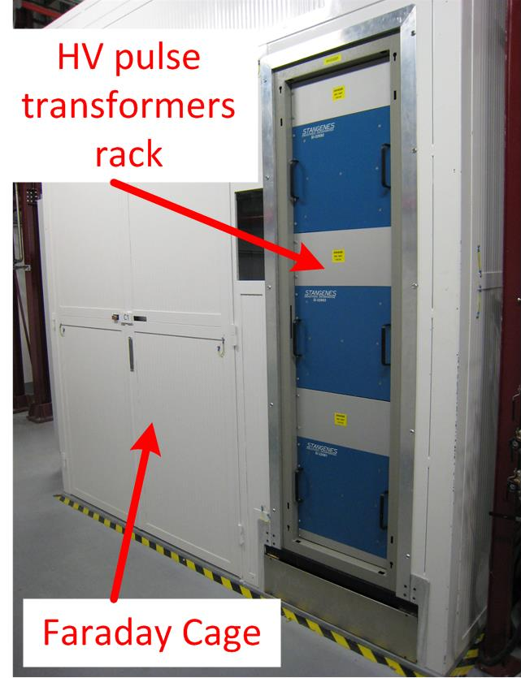
Risk control measures
Chemical safety
Oil
The transformers of the three HV pulsed power converters are immersed in oil:
Sealed oil tanks
Oil type MIDEL 7131 (3 x 95L): not toxic, high fire point (> 300˚C)
1
100L retention bund at rack bottom
Monitoring of oil pressure, temperature, levels includes in the interlock chain of the power converters.
1

Slide 10
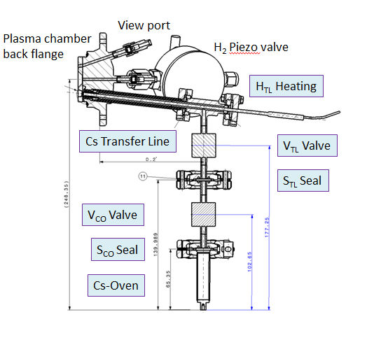
Risk control measures
Chemical safety
Caesium
(Quantity in the LINAC4 source: 100 mg to 5 g)
Chemical risk assessment (to be released).
Specific procedures to handle the caesium in Linac4 (In Work): installation, multi month operation and exchange of Cesiated ion sources.
The Cs-load and condensed Cs vapours are confined within the dispenser and the ion source vacuum tanks.
Coupling the Cs-dispenser to the source will be done according to a procedure.
Maintenance of the component inside the vacuum tank will be done in a dedicated laboratory (Cs-test stand – building 357).
All transport will be under inert atmosphere enclosed in dedicated hoods.
Personnel protective equipment is foreseen (gloves, goggles) and will be adapted to the tasks.

Slide 11
Safety documentation
The safety documentation is included in the Safety Folder of Linac4 which consists of 4 main parts:
Parts | Contents | Ref. EDMS | Status
Descriptive | Description of the facility in terms of safety, access modes, dismantling and disposal | 1227231 | Approval process closed
Demonstrative | Hazards inventory, risks induced, risk control measures, risk assessments | 1280742 | Under Engineering Check
Operational | Inventory of information notes, operational instructions and procedures related to safety, description of the project phase and organisation | 1280745 | In Work
REM (Record, Experience, Monitoring) | Inventory of all feedbacks, inspections, safety reports, non-conformities, near-misses, incidents, accidents and experience gained | 1280750 | In Work

Slide 12
Safety documentation
Status of the safety procedures for the Linac4 ion source:
Procedures | Released | To be released | In work
High voltage safety and Interlocks of the Linac4 Ion Source Test Procedure | EDMS 1314944
Access and work in the H- source cage |  | X
Safety lock-out of the Ion Source power converters |  | X
Fire brigade emergency intervention |  |  | X
Procedure in case of failure of the ventilation system of the Linac4 tunnel |  | X
Replacement of the H2 bottle | EDMS 1261469
Emergency procedure in case of problem during operation of the LINAC4 gas system | EDMS 1320768
Operation instruction of the gas system: how to connect remotely | EDMS 1320770
Caesium related procedures |  |  | X

Slide 13
Conclusion and outlook
All systems are being documented within CERN safety rules and regulations.
Manpower needs for the remaining safety documentation:
IS-02 (plasma Cs-surface) : 2 months, 0.5 FTE
IS-03 (Magnetron) : 4 months, 0.5 FTE

Slide 14
Thank you for your attention

